Slide 1
Ch12. Word representation and sequence to sequence processing
KH Wong

Slide 2
Overview
Introduction
Part1: Word representation (word embedding) for text processing
Integer mapping
BOW (Bag of words)
TF-IDF (term frequency-inverse document frequency)
Word2vec (accurate and popular)
Part2: Sequence to sequence machine learning (seq2seq)
Machine translation (MT) systems

Slide 3
Part1: Word representation (Word embedding)
For text processing
Basic ideas

Slide 4
Word embedding (representation)
https://medium.com/@japneet121/introduction-713b3d976323
Three approaches to represent words by numbers
Integer mapping (simple, not too useful)
BOW : (Bag of words)
TF-IDF : Another way to get these numbers is by using TD-IDF, which stands for term frequency-inverse document frequency
Word2vec : This is popular, will be discussed in detail
Word2vec is a group of related models that are used to produce word embedding.
Word2vec relies on either skip-grams or continuous bag of words (CBOW) to create neural word embedding

Slide 5
1. Integer mapping example
#interger_maaping.py, khw 1906, python using tf-gpu
line="test :map a text string into a dictionary.”
word_list={} #dictionary to hold the words
counter=0 #initialize the counter for words
for word in line.lower().split():#iterate over words
if word not in word_list: #check if word is in dict
word_list[word]=counter
counter+=1 #update the counter
print(word_list)
''‘ run python (tf-gpu), interger_maaping.py
{'this': 0, 'a': 1, 'test': 2, 'to': 3, 'find': 4, 'out': 5, 'how': 6, 'map': 7, 'text': 8, 'string': 9, 'into': 10, 'dictionary.': 11, 'we': 12, 'can': 13, 'us': 14, 'eit': 15, 'fro': 16, 'machine': 17, 'translation': 18, 'etc.': 19}'''

Slide 6
2. Bag of words (BoW) https://en.wikipedia.org/wiki/Bag-of-words_model#CBOW
“The bag-of-words model is commonly used in methods of document classification where the (frequency of) occurrence of each word is used as a feature for training a classifier^{[2]}.”
Sentence examples (our entire corpus of documents)
(1) John likes to watch movies. Mary likes movies too.
(2) John also likes to watch football games.
Show the word and number of occurrence (“word”:n)
BoW1 = {"John":1,"likes":2,"to":1,"watch":1,"movies":2,"Mary":1,"too":1};
BoW2 = {"John":1,"also":1,"likes":1,"to":1,"watch":1,"football":1,"games":1};

Slide 7
CMSC5707, Ch12. Seq2Seq Exercise 1: Bag of words (BoW) https://en.wikipedia.org/wiki/Bag-of-words_model#CBOW
Sentence examples (corpus of documents)
(3) Tom loves to play video games, Jane hates to play video games.
(4) Billy also likes to eat pizza, drink coke and eat chips.
Show the word and number of occurrence
Answer:
BoW3 =
BoW4 =

Slide 8
CMSC5707, Ch12. Seq2Seq Exercise ANS:1 Bag of words (BoW) https://en.wikipedia.org/wiki/Bag-of-words_model#CBOW
Sentence examples (corpus of documents)
(3) Tom loves to play video games, Jane hates to play video games.
(4) Billy also likes to eat pizza, drink coke and eat chips.
Show the word and number of occurrence
Answer:
BoW3 = {“Tom":1,"loves":1,"to":2,“play":2,“video":2,“games":2,”Jane”:1, “hates":1};
BoW4 = {“Billy":1,"also":1,"likes":1,"to":1, “eat":2, “pizza":1,drink":1,“coke":1, “and":1 ,“chips":1};

Slide 9
BOW explained (word sequence is not used) https://machinelearningmastery.com/gentle-introduction-bag-words-mo
1. Collect data (by Charles Dickens)
It was the best of times
it was the worst of times,
it was the age of wisdom,
it was the age of foolishness,
2. Design vocabulary
“it”
“was”
“the”
“best”
“of”
“times”
“worst”
“age”
“wisdom”
“foolishness”
3. Create document vector
Since there are 10 word,
so the representation vector is 10x1
E.g. first sentence, sentence (a)
“it” = 1
“was” = 1
“the” = 1
“best” = 1
“of” = 1
“times” = 1
“worst” = 0
“age” = 0
“wisdom” = 0
“foolishness” = 0
(a) It was the best of times =>
So the vector is [1, 1, 1, 1, 1, 1, 0, 0, 0, 0]

Slide 10
Exercise 2: BOW explained (word sequence is not used) https://machinelearningmastery.com/gentle-introduction-bag-words-mo
3. Create vector
Create Document Vectors
Since there are 10 words,
So the representation for each sentence is a vector of size 10x1
Collect data (corpus)
a) It was the best of times
b) it was the worst of times,
c) it was the age of wisdom,
d) it was the age of foolishness,
sentence
a
b
C
d
1 | 2 | 3 | 4 | 5 | 6 | 7 | 8 | 9 | 10
It | was | the | best | of | times | worst | age | wisdom | Foolishness
1 | 1 | 1 | 1 | 1 | 1 | 0 | 0 | 0 | 0
1 | 1 | 1 | 0 | 1 | 1 | 1 | 0 | 0 | 0
1 | 1 | 1 | 0 | 1 | 0 | 0 | 1 | 1 | 0
?

Slide 11
Answer 2: BOW explained (word sequence is not used) https://machinelearningmastery.com/gentle-introduction-bag-words-mo
3. Create vector
Create Document Vectors
Since there are 10 words,
So the representation for each sentence is a vector of size 10x1
Collect data
a) It was the best of times
b) it was the worst of times,
c) it was the age of wisdom,
d) it was the age of foolishness,
sentence
a
b
C
d
1 | 2 | 3 | 4 | 5 | 6 | 7 | 8 | 9 | 10
It | was | the | best | of | times | worst | age | wisdom | Foolishness
1 | 1 | 1 | 1 | 1 | 1 | 0 | 0 | 0 | 0
1 | 1 | 1 | 0 | 1 | 1 | 1 | 0 | 0 | 0
1 | 1 | 1 | 0 | 1 | 0 | 0 | 1 | 1 | 0
1 | 1 | 1 | 0 | 1 | 0 | 0 | 1 | 0 | 1

Slide 12
BOW: cleaning
If the vocabulary is too large, cleaning is needed.
such as:
Ignoring case
Ignoring punctuation
Ignoring frequent words that don’t contain much information, called stop words, like “a,” “of,” etc.
Fixing misspelled words.
Reducing words to their stem (e.g. “play” “plays” “playing” are considered as the same) using stemming algorithms.

Slide 13
2. TF-IDF (term frequency-inverse document frequency)
tf–idf or TFIDF, is a numerical statistic method to reflect the importance of a word is in a document
If a word appears frequently in a document, that means it is important. Result in a high score.
But if a word appears in many documents, it is not a unique identifier. Result in a low score.
It can be used to rank web pages https://www.geeksforgeeks.org/tf-idf-model-for-page-ranking/
Therefore,
common words such as "the“, "for" “this” which appear in many documents, TFIDf will be scaled down.
Words that appear frequently in a single document TFIDF, will be scaled up.

Slide 14
TF-IDF : Formulation https://ishwortimilsina.com/calculate-tf-idf-vectors/ https://zh.wikipedia.org/wiki/Tf-idf
TF: Term Frequency, which measures how frequently a term occurs in a document.
(Number of times term t appears in a document)
TF(t) =------------------------------------------------------------
(Total number of terms in the document).
IDF: Inverse Document Frequency, if a word appears in many documents, it is not a unique identifier. Result in a low score.
IDF(t) =log₁₀{ (Total number of documents)/ (Number of documents with term t in it) }.

Slide 15
TF-IDF Example
(Number of times term t appears in a document)
TF(t) =--------------------------------------------------------------------
(Total number of terms in the document).
IDF(t)=log(total no. of documents/no. of document with this term t)
To find TF: A document containing 100 words
The word ‘car’ appears 5 times.
TF (t=car)= (5 / 100) = 0.05.
To find IDF: There are 1 million documents
The word ‘Car’ appears in 100 documents
Idf(t)= log₁₀(1,000,000 / 100) = 4.
TF-IDF =TF*IDF= 0.05 * 4 = 0.2
Use log₁₀ or log_{e}, in IDF? It is all the same : as long as you use it consistently
https://stackoverflow.com/questions/56002611/when-to-use-which-base-of-log-for-tf-idf

Slide 16
Similarity between two documents
We can use
Normalized BOW (Bag Of Words)
TF-IDF
Example1 : forget about grammar, since enjoy=enjoys by word stemming, https://en.wikipedia.org/wiki/Stemming
d1: The best Italian restaurant enjoy the best pasta
d2: American restaurant enjoy the best hamburger
d3: Korean restaurant enjoy the best noodles
d4: the best the best American restaurant

Slide 17
Example1 : Similarity using BOW
Here, the representation for each sentence is a vector of size 10x1
https://www.youtube.com/watch?v=hc3DCn8viWs
words | d1 | d2 | d3 | d4
Italian | 1 | 0 | 0 | 0
Restaurant | 1 | 1 | 1 | 1
enjoy | 1 | 1 | 1 | 0
The | 2 | 1 | 1 | 2
Best | 2 | 1 | 1 | 2
pasta | 1 | 0 | 0 | 0
American | 0 | 1 | 0 | 1
hamburger | 0 | 1 | 0 | 0
Korean | 0 | 0 | 1 | 0
noodles | 0 | 0 | 1 | 0
Raw BOW data vector

Slide 18
Example : Cosine similarity between normalized BOW of sentence d1 and d4

Slide 19
Matlab
%Matlab code: Cosine similarity between normalized BOW of sentence s1 and s4
s1=[1 1 1 2 2 1 0 0 0 0]'
s4=[0 1 0 2 2 0 1 0 0 0]'
cosine_s1_s4=s1'*s4/(sqrt(s1'*s1)*sqrt(s4'*s4))
cosine_s1_s4 = 0.8216

Slide 20
Similarity between two documents
using TF-IDF

Slide 21
Similarity between sentences using TF-IDF TF(t) = (Num. of times term t appears in a doc.) /(Total num. of terms in the doc.) IDF=Log₁₀(total no. of documents/no. of document with this term)
Total documents=4, this word appears in 4 documents
words | TF |  |  |  | IDF | TF*IDF
words | d1 | d2 | d3 | d4 |  | d1 | d2 | d3 | d4
Italian | 1/8 |  |  |  | Log(4/1)=0.6 | 0.075
Restaurant | 1/8 | 1/6 | 1/6 | 1/6 | Log(4/4)=0
enjoy | 1/8 | 1/6 | 1/6 |  | Log(4/3)=0.13 | 0.016 | 0.02 | 0.02
The | 2/8 | 1/6 | 1/6 | 2/6 | Log(4/4)=0
Best | 2/8 | 1/6 | 1/6 | 2/6 | Log(4/4)=0
pasta | 1/8 |  |  |  | Log(4/1)=0.6 | 0.075
American |  | 1/6 |  | 1/6 | Log(4/2)=0.3 |  | 0.05 |  | 0.05
hamburger |  | 1/6 |  |  | Log(4/1)=0.6 |  | 0.1
Korean |  |  | 1/6 |  | Log(4/1)=0.6 |  |  | 0.1
noodles |  |  | 1/6 |  | Log(4/1)=0.6 |  |  | 0.1
(blank=0)
This sentence has 6 words
Total documents=4, this word appears in 1 document
This sentence has 8 words

Slide 22
Exercise 3: TF-IDF cosine similarity of d1,d2,d3,d4 with d4 Can be used to build a document search engine. Find in a sentence in a corpus (document set) that is similar to you input question.
 | TF-IDF | Cosine similarity with d4
d1: the best Italian restaurant enjoy the best pasta | d1=[0.075,0,0.016,0,0,0.075,0,0,0,0] | d1*d4’/ (|d1|*|d4|)=?
d2: American restaurant enjoy the best hamburger | d2=[0,0,0.02,0,0,0,0.05,0.1,0,0] | (d2*d4’)/ (|d2|*|d4|)=?
d3: Korean restaurant enjoy the best noodles | d3=[0,0,0.02,0,0,0,0,0,0.1,0.1] | ?
d4: the best the best American restaurant | d4=[0,0,0,0,0,0,0.05,0,0,0] | ?
https://www.youtube.com/watch?v=hc3DCn8viWs

Slide 23
Answer3 : TF-IDF cosine similarity of d1,d2,d3,d4 with d4
Can be used to build a document search engine. Find in a sentence in a corpus that is similar to you input question.
 | TF-IDF | Cosine similarity with d4
d1: the best Italian restaurant enjoy the best pasta | d1=[0.075,0,0.016,0,0,0.075,0,0,0,0] | d1*d4’/(|d1|*|d4|)=0
d2: American restaurant enjoy the best hamburger | d2=[0,0,0.02,0,0,0,0.05,0.1,0,0] | |d2|=sqrt(0.02^2+0.05^2+0.1^2)= 0.11 |d4|=sqrt(0.05^2)=0.05 -------------------------- (d2*d4’)/(|d2|*|d4|)= (0.05*0.05)/(0.11*0.05) =0.5
d3: Korean restaurant enjoy the best noodles | d3=[0,0,0.02,0,0,0,0,0,0.1,0.1] | d3*d4’/(|d3|*|d4|)=0
d4: the best the best American restaurant | d4=[0,0,0,0,0,0,0.05,0,0,0] | d4*d4’/(|d4|*|d4|)=1

Slide 24
Word2vec
A popular way for word representation in natural language processing
Advantage: two related words in meaning will give similar code (e.g. 30 neuron outputs, or dimensions)
Reference, download pertained word2vec dataset
https://mccormickml.com/2016/04/12/googles-pretrained-word2vec-model-in-python/
https://drive.google.com/file/d/0B7XkCwpI5KDYNlNUTTlSS21pQmM/edit?usp=sharing

Slide 25
First, we have to understand N-gram, Skip-gram
Because Word2vec relies on either
N-gram or Skip-gram

Slide 26
N-gram, Skip-gram (sequence used) https://en.wikipedia.org/wiki/N-gram#Skip-gram
An n-gram is a contiguous sequence of n items from a given sequence of text.
N-gram : Example; "dog that barks does not bite", the n-grams are:
unigrams (n=1): dog, that, barks, does, not, bite
bigrams (n=2): dog that, that barks, barks does, does not, not bite
trigrams (n=3): dog that barks, that barks does, barks does not, does not bite etc. https://www.quora.com/What-is-the-relationship-between-N-gram-and-Bag-of-words-in-natural-language-processing
skip-grams are a generalization of n-grams in which the components (typically words) need not be consecutive in the text under consideration, but may leave gaps that are skipped over
For example, in the input text:
the rain in Spain falls mainly on the plain
The set of 1-skip-2-grams includes all the bigrams (2-grams), and in addition the subsequences:
the in, rain Spain, in falls, Spain mainly, falls on, mainly the, and on plain.

Slide 27
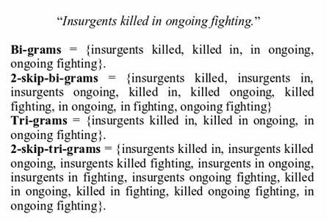
Skip-gram examples
https://i.redd.it/0s0wh7rys0l11.png

Slide 28
Exercise 4 N-gram, Skip-gram (sequence used) https://en.wikipedia.org/wiki/N-gram#Skip-gram
In the fields of computational linguistics and probability, an n-gram is a contiguous sequence of n items from a given sequence of text or speech.
N-gram : Example; "dog that barks does not bite", the n-grams are:
unigrams (n=1): dog, that, barks, does, not, bite
bigrams (n=2): dog that, that barks, barks does, does not, not bite
trigrams (n=3): dog that barks, that barks does, barks does not, does not bite etc. https://www.quora.com/What-is-the-relationship-between-N-gram-and-Bag-of-words-in-natural-language-processing
skip-grams are a generalization of n-grams in which the components (typically words) need not be consecutive in the text under consideration, but may leave gaps that are skipped over
For example, in the input text:
the rain in Spain is heavy.
The set of 1-skip-3-grams
Answer:_____________________________________________

Slide 29
ANSWER 4: N-gram, Skip-gram (sequence used) https://en.wikipedia.org/wiki/N-gram#Skip-gram
In the fields of computational linguistics and probability, an n-gram is a contiguous sequence of n items from a given sequence of text or speech.
N-gram : Example; "dog that barks does not bite", the n-grams are:
unigrams (n=1): dog, that, barks, does, not, bite
bigrams (n=2): dog that, that barks, barks does, does not, not bite
trigrams (n=3): dog that barks, that barks does, barks does not, does not bite etc. https://www.quora.com/What-is-the-relationship-between-N-gram-and-Bag-of-words-in-natural-language-processing
skip-grams are a generalization of n-grams in which the components (typically words) need not be consecutive in the text under consideration, but may leave gaps that are skipped over
For example, in the input text:
the rain in Spain is heavy.
The set of 1-skip-3-grams
Answer: the rain in, rain in spain, in Spain is, Spain is heavy,
The in Spain, rain Spain is, in is heavy

Slide 30
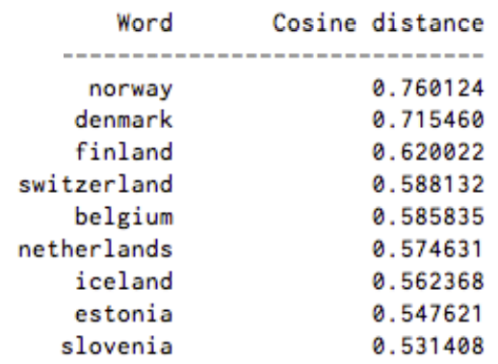
Exercise 5: word2vec for word embedding (Similar meaning words have similar code)
Represent a word by a vector of numbers
It allows words with similar meaning to be used by machine learning algorithms.
Similar input words will have similar codes as the output
In a search engine: Probability of (Sweden + Norway) using cosine distance between 2 vectors
If Sweden ice-Leland is used, what is the score? ? Answer: _0.562368___
If Sweden Estonia is used, what is the score?
Answer: __________?
For example: Here’s a list of words associated with “Sweden” using Word2vec, in order of proximity:
Probability of the relation with “Sweden”:
https://www.guru99.com/word-embedding-word2vec.html https://skymind.ai/wiki/word2vec

Slide 31
ANSWER: Exercise 5 word2vec for word embedding
Represent a word by a vector of numbers
It allows words with similar meaning to be used by machine learning algorithms.
Similar input words will have similar codes as the output
In a search engine: Probability of (Sweden + Norway) using cosine distance between 2 vectors
If Sweden ice-Leland is used, what is the score? Answer: _0.562368___
If Sweden Estonia is used, what is the score?
Answer: _0.547621__
For example: Here’s a list of words associated with “Sweden” using Word2vec, in order of proximity:
Probability of the relation with “Sweden”:
https://www.guru99.com/word-embedding-word2vec.html https://skymind.ai/wiki/word2vec

Slide 32
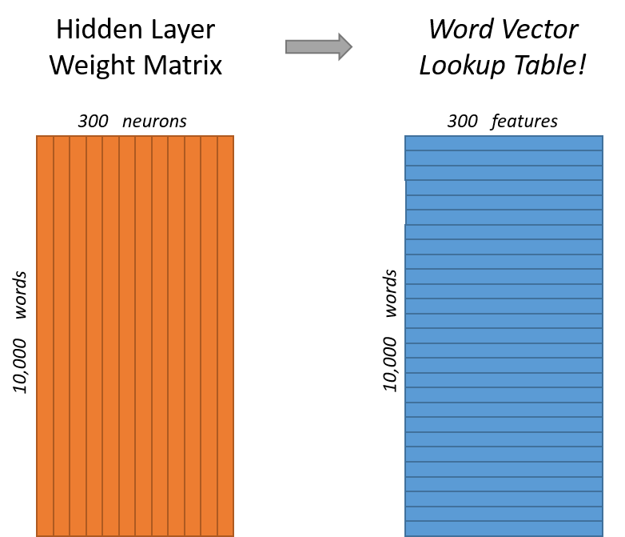
How to get Word2vec ?: First task is represent the words: Word Embedding
The task is to represent an input word using a code. E.g. for a corpus (dictionary) of 10,000 vocabulary, you have to train the network by backpropagation .
Input: 1 word , e.g. fish, the raw representation is a one-hot approach. I.e., one bit on, other bits off in a vector of 10,000 bits for a word e.g. ‘fish’.
Internal representation: 300 neurons
Word2vec Output: 300 floating point numbers
Algorithms: e.g. Word2vec, this will train the weights of the neural network to perform word embedding
300 neurons
300 features
Neural network
(hidden layer)
10,000 words
10,000 words
10000x1 bit input vector
One hot: one bit on other bits off
Word2vec neural network: Weights to be trained.
Dimension=
300 neurons
During training Word vector Output has 10,000x1 outputs (same as input)
https://github.com/tensorflow/nmt#embedding

Slide 33
Use of word2vec http://mccormickml.com/2016/04/19/word2vec-tutorial-the-skip-gram-model/
After training
A word → 300 numerical values
Similar words will have similar output vectors
A word (10000-bit one hot), e.g.
Tree, train, cycling, eat
Word vector Output: A 300-dimension vector for an input.
Word embedding
(Word2vec)
Neural network
(hidden layer)
10000-bit (one hot input)

Slide 34
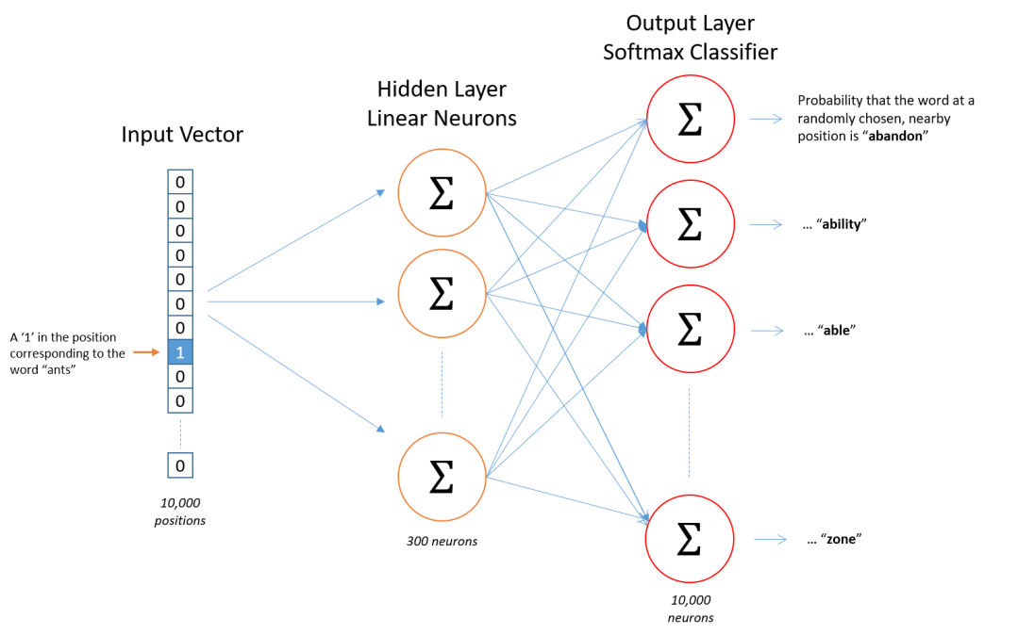
Graphic view
300 neurons
300 features for each word
Neural network
(hidden layer)
How to train a word2vec
network
10,000 words
10,000 words
Vocabulary=10,000
10,000-probility outputs.
Each for a word in the vocabulary
input =10,000-bit
one-hot
300 neurons
In hidden layer
34
Output layer =10,000-bit
(dimension same as input)

Slide 35
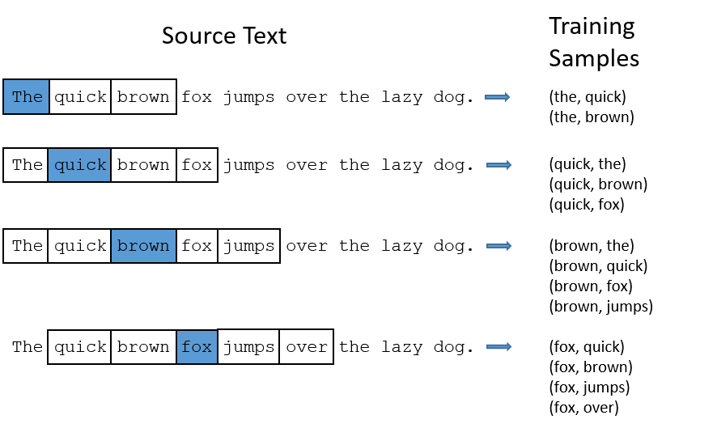
Why word embedding? It allows words with similar meaning to have similar codes, it is useful in machine learning algorithms.
How to train it:
The network has 10,000 x1 bit input. 10,000 floating point outputs. And one hidden layer of 300 neurons.
Pick 2 related words by a randomly selected neighbors scheme. I.e. for each sentence, select randomly (or using 1-skip2-grams.) an input word (‘the’) and output word (‘quick’). See training samples in diagram).
Feed the first word (‘the’ one-hot) to the input and the second word (‘quick’ one-hot) to the output. Repeat for many pairs.
After training by backpropagation, when you feed a one-hot input to the network, the word2vec output is the 300 vector ( floating point numbers) of the hidden layer.
word2vec
Vocabulary=10,000
10,000-probility outputs.
Each for a word in the vocabulary
Hidden layer
300 neurons
Word2vec output
input =10,000-bit
one-hot
Output layer
=10,000-bit

Slide 36
How to choose input/output during word2vec training
Assume the library has 10,000 words. Each word is represented by a 10,000-bit one hot vector.
During training by backpropagation, use a pair of words (e.g. from 1-skip-2-grams): 10,000-bit for input, and 10,000-floating point numbers.
After training, use the hidden layer only (a 300 floating point vector), each input will give a 300 floating point vector. It can be in seq-2-seq applications such as machine translation.
Vocabulary=10,000
10,000-probility outputs.
Each for a word in the vocabulary
input =10,000-bit
one-hot
Hidden layer
300 neurons
Word2vec output
Output layer =10,000-bit

Slide 37
Exercise 6 :Sketch the diagram if there are 1000 words, 160 hidden neurons. Show Input/output/hidden layers.
During training by backpropagation, use a pair of words : 1,000-bit for input, and 1,000-bit for output.
After training, use the hidden layer only, each input will give a 160 floating point vector for the seq-2-seq application.

Slide 38
ANSWER 6: Sketch the diagram if there are 1000 words, 160 hidden neurons. Show Input/output/hidden layers..
During training by backpropagation, use a pair of words : 10,000-bit for input, and 10,000-bit for output.
After training, use the hidden layer only, each input will give a 160 floating point vector for the seq-2-seq application.
Vocabulary=1,000
1,000-probility outputs.
Each for a word in the vocabulary
input =1,000-bit
one-hot
160 neurons
output =1,000-floating point numbers

Slide 39
There are two possible schemes to select words for training : CBOW (Continuous Bag of words) or Skip-gram
Xi-2
CBOW: Use x_{i-2}, x_{i-1,} x_{i+1,} x_{i+2} to guess x_{i}
Skip gram : Use x_{i} to guess x_{i-2,} x_{i-1,} x_{i+1,} x_{i+2}
Which model to choose?
CBOW is faster and has better representations for more frequent words.
Skip Gram works well with small amount of data and is found to represent rare words well. (more popular)
Xi-1
Sum
x_{i}
Xi+1
Xi+2
1)Continuous Bag of Word Model, window size=2
Select
switch
Xi-2
Xi-1
xi
Xi+1
Xi+2
2) Skip-Gram Model
window size=2
https://www.guru99.com/word-embedding-word2vec.html

Slide 40
How to choose words to be placed at input and output during training: CBOW (continuous Bag of words), or Skip-gram model
Each link represents many weights
Xi-2
Xi-1
Sum
Xi
Xi+1
Continuous Bag of Word Architecture
window size=2
Xi+2
i=index of the position of the word (x) in the sentence
If CBOW is used for selecting words for training : From x_{i-2}, x_{i-1,} x_{i+1,} x_{i+2} to guess x_{i}.
During backpropagation training of the network:
Add {X_{i-2} + X_{i-1} + X_{i+1} + X_{i+2} } as input and Xi as output , i.e.
Add {X_{i-2} + X_{i-1} + X_{i+1} + X_{i+2} } → input, X_{i}→ output (run backpropagation training)
Training :(use Sum {X_{i-2} + X_{i-1} + X_{i+1} + X_{i+2} } ) → target word, only once, (so it is fast)

Slide 41
How to choose words to be placed at input and output during training: use Skip-gram model
Select
switch
Xi-2
Xi-1
xi
Xi+1
Xi+2
Skip-Gram Model, window size=2
Apply Skip-gram model: Uses x_{i,} to predict x_{i-2}, x_{i-1,} x_{i+1,} x_{i+2} during backpropagation training of the network, run the following steps:
X_{i-2} → input, X_{i}→ output (run backpropagation training)
X_{i-1} → input, X_{i}→ output (run backpropagation training)
X_{i+1} → input, X_{i}→ output (run backpropagation training)
X_{i+2} → input, X_{i}→ output (run backpropagation training)
Training one pair by one pair (so it is slow, accurate, popular)

Slide 42
Skip-gram (window size=2) example: The quick brown fox jumps over the lazy dog.
During training
Target sentence |  |  |  |  |  |  |  |  |  | input | output
The | quick | brown | fox | jumps | over | the | Lazy | dog |  | the | quick
 |  |  |  |  |  |  |  | → |  | the | brown
The | quick | brown | fox | jumps | over | the | Lazy | dog |  | quick | the
 |  |  |  |  |  |  |  | → |  | quick | Brown
 |  |  |  |  |  |  |  |  |  | quick | fox
The | quick | brown | fox | jumps | over | the | Lazy | dog |  | brown | the
 |  |  |  |  |  |  |  |  |  | brown | quick
 |  |  |  |  |  |  |  | → |  | brown | fox
 |  |  |  |  |  |  |  |  |  | brown | jumps
The | quick | brown | fox | jumps | over | the | Lazy | dog |  | fox | quick
 |  |  |  |  |  |  |  |  |  | fox | brown
 |  |  |  |  |  |  |  | → |  | fox | jumps
 |  |  |  |  |  |  |  |  |  | fox | over

Slide 43
Exercise 7: (Skip gram) 2 possible architectural choices for word2vec : CBOW (Continuous Bag of Word) vs Skip gram to be used in training by backpropagation https://www.guru99.com/word-embedding-word2vec.html
Skip-gram : window size=2, Use x_{i} to predict x_{i-2}, x_{i-1,} x_{i+1,} x_{i+2}
Question: Redraw the diagram if window size =3
Select
switch
Xi-2
Xi-1
xi
Xi+1
Xi+2
Skip-gram window size=2
43

Slide 44
Answer 7: (Skip gram) 2 possible architectural choices for word2vec : CBOW (Continuous Bag of Word) vs Skip gram to be used in training by backpropagation https://www.guru99.com/word-embedding-word2vec.html
Select
switch
Xi-2
Skip-gram : window size=2, Use x_{i} to predict x_{i-2}, x_{i-1,} x_{i+1,} x_{i+2}
Answer: Redraw the diagram if windows size =3
Xi-1
xi
Xi+1
Skip-gram window size=2
Xi+2
Xi-3
Select
switch
Xi-2
Xi-1
xi
Xi+1
Xi+2
Skip-gram window size=3
Xi+3
44

Slide 45
Training of word2vec by backpropagation https://towardsdatascience.com/word2vec-made-easy-139a31a4b8ae https://nearist.ai/word2vec-tutorial%E2%80%8A-%E2%80%8Athe-skip-gram-model Mikolov, Tomas, et al. "Distributed representations of words and phrases and their compositionality." Advances in neural information processing systems. 2013.
When training this network on word pairs (input and target word) (selected by skip-gram or CBOW), the input is a one-hot vector representing the input word
During training the target word (also a one-hot presentation) is placed at the output.
After word2vec training completes, when an unknown word is presented to the word2vec input, you only use the output of the hidden layer (300x1 floating point vector) for sub-sequent processing, e.g. machine translation.

Slide 46
Training word2vec steps using skip-gram https://towardsdatascience.com/an-implementation-guide-to-word2vec-using-numpy-and-google-sheets-13445eebd281
Data Preparation — Define corpus, clean, normalize and tokenize words
Hyper-parameters — Learning rate, epochs, window size, embedding size
Generate Training Data — Build vocabulary, one-hot encoding for words, build dictionaries that map id to word and vice versa
Model Training — Pass encoded words through forward pass, calculate error rate, adjust weights using backpropagation and compute loss
Inference — Get word vector and find similar words

Slide 47
1) Data Preparation — Define corpus, clean, normalize and tokenize words
.. text data are unstructured and can be “dirty”. Cleaning them will involve steps such as removing stop words, punctuations, convert text to lowercase (actually depends on your use-case), replacing digits, etc
normalize , Word Tokenization:
https://web.stanford.edu/~jurafsky/slp3/slides/2_TextProc.pdf

Slide 48
2) Hyper-parameters
Parameters and values used in this example
Window size=2, how many neighboring words
n=10, dimension of the output vector
Epochs=50, training cycles
Learning rate =0.01, control update rate in backpropagation
Vocabulary =9 (a small toy example)

Slide 49
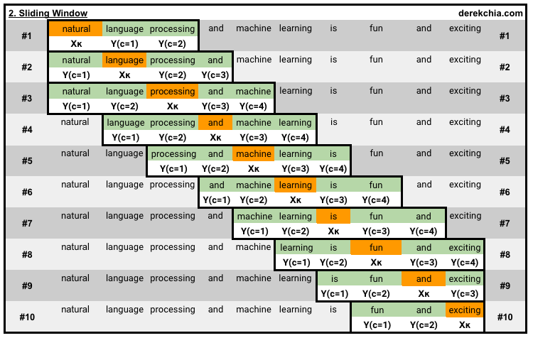
Example of window size =2 of a sentence https://towardsdatascience.com/an-implementation-guide-to-word2vec-using-numpy-and-google-sheets-13445eebd281
Using 1-skip-3-grams : see https://www.reddit.com/r/learnmachinelearning/comments/9e4ihs/kskipngram/
using skip-gram
10 windows, window#1 --> window#10

Slide 50
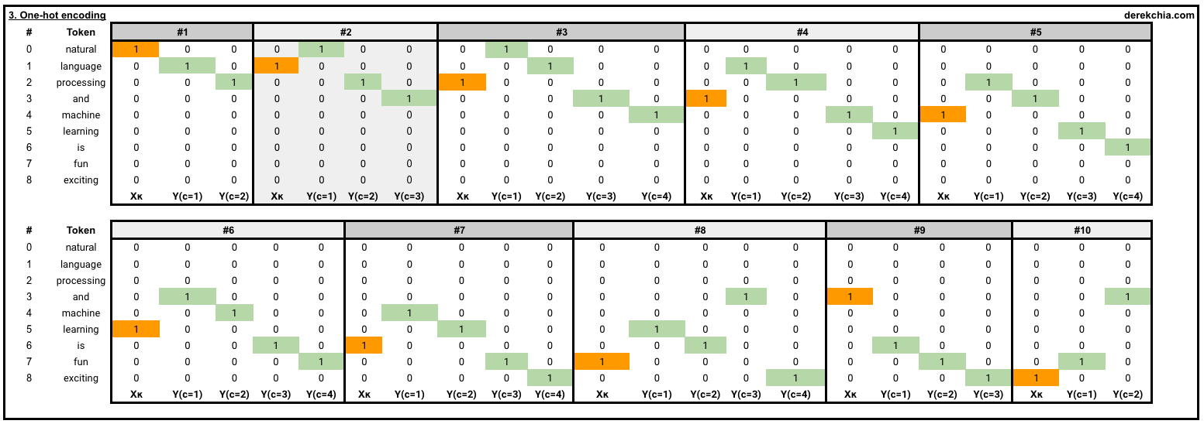
Another view : One-hot encoding for each target word and its context words
10 windows: Each window consists of both the target word and its context words, highlighted in orange and green respectively. (example: window size=2)
# 1 [Target (natural)], [Context (language, processing)] [list([1, 0, 0, 0, 0, 0, 0, 0, 0]) list([[0, 1, 0, 0, 0, 0, 0, 0, 0], [0, 0, 1, 0, 0, 0, 0, 0, 0]])]
using skip-gram

Slide 51
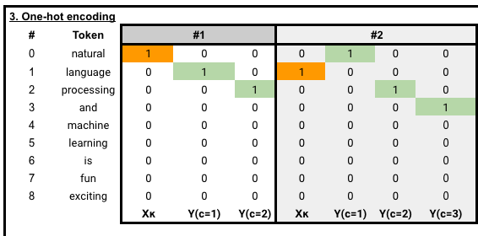
3) Generate Training Data
One–hot representation and selection of training data
Each training cycle needs a pairs of input word and prediction(target) word, e.g. {natural language}, {natural, processing}, {language, processing} etc. (based on 1-skip-3-grams) https://www.reddit.com/r/learnmachinelearning/comments/9e4ihs/kskipngram/
and more

Slide 52
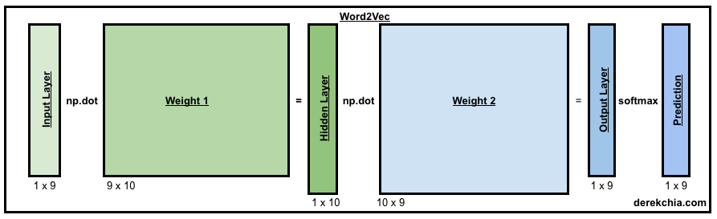
4) Model Training
Vocabulary =9 words, output vector dimension=10
Each training cycle needs a pairs of inputs :input word and prediction word, e.g. {natural language}, {natural, processing}, {language, processing} etc.
Learn the weight matrices : W1(9x10) and W2(10x9)
Training algorithm to generate the 2 weigh matrices: iterate forward / backward propagations until “loss” is small enough

Slide 53
Exercise 8 (10,000 words, 300 floating point output, redraw the diagram, describe training procedure and what is the final outputs 4) Model Training
Vocabulary =9 words, output vector dimension=10
Each training cycle needs a pairs of inputs :input word and prediction(target) word, e.g. {natural language}, {natural, processing}, {language, processing} etc.
Learn the weight matrices : W1(9x10) for the hidden layer, and W2(10x9) for the output layer
Training algorithm to generate the 2 weigh matrices: iterate forward / backward propagations until “loss” is small enough
W1
W2

Slide 54
5) Inference
After training for 50 epochs, both weights (w1 and w2) are found.
We can inference words from the input.
we look up the vector for the word “machine”. The result is :
> print(w2v.word_vec("machine"))
[ 0.76702922 -0.95673743 0.49207258 0.16240808 -0.4538815 -0.74678226 0.42072706 -0.04147312 0.08947326 -0.24245257]
We can find similar words of “machine”:
w2v.vec_sim("machine", 3) # select the top 3
machine 1.0
fun 0.6223490454018772
and 0.5190154215400249

Slide 55
Summary
Word2Vec is useful and popular
Advantage: two related words in meaning will give similar code (e.g. 30 neuron outputs, or dimensions)
It is a good representation of word by number (vectors)
It is useful for machine translation and CHATBOT

Slide 56
Part 2: Sequence to sequence processing and machine translation
Seq2seq: Theory and implementation

Slide 57
Introduction to seq2seq
Neural Machine translation
Learn by training. E.g. English-French translator development . Need a lot of English – French sentence pairs as training data (1 million pairs)
Training steps
Embedding—represent the words
Encoding --- encode the input English sentence input into an intermediate representation
Decoding ---decode the representation into French
Loss calculation
Gradient computation
Loop back to minimize Loss

Slide 58
Application of Seq2seq https://towardsdatascience.com/attn-illustrated-attention-5ec4ad276ee3
We can translate one sequence to another (e.g. machine translate)
Use RNN (Recurrent neural Network) to encoder input sequence to a vector and decode output using another RNN
Revise the notes on RNN and LSTM first.
Problem: But if the input sequence is long, error occurs
Input sequence → hidden vector → output sequence

Slide 59
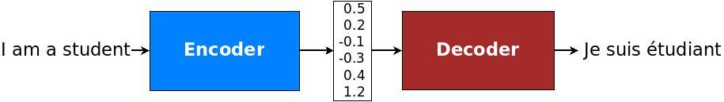
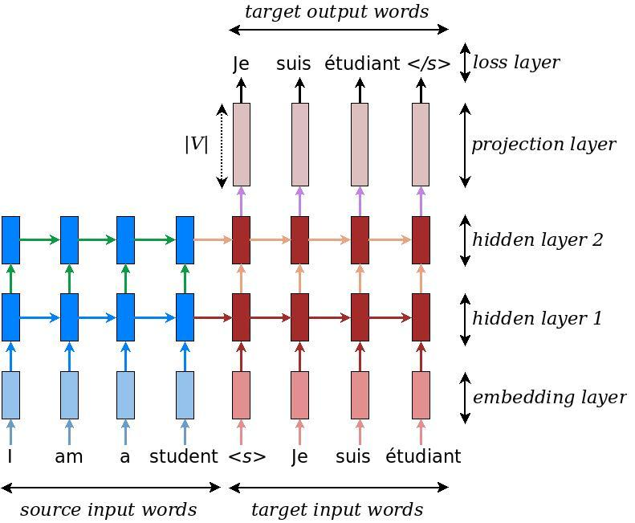
Basic idea of seq2seq approach (English to French example)
RNN or LSTM
RNN or LSTM
source embedding code. Ie, pretrained word2vec English
Target embedding code. I.e, pretrained word2vec French or Chinese
O_{t}=Encoder vector
https://github.com/tensorflow/nmt#inference--how-to-generate-translations
Pretrained word2vec tables(English, Chinese etc) https://radimrehurek.com/gensim/intro.html or
https://github.com/Embedding/Chinese-Word-Vectors or
https://wikipedia2vec.github.io/wikipedia2vec/pretrained/

Slide 60
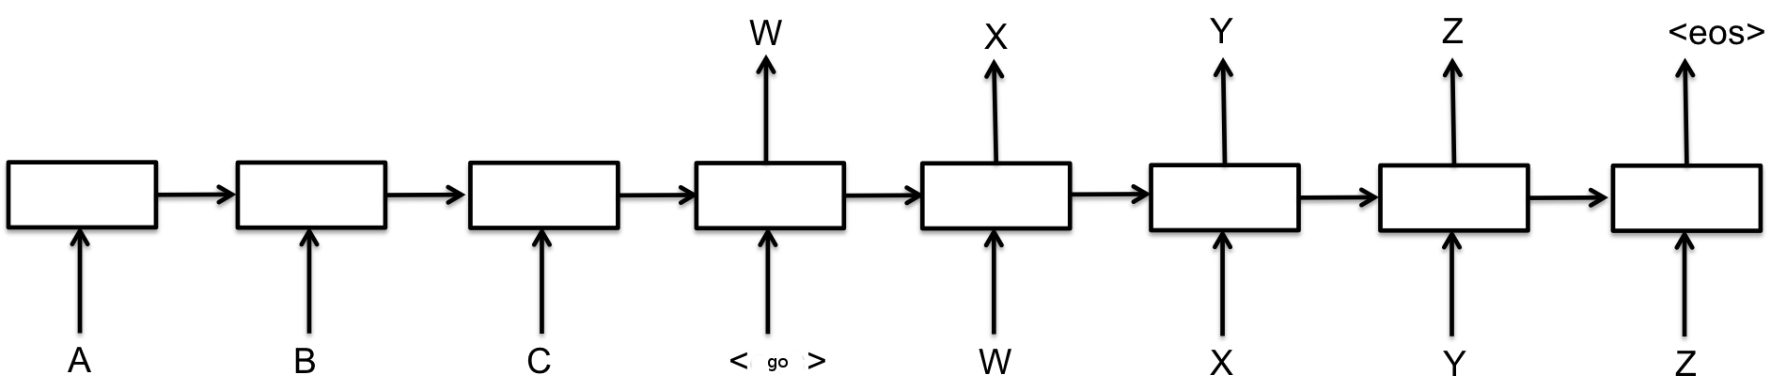
Sequence to sequence basics
Used for machine translation
E.g. translate sequence A,B,C → W,X,Y,Z
E.g. I am fine → 我很好
That means, if the input is A,B,C <go>, it will generate the output W,X,Y,Z
<GO>
“Each box in the picture above represents a cell of the RNN, most commonly a GRU cell or an LSTM cell (see the RNN Tutorial for an explanation of those). Encoder and decoder can share weights or, as is more common, use a different set of parameters. Multi-layer cells have been successfully used in sequence-to-sequence models too, e.g. for translation Sutskever et al., 2014 (pdf).” https://www.tensorflow.org/tutorials/seq2seq

Slide 61
Basic model for translating A,B,C to W,X,Y,Z,
O_{t} encoder vector
Many to one RNN/LSTM
o_{t}
h_{t+2}
h_{t+3}
h_{t+1}
<GO>
One to many RNN/LSTM
Overall is : many to many RNN/LSTM
Encoder (input sequence):
Input A,
Input B, ……..
we have a output vector (fixed size n_{y}) : O_{t} encoder vector (context vector)
which represents the sequence A,B,C
Decoder Training:
Input O_{t}, and W (W= start of sentence), target X
Input h_{t+1}, and X, target Y
Input h_{t+2}, and Y, target Z
Input h_{t+3}, and Z, target EOS (end of sentence)
Zero padding for unequal source target sequence sizes If sentences length are too short or not equal)
Good animation demo : https://zhanghanduo.github.io/post/attention/

Slide 62
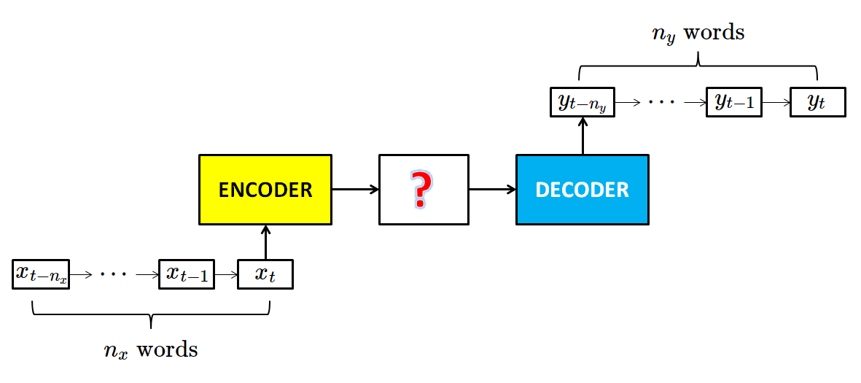
General Encoder-Decoder model
2 LSTMs, one for Encoder (many to one RNN/LSTM), one for Decoder(one to many RNN/LSTM)
O_{t} encoder vector
O_{t}
Encode
From: https://chunml.github.io/ChunML.github.io/project/Sequence-To-Sequence/

Slide 63
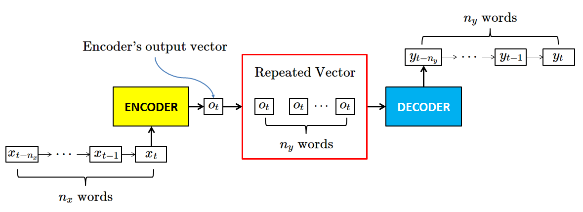
Encoder-Decoder model Example: [Guo18]
English dictionary has 80,000 words
Each word is represented by word2vec
n_{y}=15
x_{t}=256 numbers
n_{x}=15
Pad zeros to make ever sentence the same=15.
During training, many pairs of sentences are given, use the unrolled LSTM (RNN) model to train the encoder/encoder by backpropagation as usual.
[Guo18]:Guo Changyou, English to Chinese translation model, CMSC5720 CUHK MSc project report, 4.2018

Slide 64
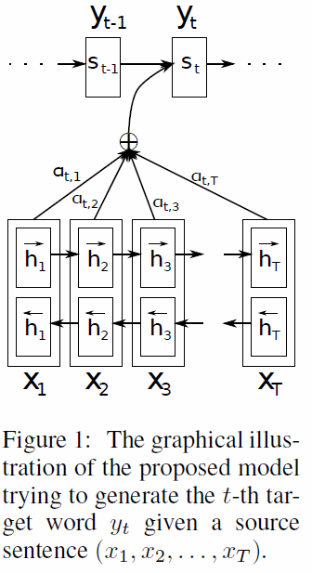
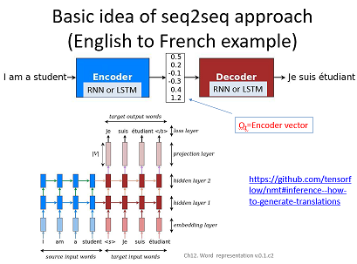
Advanced idea : The attention idea Make relevant words more important than others
In machine translation, without attention, the source language (English here) is translated to an encoder (or context) vector code (Ot) and then generate the destination language (French here ) based on that Ot code. Each step generates h(t), and affect h(t+1) and so on till it reaches the encoder vector code (Ot)
With attention, the source codes is translated to encoder vector code (Ot), but Ot is generated from a combination for all time steps output h(t). Each step generates h(t) and the encoder (or context) code (now called y_{t}) is a combination of α_{t}*al h(t) from time=1,2,..,t till it reaches the encoder vector. α_{t} is the normalization weight factor.
No attention used
attention used

Slide 65
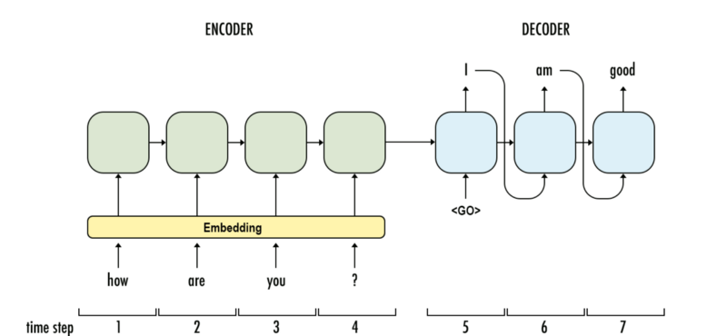
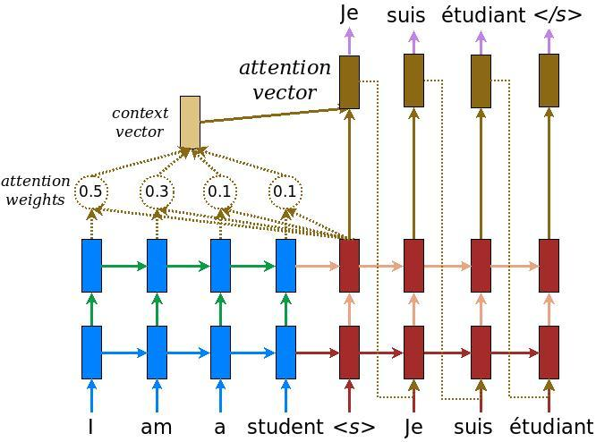
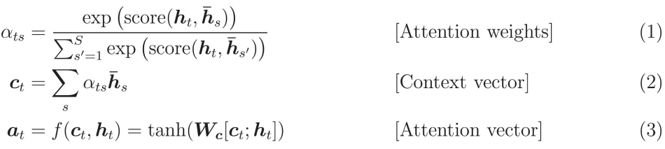
Attention example
https://medium.com/syncedreview/a-brief-overview-of-attention-mechanism-13c578ba9129

Slide 66
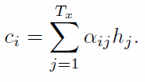
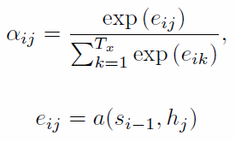

The attention mechanism a closer look
decoder
For the bucket size (T)=number of words in the source sentence
The output h₁=[$\vec{h1} ;\overset{⃐}{h}$₁] (bidirectional)
h₁
h_{T}
where
NEURAL MACHINE TRANSLATION BY JOINTLY LEARNING TO ALIGN AND TRANSLATE by Dzmitry Bahdanau
https://arxiv.org/pdf/1409.0473.pdf

Slide 67

The attention mechanism
S_{i-1}
h₁
h_{T}
h_{j}
Alignment score function a()=score(), many possible score () choices, see next slide
67

Slide 68
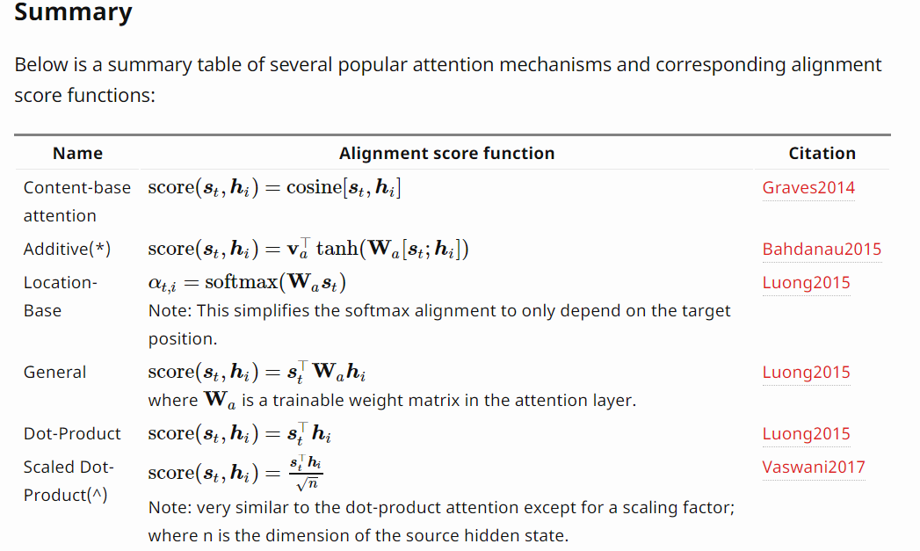
Various attention mechanisms
https://lilianweng.github.io/lil-log/2018/06/24/attention-attention.html

Slide 69
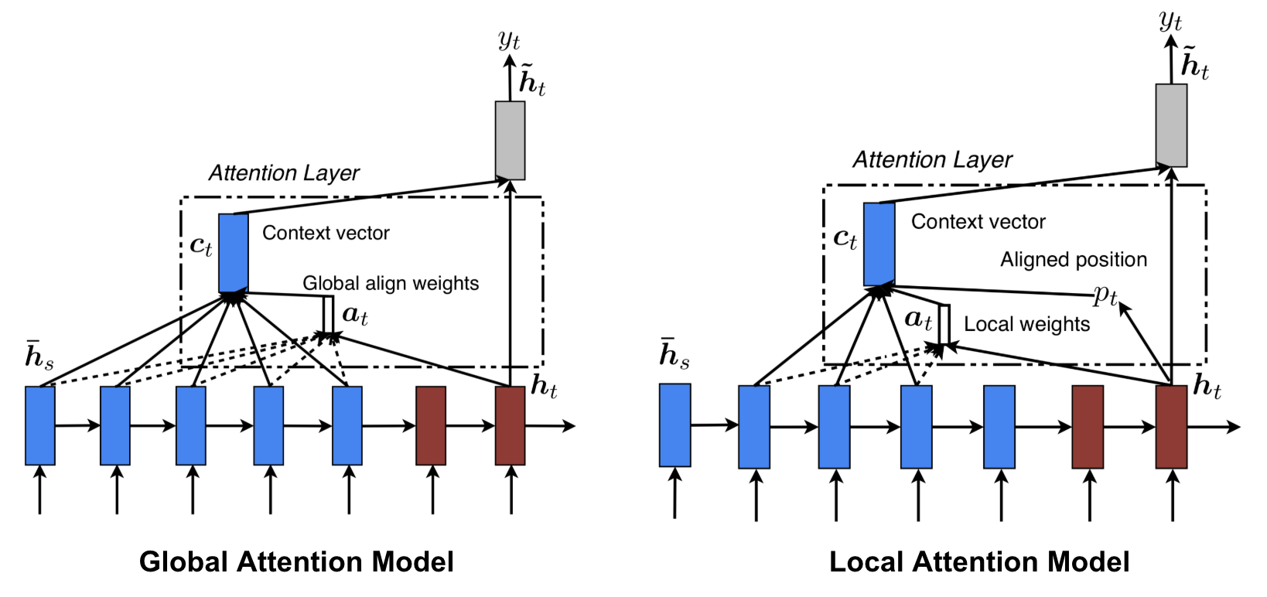
Local attention vs. global attention
Local/ global
https://lilianweng.github.io/lil-log/2018/06/24/attention-attention.html

Slide 70
Machine Translation (MT) evaluation BLEU
BLEU (bilingual evaluation understudy) is an algorithm for evaluating the quality of text which has been machine-translated from one natural language to another.
BLEU ranges from 0(lowest) to 1(highest)
Some literature use 0-1, or 0-100. (simply scale up). Reference:
Paper :- BLEU: a Method for Automatic Evaluation of Machine Translation by Kishore Papineni, etal. https://www.aclweb.org/anthology/P02-1040.pdf
Wiki:- https://en.wikipedia.org/wiki/BLEU

Slide 71
BLEU test example
On a test corpus of about 500 sentences (40 general news stories), a human translator scored 0.3468
Good machine translator can achieve 0.3 or above.
The work “Sequence to Sequence Learning with Neural Networks” by Ilya Sutskever etal, at Google achieves BLEU=34.8 (meaning 0.348)
https://papers.nips.cc/paper/5346-sequence-to-sequence-learning-with-neural-networks.pdf

Slide 72
Summary
Studied word representation and word2vec
Introduced the basic concepts of RNN for sequence prediction
Show how to use RNN (LSTM) for machine translation.
Discussed machine translation evaluation index BLEU (bilingual language understudy)

Slide 73
References
Deep Learning Book.
http://www.deeplearningbook.org/
Papers:
Fully convolutional networks for semantic segmentation by J Long, E Shelhamer, T Darrell
Sequence to sequence learning with neural networks by I Sutskever, O Vinyals, QV Le -
tutorials
http://colah.github.io/posts/2015-08-Understanding-LSTMs/
https://github.com/terryum/awesome-deep-learning-papers
turtorial:
https://theneuralperspective.com/tag/tutorials/
RNN encoder-decoder
https://theneuralperspective.com/2016/11/20/recurrent-neural-networks-rnn-part-3-encoder-decoder/
sequence to sequence model
https://arxiv.org/pdf/1703.01619.pdf
https://indico.io/blog/sequence-modeling-neuralnets-part1/
https://medium.com/towards-data-science/lstm-by-example-using-tensorflow-feb0c1968537
https://google.github.io/seq2seq/nmt/
https://chunml.github.io/ChunML.github.io/project/Sequence-To-Sequence/
parameters of lstm
https://stackoverflow.com/questions/38080035/how-to-calculate-the-number-of-parameters-of-an-lstm-network
https://datascience.stackexchange.com/questions/10615/number-of-parameters-in-an-lstm-model
https://stackoverflow.com/questions/38080035/how-to-calculate-the-number-of-parameters-of-an-lstm-network
https://www.quora.com/What-is-the-meaning-of-%E2%80%9CThe-number-of-units-in-the-LSTM-cell
https://www.quora.com/In-LSTM-how-do-you-figure-out-what-size-the-weights-are-supposed-to-be
http://kbullaughey.github.io/lstm-play/lstm/ (batch size example)
feedback
https://medium.com/@aidangomez/let-s-do-this-f9b699de31d9
Numerical examples
https://blog.aidangomez.ca/2016/04/17/Backpropogating-an-LSTM-A-Numerical-Example/
https://karanalytics.wordpress.com/2017/06/06/sequence-modelling-using-deep-learning/
http://monik.in/a-noobs-guide-to-implementing-rnn-lstm-using-tensorflow/

Slide 74
References
https://github.com/tensorflow/nmt#inference--how-to-generate-translations
https://pytorch.org/tutorials/intermediate/seq2seq_translation_tutorial.html
http://mccormickml.com/2016/04/19/word2vec-tutorial-the-skip-gram-model/

Slide 75
Appendix 1 Advanced topics on text analysis
IMDB Review Dataset for sentiment classification
Text generation
Reuters newswire topic classification task
Attention
https://medium.com/ai-society/jkljlj-7d6e699895c4
GloVe: Global Vectors for Word Representation by Jeffrey Pennington, etal., https://towardsdatascience.com/glove-research-paper-clearly-explained-7d2c3641b8a6
https://nlp.stanford.edu/projects/glove/ (Download pre-trained word vectors, e.g. glove.6B.50d.txt)
https://towardsdatascience.com/light-on-math-ml-intuitive-guide-to-understanding-glove-embeddings-b13b4f19c010
https://towardsdatascience.com/understanding-feature-engineering-part-4-deep-learning-methods-for-text-data-96c44370bbfa
https://medium.com/sciforce/word-vectors-in-natural-language-processing-global-vectors-glove-51339db89639
http://text2vec.org/glove.html

Slide 76
Appendix 2
BLEU (bilingual language understudy)
Reference:
Paper :- BLEU: a Method for Automatic Evaluation of Machine Translation by Kishore Papineni, etal. https://www.aclweb.org/anthology/P02-1040.pdf
Wiki:- https://en.wikipedia.org/wiki/BLEU

Slide 77
BLEU -Background Example 1: Precision measurement (PM) (standard unigram precsion)
Example 1. The words in candidates not found in references will be underlined
References: translated by human for reference
Candidate : translated by human or machine (PM finds out how good they are)
Candidate 1: It is a guide to action which ensures that the military always obeys the commands of the party. (words found in reference =17, total words in candidate=18) Precision measurement (PM )for Candidate 1: 17/18
Candidate 2: It is to insure the troops forever hearing the activity guidebook that party direct. (words found in reference =8, total words in candidate=14) Modified Precision measurement (PM) for Candidate 2: 8/14
-------------------------------------------------------------------------------------------------------
Reference 1: It is a guide to action that ensures that the military will forever heed Party commands.
Reference 2: It is the guiding principle which guarantees the military forces always being under the command of the Party.
Reference 3: It is the practical guide for the army always to heed the directions of the party.

Slide 78
Modified Unigram Precision calculation
https://www.aclweb.org/anthology/P02-1040.pdf
Precision measurement (standard unigram precision): The cornerstone of our metric is the familiar precision measure. To compute precision, one simply counts up the number of candidate translation words (unigrams) which occur in any reference translation and then divides by the total number of words in the candidate translation.
Test1:
Candidate: the the the the the the the.
Reference 1: The cat is on the mat.
Score=word counts in candidate appear in reference/total words in candidate=7/7. Obviously, this precision measurement is not accurate.
Modified unigram precision: To compute this, one first counts the maximum number of times a word occurs in any single reference translation.
Next, one clips the total count of each candidate word by its maximum reference count, adds these clipped counts up, and divides by the total (unclipped) number of candidate words. So in Test1: 2/7, because the first ‘the’ is clipped, and also the second the. After that the has no effect. Hence the result is 2/7.
7 words here
The maximum of “the” occur 2 times

Slide 79
Modified Unigram Precision calculation example 2
Example 2:
Candidate: the the the the the the the.
Reference 1: The cat is on the mat.
Reference 2: There is a cat on the mat.
Modified Unigram Precision = 2/7.
the modified unigram precision = Countclip/total word counts in candidate. In Example, it is 2/7, even though its standard unigram precision is 7/7 (method in previous slide). Note: the first two “the” are clipped away. So count clip is 2, total word counts in candidate is 7 .
Countclip = min(Count,Max Ref Count). In other words, one truncates each word’s count, if necessary, to not exceed the largest count observed in any single reference for that word.
As a guide to the eye, we have underlined the important words (the the in the candidate) for computing modified precision.

Slide 80
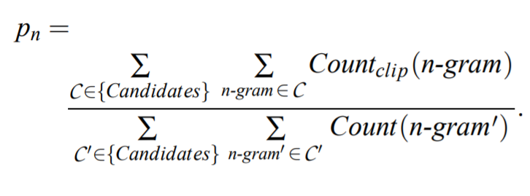
Modified n-gram precision on blocks of text
How to compute modified unigram precision:
counts the maximum number of times a word occurs in any single reference translation
one clips the total count of each candidate word by its maximum reference count
adds these clipped counts (i.e., Countclip) up, and divides by the total (unclipped) number of candidate words.
we add the clipped n-gram counts for all the candidate sentences and divide by the number of candidate n-grams in the test corpus to compute a modified precision score, p_{n}, for the entire test corpus, C can be 1,2,3,4-gram.
Add all test
candidates
Add all
n=1,2,3,4 gram
https://zhu45.org/posts/2018/Mar/28/bleu-a-method-for-automatic-evaluation-of-machine-translation/

Slide 81
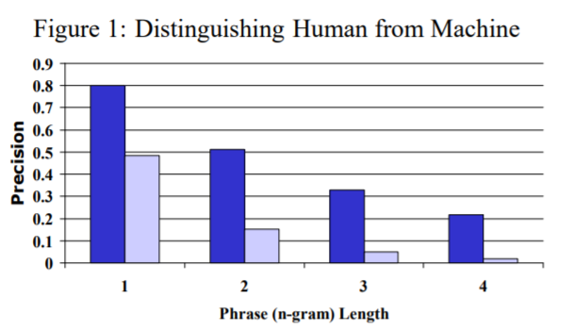
Modified n-gram precision of human and machine
plot
Human, machine of p_{n}

Slide 82
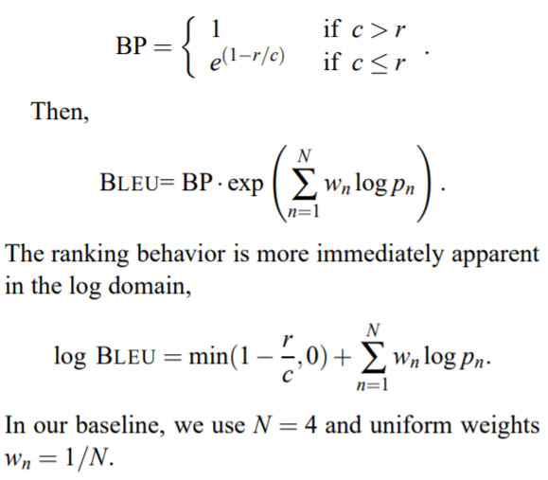
BLEU calculation
modified precision score
p_{n}
n=1,2,3,4-gram
r= corpus’ effective reference length, by summing the best match lengths for each candidate sentence in the corpus.
brevity penalty (BP)= exponential in r/c, where c is the total length of the candidate translation corpus.
If candidate sentence length >reference length, then BP=1
If the candidate sentence is shorter than reference:
c ≤ r, BP < exp(-ve) <1 ( a penalty)
https://zhu45.org/posts/2018/Mar/28/bleu-a-method-for-automatic-evaluation-of-machine-translation/

Slide 83
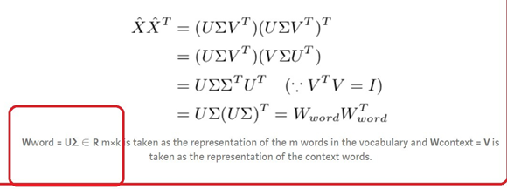
Appendix 3 Glove
GloVe: Global Vectors for Word Representation by Jeffrey Pennington, etal., https://towardsdatascience.com/glove-research-paper-clearly-explained-7d2c3641b8a6
https://towardsdatascience.com/art-of-vector-representation-of-words-5e85c59fee5
From the corpus build the co-occurrence matrix X, then find W_{word}, see below

Slide 84
Appendix 4: IMDB Review Dataset for sentiment classification
Summary:
50000 reviews (score 0 to 10)
label 0 (bad) :25000 reviews, score 4 or lower
Label1(good): 25000 reviews, score 7 or higher
Middle score ignored
We use this to train a system that is able to tell a new review is good or bad
We constructed a collection of 50,000 reviews
from IMDB, allowing no more than 30 reviews per
movie. The constructed dataset contains an even
number of positive and negative reviews, so randomly
guessing yields 50% accuracy. Following
previous work on polarity classification, we consider
only highly polarized reviews. A negative review
has a score 4 out of 10, and a positive review has
a score 7 out of 10. Neutral reviews are not included
in the dataset. In the interest of providing a
benchmark for future work in this area, we release
this dataset to the public.2
Ref : Maas, Andrew, et al. "Learning word vectors for sentiment analysis." Proceedings of the 49th annual meeting of the association for computational linguistics: Human language technologies. 2011.
https://www.aclweb.org/anthology/P11-1015.pdf
https://towardsdatascience.com/sentiment-analysis-with-python-part-1-5ce197074184

Slide 85
Read_imdb.py Show 100 reviews with label (0, or 1)
#import keras
from tensorflow.python import keras
#from tensorflow.keras import keras
NUM_WORDS=1000 # only use top 1000 words
INDEX_FROM=3 # word index offset
train,test = keras.datasets.imdb.load_data(num_words=NUM_WORDS, index_from=INDEX_FROM)
train_x,train_y = train
test_x,test_y = test
word_to_id = keras.datasets.imdb.get_word_index()
word_to_id = {k:(v+INDEX_FROM) for k,v in word_to_id.items()}
word_to_id["<PAD>"] = 0
word_to_id["<START>"] = 1
word_to_id["<UNK>"] = 2
id_to_word = {value:key for key,value in word_to_id.items()}
for i in range(0, 100):
print('xxxx The sentence index>>',i)
print(train_y[i],'train_y[] label')
print(' '.join(id_to_word[id] for id in train_x[i] ))
https://intellipaat.com/community/5718/restore-original-text-from-kerass-imdb-dataset

Slide 86
Example: display from Read_imdb.py
…
xxxx The sentence index>> 98
1 train_y[] label
<START> this movie is wonderful br br i was <UNK> i should say and surprised because of how <UNK> it was done the cast the <UNK> the effects everything <UNK> i mean it was a love story yes but what made it <UNK> from the rest was that it was told in an entertaining <UNK> <UNK> br br for me it is the <UNK> of modern <UNK> tale it's like the modern peter <UNK> simply amazing br br i <UNK> would buy a <UNK> of this the moment it hit the <UNK> br br this movie is really a <UNK> must see one 10 stars for that
xxxx The sentence index>> 99
0 train_y[] label
<START> <UNK> <UNK> cannot make horror movies first of all the casting was very wrong for this movie the only decent part was the hot <UNK> <UNK> girl from <UNK> the <UNK> <UNK> this movies has no gore usually a <UNK> <UNK> to a horror movie no action no acting and no suspense also a <UNK> <UNK> <UNK> <UNK> is a good actor but he is so <UNK> and <UNK> in this that it's sad there were a few parts that were supposed to be funny <UNK> the <UNK> horror comedy movies and no one <UNK> in the audience i thought that this movie was <UNK> <UNK> and i didn't pay attention and <UNK> it had been <UNK> to <UNK> <UNK> anyway see this movie if you liked i still know what you did last <UNK> that's the only type of person who would find this movie even <UNK> scary and seriously this is to you <UNK> <UNK> stop making horror movies this movie makes <UNK> look like <UNK> <UNK> <UNK>

Slide 87
keras.datasets.imdb.load_data() using a simple representation scheme (not using the more advanced word2vec)
Loads the IMDB dataset.
This is a dataset of 25,000 movies reviews from IMDB, labeled by sentiment (positive/negative). Reviews have been preprocessed, and each review is encoded as a list of word indexes (integers). For convenience, words are indexed by overall frequency in the dataset, so that for instance the integer "3" encodes the 3rd most frequent word in the data. This allows for quick filtering operations such as: "only consider the top 10,000 most common words, but eliminate the top 20 most common words".
As a convention, "0" does not stand for a specific word, but instead is used to encode any unknown word.
From https://keras.io/api/datasets/imdb/

Slide 88
imdb_lstm.py using keras (https://github.com/keras-team/keras/tree/master/)
'''
#Train a recurrent convolutional network on the IMDB sentiment classification task.
Gets to 0.8498 test accuracy after 2 epochs. 41 s/epoch on K520 GPU.
'''
from __future__ import print_function
from tensorflow.keras.preprocessing import sequence
from tensorflow.keras.models import Sequential
from tensorflow.keras.layers import Dense, Dropout, Activation
from tensorflow.keras.layers import Embedding
from tensorflow.keras.layers import LSTM
from tensorflow.keras.layers import Conv1D, MaxPooling1D
from tensorflow.keras.datasets import imdb
# Embedding
max_features = 20000
maxlen = 100
embedding_size = 128
# Convolution
kernel_size = 5
filters = 64
pool_size = 4
# LSTM
lstm_output_size = 70
# Training
batch_size = 30
epochs = 2
'''
Note:
batch_size is highly sensitive.
Only 2 epochs are needed as the dataset is very small.
'''
print('Loading data...')
(x_train, y_train), (x_test, y_test) = imdb.load_data(num_words=max_features)
print(len(x_train), 'train sequences')
print(len(x_test), 'test sequences')
print('Pad sequences (samples x time)')
x_train = sequence.pad_sequences(x_train, maxlen=maxlen)
x_test = sequence.pad_sequences(x_test, maxlen=maxlen)
print('x_train shape:', x_train.shape)
print('x_test shape:', x_test.shape)
print('Build model...')
model = Sequential()
model.add(Embedding(max_features, embedding_size, input_length=maxlen))
model.add(Dropout(0.25))
model.add(Conv1D(filters,
kernel_size,
padding='valid',
activation='relu',
strides=1))
model.add(MaxPooling1D(pool_size=pool_size))
model.add(LSTM(lstm_output_size))
model.add(Dense(1))
model.add(Activation('sigmoid'))
model.compile(loss='binary_crossentropy',
optimizer='adam',
metrics=['accuracy'])
print('Train...')
model.fit(x_train, y_train,
batch_size=batch_size,
epochs=epochs,
validation_data=(x_test, y_test))
score, acc = model.evaluate(x_test, y_test, batch_size=batch_size)
print('Test score:', score)
print('Test accuracy:', acc)

Slide 89
Results of imdb_lstm.py
Train on 25000 samples, validate on 25000 samples
E.g.
Epoch 7/15
25000/25000 [==============================] - 248s 10ms/sample - loss: 0.0596 - accuracy: 0.9800 - val_loss: 0.7332 - val_accuracy: 0.8141

Slide 90
Can also use word2vec for imdb
https://towardsdatascience.com/machine-learning-word-embedding-sentiment-classification-using-keras-b83c28087456

Slide 91
Appendix 5: lstm_text_generation
Learn the neural system from a text database
Generate a text story based on a seed
Source from https://github.com/keras-team/keras/tree/master/
lstm_text_generation_tf2_ok.py

Slide 92
Source code: lstm_text_generation.py https://keras.io/examples/generative/lstm_character_level_text_generation/ https://machinelearningmastery.com/how-to-develop-a-word-level-neural-language-model-in-keras/
'''
#Example script to generate text from Nietzsche's writings.
At least 20 epochs are required before the generated text
starts sounding coherent.
It is recommended to run this script on GPU, as recurrent
networks are quite computationally intensive.
If you try this script on new data, make sure your corpus
has at least ~100k characters. ~1M is better.
'''
from __future__ import print_function
from tensorflow.keras.callbacks import LambdaCallback
from tensorflow.keras.models import Sequential
from tensorflow.keras.layers import Dense
from tensorflow.keras.layers import LSTM
from tensorflow.keras.optimizers import RMSprop
from tensorflow.python.keras.utils.data_utils import get_file
import numpy as np
import random
import sys
import io
path = get_file(
'nietzsche.txt',
origin='https://s3.amazonaws.com/text-datasets/nietzsche.txt')
with io.open(path, encoding='utf-8') as f:
text = f.read().lower()
print('corpus length:', len(text))
chars = sorted(list(set(text)))
print('total chars:', len(chars))
char_indices = dict((c, i) for i, c in enumerate(chars))
indices_char = dict((i, c) for i, c in enumerate(chars))
# cut the text in semi-redundant sequences of maxlen characters
maxlen = 40
step = 3
sentences = []
next_chars = []
for i in range(0, len(text) - maxlen, step):
sentences.append(text[i: i + maxlen])
next_chars.append(text[i + maxlen])
print('nb sequences:', len(sentences))
print('Vectorization...')
x = np.zeros((len(sentences), maxlen, len(chars)), dtype=np.bool)
y = np.zeros((len(sentences), len(chars)), dtype=np.bool)
for i, sentence in enumerate(sentences):
for t, char in enumerate(sentence):
x[i, t, char_indices[char]] = 1
y[i, char_indices[next_chars[i]]] = 1
# build the model: a single LSTM
print('Build model...')
model = Sequential()
model.add(LSTM(128, input_shape=(maxlen, len(chars))))
model.add(Dense(len(chars), activation='softmax'))
optimizer = RMSprop(learning_rate=0.01)
model.compile(loss='categorical_crossentropy', optimizer=optimizer)
def sample(preds, temperature=1.0):
# helper function to sample an index from a probability array
preds = np.asarray(preds).astype('float64')
preds = np.log(preds) / temperature
exp_preds = np.exp(preds)
preds = exp_preds / np.sum(exp_preds)
probas = np.random.multinomial(1, preds, 1)
return np.argmax(probas)
def on_epoch_end(epoch, _):
# Function invoked at end of each epoch. Prints generated text.
print()
print('----- Generating text after Epoch: %d' % epoch)
start_index = random.randint(0, len(text) - maxlen - 1)
for diversity in [0.2, 0.5, 1.0, 1.2]:
print('----- diversity:', diversity)
generated = ''
sentence = text[start_index: start_index + maxlen]
generated += sentence
print('----- Generating with seed: "' + sentence + '"')
sys.stdout.write(generated)
for i in range(400):
x_pred = np.zeros((1, maxlen, len(chars)))
for t, char in enumerate(sentence):
x_pred[0, t, char_indices[char]] = 1.
preds = model.predict(x_pred, verbose=0)[0]
next_index = sample(preds, diversity)
next_char = indices_char[next_index]
sentence = sentence[1:] + next_char
sys.stdout.write(next_char)
sys.stdout.flush()
print()
print_callback = LambdaCallback(on_epoch_end=on_epoch_end)
model.fit(x, y,
batch_size=128,
epochs=60,
callbacks=[print_callback])
----- Example:
-----Generating with seed: "hey shine here and
there: those moments "
hey shine here and
there: those moments and closings. more motiyy"--that "na
are unwill sunsesses and relation,--how consideral a contemplement
"ndemoral is amperial upon our ilmudingly ! his enfatily tool? which he
saschs of the merity sacret"--kin

Slide 93
Appendix 3: Reuters newswire topic classification task.
'''Trains and evaluate a simple MLP
on the Reuters newswire topic classification task.
'''
from __future__ import print_function
import numpy as np
import tensorflow.keras
from tensorflow.keras.datasets import reuters
from tensorflow.keras.models import Sequential
from tensorflow.keras.layers import Dense, Dropout, Activation
from tensorflow.keras.preprocessing.text import Tokenizer
max_words = 1000
batch_size = 32
epochs = 5
print('Loading data...')
(x_train, y_train), (x_test, y_test) = reuters.load_data(num_words=max_words,
test_split=0.2)
print(len(x_train), 'train sequences')
print(len(x_test), 'test sequences')
num_classes = np.max(y_train) + 1
print(num_classes, 'classes')
print('Vectorizing sequence data...')
tokenizer = Tokenizer(num_words=max_words)
x_train = tokenizer.sequences_to_matrix(x_train, mode='binary')
x_test = tokenizer.sequences_to_matrix(x_test, mode='binary')
print('x_train shape:', x_train.shape)
print('x_test shape:', x_test.shape)
print('Convert class vector to binary class matrix '
'(for use with categorical_crossentropy)')
y_train = tensorflow.keras.utils.to_categorical(y_train, num_classes)
y_test = tensorflow.keras.utils.to_categorical(y_test, num_classes)
print('y_train shape:', y_train.shape)
print('y_test shape:', y_test.shape)
print('Building model...')
model = Sequential()
model.add(Dense(512, input_shape=(max_words,)))
model.add(Activation('relu'))
model.add(Dropout(0.5))
model.add(Dense(num_classes))
model.add(Activation('softmax'))
model.compile(loss='categorical_crossentropy',
optimizer='adam',
metrics=['accuracy'])
history = model.fit(x_train, y_train,
batch_size=batch_size,
epochs=epochs,
verbose=1,
validation_split=0.1)
score = model.evaluate(x_test, y_test,
batch_size=batch_size, verbose=1)
print('Test score:', score[0])
print('Test accuracy:', score[1])

Slide 94
Appendix 3: Reuters newswire topic classification task.
Learn a neural net from the Reuters newswire dataset
Then can classify the topic for a new unknown newswire
Source from https://github.com/keras-team/keras/tree/master/
keras reuters_mlp_tf2_ok.py

Slide 95
Source code: reuters_mlp.py
https://towardsdatascience.com/text-classification-in-keras-part-1-a-simple-reuters-news-classifier-9558d34d01d3
Result after 5 epochs:
le - loss: 1.8346 - accuracy: 0.7925
Test score: 0.8894582841402701
Test accuracy: 0.79252005
'''Trains and evaluate a simple MLP
on the Reuters newswire topic classification task.
'''
from __future__ import print_function
import numpy as np
import tensorflow.keras
from tensorflow.keras.datasets import reuters
from tensorflow.keras.models import Sequential
from tensorflow.keras.layers import Dense, Dropout, Activation
from tensorflow.keras.preprocessing.text import Tokenizer
max_words = 1000
batch_size = 32
epochs = 5
print('Loading data...')
(x_train, y_train), (x_test, y_test) = reuters.load_data(num_words=max_words,
test_split=0.2)
print(len(x_train), 'train sequences')
print(len(x_test), 'test sequences')
num_classes = np.max(y_train) + 1
print(num_classes, 'classes')
print('Vectorizing sequence data...')
tokenizer = Tokenizer(num_words=max_words)
x_train = tokenizer.sequences_to_matrix(x_train, mode='binary')
x_test = tokenizer.sequences_to_matrix(x_test, mode='binary')
print('x_train shape:', x_train.shape)
print('x_test shape:', x_test.shape)
print('Convert class vector to binary class matrix '
'(for use with categorical_crossentropy)')
y_train = tensorflow.keras.utils.to_categorical(y_train, num_classes)
y_test = tensorflow.keras.utils.to_categorical(y_test, num_classes)
print('y_train shape:', y_train.shape)
print('y_test shape:', y_test.shape)
print('Building model...')
model = Sequential()
model.add(Dense(512, input_shape=(max_words,)))
model.add(Activation('relu'))
model.add(Dropout(0.5))
model.add(Dense(num_classes))
model.add(Activation('softmax'))
model.compile(loss='categorical_crossentropy',
optimizer='adam',
metrics=['accuracy'])
history = model.fit(x_train, y_train,
batch_size=batch_size,
epochs=epochs,
verbose=1,
validation_split=0.1)
score = model.evaluate(x_test, y_test,
batch_size=batch_size, verbose=1)
print('Test score:', score[0])
print('Test accuracy:', score[1])

Slide 96
Result running: python tokenizer_api_test.py
#Tokenizer API#https://machinelearningmastery.com/prepare-text-data-deep-learning-keras/
>python tokenizer_api_test.py
#Example:, source code
from keras.preprocessing.text import Tokenizer
# define 5 documents
docs = ['Well done!',
'Good work',
'Great effort',
'nice work',
'Excellent!']
# create the tokenizer
t = Tokenizer()
# fit the tokenizer on the documents
t.fit_on_texts(docs)
# summarize what was learned
print(t.word_counts)
print(t.document_count)
print(t.word_index)
print(t.word_docs)
# integer encode documents
encoded_docs = t.texts_to_matrix(docs, mode='count')
print(encoded_docs)
(tf-gpu) C:\Users\khwong\projects\2020_tensorflow\tested_ok_200804b\keras_examples_ok>python tokenized_api_test.py
OrderedDict([('well', 1), ('done', 1), ('good', 1), ('work', 2), ('great', 1), ('effort', 1), ('nice', 1), ('excellent', 1)])
5
{'work': 1, 'well': 2, 'done': 3, 'good': 4, 'great': 5, 'effort': 6, 'nice': 7, 'excellent': 8}
defaultdict(<class 'int'>, {'done': 1, 'well': 1, 'good': 1, 'work': 2, 'effort': 1, 'great': 1, 'nice': 1, 'excellent': 1})
[[0. 0. 1. 1. 0. 0. 0. 0. 0.]
[0. 1. 0. 0. 1. 0. 0. 0. 0.]
[0. 0. 0. 0. 0. 1. 1. 0. 0.]
[0. 1. 0. 0. 0. 0. 0. 1. 0.]
[0. 0. 0. 0. 0. 0. 0. 0. 1.]]

Slide 97
Appendix 6: Advanced topic: Attention mechanism
To improve performance for long sequences

Slide 98
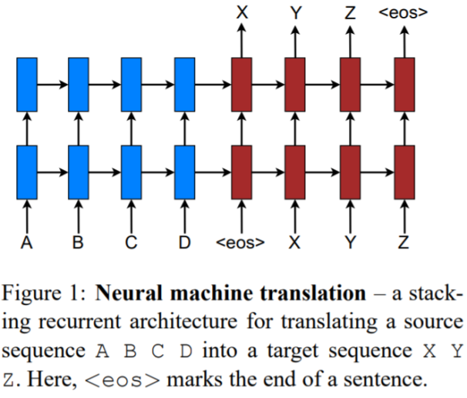
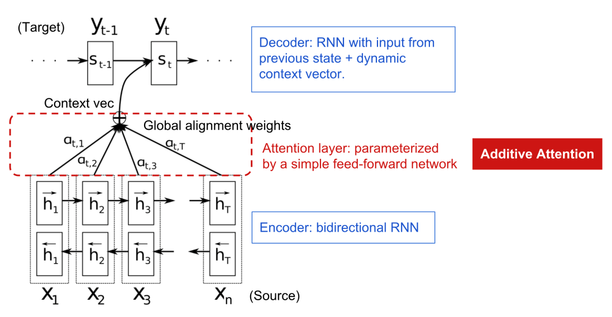
No attention vs with attention
No attention
With attention
Luong, Minh-Thang, Hieu Pham, and Christopher D. Manning. "Effective approaches to attention-based neural machine translation." arXiv preprint arXiv:1508.04025 (2015). https://arxiv.org/pdf/1508.04025.pdf

Slide 99

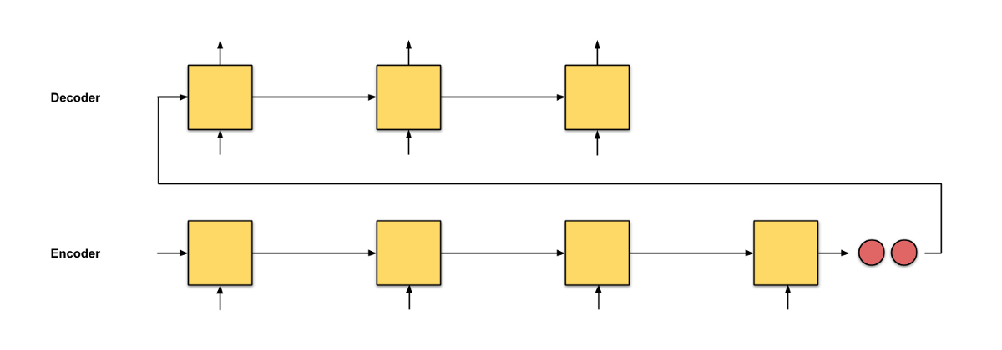
Seq2seq2 encoder/decoder for input (length=4), output(length=3)
Encoder (LSTM) → Hidden vector → (decoder(LSTM)
Encoder (LSTM): totally N=4 states (input length=4)
Decoder (LSTM): totally N=3 states (input length=3) Hidden vector: C= last encoding state
https://towardsdatascience.com/attn-illustrated-attention-5ec4ad276ee3

Slide 100
The attention idea
https://mc.ai/understanding-attention-mechanism-natural-language-processing/

Slide 101
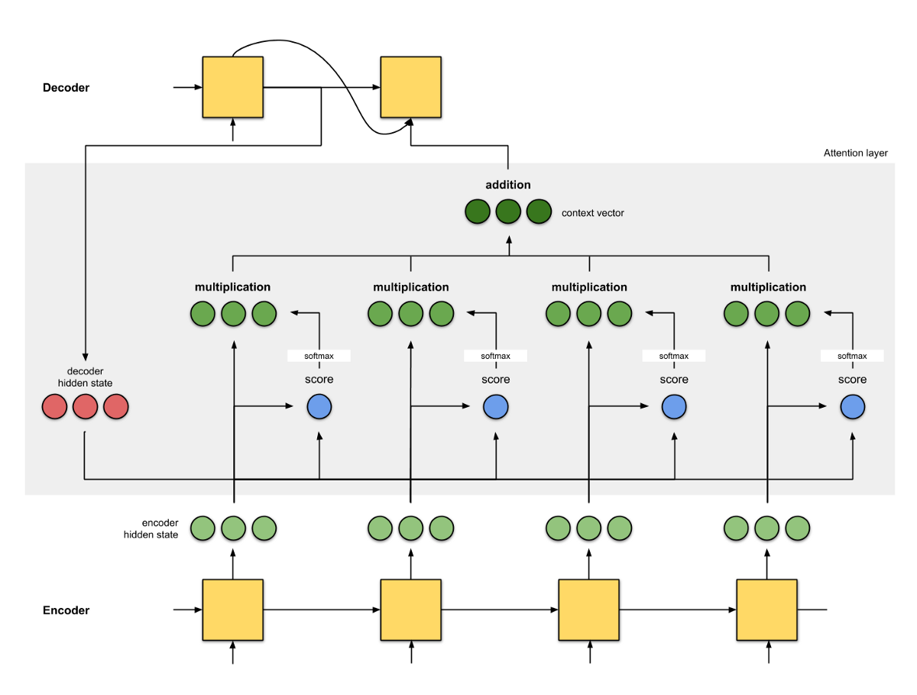
Attention details
Last decoder hidden state+ all hidden state → next decoder hidden state
https://towardsdatascience.com/attn-illustrated-attention-5ec4ad276ee3

Slide 102
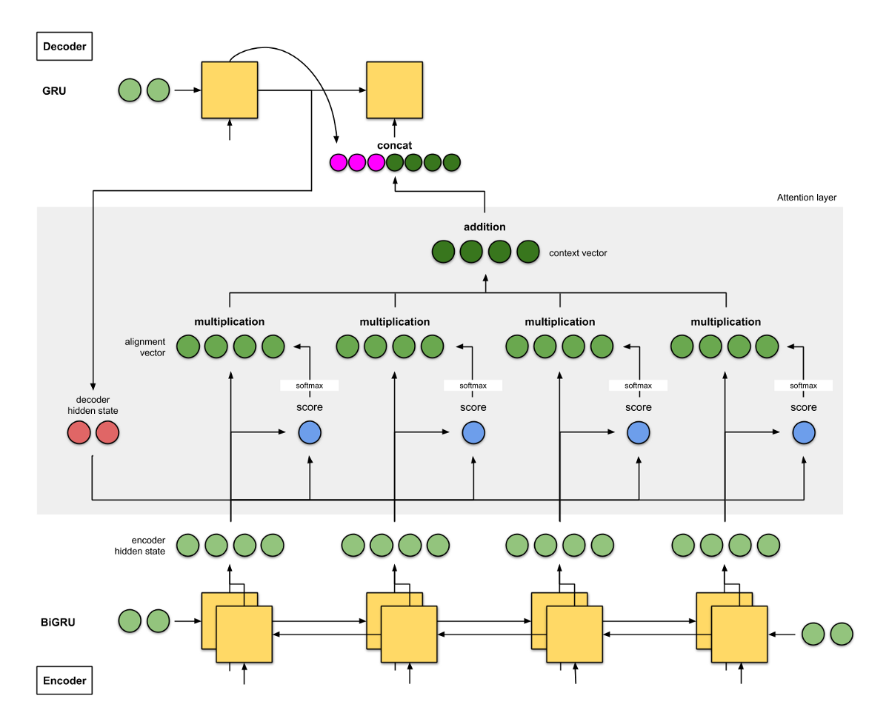
Example1: Bahdanau et. al (2015) [1] Intuition: seq2seq with bi-directional encoder + attention

Slide 103
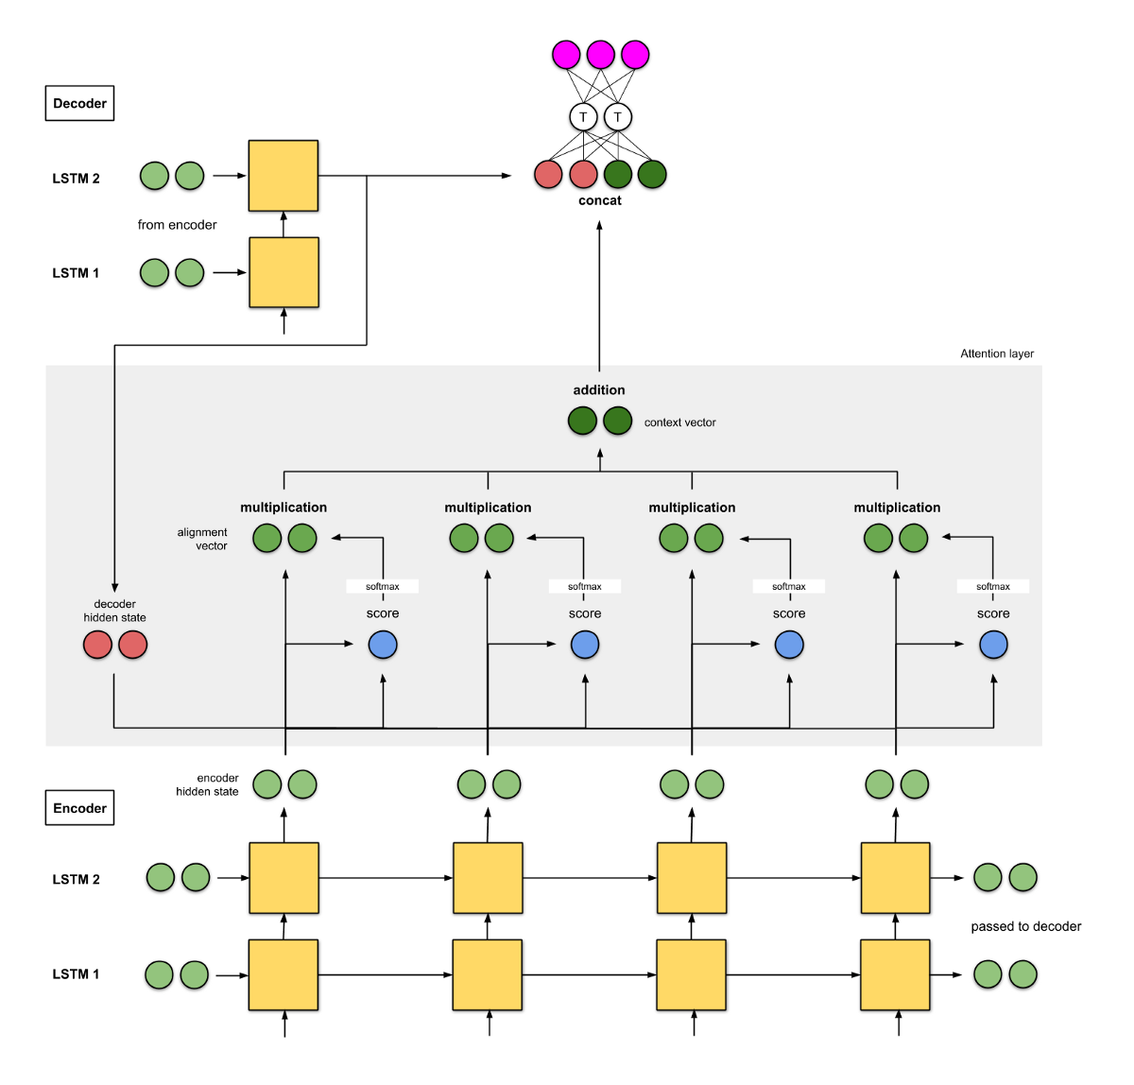
Example 2: Luong et. al (2015) [2] Intuition: seq2seq with 2-layer stacked encoder + attention

Slide 104
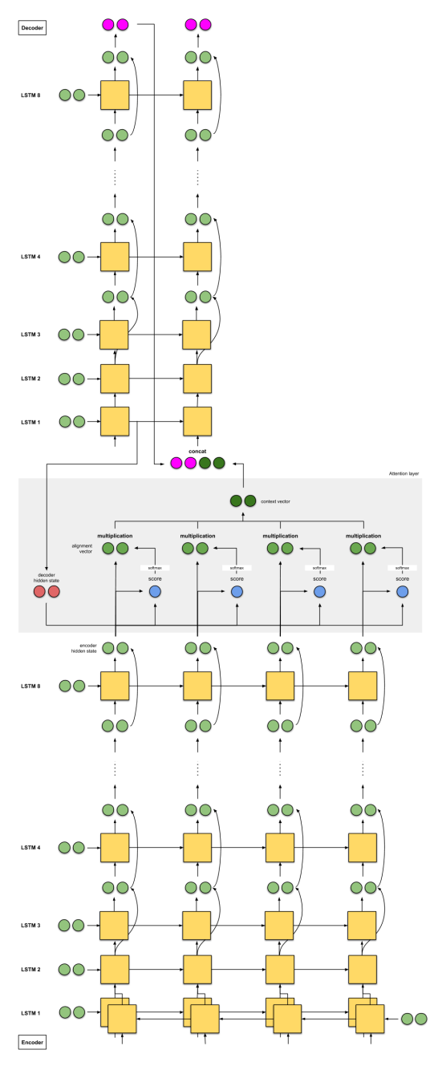
. Example 3: Google’s Neural Machine Translation (GNMT) [9] Intuition: GNMT — seq2seq with 8-stacked encoder (+bidirection+residual connections) + attention

Slide 105
Attention details Bahdanau et. al (2015)
https://towardsdatascience.com/attn-illustrated-attention-5ec4ad276ee3

Slide 106
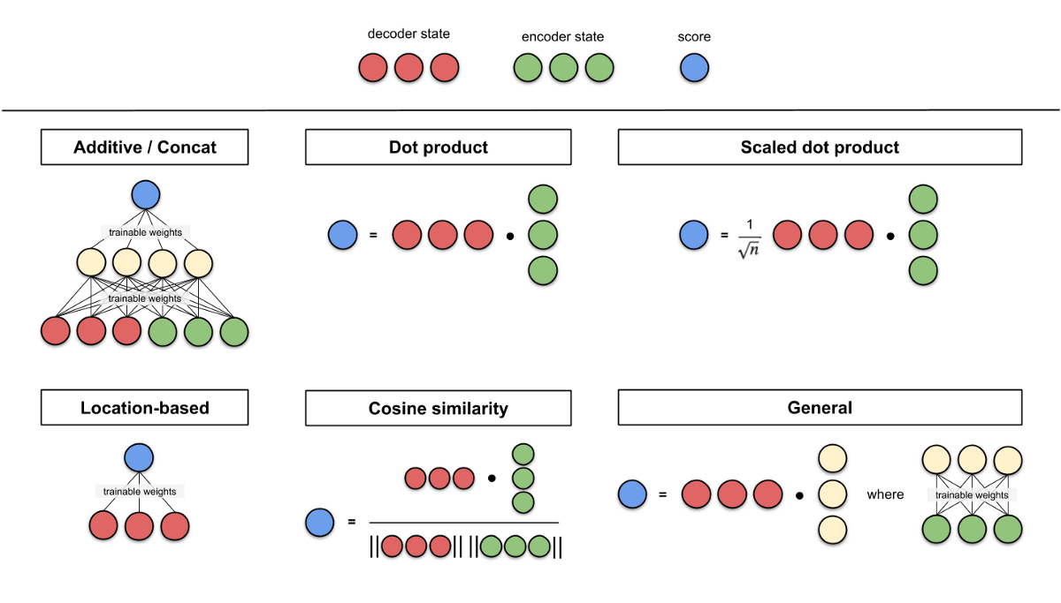
Score

Slide 107
Summary of seq2seq and attention
seq2seq
seq2seq + attention
seq2seq with bidirectional encoder + attention
seq2seq with 2-stacked encoder + attention
GNMT — seq2seq with 8-stacked encoder (+bidirection+residual connections) + attention

Slide 108
Appendix 7: Math function used: Softmax function
https://medium.com/data-science-bootcamp/understand-the-softmax-function-in-minutes-f3a59641e86d
y=[2 , 1, 0.1]’
Softmax(y)=[0.6590, 0.242,0.0986]’
exp(2)/((exp(2)+exp(1)+exp(0.1))=0.6590
exp(1)/((exp(2)+exp(1)+exp(0.1))= 0.2424
exp(0.1)/((exp(2)+exp(1)+exp(0.1))= 0.0986

Slide 109
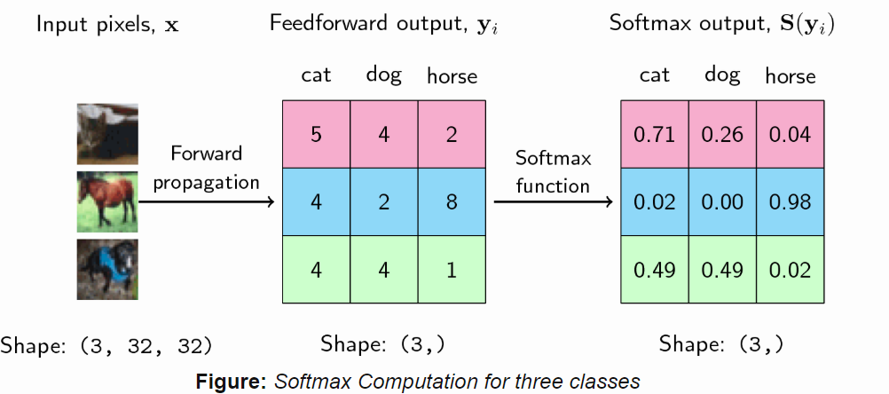
Math function used: Softmax Activation Function
https://ljvmiranda921.github.io/notebook/2017/08/13/softmax-and-the-negative-log-likelihood/#nll
exp(4)/((exp(5)+exp(4)+exp(2))=0.25949
exp(5)/((exp(5)+exp(4)+exp(2))=0.705
=5/(5+4+2)=

Slide 110
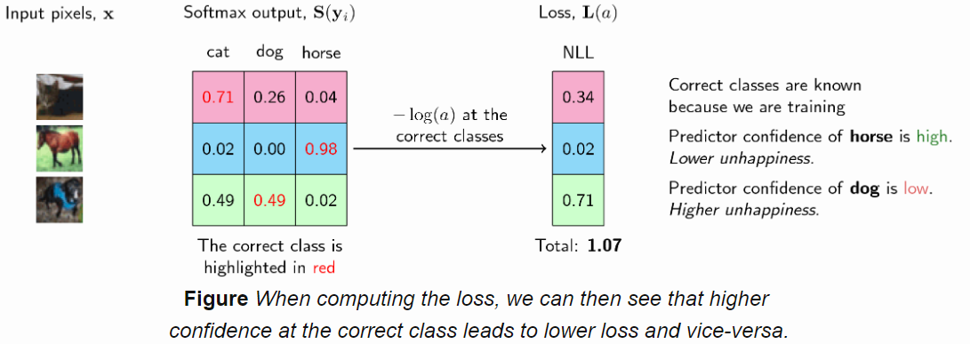
Math function used: Negative Log-Likelihood (NLL)
=-ln(likelihood)
=-ln(0.02)=3.91
=-ln(0)=infinity
=-ln(0.98)=0.02
Minimum negative log-likelihood (NLL) is picked, so 0.02 is selected
To maximize likelihood, minimum negative log-likelihood (NLL) is picked
Softmax output as the
likelihood
https://ljvmiranda921.github.io/notebook/2017/08/13/softmax-and-the-negative-log-likelihood/#nll

Slide 111
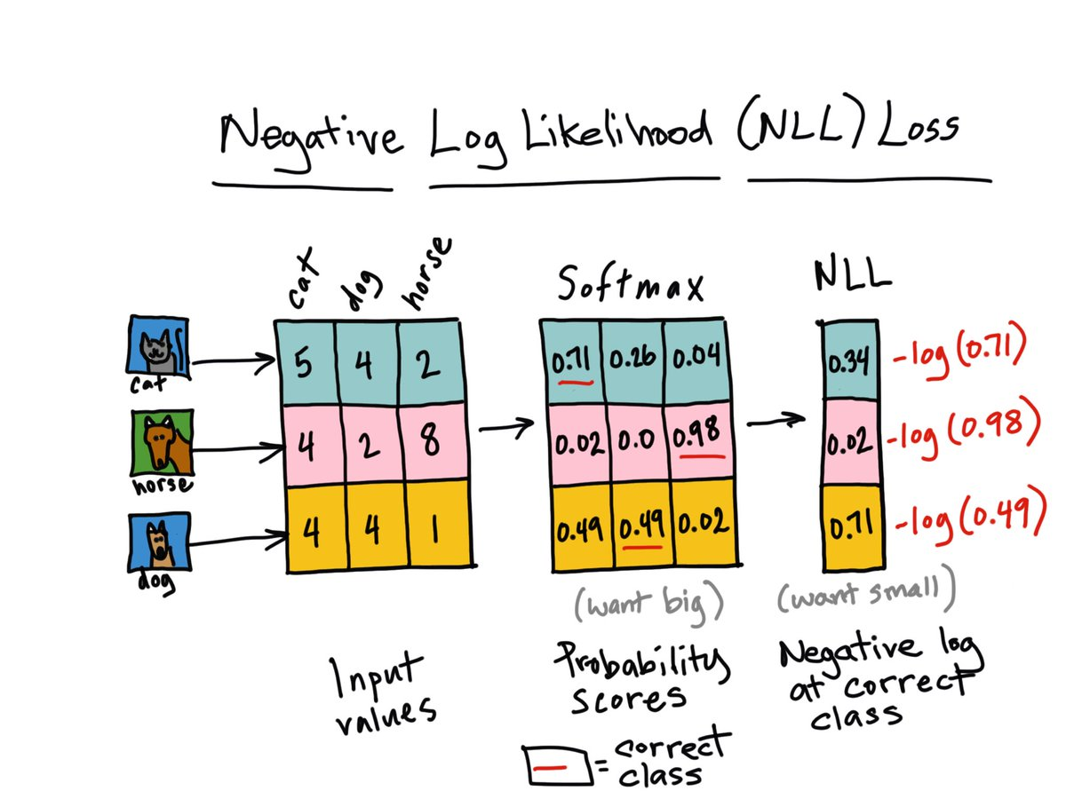
Continue

Slide 112
References
References
https://towardsdatascience.com/attn-illustrated-attention-5ec4ad276ee3
Bahdanau, Dzmitry, Kyunghyun Cho, and Yoshua Bengio. "Neural machine translation by jointly learning to align and translate." arXiv preprint arXiv:1409.0473 (2014). https://arxiv.org/abs/1409.0473
Luong, Minh-Thang, Hieu Pham, and Christopher D. Manning. "Effective approaches to attention-based neural machine translation." arXiv preprint arXiv:1508.04025 (2015). https://arxiv.org/pdf/1508.04025.pdf
[1] “Attention and Memory in Deep Learning and NLP.” - Jan 3, 2016 by Denny Britz
[2] “Neural Machine Translation (seq2seq) Tutorial”
[3] Dzmitry Bahdanau, Kyunghyun Cho, and Yoshua Bengio. “Neural machine translation by jointly learning to align and translate.” ICLR 2015.
[4] Kelvin Xu, Jimmy Ba, Ryan Kiros, Kyunghyun Cho, Aaron Courville, Ruslan Salakhudinov, Rich Zemel, and Yoshua Bengio. “Show, attend and tell: Neural image caption generation with visual attention.” ICML, 2015.
[5] Ilya Sutskever, Oriol Vinyals, and Quoc V. Le. “Sequence to sequence learning with neural networks.” NIPS 2014.
[6] Thang Luong, Hieu Pham, Christopher D. Manning. “Effective Approaches to Attention-based Neural Machine Translation.” EMNLP 2015.
[7] Denny Britz, Anna Goldie, Thang Luong, and Quoc Le. “Massive exploration of neural machine translation architectures.” ACL 2017.
[8] Ashish Vaswani, et al. “Attention is all you need.” NIPS 2017.
[9] Jianpeng Cheng, Li Dong, and Mirella Lapata. “Long short-term memory-networks for machine reading.” EMNLP 2016.
[10] Xiaolong Wang, et al. “Non-local Neural Networks.” CVPR 2018
[11] Han Zhang, Ian Goodfellow, Dimitris Metaxas, and Augustus Odena. “Self-Attention Generative Adversarial Networks.” arXiv preprint arXiv:1805.08318 (2018).
[12] Nikhil Mishra, Mostafa Rohaninejad, Xi Chen, and Pieter Abbeel. “A simple neural attentive meta-learner.” ICLR 2018.
[13] “WaveNet: A Generative Model for Raw Audio” - Sep 8, 2016 by DeepMind.
[14] Oriol Vinyals, Meire Fortunato, and Navdeep Jaitly. “Pointer networks.” NIPS 2015.
[15] Alex Graves, Greg Wayne, and Ivo Danihelka. “Neural turing machines.” arXiv preprint arXiv:1410.5401 (2014).

Slide 113
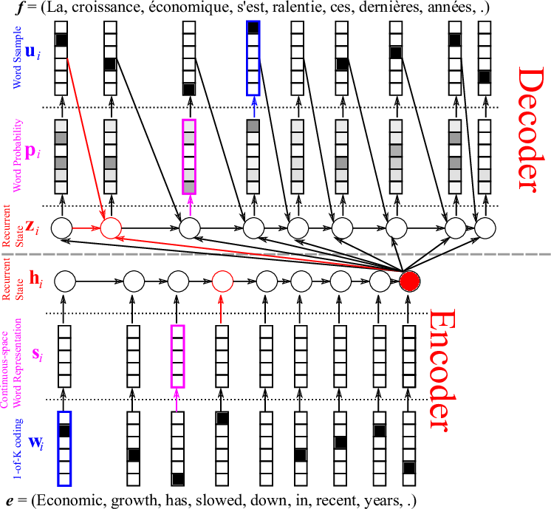
Example
X_{t}
English –French Machine translation
h_{t}
O_{t} encoder vector
https://devblogs.nvidia.com/introduction-neural-machine-translation-gpus-part-2/

Slide 114
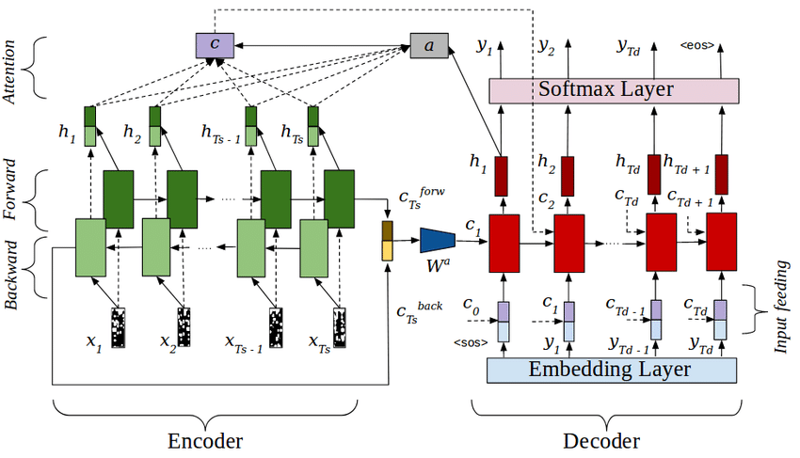
A global view of the bidirectional Seq-to-seq algorithm with attention
https://www.researchgate.net/figure/RNN-Encoder-Decoder-Network-with-Attention-layer-Encoder-is-a-bidirectional-LSTM-whose_fig2_326570264
https://towardsdatascience.com/understanding-bidirectional-rnn-in-pytorch-5bd25a5dd66
Concatenation
of 2 numbers

