Slide 1
Ch1. Support vector machine SVM
KH Wong

Slide 2
Overview
Introduction
Problem definition
Linear method
Non-linear method
Summary

Slide 3
Introduction
For making 2-class classifiers
Can solve non-linear problems using the kernel trick

Slide 4
Problem definition
Given a set of inputs x={x₁,x₂,..,x_{n}} and their labels y={y₁,y₂,..,y_{n}} as training data set (values can be +1 or -1 only). Find a classifier f() to classify the unknown inputs to give the correct label.
So that
f(x)=+1, if x has label ‘+1’
f(x)=-1, if x has label ‘-1’

Slide 5
Problem definition
Classifier inputs into 2 classes of categories
Find the line L :(w^{T}x+b=0) to separate the 2 classes.
What it means is y_{i}(w^{T}x_{i}+b)≥1 for all i=1,,n
x₂
x_{i}
x₁

Slide 6
Example
In the diagram, X_{a} has label y_{a}=+1,
x_{b} has label y_{b}=-1
We want to find two boundary lines
for f(x⁽⁺⁾)≥ +1 ,and for f(x⁽⁻⁾) ≤1 with the following characteristic
y_{i}*f(x_{i}) ≥ 1
Because:
If a point x_{i}⁽⁺⁾ has +ve label (y_{i}=+1), then f(x_{i}⁽⁺⁾) ≥ 1, so y_{i}*f(x_{i}) ≥ 1
If a point x_{i}⁽⁻⁾ has -ve label (y_{i}=-1), then f(x_{i}⁽⁻⁾) ≤ -1, so y_{i}*f(x_{i}) ≥ 1
Note:
In fact, there are two lines
f(x) ≥ 1 for +ve labels
and f(x) ≤ -1 for –ve labels
f(x)=0 is the line in the middle
x₂
+1
f()=1
f()=0
+1
f()=-1
y_{b}=+1
x_{b}=(6,3)
-1
y_{a}=-1
x_{a}=(4,2)
3
+1
2
-1
4
6
x₁

Slide 7
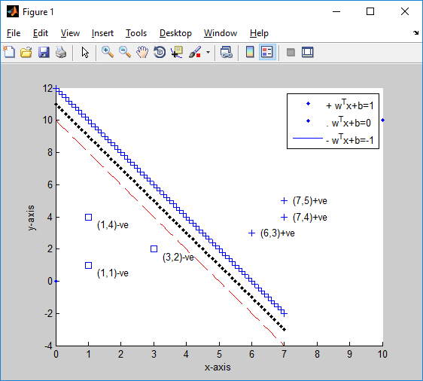
Example
We choose W and b, then the decision lines are f(x_{i})=W^{T}x_{i}+b = 1 and f(x_{i})= -(W^{T}x_{i}+b) = 1
which(W,b) satisfies y_{i}*(W^{T}x_{i}+b) ≥ 1 ?
W=[w1,w2]^{T} is a 2x1 vector
b is a scalar
e.g. A guess of f() is:
W=[1,-1]^{T}, b= -1.4
y_{b}*f(x_{b}) =+1*[ [1 -1]*[6,3]^{T}-1.4] = 6-3-1.4= +1.6 ≥ 1, so f() is correct to find the label of x_{b}.
y_{a}*f(x_{a})= -1*([1 -1]*[3,2]^{T}-1.4] )
y_{a}*f(x_{a})= -1*(3-2-1.4)=0.4 < 1,
so f() is correct. Our guess is correct but how to find the best f() is the task of SVM
The constraint
Note W controls the gradient, b controls the offset, you have a lot of choices.
(6,3)
(3,2)
Notes:
w1=2,w2=1,
w=[w1, w2]',
b= -10-1
xmin=0, ymin=0
xmax=10, ymax=10
figure(1)
clf
hold on
plot(xmin,ymin,'.')
plot(xmax,ymax,'.')
plot([xmin,ymin],[xmax,ymax],'-')
plot([xmin,ymin],[xmax,ymax],'-')
plot(7,4,'+'), text(7,4,' (7,4)+ve')
plot(7,5,'+'), text(7,5,' (7,5)+ve')
plot(6,3,'+'), text(6,3,' (6,3)+ve')
plot(3,2,'s'), text(3,2-0.5,' (3,2)-ve')
plot(1,1,'s'), text(1,1-0.5,' (1,1)-ve')
plot(1,4,'s'), text(1,4-0.5,' (1,4)-ve')
%plot w'x+b=0
x1=[0:0.1:7]';
%x2=[1:0.1:10]';
%w=[w1,w2]', x=[x1,x2]', w*x+b=0, w1*x1+w2*x2+b=0, so
x2=(-b-w1*x1)/w2
plot(x1,x2,'k.')
x2=(-b-1-w1*x1)/w2
plot(x1,x2,'r--')
x2=(-b+1-w1*x1)/w2
plot(x1,x2,'b+')
legend('+ w^Tx+b=1','. w^Tx+b=0','- w^Tx+b=-1' )
xlabel('x-axis');
ylabel('y-axis');

Slide 8
Math
Assume L is a line w^{T}x+b=0 you use it to separate the 2 classes (circles, squares), but you are not sure how to find the correct formula, i.e. w and b
If L is used, the shortest distance between the two classes is d.
It is not difficult to show that d=2 in this setup. See exercise1.
Assume the distance between the 2 vertical cutting points at y-axis is h.
Hence, by projecting the length 2 to the unit vector of w, we get d
W=[w1,w2]^{T} is a 2x1 vector
b is a scalar
x₂
h
d
x₁
Notes:
%%%%%%%%%%%%%%%%%%%%%%%%%%%%%%%%
\subsection{slide 8}
\begin{equation}
\label{slide2}
\begin{split}
&d=\frac{2w}{\| w^Tw \|}=\frac{2}{\| w\|}
\end{split}
\end{equation}

Slide 9
Exercise 1
Prove if gradient of L₍₁₎ and L₍₋₁₎ is w=[w1,w2]^{T}
Then, d=2/|w|
Answer:
x2-axis
A=(0,x2a)
h
v
B=(0,x2b)
w
d
x1-axis

Slide 10
Answer 1
Prove d=2/|w|
Answer:
w=[w1,w2]^{T}, at A
L₍₁₎: [w1,w2]*[x1a,x2a]^{T}+b= +1
When x1a=0, w2*x2a+b= 1
X2a=(1-b)/w2----------(i)
At B
L₍₋₁₎: [w1,w2]*[x1b,x2b]^{T} +b= -1
When x1b=0, w2*x2b+b= -1
X2b=(-1-b)/w2---------(ii)
Vector v=[0 ,(x2a-x2b)]^{T}
Unit vector of w = u =[w1, w2] ^{T} /|w|
d=v^{T}.u=[0 ,(x2a-x2b)].[w1, w2] ^{T} /|w|=
d=(x2a-x2b)*w2/|w|-------(iii)
From (i) and (ii), put (i) and (ii) into (iii)
d=[(1-b)/w2- (-1-b)/w2) ]*w2/|w|
d=2/|w| proved
x2-axis
A=(0,x2a)
h
v
B=(0,x2b)
w
d
x1-axis

Slide 11
Find the optimal decision line that maximizes d (gap between classes )
Lagrange multiplier method https://en.wikipedia.org/wiki/Lagrange_multiplier
x₂
d
optimal decision line
x₁

Slide 12

We need to find w,b of the decision line
$$\text{Our} \text{goal} \text{is} \text{to} \text{maximize} d=\frac{2}{\left|w\right|} (\text{the} \text{gap} \text{between}\text{ 2 }\text{classes}) \\ \text{By} \text{adjusting} w,b\text{,}\text{subject} \text{to} \left(y_{i}\left(w^{T}x_{i}+b\right)\right)≥1 \\ \text{Same} \text{as} \text{minimize} \frac{\left|w\right|}{2}\text{or}\frac{w^{T}w}{2},\text{subject} \text{to} \left(y_{i}\left(w^{T}x_{i}+b\right)−1\right)≥0 \\ \text{Using} \frac{w^{T}w}{2} \text{allow} \text{us} \text{to} \text{use} \text{quadratic} \text{programming} \text{later}\text{.} \\ \text{Lagrangian} (\text{primal} \text{form})\text{: }L(w,b,a)=\frac{1}{2}w^{T}w−\sum_{i=1}^{n}{a_{i}\left(y_{i}\left(w^{T}x_{i}+b\right)−1\right)} −−−(i) \\ \text{for} i=1,2,..n. \text{According} \text{to} \text{Wolfe} \text{duality} \\ (\text{Primal} \text{form})=\min_{\text{w}\text{,}\text{b}}\underset{all a_{i}≥0}{\text{max}}L(w,b,\{a_{i}\})= \\ (\text{dual} \text{form})=\underset{all a≥0}{\text{max}}\min_{\text{w}\text{,}\text{b}}L(w,b,\{a_{i}\}), \\ \text{We} \text{will} \text{use} \text{the} \text{dual} \text{form}\text{, }\text{therefore} \text{our} \text{task} \text{is} \text{to} \\ \underset{all a≥0}{\text{max}}\left(\min_{\text{w}\text{,}\text{b}}\left(L(w,b,\{a_{i}\})\right)\right)=\max_{all a_{i}≥0}\left(\underset{w,b}{\text{min}}\left(\frac{1}{2}w^{T}w−\sum_{i=1}^{n}{a_{i}\left(y_{i}\left(w^{T}x_{i}+b\right)−1\right)}\right)\right) \\ \text{differentiate} L(w,b,\{a_{i}\}) \text{w}\text{.}\text{r}\text{.}\text{t} w,b,\{a_{i}\} \text{and} \text{set} \text{to}\text{ 0 }\text{to} \text{find} \text{the} \text{solution}$$
Recall : this the constraint
y_{i}*(W^{T}x_{i}+b) ≥ 1
http://people.csail.mit.edu/dsontag/courses/ml13/slides/lecture6.pdf
Exchange position
In Lagrangian:
We want to maximize the constraint term factor a_{i}, but minimize the loss L( )
Notes:
%%%%%%%%%%%%%%%%%%%%%%%%%%%%%%%%
\subsection{slide 12}
Our goal is to minimize $d=\frac{2}{w}$ (the gap between 2 classes)\\
By adjusting $w,b$ subject to $\left(y_i (w^T x_i+b) \right) > 1$\\
Same as minimize $\frac{\|w\|}{2} or \frac{w^T}{w}$ , subject to $\left(y_i (w^T x_i+b) \right) -1 > 0$\\
Wsing $d=\frac{w^Tw}{2}$ allow us to use quadratic programming later.\\
Lagrangian (primal form) $L(w,b,a)=\frac{1}{2}w^T w-\sum\limits_{i=1}^{n}a_i\big( y_i (w^T w_i+b)-1 \big)---(i)$\\
for $i=1,2,...n.$ According to Wolfe duality\\
(Primal form)=$\min\limits_{w,b} \max\limits_{\forall a_i \geq 0 } L(w,b,\{a_i\})=$\\
(dual form)=$\max\limits_{\forall a_i \geq 0 } \min\limits_{w,b} L(w,b,\{a_i\})$\\
That is after the exchange of the operation $(\min, \max)$ positions\\
We will use the dual form, therefore or task is to \\
%
$\max\limits_{\forall a_i \geq 0 } \Big( \min\limits_{w,b} \big( L(w,b,\{a_i\}) \big) \Big)=
\max\limits_{\forall a_i \geq 0 }
\Big(\min\limits_{w,b}
%
\big(\frac{1}{2}w^Tw-\sum\limits_{i=1}^{n}a_i(y_i(w^T w x_i+b)-1)\big)
%
\Big)$\\
differentiate $L(w,b,\{a_i\})$ w.r.t. $w, b,{a_i}$ and set to 0 to find the solution
\begin{equation}
\label{slide2}
\end{equation}

Slide 13
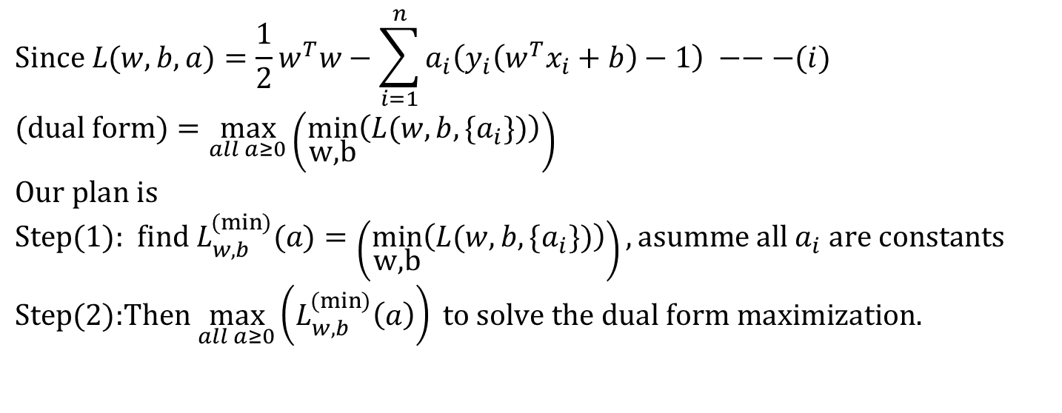
How to solve the optimization problem
$$\text{Since} L(w,b,a)=\frac{1}{2}w^{T}w−\sum_{i=1}^{n}{a_{i}\left(y_{i}\left(w^{T}x_{i}+b\right)−1\right)} −−−(i) \\ (\text{dual} \text{form})=\underset{all a≥0}{\text{max}}\left(\min_{\text{w}\text{,}\text{b}}\left(L(w,b,\{a_{i}\})\right)\right) \\ \text{Our} \text{plan} \text{is} \\ \text{Step}(1)\text{: }\text{find} L_{w,b}^{(\min{)}}(a)=\left(\min_{\text{w}\text{,}\text{b}}\left(L(w,b,\{a_{i}\})\right)\right),\text{asumme} \text{all} a_{i} \text{are} \text{constants} \\ \text{Step}(2)\text{:}\text{Then} \underset{all a≥0}{\text{max}}\left(L_{w,b}^{(\min{)}}\left(a\right)\right) \text{to} \text{solve} \text{the} \text{dual} \text{form} \text{maximization}\text{.}$$
Notes:
\subsection{slide 13}
Since
%
$L(w,b,{a})=
\frac{1}{2}w^Tw-\sum\limits_{i=1}^{n}a_i \big( y_i(w^T w x_i+b)-1 \big)$---(i)\\
(dual form)=$\max\limits_{\forall a_i \geq 0 } \Big( \min\limits_{w,b} \big( L(w,b,\{a_i\}) \big) \Big)$\\
Our plan\\
Step(1):find $L_{w,b}^{(min)}(a)=
\Big( \min\limits_{w,b} \big( L(w,b,\{a_i\}) \big) \Big)$, assume all $a_i$ are constants.\\
Step(2):Then $\max\limits_{\forall a_i \leq 0 } \big( L_{w,b}^{(min)} (a) \big)$ to solve the dual form maximization.

Slide 14
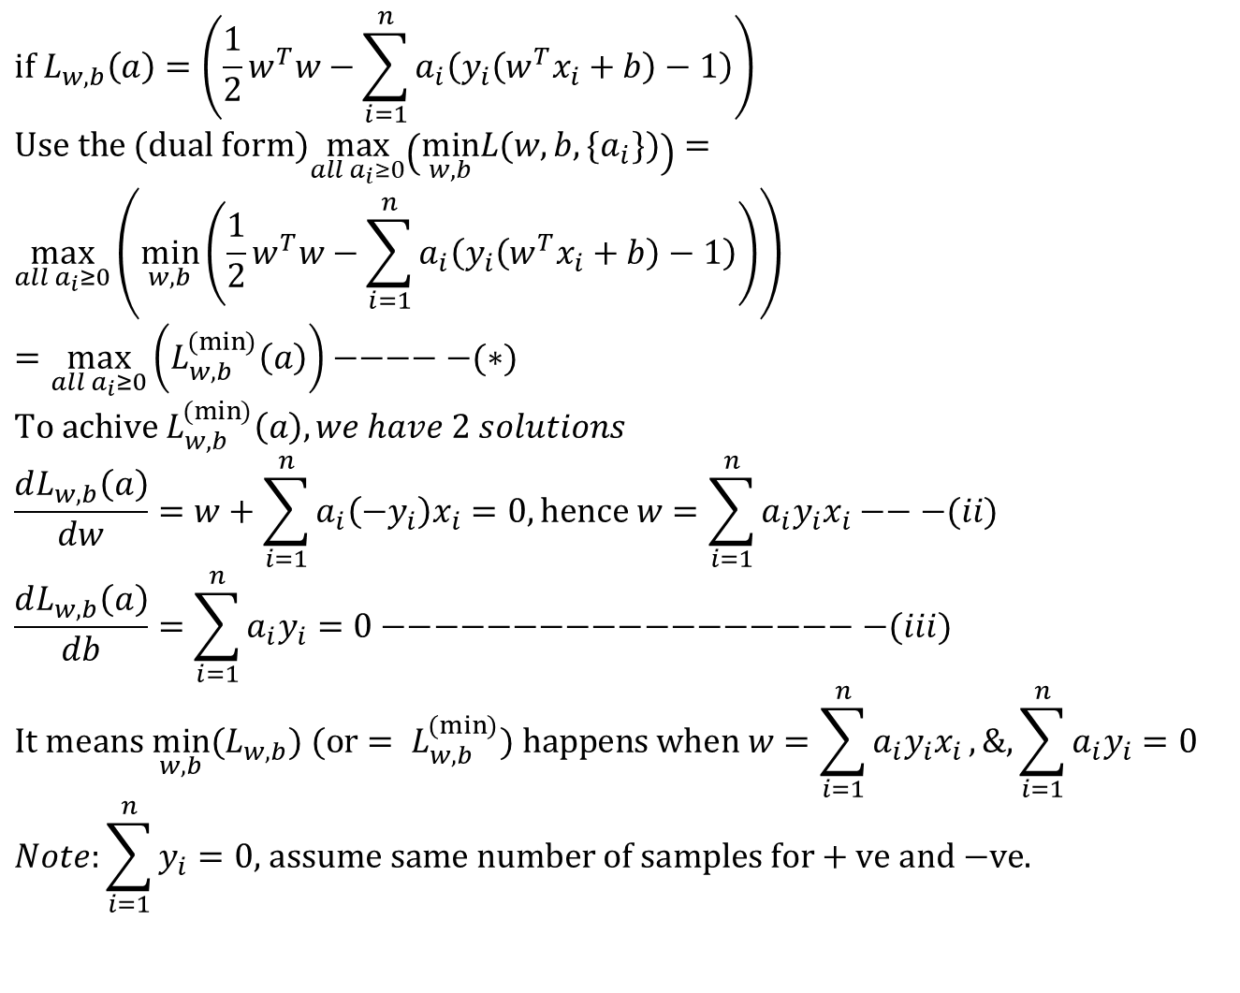
$$\text{if} L_{w,b}\left(a\right)=\left(\frac{1}{2}w^{T}w−\sum_{i=1}^{n}{a_{i}\left(y_{i}\left(w^{T}x_{i}+b\right)−1\right)}\right) \\ \text{Use} \text{the} (\text{dual} \text{form})\max_{all a_{i}≥0}\left(\underset{w,b}{\text{min}}L(w,b,\{a_{i}\})\right)= \\ \max_{all a_{i}≥0}\left(\underset{w,b}{\text{min}}\left(\frac{1}{2}w^{T}w−\sum_{i=1}^{n}{a_{i}\left(y_{i}\left(w^{T}x_{i}+b\right)−1\right)}\right)\right)=\max_{all a_{i}≥0}\left(L_{w,b}^{(\min{)}}\left(a\right)\right)−−−−−(∗) \\ \text{To} \text{achive} L_{w,b}^{(\min{)}}\left(a\right),we have 2 solutions \\ \frac{dL_{w,b}\left(a\right)}{dw}=w+\sum_{i=1}^{n}{a_{i}\left(−y_{i}\right)x_{i}}=0,\text{hence} w=\sum_{i=1}^{n}{a_{i}y_{i}x_{i}}−−−(ii) \\ \frac{dL_{w,b}\left(a\right)}{db}=\sum_{i=1}^{n}{a_{i}y_{i}}=0−−−−−−−−−−−−−−−−−−−(iii) \\ \text{It} \text{means} \underset{w,b}{\text{min}}(L_{w,b}) (\text{or}= L_{w,b}^{(\min{)}}) \text{happens} \text{when} w=\sum_{i=1}^{n}{a_{i}y_{i}x_{i}},\text{\&,}\sum_{i=1}^{n}{a_{i}y_{i}}=0 \\ Note:\sum_{i=1}^{n}{y_{i}}=0\text{, }\text{assume} \text{same} \text{number} \text{of} \text{samples} \text{for}+\text{ve} \text{and}\text{ −}\text{ve}\text{.}$$
dw
db
Notes:
%%%%%%%%%%%%%%%%%%%%%%%%%%%%%
\subsection{slide 14}
if $L_{w,b}(a)=
\Big(
\frac{1}{2}w^Tw-\sum\limits_{i=1}^{n}a_i \big( y_i(w^T x_i +b)-1 \big)
\Big)$\\
Use the (dual form)
%
$\max\limits_{\forall a_i \geq 0 } \Big( \min\limits_{w,b} \big( L(w,b,\{a_i\}) \big) \Big)=$\\
$\max\limits_{\forall a_i \geq 0 }
\Big(\min\limits_{w,b}
%
\big(\frac{1}{2}w^Tw-\sum\limits_{i=1}^{n}a_i(y_i(w^T x_i+b)-1)\big) =$
$\max\limits_{\forall a_i \geq 0 } \big( L_{w,b}^{(min)} \big)----(*)$\\
%
To achieve $L_{w,b}^{(min)}$,\\
$\frac{dL{w,b}(a)}{dw}=w+\sum\limits_{i=1}^{n}a_i(-y_i)x_i=0$, hence $w=\sum\limits_{i=1}^{n}a_i y_i x_i -----(ii)$\\
%
$\frac{dL{w,b}(a)}{db}=\sum\limits_{i=1}^{n}a_i(y_i)=0---(iii)$\\
It means $\min\limits_{w,b}(L_{w,b})(or = L_{w,b}^{(min)})$ happens when
$w=\sum\limits_{i=1}^{n}a_i y_i x_i$, and $\sum\limits_{i=1}^{n}a_i y_i =0$\\
note: $\sum\limits_{i=1}^{n}y_i=0$, assume same number of samples for +ve and -ve classes.

Slide 15
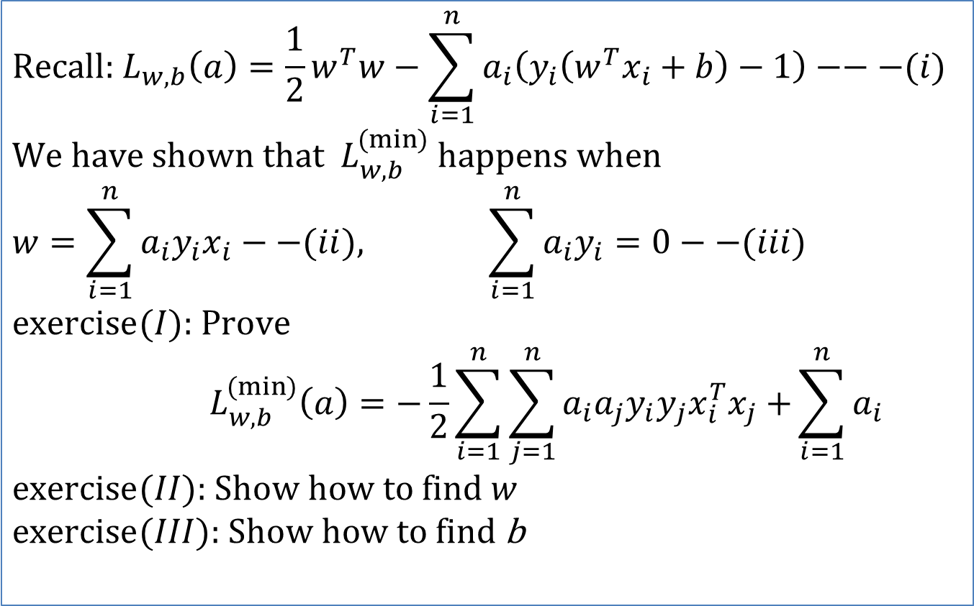
Exercise 2: Lagrangian dual problem: for finding a_{i} first , then find w and b
Recall : this the constraint
y_{i}*(W^{T}x_{i}+b) ≥ 1
$$\text{Recall}\text{: }L_{w,b}\left(a\right)=\frac{1}{2}w^{T}w−\sum_{i=1}^{n}{a_{i}\left(y_{i}\left(w^{T}x_{i}+b\right)−1\right)}−−−(i) \\ \text{We} \text{have} \text{shown} \text{that} L_{w,b}^{(\min{)}} \text{happens} \text{when} \\ w=\sum_{i=1}^{n}{a_{i}y_{i}x_{i}−−(ii), \sum_{i=1}^{n}{a_{i}y_{i}}=0−−(iii)} \\ \text{exercise}(I)\text{: }\text{Prove} \\ { L}_{w,b}^{(\min{)}}\left(a\right)=−\frac{1}{2}\sum_{i=1}^{n}{\sum_{j=1}^{n}{a_{i}a_{j}y_{i}y_{j}x_{i}^{T}x_{j}+}}\sum_{i=1}^{n}{a_{i}} \\ \text{exercise}(II)\text{: }\text{Show} \text{how} \text{to} \text{find} w \\ \text{exercise}(III)\text{: }\text{Show} \text{how} \text{to} \text{find} \text{b}$$
Notes:
%%%%%%%%%%%%%%%%%%%%%%%%%%%%%
\subsection{slide 15:Exercise 2: Lagrangian dual problem: for finding ai first , then find w and b}
Recall: $L(w,b,{a})=
\frac{1}{2}w^Tw-\sum\limits_{i=1}^{n}a_i \big( y_i(w^T x_i+b)-1 \big)---(i)$\\
We have shown that $L_{w,b}^{(min)}$ happens when\\
$w=\sum\limits_{i=1}^{n}a_i y_i x_i --(ii), \text{ and }
\sum\limits_{i=1}^{n}a_i y_i -0---(iii)$\\
Exercise (I): Prove
$L_{w,b}^{(min)}=-\frac{1}{2}\sum\limits_{i=1}^{n} \sum\limits_{j=1}^{n} a_i a_j y_i y_j x_i^Tx_j+\sum\limits_{i=1}^{n}a_i$\\
Exercise (II): Show how to find $w$.\\
Exercise (III): Show how o find $s$.

Slide 16
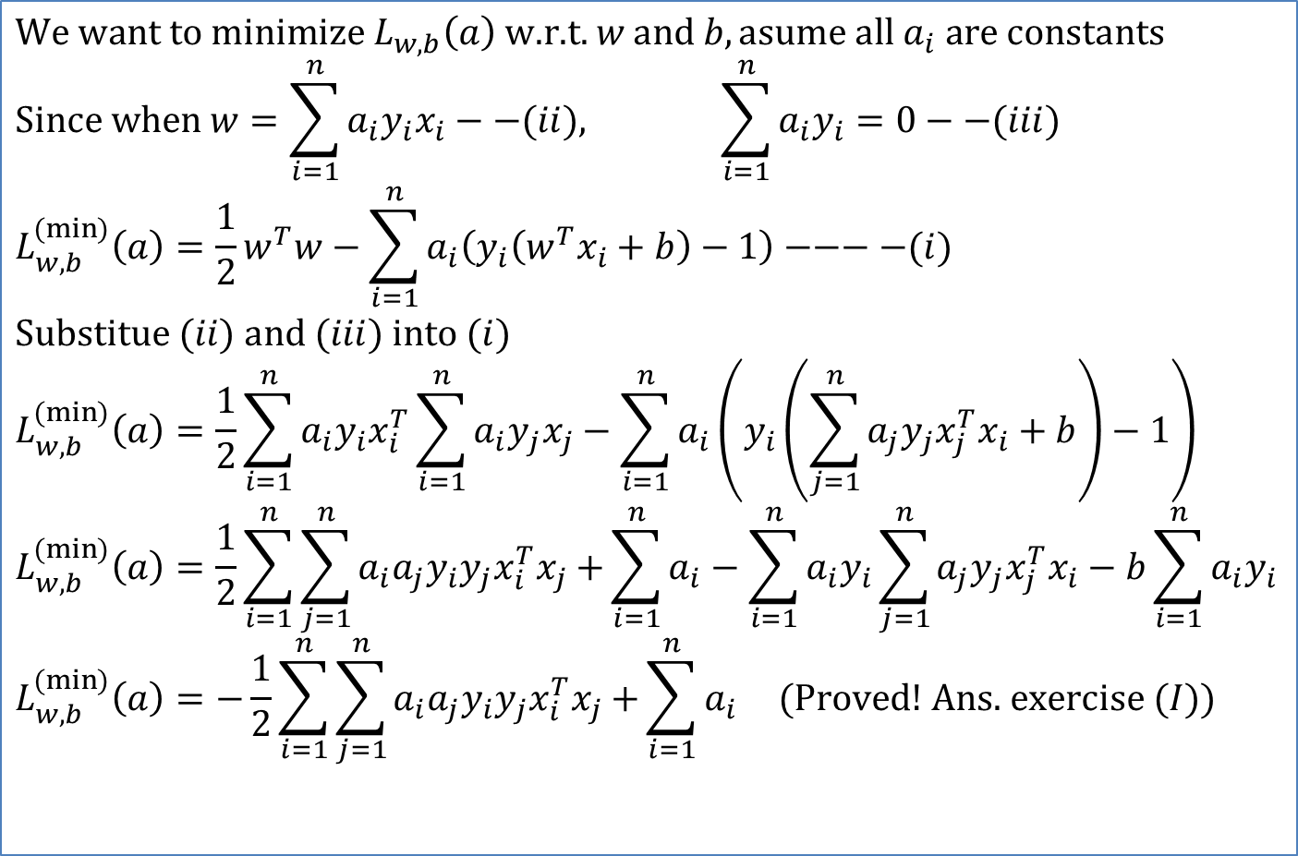
ANSWER 2a: Lagrangian dual problem: find a_{i} first, then w & b
$$\text{We} \text{want} \text{to} \text{minimize} L_{w,b}\left(a\right) \text{w}\text{.}\text{r}\text{.}\text{t}\text{. }w \text{and} b,\text{asume} \text{all} a_{i} \text{are} \text{constants} \\ \text{Since} \text{when} w=\sum_{i=1}^{n}{a_{i}y_{i}x_{i}−−(ii), \sum_{i=1}^{n}{a_{i}y_{i}}=0−−(iii)} \\ L_{w,b}^{(\min{)}}\left(a\right)=\frac{1}{2}w^{T}w−\sum_{i=1}^{n}{a_{i}\left(y_{i}\left(w^{T}x_{i}+b\right)−1\right)}−−−−(i) \\ \text{Substitue} (ii) \text{and} (iii) \text{into} (i) \\ L_{w,b}^{(\min{)}}\left(a\right)=\frac{1}{2}\sum_{i=1}^{n}{a_{i}y_{i}x_{i}^{T}}\sum_{i=1}^{n}{a_{i}y_{j}x_{j}−\sum_{i=1}^{n}{a_{i}\left(y_{i}\left(\sum_{j=1}^{n}{a_{j}y_{j}x_{j}^{T}x_{i}+b}\right)−1\right)}} \\ L_{w,b}^{(\min{)}}\left(a\right)=\frac{1}{2}\sum_{i=1}^{n}{\sum_{j=1}^{n}{a_{i}a_{j}y_{i}y_{j}x_{i}^{T}x_{j}+}}\sum_{i=1}^{n}{a_{i}}−\sum_{i=1}^{n}{a_{i}y_{i}\sum_{j=1}^{n}{a_{j}y_{j}x_{j}^{T}x_{i}}}−b\sum_{i=1}^{n}{a_{i}y_{i}} \\ L_{w,b}^{(\min{)}}\left(a\right)=−\frac{1}{2}\sum_{i=1}^{n}{\sum_{j=1}^{n}{a_{i}a_{j}y_{i}y_{j}x_{i}^{T}x_{j}+}}\sum_{i=1}^{n}{a_{i}} (\text{Proved}\text{! }\text{Ans}\text{. }\text{exercise} (I))$$
Notes:
%%%%%%%%%%%%%%%%%%%%%%%%%%%%%
\subsection{Slide 16: ANSWER 2a: Lagrangian dual problem: find $a_i$ first, then w and b}
We want to minimize $L_{w,b}(a)$ w.r.t. $w$ and $b$ , assume all $a_i $are constants:\\
Since when $w=\sum\limits_{i=1}^{n}a_i y_i x_i --(ii), \text{ and }
\sum\limits_{i=1}^{n}a_i y_i -0---(iii)$\\
$L_{w,b}^{(min)}=-\frac{1}{2}\sum\limits_{i=1}^{n} \sum\limits_{j=1}^{n} a_i a_j y_i y_j x_i^Tx_j+\sum\limits_{i=1}^{n}a_i -----(i')$\\
Substitute (ii) and (iii) into (i')\\
$L_{w,b}^{(min)}(a)=
\frac{1}{2}\sum\limits_{i=1}^{n} a_i y_i x_i^T
\sum\limits_{i=1}^{n}a_i y_i x_j
-\sum\limits_{i=1}^{n}
a_i \Big( y_i \big(
\sum\limits_{i=1}^{n} a_j y_j x^T_j x_i +b
\big) -1 \Big)$
%
$L_{w,b}^{(min)}(a)=
\frac{1}{2}\sum\limits_{i=1}^{n} \sum\limits_{j=1}^{n}
a_i a_j y_i y_j x_i^T x_j
+ \sum\limits_{j=1}^{n} a_i
- \sum\limits_{i=1}^{n} a_i y_i \sum\limits_{j=1}^{n} a_j y_j x_j^T x_i
- b \sum\limits_{i=1}^{n} a_i y_i$
%
$L_{w,b}^{(min)}(a)=
-\frac{1}{2}\sum\limits_{i=1}^{n} \sum\limits_{j=1}^{n} a_i a_j y_i y_j x^T_i x_j
+ \sum\limits_{i=1}^{n} a_i$
(Proved! Answer of exercise (I))
%

Slide 17
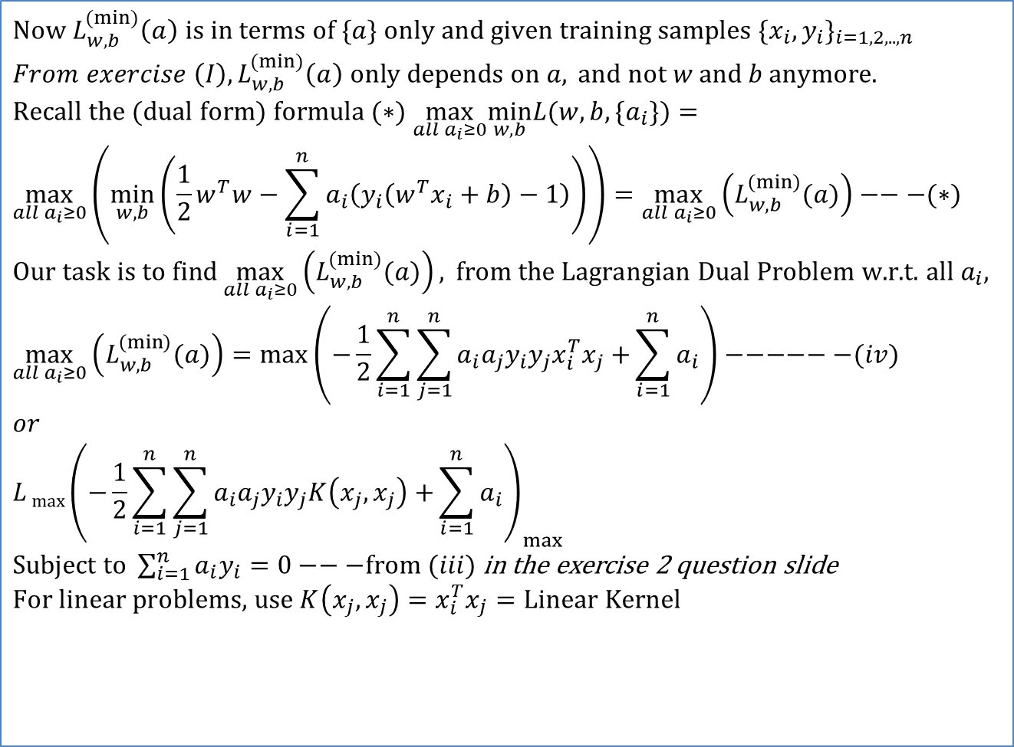
ANSWER 2b : Lagrangian dual problem: for finding a_{i} ,then w & b
$$\text{Now} L_{w,b}^{(\min{)}}\left(a\right) \text{is} \text{in} \text{terms} \text{of} \{a\} \text{only} \text{and} \text{given} \text{training} \text{samples} \{x_{i},y_{i}\}_{i=1,2,..,n} \\ From exercise \left(I\right), L_{w,b}^{(\min{)}}\left(a\right) \text{only} \text{depends} \text{on} a, \text{and} \text{not} w \text{and} b anymore\text{.} \\ \text{Recall} \text{the} (\text{dual} \text{form}) \text{formula} (∗) \max_{all a_{i}≥0}\underset{w,b}{\text{min}}L(w,b,\{a_{i}\})= \\ \max_{all a_{i}≥0}\left(\underset{w,b}{\text{min}}\left(\frac{1}{2}w^{T}w−\sum_{i=1}^{n}{a_{i}\left(y_{i}\left(w^{T}x_{i}+b\right)−1\right)}\right)\right)=\max_{all a_{i}≥0}\left(L_{w,b}^{(\min{)}}(a)\right)−−−(∗) \\ \text{Our} \text{task} \text{is} \text{to} \text{find} \max_{all a_{i}≥0}\left(L_{w,b}^{(\min{)}}(a)\right), \text{from} \text{the} \text{Lagrangian} \text{Dual} \text{Problem} \text{w}\text{.}\text{r}\text{.}\text{t}\text{. }\text{all} a_{i}, \\ \max_{all a_{i}≥0}\left(L_{w,b}^{(\min{)}}(a)\right)=\max\left(−\frac{1}{2}\sum_{i=1}^{n}{\sum_{j=1}^{n}{a_{i}a_{j}y_{i}y_{j}x_{i}^{T}x_{j}+}}\sum_{i=1}^{n}{a_{i}}\right)−−−−−−(iv) \\ or \\ {L\max\left(−\frac{1}{2}\sum_{i=1}^{n}{\sum_{j=1}^{n}{a_{i}a_{j}y_{i}y_{j}K\left(x_{j},x_{j}\right)+}}\sum_{i=1}^{n}{a_{i}}\right)}_{max}$$ $\text{Subject} \text{to} \sum_{i=1}^{n}{a_{i}y_{i}}=0−−−\text{from} (iii)$ in the exercise 2 question slide $$\text{For} \text{linear} \text{problems}\text{, }\text{use} K\left(x_{j},x_{j}\right)=x_{i}^{T}x_{j}=\text{Linear} \text{Kernel}$$
Notes:
%%%%%%%%%%%%%%%%%%%%%%%%%%%%%%%%%%%%
\subsection{slide 17: ANSWER 2b : Lagrangian dual problem: for finding $a_i$ ,then w and b}
Now $L_{w,b}^{(min)}(a)$ is in terms of $\{a\}$ and given training samples $\{x_i,y_i\}_{i=1,2,...,n}$\\
$L_{w,b}^{(min)}(a)$ only depends on $a$ and not $w$ and $b$ any more.\\
Recall the (dual form) formula (*) $\max\limits_{\forall a_i \geq 0 } \min\limits_{w,b} L(w,b,\{a_i\})=$\\
$\max\limits_{\forall a_i \geq 0 }
\Big(\min\limits_{w,b}
\big(\frac{1}{2}w^Tw-\sum\limits_{i=1}^{n}a_i(y_i(w^T x_i+b)-1)\big) =$
$\max\limits_{\forall a_i \geq 0 } \big( L_{w,b}^{(min)} (a) \big)----(*)$\\
%
Our task is to find
$\max\limits_{\forall a_i \geq 0 } \big( L_{w,b}^{(min)} (a) \big)$,
from the Lagrangian Dual Problem w.r.t. all $a_i$,\\
$\max\limits_{\forall a_i \geq 0 } \big( L_{w,b}^{(min)} (a) \big)= \max
\Big(
-\frac{1}{2} \sum\limits_{i=1}^{n} \sum\limits_{j=1}^{n} a_i a_j y_i y_j x_i^T x_j
+ \sum\limits_{i=1}^{n} a_i
\Big)---------(iv)$\\
Put $x_i^T x_j=K(x_j^T x_j)$ called the Linear Kernel\\
then\\
$L_{max}(a)=
\max
\Big(
-\frac{1}{2} \sum\limits_{i=1}^{n} \sum\limits_{j=1}^{n} a_i a_j y_i y_j K(x_j^T x_j)
+ \sum\limits_{i=1}^{n} a_i
\Big)---------(iv)$\\
Subject to $\sum\limits_{i=1}^{n}a_i y_i =0$ ---- from (iii)\\
Note: For linear problems, use $K(x_j,x_j)=x^T_ix_j=$Linear Kernel

Slide 18
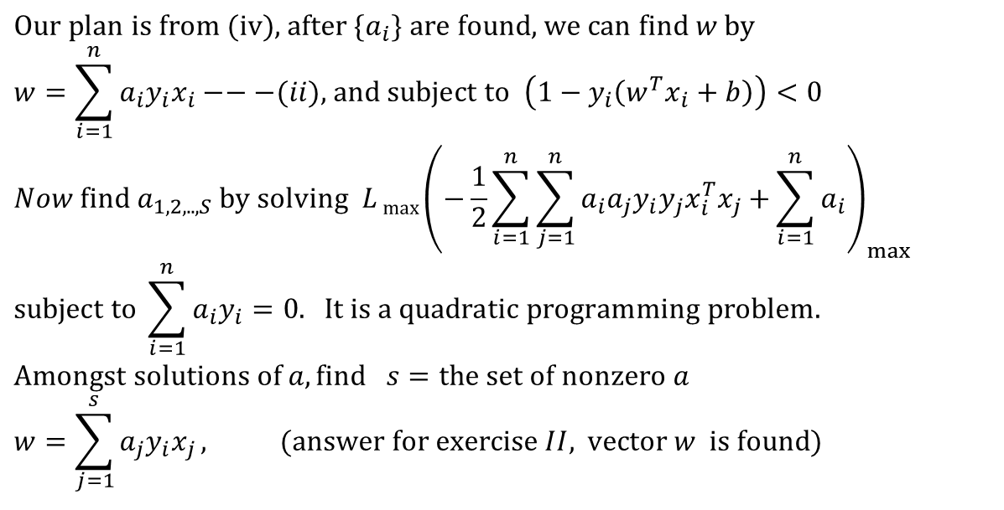
ANSWER2c: https://en.wikipedia.org/wiki/Quadratic_programming
$$\text{Our} \text{plan} \text{is} \text{from}\text{ (}\text{iv}\text{), }\text{after} \{a_{i}\} \text{are} \text{found}\text{, }\text{we} \text{can} \text{find} w \text{by} \\ w=\sum_{i=1}^{n}{a_{i}y_{i}x_{i}}−−−(ii)\text{, }\text{and} \text{subject} \text{to} \left(1−y_{i}\left(w^{T}x_{i}+b\right)\right)<0 \\ Now \text{find} a_{1,2,..,S} \text{by} \text{solving} {L\max\left(−\frac{1}{2}\sum_{i=1}^{n}{\sum_{j=1}^{n}{a_{i}a_{j}y_{i}y_{j}x_{i}^{T}x_{j}+}}\sum_{i=1}^{n}{a_{i}}\right)}_{max} \\ \text{subject} \text{to} \sum_{i=1}^{n}{a_{i}y_{i}}=0. \text{It} \text{is} \text{a} \text{quadratic} \text{programming} \text{problem}\text{. } \\ \text{Amongst} \text{solutions} \text{of} a,\text{find} s=\text{the} \text{set} \text{of} \text{nonzero} a \\ w=\sum_{j=1}^{s}{a_{j}y_{i}x_{j}}, (\text{answer} \text{for} \text{exercise} II, \text{vector} w \text{is} \text{found})$$
Each non-zero α_{i} indicates its corresponding x_{i} is a support vector.
Matlab code for finding w and b:
%find non-zero solution ‘a’,and < C avoid bad solution
S=find(alphaV>0 & alphaV<C);
w=0;
for i=S
w=w+alphaV(i)*y(i)*x(:,i);
end
b=mean(y(S)-w'*x(:,S));
Notes:
%%%%%%%%%%%%%%%%%%%%%%%%%%%%%%%%%%%%
\subsection{slide 18:ANSWER2c: }
After $\{a_i\}$ are found , we can find $w$ by\\
$w=\sum\limits_{i=0}^{n} a_i y_x----(ii)$, and subject to
$( 1-y_i (w^T x_i+b) )$\\
Then find $a_{1,2,...,s}$ by solving $L_{max}(a)=\max \big( -\frac{1}{2}
\sum\limits_{i=1}^{n} \sum\limits_{j=1}^{n} a_i a_j y_i y_j x_i^T x_j+\sum\limits_{i=1}^{n}a_i
\big)$\\
Subject to $\sum\limits_{i=1}^{n}a_i y_i =0$. It is quadratic programming problem.\\
Among solution of $a,s=$ the set of non zero a $a$.
w=$\sum\limits_{j=1}^{s}a_i y_i x_j , $ (answer for exercise II, vector $w$ is found).
\begin{verbatim}
Matlab code:
S=find(alphaV>0 & alphaV<C);
w=0;
for i=S
w=w+alphaV(i)*y(i)*x(:,i);
end
b=mean(y(S)-w'*x(:,S));
\end{verbatim}

Slide 19
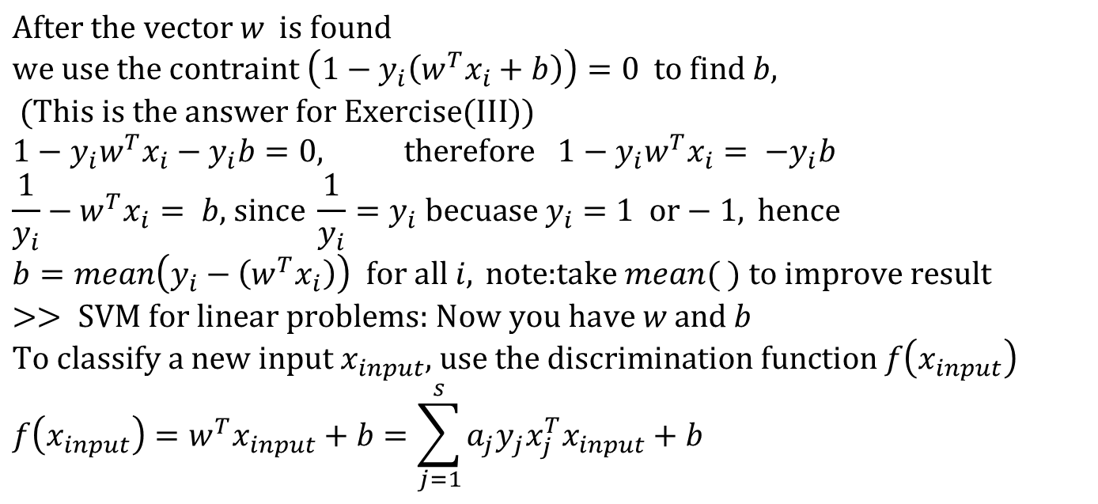
ANSWER2c: https://en.wikipedia.org/wiki/Quadratic_programming
$$\text{After} \text{the} \text{vector} w \text{is} \text{found} \\ \text{we} \text{use} \text{the} \text{contraint} \left(1−y_{i}\left(w^{T}x_{i}+b\right)\right)=0 \text{to} \text{find} b, (\text{This} \text{is} \text{the} \text{answer} \text{for} \text{Exercise}(\text{III})) \\ 1−y_{i}w^{T}x_{i}−y_{i}b=0, \text{therefore} 1−y_{i}w^{T}x_{i}=\text{ −}y_{i}b \\ \frac{1}{y_{i}}−w^{T}x_{i}= b\text{, }\text{since} \frac{1}{y_{i}}=y_{i} \text{becuase} y_{i}=1 \text{or}−1, \text{hence} \\ b=mean\left(y_{i}−\left(w^{T}x_{i}\right)\right) \text{for} \text{all} i, \text{note}\text{:}\text{take} mean( ) \text{to} \text{improve} \text{result} \\ >> \text{SVM} \text{for} \text{linear} \text{problems}\text{: }\text{Now} \text{you} \text{have} w \text{and} b \\ \text{To} \text{classify} \text{a} \text{new} \text{input} x_{input}\text{, }\text{use} \text{the} \text{discrimination} \text{function} f\left(x_{input}\right) \\ f\left(x_{input}\right)=w^{T}x_{input}+b=\sum_{j=1}^{s}{a_{j}y_{j}x_{j}^{T}x_{input}}+b$$
Matlab code for finding w and b:
%find non-zero solution ‘a’,and < C avoid bad solution
S=find(alphaV>0 & alphaV<C);
w=0;
for i=S
w=w+alphaV(i)*y(i)*x(:,i);
end
b=mean(y(S)-w'*x(:,S));
Notes:
%%%%%%%%%%%%%%%%%%%%%%%%%%%%
\subsection{slide 19:ANSWER2c:}
After the vector $w$ is found\\
We use the constraint $(1-y_i (w^T x_i b))=0)$ to find $b$, (Answer for Exercise (III))\\
$1-y_iw^Tx_i-y_ib=0,$ therefore $1-y_i w^Tx_i=-y_i b$\\
$\frac{1}{y_i}-w^T x_i = b$, since $\frac{1}{y_i}$ , because $y_i=1$ or $-1$, hence\\
$b=mean(y_i-(w^Tx_i))$ for all $i$, note: take $mean()$ to improve result
Matlab>> SVM for linear problems: Now you have $w$ and $b$\\
To classify a new $x_{input}$, use the discrimination function $f(x_{input})$\\
$f(x_{input})=w^T x_{input}+b=\sum\limits_{j=1}^{s}a_j y_j x_j^T x_{input}+b$\\
\begin{verbatim}
Matlab code:
S=find(alphaV>0 & alphaV<C);
w=0;
for i=S
w=w+alphaV(i)*y(i)*x(:,i);
end
b=mean(y(S)-w'*x(:,S));
\end{verbatim}

Slide 20
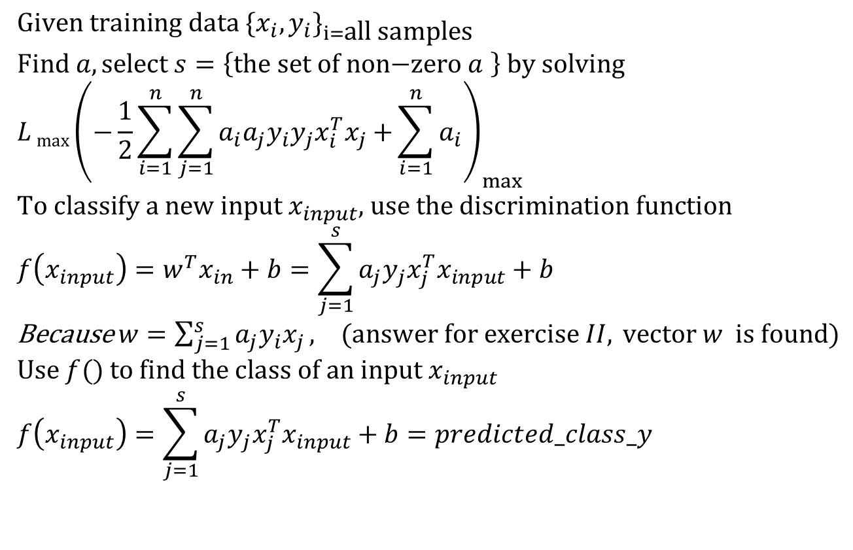
Linear Kernel: how to classify a new input
$$\text{Given} \text{training} \text{data} \{x_{i},y_{i}\}_{i=\text{all} \text{samples}} \\ \text{Find} a,\text{select} s=\left\{\text{the} \text{set} \text{of} \text{non}\text{−}\text{zero} a \right\} \text{by} \text{solving}$$
$${L\max\left(−\frac{1}{2}\sum_{i=1}^{n}{\sum_{j=1}^{n}{a_{i}a_{j}y_{i}y_{j}x_{i}^{T}x_{j}+}}\sum_{i=1}^{n}{a_{i}}\right)}_{max} \\ \text{To} \text{classify} \text{a} \text{new} \text{input} x_{input}\text{, }\text{use} \text{the} \text{discrimination} \text{function} \\ f\left(x_{input}\right)=w^{T}x_{in}+b=\sum_{j=1}^{s}{a_{j}y_{j}x_{j}^{T}x_{input}}+b$$
Because $w=\sum_{j=1}^{s}{a_{j}y_{i}x_{j}}, (\text{answer} \text{for} \text{exercise} II, \text{vector} w \text{is} \text{found})$ $$\text{Use} f() \text{to} \text{find} \text{the} \text{class} \text{of} \text{an} \text{input} x_{input} \\ f\left(x_{input}\right)=\sum_{j=1}^{s}{a_{j}y_{j}x_{j}^{T}x_{input}}+b=predicted_class_y$$
Notes:
%%%%%%%%%%%%%%%%%%%%%%%%%%%%%%%%%%%%%%
\subsection{Slide 20: Linear Kernel: how to classify a new input}
Given training data ${x_i,y_i}_{i=all samples}$\\
Find $a$, select $s$={the set of non-zero $a$} by solving (i)
$L_{max}(a)=\max \Big(
-\frac{1}{2} \sum\limits_{i=1}^{n} \sum\limits_{j=1}^{n}
a_i a_j y_i y_j x_i^T x_j +
\sum\limits_{i=1}^{n}a_i
\Big)$\\
To classify a new input $x_{input}$, use the discrimination function\\
$f(x_{input})=w^Tx_{in}+b=\sum\limits_{j=1}^{s}a_j y_j x_j^T x_{input}+b$\\
Use $f()$ to find the class of an input $x_{input}$\\
$f(x_{input})=\sum\limits_{j=1}^{s}a_j y_j x^T_j x_{input}+b=class\_y$

Slide 21
Implementation of SVM for Linear problems
How to solve it by Matlab

Slide 22

Recall earlier
$$\text{Now} L \text{is} \text{in} \text{terms} \text{of} \{a\} \text{and} \text{given} \text{training} \text{samples} \{x_{i},y_{i}\}_{i=1,2,..,n} \\ {L\max\left(−\frac{1}{2}\sum_{i=1}^{n}{\sum_{j=1}^{n}{a_{i}a_{j}y_{i}y_{j}x_{i}^{T}x_{j}+}}\sum_{i=1}^{n}{a_{i}}\right)}_{max}$$ $or$ (easier when using MATLAB optimization) $${L\min\left(\frac{1}{2}\sum_{i=1}^{n}{\sum_{j=1}^{n}{a_{i}a_{j}y_{i}y_{j}x_{i}^{T}x_{j}−}}\sum_{i=1}^{n}{a_{i}}\right)}_{min} \\ \text{Subject} \text{to} \sum_{i=1}^{n}{a_{i}y_{i}}=0 \\ \text{After} \text{non}\text{−}\text{zero} a_{i=1,2,..,n} \text{are} \text{found}\text{ (}\text{set} \text{s}\text{), }\text{then} \text{find} w$$ (Each non-zero α_{i} indicates its related x_{i} is a support vector.)
$$w=\sum_{j=1}^{s}{a_{j}y_{i}x_{j}},\text{then} \text{find} b=mean\left(y_{i}−\left(w^{T}x_{i}\right)\right) \\ \text{The} \text{discrimination} \text{function} f\left(x_{input}\right) \text{depends} \text{on} w \text{and} b \text{found} \text{above} \\ f\left(x_{input}\right)=w^{T}x_{input}+b=\sum_{j=1}^{s}{a_{j}y_{j}x_{j}^{T}x_{input}}+b=\text{class} \text{of} x_{input}$$
H = zeros(n,n);
for i=1:n
for j=i:n
H(i,j) = y(i)*y(j)*x(:,i)'*x(:,j);
H(j,i) = H(i,j);
end
end
Code part1
Notes:
%%%%%%%%%%%%%%%%%%%%%%%%%%%%%%%%%%%%
\subsection{slide22:Recall earlier (slide17)}
$L_{max}(a)=\max \big(
-\frac{1}{2} \sum\limits_{i=1}^{n} \sum\limits_{j=1}^{n}
a_i a_j y_i y_j x_i^T x_j
+\sum\limits_{i=1}^{n}a_i \big)$ \\
or (using min instead of max)\\
$L_{min}(a)=\max \big(
-\frac{1}{2} \sum\limits_{i=1}^{n} \sum\limits_{j=1}^{n}
a_i a_j ( y_i y_j x_i^T x_j )
- \sum\limits_{i=1}^{n}a_i \big)---(**)$ \\
subject to
$ \sum\limits_{i=1}^{n}a_i y_i=0$\\
After $a_{i=1,2,...,n}$ are found, then find $w$\\
$w= \sum\limits_{j=1}^{s}a_i y_i x_j$, finally find \\
$b=mean(y_i - (w^Tx_i))$\\
The discrimination function $f(x_{input})$ depends on $w$ and $b$ found above
$f(x_{input})=w^T x_{input}+b=\sum\limits_{j=1}^{s}a_j y_j x_j^T x_{input}+b$= class of $x_{input}$ \\
The term $(y_i y_j x_i^T x_j)$ in (**) can be found using the MATLAB code below
\begin{verbatim}
H = zeros(n,n);
for i=1:n
for j=i:n
H(i,j) = y(i)*y(j)*x(:,i)'*x(:,j);
H(j,i) = H(i,j);
end
end
\end{verbatim}

Slide 23
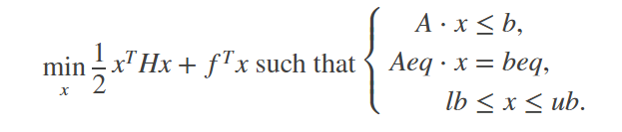
Use of Matlab library (quadprog)
Aeq=y
X becomes a
f = -ones(n,1);
Aeq=y;
beq=0;
lb=zeros(n,1);
C=2
ub=C*ones(n,1); %set C=2
Alg{1}='trust-region-reflective';
Alg{2}='interior-point-convex';
options=optimset('Algorithm',Alg{2},...
'Display','off',...
'MaxIter',20);
alpha=quadprog(H,f,[],[],Aeq,beq,lb,ub,[],options)';
beq=0
Notation used in our & matlab
To maximize is to minimize L
In this problem
a(ours)→x (matlab)
y(ours)→Aeq(matlab)
lb(lower),ub(upper) bounds are set accordingly
a=alpha(solution in program)
Code part2
Notes:
%%%%%%%%%%%%%%%%%%%%%%%%%%%%%%%%%%%%
\subsection{slide22:Recall earlier }
$L_{max}(a)=\max \big(
-\frac{1}{2} \sum\limits_{i=1}^{n} \sum\limits_{j=1}^{n}
a_i a_j y_i y_j x_i^T x_j
+\sum\limits_{i=1}^{n}a_i \big)$ \\
or (using min instead of max)\\
$L_{min}(a)=\max \big(
-\frac{1}{2} \sum\limits_{i=1}^{n} \sum\limits_{j=1}^{n}
a_i a_j ( y_i y_j x_i^T x_j )
- \sum\limits_{i=1}^{n}a_i \big)---(**)$ \\
subject to
$ \sum\limits_{i=1}^{n}a_i y_i=0$\\
After $a_{i=1,2,...,n}$ are found, then find $w$\\
$w= \sum\limits_{j=1}^{s}a_i y_i x_j$, finally find \\
$b=mean(y_i - (w^Tx_i))$\\
The discrimination function $f(x_{input})$ depends on $w$ and $b$ found above
$f(x_{input})=w^T x_{input}+b=\sum\limits_{j=1}^{s}a_j y_j x_j^T x_{input}+b$= class of $x_{input}$ \\
The term $(y_i y_j x_i^T x_j)$ in (**) can be found using the MATLAB code below
\begin{verbatim}
H = zeros(n,n);
for i=1:n
for j=i:n
H(i,j) = y(i)*y(j)*x(:,i)'*x(:,j);
H(j,i) = H(i,j);
end
end
\end{verbatim}
\subsection{slide 23:Use of Matlab (quadprog)}
$L_{min}(a)=\max \big(
-\frac{1}{2} \sum\limits_{i=1}^{n} \sum\limits_{j=1}^{n}
a_i a_j ( y_i y_j x_i^T x_j )
- \sum\limits_{i=1}^{n}a_i \big)---(**)$ \\
subject to
$ \sum\limits_{i=1}^{n}a_i y_i=0$\\
$\min\limits_x \frac{1}{2}x^T H x+f^T x$ such that
%$X(m,n)=
$\begin{cases}
A \cdot x \leq b,\\
A_eq \cdot x < beq,\\
lb \leq x \leq ub.
\end{cases}
$
\begin{verbatim}
\%MATLAB code
f = -ones(n,1);
Aeq=y;
beq=0;
lb=zeros(n,1);
C=2
ub=C*ones(n,1); %set C=2
Alg{1}='trust-region-reflective';
Alg{2}='interior-point-convex';
options=optimset('Algorithm',Alg{2},...
'Display','off',...
'MaxIter',20);
alpha=quadprog(H,f,[],[],Aeq,beq,lb,ub,[],options)';
----------------
In the quadprog() MATLAB function
Notation used in our matlab code
To maximize is to minimize L
In this problem
a(ours) \rightarrow x (matlab)
Aeq(ours) \rightarrow Aeq(matlab)
lb(lower),ub(upper) bounds are set accordingly
a=alpha(in program)
\end{verbatim}

Slide 24
%Matlab test svm_test1.m %(using linear kernel)
Using linear kernel
H = zeros(n,n);
for i=1:n
for j=i:n
H(i,j) = y(i)*y(j)*x(:,i)'*x(:,j);
H(j,i) = H(i,j);
end
end
f = -ones(n,1);
Aeq=y;
beq=0;
lb=zeros(n,1);
C=2
ub=C*ones(n,1); %set C=2
Alg{1}='trust-region-reflective';
Alg{2}='interior-point-convex';
options=optimset('Algorithm',Alg{2},...
'Display','off',...
'MaxIter',20);
alpha=quadprog(H,f,[],[],Aeq,beq,lb,ub,[],options)';
Code part1
%svm_test1.m
' test2: hard coded test'
x=[10 4
7 6
5 2
4 11
1 10
1 6]'
y=[ 1 1 1 -1 -1 -1]
n=length(y)
%%%%%%%%%%%%
ClassA = find( y == +1 );
ClassB = find( y == -1 );
%% Design SVM
Code part2

Slide 25
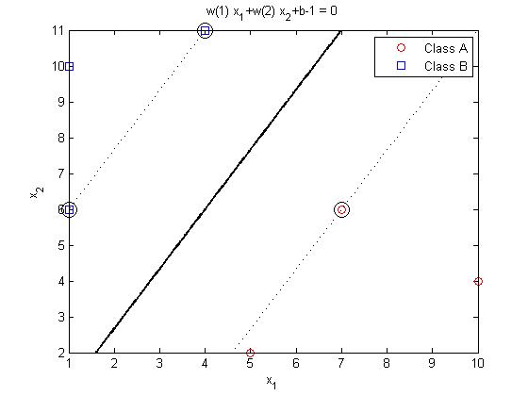
Matlab test (continue , for display)
AlmostZero=(abs(alpha)<max(abs(alpha))/1e5);
alpha(AlmostZero)=0;
S=find(alpha>0 & alpha<C);
w=0;
for i=S
w=w+alpha(i)*y(i)*x(:,i);
end
b=mean(y(S)-w'*x(:,S));
%% Plot Results
Line = @(x1,x2) w(1)*x1+w(2)*x2+b;
LineA = @(x1,x2) w(1)*x1+w(2)*x2+b+1;
LineB = @(x1,x2) w(1)*x1+w(2)*x2+b-1;
figure;
plot(x(1,ClassA),x(2,ClassA),'ro');
hold on;
plot(x(1,ClassB),x(2,ClassB),'bs');
plot(x(1,S),x(2,S),'ko','MarkerSize',12);
x1min = min(x(1,:));
x1max = max(x(1,:));
x2min = min(x(2,:));
x2max = max(x(2,:));
handle = ezplot(Line,[x1min x1max x2min x2max]);
set(handle,'Color','k','LineWidth',2);
handleA = ezplot(LineA,[x1min x1max x2min x2max]);
set(handleA,'Color','k','LineWidth',1,'LineStyle',':');
handleB = ezplot(LineB,[x1min x1max x2min x2max]);
set(handleB,'Color','k','LineWidth',1,'LineStyle',':');
legend('Class A','Class B');
Find w,b and decision line

Slide 26
svm_test1.m
%svm_test1.m
' test2: hard coded test'
x=[10 4
7 6
5 2
4 11
1 10
1 6]'
y=[ 1 1 1 -1 -1 -1]
n=length(y)
%%%%%%%%%%%%
ClassA = find( y == +1 );
ClassB = find( y == -1 );
%% Design SVM
H = zeros(n,n);
for i=1:n
for j=i:n
H(i,j) = y(i)*y(j)*x(:,i)'*x(:,j);
H(j,i) = H(i,j);
end
end
f = -ones(n,1);
Aeq=y;
beq=0;
lb=zeros(n,1);
C=2
ub=C*ones(n,1); %set C=0 for a linear problem
Alg{1}='trust-region-reflective';
Alg{2}='interior-point-convex';
options=optimset('Algorithm',Alg{2},...
'Display','off',...
'MaxIter',20);
alpha=quadprog(H,f,[],[],Aeq,beq,lb,ub,[],options)';
AlmostZero=(abs(alpha)<max(abs(alpha))/1e5);
alpha(AlmostZero)=0;
S=find(alpha>0 & alpha<C);
w=0;
for i=S
w=w+alpha(i)*y(i)*x(:,i);
end
b=mean(y(S)-w'*x(:,S));
%% Plot Results
Line = @(x1,x2) w(1)*x1+w(2)*x2+b;
LineA = @(x1,x2) w(1)*x1+w(2)*x2+b+1;
LineB = @(x1,x2) w(1)*x1+w(2)*x2+b-1;
figure;
plot(x(1,ClassA),x(2,ClassA),'ro');
hold on;
plot(x(1,ClassB),x(2,ClassB),'bs');
plot(x(1,S),x(2,S),'ko','MarkerSize',12);
x1min = min(x(1,:));
x1max = max(x(1,:));
x2min = min(x(2,:));
x2max = max(x(2,:));
handle = ezplot(Line,[x1min x1max x2min x2max]);
set(handle,'Color','k','LineWidth',2);
handleA = ezplot(LineA,[x1min x1max x2min x2max]);
set(handleA,'Color','k','LineWidth',1,'LineStyle',':');
handleB = ezplot(LineB,[x1min x1max x2min x2max]);
set(handleB,'Color','k','LineWidth',1,'LineStyle',':');
legend('Class A','Class B');

Slide 27
Exercise 3: Explaining the code: Finding the H= matrix: verify how to get these
116 | 94 | 58 | -84 | -50 | -34
94 | 85 | 47 | -94 | -67 | -43
58 | 47 | 29 | -42 | -25 | -17
-84 | -94 | -42 | 137 | 114 | 70
-50 | -67 | -25 | 114 | 101 | 61
-34 | -43 | -17 | 70 | 61 | 37
H=
%%--MATLAB code:
x=[10 4
7 6
5 2
4 11
1 10
1 6]'
y=[ 1 1 1 -1 -1 -1]
for i=1:n
for j=i:n
H(i,j) = y(i)*y(j)*x(:,i)'*x(:,j);
H(j,i) = H(i,j);
end
end

Slide 28
ANSWER 3: Show how matrix H is found
x=[10 4
7 6
5 2
4 11
1 10
1 6]
y=[ 1 1 1 -1 -1 -1]’
for i=1:n
for j=i:n
H(i,j) = y(i)*y(j)*x(:,i)'*x(:,j);
H(j,i) = H(i,j);
end
end
37=1*1*[1,6]*[1,6]’ | 61=1*1=[1,6]*[1,10] | 70=1*1*[1,6]*[4,11] | -17=1*-1*[1,6]*[5,2] | -43=1*-1*[1,6]*[7,6] | -34=1*-1*[1,6]*[10,4]’
61=1*1*[1,10][1,6]’ | 101=1*1*[1,10][1,10]’ | 114= | -25 | -67 | -50
70 | 114 | 137=1*1*[4,11]*[4,11]’ | -25 | -94 | -84
-17 | -25 | -42 | 29 | 47 | 58
-43 | -67 | -94 | 47 | 85 | 94
-34 | -50 | -84 | 58 | 94 | 116
H_{i,j}=
H wil be used in quadprog(H,f,A,b,Aeq,beq)
http://www.csd.uwo.ca/~olga/Courses/CS434a_541a/Lecture11.pdf

Slide 29
Explaining the code: Finding the H= matrix(continue)
f = -ones(n,1);
Aeq=y;
beq=0;
lb=zeros(n,1);
C=2;
ub=C*ones(n,1); %set C=2
Alg{1}='trust-region-reflective';
Alg{2}='interior-point-convex';
options=optimset('Algorithm',Alg{2},...
'Display','off',...
'MaxIter',20);
alpha=quadprog(H,f,[],[],Aeq,beq,lb,ub,[],options)';

Slide 30
Find w from α
%alpha=quadprog(H,f,[],[],Aeq,beq,lb,ub,[],options)';
alpha
AlmostZero=(abs(alpha)<max(abs(alpha))/1e5);
alpha(AlmostZero)=0;
S=find(alpha>0 & alpha<C); %can use C to control soft margin
w=0;
for i=S
w=w+alpha(i)*y(i)*x(:,i);
end
b=mean(y(S)-w'*x(:,S));
%% Plot Results
Line = @(x1,x2) w(1)*x1+w(2)*x2+b;
LineA = @(x1,x2) w(1)*x1+w(2)*x2+b+1;
LineB = @(x1,x2) w(1)*x1+w(2)*x2+b-1;

Slide 31
Plotting
figure;
plot(x(1,ClassA),x(2,ClassA),'ro');
hold on;
plot(x(1,ClassB),x(2,ClassB),'bs');
plot(x(1,S),x(2,S),'ko','MarkerSize',12);
x1min = min(x(1,:));
x1max = max(x(1,:));
x2min = min(x(2,:));
x2max = max(x(2,:));
handle = ezplot(Line,[x1min x1max x2min x2max]);
set(handle,'Color','k','LineWidth',2);
handleA = ezplot(LineA,[x1min x1max x2min x2max]);
set(handleA,'Color','k','LineWidth',1,'LineStyle',':');
handleB = ezplot(LineB,[x1min x1max x2min x2max]);
set(handleB,'Color','k','LineWidth',1,'LineStyle',':');
legend('Class A','Class B');

Slide 32
Exercise 4 : Result: select support vector using non-zero alphas
x=[10 4
7 6
5 2
4 11
1 10
1 6]
y=[ 1 1 1 -1 -1 -1]’
Where are Support vectors for A and B andd their corresponding alphas ?
ANSWER: ___________________?
alpha =
0.0000
0.0756
0.0000
0.0400
0.0000
0.0356

Slide 33
ANSWER 4 : Result: select support vector using non-zero alphas
x=[10 4
7 6
5 2
4 11
1 10
1 6]
y=[ 1 1 1 -1 -1 -1]’
Support vectors (see arrows)
Result=non-zero alphas
alpha =
0.0000
0.0756
0.0000
0.0400
0.0000
0.0356

Slide 34
function basic_SVM(n,D,S,C) for 160 data %https://www.mathworks.com/matlabcentral/fileexchange/68218-svm-basic-support-vector-machines-using-quadprog
function basic_SVM(n,D,S,C)
%https://www.mathworks.com/matlabcentral/fileexchange/68218-svm-basic-support-vector-machines-using-quadprog
% This function shows how simple is to train one of the simplest
% Support Vector Machines, by using Matlab function for
% quadratic programming (quadprog).
%
% First of all the dataset of n points in 2D is generate, as the union
% of two subsets of random numbers generated according to two gaussian
% distributions centered in (-D,-D) and in (+D,+D), respectively,
% with the same standard deviation S.
% Then a SVM is trained, using C as soft margin.
%
% Inputs
%
% n: total number of points (n/2 belongs to each of the two classes)
% D: controls the distance between the two classes.
% S: is the standard deviation of the two gaussian distributions
% C: soft margin of the SVM ( C=0 if the two class are linearly separable )
%
% % Example
% basic_SVM(160,3,1,2);
%
% See also ClassificationSVM, fitcsvm
% This code is just a simple adaptation of the one provided by ali raj:
% https://it.mathworks.com/matlabcentral/fileexchange/51248-svm
% Copyright Marco Cococcioni, 2018-07-17
if nargin < 1, n = 160; end
if nargin < 2, D = 4; end
if nargin < 3, S = 3; end
if nargin < 4, C = 2; end
%% Generate Data
x = [ D + S*randn(n/2,2);
-D + S*randn(n/2,2)]';
y = [ ones(n/2,1);
-ones(n/2,1) ]';
ClassA = find( y == +1 );
ClassB = find( y == -1 );
%% Design SVM
H = zeros(n,n);
for i=1:n
for j=i:n
H(i,j) = y(i)*y(j)*x(:,i)'*x(:,j);
H(j,i) = H(i,j);
end
end
f = -ones(n,1);
Aeq=y;
beq=0;
lb=zeros(n,1);
ub=C*ones(n,1);
Alg{1}='trust-region-reflective';
Alg{2}='interior-point-convex';
options=optimset('Algorithm',Alg{2},...
'Display','off',...
'MaxIter',20);
alpha=quadprog(H,f,[],[],Aeq,beq,lb,ub,[],options)';
AlmostZero=(abs(alpha)<max(abs(alpha))/1e5);
alpha(AlmostZero)=0;
S=find(alpha>0 & alpha<C);
w=0;
for i=S
w=w+alpha(i)*y(i)*x(:,i);
end
b=mean(y(S)-w'*x(:,S));
%% Plot Results
Line = @(x1,x2) w(1)*x1+w(2)*x2+b;
LineA = @(x1,x2) w(1)*x1+w(2)*x2+b+1;
LineB = @(x1,x2) w(1)*x1+w(2)*x2+b-1;
figure;
plot(x(1,ClassA),x(2,ClassA),'ro');
hold on;
plot(x(1,ClassB),x(2,ClassB),'bs');
plot(x(1,S),x(2,S),'ko','MarkerSize',12);
x1min = min(x(1,:));
x1max = max(x(1,:));
x2min = min(x(2,:));
x2max = max(x(2,:));
handle = ezplot(Line,[x1min x1max x2min x2max]);
set(handle,'Color','k','LineWidth',2);
handleA = ezplot(LineA,[x1min x1max x2min x2max]);
set(handleA,'Color','k','LineWidth',1,'LineStyle',':');
handleB = ezplot(LineB,[x1min x1max x2min x2max]);
set(handleB,'Color','k','LineWidth',1,'LineStyle',':');
legend('Class A','Class B');

Slide 35
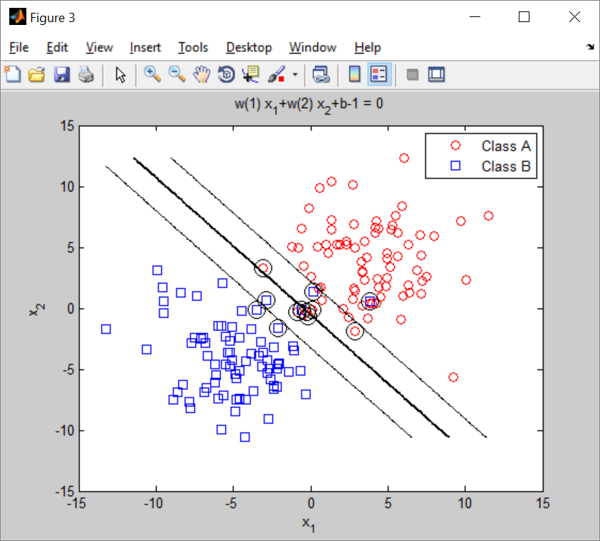
Result

Slide 36
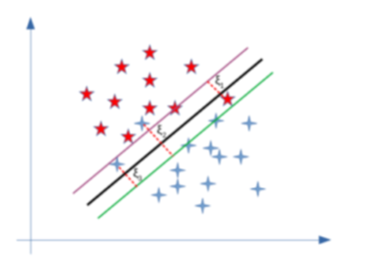
Soft margin
https://www.baeldung.com/cs/svm-hard-margin-vs-soft-margin
Some samples are allowed to live inside
the margins

Slide 37
SVM implementation for Non-linear problems
Using the kernel trick

Slide 38
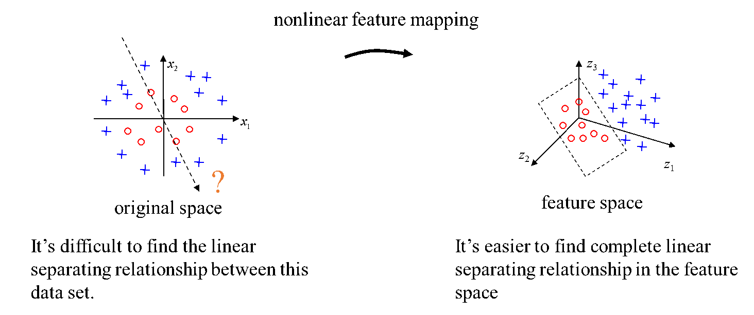
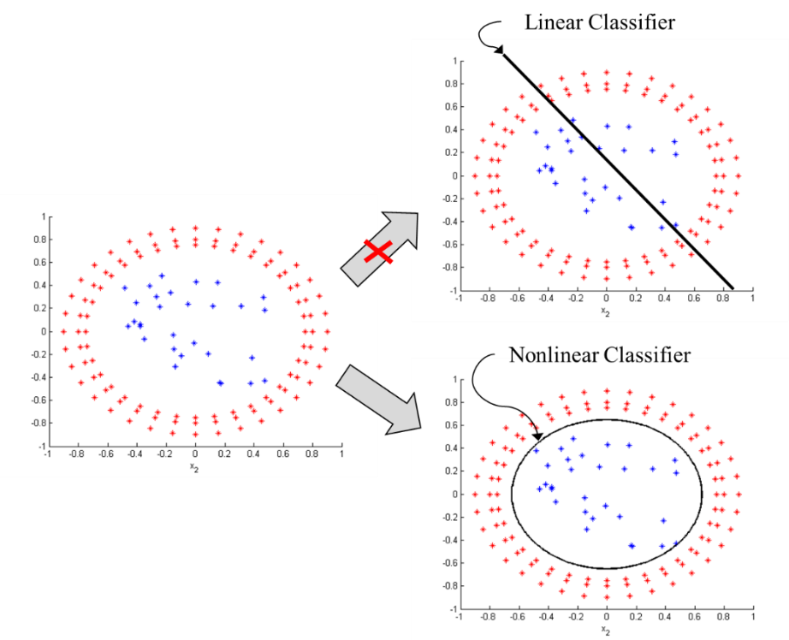
The basic concept

Slide 39
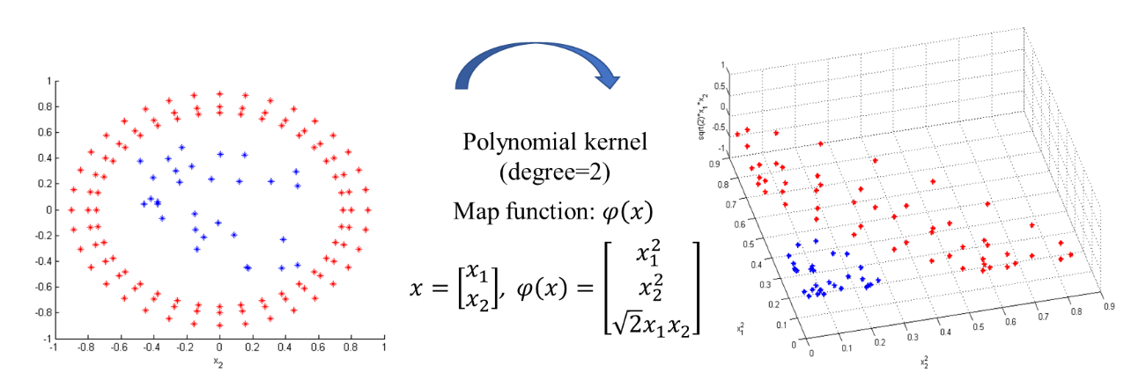
A simple Kernel example
The red dots are having large x₁,x₂ in magnitude, so in the 3-D space they will be at higher locations along the vertical axis (sqrt(2)x₁x₂)
example
x₁
sqrt(2)x₁x₂
x₂
(x₁)²
(x₂)²
(0,0,0)
original 2-D data space
Mapped to 3-D data space

Slide 40
Exercise 5: Non-linear kernel: Polynomial Kernel Write the Linear kernel for eq.(iv)
Notes:
%%%%%%%%%%%%%%%%%%%%%%%%%%%%%%%%%%%%%%
\subsection{Slide39: exercise 5 nonlinear kernel polynomial kernel write the linear kernel for equation (iv)}
We can map $x_{(n\_dimension)} \rightarrow \phi(x)_{n+1 dimension}$, to increase dimension by 1.\\
$L_{max}(a)=\max \Big(
-\frac{1}{2} \sum\limits_{i=1}^{n} \sum\limits_{j=1}^{n}
a_i a_j y_i y_j K(x_i, x_j)
+\sum\limits_{i=1}^{n} a_i
\Big)----(iv)$\\
Subject to $\sum\limits_{i=1}^{n} a_i y_i =0$\\
One choice is us $K(x_i, x_j) = (x^T_i x_j +1 )^2$ = Polynomial Kernel\\
Polynomial Kernel is popular choice:\\
$K(x_i,x_j)=(x^T_i x_j+x)^d=$\\
$(x^T_i x_j +1)^2=$ \text { if } $d=2, c=1.$
Answer:
$L_{max}(a)=max \Big(
-\frac{1}{2} \sum\limits_{i=1}^{n} \sum\limits_{j=1}^{n}
a_i a_j y_i y_j x^T_i x_j + \sum\limits_{i=1}^{n} a_i
\Big)---(iv)$

Slide 41
ANSWER 5: Non-linear kernel: Polynomial Kernel Write the Linear kernel for eq.(iv)
Notes:
See the previous slide for latex file

Slide 42
Non-Linear Kernel: how to classify a new input s{ }=set of support vectors
Notes:
%%%%%%%%%%%%%%%%%%%%%%%%%%%%%%%%%%%%
\subsection{slide41: Non-Linear Kernel: how to classify a new input}
Given training data ${x_i, y_i}_{i= all samples}$
Find $a$, select $s$={the set of non-zero $a$} by solving (i)
$L_{max}(a)=\max \Big(
-\frac{1}{2} \sum\limits_{i=1}^{n} \sum\limits_{j=1}^{n}
a_i a_j y_i y_j K(x_i, x_j)
+\sum\limits_{i=1}^{n} a_i
\Big)----(iv)$\\
To classify a new input $x_{input}$, use the discrimination function\\
$f(x_{input})= \sum\limits_{j=1}^{s} a_i y_j K(x_j, x_{input})+b=
\sum\limits_{j=1}^{s} a_i y_j K(x_j^T \cdot x_{input} +1)^2+b$\\
Use $f()$ to find the class of an input $x_{input}$\\
$f(x_{input})=\sum\limits_{j=1}^{s} a_j y_j (x^T_j \cdot x_{input} +1)^2+b=
\begin{cases}
> 0: x_{input} \text{ class }= +ve\\
\text{ otherwise}: x_{input} \text{ class } =-ve
\end{cases}
$

Slide 43
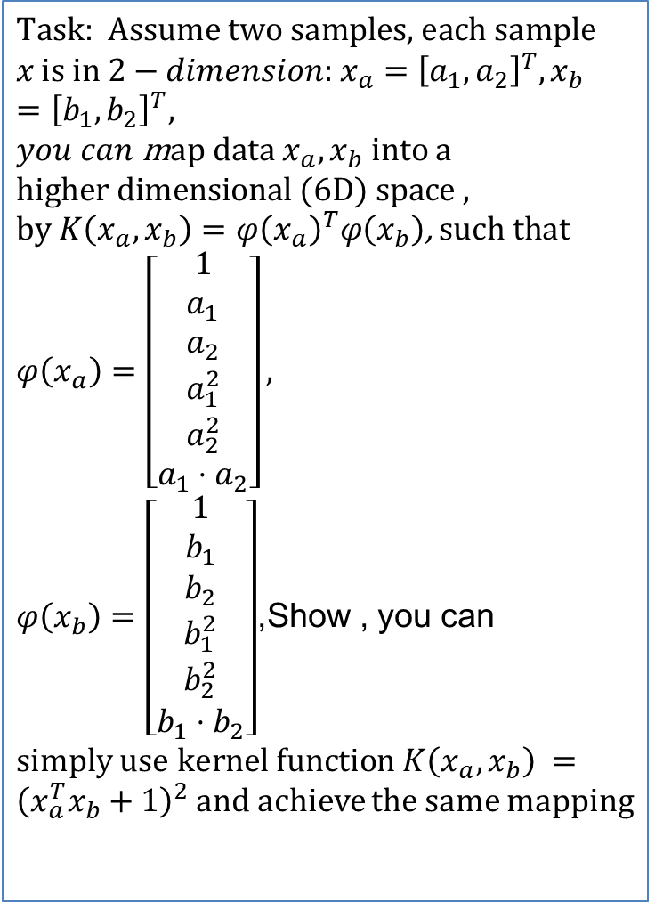
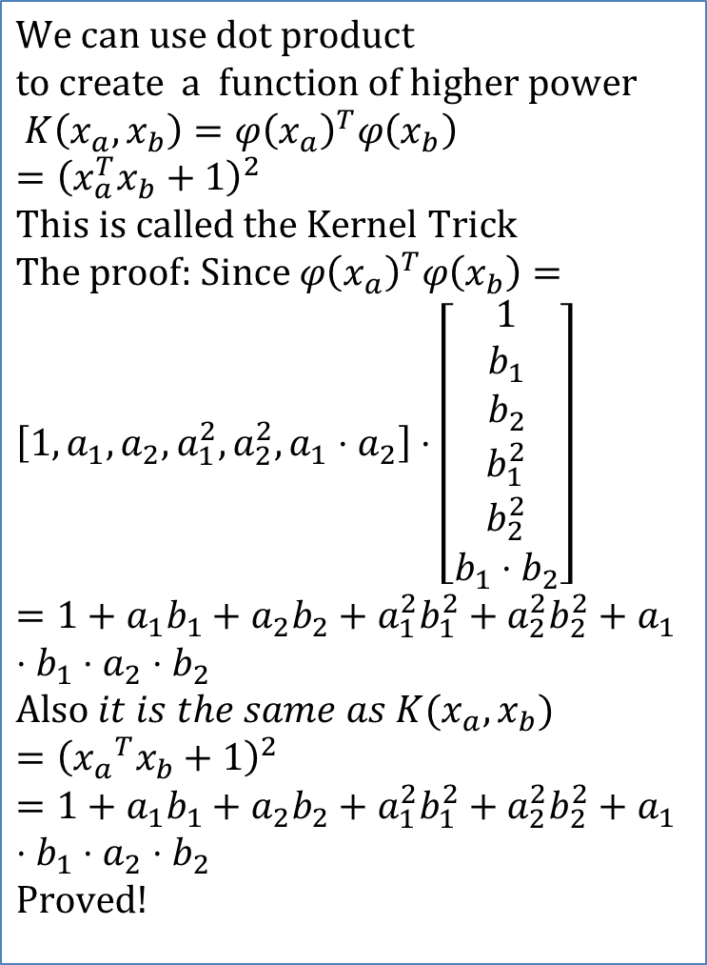
The Kernel trick: A more complex kernel
$$\text{Task}\text{: }\text{Assume} \text{two} \text{samples}\text{, }\text{each} \text{sample} \\ x \text{is} \text{in} 2−dimension\text{: }x_{a}={\left[a_{1},a_{2}\right]}^{T},x_{b}={\left[b_{1},b_{2}\right]}^{T},$$
$you can$m$\text{ap} \text{data} x_{a},x_{b} \text{into} \text{a}$ $$\text{higher} \text{dimensional}\text{ (6}\text{D}\text{) }\text{space}\text{ , }\text{by} K\left(x_{a},x_{b}\right)=φ{\left(x_{a}\right)}^{T}φ\left(x_{b}\right)\text{, }\text{such} \text{that} \\ φ\left(x_{a}\right)=\left[\begin{matrix}1 \\ a_{1} \\ a_{2} \\ a_{1}^{2} \\ a_{2}^{2} \\ a_{1}⋅a_{2}\end{matrix}\right],$$
$φ\left(x_{b}\right)=\left[\begin{matrix}1 \\ b_{1} \\ b_{2} \\ b_{1}^{2} \\ b_{2}^{2} \\ b_{1}⋅b_{2}\end{matrix}\right]$,Show , you can $\text{simply}$use$kernel function K\left(x_{a},x_{b}\right) ={\left(x_{a}^{T}x_{b}+1\right)}^{2}$ and achieve the same mapping
$$\text{We} \text{can} \text{use} \text{dot} \text{product} \\ \text{to} \text{create} \text{a} \text{function} \text{of} \text{higher} \text{power} \\ K\left(x_{a},x_{b}\right)=φ{\left(x_{a}\right)}^{T}φ\left(x_{b}\right)={\left(x_{a}^{T}x_{b}+1\right)}^{2} \\ \text{This} \text{is} \text{called} \text{the} \text{Kernel} \text{Trick} \\ \text{The} \text{proof}\text{: }\text{Since} φ{\left(x_{a}\right)}^{T}φ\left(x_{b}\right)= \\ \left[1,a_{1},a_{2},a_{1}^{2},a_{2}^{2},a_{1}⋅a_{2}\right]⋅\left[\begin{matrix}1 \\ b_{1} \\ b_{2} \\ b_{1}^{2} \\ b_{2}^{2} \\ b_{1}⋅b_{2}\end{matrix}\right] \\ =1+a_{1}b_{1}+a_{2}b_{2}+a_{1}^{2}b_{1}^{2}+a_{2}^{2}b_{2}^{2}+a_{1}⋅b_{1}⋅a_{2}⋅b_{2} \\ \text{Also} it is the same as K(x_{a},x_{b})={\left({x_{a}}^{T}x_{b}+1\right)}^{2} \\ =1+a_{1}b_{1}+a_{2}b_{2}+a_{1}^{2}b_{1}^{2}+a_{2}^{2}b_{2}^{2}+a_{1}⋅b_{1}⋅a_{2}⋅b_{2} \\ \text{Proved}\text{!}$$
https://towardsdatascience.com/support-vector-machines-svm-c9ef22815589
Notes:
%%%%%%%%%%%%%%%%%%%%%%%%%%%%%%%%%%%%
\subsection{slide42: The Kernel trick}
This document was created on: \today\ at \currenttime. \\~\\
Assume two samples, each sample $x$ has 2 features indexed 1 and 2:\\
$x_a=[a_1,a_2]^T, x_b =[b_1,b_2]^T$\\
Map data $x_a,x_b$ into higher dimension
i.e. involve $a_1 b_a, a_1 b_2,... $etc, e.g.\\
$\phi(x_a)=\begin{bmatrix}
1\\
a_1\\
a_2\\
a_1^2\\
a_2^2\\
a_1 \cdot a_2
\end{bmatrix},
\phi(x_b)=\begin{bmatrix}
1\\
b_1\\
b_2\\
b_1^2\\
b_2^2\\
b_1 \cdot b_2
\end{bmatrix}$\\
Will show that we can use dot product to create a function of higher power\\
$K(x_a,x_b)=\phi(x_a)^T\phi(x_b)=(x^T_ax_b+1)^2$\\
This is called the kernel trick\\
The proof: since $\phi(x_a)^T \phi(x_b)=$
$\begin{bmatrix}
1,a_1,a_2,a_1^2,a_2^2,a_1 \cdot a_2
\end{bmatrix} \cdot
\begin{bmatrix}
1\\
b_1\\
b_2\\
b_1^2\\
b_2^2\\
b_1 \cdot b_2
\end{bmatrix} $
%
$=1+a_1 b_1 + a_2 b_2
+ a_1^2 b_1^2+ a_2^2 b_2^2
+ a_1 b_1 a_2 b_2 $\\
%
Also $K(x_a,x_b)=(x_a^T x_b+1)^2$
$=1+a_1 b_1 + a_2 b_2
+ a_1^2 b_1^2+ a_2^2 b_2^2
+ a_1 b_1 a_2 b_2 $\\
Proved!

Slide 44
How to use : After all {a_{i}} are obtained
Use classification function to classify an input
Notes:
%%%%%%%%%%%%%%%%%%%%%%%%%%%%%%%%%%%%
\subsection{slide43: How to use : After all \{ai\} are obtained}
Use classification function for a new input.
To classify a new input $x_{input}$ , use the discrimination function $f()$\\
$>>$ Recall without Kernel function for linear problems
$w=\sum\limits_{j=1}^{s} a_j y_i x_j$\\
$f(x_{input})=w^T x_{inot} +b =
\sum\limits_{j=1}^{s} a_j y_i x_j^T x_{input} +b$\\
%%%%%%%%%%%%%%%%%%%%%%%%%
----------------------------------------------\\
$>>$ with Kernel function for non-linear problems\\
%$ \sum\limits_{j=1}^{s} a_i y_j K(x_j, x_{input})+b=
%\sum\limits_{j=1}^{s} a_i y_j K(x_j^T \cdot x_{input} +1)^2+b$
%Use $f()$ to find the class of an input $x_{input}$\\
$f(x_{input})=$\\
$\sum\limits_{j=1}^{s} a_j y_j (x^T_j \cdot x_{input} +1)^2+b=
\begin{cases}
> 0: x_{input} \text{ class }= +ve\\
\text{ otherwise}: x_{input} \text{ class } =-ve
\end{cases}$\\
%
Note : mapping $x_a$ to higher dimension (power):\\
$\phi(x_a)=\begin{bmatrix}
1\\
a_1\\
a_2\\
a_1^2\\
a_2^2\\
a_1 \cdot a_2
\end{bmatrix}
$

Slide 45
Implementation
Using Non-linear kernel for non-linear problems.
https://stats.stackexchange.com/questions/152897/how-to-intuitively-explain-what-a-kernel-is

Slide 46
Implementation to find bias b
% matlab Code in Svm_demo2 svm.m
svindex = find( alpha > epsilon);
% Find unbounded support vectors
usvindex = find( alpha > epsilon & alpha < (C - epsilon));
%usvindex = find( alpha > epsilon); %can also work.
if length(usvindex) > 0
b0 =...
(1/length(usvindex))*sum(D(usvindex) -...
H(usvindex,svindex)*alpha(svindex).*D(usvindex));
fprintf('No support vectors on margin - cannot compute bias.\n');
End
%%%%%%%%%%%%%%%%%%%%%%%%%%%%

Slide 47
Exercise 6: Write the formula for the polynomial kernel Matlab code for using the polynomial kernel , after alphas (α) are found, it can be used directly to find the third dimension data (ztemp)
% inside matlab Code in Svm_demo2 svm.m
z = b0*ones(size(x)); %% z is offset to b0
for x1 = 1 : size(x,1)
for y1 = 1 : size(x,2)
input(1) = x(x1,y1); %scan thru all areas (x,y)--> valid areas as inputs, and see output z
input(2) = y(x1,y1);
for i = 1 : length(D)
if (abs(alpha(i)) > epsilon)
z(x1,y1) = z(x1,y1) + D(i)*alpha(i)*(input*X(i,:)'+ 1)^2;
end
end
end

Slide 48
ANSWER 6: Write the formula for the polynomial kernel Matlab code for using the polynomial kernel , after alphas (α) are found, it can be used directly to find the third dimension data (ztemp)
% inside matlab Code in Svm_demo2 svm.m
z = b0*ones(size(x)); %% z is offset to b0
for x1 = 1 : size(x,1)
for y1 = 1 : size(x,2)
input(1) = x(x1,y1); %scan thru all areas (x,y)--> valid areas as inputs, and see output z
input(2) = y(x1,y1);
for i = 1 : length(D)
if (abs(alpha(i)) > epsilon)
z(x1,y1) = z(x1,y1) + D(i)*alpha(i)*(input*X(i,:)'+ 1)^2;
end
end
end

Slide 49
Svm_demo1 (new_basic_SVM) using matlab: Non-linear example using Polynomial kernel
https://notendur.hi.is/tpr/tutorials/svm/notes/chapter5_6.pdf

Slide 50
% svm_demo1.m
function new_basic_SVM(n,D,S,C)
%ref https://www.mathworks.com/matlabcentral/fileexchange/68218-svm-basic-support-vector-machines-using-quadprog
if nargin < 1, n = 160; end
if nargin < 2, D = 4; end
if nargin < 3, S = 3; end
if nargin < 4, C = 2; end
%% Generate Data
%%%%%%%%%%%%%%%test 1 data begins%%%%%%%%%%%%%%%%%%%%%%%
x = [ D + S*randn(n/2,2);% test1: random data test
-D + S*randn(n/2,2)]';
y = [ ones(n/2,1);
-ones(n/2,1) ]';
n=length(y)
%%%%%%%%%%%%%%%%%%%%%%%%%%%%%%%
ClassA = find( y == +1 );
ClassB = find( y == -1 );
%% Design SVM
H = zeros(n,n);
for i=1:n
for j=i:n
%H(i,j) = y(i)*y(j)*xx(:,i)'*xx(:,j); %linear kernel
H(i,j) = y(i)*y(j)*(x(:,i)'*x(:,j)+1)^2;%polynomial
H(j,i) = H(i,j);
end
end
f = -ones(n,1);
Aeq=y;
beq=0;
lb=zeros(n,1);
ub=C*ones(n,1);
Alg{1}='trust-region-reflective';
Alg{2}='interior-point-convex';
options=optimset('Algorithm',Alg{2},...
'Display','off',...
'MaxIter',20);
alphaV=quadprog(H,f,[],[],Aeq,beq,lb,ub,[],options)';
Using Polynomial kernel

Slide 51
alphaV
AlmostZero=(abs(alphaV)<max(abs(alphaV))/1e5);
alphaV(AlmostZero)=0;
S=find(alphaV>0 & alphaV<C);
w=0;
for i=S
w=w+alphaV(i)*y(i)*x(:,i);
end
b=mean(y(S)-w'*x(:,S));
ztemp=zeros(1,n);
for j=1:n %test all samples
test_x=x(:,j);
for i=S
ztemp(j)=ztemp(j)+alphaV(i)*y(i)*(x(:,i)'*test_x+1)^2;
%find result directly, not depends on w,b
end
end
'show and compare ----------------s'
y, ztemp, ztemp2=ztemp--mean(ztemp)
%%%%%%%%%%%%%%% figire 33333333333 --
figure(3),clf,hold on
for i=1:n
if y(i)== +1
plot3(x(1,i),x(2,i),ztemp(i),'r+'); %ztemp2 not used
end
if y(i)== -1
plot3(x(1,i),x(2,i),ztemp(i),'bo')
end
xlabel('x axis')
ylabel('y axis')
zlabel('z axis')
end
%ok plot the decision plane, z=0
pointA = [15 , -15, 0]; pointB = [-15,0,0];pointC = [0,15,0];
plane1 = cross(pointA-pointB, pointA-pointC)
points=[pointA' pointB' pointC']; % using the data given in the question
ss=fill3(points(1,:),points(2,:),points(3,:),'r')
grid on, alpha(0.5),view(3)
Find
W,b

Slide 52
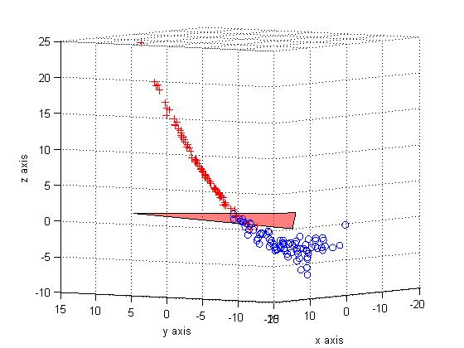
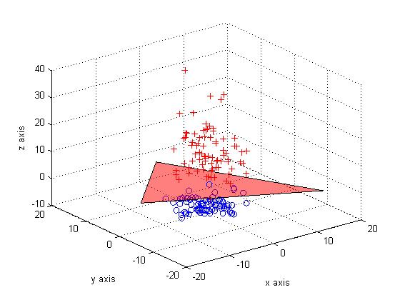
New_basic_SVM(n,D,S,C) demo1
2 different views of the result

Slide 53
Svm_demo1.m:new_basic_SVM(n,D,S,C) (using polynomial kernel)
function basic_SVM(n,D,S,C) % svm_demo1.m
%ref https://www.mathworks.com/matlabcentral/fileexchange/68218-svm-basic-support-vector-machines-using-quadprog
if nargin < 1, n = 160; end
if nargin < 2, D = 4; end
if nargin < 3, S = 3; end
if nargin < 4, C = 2; end
%% Generate Data
%%%%%%%%%%%%%%%test 1 data begins%%%%%%%%%%%%%%%%%%%%%%%
x = [ D + S*randn(n/2,2);% test1: random data test
-D + S*randn(n/2,2)]';
y = [ ones(n/2,1);
-ones(n/2,1) ]';
n=length(y)
%%%%%%%%%%%%%%%%%%%%%%%%%%%%%%%
ClassA = find( y == +1 );
ClassB = find( y == -1 );
%% Design SVM
H = zeros(n,n);
for i=1:n
for j=i:n
%H(i,j) = y(i)*y(j)*xx(:,i)'*xx(:,j); %linear kernel
H(i,j) = y(i)*y(j)*(x(:,i)'*x(:,j)+1)^2; %polynomial kernel
H(j,i) = H(i,j);
end
end
f = -ones(n,1);
Aeq=y;
beq=0;
lb=zeros(n,1);
ub=C*ones(n,1);
Alg{1}='trust-region-reflective';
Alg{2}='interior-point-convex';
options=optimset('Algorithm',Alg{2},...
'Display','off',...
'MaxIter',20);
alphaV=quadprog(H,f,[],[],Aeq,beq,lb,ub,[],options)';
alphaV
AlmostZero=(abs(alphaV)<max(abs(alphaV))/1e5);
alphaV(AlmostZero)=0;
S=find(alphaV>0 & alphaV<C);
w=0;
for i=S
w=w+alphaV(i)*y(i)*x(:,i);
end
b=mean(y(S)-w'*x(:,S));
ztemp=zeros(1,n);
for j=1:n %test all samples
test_x=x(:,j);
for i=S
ztemp(j)=ztemp(j)+alphaV(i)*y(i)*(x(:,i)'*test_x+1)^2; %find result not depends on w
end
end
'show and compare ----------------s'
y, ztemp, ztemp2=ztemp--mean(ztemp)
%%%%%%%%%%%%%%% figire 33333333333 --
figure(3),clf,hold on
for i=1:n
if y(i)== +1
plot3(x(1,i),x(2,i),ztemp(i),'r+'); %ztemp2 not used
end
if y(i)== -1
plot3(x(1,i),x(2,i),ztemp(i),'bo')
end
xlabel('x axis')
ylabel('y axis')
zlabel('z axis')
end
%ok plot the decision plane, z=0
pointA = [15 , -15, 0]; pointB = [-15,0,0];pointC = [0,15,0];
plane1 = cross(pointA-pointB, pointA-pointC)
points=[pointA' pointB' pointC']; % using the data given in the question
ss=fill3(points(1,:),points(2,:),points(3,:),'r')
grid on, alpha(0.5),view(3)

Slide 54
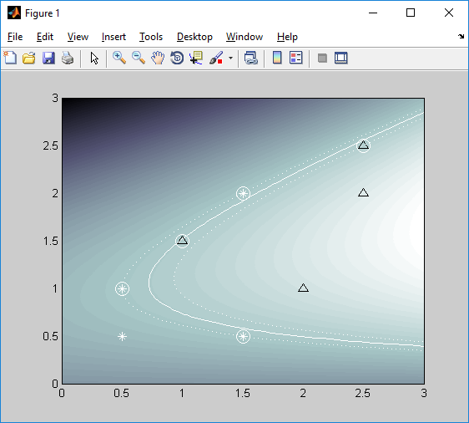
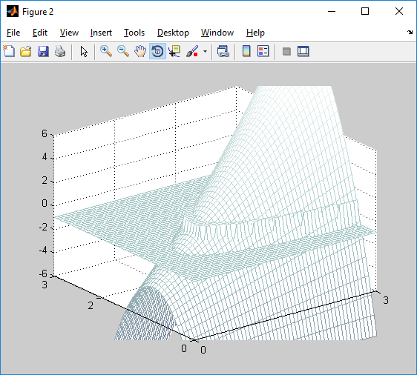
Demo2: using matlab (using polynomial kernel)
Svm_demo2 svm.m demo with graphical display

Slide 55
%Example using matlab svm_demo2
f = -ones(n,1);
% Add small amount of zero order regularisation to
% avoid problems when Hessian is badly conditioned.
H = H+1e-10*eye(size(H));
% Parameters for the Optimization problem
vlb = zeros(q,1); % Lower bound of lambdas = 0
vub = C*ones(q,1); % Upper bound C
x0 = zeros(q,1); % Initial point is 0
numeqconstraints = 1; % Number of equality constraints
A = D'; % Set up the equality constraint
b = 0;
% Solve the Optimization Problem
%[alpha lambda how] = qp(H, f, A, b, vlb, vub, x0, numeqconstraints);
%%% https://www.mathworks.com/matlabcentral/newsreader/view_thread/296517
%Kanika, I believe if you change this:
%> [alpha lambda how] = qp(H, f, A, b, vlb, vub, x0, numeqconstraints);
%to:
%[alpha,fval,exitflag,output,lambda]= quadprog(H, f, A(2:end, :), b(2:end),
%A(1, :), b(1), vlb, vub, x0);
%[alpha,fval,exitflag,output,lambda] =...
% quadprog(H, f, A(2:end, :), b(2:end), A(1, :), b(1), vlb, vub, x0);
[alpha,fval,exitflag,output,lambda] =...
quadprog(H, f, A, b, A(1, :), b(1), vlb, vub, x0);
Function svm_demo2
close all
clearvars
X=[0.5 0.5
0.5 1.0
1. 1.5
1.5 0.5
1.5 2.0
2.0 1.0
2.5 2.0
2.5 2.5];
D =[-1 -1 1 -1 -1 1 1 1]';
q = size(X,1);
C = 150;
% tolerance for Support Vector Detection
epsilon = C*1e-6;
ord = 2; % Order of polynomial kernel
H = zeros(q,q); % Initialize Hessian matrix
for i=1:q % Set up the Hessian
for j=1:q
H(i,j) = D(i)*D(j)*(X(i,:)*X(j,:)'+1)^ord;
end
end
n=length(D)%8 % a guess
Using Polynomial kernel

Slide 56
Z is offset to b0
z = b0*ones(size(x));
for x1 = 1 : size(x,1)
for y1 = 1 : size(x,2)
input(1) = x(x1,y1); %scan throu all areas (x,y)--> valid areas as inputs, and see output z
input(2) = y(x1,y1);
for i = 1 : length(D)
if (abs(alpha(i)) > epsilon)
z(x1,y1) = z(x1,y1) + D(i)*alpha(i)*(input*X(i,:)'+ 1)^2; %Specific to poly!!!!
end
end
end
end
sp = pcolor(x,y,z);
shading interp;
colormap(bone);
svindex = find( alpha > epsilon);
% Find unbounded support vectors
usvindex = find( alpha > epsilon & alpha < (C - epsilon));
if length(usvindex) > 0
b0 =...
(1/length(usvindex))*sum(D(usvindex) -...
H(usvindex,svindex)*alpha(svindex).*D(usvindex));
else
fprintf('No support vectors on margin - cannot compute bias.\n');
end
xmin = 0;xmax = 3;ymin = 0;ymax = 3;
figure(1),clf
% Plot function value
[x,y] = meshgrid(xmin:(xmax-xmin)/50:xmax,ymin:(ymax-ymin)/50:ymax);
Find b0
Find the third dimension output z(x,y).
If higher than threshold it is class A else B
(Z is offset with b0 already)

Slide 57
hold on
for i = 1:size(D)
if (D(i) == 1)
h(1) = plot(X(i,1),X(i,2),'k^', 'MarkerSize', 8); % Class A
else
h(2) = plot(X(i,1),X(i,2),'w*', 'MarkerSize', 8); % Class B
end
if (abs(alpha(i)) > epsilon)
plot(X(i,1),X(i,2),'wo', 'MarkerSize', 12) % Support Vector
end
end
% Plot Boundary contour
hold on
contour(x,y,z,[0 0],'w')
contour(x,y,z,[-1 -1],'w:')
contour(x,y,z,[1 1],'w:')
hold off
figure(2)
clf
mesh(x,y,z)
rotate3d on
hold on
decision = sign(z);
mesh(x,y,decision);
axis([0 3 0 3 -6 6]);
rotate3d on
colormap(bone)
'end done'

Slide 58
svm_demo2: with Graphic Display
% ==========================================================
%https://www.mathworks.com/matlabcentral/newsreader/view_thread/296517
% Neural Networks A Classroom Approach
% Satish Kumar
% Copyright Tata McGraw Hill, 2004
%
% MATLAB code that implements the SVM for non-linearly
% separable data
% Reference: Table 8.6;Page 294
%
% ==========================================================
function svm_demo2
close all
clearvars
X=[0.5 0.5
0.5 1.0
1. 1.5
1.5 0.5
1.5 2.0
2.0 1.0
2.5 2.0
2.5 2.5];
D =[-1 -1 1 -1 -1 1 1 1]';
q = size(X,1);
C = 150;
% tolerance for Support Vector Detection
epsilon = C*1e-6;
ord = 2; % Order of polynomial kernel
H = zeros(q,q); % Initialize Hessian matrix
for i=1:q % Set up the Hessian
for j=1:q
H(i,j) = D(i)*D(j)*(X(i,:)*X(j,:)'+1)^ord;
end
end
n=length(D)%8 % a guess
f = -ones(n,1);
% Add small amount of zero order regularisation to
% avoid problems when Hessian is badly conditioned.
H = H+1e-10*eye(size(H));
% Parameters for the Optimization problem
vlb = zeros(q,1); % Lower bound of lambdas = 0
vub = C*ones(q,1); % Upper bound C
x0 = zeros(q,1); % Initial point is 0
numeqconstraints = 1; % Number of equality constraints
A = D'; % Set up the equality constraint
b = 0;
% Solve the Optimization Problem
%[alpha lambda how] = qp(H, f, A, b, vlb, vub, x0, numeqconstraints);
%%% https://www.mathworks.com/matlabcentral/newsreader/view_thread/296517
%Kanika, I believe if you change this:
%> [alpha lambda how] = qp(H, f, A, b, vlb, vub, x0, numeqconstraints);
%to:
%[alpha,fval,exitflag,output,lambda]= quadprog(H, f, A(2:end, :), b(2:end),
%A(1, :), b(1), vlb, vub, x0);
%[alpha,fval,exitflag,output,lambda] =...
% quadprog(H, f, A(2:end, :), b(2:end), A(1, :), b(1), vlb, vub, x0);
[alpha,fval,exitflag,output,lambda] =...
quadprog(H, f, A, b, A(1, :), b(1), vlb, vub, x0);
svindex = find( alpha > epsilon);
% Find unbounded support vectors
usvindex = find( alpha > epsilon & alpha < (C - epsilon));
if length(usvindex) > 0
b0 =...
(1/length(usvindex))*sum(D(usvindex) -...
H(usvindex,svindex)*alpha(svindex).*D(usvindex));
else
fprintf('No support vectors on margin - cannot compute bias.\n');
end
xmin = 0;
xmax = 3;
ymin = 0;
ymax = 3;
figure(1)
clf
% Plot function value
[x,y] = meshgrid(xmin:(xmax-xmin)/50:xmax,ymin:(ymax-ymin)/50:ymax);
z = b0*ones(size(x));
for x1 = 1 : size(x,1)
for y1 = 1 : size(x,2)
input(1) = x(x1,y1);
input(2) = y(x1,y1);
for i = 1 : length(D)
if (abs(alpha(i)) > epsilon)
z(x1,y1) = z(x1,y1) + D(i)*alpha(i)*(input*X(i,:)'+ 1)^2; %Specific to poly!!!!
end
end
end
end
sp = pcolor(x,y,z);
shading interp;
colormap(bone);
hold on
for i = 1:size(D)
if (D(i) == 1)
h(1) = plot(X(i,1),X(i,2),'k^', 'MarkerSize', 8); % Class A
else
h(2) = plot(X(i,1),X(i,2),'w*', 'MarkerSize', 8); % Class B
end
if (abs(alpha(i)) > epsilon)
plot(X(i,1),X(i,2),'wo', 'MarkerSize', 12) % Support Vector
end
end
% Plot Boundary contour
hold on
contour(x,y,z,[0 0],'w')
contour(x,y,z,[-1 -1],'w:')
contour(x,y,z,[1 1],'w:')
hold off
figure(2)
clf
mesh(x,y,z)
rotate3d on
hold on
decision = sign(z);
mesh(x,y,decision);
axis([0 3 0 3 -6 6]);
rotate3d on
colormap(bone)
'end done'
https://www.mathworks.com/matlabcentral/newsreader/view_thread/296517

Slide 59
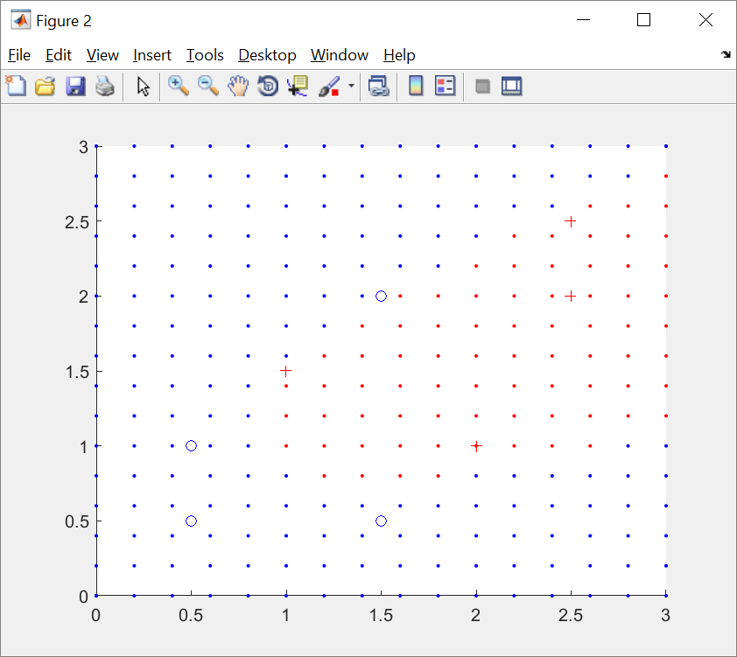
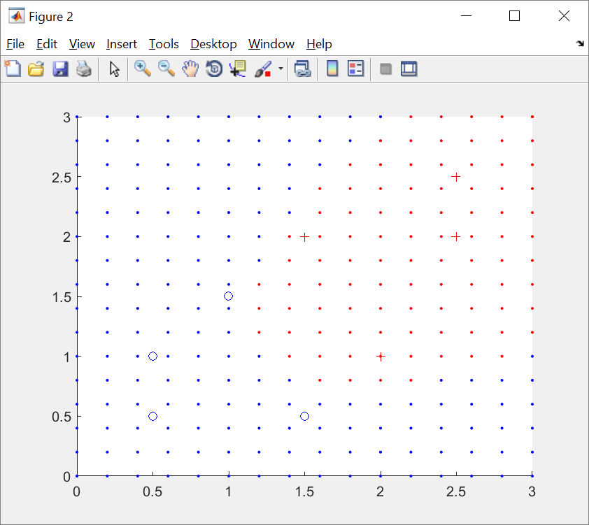
Example svm_demo3.m
%Clear %matlab code for svm
%Clear %matlab code for svm
%x=[1 2 4 5 6 ]
%y=[1 1 -1 -1 1 ]
%testing svm2.m
function svm_demo3
x=[0.5 0.5
0.5 1.0
1. 1.5
1.5 0.5
1.5 2.0
2.0 1.0
2.5 2.0
2.5 2.5];
y =[-1 -1 1 -1 -1 1 1 1]'; %test 1
%y =[-1 -1 -1 -1 1 1 1 1]'; %test2
H=0
for j=1:length(x)
for i=1:length(y)
H(i,j)=y(i)*y(j)* (x(i,:)*x(j,:)'+1)^2
end
end
H
f=[-1 -1 -1 -1 -1 -1 -1 -1]'
A=y
b=0
'vub=[100 100 100 100 100]'
x0=[0 0 0 0 0]'%init values
%[alpha,fval,exitflag,output,lambda] =...
% quadprog(H, f, A, b, A(1, :), b(1), vlb, vub, x0);
%quadprog(H,f,A,b,A,b,vlb,vub,x0)
a=quadprog(H,f)
figure(2)
clf
hold on
for i=1:length(x)
if y(i)==1
plot(x(i,1),x(i,2),'r+')
else
plot(x(i,1),x(i,2),'bo')
end
end
plot(0,0,'.')
plot(3,3,'.')
input=[2,2]
f=0;
%%%%%%%%%%% claasifier
%for j=1:length(x)
for i=1:length(y)
f=f+a(i)*y(i)*(x(i,:)*input'+1)^2 ;
end
%end
%%%%%%%%%%%%testing
for xx=0:0.2:3
for yy=0:0.2:3
input=[xx,yy]
f=0;
%%%%%%%%%%% classifier
%for j=1:length(x)
for i=1:length(y)
f=f+a(i)*y(i)*(x(i,:)*input'+1)^2 ;
end
if f>0
plot(xx,yy,'r.')
else
plot(xx,yy,'b.')
end
end
end
Result:
demo3
Linearly
Non-separable
Result:
demo3
Linearly
separable

Slide 60
Appendix

Slide 61
Dual
The Lagrangian Dual Problem: instead of minimizing over w, b,
subject to constraints involving a’s, we can maximize over a (the
dual variable) subject to the relations obtained previously for w and b
http://web.mit.edu/6.034/wwwbob/svm-notes-long-08.pdf
https://en.wikipedia.org/wiki/Duality_(optimization)
https://en.wikipedia.org/wiki/Lagrange_multiplier
https://en.wikipedia.org/wiki/Quadratic_programming

Slide 62

Demos
https://www.youtube.com/watch?v=3liCbRZPrZA

Slide 63
Matrix form

Slide 64
Example

Slide 65
Supporting vectors First find all a_{i}, and sort out those non-zero a_{i} Non zero a_{i} , are supporting vectors, Then use (ii) to find w

Slide 66
Supporting vectors using kernel function First find all a_{i}, and sort out those non-zero a_{i} Non zero a_{i} , are supporting vectors, Then use (ii) to find w

Slide 68
ANSWER2: Lagrangian dual problem: find a_{i} first , then find w and b (one page)
https://en.wikipedia.org/wiki/Quadratic_programming

Slide 69
Summary

Slide 70
Non-linear Kernel

Slide 73
Math background: quadratic programming
To minimize a second order function based on some constraints

Slide 74
Quadratic programming

Slide 75
Reference: use of matlab: quadprog
quadprog(H,f,A,b,Aeq,beq)

Slide 76
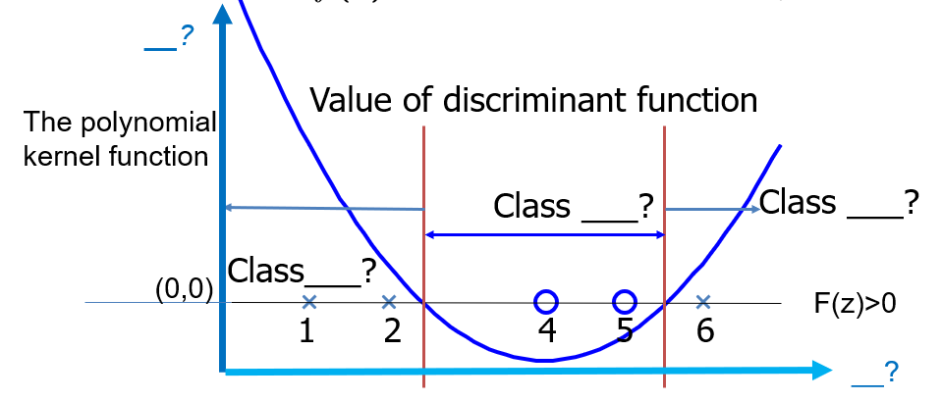
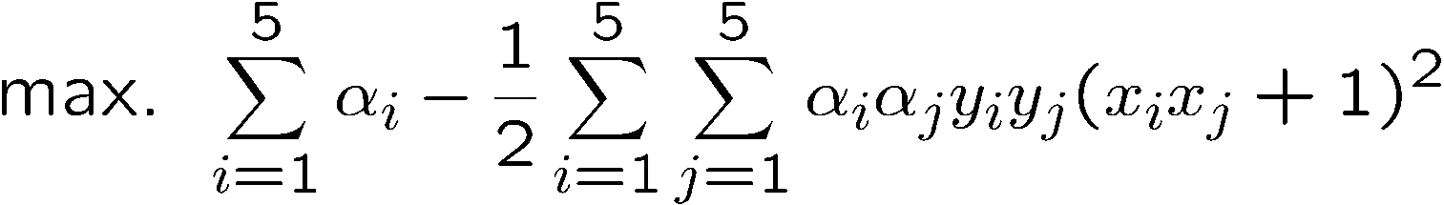

1-D Example for non-linear problems
http://www.cse.ust.hk/~qyang/521/PPT/SVM.ppt
Suppose we have 5 one-dimensional data points
x₁=1, x₂=2, x₃=4, x₄=5, x₅=6, with 1, 2, 6 as class 1 and 4, 5 as class 2 ⇒ y₁=1, y₂=1, y₃=-1, y₄=-1, y₅=1
We use the polynomial kernel of degree 2
K(x,y) = (xy+1)²
C is set to 100
We first find α_{i} (i=1, …, 5) by
Notes:
H =
4 9 -25 -36 49
9 25 -81 -121 169
-25 -81 289 441 -625
-36 -121 441 676 -961
49 169 -625 -961 1369

Slide 77



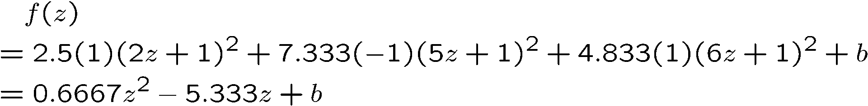


EXERCISE 7: 1-D Example, fill in
By using a QP solver, we get
α₁=0, α₂=2.5, α₃=0, α₄=7.333, α₅=4.833
Note that the constraints are indeed satisfied
The support vectors are {x₂=2, x₄=5, x₅=6}
y₁=1, y₂=1, y₃=-1, y₄=-1, y₅=1
The discriminant function is as follows, solve for z
b is recovered by solving f(2)=1 or by f(5)=-1 or by f(6)=1, as x₂ and x₅ lie on the line and x₄ lies on the line
All three give b=9
>0
Notes:
The optimization toolbox of matlab contains a quadratic programming solver

Slide 78
ANSWER 7: 1-D Example
By using a QP solver, we get
α₁=0, α₂=2.5, α₃=0, α₄=7.333, α₅=4.833
Note that the constraints are indeed satisfied
The support vectors are {x₂=2, x₄=5, x₅=6}
y₁=1, y₂=1, y₃=-1, y₄=-1, y₅=1
The discriminant function is as follows, solve for z
b is recovered by solving f(2)=1 or by f(5)=-1 or by f(6)=1, as x₂ and x₅ lie on the line and x₄ lies on the line
All three give b=9
>0
Notes:
The optimization toolbox of matlab contains a quadratic programming solver

Slide 79
Show b=9
f(z)=0.6667z^2-5.333z+b
Matlab code test
>> z=2; fz=1;
b1=fz-0.6667*z^2+5.333*z
z=5; fz=-1;
b2=fz-0.6667*z^2+5.333*z
z=6; fz=1;
b3=fz-0.6667*z^2+5.333*z
b=(b1+b2+b3)/3
b1 = 8.9992
b2 = 8.9975
b3 = 8.9968
b = 8.9978

Slide 80
Exercise 8, Name the coordinate systems and fill in ___?
Example: the original data is 1-D , after apply the polynomial kernel function SVM, the problem becomes 2D
>0
__?
Value of discriminant function
The polynomial kernel function
Class ___?
Class ___?
Class___?
(0,0)
F(z)>0
1
2
4
5
6
__?

Slide 81
ANSWER 8: Name the coordinate systems and fill in ___?
Example: the original data is 1-D , after apply the polynomial kernel function SVM, the problem becomes 2D, F(z) >0 can form the decision line.
>0
f(z)
Value of discriminant function
The polynomial kernel function
Class 2
Class 1
class 1
(0,0)
F(z)>0
1
2
4
5
6
z

