Slide 1
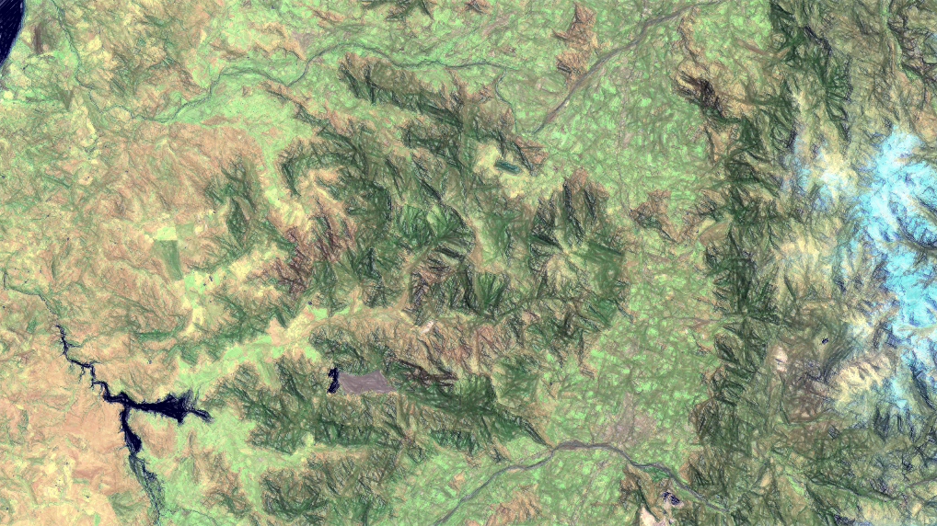


Ch.1 Spectral Resilience dynamics: Responses of Sclerophyllous and Nothofagus Forest to droughts and fires in Central Chile.
José A. Lastra (GRS)
Funded by: ANID BECAS/DOCTORADO EN EL EXTRANJERO 2023/72230136
June 2024

Slide 2
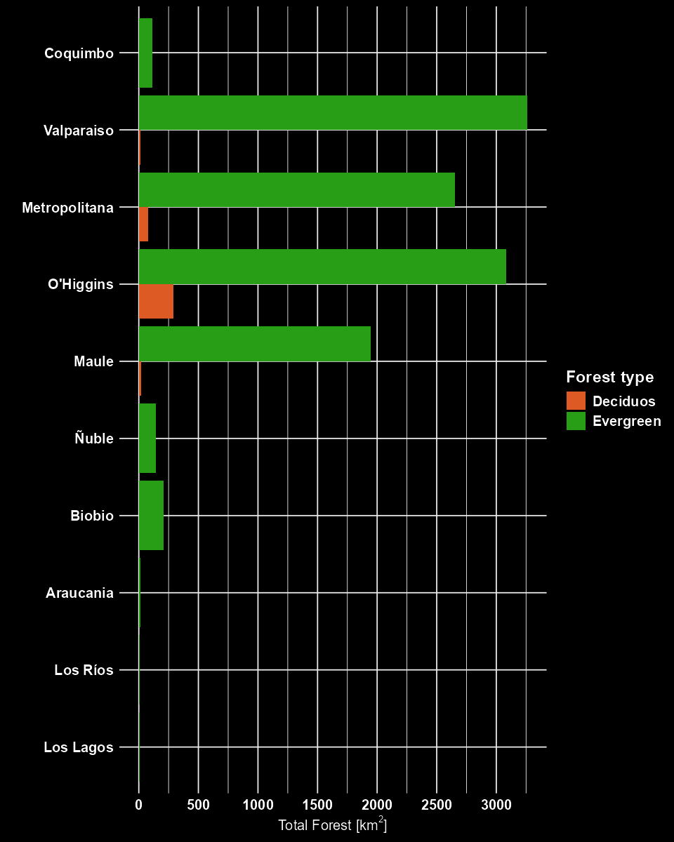
Study area
Sclerophyllous and Nothofagus macrocarpa forest
Cadaster and Evaluation of Native Vegetative Resources of Chile (2013 - 2019)
Forest distribution identification
Native vegetation resources cadaster (National Forestry Corporation, CONAF)
Area filtering criteria
Forest type
Standardization and normalization of data
Merge regions
Cover
Dominant species
Database homologation
Summary Statistics
Minimum area
3px (2700 m²)

Slide 3
Study area
Sclerophyllous and Nothofagus macrocarpa forest
Forest distribution identification
Native vegetation resources cadaster (National Forestry Corporation, CONAF)
Land Cover Chilean Map (Zhao et al., 2016)
Area filtering criteria
Forest type
Standardization and normalization of data
Merge regions
Cover
Dominant species
Database homologation
Summary Statistics
Minimum area
Cadastre and Evaluation of Native Vegetative Resources of Chile:
Coquimbo 2014
Valparaiso 2019 (v2)
Metropolitana 2019 (updated)
O’Higgins 2013
Maule 2016
Biobio 2015
Araucania 2017 (updated)
Los rios 2017 (updated)
Los lagos 2018 (updated)
Ñuble 2015
National Forestry Corporation

Slide 4

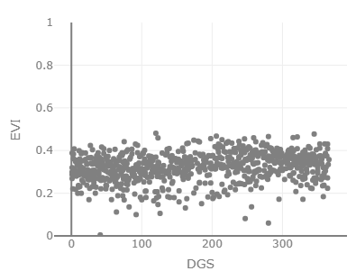
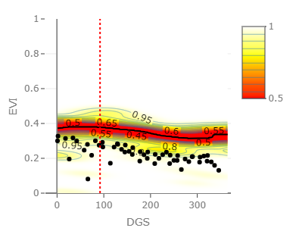
Spectral Resilience
Anomaly detection
KDE estimation
Resilience metrics
Recovery rates
Validation
Fire scars database (Brull, 2018)
Time under perturbation
Intensity
Landscape Fire Scars Database (Miranda et al., 2022)
CR2Met database V2.5 (Boisier, 2023)
Reference period
Sep 30th , 2019
Anomaly detection period
VI
VI
RFD

