Slide 1
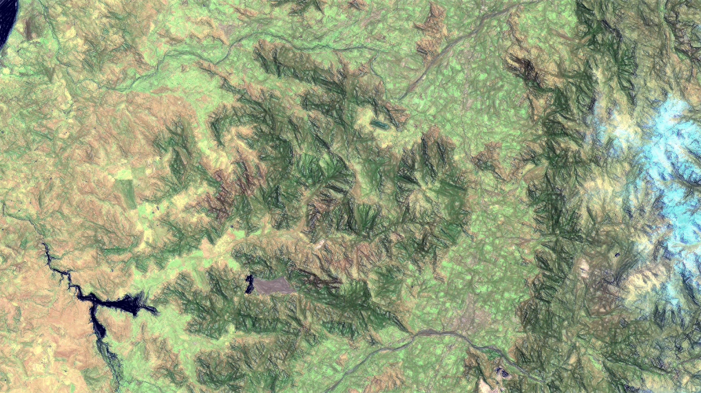


Ch.1: Disturbance analysis for Central-South Chile
José A. Lastra (GRS)
Funded by: ANID BECAS/DOCTORADO EN EL EXTRANJERO 2023/72230136
June 2024

Slide 2
