Slide 1

Exploratory Data Analysis
G2M insight for Cab Investment firm
20-Jun-2022

Slide 2
General description – G2M insight for cab investment firm
XYZ is a private firm in US. Due to remarkable growth in the Cab Industry in last few years, it is planning for an investment in Cab industry, they want to understand the market before taking a final decision.
Objective: Transform the data provided into useful information in order to identify the best company for investment.
This presentation consists of 3 main parts:
1. Data exploration
2. Profit forecasting
3. Recommendations to take the best decision.

Slide 3
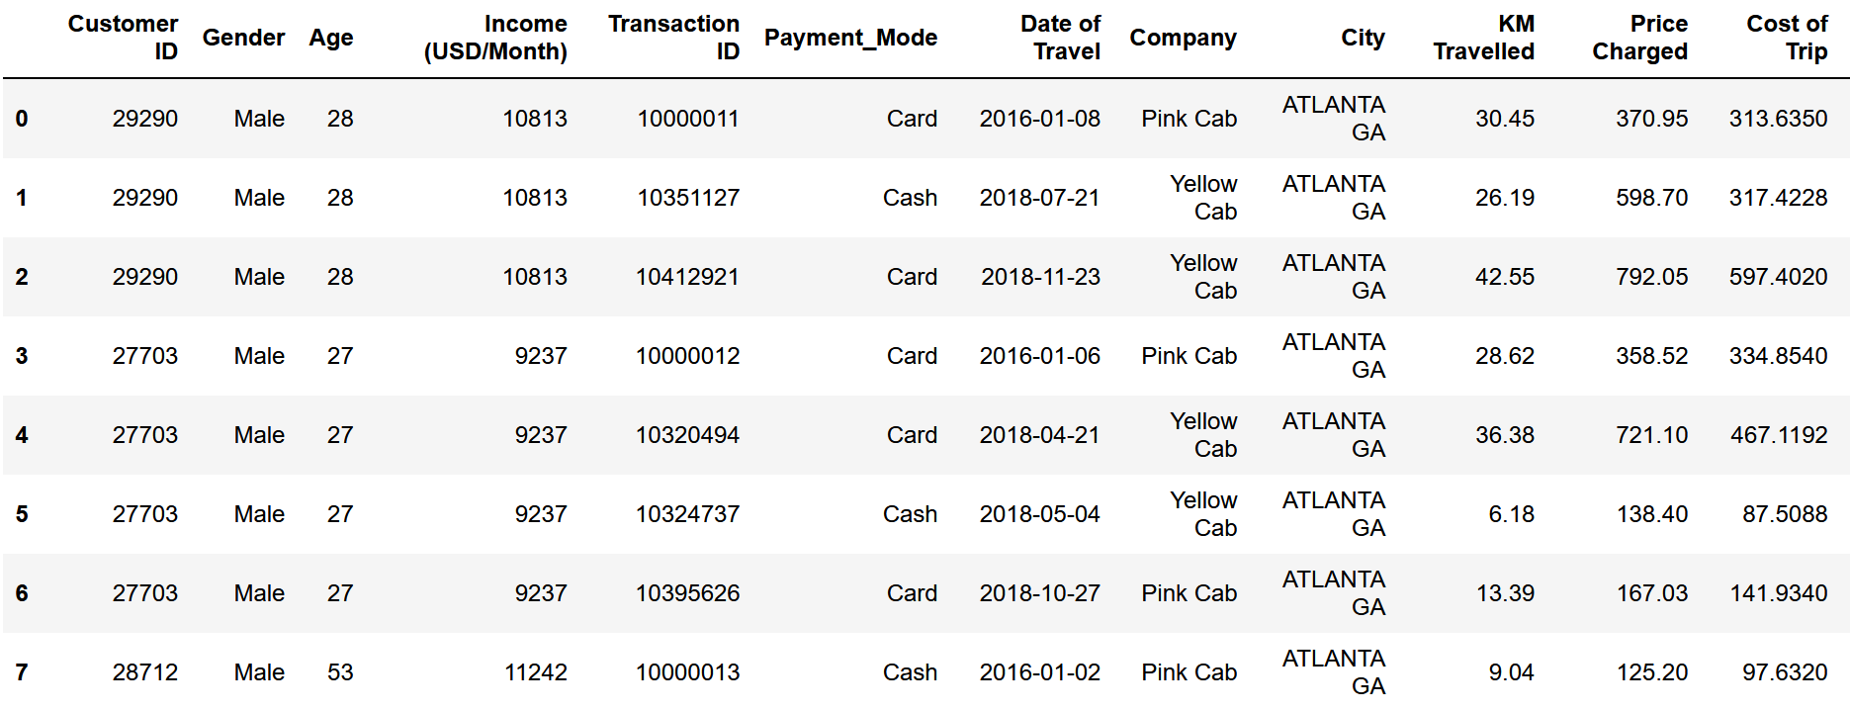
Data Exploration – G2M insight for cab investment firm
Data consists of 4 .csv files containing originally 14 features (timeframe Jan-2016 to Dec-2018), here is a sample for some relevant features:

Slide 4
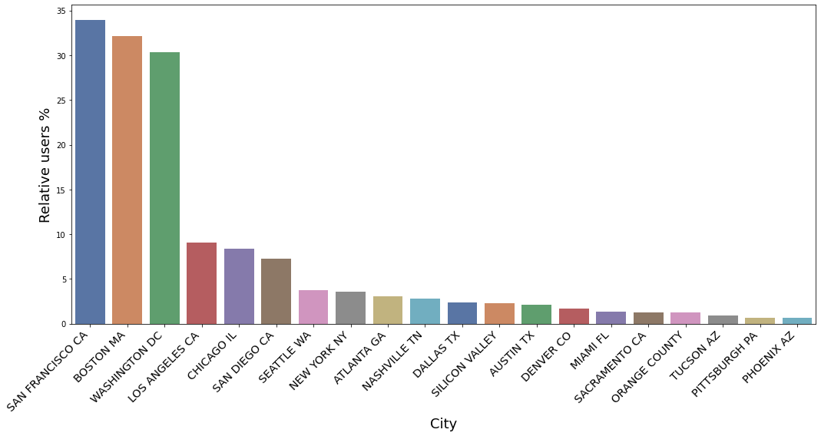
Notable cities – G2M insight for cab investment firm
Here we notice that San Francisco, Boston and Washington have the highest number of users relative to the total population of the city (more tan 30%).

Slide 5
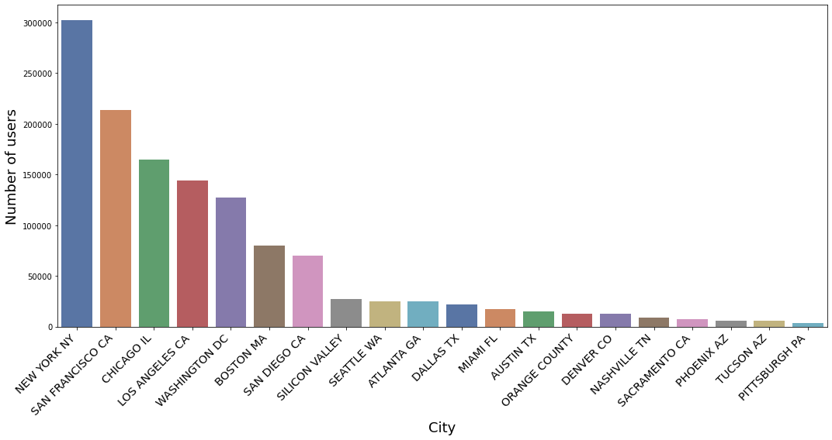
Notable cities – G2M insight for cab investment firm
In terms of total number of users New York and San Francisco have more than 200 000 users. In particular, San Francisco should be considered an important city for cab companies.

Slide 6
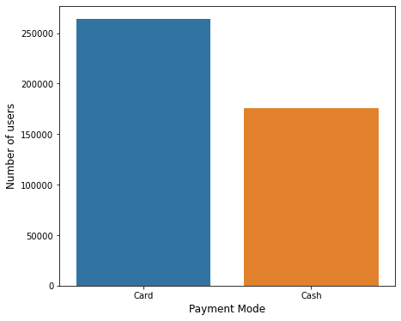
Card or cash – G2M insight for cab investment firm
In general people prefer card over cash as payment mode, we should consider companies that provide this service as a positive thing.

Slide 7
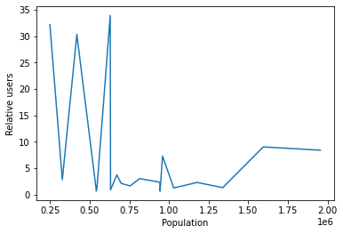
Population vs Relative users – G2M insight for cab investment firm
We see that the success cases (more relative users) happens in cities with less than 750 000 population, is there a relation between population density and the number of relative users?

Slide 8
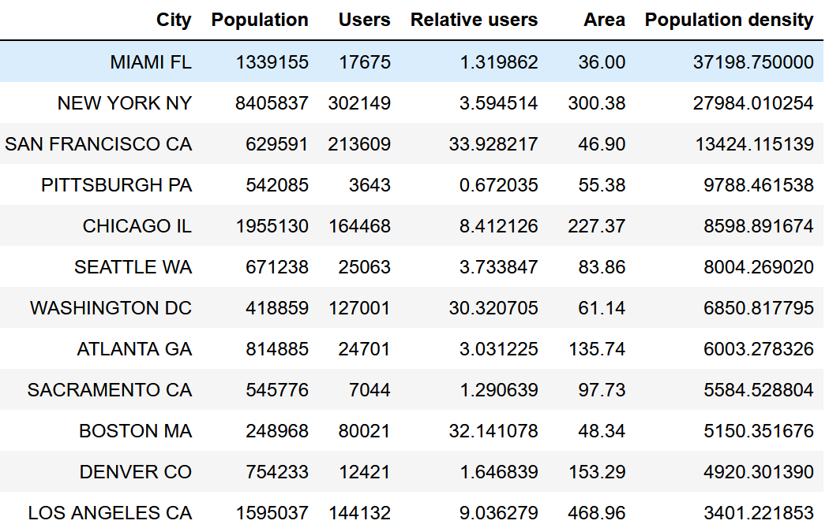
Population density – G2M insight for cab investment firm
We added the area for each city and calculated the population density, we found that New York and San Franciso are 2 of the most dense cities and also success cases!

Slide 9
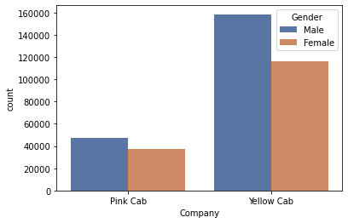
Number of users per company – G2M insight for cab investment firm
We see there is a complete dominance of the Yellow cab company in terms of number of users.

Slide 10
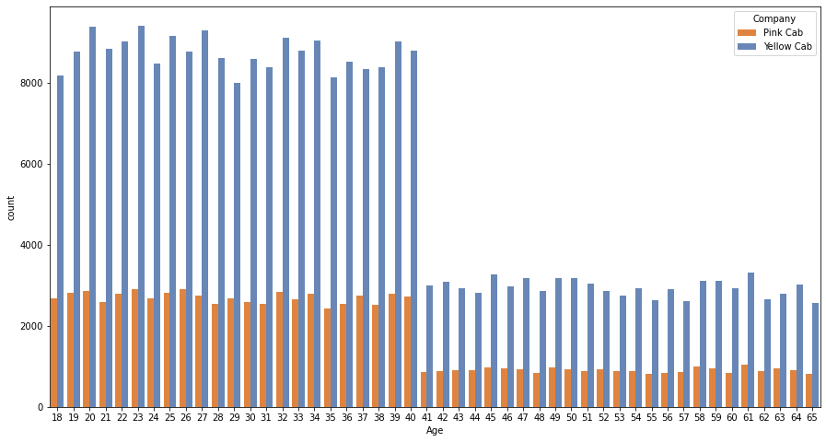
Age vs number of users – G2M insight for cab investment firm
There is a strange gap at the age 40, maybe the way data was collected caused that, but overall we see that company preference doesn’t change much with age and the proportion of users between the 2 companies is preserved.

Slide 11
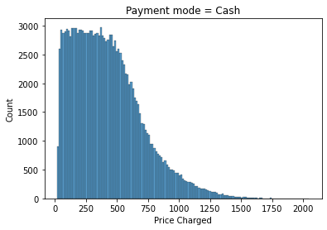
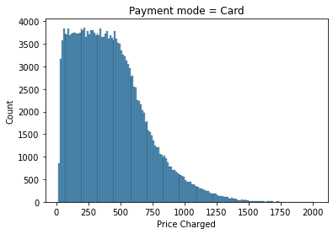
Number of users vs price charged – G2M insight for cab investment firm
Cash and Card distributions for the number of users per price charged are quite similar, we can notice that the scale for Cash distribution is bigger.

Slide 12
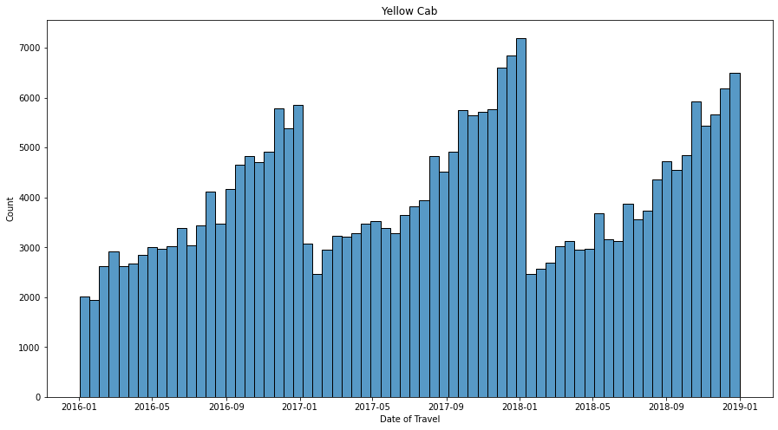
Number of users over time (Yellow cab) – G2M insight for cab investment firm
We can clearly see an annual seasonality in the number of users for the yellow cab company.

Slide 13
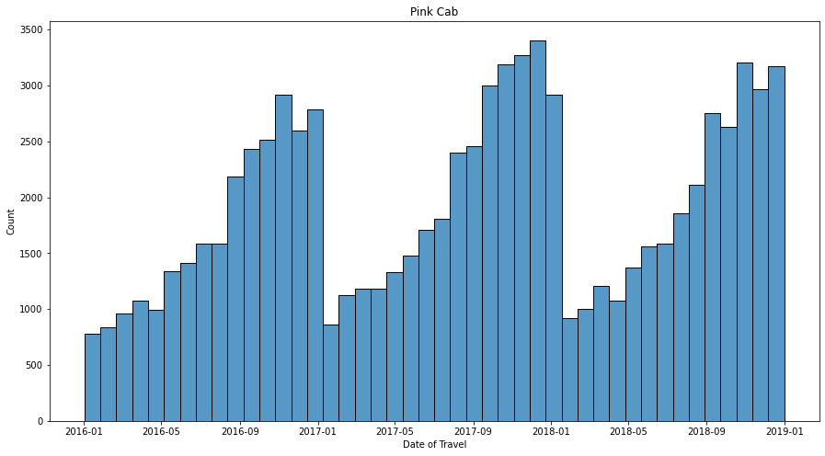
Number of users over time (Pink cab) – G2M insight for cab investment firm
The Pink cab company share the seasonality, we can also notice the scale is smaller in this case (half of the Yellow cab company).

Slide 14
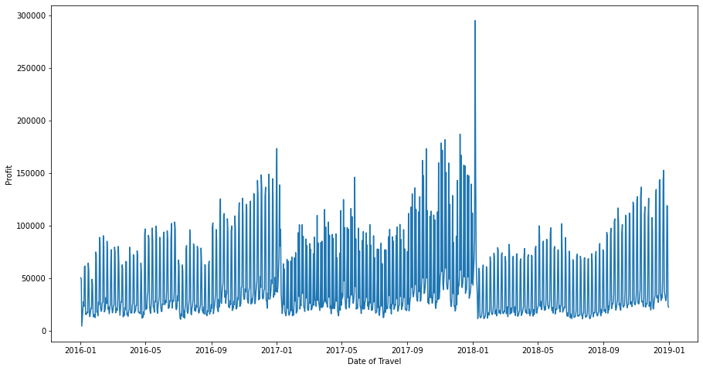
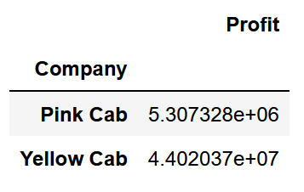
Profit – G2M insight for cab investment firm
We see there is a different kind of seasonality besides annual, can we forecast profit 1 year into the future with the help of a SARIMA model?

Slide 15
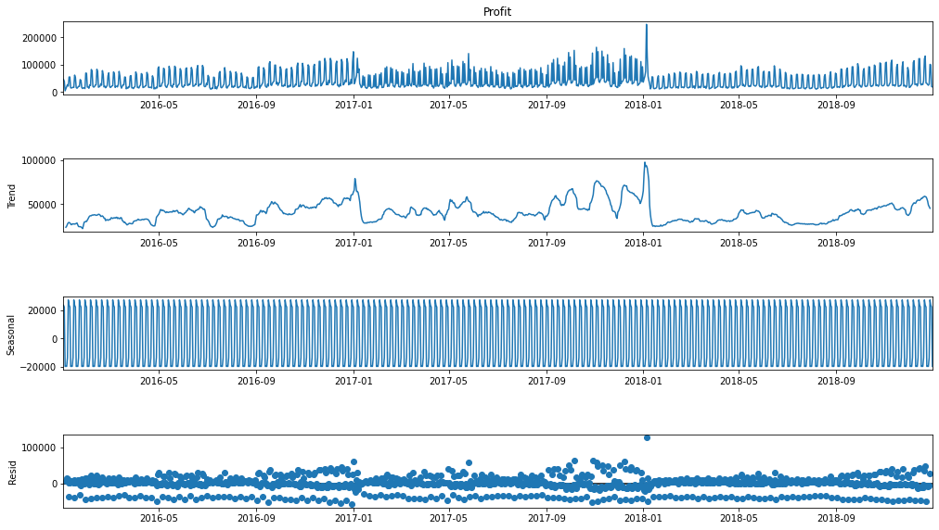
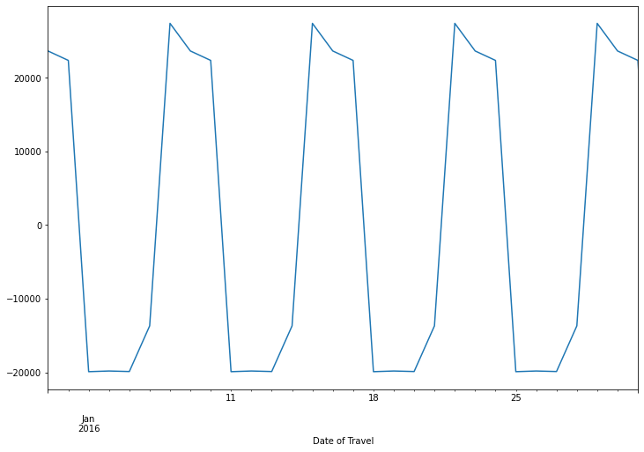
ETS for the yellow cab company profit – G2M insight for cab investment firm
Above we plotted the seasonal component, and we detected an additional weekly seasonality.

Slide 16
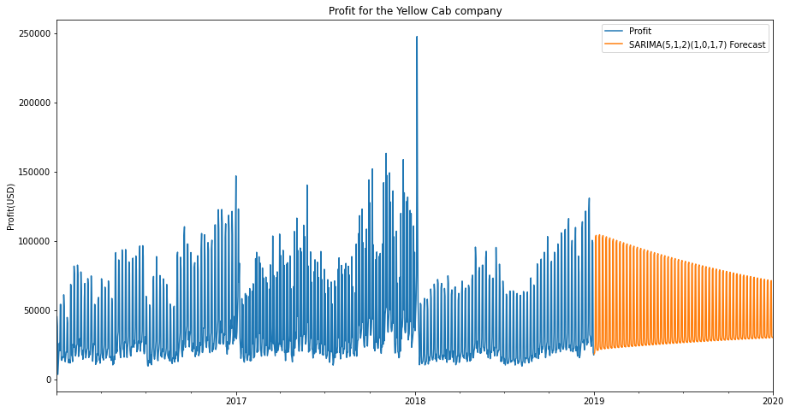
Profit forecast using SARIMA – G2M insight for cab investment firm
Our model detects the 7 days seasonality but it is completely ignoring the annual seasonality.

Slide 17
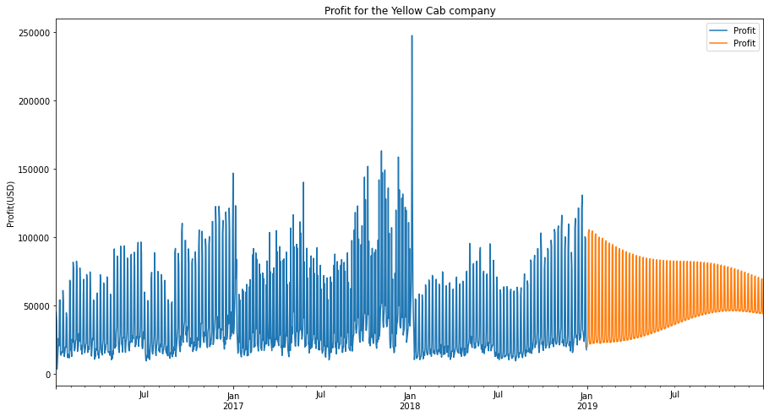
Profit forecast using SARIMA with Fourier terms – G2M insight for cab investment firm
Our model improved a little but not enought to make any prediction.

Slide 18


Revenue growth – G2M insight for cab investment firm
Despite 2018 being a bad year for both cab companies, Yellow cab revenue growth is still higher than Pink cab revenue.

Slide 19
Recommendation – G2M insight for cab investment firm
Summary :
Yellow cab company has 2 times the customer reach of the Pink cab company over the entire
year.
2. Yellow cab company has 3 times the Pink cab company preference for all ages (18-65).
3. The total profit of the Yellow cab company is 8 times the Pink cab's profit.
4. Yellow cab company dominates over cities like San Francisco and New York (top in number of users and relative users).
5. Despite both companies losing profit in 2018, Yellow cab revenue growth is still higher.
According to this information we recommend Yellow cab company for investment.

Slide 20

Thank You

