Slide 1

EDA presentation and proposed
modelling technique
Advance NLP : Hate Speech detection using Transformers
(Deep Learning)
Jose Luis Castañeda Terrones
16-Aug-2022

Slide 2
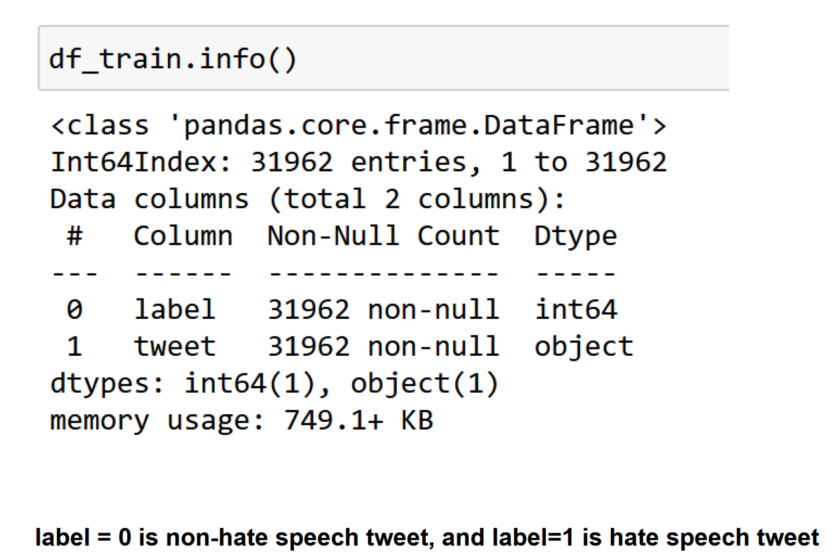
Data Description
Data consists of 31962 labeled tweets for training.

Slide 3
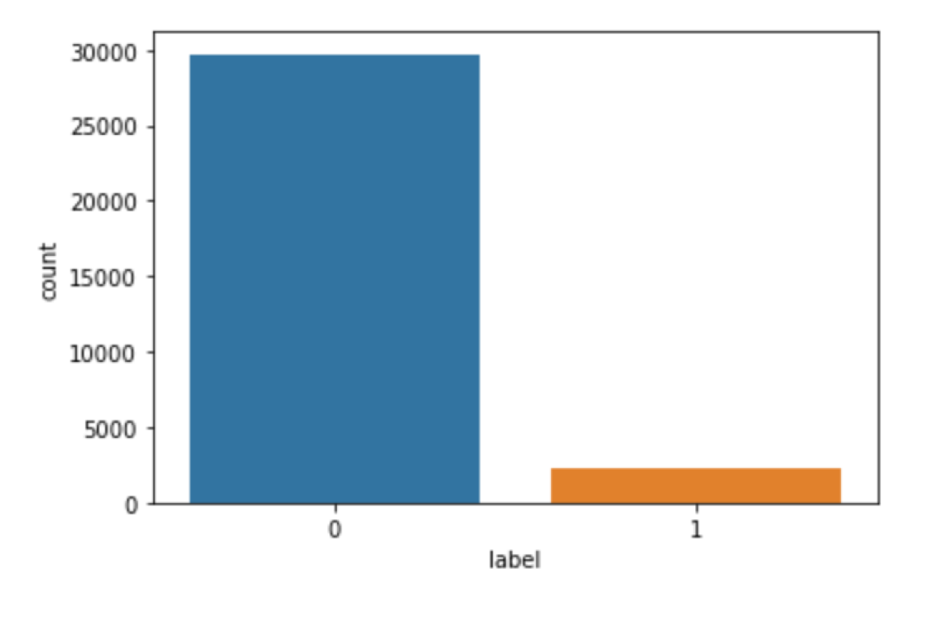
Data is imbalanced
There is more than 90% of non-hate speech tweets (label=0).

Slide 4
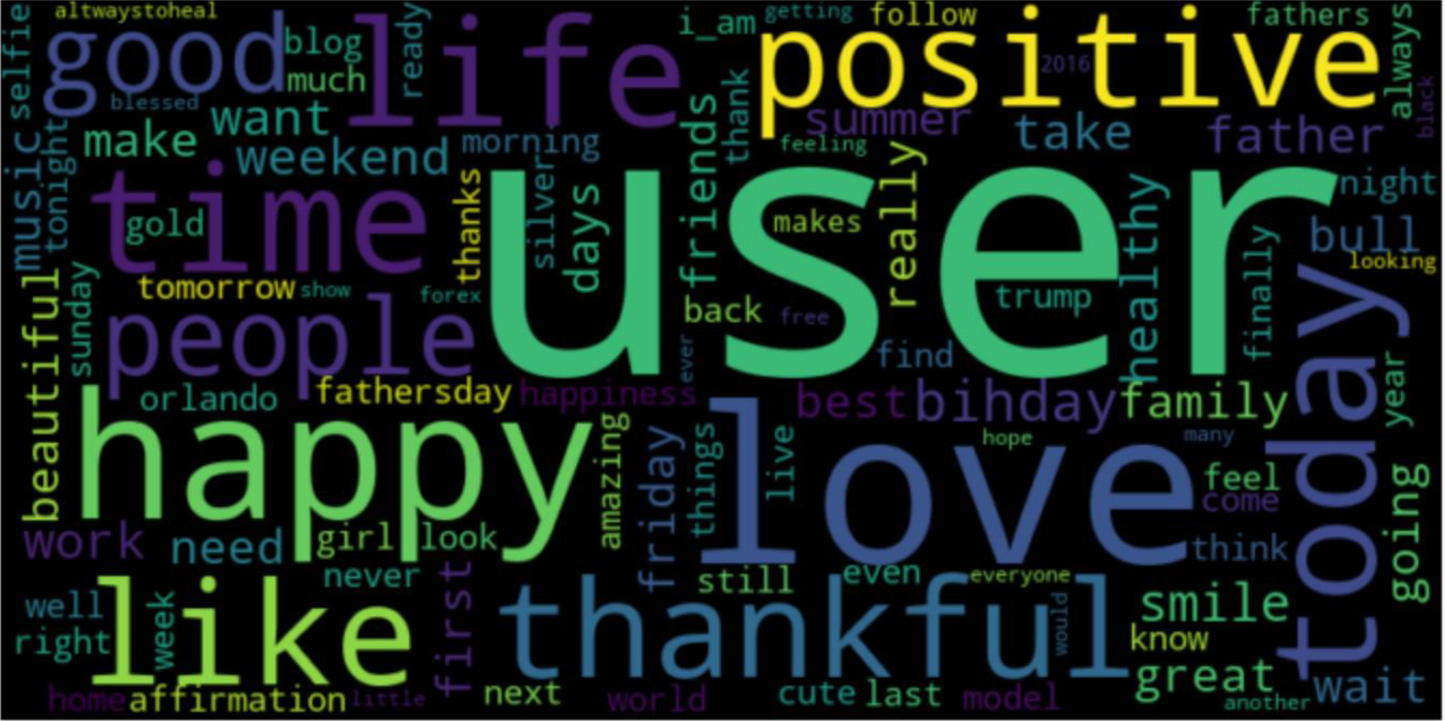
Graphical representation of the most common words

Slide 5
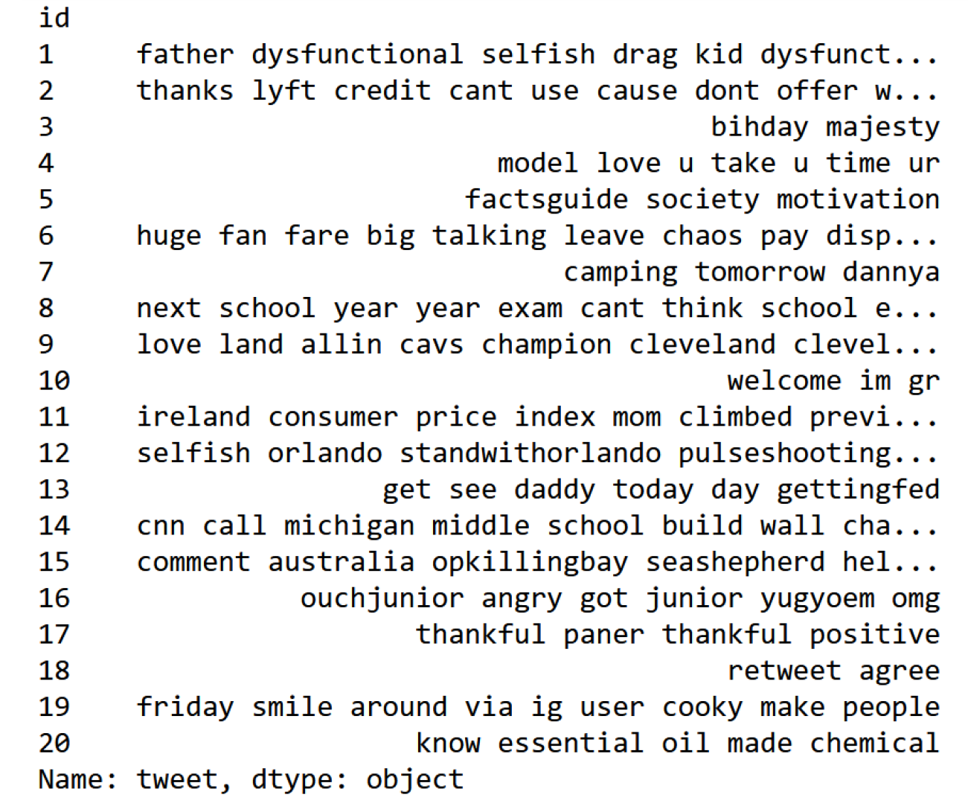
Cleaning the tweets

Slide 6
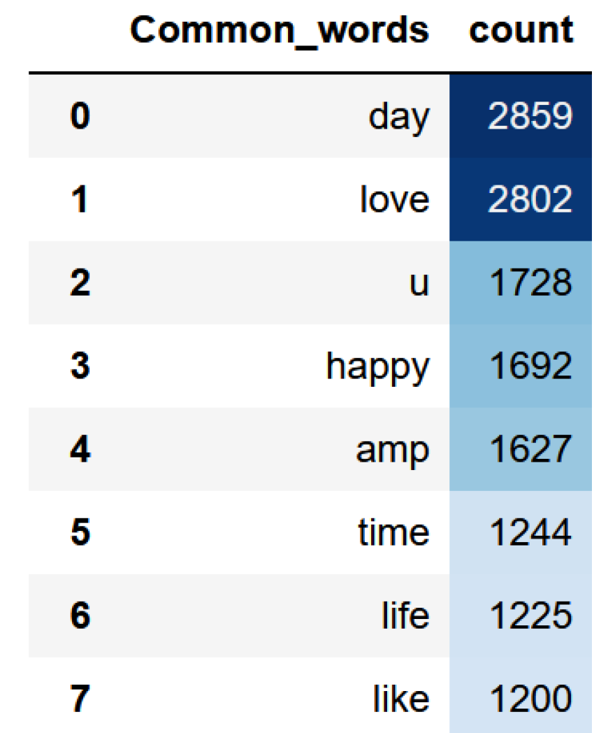
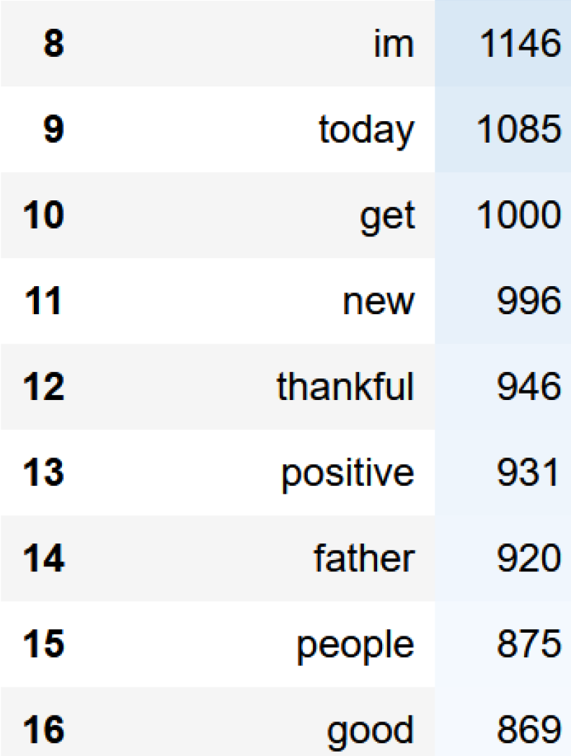
Most common words

Slide 7
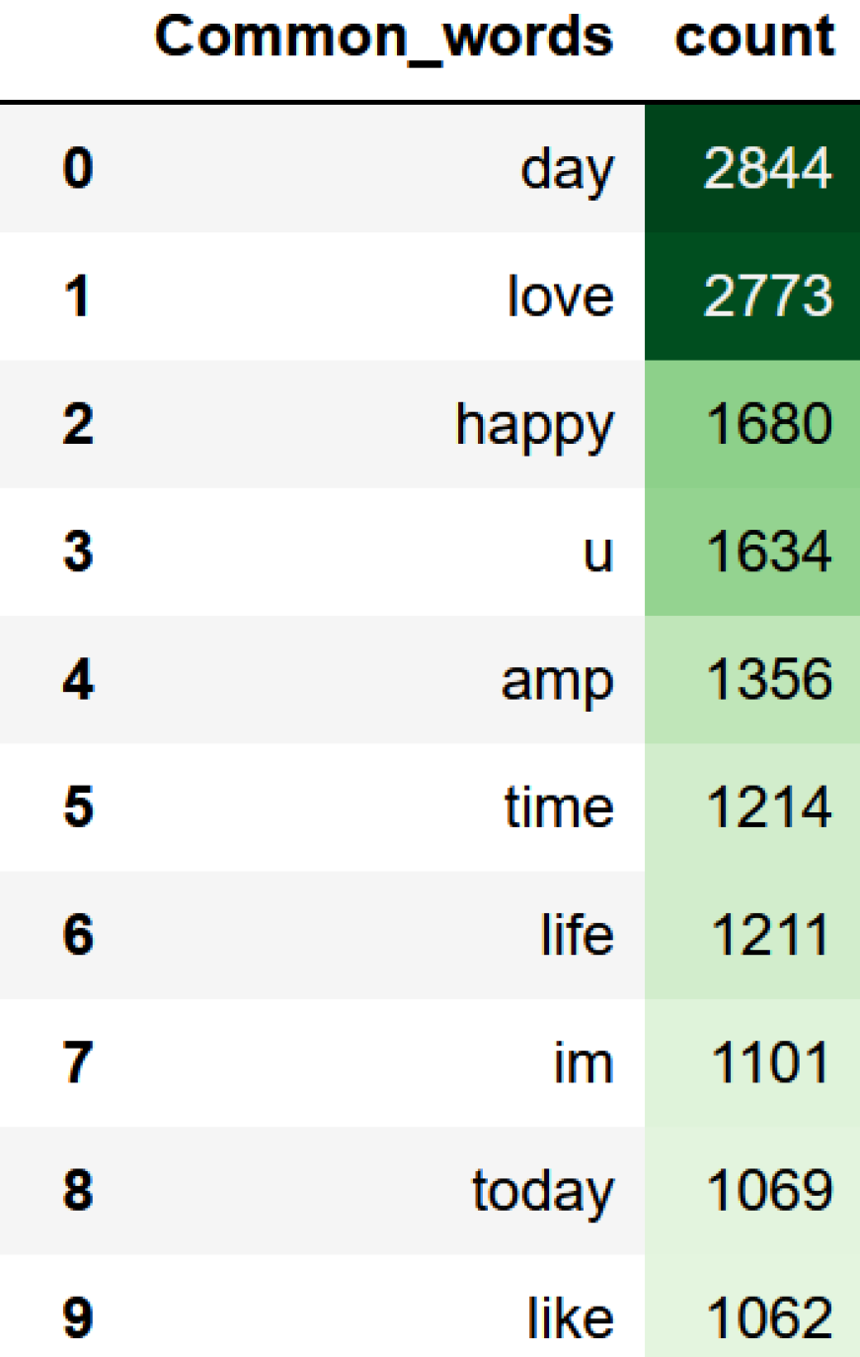
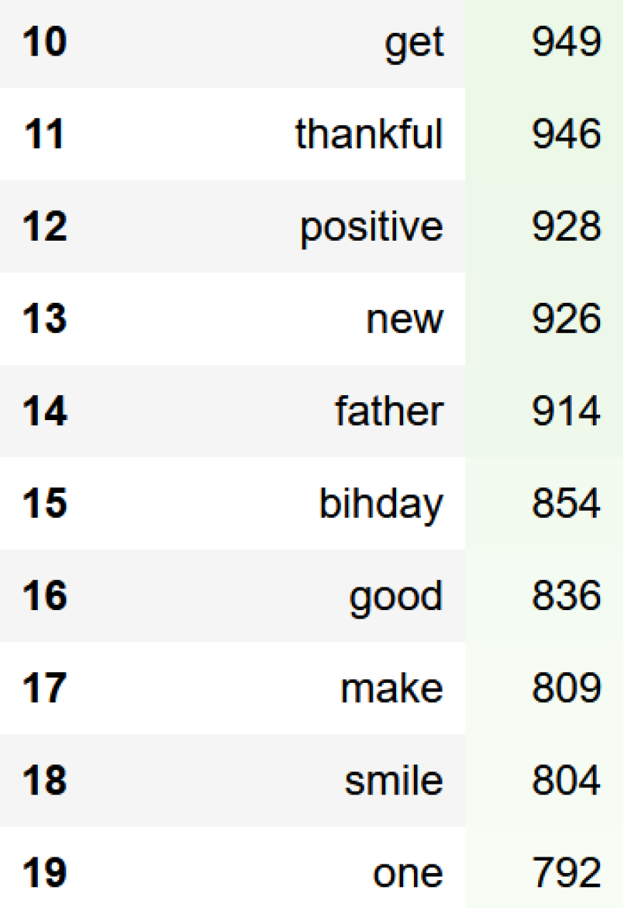
Most positive common words (non-hate speech)

Slide 8
Suggested models
Because we are working with text data, we will evaluate the performance using the following models:
Logistic regression.
2. LSTM
3. Transformers

Slide 9

Thank You

