Slide 1
Gotta Get Git: A Hands-On Git
& GitHub Tutorial
Jose P. Madriaga
Dr. Andrés Cisneros
Department of Physics, University of Texas at Dallas
October 12th, 2026

Slide 2

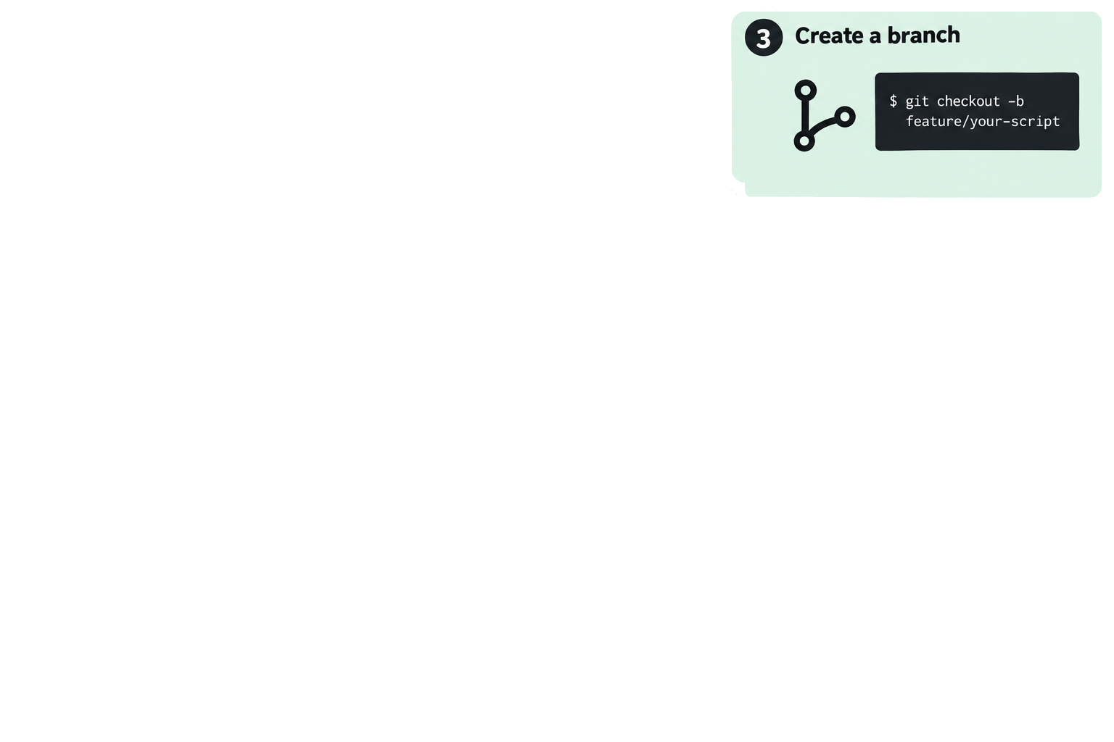
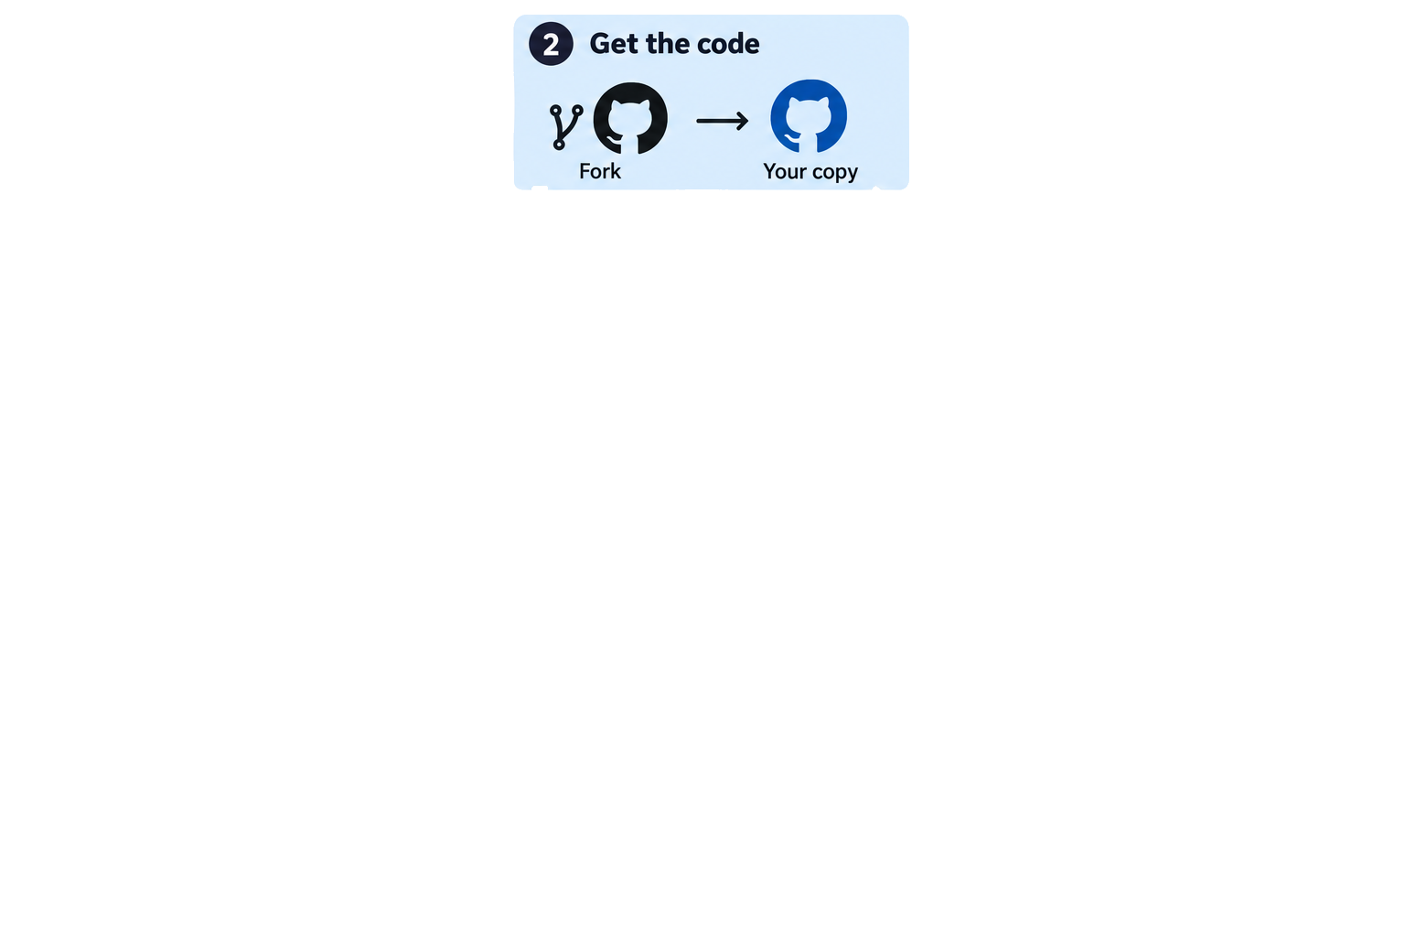
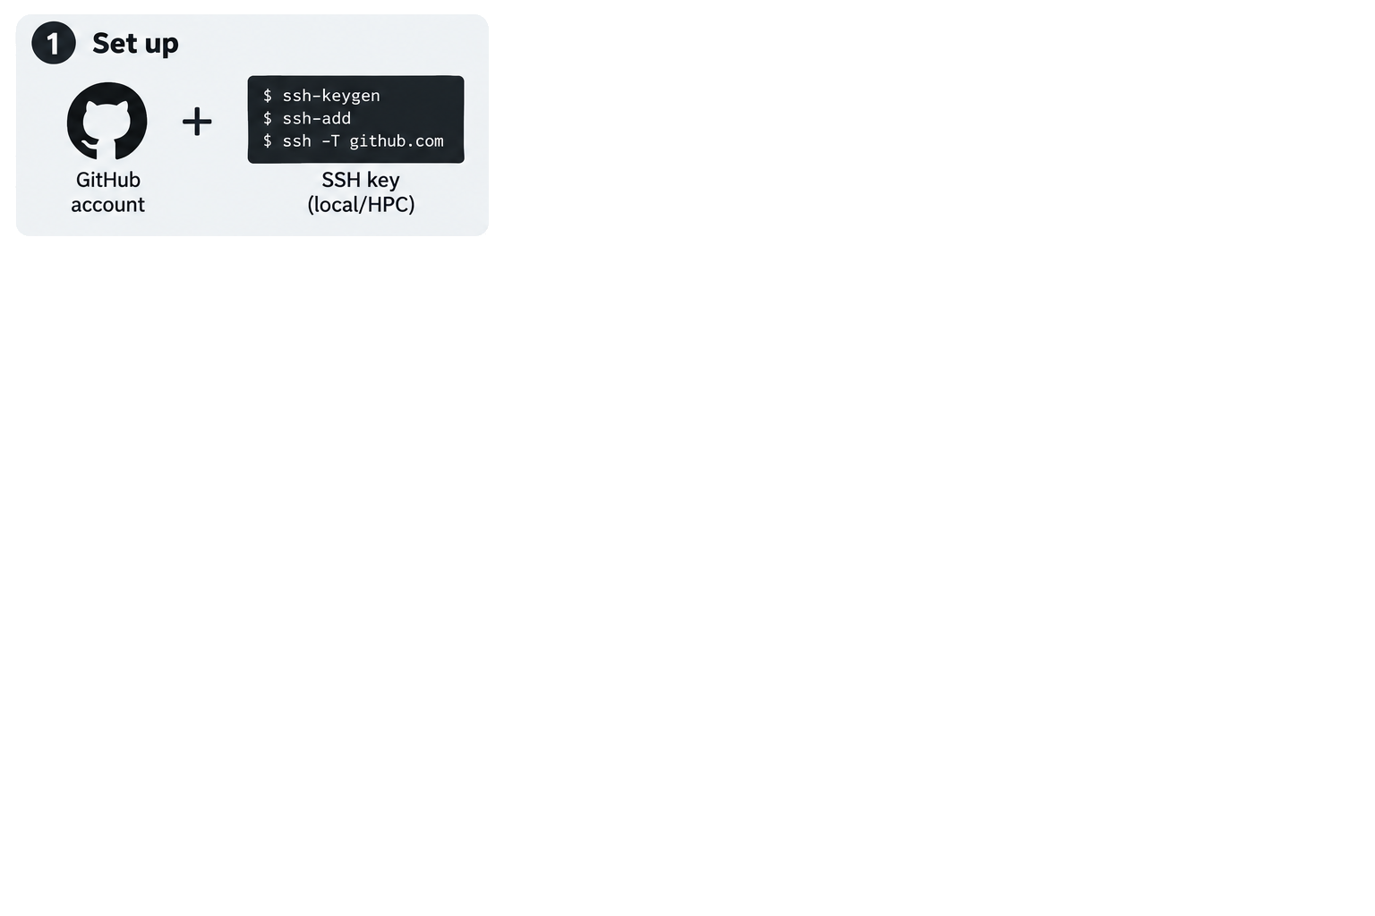
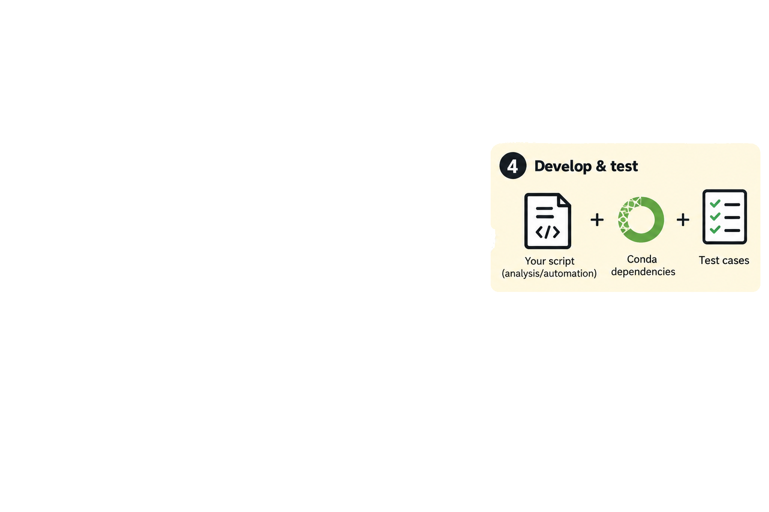


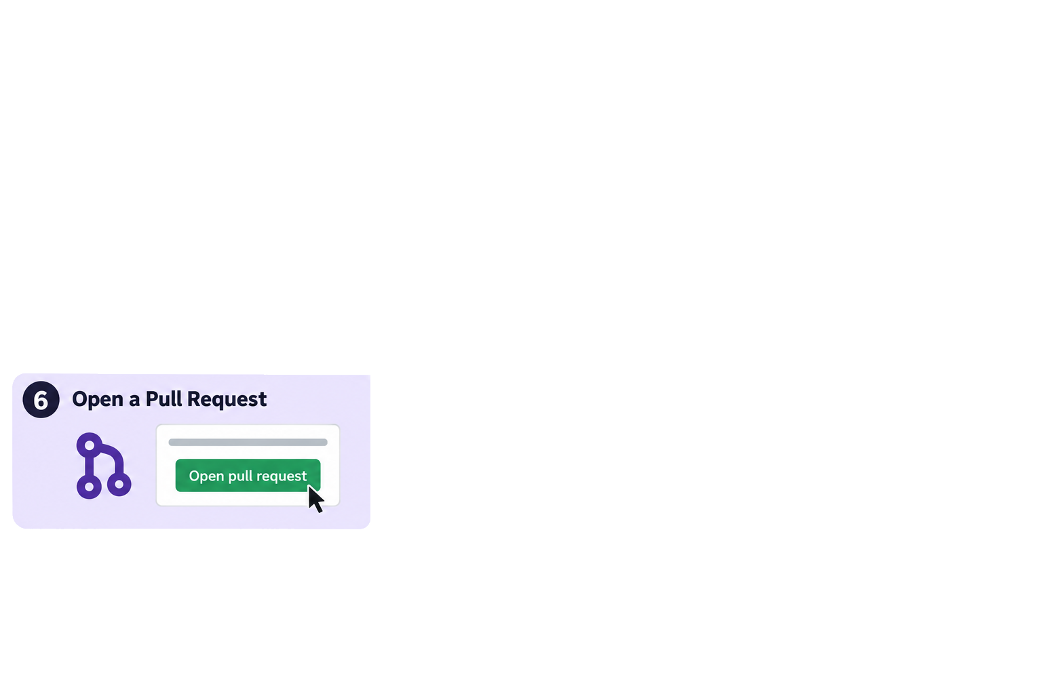
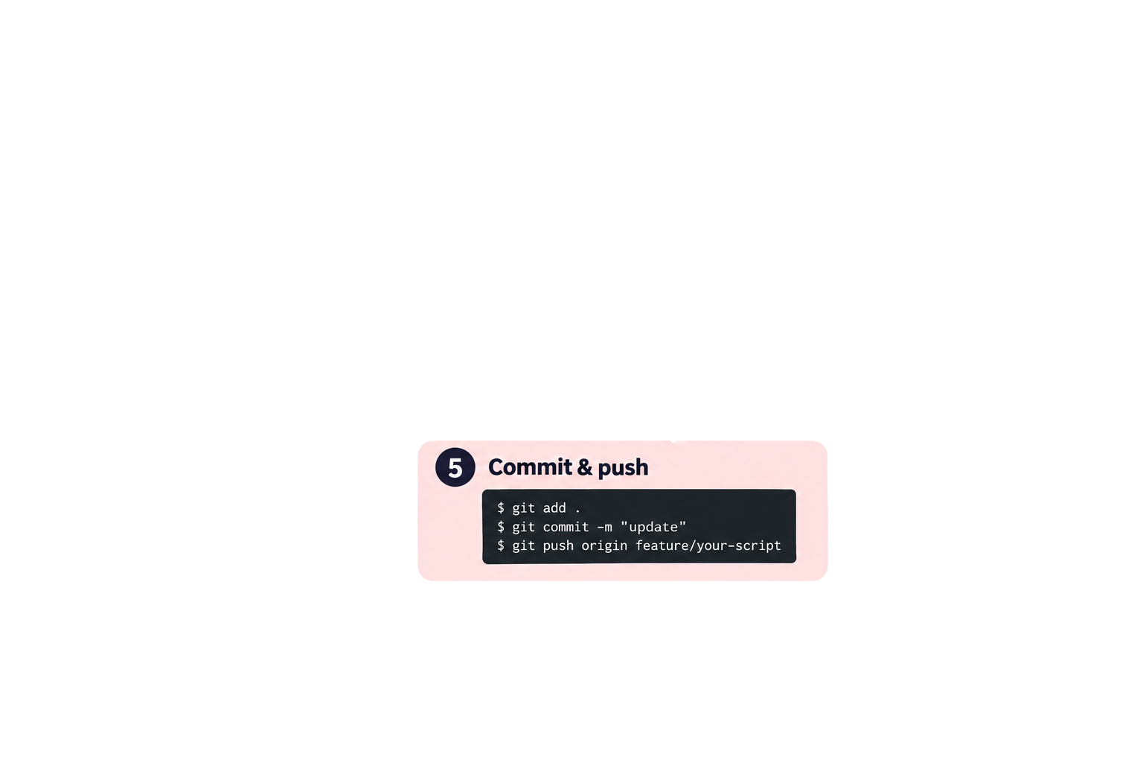
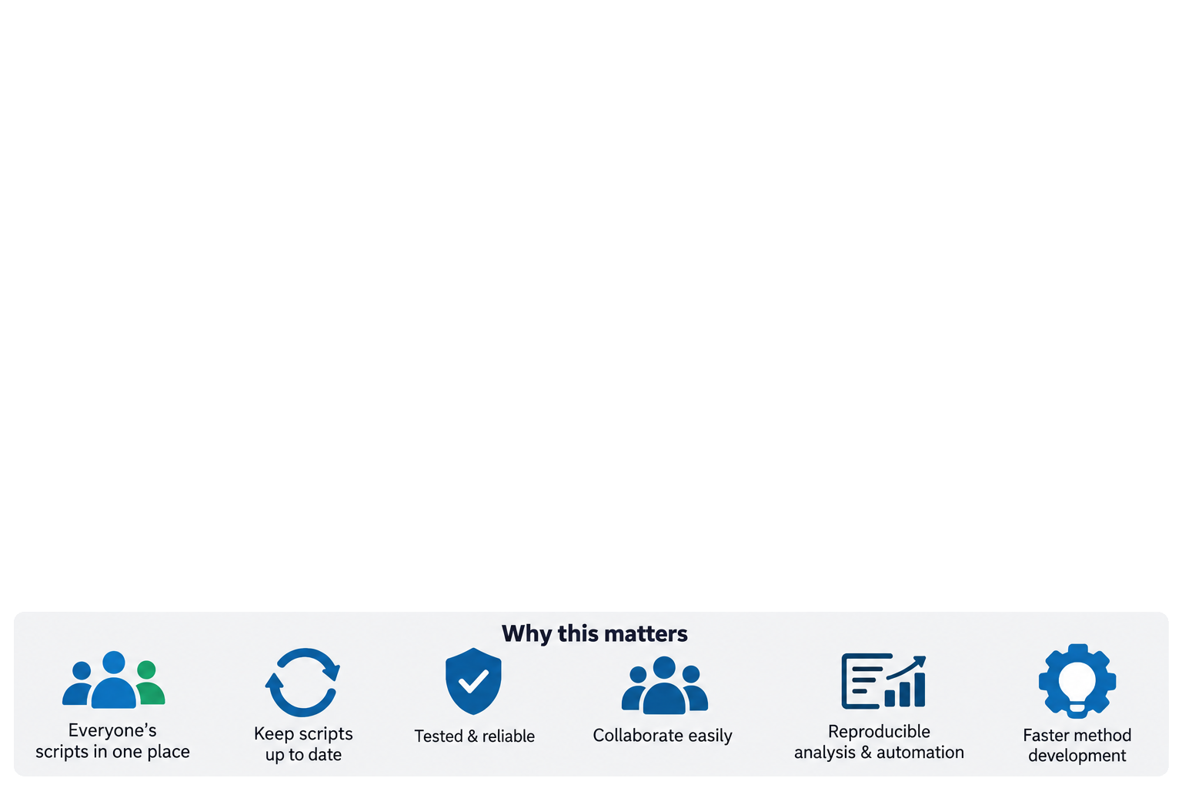

Git Workflow

Slide 3
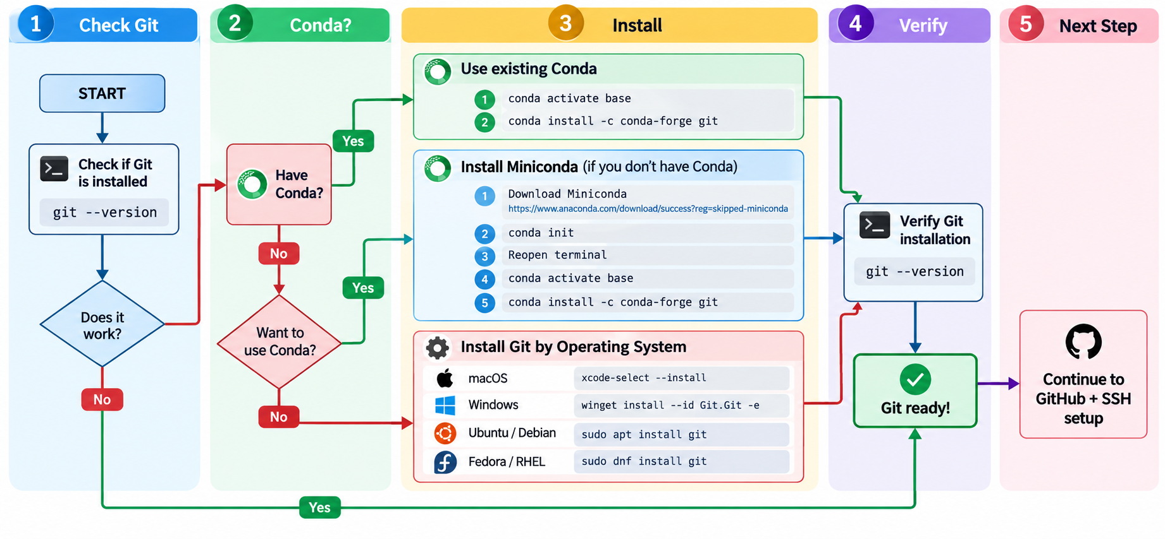
(1) Git Setup

Slide 4
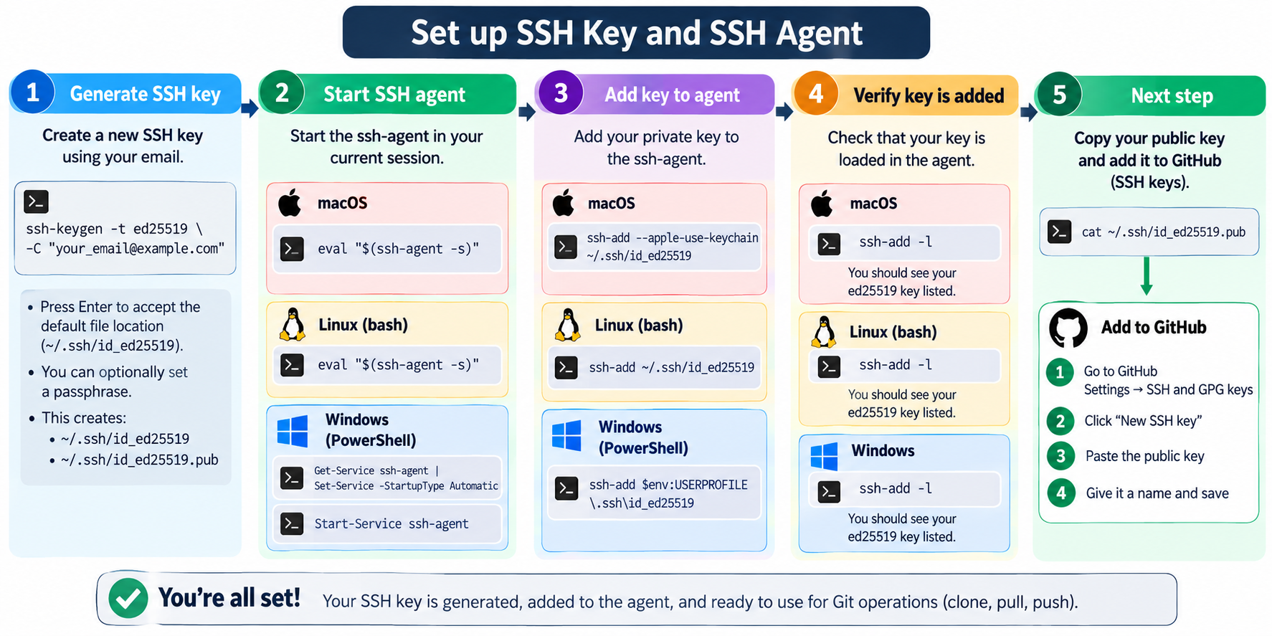
(1) SSH Key Setup

Slide 5
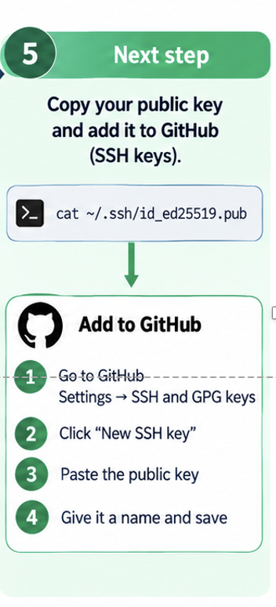
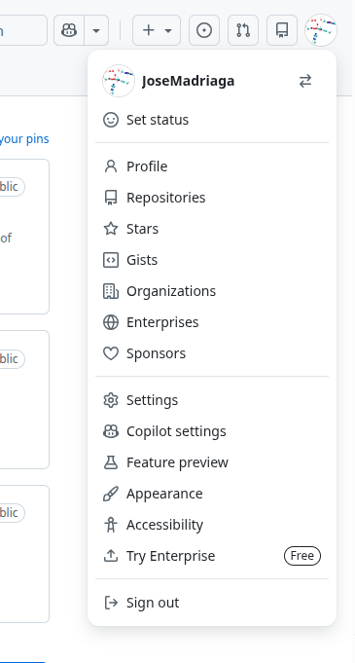
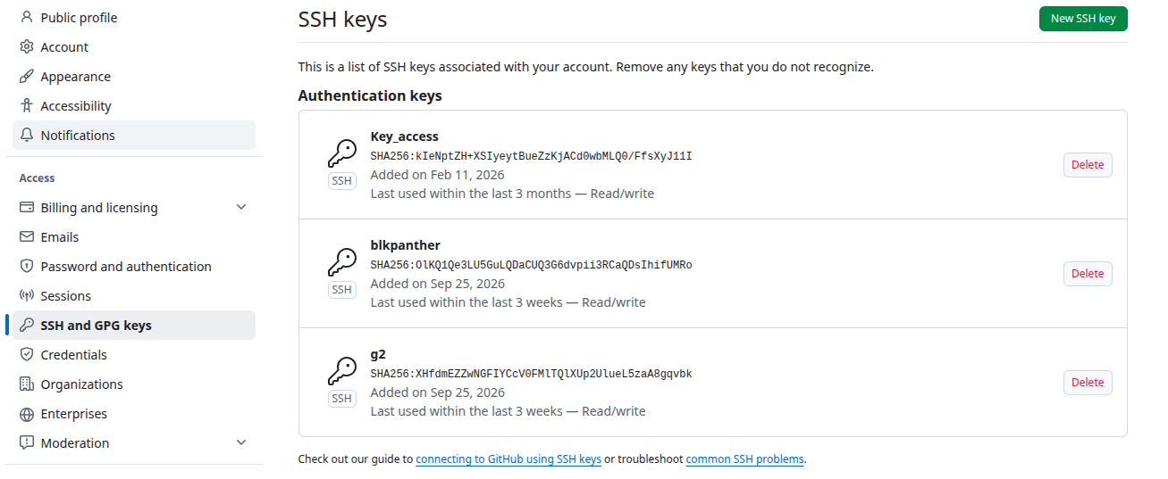
(1) SSH Key Setup
ssh -T git@github.com
Hi JoseMadriaga! You've successfully authenticated

Slide 6
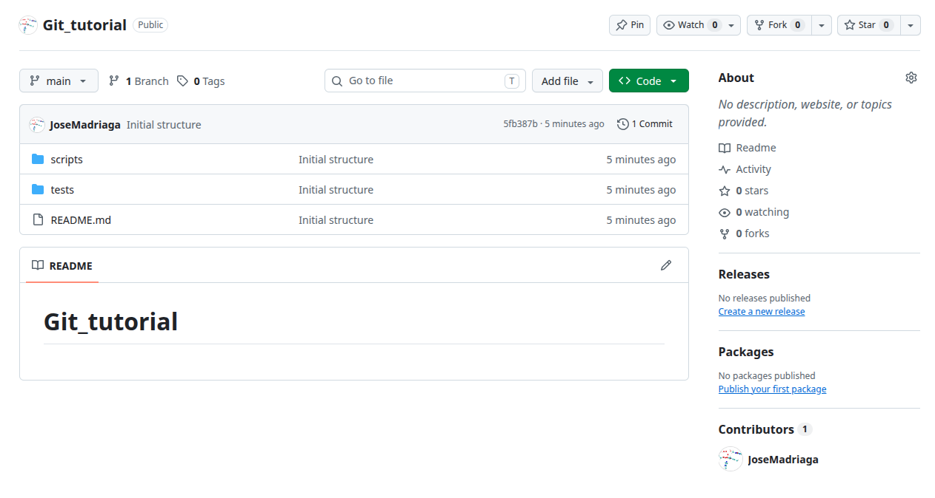
(2) Fork
https://github.com/JoseMadriaga/Git_tutorial.git

Slide 7
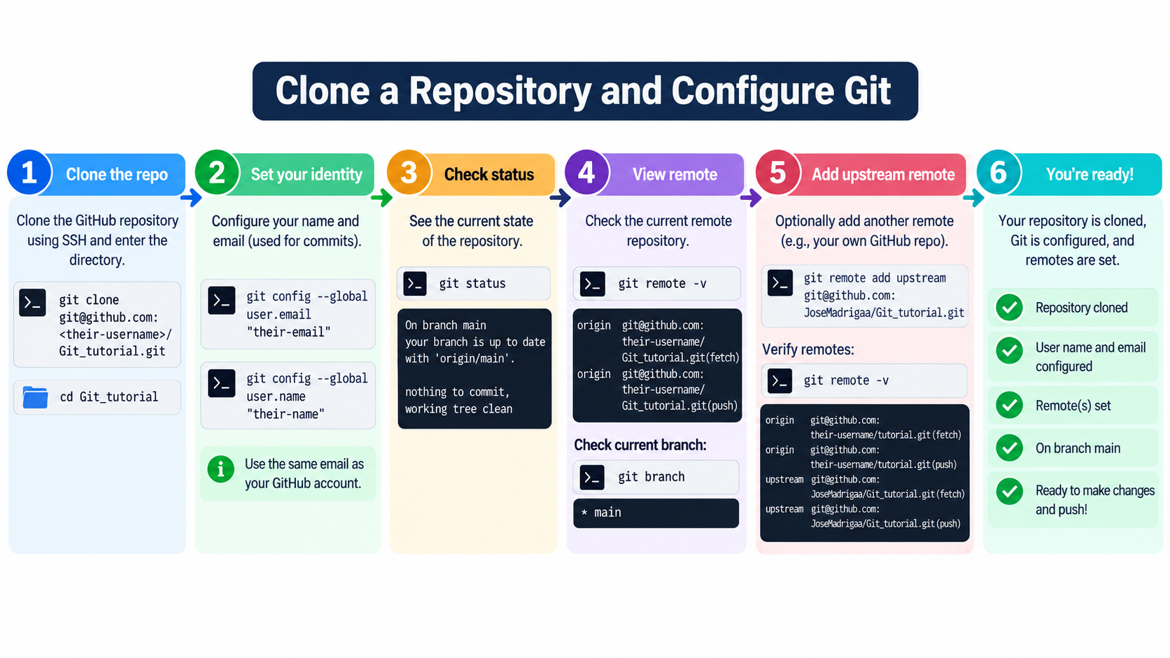
(3) Configure Git and Clone Repository

Slide 8
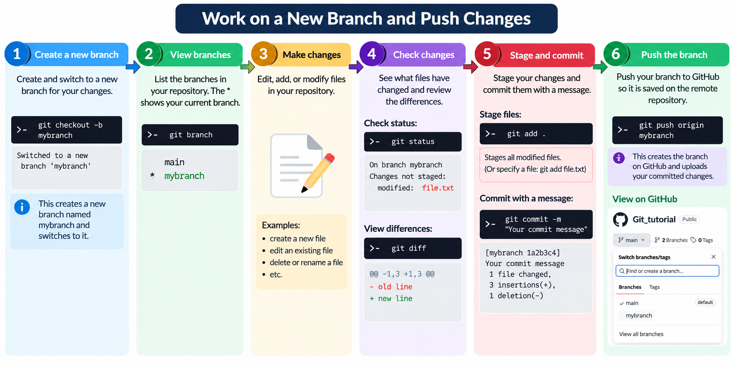
(4-5) Work on New Branch and Push Changes

Slide 9
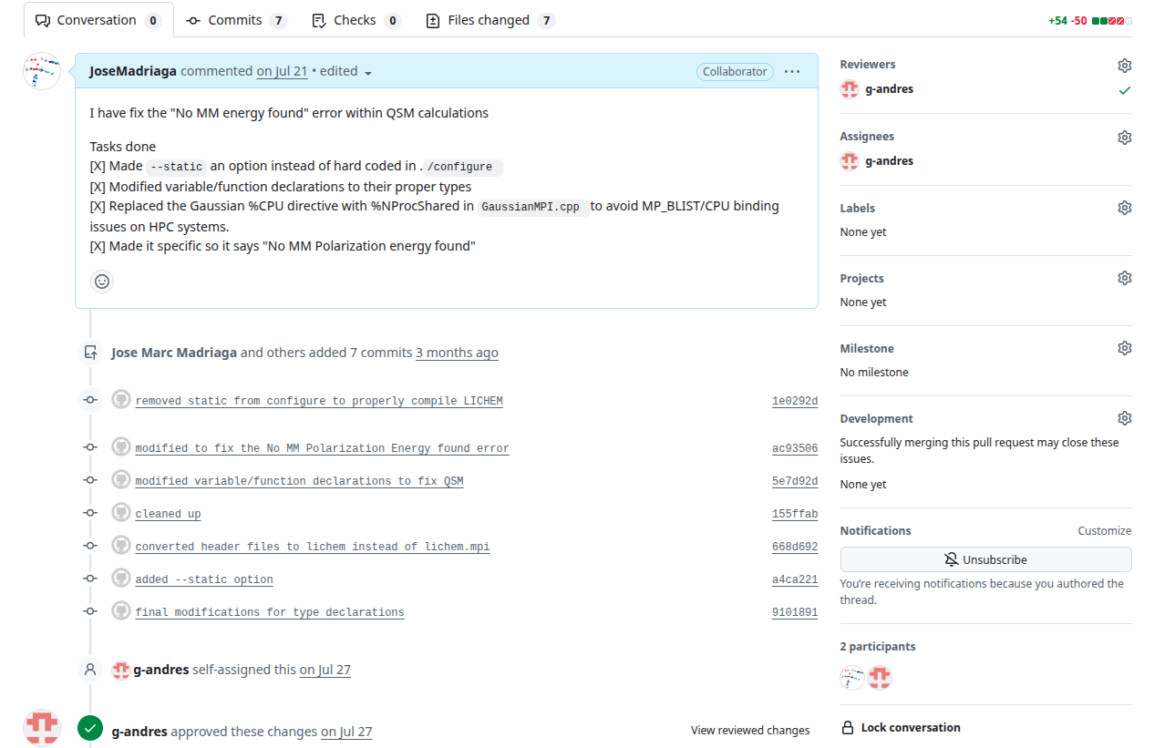
(6) Example of a Pull Request

Slide 10
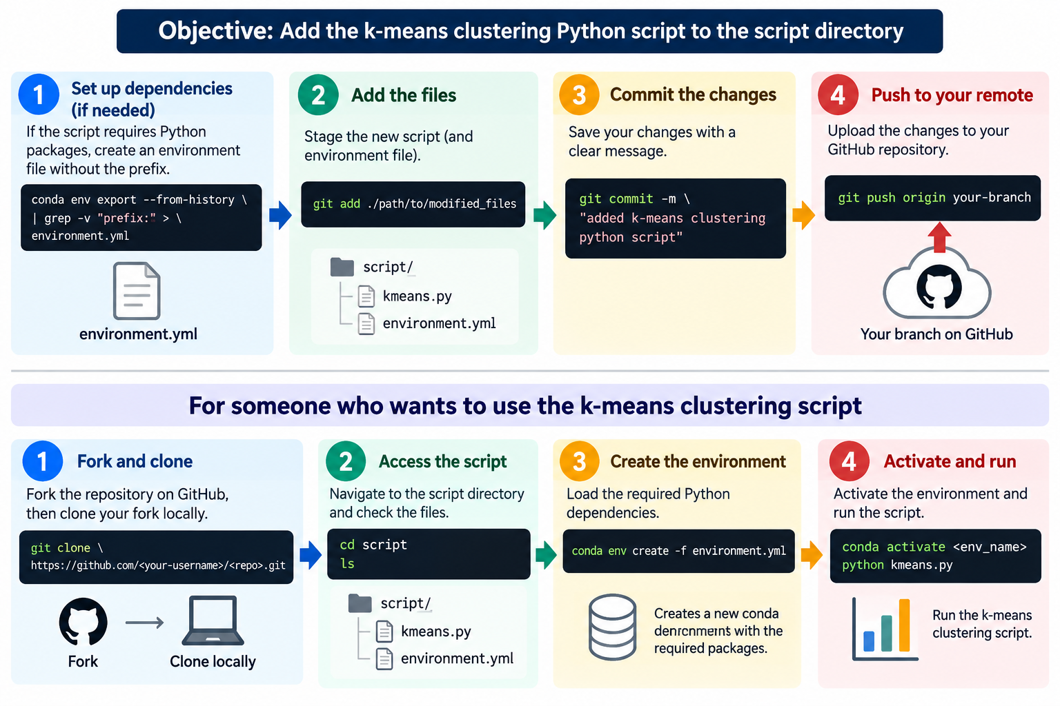
(3-5) Example of Pushing Changes

Slide 11
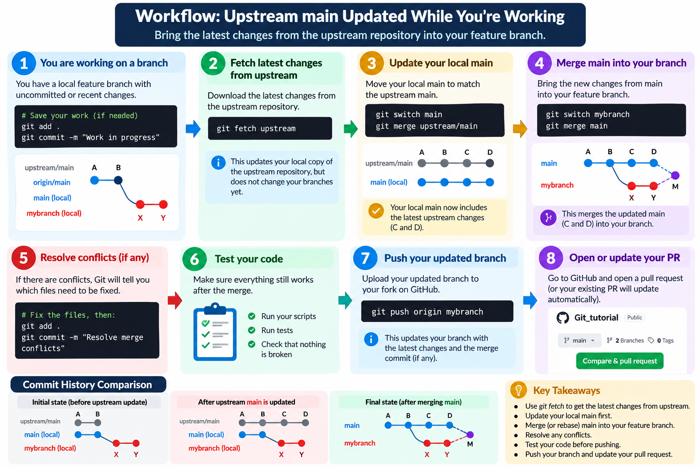
(3) Upstream Main Updated

Slide 12

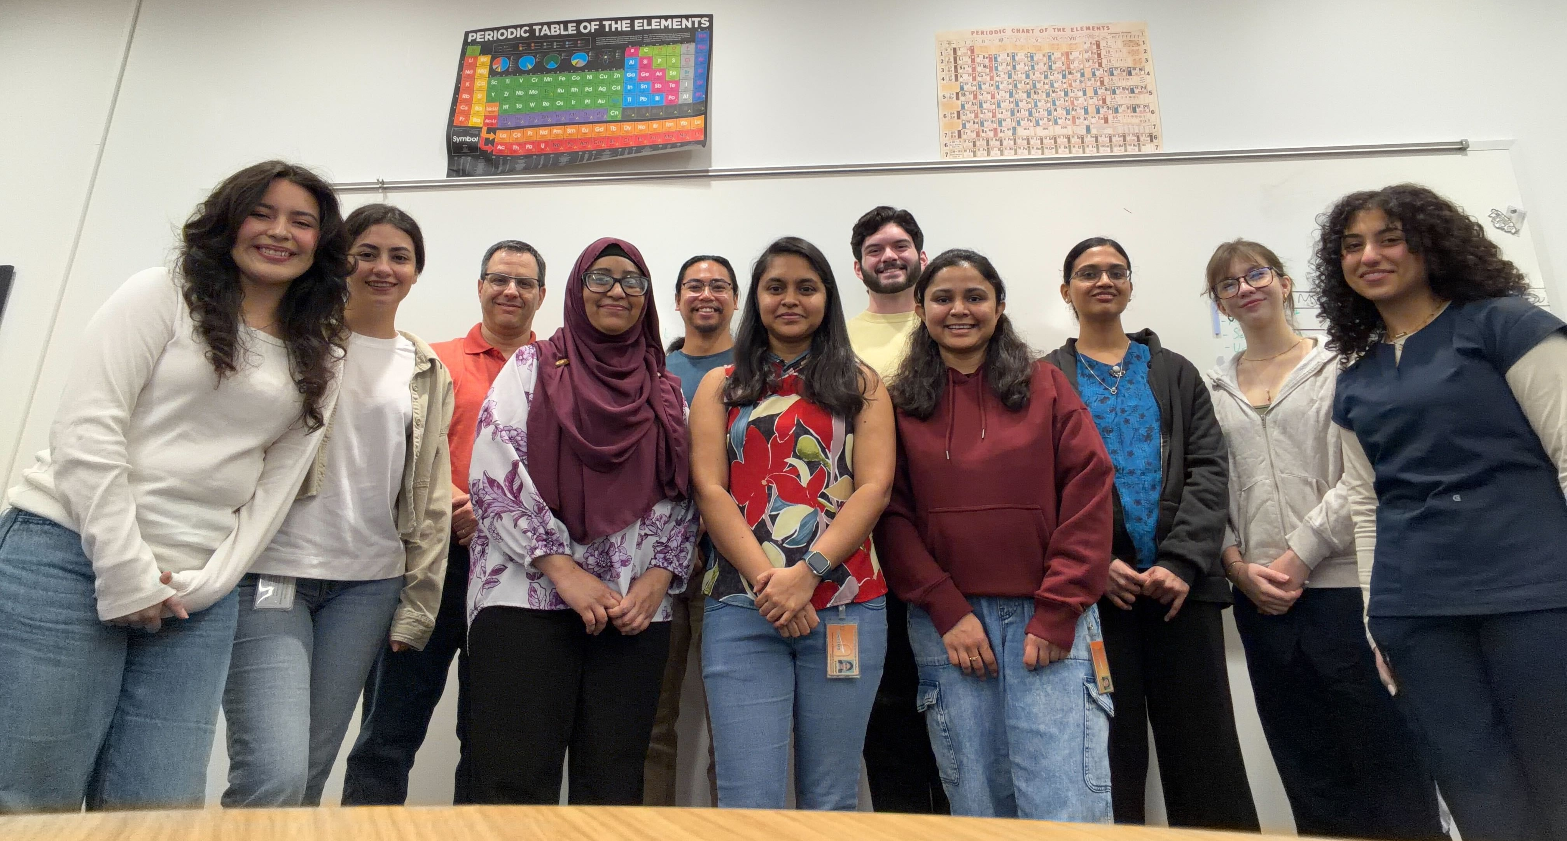






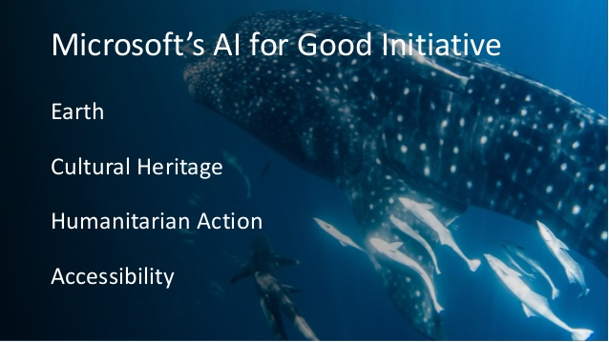



Acknowledgements
Alumni
Dr. Jessica Arcudia Muñoz (CINVESTAV)
Dr. Arkanil Roy (LSU)
Dr. Shubham Chatterjee (UMass Amherst)
Dr. Yazdan Maghsoud (GATech)
Dr. J. Enrique Vázquez
Dr. Madison Berger (USFDA)
Dr. Emmett Leddin (MSU-SoM)
Dr. Erik A. Vázquez Montelongo (U. Celaya.)
Dr. Mark A. Hix (Wayne State U.)
Dr. Alice Walker (Wayne State U.)
Dr. Pavel Silvestrov
Dr. Hedieh Torabifard (UT-Dallas)
Dr. Yi-Jung Tu (Natl. Chi Nan U.)
Dr. Sajeewa Dewage (Wayamba U.)
Dr. Dong Fang (Xtalpi)
Dr. Rebecca Swett (Relay ThX)
Dr. Jorge A. Nochebuena (Augusta U.)
Dr. Tanay Debnath (Queen’s U.)
Dr. Sehr Naseem-Khan
Dr. Hatice Gokcan (CMU)
Dr. Eric Kratz (Continental)
Dr. Oleg Starovoytov (SLTU)
Dr. Bob Duke
Group Members
Dr. Upeksha Dissanayake
Sarthi Polara
Abeda Shamma
Mozhdeh Ghafari
Daniel Pearson
Archita Cunappakam
Shardul Parthasarathy
Tatiana Materova
Feruzbek Khasanov
Rawan Lilo
Regina Merino
Emma Hiros
THANK YOU!
Collaborators
Pengyu Ren (UT-Austin)
Iannis Aifantis (NYU Med)
Faruck Morcos (UTD)
Tom Darden (OpenEye)
Michael Kolodrubetz (UTD)
Jean-Philip Piquemal (Sorbonne U.)
Ronald Smaldone (UTD)
Rahul Kohli (U. Penn)
Edgar Flores (U. Guadalajara)
Vicent Moliner (UJI)
Liliana Quintanar (CINVESTAV)
Rudi Fasan (UTD)
Penny Beuning (Northeastern U.)
Joaquín Barroso-Flores (UNAM)
Linda Chelico (U. Saskatchewan)
Shubin Liu (UNC)
Stas Groysman (WSU)
Berny Schlegel (WSU)
Judy Wu (U. Houston)
Francesco Paesani (UCSD)
Funding
Computing Time
R01GM108583; R01GM118501 CHE-1856162 HR00112330022
T32GM136501, R35GM151951 OAC-2117247

Slide 13
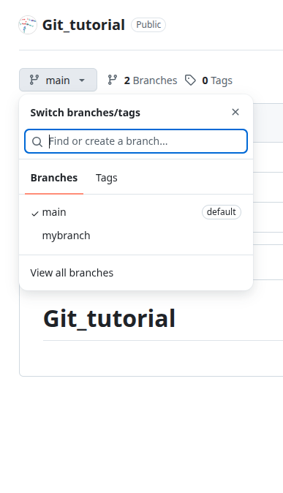
git checkout -b mybranch
git commit -m
Switched to a new branch 'mybranch'
git push origin mybranch
git branch
main
* mybranch
Their modification
git status
git diff
git add

Slide 15
conda activate git_tutorial
conda env export --from-history > environment.yml

