Slide 1
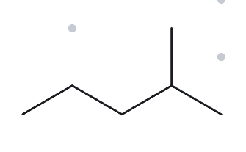
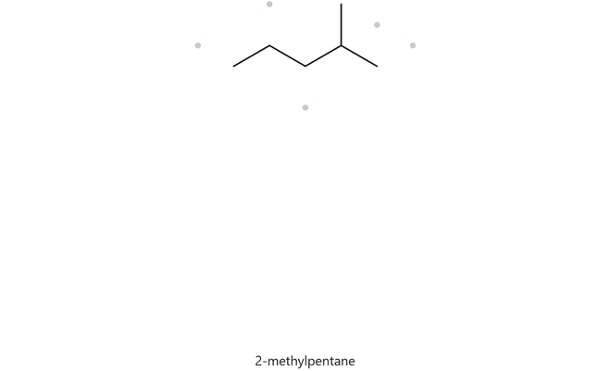
CARD A01 - STRUCTURE NAME
FOUNDATION LEVEL: MOLECULAR FORMULA (COUNTED): C₆H₁₄
  NUMBERED PARENT
  NAMING TRAIL
  Parent: Longest chain has 5 carbons, so the parent is pentane.
  Numbering: Number from the right end. The branch is at carbon 2 instead of carbon 4.
  Substituents: One methyl group at carbon 2.
4
2
1
5
3
  MY NAME
  THE ALKANE CHECK
2-methylpentane
returned name: 2-methylpentane
lowest locants
punctuation
longest chain confirmed
alphabetical order
formula counted

Slide 2
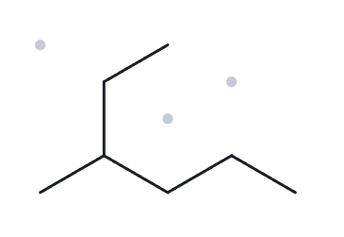
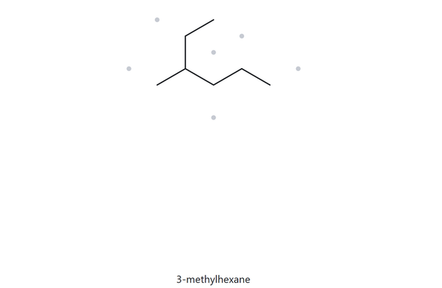
CARD A02 - STRUCTURE NAME
FOUNDATION LEVEL, MOLECULAR FORMULA (COUNTED): C₇H₁₆
  NUMBERED PARENT
  NAMING TRAIL
1
  Parent: The longest continuous chain has 6 carbon atoms, following the bent path through the upper branch. The parent is hexane.
  Numbering: Number from the upper-right end. The branch is at carbon 3 instead of carbon 4.
  Substituents: One methyl group at carbon 3.
2
3
5
4
6
  MY NAME
  THE ALKANE CHECK
3-methylhexane
returned name: 3-methylhexane
lowest locants
punctuation
longest chain confirmed
alphabetical order
formula counted

Slide 3
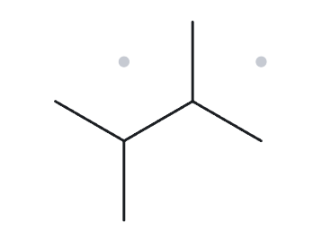
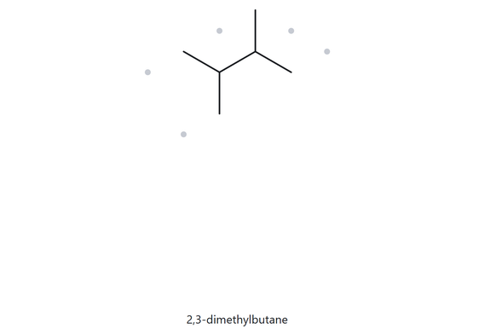
CARD A03 - STRUCTURE NAME
FOUNDATION LEVEL: MOLECULAR FORMULA (COUNTED): C₆H₁₄
  NUMBERED PARENT
  NAMING TRAIL
  Parent: The longest chain has 4 carbon atoms, so the parent is butane.
  Numbering: Either direction gives the same locants, 2 and 3.
  Substituents: Two methyl groups at carbons 2 and 3. Use the prefix di-.
1
3
2
4
  MY NAME
  THE ALKANE CHECK
2,3-dimethylbutane
returned name: 2-methylpentane
lowest locants
punctuation
longest chain confirmed
alphabetical order
formula counted

Slide 4
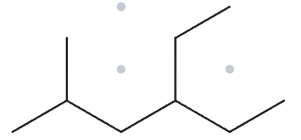
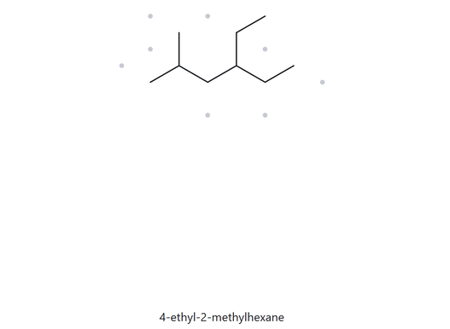
CARD A04 - STRUCTURE NAME
DEVELOPING LEVEL: MOLECULAR FORMULA (COUNTED): C₉H₂₀
  NUMBERED PARENT
  NAMING TRAIL
  Parent: The longest chain has 6 carbon atoms, so the parent is hexane.
  Numbering: Number from the left end. The locants are 2 and 4, which are lower than 3 and 5 when numbered from the opposite end.
  Substituents: One ethyl group at carbon 4 and one methyl group at carbon 2. Write ethyl first because it comes before methyl alphabetically.
2
4
6
1
3
5
  MY NAME
  THE ALKANE CHECK
4-ethyl-2-methylhexane
returned name: 4-ethyl-2-methylhexane
lowest locants
punctuation
longest chain confirmed
alphabetical order
formula counted

Slide 5
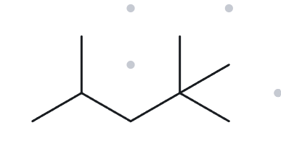
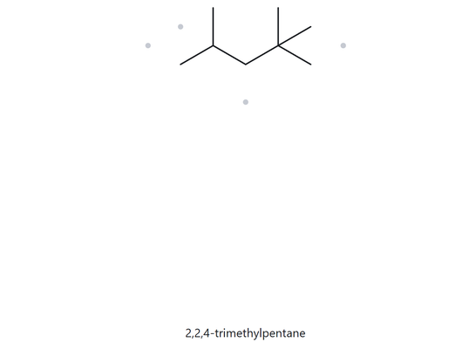
CARD A05 - STRUCTURE NAME
DEVELOPING LEVEL: MOLECULAR FORMULA (COUNTED): C₈H₁₈
  NUMBERED PARENT
  NAMING TRAIL
  Parent: The longest chain has 5 carbon atoms, so the parent is pentane.
  Numbering: Number from the right end. This gives locants 2, 2, and 4 instead of 2, 4, and 4.
  Substituents: Three methyl groups at carbons 2, 2, and 4. Use the prefix tri-.
1
4
2
5
3
  MY NAME
  THE ALKANE CHECK
2,2,4-trimethylpentane
returned name: 2,2,4-trimethylpentane
lowest locants
punctuation
longest chain confirmed
alphabetical order
formula counted

Slide 6
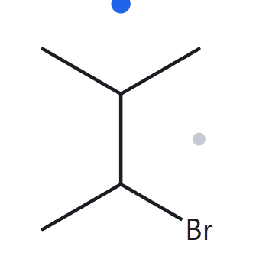
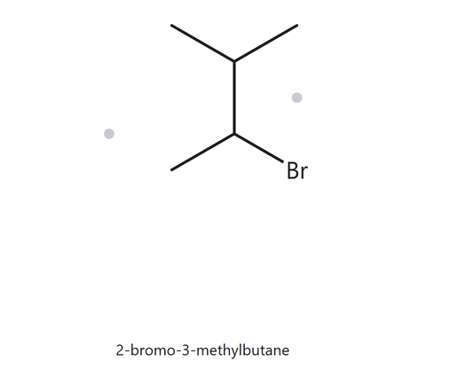
CARD A06 - STRUCTURE NAME
DEVELOPING LEVEL: MOLECULAR FORMULA (COUNTED): C₅H₁₁BR
  NUMBERED PARENT
  NAMING TRAIL
4
  Parent: The longest chain has 4 carbon atoms, so the parent is butane.
  Numbering: Both directions give locants 2 and 3. Break the tie alphabetically: bromo comes before methyl, so bromine receives the lower number.
  Substituents: One bromo group at carbon 2 and one methyl group at carbon 3.
3
2
1
  MY NAME
  THE ALKANE CHECK
2-bromo-3-methylbutane
returned name: 2-bromo-3-methylbutane
lowest locants
punctuation
longest chain confirmed
alphabetical order
formula counted

Slide 7
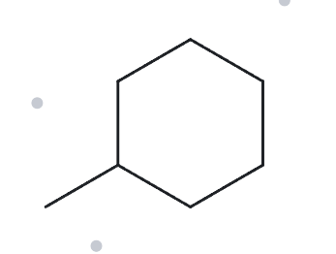
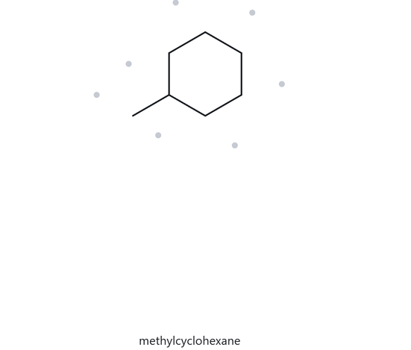
CARD A07 - STRUCTURE NAME
DEVELOPING LEVEL: MOLECULAR FORMULA (COUNTED): C₇H₁₄
  NUMBERED PARENT
  NAMING TRAIL
5
  Parent: The ring has 6 carbon atoms, so the parent is cyclohexane.
  Numbering: There is only one substituent, so a locant is unnecessary.
  Substituents: One methyl group.
6
4
1
3
2
  MY NAME
  THE ALKANE CHECK
methylcyclohexane
returned name: methylcyclohexane
lowest locants
punctuation
longest chain confirmed
alphabetical order
formula counted

Slide 8
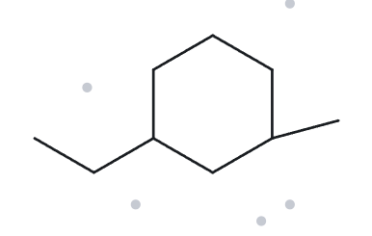
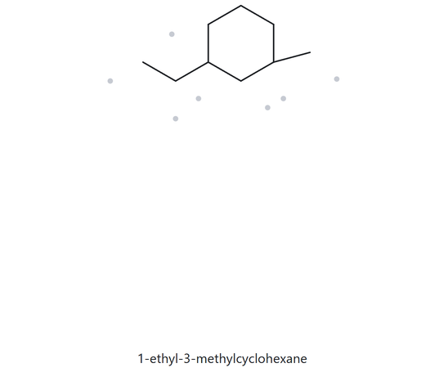
CARD A08 - STRUCTURE NAME
CHALLENGE LEVEL: MOLECULAR FORMULA (COUNTED): C₉H₁₈
  NUMBERED PARENT
  NAMING TRAIL
5
  Parent: The ring has 6 carbon atoms, so the parent is cyclohexane.
  Numbering: The substituents have locants 1 and 3 in either direction. Give carbon 1 to ethyl because it comes before methyl alphabetically.
  Substituents: One ethyl group at carbon 1 and one methyl group at carbon 3
6
4
1
3
2
  MY NAME
  THE ALKANE CHECK
1-ethyl-3-methylcyclohexane
returned name: 1-ethyl-3-methylcyclohexane
lowest locants
punctuation
longest chain confirmed
alphabetical order
formula counted

Slide 9
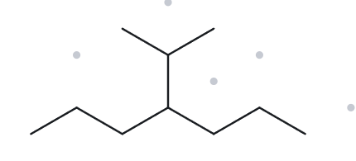
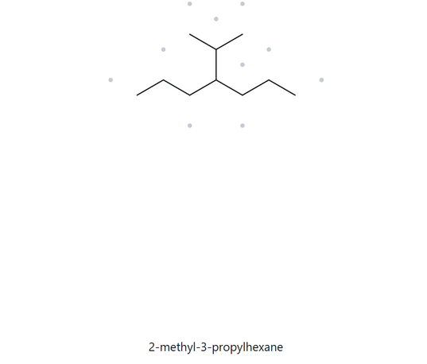
CARD A09 - STRUCTURE NAME
CHALLENGE LEVEL: MOLECULAR FORMULA (COUNTED): C₁₀H₂₂
  NUMBERED PARENT
  NAMING TRAIL
  Parent: The longest continuous chain has 7 carbon atoms, so the parent is heptane.
  Numbering: Number from either end. Both directions give the substituent at carbon 4.
  Substituents: One propan-2-yl group at carbon 4. The substituent contains 3 carbon atoms and is attached to the parent chain through its second carbon.
2
6
3
4
5
1
7
  MY NAME
  THE ALKANE CHECK
4(propan-2-yl)heptane
returned name: 2-methyl-3-propylhexane
lowest locants
punctuation
longest chain confirmed
alphabetical order
formula counted

Slide 10
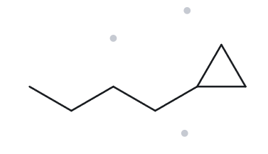
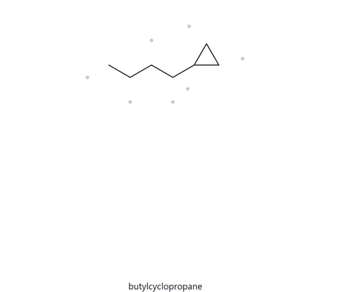
CARD A10 - STRUCTURE NAME
CHALLENGE LEVEL: MOLECULAR FORMULA (COUNTED): C₇H₁₄
  NUMBERED PARENT
  NAMING TRAIL
  Parent: The open chain has 4 carbon atoms, while the ring has 3. Therefore, the parent is butane.
  Numbering: Number from the end nearest the ring, placing the substituent at carbon 1.
  Substituents: One cyclopropyl group at carbon 1.
4
2
3
1
  MY NAME
  THE ALKANE CHECK
1-cyclopropylbutane
returned name: butylcyclopropane
lowest locants
punctuation
longest chain confirmed
alphabetical order
formula counted

Slide 11
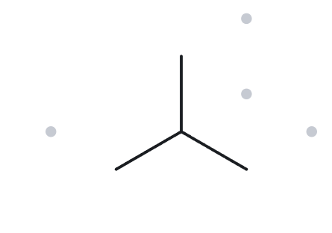
CARD B01 - NAME STRUCTURE
FOUNDATION LEVEL: GIVEN NAME: 2-METHYLPROPANE
  NAME DECODED
  BOND LINE STRUCTURE (THE ALKANE)
  Parent: propane, 3 carbon atoms, open chain.
  Substituent: methyl (CH₃) at carbon 2.
  expected formula:Carbon 2 has one hydrogen because it is connected to three carbons. The other three carbons have three hydrogens each. Therefore, the formula is C₄H₁₀.
  FORMULA CHECK
  BACK-CHECK
  Formula counted from structure: C₄H₁₀
  General formula result: C₄H₁₀
  Verdict: Match.
  Name returned by The Alkane: 2-methylpropane
  Verdict: Match
parent length matches
substituent position match
formula agrees
back-check recorded

Slide 12
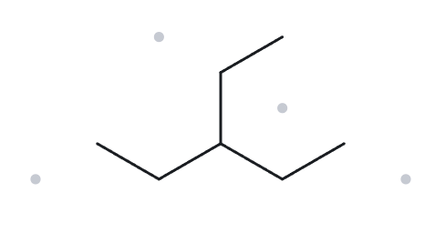
CARD B02 - NAME STRUCTURE
FOUNDATION LEVEL: GIVEN NAME: 3-ETHYLPENTANE
  NAME DECODED
  BOND LINE STRUCTURE (THE ALKANE)
  Parent: pentane, 5 carbon atoms, open chain.
  Substituent: ethyl (CH₂CH₃) at carbon 3.
  expected formula: Carbon 3 has one hydrogen, the two end carbons have three each, and the remaining four carbons have two or three as needed. Total: 7 carbons and 16 hydrogens. Therefore, C₇H₁₆.
  FORMULA CHECK
  BACK-CHECK
  Formula counted from structure: C₇H₁₆
  General formula result: C₇H₁₆
  Verdict: Match.
  Name returned by The Alkane: 3-ethylpentane
  Verdict: Match
parent length matches
substituent position match
formula agrees
back-check recorded

Slide 13
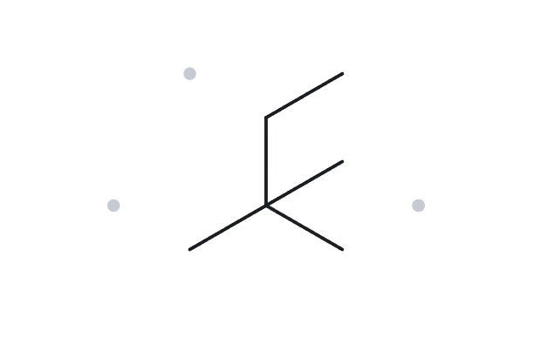
CARD B03 - NAME STRUCTURE
FOUNDATION LEVEL: GIVEN NAME: 2,2-DIMETHYLBUTANE
  NAME DECODED
  BOND LINE STRUCTURE (THE ALKANE)
  Parent: butane, 4 carbon atoms, open chain.
  Substituents: two methyl groups at carbon 2.
  expected formula: Carbon 2 has no hydrogens because it is connected to four carbons. The three methyl groups have three hydrogens each, while the remaining carbons complete the total. Therefore, C₆H₁₄.
  FORMULA CHECK
  BACK-CHECK
  Formula counted from structure: C₆H₁₄
  General formula result: C₆H₁₄
  Verdict: Match.
  Name returned by The Alkane: 2,2-dimethylbutane
  Verdict: Match
parent length matches
substituent position match
formula agrees
back-check recorded

Slide 14
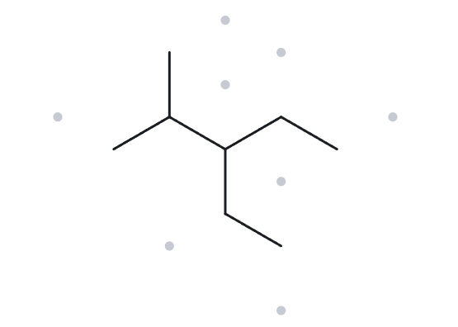
CARD B04 - NAME STRUCTURE
DEVELOPING LEVEL: GIVEN NAME: 3-ETHYL-2-METHYLPENTANE
  NAME DECODED
  BOND LINE STRUCTURE (THE ALKANE)
  Parent: pentane, 5 carbon atoms, open chain.
  Substituents:
-Ethyl (CH₂CH₃) at carbon 3.
-Methyl (CH₃) at carbon 2.
  expected formula: Carbons 2 and 3 each have one hydrogen because they are connected to three carbons. The remaining carbons have two or three hydrogens. Therefore, C₈H₁₈.
  FORMULA CHECK
  BACK-CHECK
  Formula counted from structure: C₈H₁₈.
  General formula result: C₈H₁₈.
  Verdict: Match.
  Name returned by The Alkane: 3-ethyl-2-methylpentane
  Verdict: Match
parent length matches
substituent position match
formula agrees
back-check recorded

Slide 15
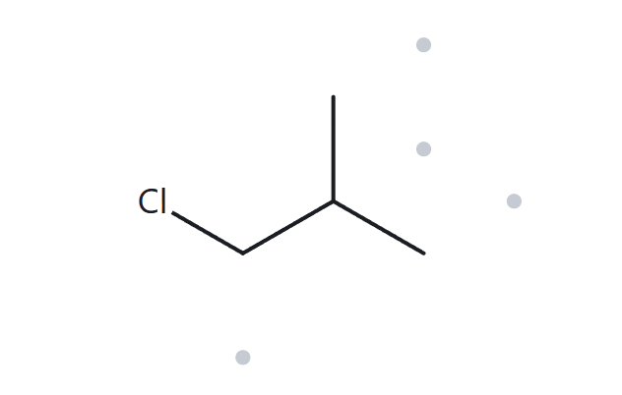
CARD B05 - NAME STRUCTURE
DEVELOPING LEVEL: GIVEN NAME: 1-CHLORO-2-METHYLPROPANE
  NAME DECODED
  BOND LINE STRUCTURE (THE ALKANE)
  Parent: propane, 3 carbon atoms, open chain.
  Substituents:
-Chloro (Cl) at carbon 1.
-Methyl (CH₃) at carbon 2.
  Expected formula: Carbon 1 has two hydrogens, carbon 2 has one, and the two methyl carbons have three each. Including chlorine, the formula is C₄H₉Cl.
  FORMULA CHECK
  BACK-CHECK
  Formula counted from structure: C₄H₉Cl.
  General formula result after halogen substitution: C₄H₉Cl.
  Verdict: Match.
  Name returned by The Alkane: 1-chloro-2-methylpropane
  Verdict: Match
parent length matches
substituent position match
formula agrees
back-check recorded

Slide 16
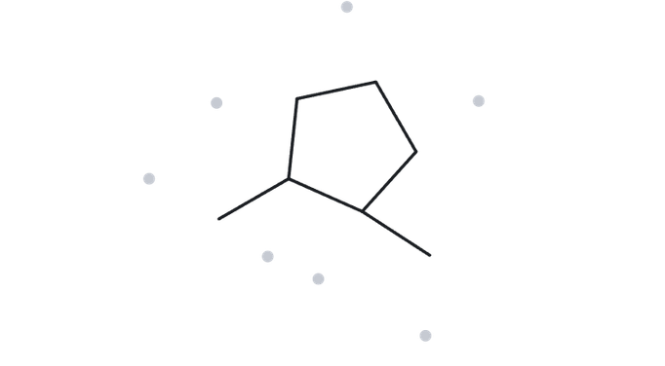
CARD B06 - NAME STRUCTURE
DEVELOPING LEVEL: GIVEN NAME: 1,2-DIMETHYLCYCLOPENTANE
  NAME DECODED
  BOND LINE STRUCTURE (THE ALKANE)
  Parent: cyclopentane, 5 carbon atoms, one ring.
  Substituents: two methyl groups at carbons 1 and 2.
  Expected formula: Ring carbons 1 and 2 each have one hydrogen. The other three ring carbons have two each, and the methyl groups have three each. Therefore, C₇H₁₄.
  FORMULA CHECK
  BACK-CHECK
  Formula counted from structure: C₇H₁₄.
  General formula result: C₇H₁₄.
  Verdict: Match.
  Name returned by The Alkane: 1,2-dimethylcyclopentane
  Verdict: Match
parent length matches
substituent position match
formula agrees
back-check recorded

Slide 17
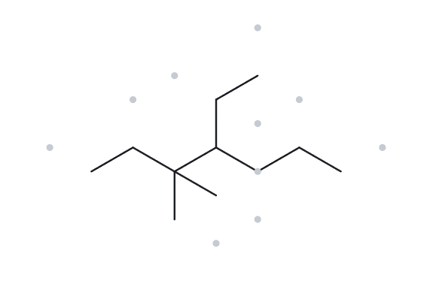
CARD B07 - NAME STRUCTURE
DEVELOPING LEVEL: GIVEN NAME: 4-ETHYL-3,3-DIMETHYLHEPTANE
  NAME DECODED
  BOND LINE STRUCTURE (THE ALKANE)
  Parent: heptane, 7 carbon atoms, open chain.
  Substituents:
-Ethyl (CH₂CH₃) at carbon 4.
-Two methyl groups at carbon 3.
  Expected formula:Carbon 3 has no hydrogens, while carbon 4 has one. The remaining carbons have two or three hydrogens. Therefore, C₁₁H₂₄.
  FORMULA CHECK
  BACK-CHECK
  Formula counted from structure: C₁₁H₂₄.
  General formula result: C₁₁H₂₄.
  Verdict: Match.
  Name returned by The Alkane: 4-ethyl-3,3-dimethylheptane
  Verdict: Match
parent length matches
substituent position match
formula agrees
back-check recorded

Slide 18
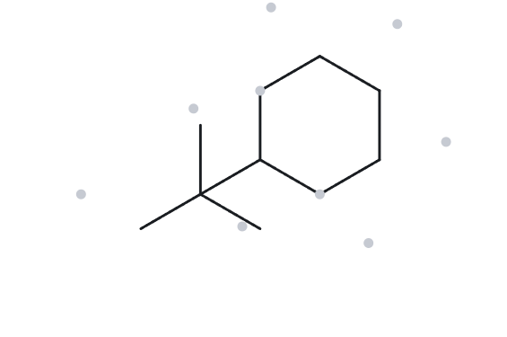
CARD B08 - NAME STRUCTURE
CHALLENGE LEVEL: GIVEN NAME: TERT-BUTYLCYCLOHEXANE
  NAME DECODED
  BOND LINE STRUCTURE (THE ALKANE)
  Parent: cyclohexane, 6 carbon atoms, one ring.
  Substituent: tert-butyl, attached to the ring.
  The tert-butyl group contains one central carbon bonded to three methyl groups.
  A locant is not necessary because there is only one substituent on the ring.
  Expected formula:The attached ring carbon has one hydrogen, while the other five ring carbons have two each. The central tert-butyl carbon has none, and its three methyl groups have three each. Therefore, C₁₀H₂₀.
  FORMULA CHECK
  BACK-CHECK
  Formula counted from structure: C₁₀H₂₀.
  General formula result: C₁₀H₂₀.
  Verdict: Match.
  Name returned by The Alkane:(1,1-dimethylethyl)cyclohexane
  Verdict: does not match
  reason: they dont match in name only but they represent the same compound
parent length matches
substituent position match
formula agrees
back-check recorded

Slide 19
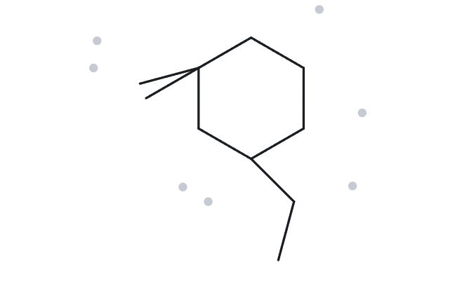
CARD B09 - NAME STRUCTURE
CHALLENGE LEVEL: GIVEN NAME: 3-ETHYL-1,1-DIMETHYLCYCLOHEXANE
  NAME DECODED
  BOND LINE STRUCTURE (THE ALKANE)
  Parent: cyclohexane, 6 carbon atoms, one ring.
  Substituents:
-Two methyl groups at carbon 1.
-One ethyl group at carbon 3.
  Expected formula:Carbon 1 has no hydrogens, and carbon 3 has one. The other ring carbons have two each, while the branches complete the remaining hydrogens. Therefore, C₁₀H₂₀.
  FORMULA CHECK
  BACK-CHECK
  Formula counted from structure: C₁₀H₂₀.
  General formula result: C₁₀H₂₀.
  Verdict: Match.
  Name returned by The Alkane: 3-ethyl-1,1-dimethylcyclohexane
  Verdict: does not match
parent length matches
substituent position match
formula agrees
back-check recorded

Slide 20
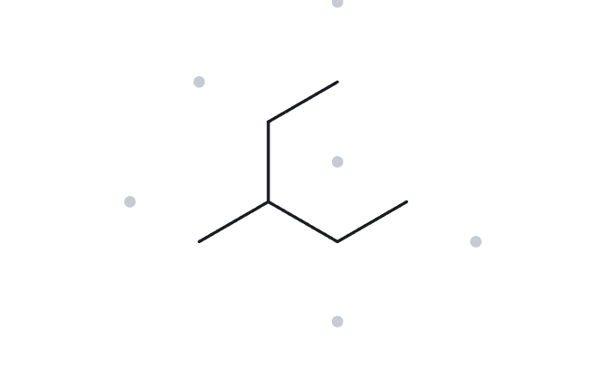
CARD B10 - NAME STRUCTURE
CHALLENGE LEVEL: GIVEN NAME: 2-ETHYLBUTANE
  NAME DECODED
  BOND LINE STRUCTURE (THE ALKANE)
  Given parent: butane, 4 carbon atoms, open chain.
  Given substituent: ethyl (CH₂CH₃) at carbon 2.
  Expected formula: The central carbon has one hydrogen, the two end carbons have three each, and the remaining carbons have two or three. Therefore, C₆H₁₄.
  FORMULA CHECK
  BACK-CHECK
  Formula counted from structure: C₆H₁₄.
  General formula result: C₆H₁₄.
  Verdict: Match.
  Name returned by The Alkane: 3-methylpentane
  Verdict: does not match
  reason: It broke the longest chain rule
parent length matches
substituent position match
formula agrees
back-check recorded

