Slide 1
Arduino Controller
Jose Ocasio

Slide 2
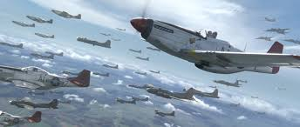
The Idea
Ever wanted to fly?
Airplane Dogfight? Be A Superhero?
Platform w/ 6-axis motion sensor (3-axis gyroscope, 3-axis accelerometer)
~2 joysticks

Slide 3
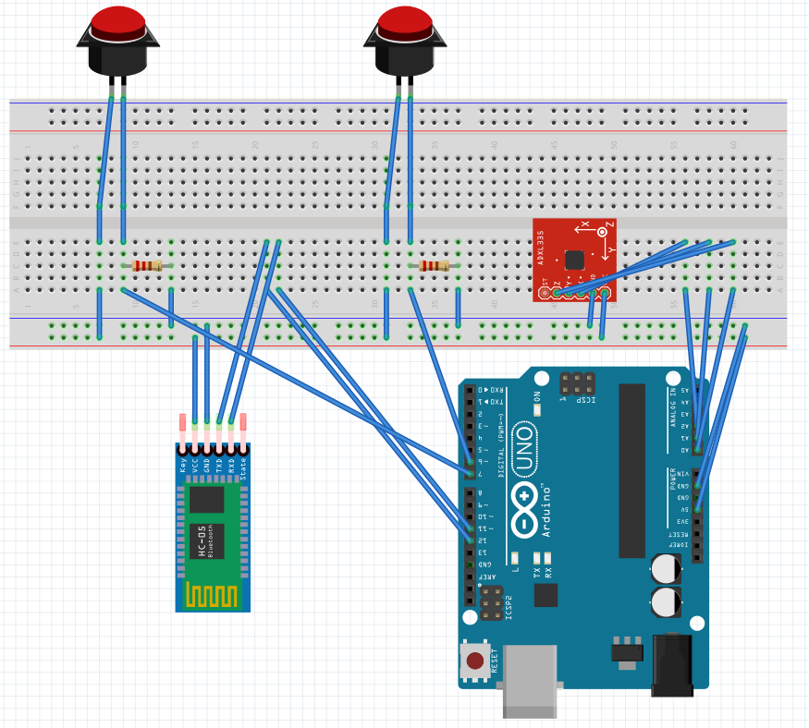
Schedule
Week 3-4: Order parts & Start game framework.
Week 4-5: Build Basic Controller & Continue Game
Week 6-7: Integrate Controller To Game
Week 8-10: Build Platform to attach controller too
Week 11+: Debug, Testing, And Iteration

