Slide 1
SSIM
DATA MINING MARKET
A DISTRIBUTED APPROACH TO SOLVE THE ALGORITHM SELECTION PROBLEM
José Pedro Marques, André Maia

Slide 2
Motivation
Given a Data Mining problem, which algorithm should we used to solve it?
Motivation
Framework
Problem Characterization
The Process
Problem Description
Algorithms
Technology
Work Plan
Questions
1

Slide 3
Motivation
K-NN ?
C 4.5 ?
SVM ?
Apriori ?
Naïve Bayes ?
…..
Motivation
Framework
Problem Characterization
The Process
Problem Description
Algorithms
Technology
Work Plan
Questions
2

Slide 4
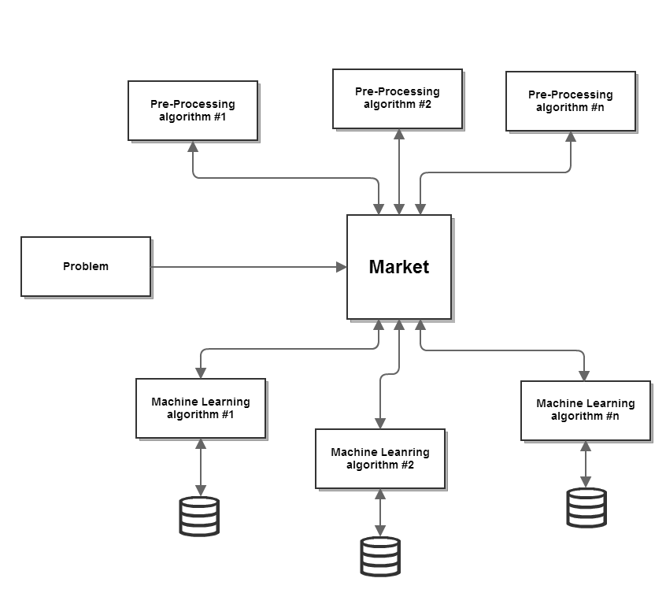
The Data Mining Market
Motivation
Framework
Problem Characterization
The Process
Problem Description
Algorithms
Technology
Work Plan
Questions
3

Slide 5
Problem Characterization
Given two problems, how can we compare them?
Are they similar? If not, how different are they?
How can one agent (ML algorithm) try to predict its result given that problem?
Motivation
Framework
Problem Characterization
The Process
Problem Description
Algorithms
Technology
Work Plan
Questions
4

Slide 6
Problem Characterization
Number of examples in the dataset
Proportion of symbolic attributes
Proportion of attributes with outliers
Entropy of classes
Motivation
Framework
Problem Characterization
The Process
Problem Description
Algorithms
Technology
Work Plan
Questions
6

Slide 7
Problem Characterization
Number of examples in the dataset
Discriminates algorithms according to how scalable they are with respect to this measure.
Proportion of symbolic attributes
Proportion of attributes with outliers
Entropy of classes
Motivation
Framework
Problem Characterization
The Process
Problem Description
Algorithms
Technology
Work Plan
Questions
6

Slide 8
Problem Characterization
Number of examples in the dataset
Proportion of symbolic attributes
Indicative of the aptitude or inadequacy of the algorithm to deal with symbolic or numeric attributes
Proportion of attributes with outliers
Entropy of classes
Motivation
Framework
Problem Characterization
The Process
Problem Description
Algorithms
Technology
Work Plan
Questions
6

Slide 9
Problem Characterization
Number of examples in the dataset
Proportion of symbolic attributes
Proportion of attributes with outliers
Discriminates algorithms according to how robust they are to outlying values in numeric attributes, which are possibly due to noise.
Entropy of classes
Motivation
Framework
Problem Characterization
The Process
Problem Description
Algorithms
Technology
Work Plan
Questions
6

Slide 10
Problem Characterization
Number of examples in the dataset
Proportion of symbolic attributes
Proportion of attributes with outliers
Entropy of classes
Combines information about the number of classes and their frequency, measuring one aspect of problem difﬁculty
Motivation
Framework
Problem Characterization
The Process
Problem Description
Algorithms
Technology
Work Plan
Questions
6

Slide 11
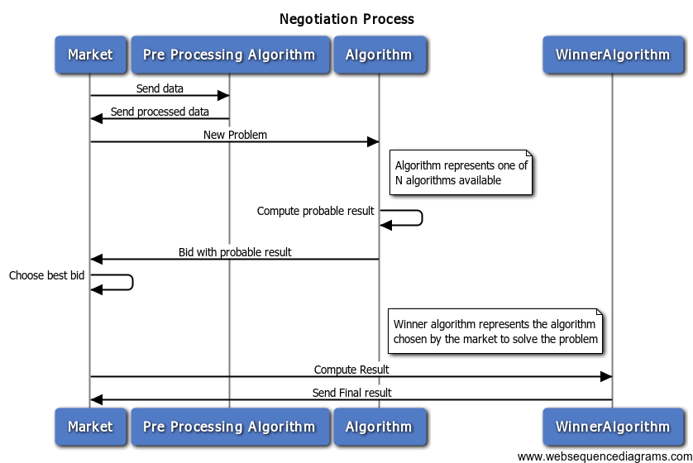
The Process
Motivation
Framework
Problem Characterization
The Process
Problem Description
Algorithms
Technology
Work Plan
Questions
9

Slide 12
Test Problem Description
The information from any transaction reaches INE and the data is inserted and verified manually
All manual processes lead to errors
Automatically select a subset with almost all errors
Motivation
Framework
Problem Characterization
The Process
Problem Description
Algorithms
Technology
Work Plan
Questions
10

Slide 13
Algorithms
Clustering for Outlier Detection
Decision Trees for Outlier Detection
Cell based outlier detection
Motivation
Framework
Problem Characterization
The Process
Problem Description
Algorithms
Technology
Work Plan
Questions
11

Slide 14




Technology
REST
+
Motivation
Framework
Problem Characterization
The Process
Problem Description
Algorithms
Technology
Work Plan
Questions
12

Slide 15
Work Plan
Implement the server skeleton
Implement the R-Java link
Implement the problem characterization
Implement the first agent
Implement the server API
Implement the rest of the agents
Fine tune the negotiation process
Motivation
Framework
Problem Characterization
The Process
Problem Description
Algorithms
Technology
Work Plan
Questions
13

Slide 16
Questions?
Motivation
Framework
Problem Characterization
The Process
Problem Description
Algorithms
Technology
Work Plan
Questions
14

