Slide 1
SSIM
DATA MINING MARKET
A DISTRIBUTED APPROACH TO SOLVE THE ALGORITHM SELECTION PROBLEM
José Pedro Marques, André Maia

Slide 2
Motivation
Given a Data Mining problem, which algorithm should we used to solve it?
Problem Description
Hard Constraints
Soft Constraints
Algorithms
Iterative Construction
Simulated Annealing
Evolutionary Algorithm
Solution Evaluation
First Approach
Second Approach
Results
Questions
1

Slide 3
Motivation
K-NN ?
C 4.5 ?
SVM ?
Apriori ?
Naïve Bayes ?
…..
Problem Description
Hard Constraints
Soft Constraints
Algorithms
Iterative Construction
Simulated Annealing
Evolutionary Algorithm
Solution Evaluation
First Approach
Second Approach
Results
Questions
1

Slide 4
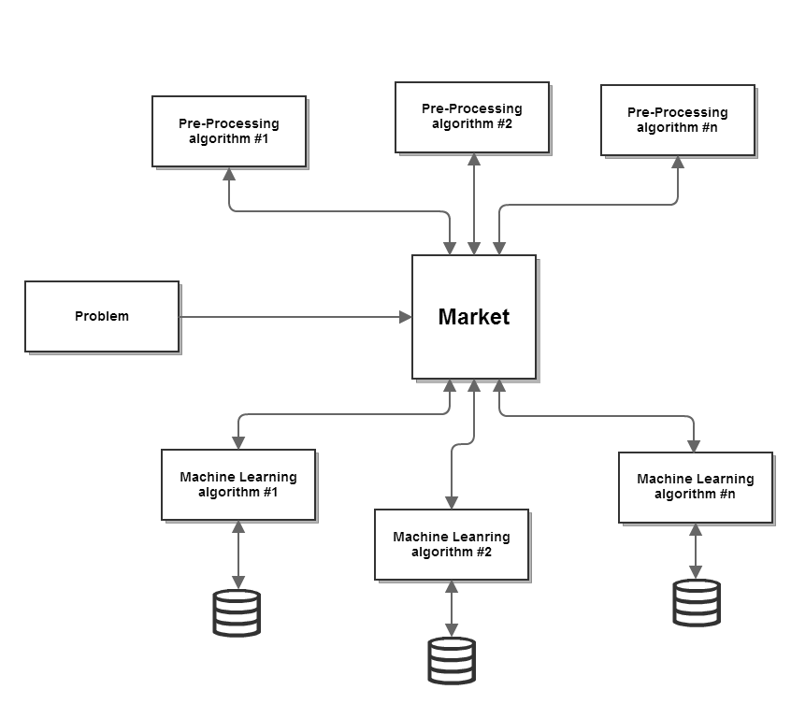
The Data Mining Market
Problem Description
Hard Constraints
Soft Constraints
Algorithms
Iterative Construction
Simulated Annealing
Evolutionary Algorithm
Solution Evaluation
First Approach
Second Approach
Results
Questions
2

Slide 5
Problem Characterization
Given two problems, how can we compare them?
Are they similar? If not, how different are they?
How can one agent (ML algorithm) try to predict its result given that problem?
Problem Description
Hard Constraints
Soft Constraints
Algorithms
Iterative Construction
Simulated Annealing
Evolutionary Algorithm
Solution Evaluation
First Approach
Second Approach
Results
Questions
3

Slide 6
Problem Characterization
Simple measures
Statistical measures
Information based measures
Problem Description
Hard Constraints
Soft Constraints
Algorithms
Iterative Construction
Simulated Annealing
Evolutionary Algorithm
Solution Evaluation
First Approach
Second Approach
Results
Questions
3

Slide 7
Simple Measures
Number of examples in the dataset
Number of attributes.
Proportion of binary attributes
…
Problem Description
Hard Constraints
Soft Constraints
Algorithms
Iterative Construction
Simulated Annealing
Evolutionary Algorithm
Solution Evaluation
First Approach
Second Approach
Results
Questions
3

Slide 8
Statistical Measures
Standard deviation ratio.
Skewness
Kurtosis
…
Problem Description
Hard Constraints
Soft Constraints
Algorithms
Iterative Construction
Simulated Annealing
Evolutionary Algorithm
Solution Evaluation
First Approach
Second Approach
Results
Questions
3

Slide 9
Information Measures
Mean entropy (complexity) of attributes.
Entropy (complexity) of class
Mean mutual information of class and attributes
Equivalent number of attributes
Problem Description
Hard Constraints
Soft Constraints
Algorithms
Iterative Construction
Simulated Annealing
Evolutionary Algorithm
Solution Evaluation
First Approach
Second Approach
Results
Questions
3

Slide 10
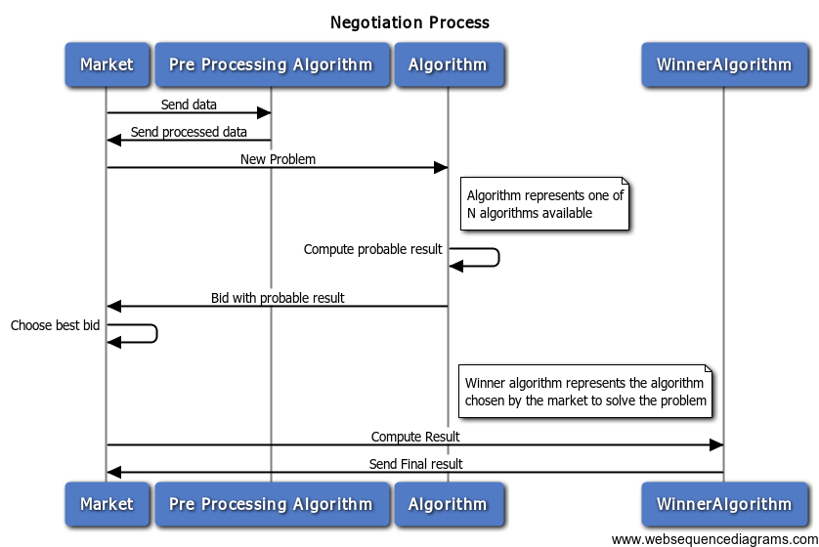
The Process
Problem Description
Hard Constraints
Soft Constraints
Algorithms
Iterative Construction
Simulated Annealing
Evolutionary Algorithm
Solution Evaluation
First Approach
Second Approach
Results
Questions
5

Slide 11
Test Problem Description
Problem Description
Hard Constraints
Soft Constraints
Algorithms
Iterative Construction
Simulated Annealing
Evolutionary Algorithm
Solution Evaluation
First Approach
Second Approach
Results
Questions
3

Slide 12
Algorithms
Problem Description
Hard Constraints
Soft Constraints
Algorithms
Iterative Construction
Simulated Annealing
Evolutionary Algorithm
Solution Evaluation
First Approach
Second Approach
Results
Questions
6

Slide 13




Technology
REST
+
Problem Description
Hard Constraints
Soft Constraints
Algorithms
Iterative Construction
Simulated Annealing
Evolutionary Algorithm
Solution Evaluation
First Approach
Second Approach
Results
Questions
6

Slide 14
Work Plan
Problem Description
Hard Constraints
Soft Constraints
Algorithms
Iterative Construction
Simulated Annealing
Evolutionary Algorithm
Solution Evaluation
First Approach
Second Approach
Results
Questions
6

Slide 15
Questions?
Problem Description
Hard Constraints
Soft Constraints
Algorithms
Iterative Construction
Simulated Annealing
Evolutionary Algorithm
Solution Evaluation
First Approach
Second Approach
Results
Questions
6

