Slide 1
SSIM
DATA MINING MARKET
A DISTRIBUTED APPROACH TO SOLVE THE ALGORITHM SELECTION PROBLEM
José Pedro Marques, André Maia

Slide 2
Motivation
Given a Data Mining problem, which algorithm should we used to solve it?
Motivation
Framework
Problem Characterization
The Process
Problem Description
Algorithms
Technology
Work Plan
Questions
1

Slide 3
Motivation
K-NN ?
C 4.5 ?
SVM ?
Apriori ?
Naïve Bayes ?
…..
Motivation
Framework
Problem Characterization
The Process
Problem Description
Algorithms
Technology
Work Plan
Questions
2

Slide 4
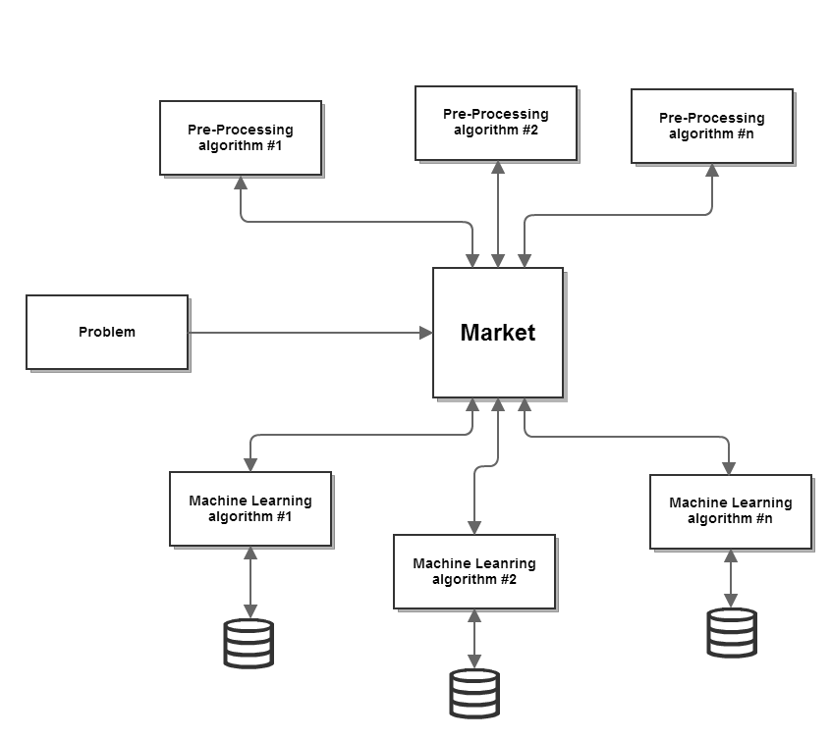
The Data Mining Market
Motivation
Framework
Problem Characterization
The Process
Problem Description
Algorithms
Technology
Work Plan
Questions
3

Slide 5
Problem Characterization
Given two problems, how can we compare them?
Are they similar? If not, how different are they?
How can one agent (ML algorithm) try to predict its result given that problem?
Motivation
Framework
Problem Characterization
The Process
Problem Description
Algorithms
Technology
Work Plan
Questions
4

Slide 6
Problem Characterization
Simple measures
Statistical measures
Information based measures
Motivation
Framework
Problem Characterization
The Process
Problem Description
Algorithms
Technology
Work Plan
Questions
5

Slide 7
Simple Measures
Number of examples in the dataset
Number of attributes.
Proportion of binary attributes
…
Motivation
Framework
Problem Characterization
The Process
Problem Description
Algorithms
Technology
Work Plan
Questions
6

Slide 8
Statistical Measures
Standard deviation ratio.
Skewness
Kurtosis
…
Motivation
Framework
Problem Characterization
The Process
Problem Description
Algorithms
Technology
Work Plan
Questions
7

Slide 9
Information Measures
Mean entropy (complexity) of attributes.
Entropy (complexity) of class
Mean mutual information of class and attributes
Equivalent number of attributes
Motivation
Framework
Problem Characterization
The Process
Problem Description
Algorithms
Technology
Work Plan
Questions
8

Slide 10
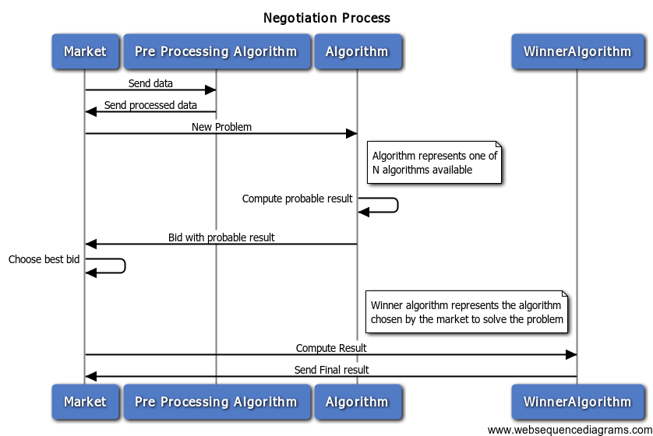
The Process
Motivation
Framework
Problem Characterization
The Process
Problem Description
Algorithms
Technology
Work Plan
Questions
9

Slide 11
Test Problem Description
The information from any transaction reaches INE
Data inserted and verified manually
All manual processes lead to errors
Automatically select a subset with almost all errors
Motivation
Framework
Problem Characterization
The Process
Problem Description
Algorithms
Technology
Work Plan
Questions
10

Slide 12
Algorithms
Clustering for Outlier Detection
Decision Trees for Outlier Detection
Cell based outlier detection
Motivation
Framework
Problem Characterization
The Process
Problem Description
Algorithms
Technology
Work Plan
Questions
11

Slide 13




Technology
REST
+
Motivation
Framework
Problem Characterization
The Process
Problem Description
Algorithms
Technology
Work Plan
Questions
12

Slide 14
Work Plan
Motivation
Framework
Problem Characterization
The Process
Problem Description
Algorithms
Technology
Work Plan
Questions
13

Slide 15
Questions?
Motivation
Framework
Problem Characterization
The Process
Problem Description
Algorithms
Technology
Work Plan
Questions
14

