Slide 1
SSIM
DATA MINING MARKET
A DISTRIBUTED APPROACH TO SOLVE THE ALGORITHM SELECTION PROBLEM
José Pedro Marques, André Maia

Slide 2
Motivation
Given a Data Mining problem, which algorithm should we used to solve it?
Problem Description
Hard Constraints
Soft Constraints
Algorithms
Iterative Construction
Simulated Annealing
Evolutionary Algorithm
Solution Evaluation
First Approach
Second Approach
Results
Questions
1

Slide 3
Motivation
K-NN ?
C 4.5 ?
SVM ?
Apriori ?
Naïve Bayes ?
…..
Problem Description
Hard Constraints
Soft Constraints
Algorithms
Iterative Construction
Simulated Annealing
Evolutionary Algorithm
Solution Evaluation
First Approach
Second Approach
Results
Questions
1

Slide 4
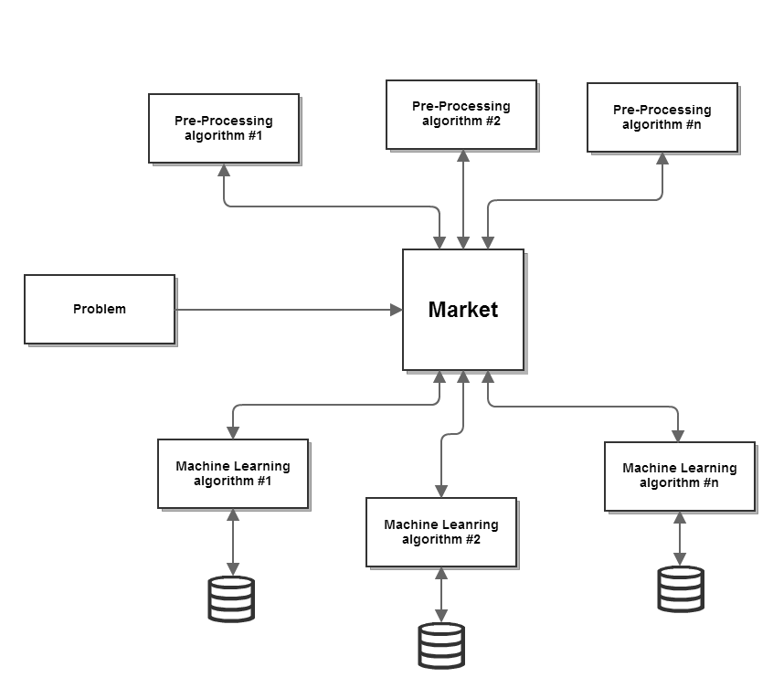
The Data Mining Market
Problem Description
Hard Constraints
Soft Constraints
Algorithms
Iterative Construction
Simulated Annealing
Evolutionary Algorithm
Solution Evaluation
First Approach
Second Approach
Results
Questions
2

Slide 5
Problem Characterization
Given two problems, how can we compare them?
Are they similar? If not, how different are they?
How can one agent (ML algorithm) try to predict its result given that problem?
Problem Description
Hard Constraints
Soft Constraints
Algorithms
Iterative Construction
Simulated Annealing
Evolutionary Algorithm
Solution Evaluation
First Approach
Second Approach
Results
Questions
3

Slide 6
Problem Characterization
Simple measures
Statistical measures
Information based measures
Problem Description
Hard Constraints
Soft Constraints
Algorithms
Iterative Construction
Simulated Annealing
Evolutionary Algorithm
Solution Evaluation
First Approach
Second Approach
Results
Questions
3

Slide 7
Simple Measures
Number of examples in the dataset
Number of attributes.
Proportion of binary attributes
…
Problem Description
Hard Constraints
Soft Constraints
Algorithms
Iterative Construction
Simulated Annealing
Evolutionary Algorithm
Solution Evaluation
First Approach
Second Approach
Results
Questions
3

Slide 8
Statistical Measures
Standard deviation ratio.
Skewness
Kurtosis
…
Problem Description
Hard Constraints
Soft Constraints
Algorithms
Iterative Construction
Simulated Annealing
Evolutionary Algorithm
Solution Evaluation
First Approach
Second Approach
Results
Questions
3

Slide 9
Information Measures
Mean entropy (complexity) of attributes.
Entropy (complexity) of class
Mean mutual information of class and attributes
Equivalent number of attributes
Problem Description
Hard Constraints
Soft Constraints
Algorithms
Iterative Construction
Simulated Annealing
Evolutionary Algorithm
Solution Evaluation
First Approach
Second Approach
Results
Questions
3

Slide 10
The Process
Problem Description
Hard Constraints
Soft Constraints
Algorithms
Iterative Construction
Simulated Annealing
Evolutionary Algorithm
Solution Evaluation
First Approach
Second Approach
Results
Questions
5

Slide 11
Algorithms
Iterative Construction
Simulated Annealing
Evolutionary Algorithm
Problem Description
Hard Constraints
Soft Constraints
Algorithms
Iterative Construction
Simulated Annealing
Evolutionary Algorithm
Solution Evaluation
First Approach
Second Approach
Results
Questions
6

Slide 12
Iterative Construction
Stopping criteria : Fixed number of iterations or all events assigned
Parameters: Event choosing criteria – Random or Most restricted.
Problem Description
Hard Constraints
Soft Constraints
Algorithms
Iterative Construction
Simulated Annealing
Evolutionary Algorithm
Solution Evaluation
First Approach
Second Approach
Results
Questions
7

Slide 13
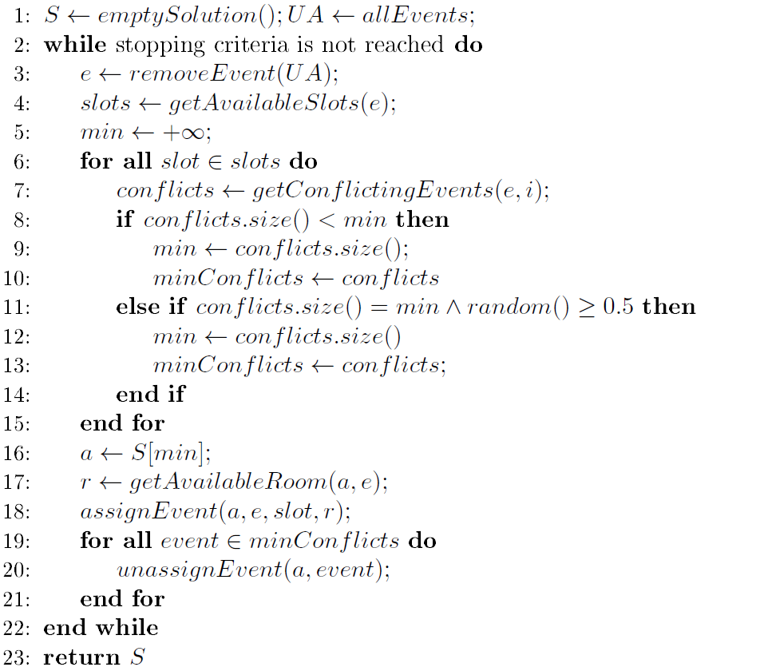
Iterative Construction
Pseudo code:
Problem Description
Hard Constraints
Soft Constraints
Algorithms
Iterative Construction
Simulated Annealing
Evolutionary Algorithm
Solution Evaluation
First Approach
Second Approach
Results
Questions
8

Slide 14
Simulated Annealing
Stopping criteria : Fixed number of stable iterations or solution value = 0
Parameters:
Initial Temperature
Cooling Factor
Cooling Rate
Maximum Number of Stable Iterations
Objective Function
Problem Description
Hard Constraints
Soft Constraints
Algorithms
Iterative Construction
Simulated Annealing
Evolutionary Algorithm
Solution Evaluation
First Approach
Second Approach
Results
Questions
9

Slide 15
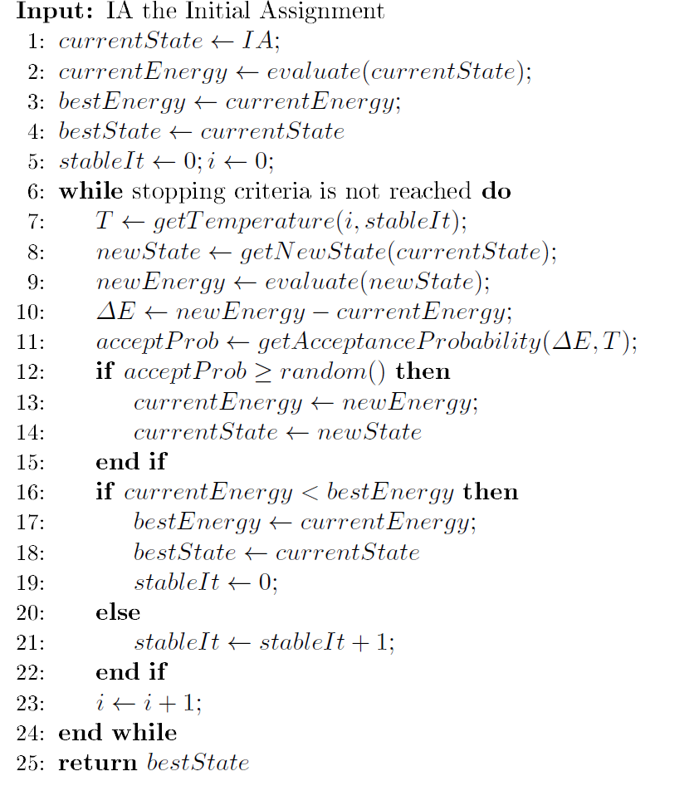
Simulated Annealing
Pseudo code:
Problem Description
Hard Constraints
Soft Constraints
Algorithms
Iterative Construction
Simulated Annealing
Evolutionary Algorithm
Solution Evaluation
First Approach
Second Approach
Results
Questions
10

Slide 16
Simulated Annealing
Neighbours:
Time Move
Room Move
Event Move
Event Swap
Problem Description
Hard Constraints
Soft Constraints
Algorithms
Iterative Construction
Simulated Annealing
Evolutionary Algorithm
Solution Evaluation
First Approach
Second Approach
Results
Questions
11

Slide 17
Simulated Annealing
Time | Monday | Tuesday | Wednesday | Thursday | Friday
08:00
09:00
10:00
11:00
12:00
14:00
15:00
16:00
17:00
Neighbours:
Time Move
Room Move
Event Move
Event Swap
Unassigned Events
Event B
Event C
…
Event N
Room -1 | Room 0 | Room 1 | Room 2 | …… | Room N
Event X | Event Y |  | Event Z | ……
Room -1 | Room 0 | Room 1 | Room 2 | …… | Room N
Event X |  |  | Event W | …… | Event A
Problem Description
Hard Constraints
Soft Constraints
Algorithms
Iterative Construction
Simulated Annealing
Evolutionary Algorithm
Solution Evaluation
First Approach
Second Approach
Results
Questions
12

Slide 18
Simulated Annealing
Time | Monday | Tuesday | Wednesday | Thursday | Friday
08:00
09:00
10:00
11:00
12:00
14:00
15:00
16:00
17:00
Neighbours:
Time Move
Room Move
Event Move
Event Swap
Unassigned Events
Event B
Event C
…
Event N
Room -1 | Room 0 | Room 1 | Room 2 | …… | Room N
Event X | Event Y | Event X | Event Z | ……
Problem Description
Hard Constraints
Soft Constraints
Algorithms
Iterative Construction
Simulated Annealing
Evolutionary Algorithm
Solution Evaluation
First Approach
Second Approach
Results
Questions
13

Slide 19
Simulated Annealing
Time | Monday | Tuesday | Wednesday | Thursday | Friday
08:00
09:00
10:00
11:00
12:00
14:00
15:00
16:00
17:00
Neighbours:
Time Move
Room Move
Event Move
Event Swap
Unassigned Events
Event B
Event C
…
Event N
Room -1 | Room 0 | Room 1 | Room 2 | …… | Room N
 | Event Y |  | Event Z | ……
Room -1 | Room 0 | Room 1 | Room 2 | …… | Room N
 |  | Event B | Event W | …… | Event A
Problem Description
Hard Constraints
Soft Constraints
Algorithms
Iterative Construction
Simulated Annealing
Evolutionary Algorithm
Solution Evaluation
First Approach
Second Approach
Results
Questions
14

Slide 20
Simulated Annealing
Time | Monday | Tuesday | Wednesday | Thursday | Friday
08:00
09:00
10:00
11:00
12:00
14:00
15:00
16:00
17:00
Neighbours:
Time Move
Room Move
Event Move
Event Swap
Unassigned Events
Event B
Event C
…
Event N
Room -1 | Room 0 | Room 1 | Room 2 | …… | Room N
Event W | Event Y |  | Event Z | ……
Room -1 | Room 0 | Room 1 | Room 2 | …… | Room N
 |  | Event X | Event W | …… | Event A
Problem Description
Hard Constraints
Soft Constraints
Algorithms
Iterative Construction
Simulated Annealing
Evolutionary Algorithm
Solution Evaluation
First Approach
Second Approach
Results
Questions
15

Slide 21
Evolutionary Algorithm
Stopping criteria : Fixed number of stable iterations or solution value = 0
Parameters:
Population Size
Mutation probability
Maximum Number of Stable Iterations
Objective Function
Problem Description
Hard Constraints
Soft Constraints
Algorithms
Iterative Construction
Simulated Annealing
Evolutionary Algorithm
Solution Evaluation
First Approach
Second Approach
Results
Questions
16

Slide 22
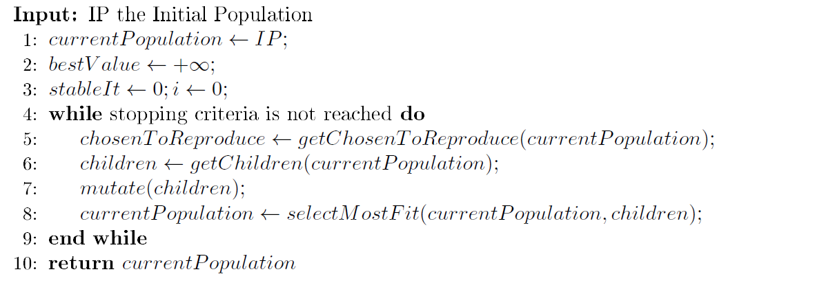
Evolutionary Algorithm
Pseudo code:
Problem Description
Hard Constraints
Soft Constraints
Algorithms
Iterative Construction
Simulated Annealing
Evolutionary Algorithm
Solution Evaluation
First Approach
Second Approach
Results
Questions
17

Slide 23
Evolutionary Algorithm
Crossover Function:
Time | Monday | Tuesday | Wednesday | Thursday | Friday
08:00
09:00
10:00
11:00
12:00
14:00
15:00
16:00
17:00 | 9 | 18 | 27 | 36 | 45
Unassigned Events
Event B
Event C
…
Event N
Room 0 | Room 1 | Room 2 | Room 3 | …… | Room N
Event X | Event Y |  | Event Z | ……
Problem Description
Hard Constraints
Soft Constraints
Algorithms
Iterative Construction
Simulated Annealing
Evolutionary Algorithm
Solution Evaluation
First Approach
Second Approach
Results
Questions
18

Slide 24
Solution Evaluation
Distance to Feasibility :
Number of unassigned events or assigned with no room * Number of student in each event
Number of soft constraints violations
number of occurrences of a student having more than two classes consecutively
number of occurrences of a student having a class in the last timeslot of the day.
number of occurrences of a student having just one class on a day
Problem Description
Hard Constraints
Soft Constraints
Algorithms
Iterative Construction
Simulated Annealing
Evolutionary Algorithm
Solution Evaluation
First Approach
Second Approach
Results
Questions
19

Slide 25
First Approach
Iterative Construction (Most Constrained)
Simulated Annealing (Distance to Feasibility)
Simulated Annealing (Distance to Feasibility*K + Soft Constraints)
Problem Description
Hard Constraints
Soft Constraints
Algorithms
Iterative Construction
Simulated Annealing
Evolutionary Algorithm
Solution Evaluation
First Approach
Second Approach
Results
Questions
20

Slide 26
Second Approach
Iterative Construction (Random)
Simulated Annealing (Low Temperature , Cooling rate = 1, Distance to Feasibility) -> Hill Climbing
Evolutionary Algorithm (Distance to Feasibility*K + Soft Constraints)
Problem Description
Hard Constraints
Soft Constraints
Algorithms
Iterative Construction
Simulated Annealing
Evolutionary Algorithm
Solution Evaluation
First Approach
Second Approach
Results
Questions
21

Slide 27
Results
Distance to Feasibility
Soft Constraints
Overall Value
Time
Problem Description
Hard Constraints
Soft Constraints
Algorithms
Iterative Construction
Simulated Annealing
Evolutionary Algorithm
Solution Evaluation
First Approach
Second Approach
Results
Questions
22

Slide 28
Results
Problem Description
Hard Constraints
Soft Constraints
Algorithms
Iterative Construction
Simulated Annealing
Evolutionary Algorithm
Solution Evaluation
First Approach
Second Approach
Results
Questions
23

Slide 29
Results
Problem Description
Hard Constraints
Soft Constraints
Algorithms
Iterative Construction
Simulated Annealing
Evolutionary Algorithm
Solution Evaluation
First Approach
Second Approach
Results
Questions
24

Slide 30
Results
Problem Description
Hard Constraints
Soft Constraints
Algorithms
Iterative Construction
Simulated Annealing
Evolutionary Algorithm
Solution Evaluation
First Approach
Second Approach
Results
Questions
25

Slide 31
Results
Problem Description
Hard Constraints
Soft Constraints
Algorithms
Iterative Construction
Simulated Annealing
Evolutionary Algorithm
Solution Evaluation
First Approach
Second Approach
Results
Questions
26

Slide 32
Questions?
Problem Description
Hard Constraints
Soft Constraints
Algorithms
Iterative Construction
Simulated Annealing
Evolutionary Algorithm
Solution Evaluation
First Approach
Second Approach
Results
Questions
27

