Slide 1
Data and Source Code description
25/10/2023, JP

Slide 2
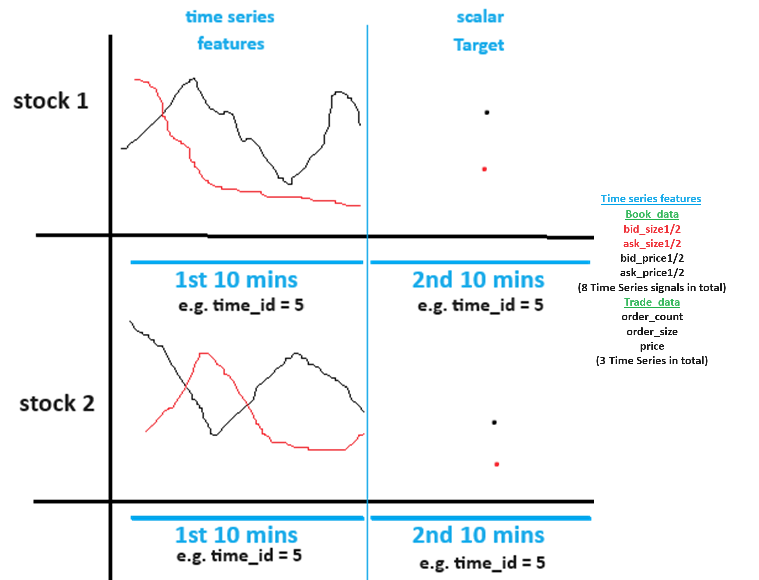

Slide 3


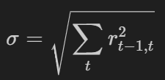
S_t2, s_t1 = WAP.
What inputs drive volatitlity?
Sigma is large when rt-1,t is large
rt-1,t is large when large difference between st2 and st1, i.e. WAP.
Assuming the bid and ask prices are comparable (because volatility is comparable?) across time_id and stock_id. i.e. bid_price of 0.9 in one stock_id and one time_id is equal to bid_price of 0.9 in another stock_id and one time_id. similarly, for ask price.
WAP’s numerator has to be large and denominator small for one time instance t2 or (resp. t1) and vice versa (i.e.WAP’s numerator is small and denominator is large ) in the other time instance t1 or (resp. t2).
WAP is big when both bidprice and askprice are big (numerator) and bidsize and asksize are small (denominator). WAP is small when both bidprice and askprice are small (numerator) and bidsize and asksize are big (denominator).
Check if minimum/maximum bidsize1 and asksize1 in a time_id correlated with target realized volatitlity for the same time_id?
Check if minimum/maximum bidprice1 and askprice1 is correlated with target realized volatitlity for the same time_id?
Also check the correlation between (minimum – maximum) (i.e. range) vs. realized volatitliy of target.
Also check if average of bid_price1 in t2 minus bid_ price1 in t1 within a time_id is correlated with target. Check the same for bid_price
calculate correlation between bid_price1 and ask_price1 in a time_id (positive correlation leads to a larger/smaller wap’s numerator) then check correlation with target realized voaltitlity.
calculate correlation between bid_size1 and ask_size1 in a time_id (positive correlation leads to a larger/smaller wap’s denominator)
Calculate pairs of correlation between a time series in this list [bid_price1, ask_price1] and this list [bid_size1, ask_size1] in a time_id (negative correlation leads to a larger/smaller wap) i.e. corr(bid_price1, ask_size1), corr(bid_price1, bid_size1), corr(ask_price1, bid_size1), corr(ask_price1, bid_size1)
Do the above for bid/ask_price2, bid/ask_size2 as well.

Slide 4
What features in the first 10 min that affect volatility in the next 10 mins?
Feature that has Delayed effect on volatility?
Rolling average or moving average volatility can identify a lasting trend of high or low volatility.
WAP price trend up/down in the second 10 mins is negatively correlated with realized volatility in the 2nd 10 mins. This is called the leverage effect. Cam we forecast trend in the 2nd 10 mins? Try using moving average of WAP of different window sizes and check if current price is above or below average. to predict short term trend in 2nd 10 mins.
Use Trade execution data to see correlation with target realized volatility. Done!! Yes highly correlated!
Use a GARCH model on the time series available in the first 10 mins. to predict volatility into X (X<10) minutes of the second 10 minutes. Check correlation for different average x minutes realized volatility against the target realized volatility and choose the best x minutes of average volatility for each stock.
Use reverse engineered time ids to make more accurate GARCH models. Use this part of ensemble models
Check current liquidity in order book and trade execution book to predict future volatility
Plot ACF of squared returns time series to leverage the Volatility clustering (persistence) phenomenon to predict/extend into second 10 minutes. Remember volatility is square root of sum of squared returns.

Slide 5
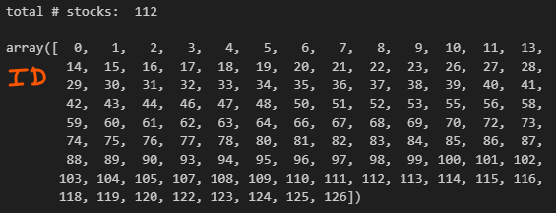
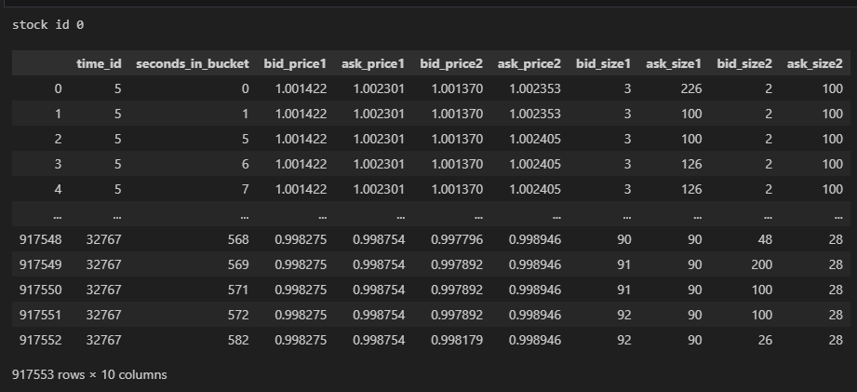
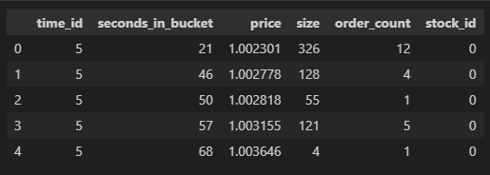
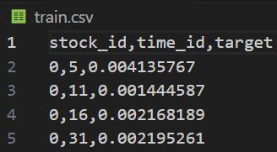
Main folder
Raw Data
book_train.parquet: contains sub-directory with 112 files. Each file e.g. a) below represents a stock and contains columns “time_id”, “seconds_in_bucket”, “bid_price1”, “ask_price1”, “bid_price2”, “ask_price2”, “bid_size1”, “ask_size1”, “bid_size2” ,”ask_size2”. “time_id ” is shuffled and NOT in ascending order. Inside a “time_id” the “seconds_in_bucket” are in ascending order although NOT consecutive.
Stock_id=0 : file schema/metadata shown on right
trade_train.parquet: contains sub-directory with 112 files of same stocks as above. It contains columns “time_id”, “seconds_in_bucket”, “price”, “size”, “order_count”, “stock_id”. “price” refers to actual trade execution price with prices weighted averaged by the order size (number of shares) in each transaction (order_count) in one second. “order_count” refers to the number of unique trade orders taking place. “size” refers to the sum number of shares traded from all the order_counts.
train.csv: contains columns “time_id”, “target”, “stock_id”.
Augmented Raw Data
20_min_volatitliy.parquet: contains sub-directory with two files a) and b) below and each containing columns “stock_id-time_id”, “target”, ”first_10_min_vol”. “first_10_min_vol” column has first 10 mins. calculated realized volatility from inputs in book_train.parquet. “target” column has second 10 mins realized volatility. Inputs to calculation of “target” are unknown.
20_min_volatility_all_stocks.parquet: all stocks concatenated on axis=0
stock_X_20_min_vol.parquet: individual stock X.
Data
Src

Slide 6
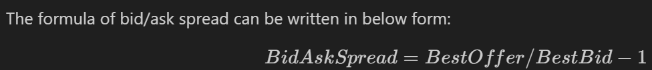
Feature ideas from Kaggle forum
When calculating realized volatility did you first ffill for the missing book order seconds? Actually, forward fill does not affect the volatility calculation because log (s_t2/s_t1) = log(1) = 0. It does not volatility.
Compute Wap2 using ask/bid_price/size 2.
Aggwap
Just use skew, kurtosis, min, max, std,and all other statistics for each bid ask wap etc… in each time id.
Standard Deviations of Price Variables Most POSITIVELY Highly Correlated with Target
Minimums of Prices Variables Most NEGATIVELY Highly Correlated with Target;
the std of bid price was often more highly correlated with the target than the wap calculation.
Use bid ask spread = ask_price1 / bid_price1 - 1

Slide 7
Feature ideas from Kaggle forum
wap1_log_high_low - this is log(highest wap1 in interval) - log(lowest wap1 in interval)
https://www.kaggle.com/competitions/optiver-realized-volatility-prediction/discussion/276137(finance theoretical feature)
https://www.kaggle.com/competitions/optiver-realized-volatility-prediction/discussion/273915(finance theoretical feature)
https://www.kaggle.com/competitions/optiver-realized-volatility-prediction/discussion/291020
https://www.kaggle.com/competitions/optiver-realized-volatility-prediction/discussion/265143
https://www.kaggle.com/competitions/optiver-realized-volatility-prediction/discussion/276506 (random feature, don’t try it!)

Slide 8
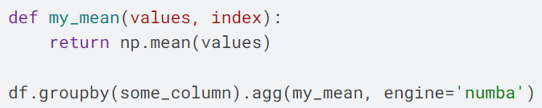
Computation optimization
Use GPU Rapids to speeup feature extraction. https://www.kaggle.com/code/aerdem4/accelerating-trading-on-gpu-via-rapids/notebook
https://www.kaggle.com/code/medali1992/optiver-feature-engineering-rapids-joblib/notebook
When aggregating features by pandas, we can accelerate it by Numba. Here is a groupby example:
https://www.kaggle.com/code/arenagrenade/optimization-36x-data-pre-processing-with-numba/comments

Slide 9
Feature Selection from 100s of features
https://www.kaggle.com/competitions/optiver-realized-volatility-prediction/discussion/256080
https://www.kaggle.com/code/prashant111/comprehensive-guide-on-feature-selection/notebook
https://machinelearningmastery.com/feature-selection-with-real-and-categorical-data/#:~:text=Feature%20selection%20is%20the%20process,the%20performance%20of%20the%20model.

Slide 10
Explainability
https://www.kaggle.com/code/carlmcbrideellis/feature-selection-using-the-boruta-shap-package/notebook
Observing the distribution of the data and considering the meaning of the columns is much more important than blindly making feature selections.
https://www.kaggle.com/code/carlmcbrideellis/variance-inflation-factor-vif-and-explainability?scriptVersionId=106052481

Slide 11
Validation
https://www.kaggle.com/code/konradb/we-need-to-go-deeper-and-validate/notebook
https://www.kaggle.com/code/nrcjea001/lgbm-baseline-no-leaks-stratifiedgroupkfold/notebook

Slide 12
Main folder
Features
1)
Data
Src

Slide 13
A compilation of solutions & other conversations
https://www.kaggle.com/c/optiver-realized-volatility-prediction/discussion/275825
https://www.kaggle.com/c/optiver-realized-volatility-prediction/discussion/275169
Also a really cool and innovative approach that models inter-stock relationships & also using custom features in their architecture.

Slide 14
Reference: Jacoby jager’s FE code TIME BINNED DATA GEN
train_binned = get_dataSet(stock_ids = list(np.unique(train['stock_id'])), dataType = 'train’)
Inside get_dataSet()
stock_stats = Parallel(n_jobs=3)( delayed(get_stock_stat)(stock_id, dataType) for stock_id in stock_ids )
Call get_stock_stat() for each stock id
Inside get_stock_stat()
df_book = pd.read_parquet(os.path.join(path_data, 'book_{}.parquet/stock_id={}/'.format(dataType, stock_id)))
Read one stock’s parquet file inside df_book
df_book['ask_vol1'] = df_book['ask_price1']*df_book['ask_size1']
Compute ask/bid volume level 1/2,
df_book['log_ask1'] = np.log( df_book['ask_price1'] )
Compute log ask/bid price level 1/2, using formual given in competition.
df_book['wap1’] , df_book['wap2']
Compute wap 1/2 using level 1/2 log ask/bid, Why log? Variance stabilization (normalizes any skewed distribution) and linearization (linearizes exponentially varying data) data is in several orders of magnitude e.g. 0.1 0.001, 10, 10000 etc.
df_book['wapq0'] = full_book_wap_bisect( df_book, lvl=0)
df_book['wapq1'] = full_book_wap_bisect( df_book, lvl=1)
df_book['wapq2'] = full_book_wap_bisect( df_book, lvl=2)
df_book['wapq3'] = full_book_wap_bisect( df_book, lvl=3)
df_book['wapq4'] = full_book_wap_bisect( df_book, lvl=4)

Slide 15
Reference: Jacoby jager’s FE code TIME BINNED DATA GEN
Leaving get_stock_stat()
Entering full_book_wap_bisect()
This function computes the optimal wap price using a different formula. If wap computed using our formula is different from the optimal wap price then there it might indicate high or low volatility?? what is difference between wap formula and jager’s bisection algorithm finding it?
the `full_book_wap_bisect` function uses a bisection search algorithm to iteratively narrow down the range of prices and find the weighted average price of a full book based on logarithmic ask and bid prices and their corresponding sizes.
In the code the wap (equilibrium price) is computed using the function full_book_wap_bisect( df_book, lvl=0) using a bisection algorithm iteratively and the wap moves towards the price (either bid or ask price) which has bigger bid or ask size and smaller . increasing lvl increases importance/weight of distance compared to size in f calculation. Higher lvl. Additionally, odd values of lvl make s negative and if bid size/price > ask size/price then p moves towards ask price. Similarly, opposite is true. For even values, always pushed towards ask price??
Back Inside get_stock_stat()
PROBABLY, he will compare the df_book[‘wap1/2’] with different optimal values df_book['wapq0'] = full_book_wap_bisect( df_book, lvl=0), df_book['wapq1'] = full_book_wap_bisect( df_book, lvl=1), df_book['wapq2'] = full_book_wap_bisect( df_book, lvl=2), df_book['wapq3'] = full_book_wap_bisect( df_book, lvl=3) , df_book['wapq4'] = full_book_wap_bisect( df_book, lvl=4) to indicate the direction of volatitliy.
df_book['liquidity2f1'] = (
df_book['bid_vol1']/( 1000*(df_book['wap1'] - df_book['log_bid1']) )**2
+ df_book['ask_vol1']/( 1000*(df_book['wap1'] - df_book['log_ask1']) )**2
)
This calculation appears to be a measure of liquidity, which in finance is a measure of the ability to buy or sell assets without causing a significant change in their price. If log_ask/bid price is far away from wap that means that the asset is not liquid.
df_book['liquidity1'] = ( df_book['bid_vol1']/( 1000*(df_book['wapq1'] - df_book['log_bid1']) )
+ df_book['bid_vol2']/( 1000*(df_book['wapq1'] - df_book['log_bid2']) )
- df_book['ask_vol1']/( 1000*(df_book['wapq1'] - df_book['log_ask1']) )
- df_book['ask_vol2']/( 1000*(df_book['wapq1'] - df_book['log_ask2']) ) )
Why is it bid minus ask in the above where liquidity is odd? And bid plus ask when liquidity is even. This is because wapq1 < log_ask1 so wapq1 < log_ask1 is negative and we need to have negative sign to make it positive.

Slide 16
Reference: Jacoby jager’s FE code TIME BINNED DATA GEN
df_book['spread'] = df_book['log_ask1'] - df_book['log_bid1']
df_book['inv_spread'] = (df_book['log_ask1'] - df_book['log_bid1'])**-2
df_book['log_spread'] = np.log(df_book['log_ask1'] - df_book['log_bid1'])
df_book['log_spread2'] = np.log(df_book['log_ask2'] - df_book['log_bid2’])
Compute bid ask spread. When spread is a very small value close to zero we take log of it to larger number for numerical stability?
df_book['book_size1'] = df_book['ask_vol1'] + df_book['bid_vol1']
df_book['book_size'] = df_book['ask_vol1'] + df_book['bid_vol1'] + df_book['ask_vol2'] + df_book['bid_vol2’]
Find total volume of trade.
df_book['askliq1bal'] = ( df_book['ask_vol1']/( 1000*(df_book['wapq1'] - df_book['log_ask1']) )**1
- df_book['ask_vol2']/( 1000*(df_book['wapq1'] - df_book['log_ask2']) )**1 )
df_book['bidliq1bal'] = ( df_book['bid_vol1']/( 1000*(df_book['wapq1'] - df_book['log_bid1']) )**1 - df_book['bid_vol2']/( 1000*(df_book['wapq1'] - df_book['log_bid2']))**1 )
Difference/balance in liquidity in level 1 and level 2.
df_book['lr1' ] = df_book.groupby(by = ['time_id'])['wap1' ].apply(diff).fillna(0).values
df_book['lr2' ] = df_book.groupby(by = ['time_id'])['wap2' ].apply(diff).fillna(0).values
df_book['lrq0'] = df_book.groupby(by = ['time_id'])['wapq0'].apply(diff).fillna(0).values
df_book['lrq1'] = df_book.groupby(by = ['time_id'])['wapq1'].apply(diff).fillna(0).values
df_book['lrq2'] = df_book.groupby(by = ['time_id'])['wapq2'].apply(diff).fillna(0).values
These are calculating returns by taking first differences. Checking for increase/decrease

Slide 17
Reference: Jacoby jager’s FE code TIME BINNED DATA GEN
df_book['lrq0_lp'] = (df_book['liqret1']>0)*df_book['lr1']
df_book['lrq0_lm'] = (df_book['liqret1']<0)*df_book['lr1’] # wap1 when liquidity had negative returns.
Positive and negative returns (first difference) of liquidity. This checks When liquidity increases or decreases. When liquidity increases, take the returns of wap1 and save it in df_book['lrq0_lp'] likwise opposite for df_book['lrq0_lm'] . NOTE: df_book['lr1' ] = df_book.groupby(by = ['time_id'])['wap1' ].apply(diff).fillna(0).values
trade_stat = pd.read_parquet(os.path.join(path_data,'trade_{}.parquet/stock_id={}'.format(dataType, stock_id)))
Trade is actual execution data. We can compare wapq0-4 with these prices.
trade_stat['volume'] = trade_stat['size']*trade_stat['price']
Find volume of trade
stats['avol1'] = binned_sum_impulse(np.array(df_book['seconds_in_bucket']), np.abs(np.array(df_book['lr1'])), 20, 30, ids.shape[0])
Leaving get_stock_stat()
Entering binned_sum_impulse()
def binned_sum_impulse(t, x, bin_width, n_bins, n_rows):
Time in seconds is not evenly distributed for all time ids so time id is bucketized. 30 bins of 20 seconds bid width each. n_rows refers to np.array(df_book[['stock_id', 'time_id']]).shape[0]. i.e. total number of rows of time ids for the stock id we are handling currnetly. Recall each stock id is handled seperately. Basically aggregates by summing up all the entries in x that is within the bin.
Leaving binned_sum_impulse()
Entering get_stock_stat()
Basically, all avol1, avol2, lr1, qvol1 (quadratic volume.) and so on...

Slide 18
Reference: Jacoby jager’s FE code TIME BINNED DATA GEN
stats['wap1'] = binned_time_weighted_mean_stat(np.array(df_book['seconds_in_bucket']),np.array(df_book['wap1']),np.ones((df_book.shape[0])),20, 30, ids.shape[0])
Leaving get_stock_stat()
Back Inside binned_time_weighted_mean_stat()
Basically, it weights the values by time elapsed. e.g. x1, x2,… t1,t2,….. the new value = x1*(t2-t1) , x2*(t3-t2), …., . This is done within a bin. Then these are summed together within a bin and then divided by the sum of t2-t1 + t3-t2 …. Note: All prev_weight’s are just ones.
Leaving get_stock_stat()
Back Inside get_dataset()
time_ids = sum([list(ss['time_id']) for ss in stock_stats], [] )
time_ids = list(np.unique(time_ids))
for key in stock_stats[0].keys():
if key == 'time_id':
continue
Z = np.zeros(( n_time_ids, n_stock_ids, n_bins))
for k in range(n_stock_ids):
ss = stock_stats[k]
#ts = index_into_set(np.array(time_ids), ss['time_id']).astype(int)
Get all the unique time_ids from ALL the stocks and store in time_ids.

Slide 19
Reference: Jacoby jager’s FE code TIME BINNED DATA GEN
1.Leaving get_stock_stat()
Inside second index_into_set() function (Not first)
b = index_into_set(np.array(time_ids), ss['time_id'])
Z[ b, k, :] = ss[key]
Z[~b, k, :] = np.nanmean(ss[key])
For each column in the stock_stats dictionary. And for each stock id We check which of the unique time_ids are available or missing for the particular stock id. b is a truth and false numpy arrayrepresenting the time_id’s index availability. If a time id is missing then the entire column’s mean is used there.
Finally, the output of get_stock_stat() function results in dictionary train_binned with keys being the features and each feature having shape of (time_id=3830,stock_id= 112, bins=30). This goes into the clustering section next.

Slide 20
Reference: Jacoby jager’s FE code CLUSTERING
rvol = train_binned['root_volume']
vol = train_binned['volume']
vol1 = train_binned['vol1']
lr1 = train_binned['lr1']
lsprd = train_binned['log_spread']
r4liq3 = train_binned['liquidity3_4th_root']
liq2 = train_binned['liquidity2']
Code STARTS here. Only certain features (4) lr1,tvpl3, vol1 and rvol are used in clustering.
'root_volume’ is bucketized from trade_stat['volume'] **0.5 , where trade_stat['volume'] = trade_stat['size']*trade_stat['price']. This is squareroot of volume.
Volume is bucketized from trade_stat['volume']. where trade_stat['volume'] = trade_stat['size']*trade_stat['price']
vol1 is bucketized from np.array(df_book['lr1'])**2, where df_book['lr1' ] = df_book.groupby(by = ['time_id'])['wap1' ].apply(diff).fillna(0).values which is first difference of wap1. Its like increase and decrease of wap1. Wap1 is already in log terms so taking difference is like individual/instantaneous volatilities. This is first order volatility.
lr1 is bucketized from np.array(df_book['lr1']), where df_book['lr1' ] = df_book.groupby(by = ['time_id'])['wap1' ].apply(diff).fillna(0).values which is first difference of wap1. Its like increase and decrease of wap1. This is first order log returns.
'log_spread' is bucketized from np.log(np.array((df_book['spread']))) where df_book['spread'] = df_book['log_ask1'] – df_book['log_bid1']

Slide 21
Reference: Jacoby jager’s FE code CLUSTERING
liquidity3_4th_root is bucketized from np.array((df_book['liquidity3']**0.25)) where its just a definition of liquidity with negative signs and power of 3.
df_book['liquidity3'] = (df_book['bid_vol1']/( 1000*(df_book['wapq3'] - df_book['log_bid1']) )**3
+ df_book['bid_vol2']/( 1000*(df_book['wapq3'] - df_book['log_bid2']) )**3
- df_book['ask_vol1']/( 1000*(df_book['wapq3'] - df_book['log_ask1']) )**3
- df_book['ask_vol2']/( 1000*(df_book['wapq3'] - df_book['log_ask2']) )**3
). This is 4th root of which is 3rd order liquidity. Why is it bid minus ask in the above where liquidity is odd? And bid plus ask when liquidity is even? This is because wapq1 < log_ask1 so wapq1 < log_ask1 is negative and we need to have negative sign to make it positive.
liquidity2 is bucketized from np.array((df_book['liquidity2'])) where its just a definition of liquidity with positive signs and power of 2.
df_book['liquidity2'] = (df_book['bid_vol1']/( 1000*(df_book['wapq2'] - df_book['log_bid1']) )**2
+ df_book['bid_vol2']/( 1000*(df_book['wapq2'] - df_book['log_bid2']) )**2
+ df_book['ask_vol1']/( 1000*(df_book['wapq2'] - df_book['log_ask1']) )**2
+ df_book['ask_vol2']/( 1000*(df_book['wapq2'] - df_book['log_ask2']) )**2
). This is 2nd order liquidity.

Slide 22
Reference: Jacoby jager’s FE code CLUSTERING
lr1 = np.mean(lr1,2)
vol1 = np.mean(vol1**2, 2)**.5
tvpl3 = np.log(np.mean( rvol, 2)**(1/2)/np.mean( (r4liq3[:,:, 0:]), 2)**(4/3))
rvol = np.log(np.mean(rvol**.5,2))
lsprd = (np.mean(lsprd,2))
vol1 = np.log(vol1)
vol = (np.mean(vol,2) )
The above code is taking mean over all the bins for the feature. Taking mean of volatilities vol1 is to first square them and then root them. Average Voltility or standard deviation is calculated by taking the square root of average of invidual variances rather than average of individual standard deviation because the latter underestimates the calculated average standard deviation. Generally, taking log helps to normalize the skewed distributions so he has taken log every where. This is necessary in order to use models like Gaussian Mixuter Modles.
lr1_clusters1 = get_clusters(lr1, depth=1)
Inside get_clusters()
x[~np.isfinite(x)] = np.mean(x[np.isfinite(x)]) # x shape of (time_id=3830,stock_id= 112)
x = x - np.nanmean(x, 0)
x = x / (np.nanstd(x, 0)+1e-20)
C = np.corrcoef(x.T) # C shape of ( 112 x 112)
C = np.arctanh(C) # normalize the distirution of C, make it more symmetric and stabilize the variance as correlation is bounded by [-1,1]

Slide 23
Reference: Jacoby jager’s FE code CLUSTERING
a = np.arange(C.shape[0])
C[a,a] = 0
m = np.mean(C, 1, keepdims=True)
C = C - (m + m.T)
C[a,a] = np.mean(C)
The code above normalizes the incoming feature of x and calcualtes correlaiton matrix of x. Fisher Z transform C. Mean center C.
pca = PCA(x.shape[1])
pca.fit(x)
c = pca.components_ * pca.singular_values_[:,np.newaxis]**.5
# singular values represent the variance contribution of each component or the true rank of the matrix
# when singular values are close to zero, the corresponding components can be ignored so we multiply the components with singular values
c = c.T # features (stock ids) x components
c[:,0] = c[:,0]
p = otree_clusters(c, depth) # shape = (112), cluster labels are in p after clustering on all the PCs of the stock ids. Feature in PCA documentaiton is stock id.

Slide 24
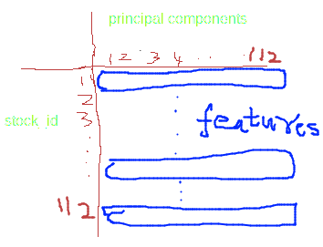
Reference: Jacoby jager’s FE code CLUSTERING
1.The above code finds PCA wth 112 Pcs. PCA computes a matrix c by multiplying the principal components (pca.components_) by the square root of the singular values (pca.singular_values_). This is a common way to obtain the principal components scaled by the corresponding singular values importance (>> 0).
Basically, p is just returning cluster labels are in p after clustering on all the PCs of the features. Shape = (112). Note we are clustering over all the Pcs of a stock_id.
e.g.

Slide 25
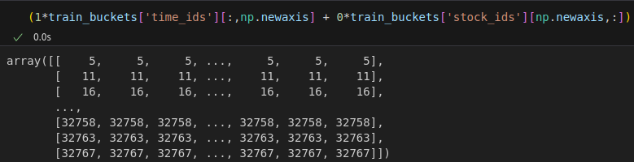
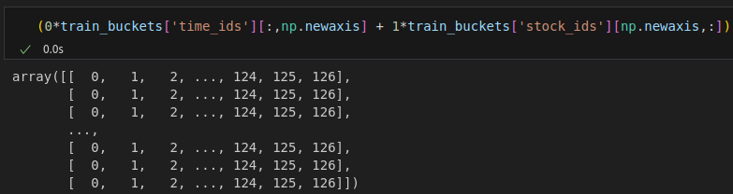
Reference: Jacoby jager’s FE code Feature Engineering
1.train_feat = get_features(train_binned)
Back Inside get_features()
final_features = {}

Slide 26
Reference: Jacoby jager’s FE code Feature Engineering
1.

Slide 27
Reference: Jacoby jager’s FE code Feature Engineering
1.

Slide 28
Reference: Jacoby jager’s FE code Feature Engineering
1.

Slide 29
Reference: Jacoby jager’s FE code Feature Engineering
1.

Slide 30
Reference: Jacoby jager’s FE code Feature Engineering
1.

Slide 31
Reference: Jacoby jager’s FE code Feature Engineering
1.

Slide 32
Reference: Jacoby jager’s FE code Feature Engineering
1.

Slide 33
Reference: Jacoby jager’s FE code Feature Engineering
1.

Slide 34
Reference: Jacoby jager’s FE code Feature Engineering
1.

Slide 35
Reference: Jacoby jager’s FE code Feature Engineering
1.

Slide 36
Reference: Jacoby jager’s FE code Feature Engineering
1.

Slide 37
Reference: Jacoby jager’s FE code Feature Engineering
1.

Slide 38
Reference: Jacoby jager’s FE code Feature Engineering
1.

Slide 39
Reference: Jacoby jager’s FE code Feature Engineering – Important features from LGBM
Important features 1
tbin_var_from_20
V1spprojt15f25
V1spprojt15f29
stock_id
vol1stock_mean_from_25
Vlsprojt5f25
tbin_var_from_10
Important features 2
v1spprojt15f25_g1
tbin_var_from_20
V1spprojt15f25
V1spprojt15f29
vol1stock_mean_from_25
tbin_var_from_10
v1liq3projt5f25
Important features 3
V1spprojt15f25
V1liq3sprojt5f25
vol1stock_mean_From_25
v1spprojt15f25_g1
V1spprojt15f29
cvol1_15_15s
vol1stock_mean_from_20

Slide 40
Reference: Jacoby jager’s FE code Feature Engineering
1.

Slide 41
Reference: Jacoby jager’s FE code Feature Engineering
1.

Slide 42
Reference: Jacoby jager’s FE code Feature Engineering
1.

Slide 43
Reference: Jacoby jager’s FE code Feature Engineering
1.

Slide 44
Reference: Jacoby jager’s FE code
1.

Slide 45
Reference: Jacoby jager’s FE code
1.

Slide 46
Reference: Jacoby jager’s FE code
1.

Slide 47
Reference: Jacoby jager’s FE code
1.

