Slide 1
Data and Source Code description
25/10/2023, JP

Slide 2
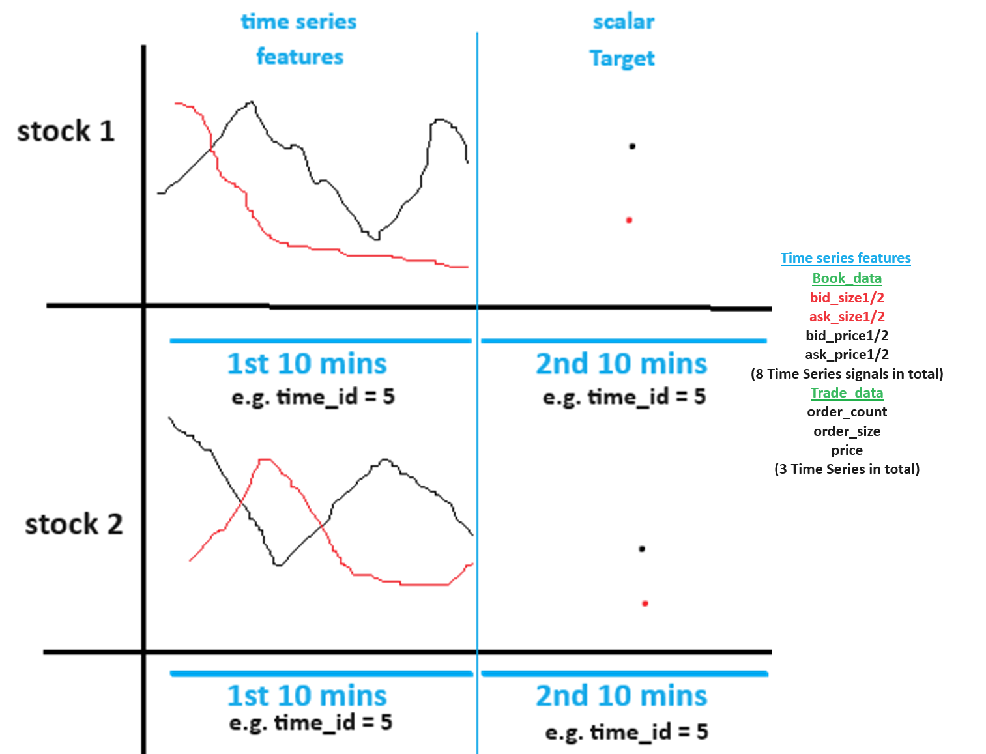

Slide 3


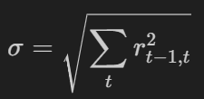
S_t2, s_t1 = WAP.
What inputs drive volatitlity?
Sigma is large when rt-1,t is large
rt-1,t is large when large difference between st2 and st1, i.e. WAP.
Assuming the bid and ask prices are comparable (because volatility is comparable?) across time_id and stock_id. i.e. bid_price of 0.9 in one stock_id and one time_id is equal to bid_price of 0.9 in another stock_id and one time_id. similarly, for ask price.
WAP’s numerator has to be large and denominator small for one time instance t2 or (resp. t1) and vice versa (i.e.WAP’s numerator is small and denominator is large ) in the other time instance t1 or (resp. t2).
WAP is big when both bidprice and askprice are big (numerator) and bidsize and asksize are small (denominator). WAP is small when both bidprice and askprice are small (numerator) and bidsize and asksize are big (denominator).
Check if minimum/maximum bidsize1 and asksize1 in a time_id correlated with target realized volatitlity for the same time_id?
Check if minimum/maximum bidprice1 and askprice1 is correlated with target realized volatitlity for the same time_id?
Also check the correlation between (minimum – maximum) (i.e. range) vs. realized volatitliy of target.
Also check if average of bid_price1 in t2 minus bid_ price1 in t1 within a time_id is correlated with target. Check the same for bid_price
calculate correlation between bid_price1 and ask_price1 in a time_id (positive correlation leads to a larger/smaller wap’s numerator) then check correlation with target realized voaltitlity.
calculate correlation between bid_size1 and ask_size1 in a time_id (positive correlation leads to a larger/smaller wap’s denominator)
Calculate pairs of correlation between a time series in this list [bid_price1, ask_price1] and this list [bid_size1, ask_size1] in a time_id (negative correlation leads to a larger/smaller wap) i.e. corr(bid_price1, ask_size1), corr(bid_price1, bid_size1), corr(ask_price1, bid_size1), corr(ask_price1, bid_size1)
Do the above for bid/ask_price2, bid/ask_size2 as well.

Slide 4
What features in the first 10 min that affect volatility in the next 10 mins?
Feature that has Delayed effect on volatility?
Rolling average or moving average volatility can identify a lasting trend of high or low volatility..
WAP price trend up/down in the second 10 mins is negatively correlated with realized volatility in the 2nd 1o mins. This is called the leverage effect. Cam we forecast trend in the 2nd 10 mins? Try using moving average of WAP of different window sizes and check if current price is above or below average. to predict short term trend in 2nd 10 mins.
Use Trade execution data to see correlation with target realized volatility. Done!! Yes highly correlated!
Use a GARCH model on the time series available in the first 10 mins. to predict volatility into X (X<10) minutes of the second 10 minutes. Check correlation for different average x minutes realized volatility against the target realized volatility and choose the best x minutes of average volatility for each stock.
Plot ACF of squared returns time series to leverage the Volatility clustering (persistence) phenomenon to predict/extend into second 10 minutes. Remember volatility is square root of sum of squared returns.

Slide 5
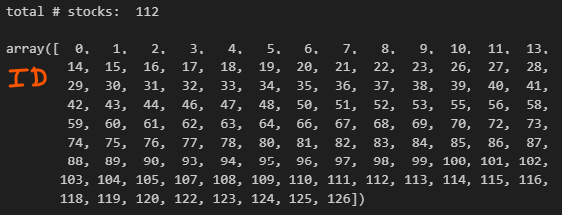
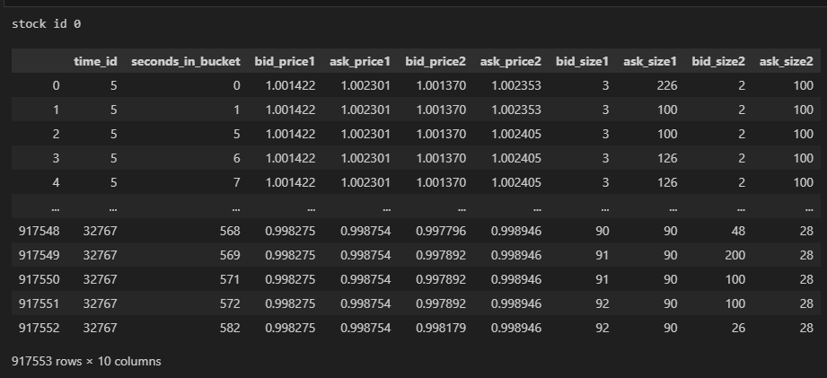
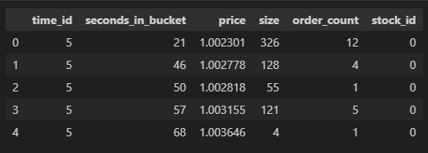
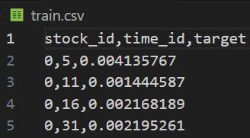
Main folder
Raw Data
book_train.parquet: contains sub-directory with 112 files. Each file e.g. a) below represents a stock and contains columns “time_id”, “seconds_in_bucket”, “bid_price1”, “ask_price1”, “bid_price2”, “ask_price2”, “bid_size1”, “ask_size1”, “bid_size2” ,”ask_size2”. “time_id ” is shuffled and NOT in ascending order. Inside a “time_id” the “seconds_in_bucket” are in ascending order although NOT consecutive.
Stock_id=0 : file schema/metadata shown on right
trade_train.parquet: contains sub-directory with 112 files of same stocks as above. It contains columns “time_id”, “seconds_in_bucket”, “price”, “size”, “order_count”, “stock_id”. “price” refers to actual trade execution price with prices weighted averaged by the order size (number of shares) in each transaction (order_count) in one second. “order_count” refers to the number of unique trade orders taking place. “size” refers to the sum number of shares traded from all the order_counts.
train.csv: contains columns “time_id”, “target”, “stock_id”.
Augmented Raw Data
20_min_volatitliy.parquet: contains sub-directory with two files a) and b) below and each containing columns “stock_id-time_id”, “target”, ”first_10_min_vol”. “first_10_min_vol” column has first 10 mins. calculated realized volatility from inputs in book_train.parquet. “target” column has second 10 mins realized volatility. Inputs to calculation of “target” are unknown.
20_min_volatility_all_stocks.parquet: all stocks concatenated on axis=0
stock_X_20_min_vol.parquet: individual stock X.
Data
Src

Slide 6
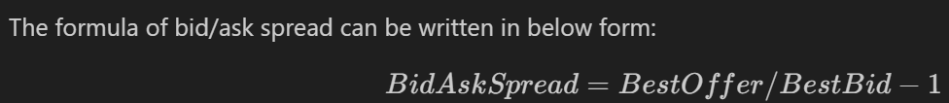
Feature ideas from Kaggle forum
When calculating realized volatility did you first ffill for the missing book order seconds? Actually, forward fill does not affect the volatility calculation because log (s_t2/s_t1) = log(1) = 0. It does not volatility.
Compute Wap2 using ask/bid_price/size 2.
Aggwap
Just use skew, kurtosis, min, max, std,and all other statistics for each bid ask wap etc… in each time id.
Standard Deviations of Price Variables Most POSITIVELY Highly Correlated with Target
Minimums of Prices Variables Most NEGATIVELY Highly Correlated with Target;
the std of bid price was often more highly correlated with the target than the wap calculation.
Use bid ask spread = ask_price1 / bid_price1 - 1

Slide 7
Feature ideas from Kaggle forum
wap1_log_high_low - this is log(highest wap1 in interval) - log(lowest wap1 in interval)
https://www.kaggle.com/competitions/optiver-realized-volatility-prediction/discussion/273915
https://www.kaggle.com/competitions/optiver-realized-volatility-prediction/discussion/276137
https://www.kaggle.com/competitions/optiver-realized-volatility-prediction/discussion/276137
https://www.kaggle.com/competitions/optiver-realized-volatility-prediction/discussion/291020
https://www.kaggle.com/competitions/optiver-realized-volatility-prediction/discussion/276506
https://www.kaggle.com/competitions/optiver-realized-volatility-prediction/discussion/265143

Slide 8
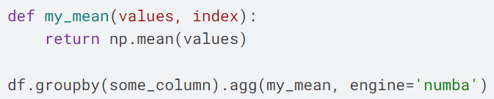
Computation optimization
Use GPU Rapids to speeup feature extraction. https://www.kaggle.com/code/aerdem4/accelerating-trading-on-gpu-via-rapids/notebook
https://www.kaggle.com/code/medali1992/optiver-feature-engineering-rapids-joblib/notebook
When aggregating features by pandas, we can accelerate it by Numba. Here is a groupby example:
https://www.kaggle.com/code/arenagrenade/optimization-36x-data-pre-processing-with-numba/comments

Slide 9
Feature Selection from 100s of features
https://www.kaggle.com/competitions/optiver-realized-volatility-prediction/discussion/256080
https://www.kaggle.com/code/prashant111/comprehensive-guide-on-feature-selection/notebook
https://machinelearningmastery.com/feature-selection-with-real-and-categorical-data/#:~:text=Feature%20selection%20is%20the%20process,the%20performance%20of%20the%20model.

Slide 10
Explainability
https://www.kaggle.com/code/carlmcbrideellis/feature-selection-using-the-boruta-shap-package/notebook
Observing the distribution of the data and considering the meaning of the columns is much more important than blindly making feature selections.
https://www.kaggle.com/code/carlmcbrideellis/variance-inflation-factor-vif-and-explainability?scriptVersionId=106052481

Slide 11
Validation
https://www.kaggle.com/code/konradb/we-need-to-go-deeper-and-validate/notebook
https://www.kaggle.com/code/nrcjea001/lgbm-baseline-no-leaks-stratifiedgroupkfold/notebook

Slide 12
Main folder
Features
1)
Data
Src

