Slide 1



Deep Learning Emotion Recognition
Learning Neural Networking while traying to understand the feeling of other peoples.

Slide 2
Why Emotion Recognition?
Now this days one of the hardest things to understand is the feeling and the emotion of the people that are around us.
It can save lives.
It’s part of our health
It can also be used for marketing and advertising.

Slide 3
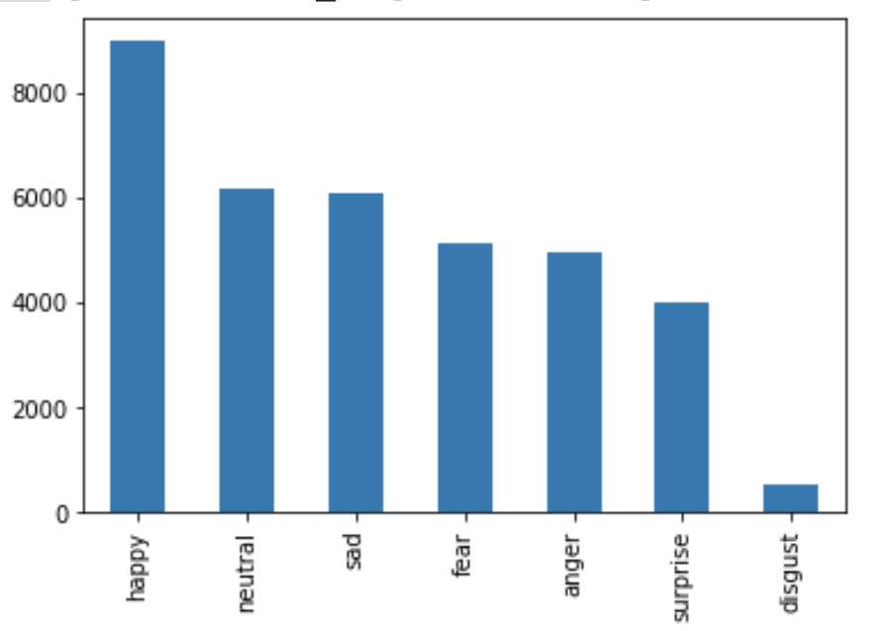
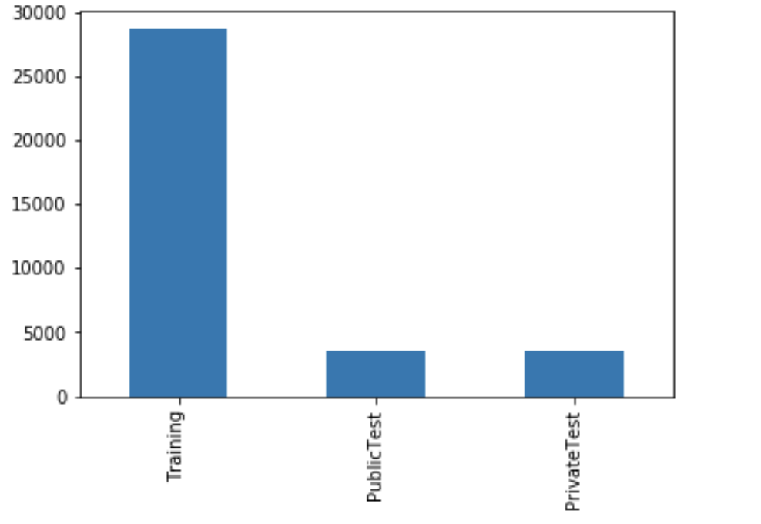
The data-set
CSV files: 3 columns (emotion, pixels and usage), 35887 rows
Pictures of 48x 48 pixels
7 emotions.
Not N/a

Slide 4

Getting ready to train
We must split the data, for training and test.
Balance the data.
Change the the categorical values to numerical values.
Normalize it, every pixels in a layer of color comes from a range between 0 and 255; for our model we need to normalize the values between 0 and 1.

Slide 5

CNN Architecture
Inputs, black and white pictures 48x 48
Model: keras.sequential().
Layers
Convolution: this is always our first layer, our spotlight filter.
Max pooling: get the best or max values of what you want to get.
Dropout: to partially remember.
Dense: our classification layer

Slide 6

Training and Hyperparameters
Hyperparameters.
Epochs: how many times we have a to pass the images.
Batch size: how many pictures at a time.
Learning rate: how much you need the machine to learn.

Slide 7






Results
Accuracy: 59.60%
Happy | Neutral | Happy | Neutral | Happy | Anger

Slide 8

Thank you!
Relieved

