Slide 1
Recursion
AP Computer Science A

Slide 2
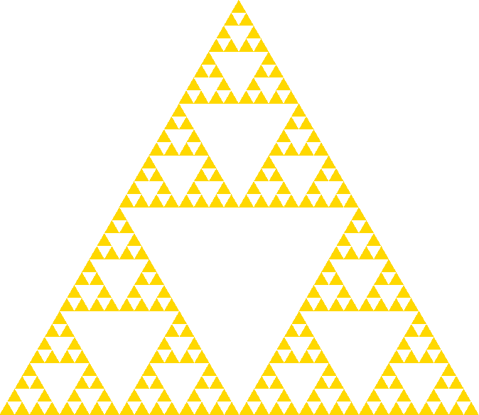
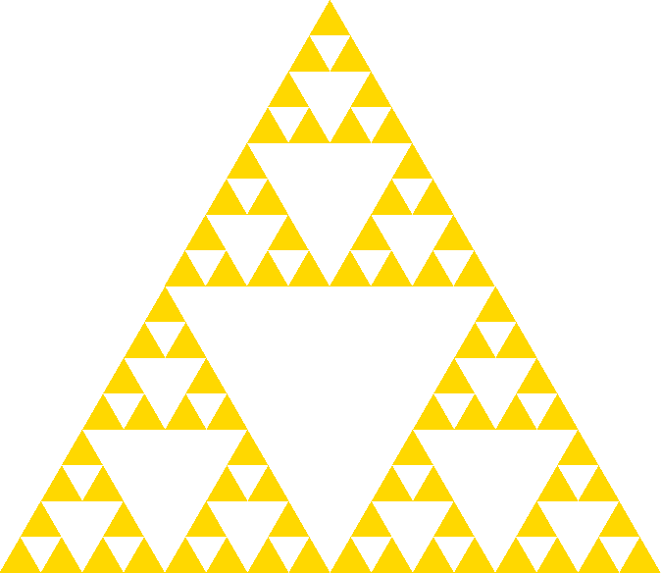




A Geographical Example

Slide 3
What is Recursion?

