Slide 1
Variables and Data Types
Java Programming for Absolute Beginners Phase I

Slide 2
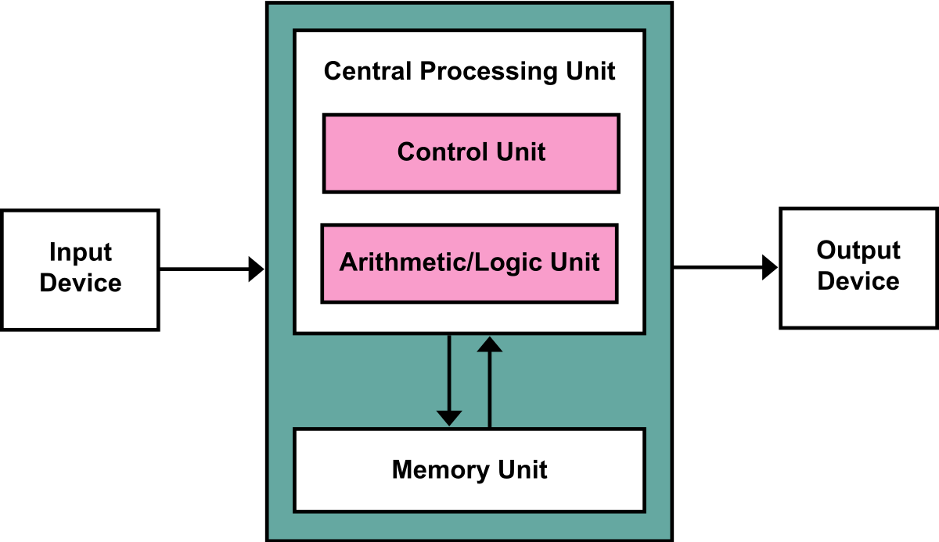
A Quick Note on Memory

Slide 3
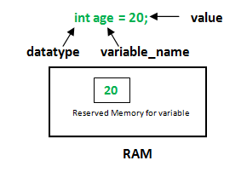
What is a Variable?
Think of a variable as a placeholder for data in memory.
All variables have a name, a value, and a data type.
Remember that in memory there only exists one’s and zero’s, so the meaning of the value is determined by the data type of the variable.
There are two types of data types in Java: primitive and non-primitive.

Slide 4
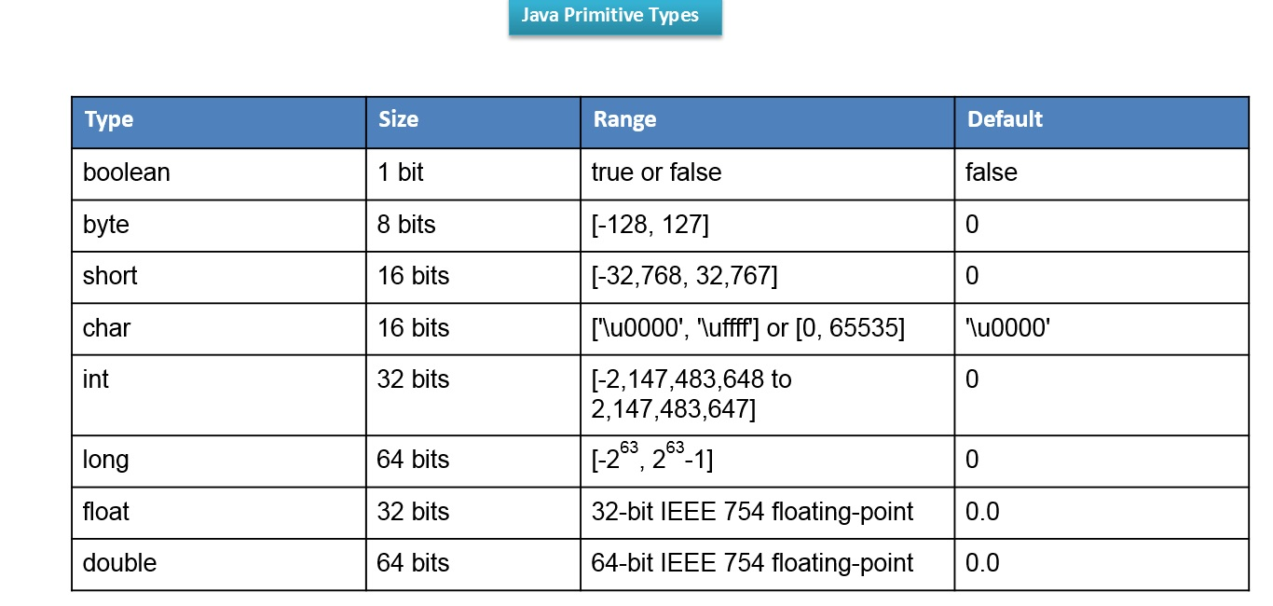
Primitive Data Types

Slide 5
Declaring a Variable in Java
Java is a strongly typed language, meaning a variable must be declared with a data type, and that data type cannot be changed.
Declaring a variable will allocate space in RAM for that variable. The amount of bits allocated depends on the data type.
The syntax to declare a variable in Java is as follows:
<data_type> <variable_name>;
Example: int i;
Example: double x;
Example: int age;
Example: String hello;

Slide 6
Variable Name Rules
We will be calling referring to variable names as identifiers, because these rules apply to more than just variables (more on that later).
Variables are given meaningful names to make programs expressive, but there are some limitations on how we can name our variables.
An identifier must:
Start with either a letter (a-z | A-Z), a dollar sign ($), or an underscore (_)
May contain numbers after the first character
May be any amount of characters after first character
Must be unique in its scope (more on that later)
May not contain spaces or special characters such as #, +, -, *, /, !, ., ,, etc.
Are case sensitive
May not match a reserved keyword (words like: public, int, static, final, void, class, etc)
https://en.wikipedia.org/wiki/List_of_Java_keywords
https://www.geeksforgeeks.org/java-naming-conventions/

Slide 7
Giving variables values
Giving a variable a value is known as assignment.
Assignment is achieved using an assignment operator, which in Java is the equals sign (=).
The first time a variable is assigned is known as initializing.
Example:
int age;
age = 20;
Example 2: int age = 20;
Note how you can initialize a variable at the same time as the declaration.
To reassign a variable, simply use the assignment operator again.
The assignment operation is executed right to left, meaning the value on the right hand side (RHS) is evaluated and then the result is stored in the variable on the left hand side (LHS)
On the LHS of an assignment can only be a singular variable name, while on the RHS can be either a literal, or an expression.

Slide 8
The RHS of an Assignment: Literals
The RHS of an assignment can contain either a literal, or an expression.
A literal is basically a direct value written into your program. There different types of literals in Java which represent different data.
Numeric Literals:
Integer Literals: An integer literal is a positive whole number that can be written in the following bases:
Base 10: Base 10 literals are numbers that we are used to, like 1, and 2, and 50.
Base 8: Base 8 literals are prefixed by a leading 0, so the number 10 in a base 8 literal would be 012
Base 16: Base 16 (or hexadecimal) literals are written with 0x as the prefix, so we can have values like 0xFF.
Base 2: Base 2 (binary) literals are prefixed with 0b, so the number 12 would be 0b1100
(Underscores may be used in integer literals)
Floating Point Literals:
Floats are how we used real numbers in Java they can either be written in standard notation or in scientific notation with an E. For example, we can have either 120.5f or 1.205E2f. Note all floating point literals must end in the letter f, without the f, the literal would be treated as a double.

Slide 9
More Literals
Boolean Literals:
Either true or false
Character Literals:
Characters are denoted by a single character surrounded by single quotes.
Example: ‘A’
String Literals
Strings are the only non-primitive that can be used with literals.
A string literal is a series of characters enclosed in double quotation marks.
Example “hello!”
Note: There are such things as “escape characters” we can use in our character and string literals, read up on them here: https://docs.oracle.com/javase/tutorial/java/data/characters.html

Slide 10
The RHS of an Assignment: Expressions
The other option for an RHS of an assignment is an expression.
An expression is a combination of literals, variables, and operators that produces a value.
Example: x + y * 3
Today we will only be looking at arithmetic expressions.
An operator is a symbol used to represent a manipulation of data.
There are three types of operators:
Arithmetic Operators (adding, subtracting, etc.)
Relational Operators (is equal to, is greater than, etc.)
Logical Operators (and, or, not, etc.)
Assignment Operators
Increment/Decrement Operators
Bitwise Operators (these are not in the scope of this class)

Slide 11
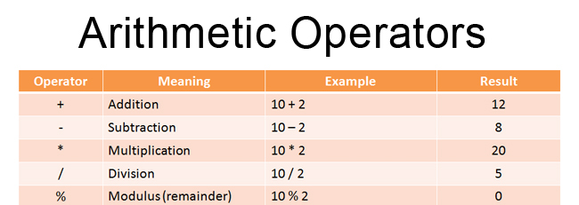

Slide 12
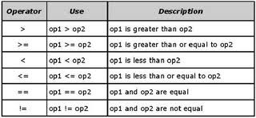
Relational Operators

Slide 13
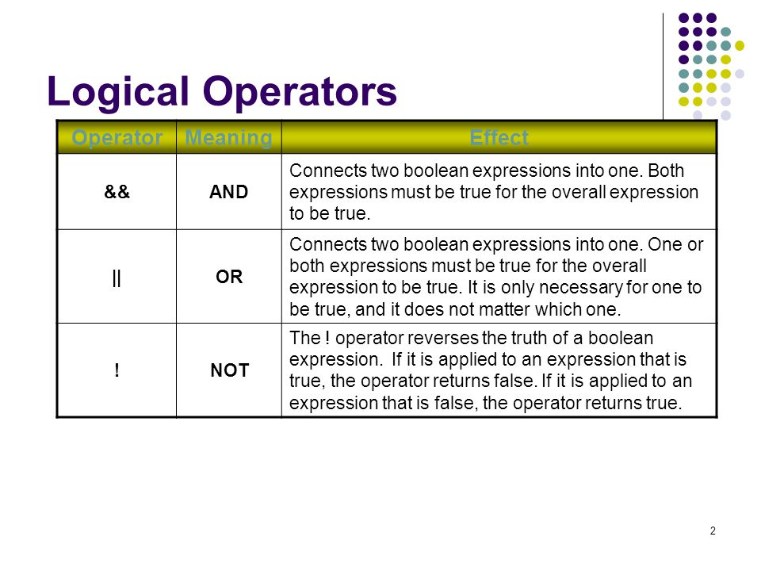

Slide 14
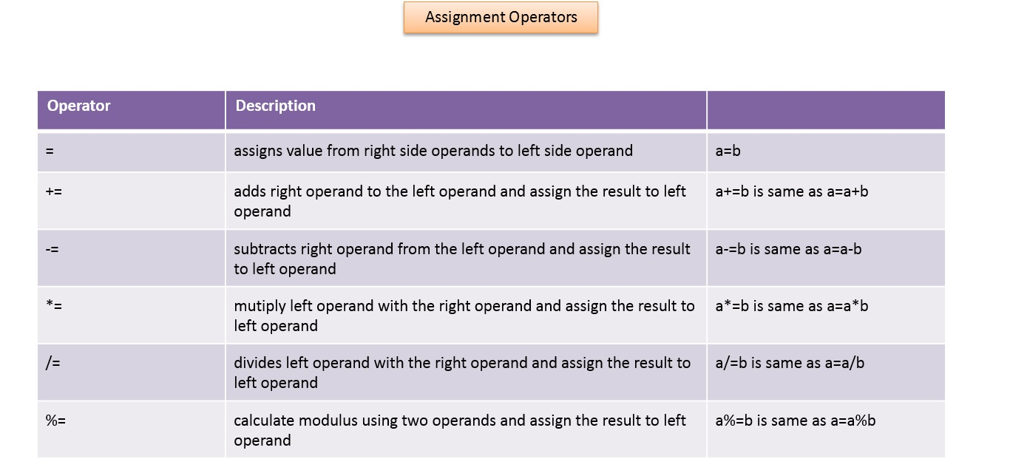

Slide 15
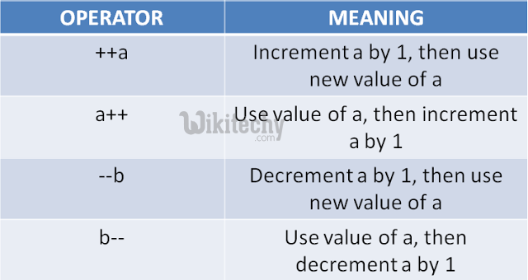
Increment and Decrement Operators

Slide 16
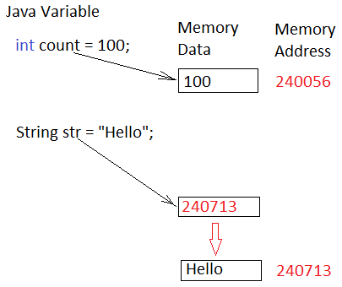
Strings
Think of a string as a list of chars.
Strings are non-primitive, making them different from the variables we have been looking at.
The value at the variable in memory is not the string itself, but a reference to the string.
String literals are double quotes surrounding characters.
Strings are immutable, meaning their values cannot be changed, to update the value of a string, a new one must be created and the reference must be reassigned.

Slide 17
String Concatenation
The String Concatenation Operator (+) is used to combine two strings together.
Other data can also concatenated with a string, which is perfect for printing data to the console.
Be careful, the concatenation operator has the same precedence as the addition operator, which can yield strange results
Example: String s=50+30+"Hello"+40+40;
s has a value of 80Hello4040
Using parentheses can force desired results.
Notes:
Go Over Code Examples

Slide 18

Any Questions?

