Slide 1
Absolute Basics
Java Programming for Absolute Beginners Phase I

Slide 2
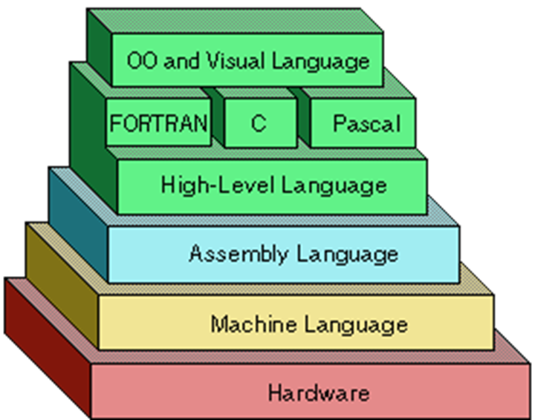
What is Programming?
Programming is the process of giving instructions to be executed by a computer.
Programming is done at various “levels” where each level is more abstracted than the level below.
In the end, the computer only receives instructions as one’s and zero’s, known as “machine code”.

Slide 3
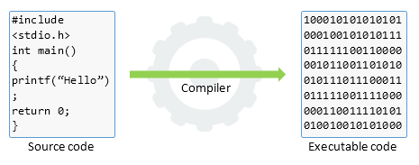
What is a compiler?
Remember that computers can only execute instructions as one’s and zero’s. However, that is not what we will be writing.
We are writing source code, which is human readable code that will be run through a special program called a compiler which basically translates our source code into binary machine code.

Slide 4
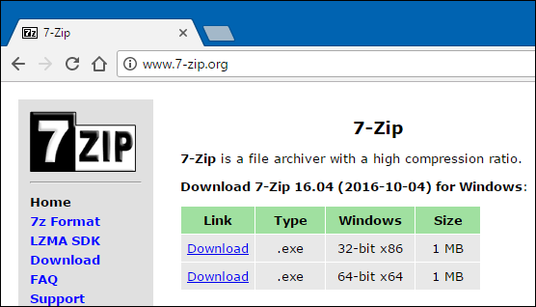
A Problem
CPU’s are not created equal.
Creators of CPU’s design their chips to follow specific architectures, which determine what each binary instruction means.
This means that machine code for one CPU may not work on another.
Some compilers can target multiple architectures to remedy this problem for developers, but ultimately, different versions of a program must be distributed for each architecture a developer wants to target.

Slide 5
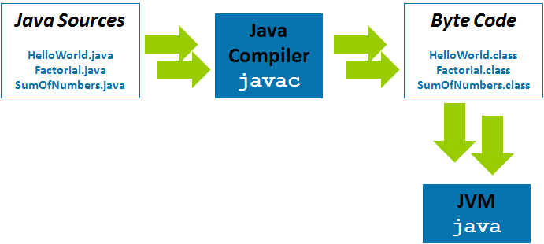
What is Java?
Java is a high order C-like programming language that we will be coding in.
Java is special because instead of compiling for the CPU directly, it compiles to a special type of binary code known as Byte Code.
This byte code is then interpreted by a program on the end user’s machine called the Java Virtual Machine (JVM).
The reason for this is so that the developer can distribute only one version of their program to work on all sorts of devices. All the end user must do is install the JVM.
Note: Java source code files have extension .java, and compiled files have extension .class.

Slide 6
What You Will Need to Get Started
All a developer really needs to program in Java is a text editor and the Java Development Kit (JDK).
The JDK is a set of tools that allows developers to develop and compile Java programs.
There are multiple versions of the JDK, but we will be using JDK 1.8 in this course. (as of writing this the latest version is 1.11)

Slide 7
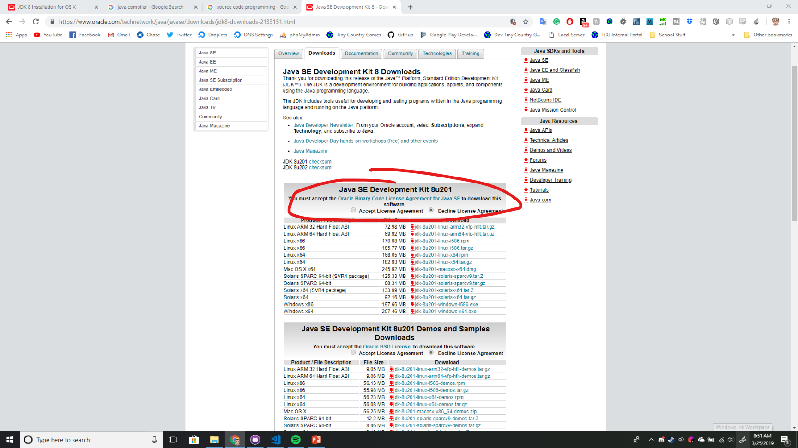
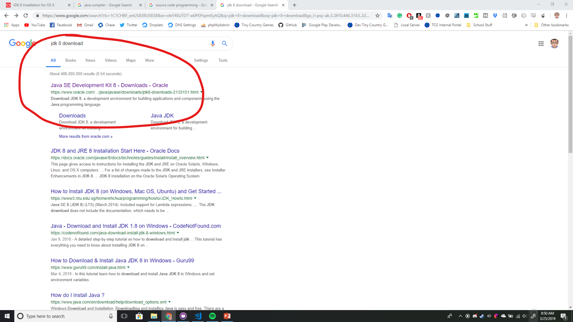
Installing the JDK
To install the JDK, simply search for “jdk 8 download” in your favorite search engine or go to the following url: https://www.oracle.com/technetwork/java/javase/downloads/jdk8-downloads-2133151.html
Accept the license agreement, and click the link corresponding to your computer.
Windows users will need to update their PATH variable.

Slide 8
IDE
Once you have installed the JDK, you really are good to get started right away. You can write Java source code in any text editor and compile it manually using the javac command in the command line of your operating system.
However, there are special text editors for programmers called Integrated Development Environments (IDE’s). They are helpful for many reasons including integrated consoles, “run buttons”, syntax highlighting, code completion, error detection, error warnings, and so on.
We will be using an IDE that is quite popular called IntelliJ IDEA.

Slide 9
Installing IntelliJ IDEA
Go to the following url: https://www.jetbrains.com/idea/download
Click on download for the Community Edition, there is a paid version but for our purposes we do not need all the features included in that.
Do not try to crack the Ultimate Edition, the Community Edition is more than enough.
Run the installation and open up the software.

Slide 10
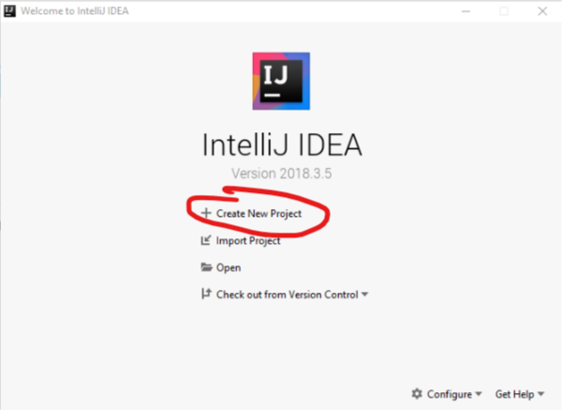
Your First Program!
You are now ready to begin coding, once IntelliJ is open on your computer, click on “Create New Project”, click “Next” twice, then, choose a memorable location for your first project and called it HelloWorld, finally click “Finish”

Slide 11
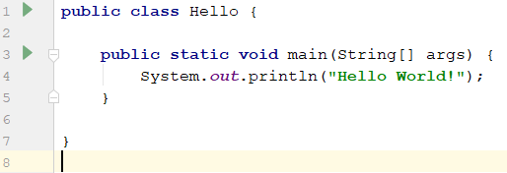
Hello World
Right click on the “src” folder and select “New” -> “Java Class”. Call it “Hello” exactly, all Java classes should start with a capital letter and may not contain spaces. Now, type the following program:
To run the program, click the green triangle next to the class and click “Run Hello.main()”

Slide 12
Congratulations!
You have just written your first Java program!
With all the setup you did today, you are ready to begin learning how to program, and once the basics are all covered, we will be making games in no time!

Slide 13

Any Questions?

