Slide 1
Flow Control
Java Programming for Absolute Beginners Phase I

Slide 2

Booleans
A Boolean is a data type whose value can be either true or false.
There are several operators that can be performed on Booleans:
AND: returns true if both given Booleans are true
OR: returns true if at least one given Boolean is true
NOT: negates the given Boolean, if it is true, the operation returns false, and if it is false, the operation returns true.

Slide 3
Truth Tables
The different results of a different Boolean operations can be expressed in tables called Truth Tables.
A | B | A OR B
T | T | T
T | F | T
F | T | T
F | F | F
A | B | A AND B
T | T | T
T | F | F
F | T | F
F | F | F
A | NOT A
T | F
F | T

Slide 4
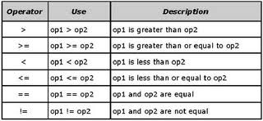
Relational Operators
These relational operators result in Boolean values.
They can be put together for Boolean expressions.

Slide 5

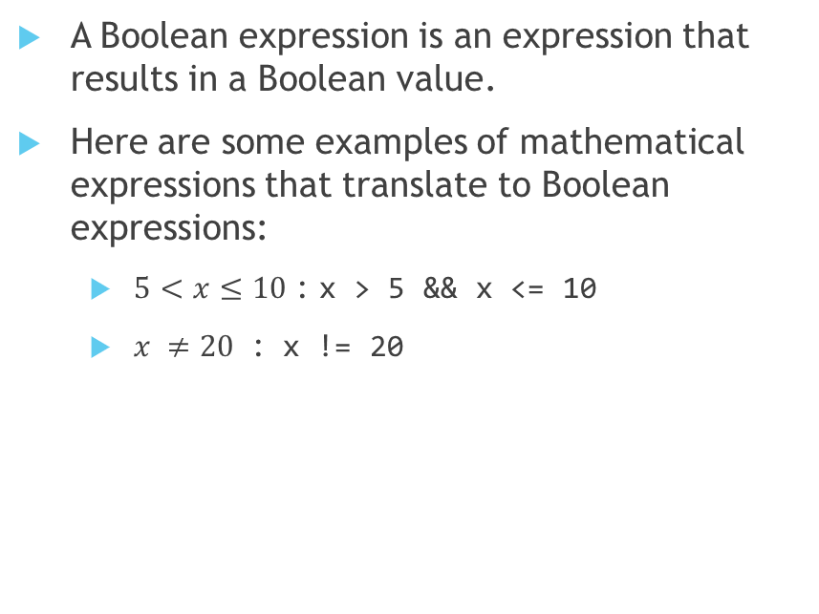
Boolean Expressions
A Boolean expression is an expression that results in a Boolean value.
Here are some examples of mathematical expressions that translate to Boolean expressions:
$5<x≤10$ : x > 5 && x <= 10
$x ≠20$ : x != 20

Slide 6
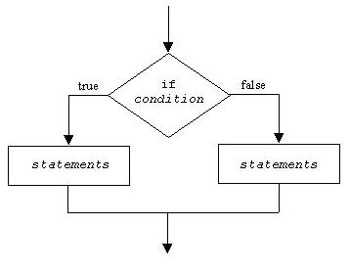
So What are Booleans Used For?
So far, all of our programs have executed from top to bottom, the same way every time, this can be useful for a variety of different problems, but the power of computer shines when the program can make decisions.
Our programs could now make all sorts of decisions, and the flow of the program can consist of branching and looping.

Slide 7
If Statements
In Java, if statements are used for flow control.
These are the four types: if, if-else, if-else if, if-else if-else
<statements>
if(<booleanExpr>) {
<statements>
}
<statemets>
<statements>
if(<booleanExpr>) {
<statements>
} else {
<statements>
}
<statements>
<statements>
if(<booleanExpr>) {
<statements>
} else if(<booleanExpr>) {
<statements>
}
<statements>
<statements>
if(<booleanExpr>) {
<statements>
} else if(<booleanExpr>) {
<statements>
} else {
<statements>
}
<statements>

Slide 8
If Statement
Execute <statements_1>
Check <booleanExpr>, if it is true, go to 3, otherwise go to 4.
Execute <statements_2>
Execute <statements_3>
<statements_1>
if(<booleanExpr>) {
<statements_2>
}
<statements_3>

Slide 9
If-Else Statement
Execute <statements_1>
Check <booleanExpr> if it is true, go to three, if it is false, go to 5.
Execute <statements_2>
Go to 6
Execute <statements_3>
Execute <statements_4>
<statements_1>
if(<booleanExpr>) {
<statements_2>
} else {
<statements_3>
}
<statements_4>

Slide 10
If-Else If Statement
<statements_1>
if(<boolExpr_1>) {
<statements_2>
} else if (<boolExpr_2>) {
<statements_3>
}
<statements_4>
Execute <statements_1>
Check <boolExpr_1>, if true, go to 3, if false, go to 5
Execute <statements_2>
Go to 7
Check <boolExpr_2>, if true, go to 6, if false, go to 7
Execute <statements_3>
Execute <statements_4>
Note: You can have as many else if blocks after an if statement as you want.

Slide 11
If-Else If-Else Statement
<statements_1>
if(<boolExpr_1>) {
<statements_2>
} else if (<boolExpr_2>) {
<statements_3>
} else {
<statements_4>
}
<statements_5>
Execute <statements_1>
Check <boolExpr_1>, if it is true, go to 3, if it is false, go to 5
Execute <statements_2>
Go to 9
Check <boolExpr_2>, if it is true, go to 6, if it is false, go to 8
Execute <statements_3>
Got to 9
Execute <statements_4>
Execute <statements_5>
Note: You can have as many else if blocks between the if and the else, but only one else is allowed.

Slide 12
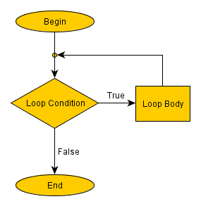
Loops
Computers are very good at executing the same task over and over again.
They can even perform the same task millions of times, with only a slight variation between each iteration.
Programmers accomplish this using a loop, which is a block of code that will be repeated, rather than writing the same code millions of times.
There are several types of loops, today we will be looking at the while loop and the for loop.

Slide 13
While Loop
<statements_1>
while (<boolExpr>) {
<statements_2>
}
<statements_3>
Execute <statements_1>
Check <boolExpr>, if it is true, go to 3, if it is false, go to 5.
Execute <statements_2>
Go to 2
Execute <statements_3>

Slide 14
For Loop
<statements_1>
for (<initializer>; <boolExpr>; <incrementor>) {
<statements_2>
}
<statements_3>
Execute <statements_1>
Execute <initializer>
Check <boolExpr>, if it is true, go to 4, if it is false, go to 7
Execute <statements_2>
Execute <incrementor>
Go to 3
Execute <statements_3>
Notes:
Go to examples

Slide 15

Any Questions?

