Slide 1
SENIOR PROJECT PRESENTATIONS
Santa Susana High School Class of 2016

Slide 2
Mr. Torti’s SENIOR PROJECT
Santa Susana High School Class of 2016

Slide 3
SENIOR PROJECTS
Santa Susana High School Class of 2016

Slide 4
Introduction – About Me
AP of Santa Susana High School
Inherited Senior Project from Mr. Buckle in 2014-2015 school year
Observed process and chatted with stakeholders.
GOAL FOR 2015-2016 – Initiate process of updating / revitalizing Senior Projects at SSHS

Slide 5
PROCESS
Interviews
Students (Class of 2015) – In March-April 2015
“It was a lot of paperwork and hoops to jump through.”
“I’m happy to have done it, but it was stressful because of the timing.”
“I wish I could show other people what I did. I feel like it gets left here.”

Slide 6
PROCESS
Teachers
“Students are overwhelmed by process.”
“Approval process should include more teachers to ensure higher quality projects.”
“A lot of kids just throw something together – not a good showing of their abilities.”
“Paper portfolio is kind of evidence of the process, not the project.”
“Paper portfolio is hard to share with panelists – only one copy available.”

Slide 7

PROCESS
Generated proposal for changes to portfolios
Digital Portfolio
Student can “take it with them” – share with anyone
Relies on skills already developed in 12th grade
Panelists can all review portfolios before presentations, at the same time, using Chromebooks or other computer technology

Slide 8


PROCESS
Generated proposal for changes to approval process
Juniors to submit proposals via 11th grade English
Will be reviewed and approved before end of junior year
Gives students whole summer to get started/finished with project

Slide 9
STRENGTHS
Digital portfolios MUCH faster to create, include multimedia
MUCH higher rate of completion (over 75% of senior class!)
Teachers and staff already impressed with quality of presentations in draft portfolios
PORTFOLIO SUBMISSIONS

Slide 10


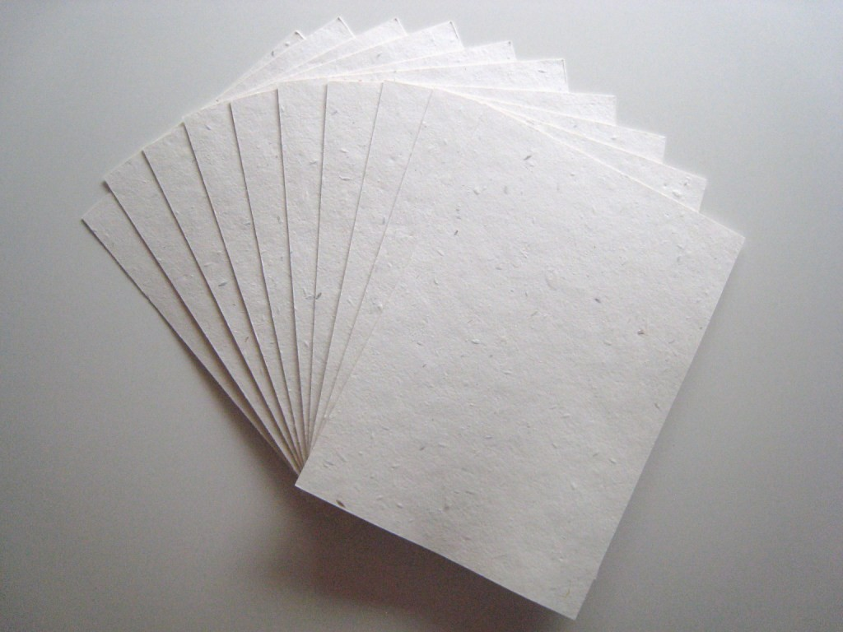
WEAKNESSES
Digital NOT EQUIVALENT to Paper
Some forms and parts of the process hard to digitize, perhaps irrelevant
Must reevaluate required pieces of portfolio in terms of purpose of portfolio

Slide 11
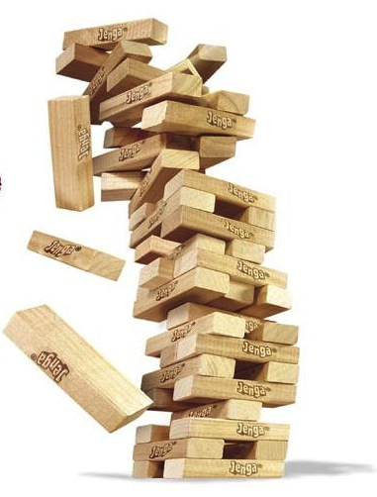
VALUE of PROCESS
Learned
A system that includes the work and effort of many people cannot be changed by sheer force of will or by a snap of the fingers.
Senior Project is like JENGA.
Still Learning
Completion Rate

Slide 12

SSHS SLO
Scholarly
Research, soft data – no easy answers
Skilled
Patience, leadership, knowledge of relevant technology
Humane
Response to student and teacher concerns – attempt to serve needs of the community

Slide 13
CONCLUSION
It’s not your fault, but it is your problem. Mr. Bradley Torti

