Slide 1

Santa Susana High School
Class of 2019
Registration Night
Please fill out your first name, last name, student ID number, and
current middle school.
Please wait to fill out the rest of the forms.
Use a pencil!
This presentation will be available to view on-line @ www.SantaSusana.org

Slide 2
OVERVIEW OF REGISTRATION PROCESS
Timeline
  Complete registration form tonight
  Counselors will sit down 1:1 with students to check their request forms for appropriate placement
    No Questions? Drop off your form in the bin!
  Students will receive their schedules via AERIES in August
Information received tonight
  Registration Course Request Form (PINK FORM)
  HS Grad Requirements vs. “a-g” requirements
  “a-g” approved courses
  Math & Science flow charts
  English 9 Honors Application & Summer Assignment

Slide 3
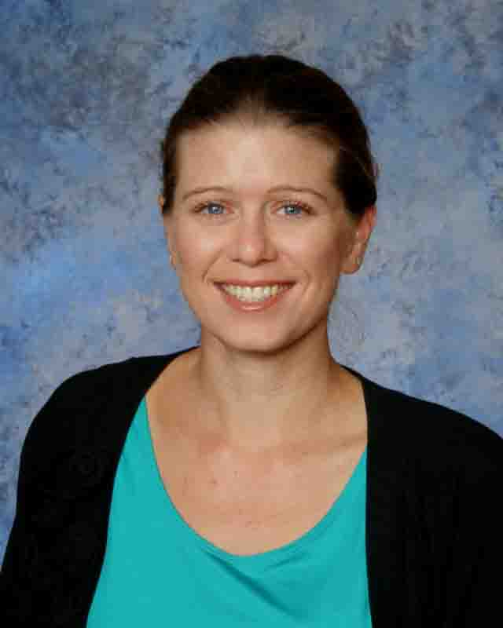
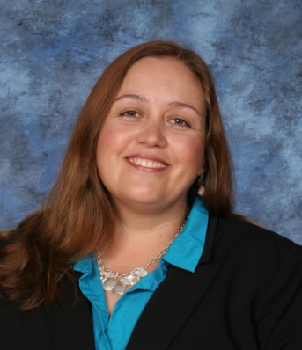
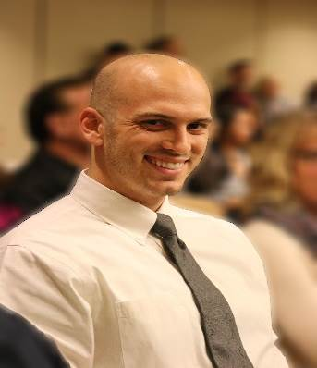
WELCOME & INTRODUCTIONS
Principal
Wendy Mayea
Assistant Principals
Ms. Shayna Ledesma 9th- 10th
Mr. Brad Torti 11th- 12th

Slide 4
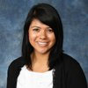
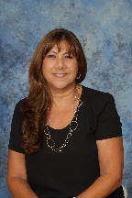
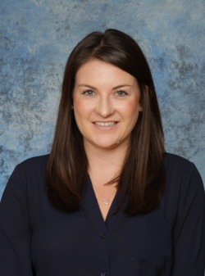
Who is your school counselor?
A-GL: Ms. Jillian Bischoff
GO-N: Mrs. Jody Melanson
O-Z: Ms. Kelsey McMahon

Slide 5
Career & College Center (CCC)
Career Counselor–Mrs. Jennifer Wigdor
College and Career Search
Career Interest Inventories
College Admissions information
SAT/ACT Information
Updated Scholarship Information
College Visits/Military Visits/Vocational School Visits
STUDENTS AND PARENTS WELCOME !

Slide 6
SUMMER INFORMATION PACKET
During August, all students enrolled at SSHS will be mailed an information packet.
  Freshman Orientation date
  Beginning of the year information
    Locker & Schedule distribution
    AUP Form
    Update Registration Info

Slide 7
EXTRACURRICULAR ACTIVITIES
Santa Susana High School has many extracurricular activities available to students:
Leadership
CSF
Performing Arts
Campus Clubs
Once you are a Santa Susana High School student your quarter report cards will be used to determine outside school hours performance and extra-curricular activity eligibility.
*** Students must have a minimum 2.00 GPA!!

Slide 8
PROGESS REPORTS & REPORT CARDS
Progress reports are issued every five weeks
Semester grades (January & June) will count as the official transcript grade
Parents have access to grades through Aeries or other teacher grading programs
Email teachers directly if your student is having trouble in a specific class

Slide 9
CLASS CREDIT
Students take 6 classes each semester. Each class is worth 5 credits; therefore, a student who passes all classes will receive 60 credits each year and 240 credits at the end of four years.
Student must complete each class with a “D” or better to receive high school credit.
Please note: Santa Susana High School does not put classes that do not contribute to graduation requirements on students transcripts.

Slide 10
HIGH SCHOOL GRADUATION
REQUIREMENTS
English – 4 years
Math – 3 years (must pass Alg I)
Physical Education – 2 years
Fine Arts OR Foreign Language – 1 year
Social Science –3 years
Science – 3 years
Practical Art – 1 semester
Health – 1 semester
Computer Education – 1 semester
Electives –55 credits
TOTAL CREDITS = 230

Slide 11
Other requirements
Algebra I
Students will take the California High School Exit Exam for the first time during their Sophomore year
  ELA/MATH
Notes:
1X- Sophomore year
2X- Junior year
5X- Senior year

Slide 12
CSU/UC COLLEGE ENTRANCE REQUIRMENTS
“a-g”
A. History/Social Sci. – 2 years
B. English – 4 years
C. Math – 3 years
  (Alg./Geom./Alg. II)
D. Lab Science – 2 years
E. Foreign Language – 2 years
F. Visual/Performing Art- 1 year
Electives – 1 year
MINIMUM REQUIREMENTS
Grade of C or Better!
Must enroll in CP/Honors/AP courses to be ‘a-g’ eligible

Slide 13
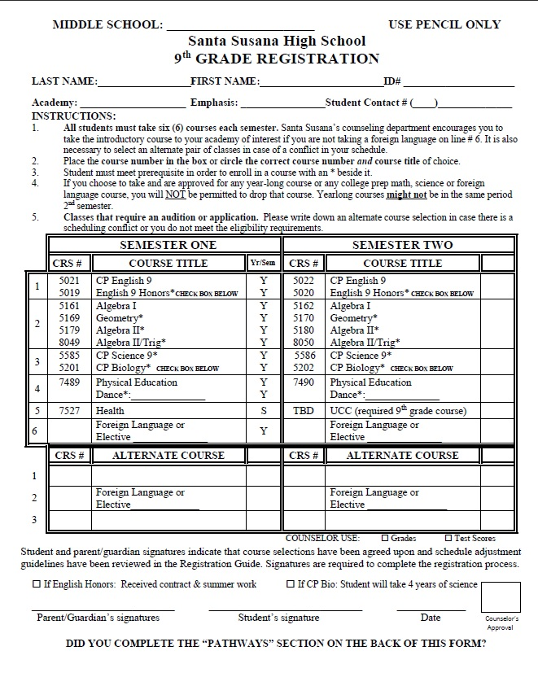
Selecting your School & Academy
See Schools & Academy Handout
  Priority registration in your specific area of interest

Slide 14
SCHOOLS & ACADEMIES
School of ACADEMICS
  Academy of Accelerated Academics
    Emphasis- Humanities
    Emphasis- Science
    Emphasis- Math
    Emphasis- STEM
  Academy of Law and Society

Slide 15
SCHOOLS & ACADEMIES
School of TECHNICAL ARTS
  Academy of Digital Graphics & Publication
  Academy of TV & the Art of Film
  Academy of Stagecraft
  Academy of Internet Development

Slide 16
SCHOOLS & ACADEMIES
School of VISUAL & PERFORMING ARTS
  Academy of Fine Arts
  Academy of Performing Arts
    Emphasis- Vocal Music
    Emphasis- Instrumental Music
    Emphasis- Theatre
    Emphasis- Dance
    Emphasis- Musical Theatre

Slide 17
REGISTRATION OF CLASSES
Use a pencil
Double Check: NAME, ID#, CURRENT SCHOOL, CONTACT NUMBER

Slide 18
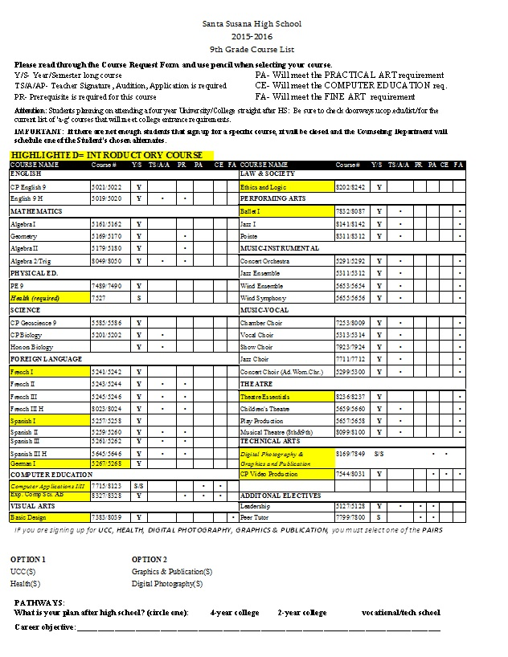
Pathway

Slide 19
*COURSE CHANGE
DISTRICT POLICY*
Schedule changes requested by parents/ students for specific teachers cannot be honored.
i.e. I want my son to have Mrs. Smith
i.e. I do not want my daughter to have Mrs. Smith
If you are enrolled in any year-long CP, Honors, or AP course, you will NOT be allowed to drop that course at the semester. Please take your Course Request Form seriously & choose wisely!
Year long courses may not be in the same period second semester.

Slide 20
Selecting Courses
Circle the ENTIRE course number and course title
Write in course numbers when needed *see backside of form
Write clearly

Slide 21
CIRCLE an ENGLISH Course
All Freshman will be placed into English
  ENGLISH 9 (unless student qualifies for English 9 Honors)
Students who are interested in English 9 Honors must meet the following requirements:
  An A or B in HONORS English and/or an A in general English and/or has a recommendation from the current/previous English teacher
  Graded Essay submitted
  APPLICATION DUE
  Friday, APRIL 17th to the Counseling Office
  *Summer Assignment- Pick up tonight & SIGN! Due first day of school

Slide 22
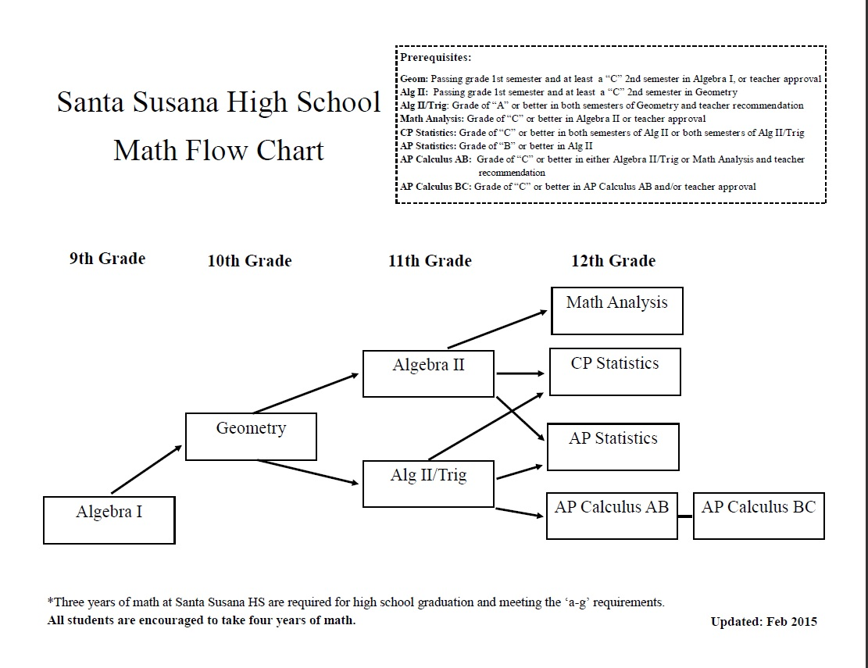

Slide 23
CIRCLE a MATH course
Mark the appropriate Math according to your current Math status:
Current Math | Freshman Math
Math 8 | Algebra I
Algebra I (earning a C or better) | Geometry
Algebra I (earning a D or lower) | Algebra I
Geometry ( earning a C or better) | Algebra II
Geometry (earning double A’s) | Algebra II/Trig
* Math & Science Flow Chart

Slide 24
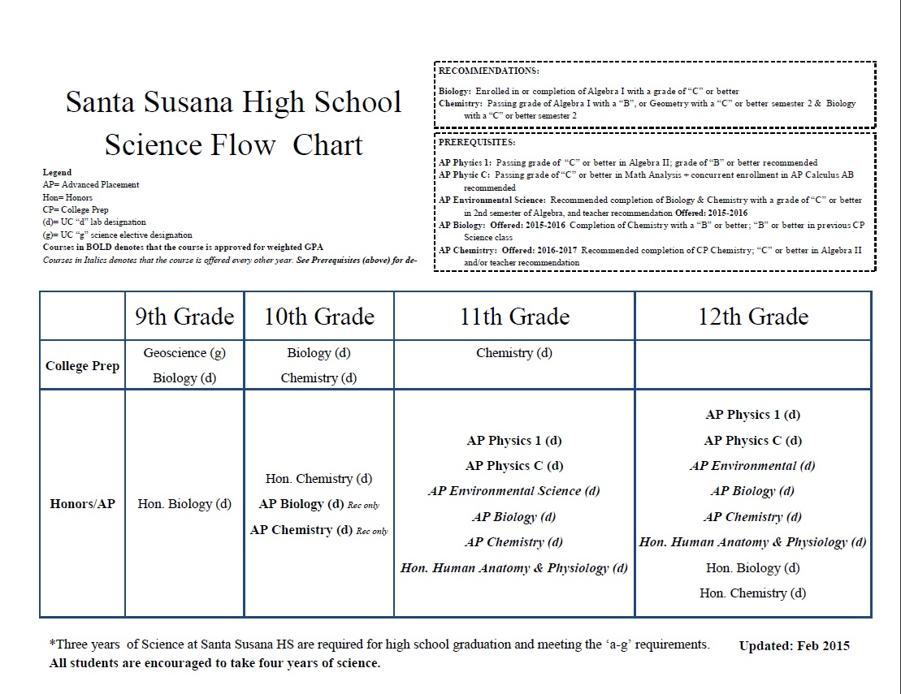

Slide 25
CIRCLE a SCIENCE Course
Geoscience
  Advise? Concurrently enrolled in Algebra I or Geometry
CP Biology
  Advise? Completion of Algebra I, strong Science student. Must take Science all FOUR YEARS.

Slide 26
CIRCLE
PHYSICAL EDUCATION Course
Students MUST enroll in P.E.
Students may enroll in Ballet I/Jazz I/Tap I* for P.E. credit.
*Audition and/or teacher approval required
Haven’t auditioned yet?
Please contact the individual teacher
Independent PE? Talk to a counselor. Applications due no later than May 29th.

Slide 27
CIRCLE Health/UCC Course
ALL students will be enrolled in one semester of Health and one semester of Understanding Career Choices
EXCEPTION: Students may take UCC & Health this summer if they are taking one of the following courses in combination with a Foreign Language or Leadership* COUNSELOR APPROVAL NEEDED

Slide 28
Choose an ELECTIVE
You may choose your last class from the list of electives (Foreign Language OR Elective). When choosing your elective, keep UC/CSU and High School graduation requirements in mind.
  Advise? Foreign Language: Solid English Student. Please remember that Foreign Language is another academic/rigorous core course to add to your Freshman schedule.
8th Graders in Spanish1: Spanish I will NOT go on your high school transcript but, it will count towards “a-g” for UC/CSU admissions
Important: List at least 3 alternative classes you would consider taking

Slide 29
COMPLETE SCHEDULE
Your PINK registration sheet should be completed with each area CIRCLED. Any unmarked courses will be selected for you. All placement will be checked along with grades and test scores. Schedule changes can be made due to second semester final grades without notification.
Check for the following:
ENGLISH
MATH
PHYSICAL EDUCATION
SCIENCE
HEALTH and UCC*
ELECTIVE & alternates

Slide 30

TURN IT IN!
Complete the Registration Form
  Please do not leave any blanks
  Honors English/CP Bio? Please check the box!!
  Parent Signature & Student’s Signature
Meet with counselor 1:1 to “double check” course selection.
Or drop in the bin at the front of the stage
See you in August 2015
Facebook.com/SSHSCounseling

