Slide 1
Introduction
COMP232
Programming Languages
Instructor: Prof. Bieszczad

Slide 2
Outline
Why do we need programming languages?
Why should we study languages?
Why do we have a plethora of languages?
Programming paradigms
Language classification
Language selection guidelines
Language design influences

Slide 3
Programming Language
A programming language is a standardized communication technique for describing instructions for a computer.
Each programming language has a set of syntactic and semantic rules used to define computer programs.
A language enables a programmer to precisely specify:
what data a computer is to act upon,
how these data are to be stored/transmitted, and
what actions are to be taken under various circumstances.

Slide 4
Programming Language Features
Each programming language can be thought of as a set of formal specifications concerning syntax, vocabulary, and meaning.
These specifications usually include:
Data types
Data structures
Instruction and flow control
Design philosophy
Compilation and interpretation
Popular languages have standardization bodies that meet regularly to create and publish formal definitions of the language and discuss the extension of existing definitions.
for example, JCP (Java Community Process) that manages JSRs (Java Specifications Requests)
standardization is a time-consuming and difficult process. For example, a committee began work on producing a standard version of C++ in 1989 – it was approved in 1998.

Slide 5
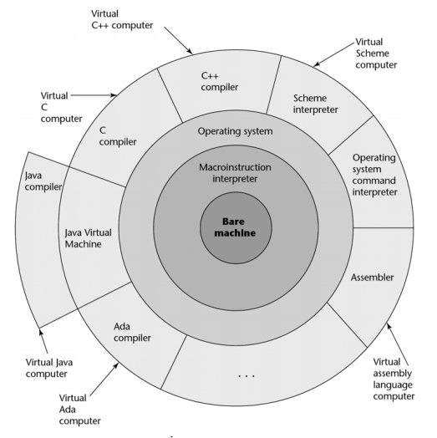
Why Do We Need Languages?
Way of thinking
Way of expressing algorithms
Way of specifying what you want
Abstraction of a virtual machine
Dealing with the hardware without getting down into the bits
Two perspectives of languages:
the user's point of view
the implementer's point of view

Slide 6
Why Study Programming Languages?
Improved background for choosing appropriate languages
e.g., Java vs. PHP vs. Python vs. Ruby for Web programming
Increased ability to learn new languages
if you think in terms of iteration, recursion, abstraction (for example), you will find it easier to assimilate the syntax and semantic details of a new language
Increased ability to express ideas
Understand obscure features
Understand implementation costs
choose between alternative ways of doing things, based on knowledge of what will be done underneath
Figure out how to do things in languages that don't support them explicitly
Better understanding of significance of implementation
Overall advancement of computing

Slide 7
Why so Many Programming Languages?
Many application domains
Evolution
we've learned better ways of doing things over time
Socio-economic factors
proprietary interests
commercial advantage
Orientation toward special purposes
Orientation toward special hardware
Diverse ideas about what is pleasant (“elegant”) to use

Slide 8
Programming Domains
Scientific applications
Efficiency, fast floating-point arithmetic for a large number of computations
e.g., Fortran (first language), C, Math-oriented languages like MATLAB, R
Business applications
Decimal arithmetic, producing elaborate reports
e.g., COBOL (first language), Java, XML
Artificial Intelligence
Symbolic computations, list of data
symbols rather than numbers manipulated
e.g., LISP (first language), Prolog, expert system shells like JESS (java Expert System Shell) and CLIPS
Systems programming
Need efficiency because of continuous use
Direct access to resources of the operating system
e.g., PL/I (early language stands for Programming Language 1 – an alternative to assembly language for low-level computer processing functions), later C, Ada
Miscellaneous
markup (e.g., XHTML, XML), scripting (e.g., PHP, JavaScript), general-purpose (e.g., Java), transformation (e.g., XSLT), art/animation (e.g., ActionScript)

Slide 9
Genealogy of Languages
http://www.levenez.com/lang/lang.pdf

Slide 10
What makes a language successful?
Easy to learn
e.g., BASIC, Pascal, LOGO, Scheme
Easy to express things, easy to use once fluent, "powerful”
e.g., C, Common Lisp, Algol, Perl
Solid standards
most popular languages
Easy to implement
e.g., BASIC, Forth
Possible to compile to very good (fast/small) code
e.g., C, Fortran
Backing of a powerful sponsor
e.g., COBOL, PL/1, Ada, Visual Basic, C#
Wide dissemination at minimal cost
originally, Pascal, Turing, Java
currently, most languages (although good compilers and virtual machines still need to be purchased)

Slide 11
Programming Paradigms
Every programming language supports a slightly different or dramatically different style of problem solving: Programming Paradigm
The same computation can be expressed in various languages, and then run on the same computer.
A language can fit a variety of paradigms
e.g., Python is object-oriented and scripting

Slide 12
Example: The GCD Algorithm
int gcd(int a, int b) { // C - iterative
while (a != b) {
if (a > b) a = a - b;
else b = b - a;
}
return a;
}
int gcd( int a, int b ) // C - recursive
{
return (a == b) ? a : ((a > b)? gcd(a-b, b) : gcd(a, b-a));
}
(define gcd ; Scheme
(lambda (a b)
(cond ((= a b) a)
((> a b) (gcd (- a b) b))
(else (gcd (- b a) a)))))
gcd(A, B, G) :- A = B, G = A. % Prolog
gcd(A, B, G) :- A > B, C is A-B, gcd(C, B, G).
gcd(A, B, G) :- B > A, C is B-A, gcd(C, A, G).

Slide 13
Classification by Paradigm
Imperative: how do we solve a problem (what steps does a solution have)?
Logic-based: it models computation as an attempt to find values that satisfy certain specified relationships, using goal-directed search through a list of logical rules
Functional: what simple operations can be applied to solving a problem, how are they mutually related, and how can they be combined? (a program and every element of the program is a function from inputs to outputs)
Object-oriented: what objects play roles in a problem, what can they do, and how do they interact to solve a problem?
Scripting: how to glue together available utilities to quickly implement a solution to a problem?

Slide 14
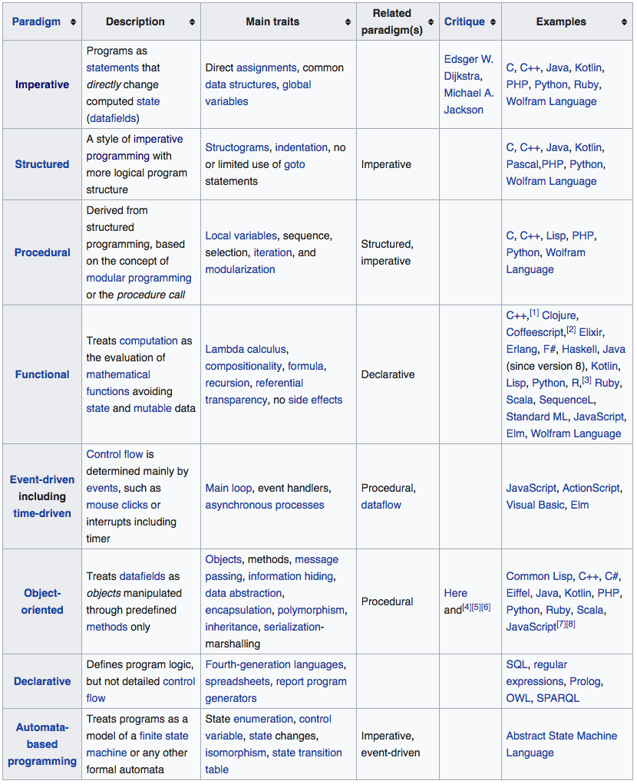
Comparison of Programming Paradigms

Slide 15
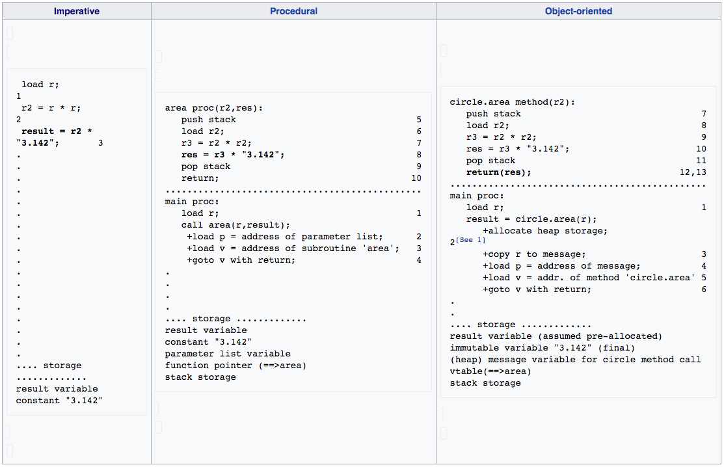
Comparison of Programming Paradigms

Slide 16
Classification by Generality of Use
General-purpose programming languages (most of the known languages are in this category);
Specialized programming languages
for example:
database query,
expert system shells,
vector-processing,
report generation,
scripting,
formatting,
and many more.

Slide 17
Classification by Abstraction Level
Low-level languages (machine languages, assembly languages).
High-level languages (most of the well-known languages belong in this category).
Very high-level languages
Domain specific and goal oriented, limited to a very specific application, purpose, or type of task
Prolog is sometimes listed in this category, so are Ruby and Python, RAD systems (e.g., Rails) and some other specialized languages.
Specialized languages; e.g., Matlab, R, Lua
Philosophy: as close to your thinking as possible
Beyond programming languages:
programming environments,
software development tools, and workbenches.

Slide 18
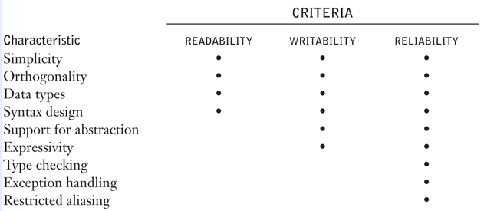
Language Evaluation Criteria

Slide 19
Language Evaluation Criteria
Readability
the ease with which programs can be read and understood
Writability
the ease with which a language can be used to create programs
Reliability
conformance to specifications (i.e., performs to its specifications)
Cost
the ultimate total cost

Slide 20
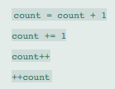
Evaluation Criteria: Writability
Overall simplicity
a manageable set of features and constructs
a language with a large number of basic constructs is more difficult to learn
operator overloading, often useful can affect writability and readability
feature multiplicity, for example in java one can increment a simple integer in four different ways:
Orthogonality
In programming language means that a relatively small set of primitive constructs can be combined in a relatively small number of ways to build the control and data structures of the language
every possible combination of primitives is legal and meaningful
a smaller number of primitive constructs and a consistent set of rules for combining them (that is, orthogonality) is much better than simply having a large number of primitives. A programmer can design a solution to a complex problem after learning only a simple set of primitive constructs.
On the other hand, too much orthogonality can be a detriment to writability. Errors in programs can go undetected when nearly any combination of primitives is legal. This can lead to code absurdities that cannot be discovered by the compiler.

Slide 21
Evaluation Criteria: Writability
Support for abstraction
The ability to define and use complex structures or operations in ways that allow details to be ignored
Expressivity
A language has relatively convenient, rather than cumbersome, ways of specifying operations and computations. For example, in C, the notation count++ is more convenient and shorter than count = count + 1.
The inclusion of the for statement in Java makes writing counting loops easier than with the use of while, which is also possible.

Slide 22
Evaluation Criteria: Readability
Simplicity and orthogonality
few constructs, a small number of primitives, a small set of rules for combining them
just like for writability
minimal feature multiplicity (means of doing the same operation)
minimal operator overloading
Control statements
the presence of well-known control structures (e.g., loops, conditional statements)
Data types and structures
the presence of adequate facilities for defining data structures
for example, in the original version of C, we might have an assignment such as the following:
timeout = 1 - the meaning of this statement is unclear,
whereas in a language that includes Boolean types, we would have the following:
timeout = true - the meaning of this statement is perfectly clear.

Slide 23
Evaluation Criteria: Readability
Syntax considerations
flexible composition of identifiers
self-descriptive constructs, meaningful keywords (while, class, for)
method of forming compound statements, or statement groups, primarily in control constructs:
some languages have used matching pairs of special words or symbols to form groups. C and its descendants use braces to specify compound statements.
All of these languages have diminished readability because statement groups are always terminated in the same way, which makes it difficult to determine which group is being ended when an end or a right brace appears
another important issue is whether the special words of a language can be used as names for program variables. If so, then the resulting programs can be very confusing.
for example, in Fortran 95, special words, such as Do and End, are legal variable names, so the appearance of these words in a program may or may not connote something special
designing statements so that their appearance, at least partially, indicates their purpose is an obvious aid to readability. Semantics, or meaning, should follow directly from syntax, or form.
in some cases, this principle is violated by two language constructs that are identical or similar in appearance but have different meanings, depending perhaps on context.
in C, for example, the meaning of the reserved word static depends on the context of its appearance. If used on the definition of a variable inside a function, it means the variable is created at compile time. If used on the definition of a variable that is outside all functions, then it means the variable is visible only in the file in which its definition appears; that is, it is not exported from that file

Slide 24
Evaluation Criteria: Reliability
Type checking
Testing for type errors in a given program, either by the compiler or during program execution.
Because run-time type checking is expensive, compile-time type checking is more desirable.
Furthermore, the earlier errors in programs are detected, the less expensive it is to make the required repairs.
For example the design of Java requires checks of the types of nearly all variables and expressions at compile time. This virtually eliminates type errors at run time in Java programs.

Slide 25
Evaluation Criteria: Reliability
Exception handling
The ability of a program to intercept run-time errors (as well as other unusual conditions detectable by the program), take corrective measures, and then continue
Readability and writability
A language that does not support “natural” ways of expressing an algorithm will necessarily use “unnatural” approaches, and hence reduced reliability
Unnatural approaches are less likely to be correct for all possible situations.
The easier a program is to write, the more likely it is to be correct.
Readability affects reliability in both the writing and maintenance phases of the program life cycle. Programs that are difficult to read are difficult both to write and to modify.

Slide 26
Evaluation Criteria: Cost
Training programmers to use language
which is a function of the simplicity and orthogonality of the language and the experience of the programmers. Although more powerful languages are not necessarily more difficult to learn, they often are
Writing programs
This is a function of the writability of the language, which depends in part on its closeness in purpose to the particular application. The original efforts to design and implement high-level languages were driven by the desire to lower the costs of creating software
Compiling programs
Both the cost of training programmers and the cost of writing programs in a language can be significantly reduced in a good programming environment
Language implementation system: availability of free compilers
Executing programs
the cost of executing programs written in a language is greatly influenced by that language’s design. A language that requires many run-time type checks will prohibit fast code execution, regardless of the quality of the compiler. Although execution efficiency was the foremost concern in the design of early languages, it is now considered to be less important
Reliability: poor reliability leads to high costs
If the software fails in a critical system, such as a nuclear power plant or an X-ray machine for medical use, the cost could be very high.
The failures of noncritical systems can also be very expensive in terms of lost future business or lawsuits over defective software systems.
Maintaining programs
which includes both corrections and modifications to add new functionality. The cost of software maintenance depends on a number of language characteristics, primarily readability. Because maintenance is often done by individuals other than the original author of the software, poor readability can make the task extremely challenging.
The importance of software maintainability cannot be overstated. It has been estimated that for large software systems with relatively long lifetimes, maintenance costs can be as high as two to four times as much as development costs

Slide 27
Evaluation Criteria: Others
Portability
The ease with which programs can be moved from one implementation to another
Generality
The applicability to a wide range of applications
Well-definedness
The completeness and precision of the language’s official definition
Compilers and interpreters should treat the same code uniformly

Slide 28
Language Design Trade-Offs
Language design criteria are weighed differently from different perspectives.
Language implementors are concerned primarily with the difficulty of implementing the constructs and features of the language.
Language users are worried about writability first and readability later.
Language designers are likely to emphasize elegance and the ability to attract widespread use.
These characteristics often conflict with one another

Slide 29
Language Design Trade-Offs
Conflicting criteria
Reliability vs. cost of execution
for example: Java demands all references to array elements be checked for proper indexing but that leads to increased execution costs
Readability vs. writability
for example: C provides many powerful operators, allowing complex computations to be written in a compact program but at the cost of poor readability
Writability (flexibility) vs. reliability
for example: C/C++ pointers are powerful and very flexible but not reliably used

Slide 30
Influences on Language Design
Computer Architecture
Many languages are developed around the prevalent computer architecture, known as the Von Neumann Architecture
Programming Methodologies
New software development methodologies (e.g., object-oriented software development, RAD) led to new programming paradigms and by extension, new programming languages

Slide 31
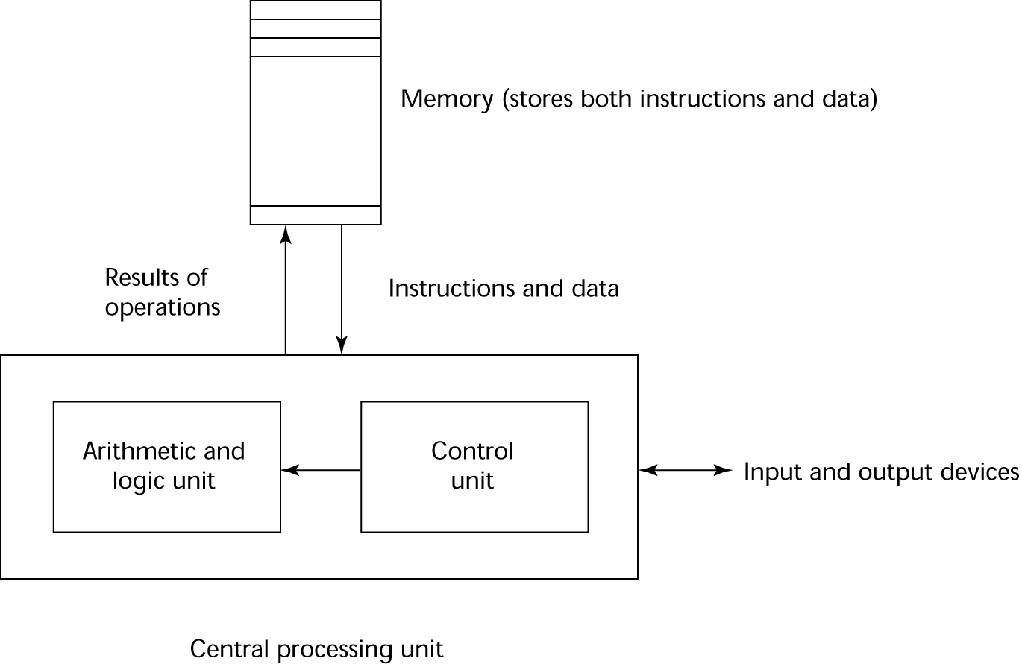
Computer Architecture Influence
Imperative languages, most dominant, because of von Neumann computers
Data and programs stored in memory
Memory is separate from CPU
Instructions and data are piped from memory to CPU
Basis for imperative languages
Variables model memory cells
Assignment statements model piping
Iteration is efficient
Von Neumann Architecture

Slide 32
Computer Architecture Influence
Fetch-execute-cycle (on a von Neumann architecture computer):
initialize the program counter
repeat forever
fetch the instruction pointed by the counter
increment the counter
decode the instruction
execute the instruction
end repeat
“von Neumann Bottleneck”:
the processor and memory are separate, and data moves between the two – in that configuration, latency is unavoidable
memory improvements have mostly improved the ability to store more data in less space – rather than transfer rates. As speeds have increased, the processor has spent an increasing amount of time idle, waiting for data to be fetched from memory
no matter how fast a given processor can work, in effect it is limited to the rate of transfer allowed by the bottleneck

Slide 33
Programming Methodologies
1950s and early 1960s: Simple applications; worry about machine efficiency
Late 1960s: People efficiency became important; readability, better control structures
structured programming
top-down design and step-wise refinement
Late 1970s: Process-oriented to data-oriented
data abstraction
Middle 1980s: Object-oriented programming
Data abstraction + inheritance + polymorphism
1990s: The Internet
page scripting, Web services, animation
2000s: Very High Level Languages
hiding ever more details, visual design, rapid development

Slide 34



Questions?
We talked about:
Why do we need programming languages?
Why should we study languages?
Why do we have a plethora of languages?
Programming paradigms
Language classification
Language selection guidelines
Language design influences
Hmmm…

