Slide 1

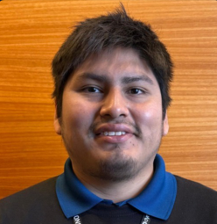







Jose Romero
[Presentation title]
ACE Solutions Lead.Consultant
[Subtitle: what the audience will get]
Notes:
PATRÓN cover · Portada sobre fondo de marca. Cambia título y subtítulo; el presentador, la foto y las insignias quedan como están.

Slide 2
Agenda
🎯 [Agenda item 1]
🎯 [Agenda item 2]
🎯 [Agenda item 3]
🎯 [Agenda item 4]
Notes:
PATRÓN agenda · Fondo degradado. 3 a 6 puntos de agenda, uno por línea, con el ícono 🎯.

Slide 3
[The bottom line]
🎯 [Key message 1]
🎯 [Key message 2]
🎯 [Key message 3]
Notes:
PATRÓN key-messages · Fondo degradado. Los 3 mensajes que el público debe recordar (bottom line). Máx. 2 líneas cada uno.

Slide 4
[Section title]
Notes:
PATRÓN section · Separador de sección sobre fondo degradado. Un título corto.

Slide 5
[Statement title]
[Supporting point 1]
[Supporting point 2]
[Supporting point 3]
Notes:
PATRÓN statement · Fondo degradado con título y 1 a 4 puntos breves. Para contexto o una idea fuerza.

Slide 6
[Slide title: the takeaway in one sentence]
[LEFT COLUMN LABEL]
[RIGHT COLUMN LABEL]
[CONTEXT 1]
“[What they said 1]”
[What we found 1]
[CONTEXT 2]
“[What they said 2]”
[What we found 2]
[CONTEXT 3]
“[What they said 3]”
[What we found 3]
[CONTEXT 4]
“[What they said 4]”
[What we found 4]
[Takeaway banner: the one idea to remember]
Notes:
PATRÓN from-to · 4 filas 'lo que se dijo → lo que encontramos' y un banner de cierre. Para síntoma vs. causa, antes vs. después, mito vs. realidad.

Slide 7
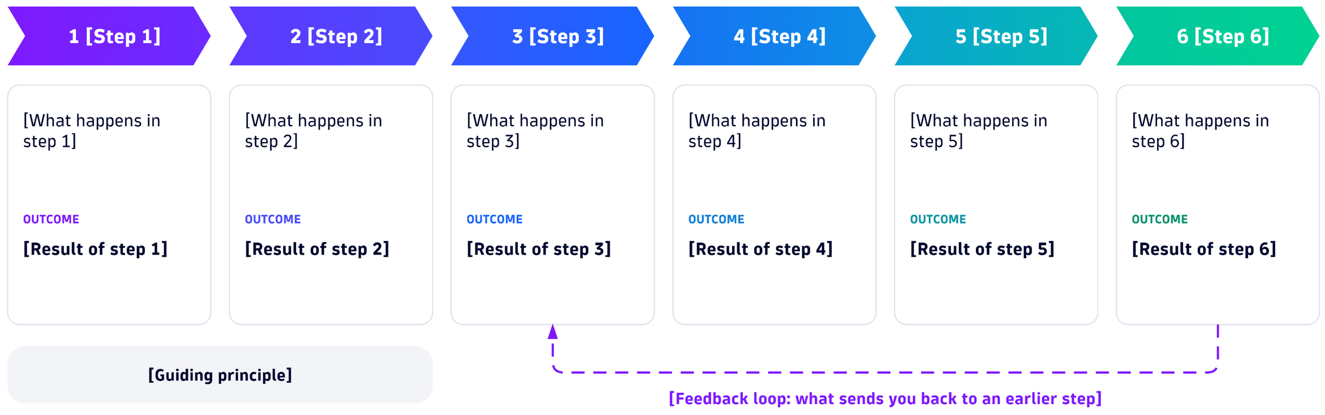
[Slide title: the takeaway in one sentence]
[Banner lead-in]: [Banner message]
Notes:
PATRÓN diagram-banner · Un diagrama draw.io a todo el ancho (imagen 'diagram', proporción ~3.2:1) y un banner que lo enmarca.

Slide 8
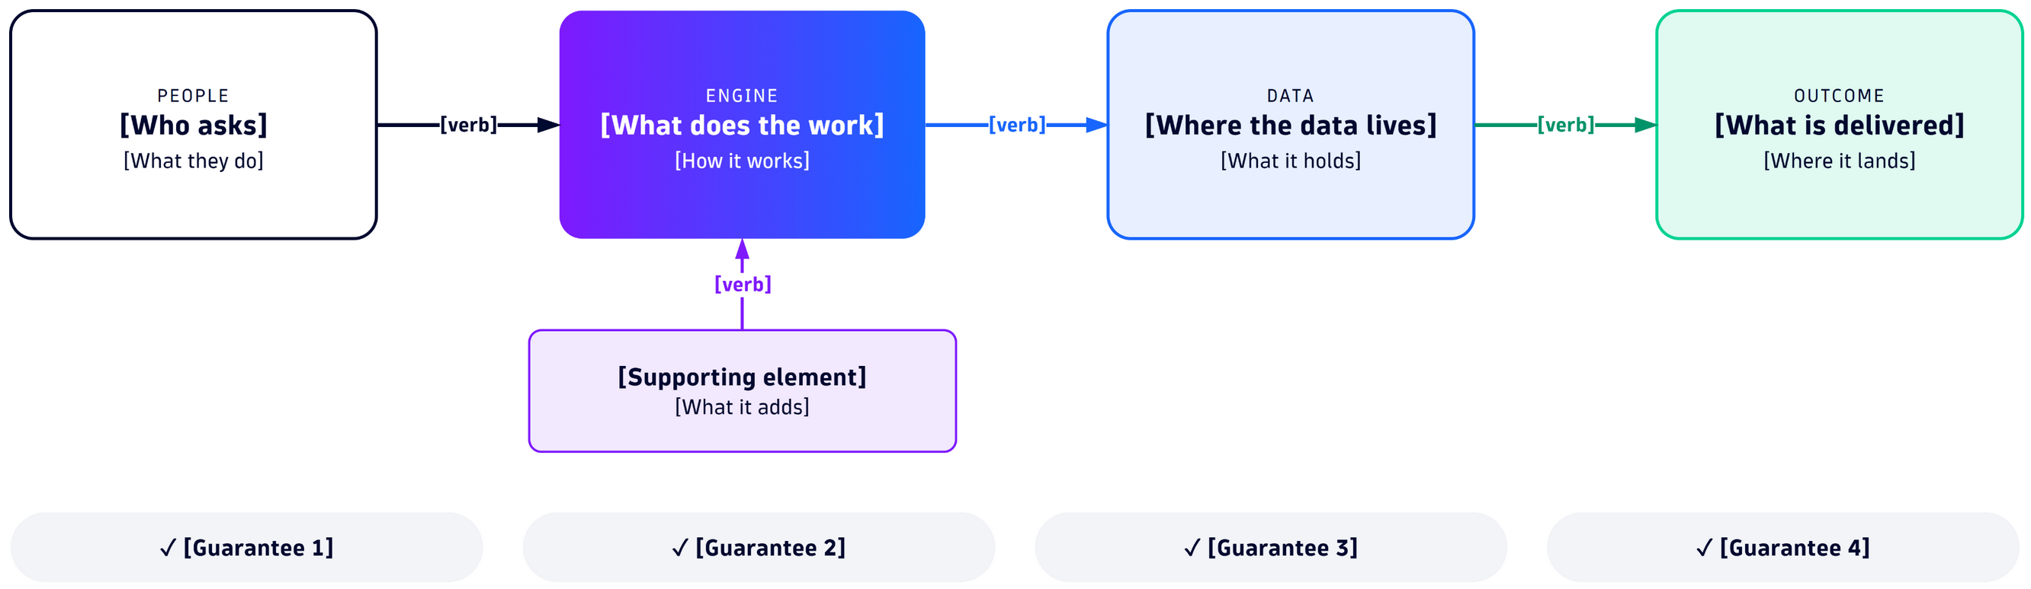
[Slide title: the takeaway in one sentence]
[Principle 1]: [What principle 1 means]
[Principle 2]: [What principle 2 means]
[Principle 3]: [What principle 3 means]
Notes:
PATRÓN diagram-principles · Diagrama a todo el ancho (proporción ~3.4:1) y 3 principios con etiqueta en color.

Slide 9


[Slide title: the takeaway in one sentence]
[TOP SECTION LABEL]
[Card 1 title]
[Card 1 text]
[Card 2 title]
[Card 2 text]
[Card 3 title]
[Card 3 text]
[Card 4 title]
[Card 4 text]
[BOTTOM SECTION LABEL]
[Step 1]
[Step 2]
[Step 3]
[Step 4]
[Step 1 meaning]
[Step 2 meaning]
[Step 3 meaning]
[Step 4 meaning]
[Banner start] [highlighted phrase] [banner end]
Notes:
PATRÓN cards-steps · Arriba 4 tarjetas (qué incluye), abajo 4 chevrons con su significado y un banner con una frase destacada.

Slide 10
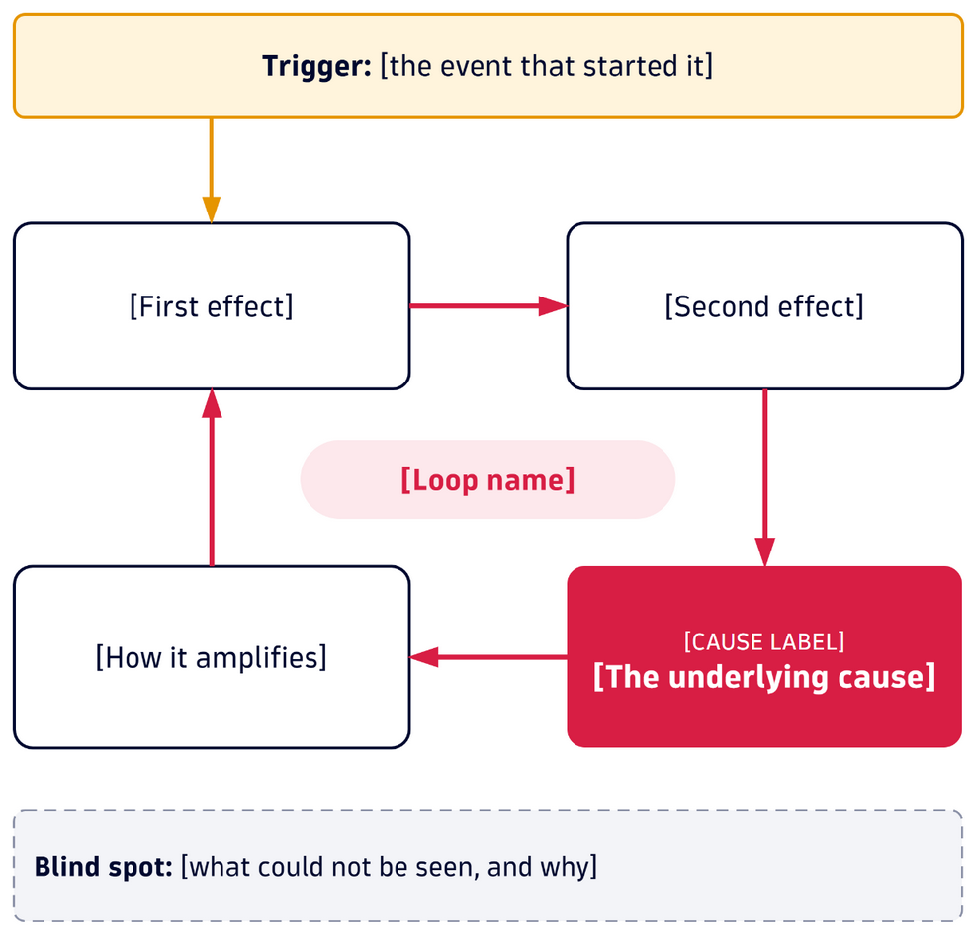
[Slide title: the takeaway in one sentence]
[QUOTE LABEL]
“[What the customer said, in their words]”
[KPI COLUMN LABEL]
[DIAGRAM LABEL]
[ACTIONS LABEL]
[KPI 1]
[KPI 1 meaning]
[Tag 1]
[Action 1]
[Tag 2]
[Action 2]
[KPI 2]
[KPI 2 meaning]
[Tag 3]
[Action 3]
[KPI 3]
[KPI 3 meaning]
[Callout: the lesson in one sentence]
Notes:
PATRÓN case · Caso de cliente: cita, 3 KPIs, diagrama causal (imagen 'diagram', ~1:1), 3 acciones con etiqueta y una lección.

Slide 11
[Slide title: the takeaway in one sentence]
[Panel A title]
[Panel B title]
“[Panel A quote]”
“[Panel B quote]”
[A-1]
[A-1 meaning]
[A-2]
[A-2 meaning]
[A-3]
[A-3 meaning]
[B-1]
[B-1 meaning]
[B-2]
[B-2 meaning]
[B-3]
[B-3 meaning]
[A LABEL]
[B LABEL]
[Panel A recommendation]
[Panel B recommendation]
[A BOX LABEL]
[Panel A expected outcome]
[B BOX LABEL]
[Panel B expected outcome]
Notes:
PATRÓN two-panels · Dos paneles comparables (A y B), cada uno con cita, 3 KPIs, recomendación y resultado esperado.

Slide 12
[Slide title: the takeaway in one sentence]
[KPI 1]
[KPI 2]
[KPI 3]
[KPI 4]
[KPI 1 meaning]
[KPI 2 meaning]
[KPI 3 meaning]
[KPI 4 meaning]
[KPI 1 SOURCE]
[KPI 2 SOURCE]
[KPI 3 SOURCE]
[KPI 4 SOURCE]
1
[Benefit 1 title]
[Benefit 1 text]
2
[Benefit 2 title]
[Benefit 2 text]
3
[Benefit 3 title]
[Benefit 3 text]
Notes:
PATRÓN kpis · 4 cifras grandes con su significado y fuente, y 3 beneficios numerados.

Slide 13
[Slide title: the takeaway in one sentence]
1
2
3
4
[Step 1 name]
[Step 1 description]
[Step 2 name]
[Step 2 description]
[Step 3 name]
[Step 3 description]
[Step 4 name]
[Step 4 description]
[ASK LABEL]
[The ask: what you need from the audience]
Notes:
PATRÓN roadmap · 4 pasos numerados y un banner con el pedido a la audiencia.

Slide 14
[Slide title: the takeaway in one sentence]
[Duration A]
[Duration B]
[Phase 1]
[Phase 2]
[Phase 3]
[Phase 4]
[Phase 1 activity 1]
[Phase 2 activity 1]
[Workstream 1]
[Workstream 1 detail]
[Phase 1 activity 2]
[Phase 2 activity 2]
[Phase 2 activity 2 detail]
[Workstream 2]
[Workstream 2 detail]
[Workstream 3]
[Workstream 3 detail]
[Workstream 4]
[Workstream 4 detail]
[Owner 1]
[Owner 2]
[Role 1]
[Role 3]
[Role 2]
[Owner 3]
[Role 4]
[Start]
[Milestone]
[End]
Notes:
PATRÓN phases-plan · Plan por fases tipo Gantt: 4 fases, actividades, frentes de trabajo, roles y responsables, inicio, hito y fin.

Slide 15
[Slide title: the takeaway in one sentence]
[Left list title]
[Right list title]
[Risk 1]
[Risk 2]
[Prerequisite 1]
[Prerequisite 2]
Notes:
PATRÓN risks-prereqs · Dos listas: riesgos (borde rojo) y prerrequisitos (borde verde).

Slide 16
Thank You
Notes:
PATRÓN closing · Cierre sobre fondo degradado. 'Thank You' o 'Gracias' según el idioma.

