Slide 1


INFORMATION RETRIEVAL EXTRACTION AND INTEGRATION
LAB ML RANKING ASSIGNMENT
José Antonio Ruiz Heredia
Joseph Tartivel
Álvaro Honrubia

Slide 2
01
INTRODUCTION
ADARANK: A BOOSTING ALGORITHM FOR INFORMATION RETRIEVAL
02
CONSTRUCTING THE TRAINING DATASET
TABLE OF CONTENTS
03
MODEL DEVELOPMENT AND IMPLEMENTATION
04
EXPANDING THE DATASET
05
EVALUATION AND CONCLUSION
A brief introduction of the project.
Presentation of research paper used for this work.
Presentation of the dataset used and how we prepared it for AdaRank.
Description of the implementation of the project.
Explanation of the methods used to expand the DataSet in terms and in query.
06
Evaluation of the different experiments and a view of potentials improvements.

Slide 3
INTRODUCTION
Challenge: Ranking lab tests efficiently and accurately
Solution: Machine learning ranking (MLR) methods to optimize search results
Focus: Using AdaRank to improve retrieval of lab tests in response to queries
Goal: Build and train a ranking model on documents related to specific medical tests

Slide 4
ADARANK: A BOOSTING ALGORITHM FOR INFORMATION RETRIEVAL
Concept: AdaRank improves search results through iterative learning
Approach: Adjusts focus over time, giving more weight to incorrectly ranked cases
Advantage over Traditional Methods:
Pointwise methods: Score documents individually, don't optimize ordering
Pairwise methods (Ranking SVM, RankBoost): Compare document pairs but don't optimize full list
AdaRank: Considers entire list at once, directly optimizes performance metrics like NDCG

Slide 5
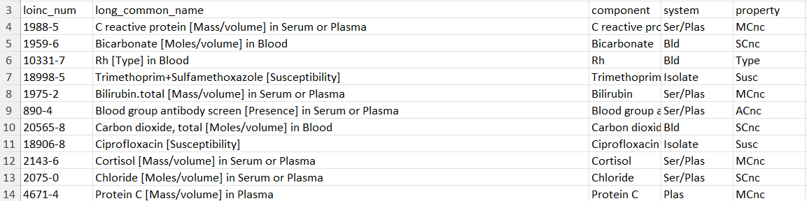
CONSTRUCTING THE TRAINING DATASET: PRE-PROCESSING
We need a clean dataset to calculate relevance score
“Dirty” Text: Ponctuation, special characters, capital letters…
Useless Information: Grammar, LOINC number, repetition…
Abbreviations: “Bld” instead of “Blood”, “Plas” instead of “Plasma”...
Bad Structuring: Units of measurement in the “name” column…

Slide 6
CONSTRUCTING THE TRAINING DATASET: PRE-PROCESSING
“Dirty” Text -> Text Cleaning
Convert text to lowercase, remove punctuation and special characters.
Useless Information -> Lemmatization
Eliminate common stop words and reduce words to their base forms.
Abbreviations -> Mapping Dictionary
Standardize the terminology.
Bad Structuring -> Column Creation
Creation of a new column for the unit of measurement.

Slide 7
CONSTRUCTING THE TRAINING DATASET: HYBRID SCORING
Traditional Scoring
+ Embeddings Scoring
= Hybrid Scoring
Keyword Matching
Semantic Similarity
Capture relationships beyond exact keyword matches.

Slide 8
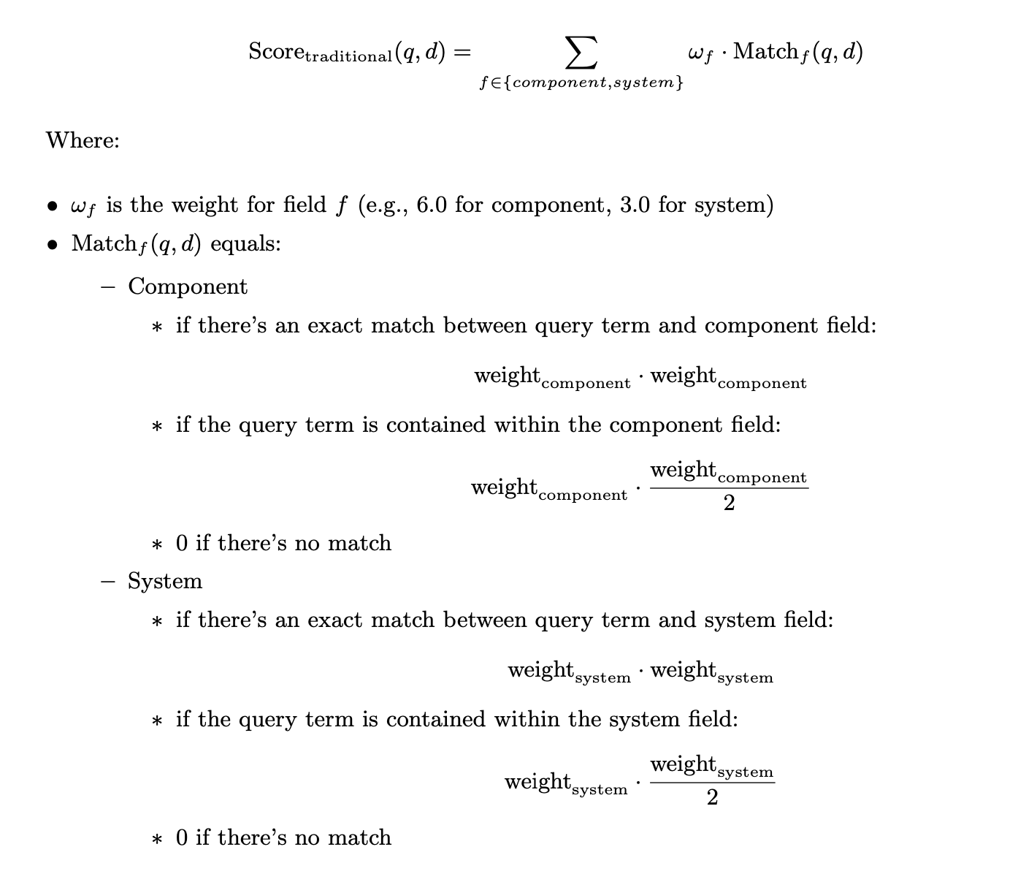
CONSTRUCTING THE TRAINING DATASET: TRADITIONAL SCORING
For column “Component” and “System”
To capture exact keyword matches.

Slide 9
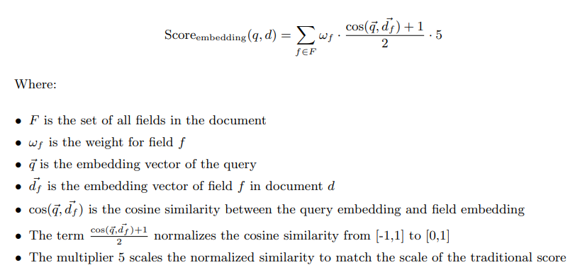
CONSTRUCTING THE TRAINING DATASET: EMBEDDINGS SCORING
With the pre-trained biomedical embedding model: BioBERT-MNLI
To calculate semantic similarity between the query and document fields

Slide 10
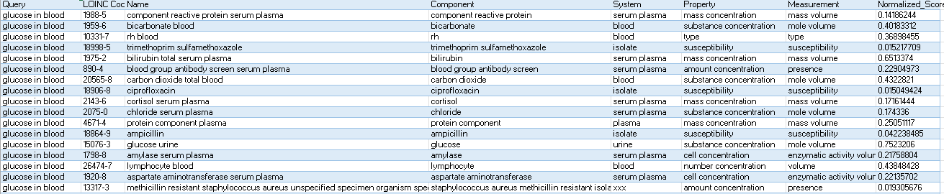
CONSTRUCTING THE TRAINING DATASET: FINAL RESULT
Normalized Relevance Score using Min-Max.
Allowing to train the AdaRank Algorithm.

Slide 11
MODEL DEVELOPMENT AND IMPLEMENTATION
Dataset Preparation:
Encoded categorical features to numerical representations
Score labels by scaling normalized scores to integers
Split data: 75% training, 25% testing
Implementation:
LightGBM with rank_xendcg objective
Simulated AdaRank's boosting and reweighting mechanism
Parameters: boosting_type, num_leaves, learning_rate, max_depth, feature_fraction, label_gain, regularization…

Slide 12
EXPANDING THE DATASET
Query Expansion:
Added new queries: "calcium in serum", "cells in urine"
Added variations based on component: "bilirubin", "cells", "leukocytes", "calcium”, “glucose”
Added variations based on system: “blood”, “serum or plasma”, “urine”
Model Optimization:
Adjusted hyperparameters and learning rates depending on the dataset
Evaluated each version of the dataset to measure impact on ranking quality

Slide 13
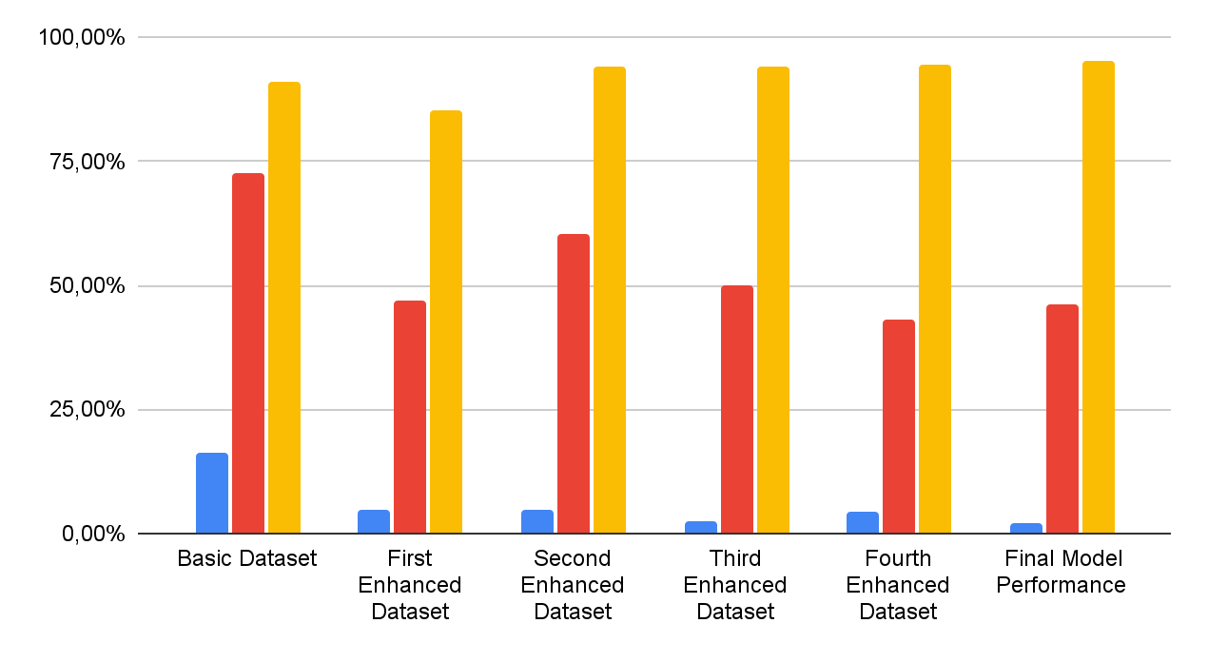
EVALUATION
NDCG: 0.9517
Spearman’s: 0.4615
MSE: 0.0191
NDCG
Spearman
MSE

Slide 14
CONCLUSION
Project Insights
Dataset diversity impacts ranking performance
Adding medical queries improves model adaptability
AdaRank effectively optimizes ranking for medical retrieval
Implications
Improved search efficiency supports better clinical decision-making
Structured search optimization more important as medical information grows

