Slide 1


Comparison and discussion of two Profile-based Retrieval Systems
José Antonio Ruiz Heredia
Joseph Tartivel
Álvaro Honrubia

Slide 2


INTRODUCTION
LinkedIn
Domain of Job Portals.
System for Job Matching.
Enhances job search and a better quality of applicants for specific roles.
Coursera
Domain of Online Learning Platforms.
System for Skill Development based on personalized courses..
Enhances access to education and improves career opportunities through specialized courses and certifications.

Slide 3


METHOD USED BY LINKEDIN
RETRIEVAL STAGE
RANKING STAGE
FORECASTING
A candidate selection model filters job listings before ranking them.
Reduce search latency:
Decision trees
Query construction
Sort based on:
Explicit user data (e.g., profile or past applications)
Implicit signals (e.g., users’ clicks.)
The system applies machine learning models like GLMix to score and rank jobs.
LiJAR System balances job applications preventing job postings from receiving too many or too few applications.

Slide 4
METHOD USED BY COURSERA
Collaborative Filtering (CF)
Content-Based Filtering (CBF)
User-based: Recommends courses based on similar users' behavior.
Item-based: Finds relationships between courses through user interactions.
Analysis of metadata: keywords, topics, and descriptions from courses.
Builds user profiles from past interactions to recommend relevant courses.
Profiling
Hybridisation
Explicit: Users manually enter their learning goals.
Implicit: The system tracks behavior and updates preferences dynamically (CBF sistem).
Weighted Hybrid: Combines CF and CBF with different weights.
Switching Hybrid: Uses CF if data is available, otherwise CBF.
Feature Augmentation: One model enhances another with generated features.

Slide 5
COMPARISON BETWEEN THE SYSTEMS
SYSTEM | PURPOSE | METHOD | DATA | STRENGTHS | CHALLENGES
LinkedIn | Matching users to suitable jobs | Multi-tier distributed service that retrieves and ranks job postings | Past applications, user profile and employer preferences | Scalability & Efficiency Balancing Job Application High availability | Real-time personalization Unique job market constraints
Coursera | Recommending personalized courses | Hybrid content-based& collaborative filtering associated to contextual modeling | Educational & professional background, context and learning preferences | Adaptable and personalized learning experience. | Requires continuous user input

Slide 6
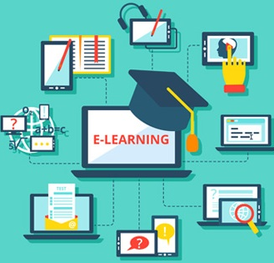

CONCLUSIONS
SUMMARY
FILTER BUBBLE
LinkedIn uses ML-based ranking.
Coursera uses hybrid collaborative and content-based filtering.
Limit users' exposure to diverse job or learning opportunities.
CONTINUOUS IMPROVEMENT
BALANCED APPLICATIONS
Both systems require to adapt in real time to avoid over reliance in past actions.
In LinkedIn, jobs must be balanced preventing some jobs from being flooded while others remain unseen.

Slide 7
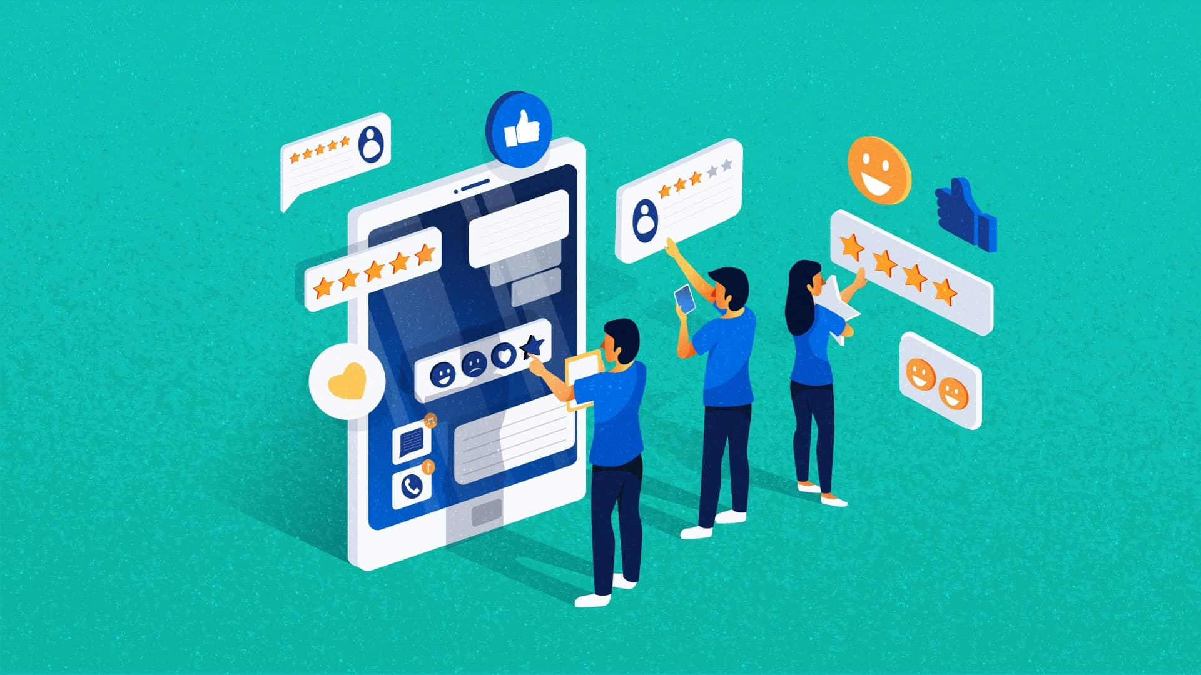
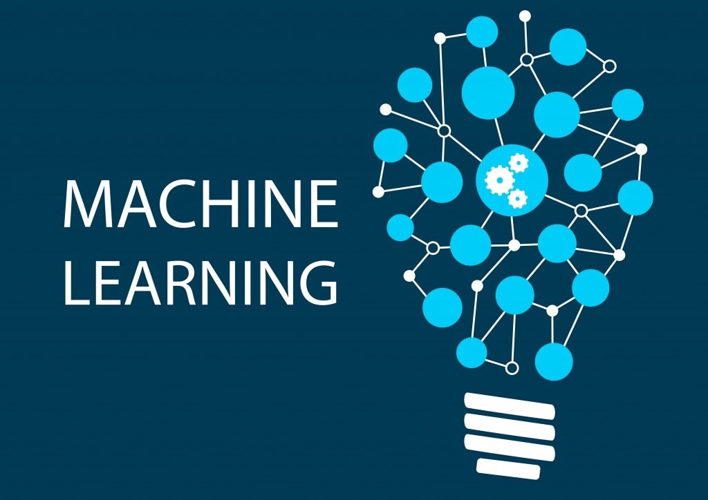
IMPROVEMENT PROPOSALS
RESOURCE | LINKEDIN | COURSERA
Bias Mitigation | Explainable AI to provide transparency. | Adversarial Debiasing to deal with Over-reliance on past user actions.
User Feedback | NLP on user interactions (e.g., messages and posts) to infer job preferences. | NLP-based chatbots to collect more feedback.
Method | Include bidirectional recommendation to also help recruiters to find the best candidates. | Use of NLP to understand better the content and recommend not only based on titles and tags.
Personalization | Integrate external labor market data to improve rankings. | Incorporate users profiles more deeply and AI-driven adaptive learning.

Slide 8
THANKS FOR YOUR ATTENTION

