Slide 1

Entrepreneurship Finance Basics
College Leap | NBPC Educational Workshop
Jose Wang-Nava, CPA, MBA

Slide 2

Engage and Interact
ENGAGE & INTERACT

Slide 3

Where are you joining us from (what city)?
ⓘ Start presenting to display the poll results on this slide.
Notes:
📣 This is Slido interaction slide, please don't delete it. ✅ Click on 'Present with Slido' and the poll will launch automatically when you get to this slide.

Slide 4

Contents & Assumptions
Topics Covered
Unit Cost
Start-Up Costs and Operating Costs
Sales Projections
Income Statement Projections (3-5 yrs)
Balance Sheet Projections (3-5 yrs)
Fixed and Variable Costs
Break-Even
Free Cash Flow (Cash Flow Statement)
The Right Brain “meets” the Left Brain
A1. 4 Types of Entrepreneurship Ventures
Life-Cycle Stages of Business / Entrepreneurial Ventures
Evaluating Business/Entrepreneurial Ventures
D. Basic Entrepreneurial Finance Metrics >>>>>>

Slide 5
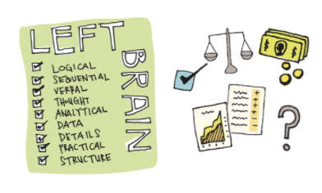

A. Left vs Right Brain
Well-Defined Problems
Ill-Defined Problems

Slide 6

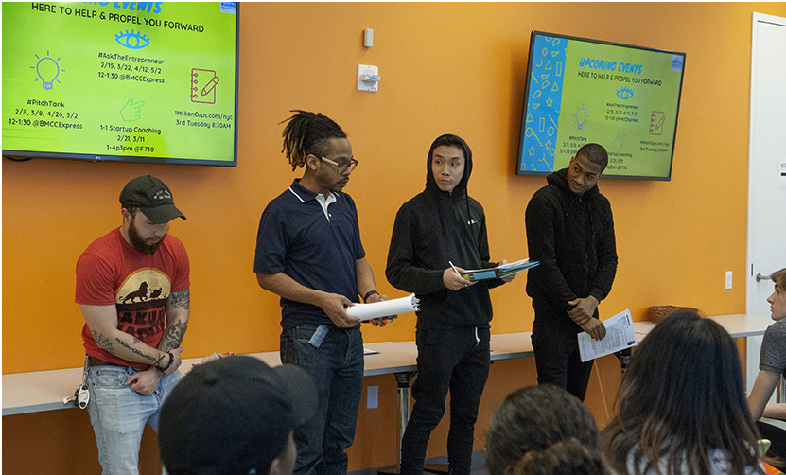
A. Left vs Right Brain
Yourself, Friends, Family
Angel Investors, VCs, etc.
“Hmmmm, really? “Sounds Risky”
“Prove it”
“How Much?”
“AWESOME IDEA”
“What do you think?
“Give me money”

Slide 7

A. Bridging the Left-Right Brain

Slide 8
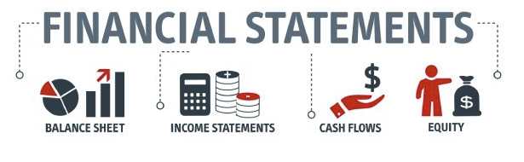

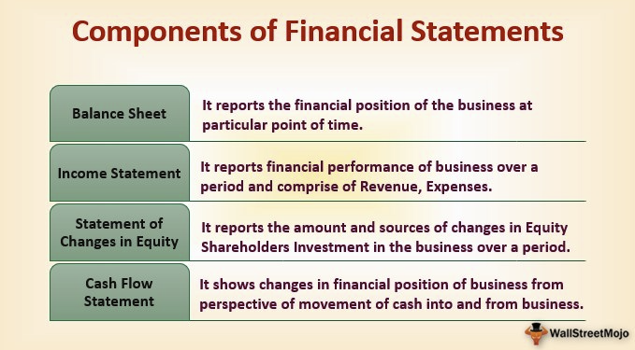
A. Bridging the Left-Right Brain
Common Language in Business and in Entrepreneurship

Slide 9
A. Left vs Right Brain
innovation
...........................
introduction of a new idea, product, or process
entrepreneurial opportunities
...........................
ideas with potential to create value through different or new, repackaged, or repositioned products, markets, processes, or services
entrepreneurship
...........................
process of converting ideas into commercial opportunities and creating value
entrepreneurial finance
...........................
application and adaptation of financial tools and techniques to the planning, funding, operations, and valuation of an entrepreneurial venture
risk
...........................
market, competitive, technology, strategic, financial
burn rate
...........................
rate at which a new company is spending its venture capital to finance overhead before generating positive cash flow from operations. It is a measure of negative cash flow.
disruptive innovation
...........................
an innovation that creates a new market or network that disrupts and displaces
entrepreneur
...........................
individual who thinks and acts to convert ideas into commercial opportunities and to create value
profit
...........................
Revenues - Expenses
Exit Strategy
...........................
An exit strategy is a contingency plan that is executed by a business owner to liquidate a position in a financial asset or dispose of tangible business assets once predetermined criteria for either has been met or exceeded
Free cash
.......................
cash exceeding that which is needed to operate, pay creditors, and invest in assets
entrepreneurial process
...........................
developing opportunities, gathering resources, and managing and building operations with the goal of creating value
Notes:
In simple terms, risk is the possibility of something bad happening. Risk involves uncertainty about the effects/implications of an activity with respect to something that humans value (such as health, well-being, wealth, property or the environment), often focusing on negative, undesirable consequences.
The risk of taking yourself and your family into an unfamiliar storm of stress and uncertainty. The risk that you've miscalculated an opportunity, or your own internal resources as you plunge into a new venture

Slide 10
A1. 4 Types of Entrepreneurial Ventures
lifestyle firms or Salary-replacement firms (small business entrepreneurship)
........................
Offers owners the ability to pursue specific lifestyles while being paid for doing what they like to do or as a salary-replacement living strategy.
Scalable entrepreneurial ventures
...........................
Entrepreneurial firms that are cash flow–and performance-oriented as reflected in rapid value creation over time (rapid growth)
Social Entrepreneurship
...........................
Firms that pursues not only profit but also measures its performance on the positive impact the business makes on society – whether social, cultural or environmental
Intrapreneurship
...........................
an employee of a large corporation who is given freedom and financial support to create new products, services, systems, etc., and does not have to follow the corporation's usual routines or protocols.

Slide 11
B. Life-Cycle Stages of Bus/Entrep. Ventures
venture life cycle
..........................
stages of a successful venture’s life from development through various stages of revenue growth
Early-stage ventures
..........................
new or very young firms with little or no operating history
seasoned firms
...........................
firms with successful operating histories and operating in their rapid-growth or maturity life cycle stages

Slide 12
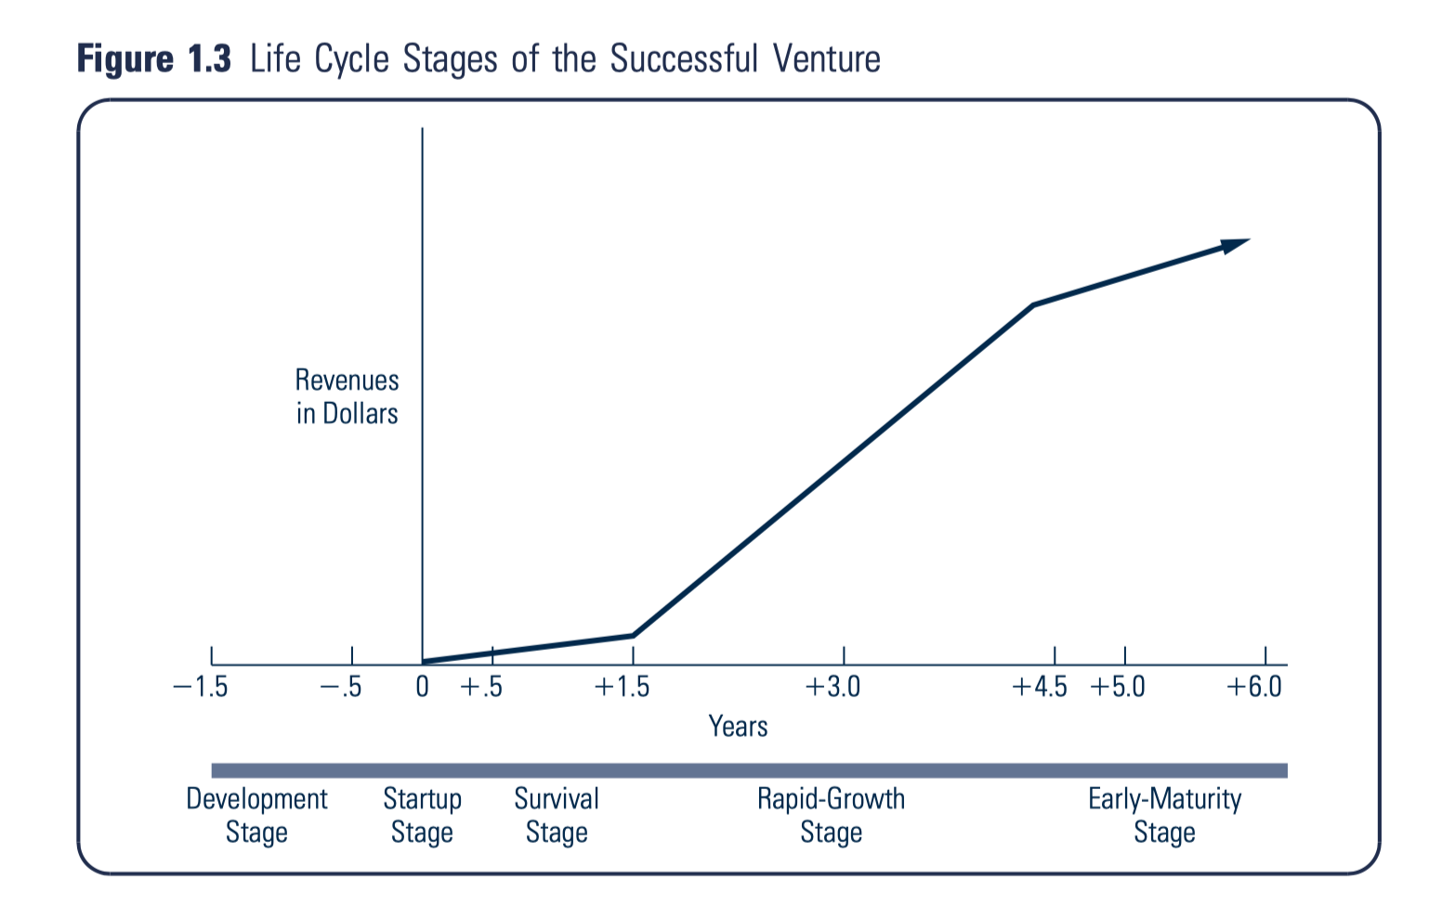
B. Life-Cycle Stages of Bus/Entrep. Ventures
Source: Leach & Melicher (2018). Entrepreneurial Finance, 6e, Cengage Learning

Slide 13
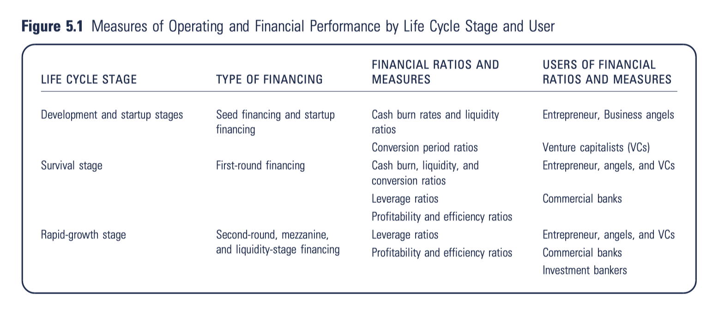
B. Life-Cycle Stages of Bus/Entrep. Ventures (Cont.)
Source: Leach & Melicher (2018). Entrepreneurial Finance, 6e, Cengage Learning

Slide 14
Type: F-Financial or M-Managerial or 0-None
ⓘ Start presenting to display the poll results on this slide.
Notes:
📣 This is Slido interaction slide, please don't delete it. ✅ Click on 'Present with Slido' and the poll will launch automatically when you get to this slide.

Slide 15


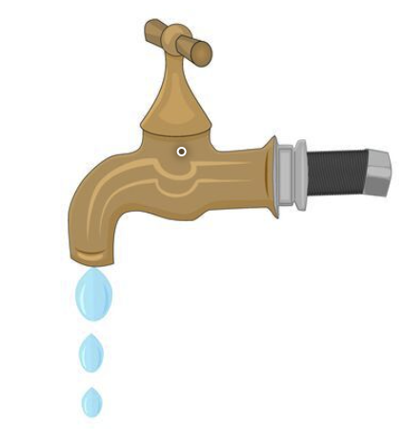

Flows and Levels
Income (wages)
Investment Income
Net Savings or Borrowings
Balance Sheet
Equity / Net Worth
[Assets - Debts]
Expenditures: fixed, discretionary, 1-time
Unexpected Expenditures

Slide 16
D. Basic Entrepreneurial Financial Metrics
Covered in this Workshop
Balance Sheet Projections (3-5 yrs)
Start-Up Costs
Income Statement Projections (3-5 yrs)
Unit Cost
Sales Projections
Operating Costs/Expenses
Break-Even Analysis
Fixed and Variable Costs
Cash Flow Statement
Free Cash Flow
NOT COVERED in this Workshop
Trend Analysis, Cross-Sector Analysis, Industry Benchmarking
Liquidity Ratios
Profitability Ratios
Leverage Ratios
Cash Conversion Cycle (Sales and Purch Conv. Cycles)
Burn Rate (Cash Burn, Cash Build, Net Burn Rate)

Slide 17

D. Recommended Approach
Sales/Revenue Projections: Sales Price x Units Sold
Determine Unit of Product or Service
Estimate Unit’s Cost
Estimate Total Demand for Product Service
Determine Price per Unit of Sale
Estimate Start-Up Costs
Estimate Operating Costs for first month and for the following 12-months, stating your assumptions for changes.
If you want to show break-even (not requested for this competition), you should also categorize each of the costs above as either FIXED or VARIABLE
Construct your 12-month Income Statement Projection given the above.
Construct the following yearly projections (Years 2-5), given growth factors or other changes within each year -- state your assumptions.
Note that I have added a cash flow section to the 5-yr income statement tab in the SCORE template.
For the College Leap Competition >>>>

Slide 18
Check each that you have already completed
ⓘ Start presenting to display the poll results on this slide.
Notes:
📣 This is Slido interaction slide, please don't delete it. ✅ Click on 'Present with Slido' and the poll will launch automatically when you get to this slide.

Slide 19
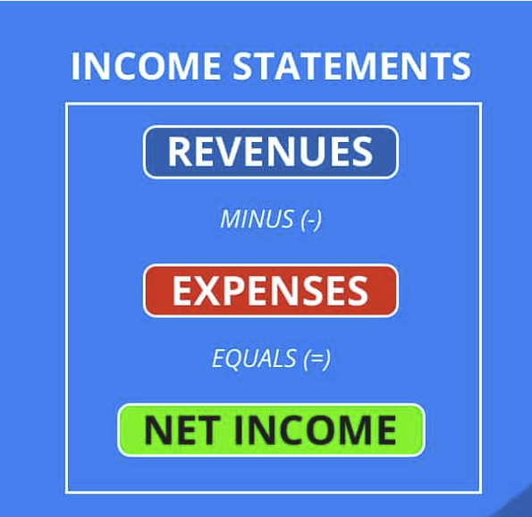
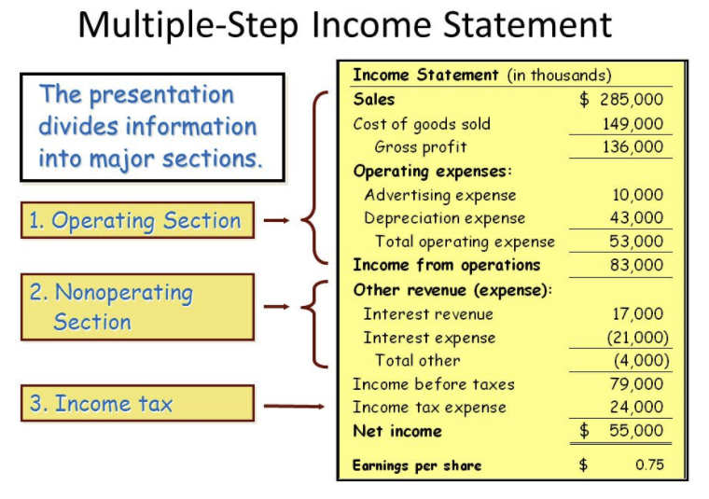
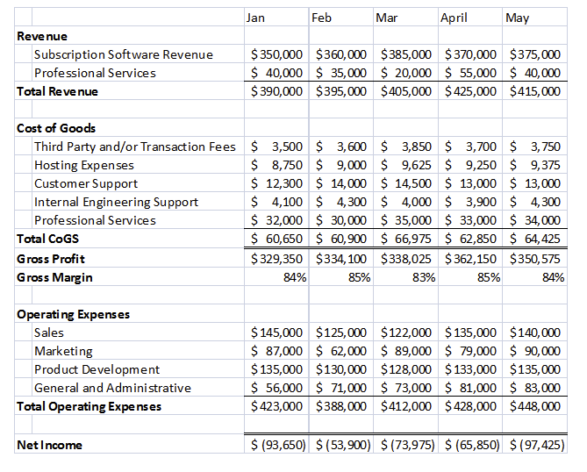
D. Sales & Operating Expenses Projections and the Income Statement

Slide 20
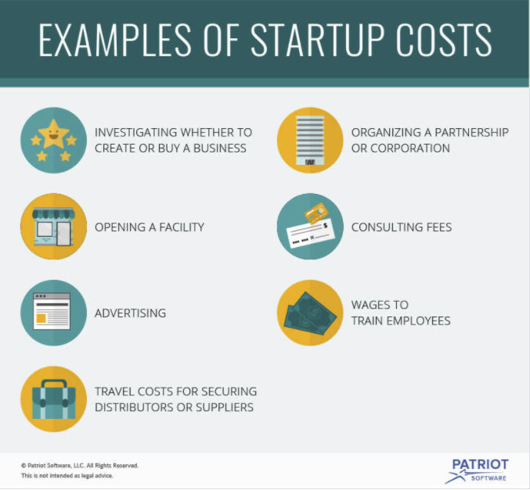
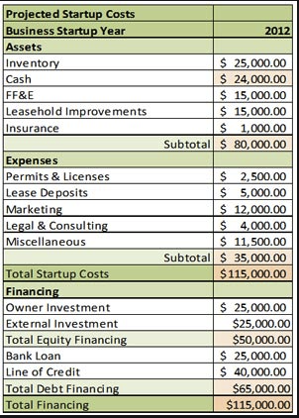
D. Startup Costs and the Balance Sheet
Definition
Non-recurring costs associated with setting up a business, such as accountant's fees, legal fees, registration charges, as well as advertising, promotional activities, and employee training. Also called startup expenses, preliminary expenses, or pre-opening expenses.

Slide 21
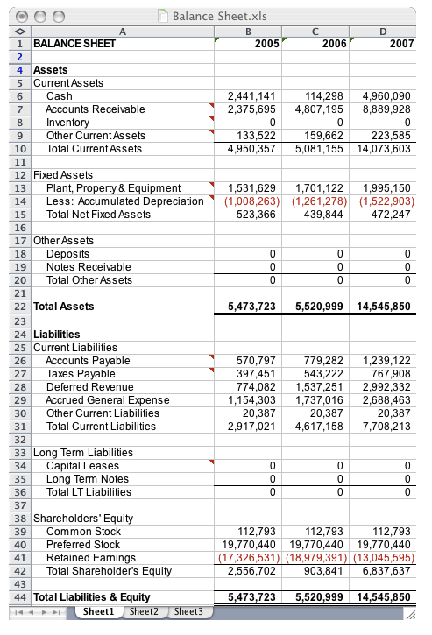
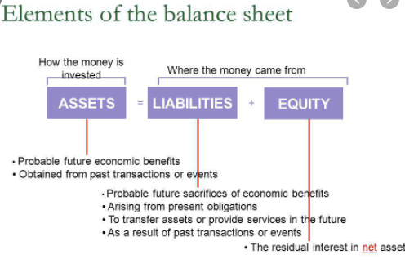
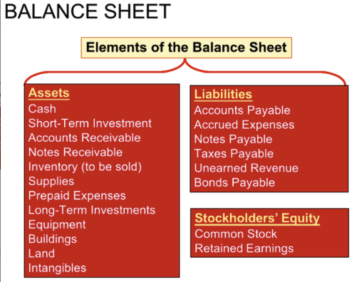
D. The Balance Sheet
Definition
A balance sheet is a financial statement that reports a company's assets, liabilities and shareholders' equity at a specific point in time, and provides a basis for computing rates of return and evaluating its capital structure. It is a financial statement that provides a snapshot of what a company owns and owes, as well as the amount invested by shareholders.

Slide 22
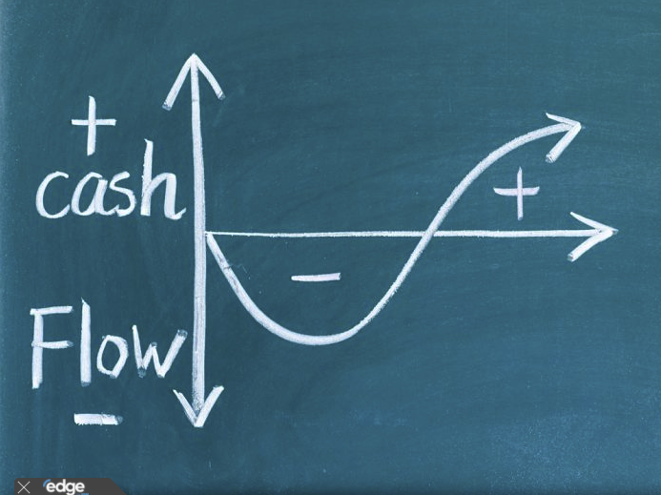
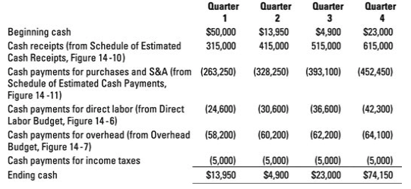
D. Statement of Cash Flows and Free Cash Flow
Cash Flow:
Definition: The difference between the available cash at the beginning of an accounting period and that at the end of the period. Cash comes in from sales, loan proceeds, investments and the sale of assets and goes out to pay for operating and direct expenses, principal debt service, and the purchase of asset

Slide 23
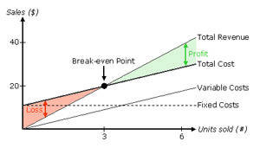
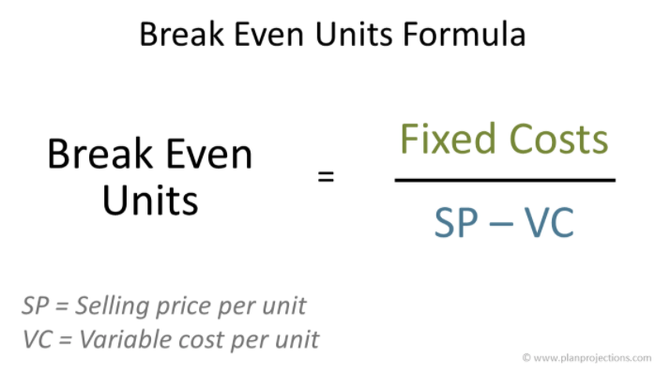
D. Variable and Fixed Costs and Break-Even Analysis (dollars, units)
Definition
Break-Even Point
The point at which total revenue equals total costs or expenses.
SP - VC = Contribution Margin

Slide 24
D. Recommended Approach
There are a few videos and templates from various sources under the google-folder (link below).
Your focus for the College Leap Competition = a 5-year Income Statement Projection, therefore you may want to use either the SCORE or TSAI as templates that you should modify to fit your situation.
Sales/Revenue Projections: Sales Price x Units Sold
Determine Unit of Product or Service
Estimate Unit’s Cost
Estimate Total Demand for Product Service
Determine Price per Unit of Sale
Estimate Start-Up Costs
Estimate Operating Costs for first month and for the following 12-months, stating your assumptions for changes.
If you want to show break-even (not requested for this competition), you should also categorize each of the costs above as either FIXED or VARIABLE
Construct your 12-month Income Statement Projection given the above.
Construct the following yearly projections (Years 2-5), given growth factors or other changes within each year -- state your assumptions.
Note that I have added a cash flow section to the 5-yr income statement tab in the SCORE template.
https://drive.google.com/drive/folders/1KvZYi4l4PUAhxwLG8SduF5gUmitY-U-w?usp=sharing

Slide 25
E. Other Considerations
Accrual vs Cash Accounting
Time Value of Money
https://drive.google.com/drive/folders/1KvZYi4l4PUAhxwLG8SduF5gUmitY-U-w?usp=sharing

