Slide 1
MY HOST BizMate – Modern UI Overview
Core Modules • Automations • AI • Cultural Intelligence

Slide 2
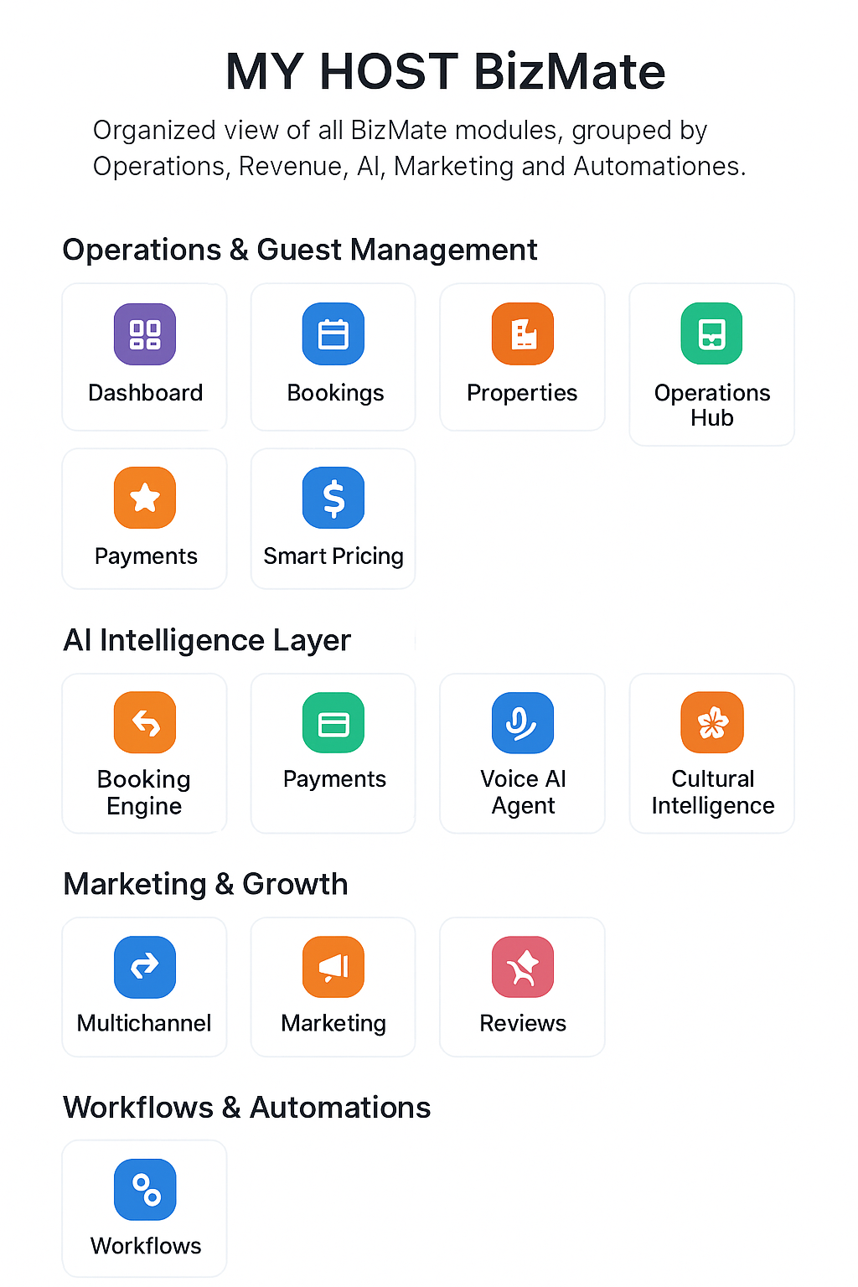

Slide 3
PROPERTIES 🏡
CUSTOMERS 👥
BOOKINGS 📘
COMMUNICATION 💬
MARKETING + SOCIAL 📣
ACTIVITIES 📝
PAYMENTS 💳
AI ASSISTANT 🤖
REVENUE 💵
LOCAL CULTURE 🌺
WORKFLOWS 🔄
AI VOICE 🎧
DASHBOARD 📊

Slide 4
Operations & Guest Management
• Dashboard 📊: Real-time KPIs: occupancy, revenue, trends.
• Bookings 📅: Unified calendar, check-ins, availability.
• Messages 💬: AI WhatsApp/email replies & templates.

Slide 5
Revenue & Pricing
• Payments 💳: QRIS, GoPay, OVO, Stripe centralized.
• Smart Pricing 💹: Dynamic pricing based on demand.
• Reports 📈: 12-month analytics & insights.

Slide 6
AI Intelligence Layer
• AI Assistant 🤖: Recommends actions & optimizations.
• AI Voice Agent 🎧: Handles calls, FAQs, upsells.
• Cultural Intelligence 🌺: Local customs, etiquette & messages.

Slide 7
Marketing & Growth
• Multichannel 🔗: Sync with Booking, Airbnb, Agoda.
• Marketing 📣: Campaign planning + AI content.
• Social Publisher 📱: Schedule IG, TikTok, YouTube posts.

