Slide 1
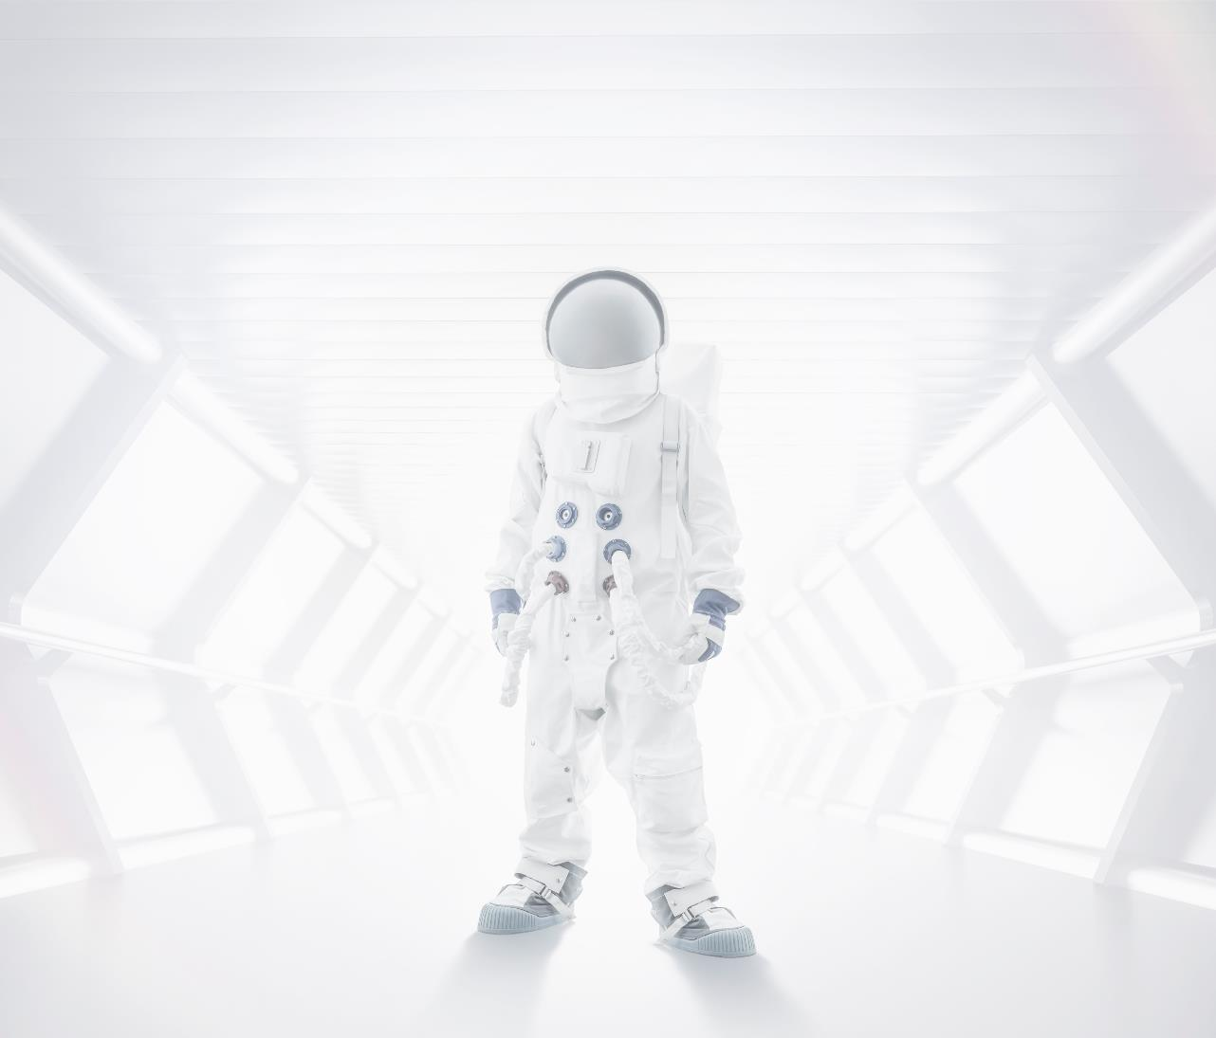
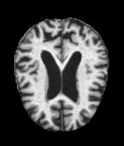
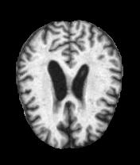
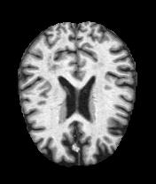
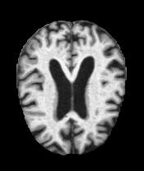
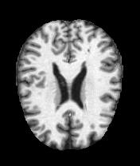
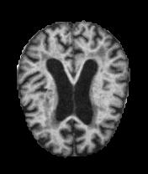
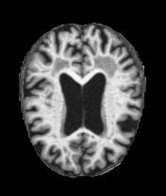
Alzheimer's Disease Classification
Elhai Mansbach, Yosef Sokolov

Slide 2

Project Overview
Alzheimer's disease is a neurological disorder characterized by memory impairment and cognitive decline.
It is a leading cause of death and currently has no cure. However, with proper medical treatment, the progression of the disease can be delayed.
Automated classification systems can assist medical professionals in diagnosing the stage of Alzheimer's disease and providing appropriate medical interventions. These systems serve as valuable tools to aid in the early detection and management of the disease.

Slide 3
Project Objective
Develop models for the detection of Alzheimer's disease from MRI brain scans.
The models aimed to classify whether a subject has Alzheimer's disease or not based on the patterns identified in the MRI scans associated with Alzheimer's disease.
The goal was to train the models to accurately identify these patterns and make predictions about the presence of Alzheimer's disease based on the MRI images.

Slide 4
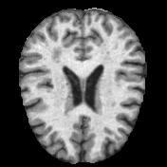
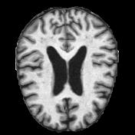
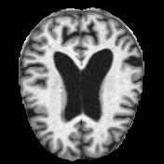
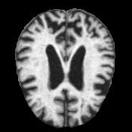
Data-Set
The dataset consists of 6400 MRI brain scans of people with different levels of dementia (divided to train & test sets).
There are 4 classes of scans:
Non-Demented- 3200 scans
Very Mild Demented- 2,240 scans
Mild Demented- 896 scans
Moderate Demented- 64 scans
The difficulty in classifying scans can be attributed to the intricate details that may not be easily distinguishable to the human eye.
1
2
3
4
Set | Total | Normal | Very-Mild | Mild | Moderate | Normal % | Very-Mild % | Mild % | Moderate %
Train | 5121 | 2560 | 1792 | 717 | 52 | 50.0 | 35.0 | 14.0 | 1.0
Test | 1279 | 640 | 448 | 179 | 12 | 50.0 | 35.0 | 14.0 | 1.0
https://www.kaggle.com/datasets/tourist55/alzheimers-dataset-4-class-of-images?datasetId=457093

Slide 5
Main Challenges and Solutions
Non-square images
ML models can get only vectors as input
CNN Training Time
Imbalanced Data
The images are in size 176 * 208 (non-square) while the CNN model requires squared input images.
Resize all images to a squared size of 176 * 176, which matches the smallest given image size in the dataset
There is a high imbalance in the data (a lot of Non-Demented and very few Moderate Demented).
Used the “class_weight =balanced” parameter in the ML models and data augmentation for the CNN model.
The data contains images (3 matrices) and the ML models need to have vectors as input.
Convert from RGB to grayscale (single matrix).
Flat the matrix to a vector (by concatenation of rows).
CNN models can be computationally expensive to train.
Use early stopping during CNN training to prevent overfitting and reduce training time

Slide 6
Our Techniques
KNN Model K-nearest neighbors
Decision Tree Classifier
SVM Classifier Support Vector Machine
CNN Model kind of network architecture for deep learning algorithms and is specifically used for image recognition and tasks that involve the processing of pixel data.
We will construct multiple models utilizing various learning techniques, including some that were covered during the course throughout the semester.

Slide 7
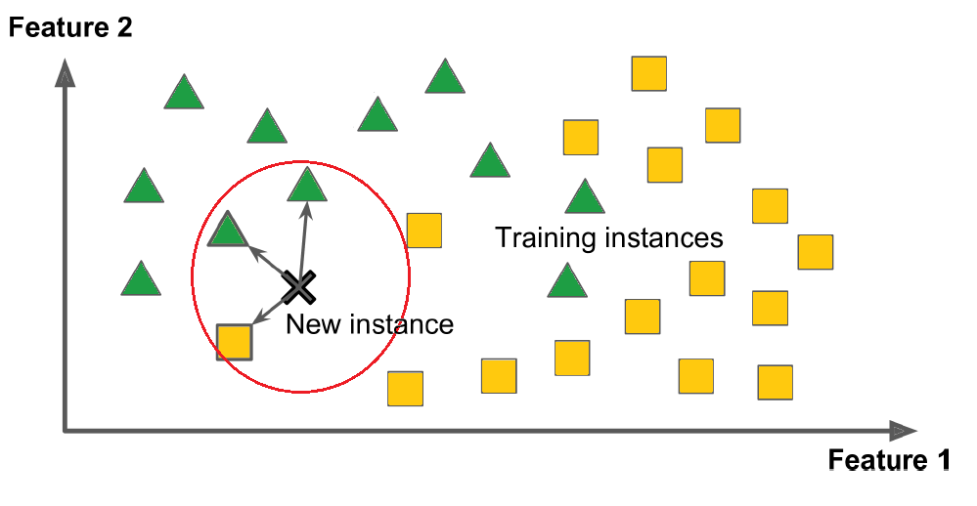
K-Nearest Neighbors (KNN) Model
It operates on the principle that similar data points are likely to have similar labels or values.
KNN assigns a class or predicts a value for a new data point based on the majority class or average value of its k nearest neighbors in the feature space.
The value of k is a hyperparameter that can be tuned to optimize the model's performance.

Slide 8
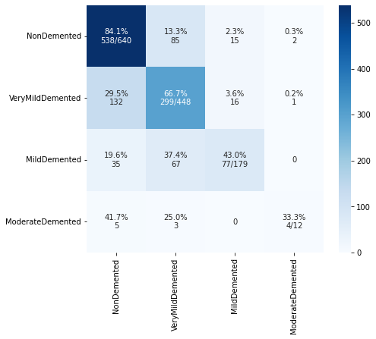
K-Nearest Neighbors (KNN) Model - RESULTS
n_neighbors = 5
Weights = distance (closer neighbors of a query point will have a greater influence than neighbors which are further away).
Y-axis = actual X-axis= predicted
The model's performance seems to be relatively good, with an accuracy of about 71.77%.
The model seems to perform well for the majority class (Non-Demented) but struggles with the minority classes (Moderate Demented and Mild Demented).
Classification Accuracy: 0.7177482408131353

Slide 9
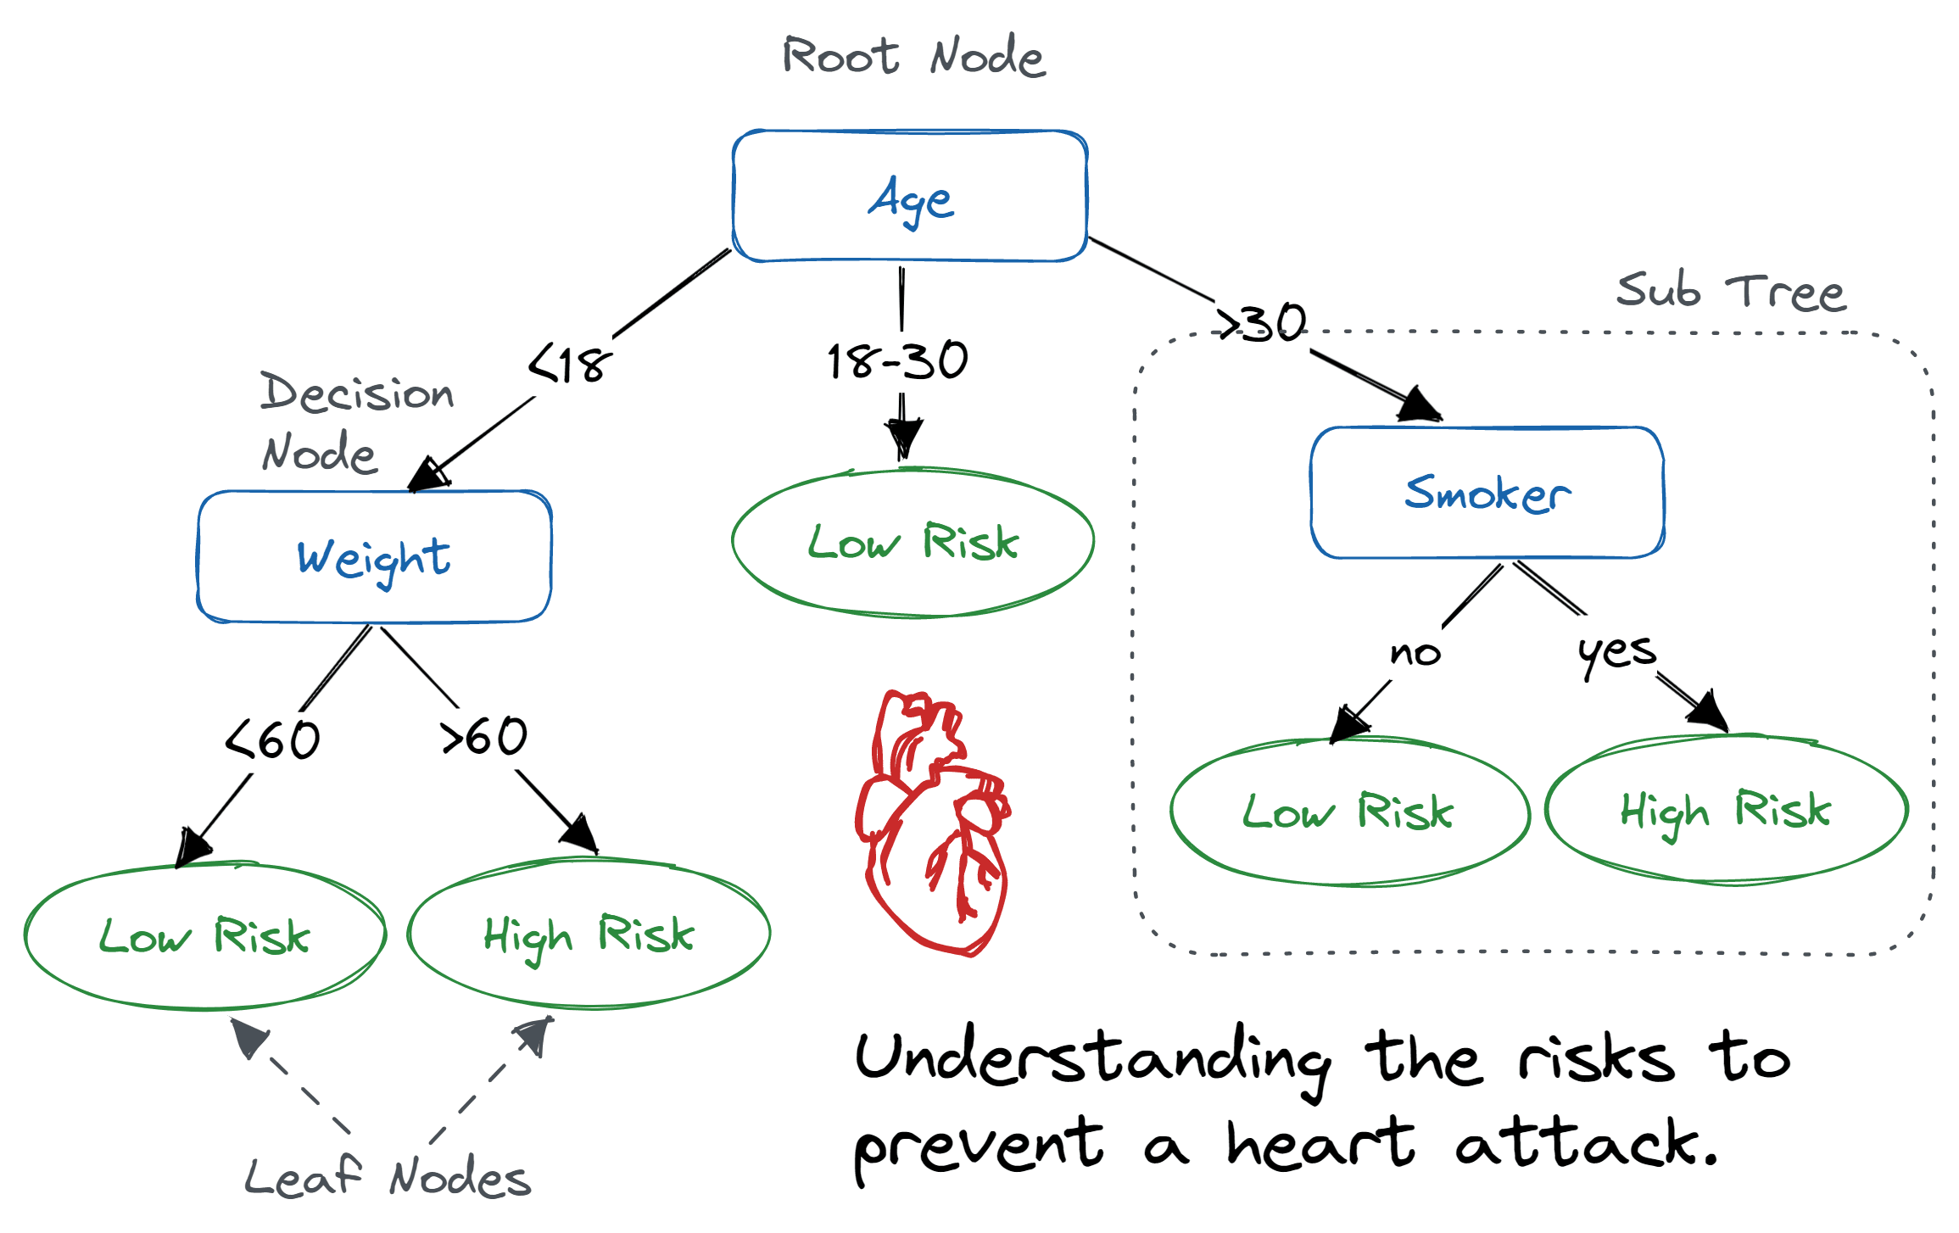
Decision Tree Classifier
It operates by recursively partitioning the feature space into smaller regions based on the feature values, ultimately forming a tree-like structure.
At each internal node, the decision tree algorithm selects the most informative feature to split the data, aiming to maximize the homogeneity of the target labels within each partition.
The final leaves of the tree represent the predicted classes for classification.
Prone to overfitting, which can be mitigated using ensemble methods like Random Forests or Gradient Boosting.

Slide 10
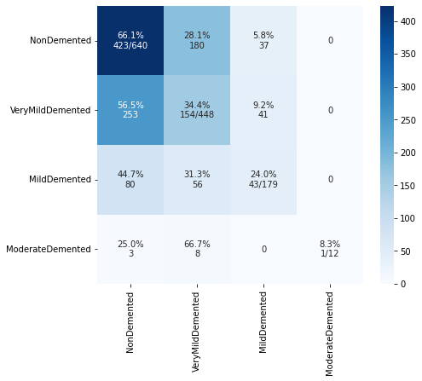
Decision Tree Classifier - RESULTS
The model's accuracy is around 48.55%, indicating it predicts correctly for about half of the instances.
The model is better at identifying Non-Demented class and Very-Mild Demented instances than the other classes (maybe because they have more instances).
The model is very confident when predicting Moderate Demented and Mild-Demented.
The low performance suggests that it may not be the most effective approach for image classification tasks, particularly when dealing with raw pixel data.
Classification Accuracy: 0.48553557466770914

Slide 11
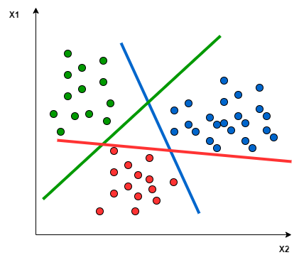
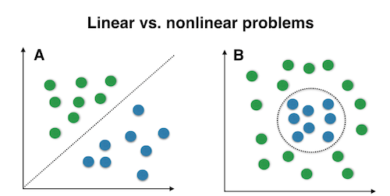
SVM Classifier
Aims to find the optimal hyperplane that best separates different classes in the feature space, maximizing the margin between support vectors.
It works well with both numeric and non-numeric features and can handle high-dimensional feature spaces.

Slide 12
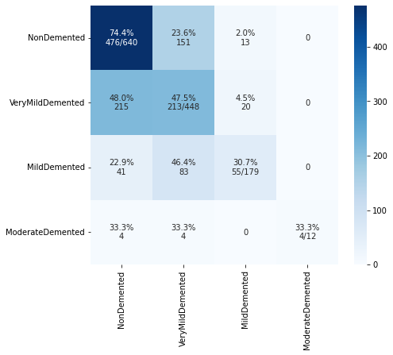
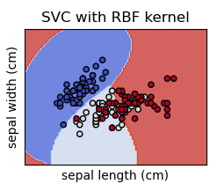
SVM Classifier- RESULTS
kernel= ‘rbf’ - enables SVM to find a nonlinear decision boundary in the original feature space.
The SVM model encountered difficulty in accurately defining the boundary between the Non-Demented and the Very-Mild Demented classes, and between the Very-Mild Demented and the Mild Demented classes.
The model is very confident when predicting Moderate Demented and Mild Demented.
Classification Accuracy: 0.584831899921814

Slide 13
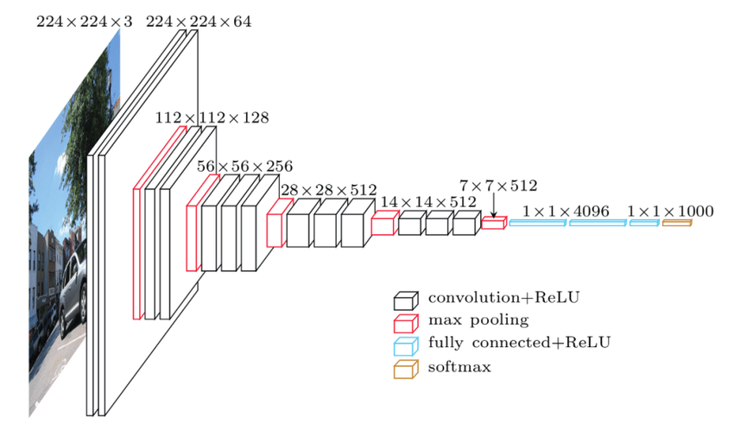
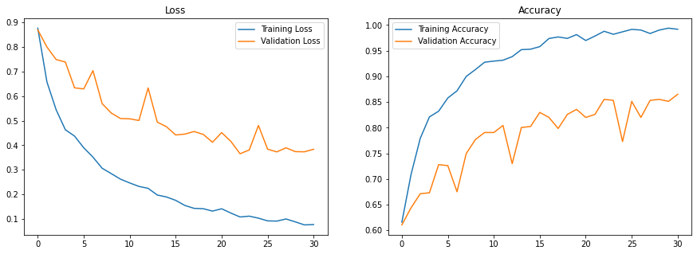
CNN Model – VGG 16
Kind of network architecture for deep learning algorithms and is specifically used for image recognition and tasks that involve the processing of pixel data.
We try one of the well-known architectures used for image classification named VGG16*.
Throughout the training process, a clear trend emerges: the training loss steadily decreases, accompanied by a decrease in the validation loss. Simultaneously, the accuracy of both the training and validation sets steadily improves.
* https://datagen.tech/guides/computer-vision/cnn-convolutional-neural-network/#:~:text=A%20Convolutional%20Neural%20Network%20(CNN,representations%20from%20raw%20input%20images.

Slide 14
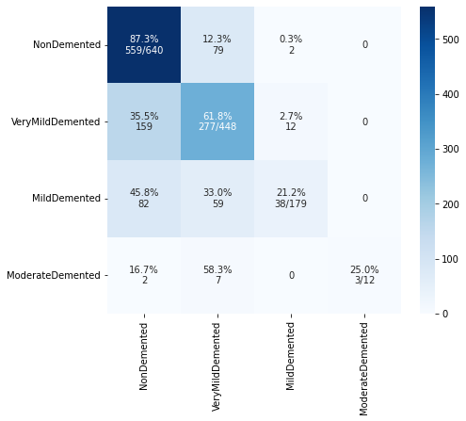
CNN (VGG16)- RESULTS
The model was trained using 50 iterations (weights updating).
To deal with the imbalance we use the ImageDataGenerator tool which generates batches of image data with real-time data augmentation.
We are new to this area, but we see the potential for improvement through exploring different architectures and making adjustments.
Despite our limited expertise, the results are promising and comparable to K-Nearest Neighbors (KNN), indicating the possibility of achieving even better outcomes with further refinement and exploration.
Classification Accuracy: 0.6856919468334637

Slide 15

Results
KNN achieved an accuracy of 70.84%, indicating reasonably good performance in the classification task. It might be a suitable choice for this problem given its simplicity and moderate accuracy as it finds similarity between images from the same class as they are close to each-other in the feature space.
Decision Tree showed an accuracy of 48.56%, indicating limited success in classifying instances. In image classification, the raw pixel data has a high dimensionality, making it challenging for decision trees to capture the intricate patterns and spatial relationships present in images.
SVM achieved an accuracy of 58.48%, suggesting moderate success in the classification task. SVM's flexibility with kernel functions might be helpful in handling complex decision boundaries.
CNN, being a deep learning model, achieved an accuracy of 68.57%, demonstrating good performance , indicating that deep learning approaches can be promising for Alzheimer's disease classification from MRI brain scans.

Slide 16

Conclusions & Future Work
In this project, we present four models for detecting the level of dementia of a person given his MRI brain scan.
Among the models tested, CNN and KNN achieved the highest accuracy, making them the best-performing model for this classification task.
Overall, the classification accuracies achieved by the models are moderate, suggesting that further research might be necessary to achieve higher accuracy and better performance.
To enhance the model, we could explore various hyperparameter combinations using different techniques. However, due to limited time and resources, we were unable to perform an extensive search.
By adding more samples to the data (especially to the minority classes), we believe that the results would improve.
Simplifying into binary classification (Demented and Non-Demented) may be beneficial given limited data samples.

Slide 17
Thank You

