Slide 1
PASSWORD STRENGTH TESTER
Mahdi Laafif – Khalil Elachkham – Mohamed Haroun Cheriha

Slide 2
TABLE OF CONTENTS
01
02
03
Backend
Frontend
Overview of the website
- Flask: app.py
- HTML / CSS
- JavaScript

Slide 3
Overview of the website
01

Slide 4
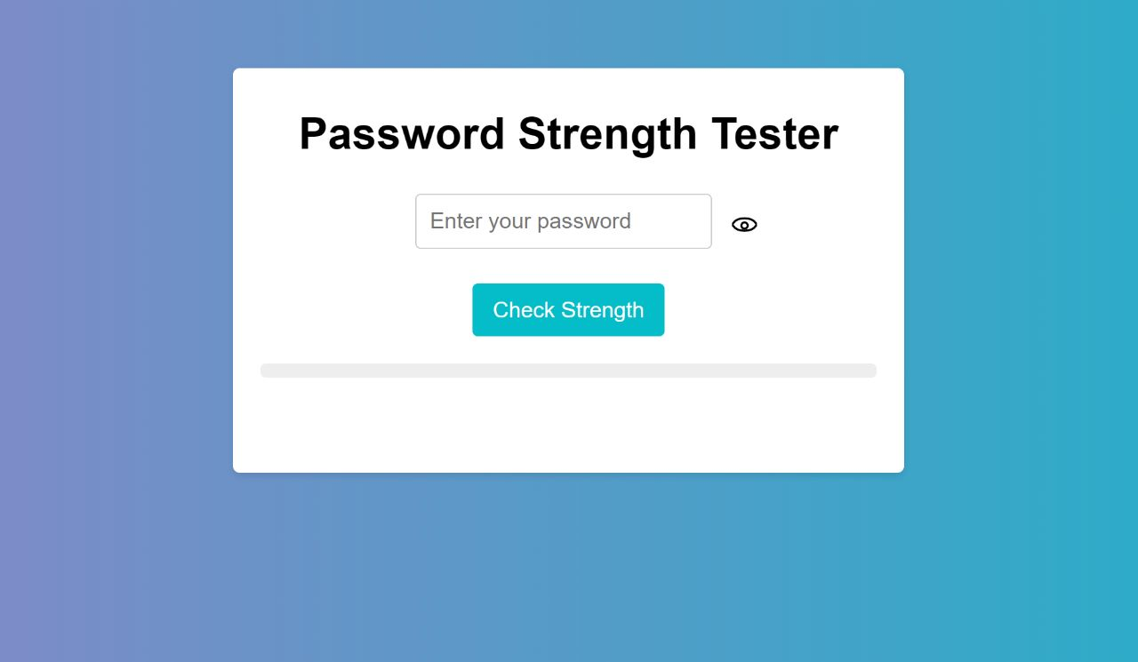
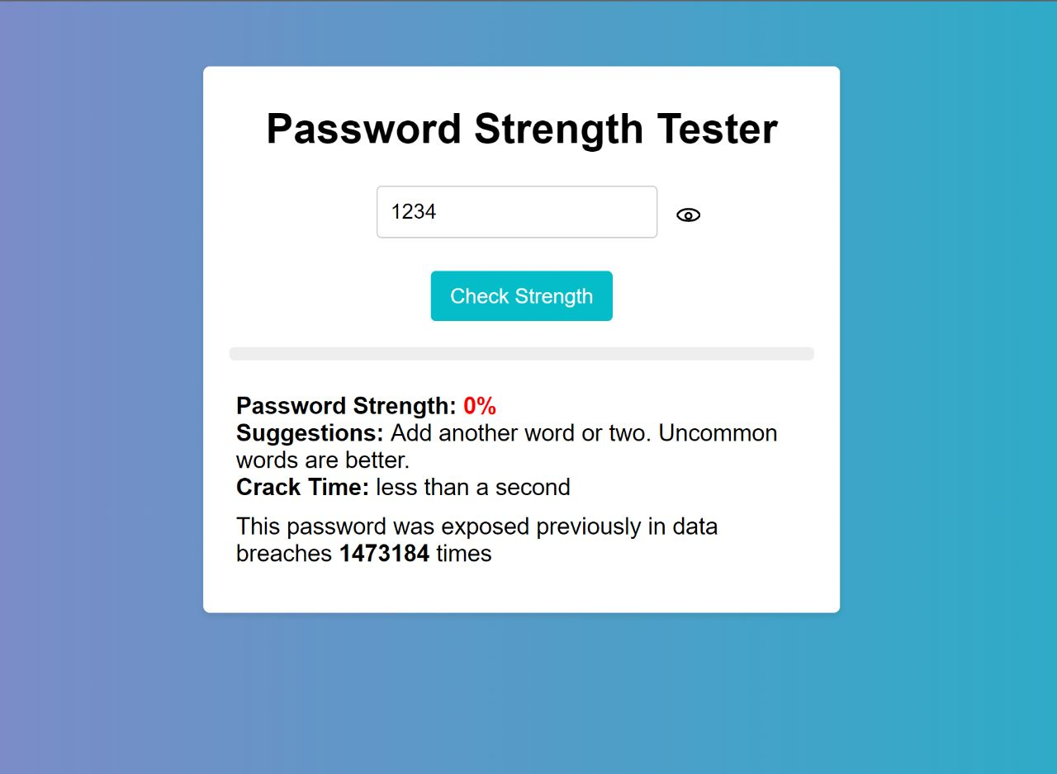
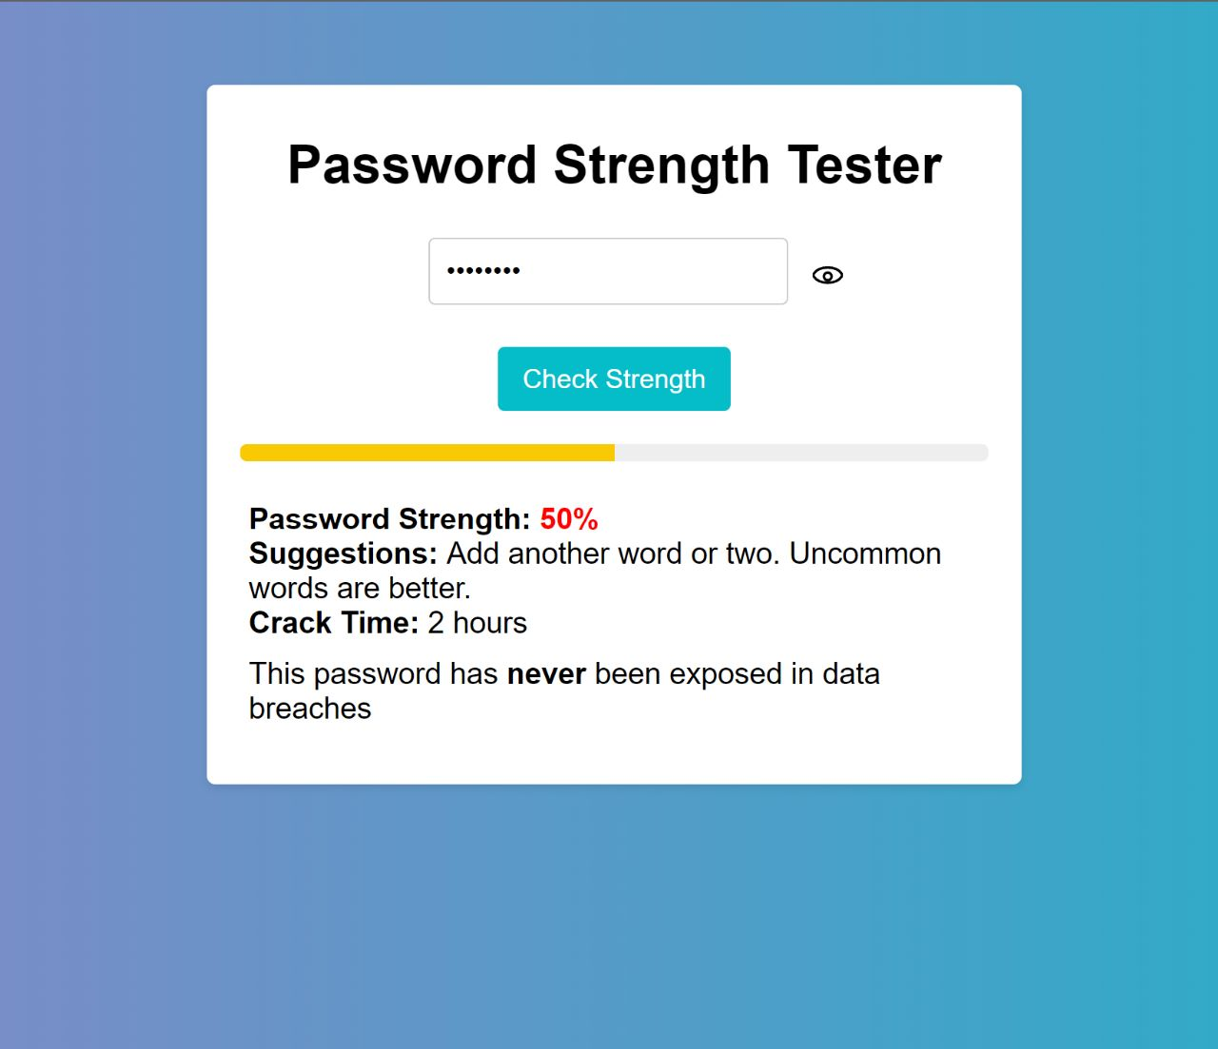
SNEAK PEEK

Slide 5
Show / Hide password icon
Suggestions to improve the password
Password strength meter
Password strength score
Time needed to crack the password
States whether the password has been exposed previously in data breaches

Slide 6
Backend
02

Slide 7
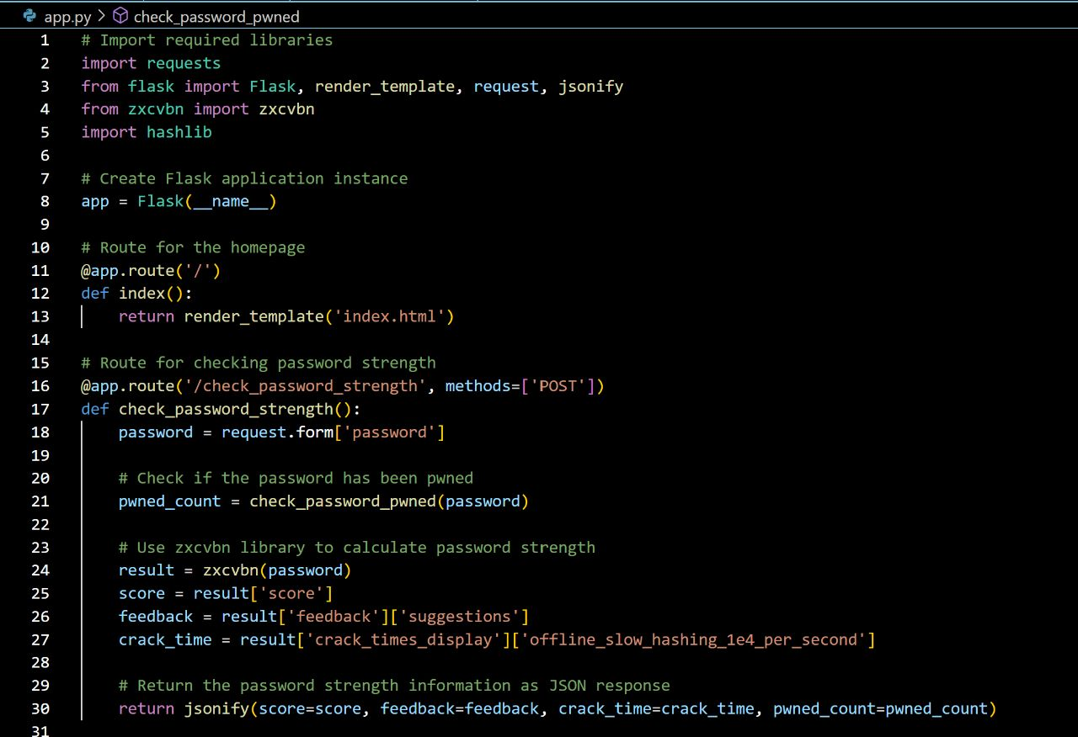
App.py: check_password_strength()
The check_password_strength function in app.py assesses the strength of a user-entered password. It calculates the password's score, provides feedback suggestions, and estimates its crack time using the zxcvbn library. The function also checks if the password has been compromised in data breaches. It returns a JSON response with the score, feedback, crack time, and pwned count. In the client-side code, the response is used to update the UI, displaying the password's strength level, feedback, crack time, and indicating if the password has been previously exposed.

Slide 8
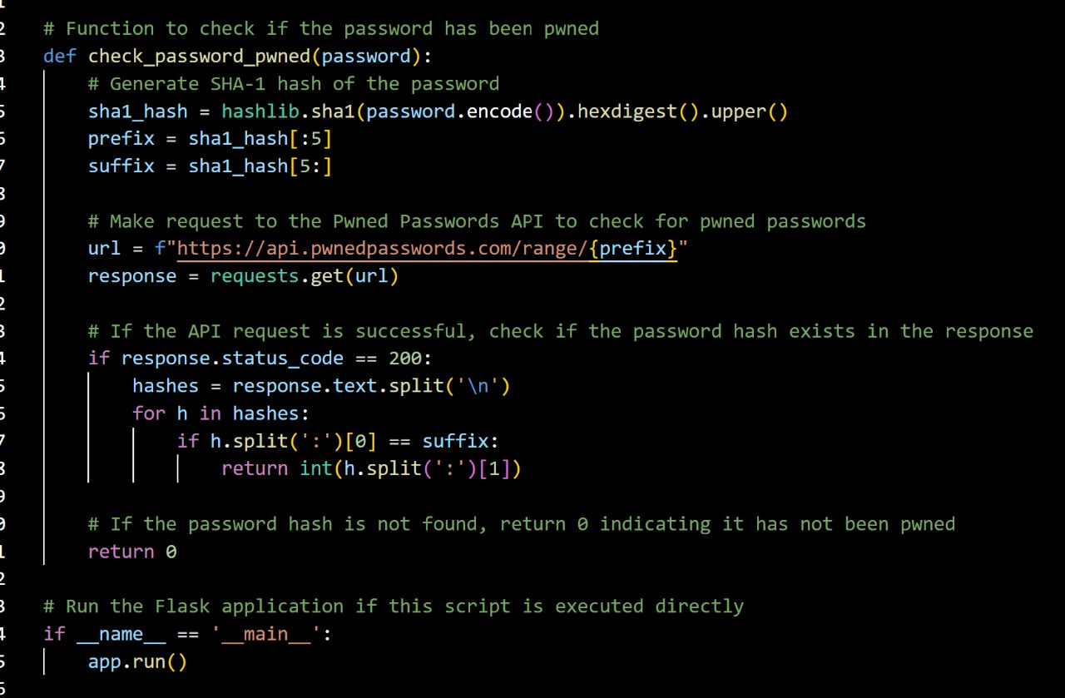
App.py: check_password_pwned()
The check_password_pwned function in app.py checks if a password has been compromised in data breaches. It generates a SHA-1 hash of the password and queries the Pwned Passwords API using the hash. If the API response indicates a match, it returns the count of how many times the password has been compromised. If no match is found, it returns 0. The function helps determine if a password has been previously exposed, assisting users in choosing more secure passwords.

Slide 9
Frontend
03

Slide 10
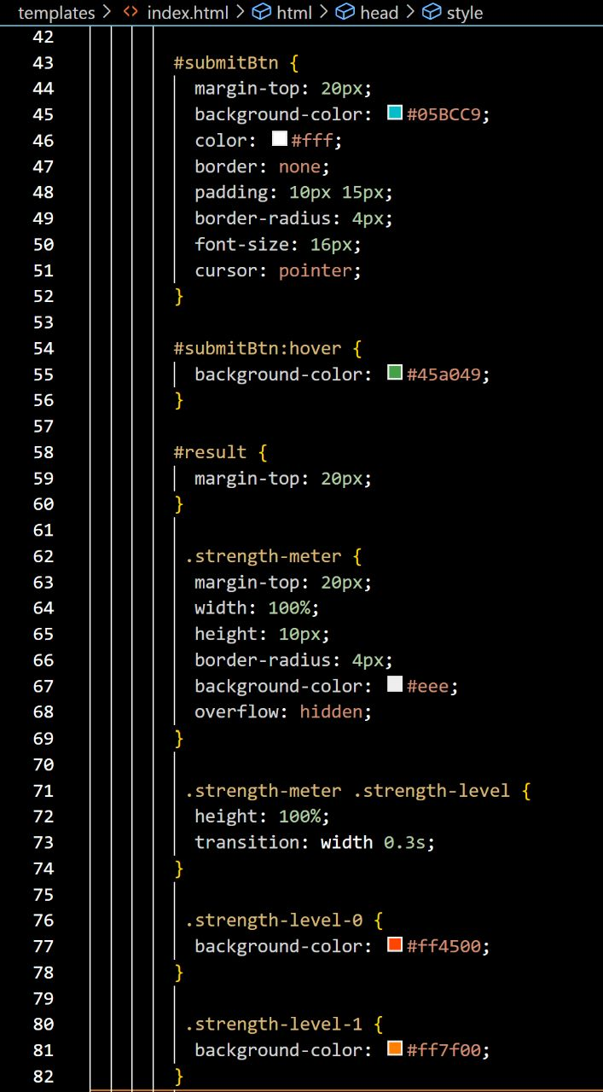
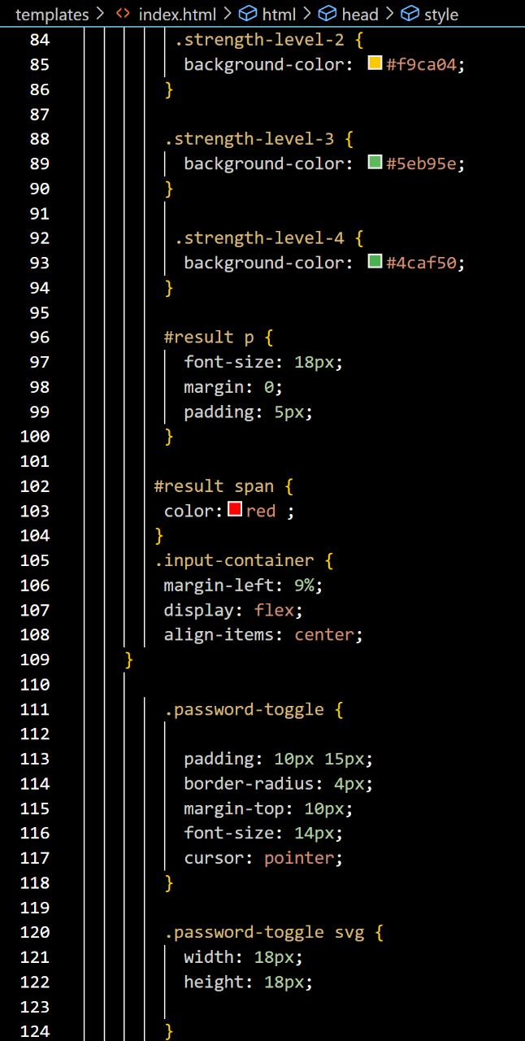
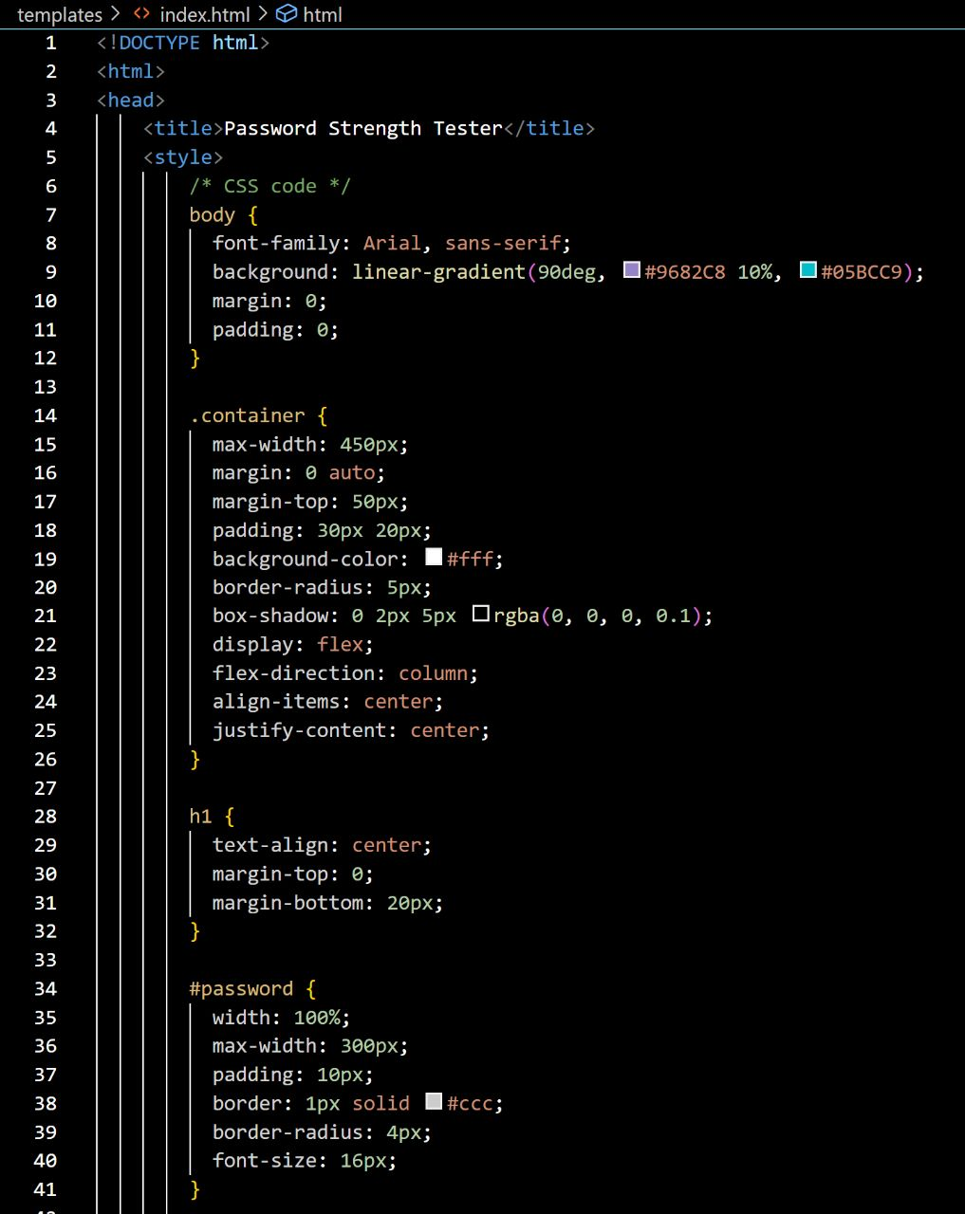
CSS:

Slide 11
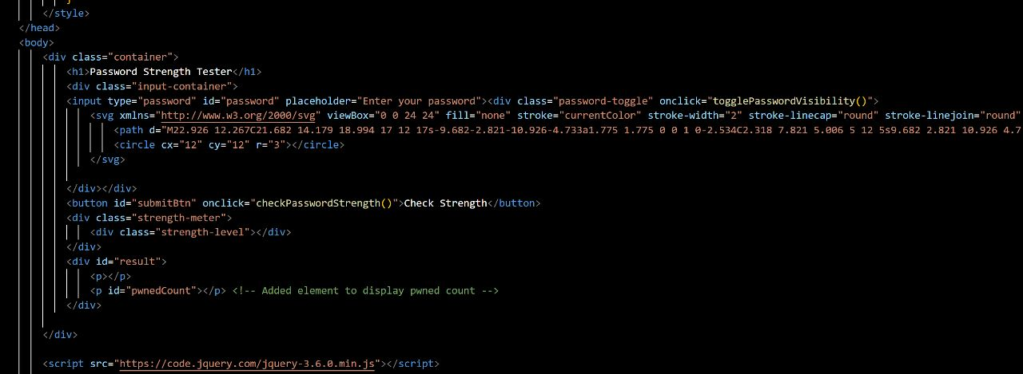
HTML:

Slide 12
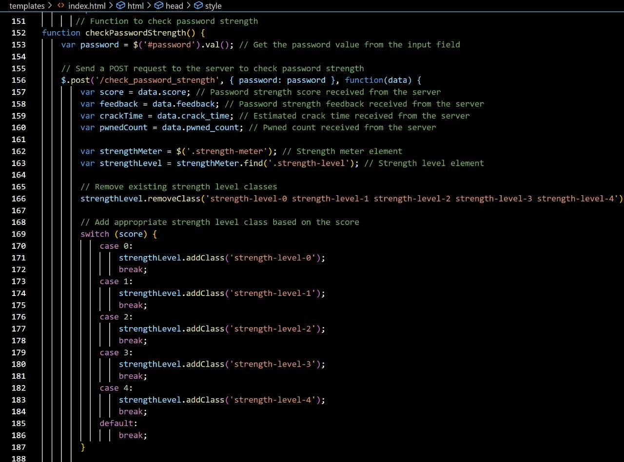
JavaScript: check_password_strength()

Slide 13
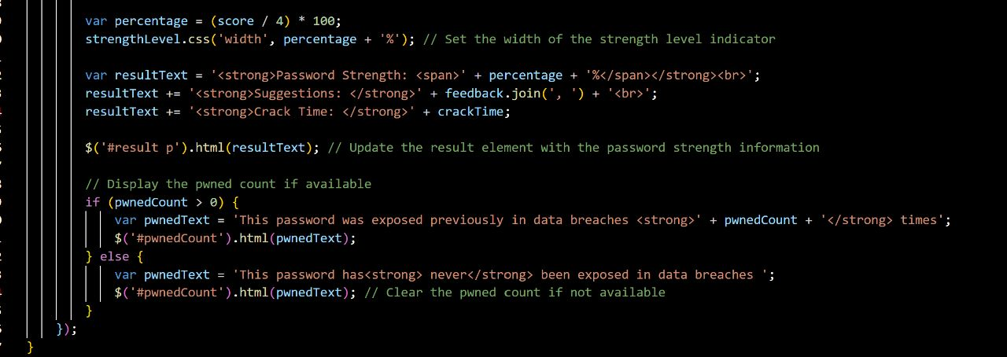
JavaScript: check_password_strength()
The checkPasswordStrength function in index.html evaluates the strength of a user-entered password. It sends a POST request to the server, receiving a response with the password's score, feedback, crack time, and pwned count. The function updates the UI by adjusting CSS classes and meter width to represent the password's strength level. It generates HTML elements to display the password's strength, feedback, and crack time. If the password has been compromised, it shows the number of exposures; otherwise, it indicates that the password has never been exposed.

Slide 14
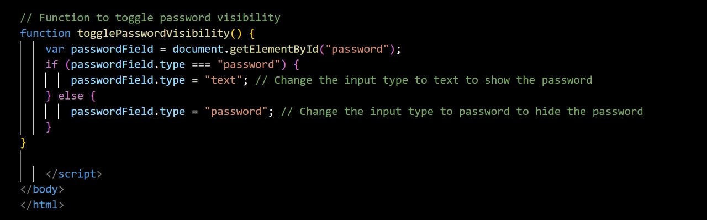
JavaScript: togglePasswordVisibility()
The togglePasswordVisibility function in index.html is responsible for toggling the visibility of the entered password. It retrieves the password field element and checks its current type. If it is set to "password", the function changes it to "text" to display the password characters. If it is set to "text", the function changes it back to "password" to hide the password characters. By toggling the password field type, the function allows the user to control the visibility of the entered password.

Slide 15
THANK YOU FOR YOUR ATTENTION
This project was realized by: Mahdi Laafif – Khalil Elachkham – Mohamed Haroun Cheriha

