Slide 1

CityVG application project

Slide 2
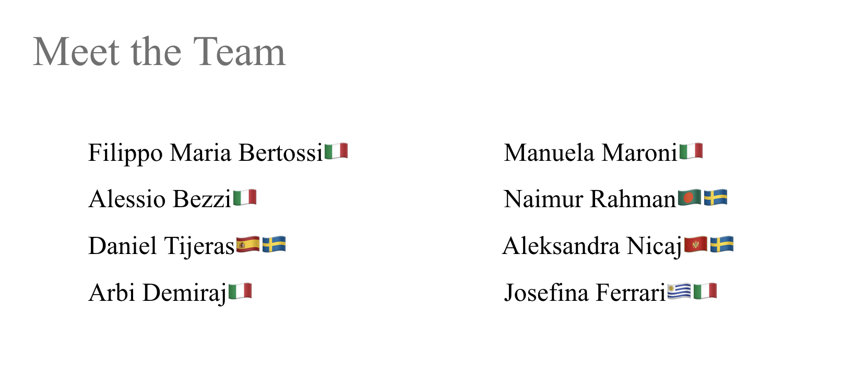

Slide 3
Team Organization
Implementation of Scrum through Jira:
Sprint Planning: Tasks are created and assigned in Jira during sprint planning
Backlog Management: Jira helps prioritize and refine the product backlog
Daily Standups: Team members update Jira boards daily, providing visibility into progress and any blockers.
Sprint Reviews & Retrospectives: Jira tracks completed tasks, facilitating reviews and continuous improvements post-sprint.
Scrum Roles:
Product Owner: Alessio Bezzi
Scrum Master: Aleksandra Nicaj

Slide 4






Project description
Design an app to generate guided tours
Plan routes according to available time and user preferences
Facilitate booking and purchase of tickets from the same app
Use recommenders and maps to optimise routes
Delivering a cross-platform experience on mobile and web
Allow switching devices during the visit

Slide 5
Target of the project
Tourists that do not have too much time to plan their trips
Groups who have specific requirements such as elderly or kids
People who do not have enough time to book guided visits or they prefer their own organisation
Students that might be looking for the cheapest way of visiting the place in question

Slide 6
Requirements
Automation of tour planning:
instead of manually researching user can combine all the information he needs through cityVG
Time Constraint:
to reduce planning time
Personalized experience:
to filter hundreds of choices and recommend based on preferences
Real time adaptability:
that facilitates access to external services
Integration:
to integrate different services in one device

Slide 7
System architecture
Frontend:
Flutter for cross-platform support (Android, iOS, Web)
Backend:
PHP/Python for server logic and reasoning system, matching user preferences with city attractions
Database:
Firebase for storing storing user data, visit plans and city informations
External integrations:
Reservation/Ticketing APIs (if available) with a proxy for handling third-party bookings
Stripe for secure payments

Slide 8
Quality assurance procedures (1)
Test-Driven Development (TDD)
Cross-Platform Automated Testing with Appium (Java)
Writing Test Cases Before Development (TestRail)
Manual Continuous Testing
Regression Testing
Integration Testing
Collaborative QA Process Using Jira
User Acceptance Testing (UAT)
Incorporating User Feedback

Slide 9
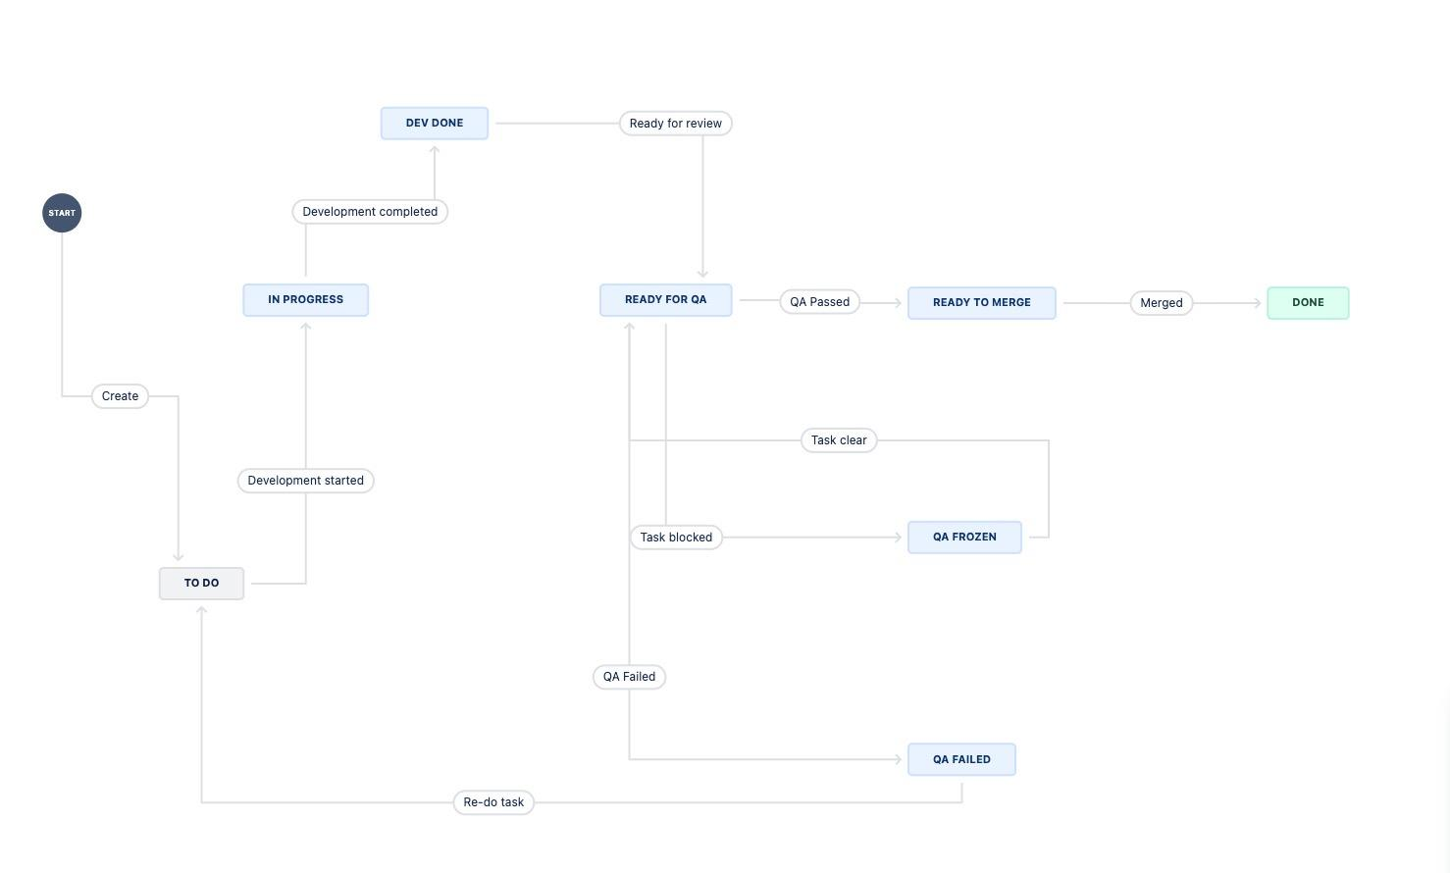
Jira workflow

Slide 10
Risk assessment analysis (1)
Payment data
Risk: Sensitive payment information might be exposed
Mitigation: Use an external service like Stripe to handle payments securely
Location data
Risk: Location data may be stolen and misused for criminal activity (e.g., burglary)
Mitigation: Implement secure communication, minimize data retention, and anonymize data

Slide 11
Risk assessment analysis (2)
Integration issues
Risk: Difficulties may arise in integrating third-party services (e.g., APIs for ticket reservations, Stripe, WikiTravel)
Mitigation: Allocate some extra time in each sprint for integration task

Slide 12
Communication
Communication Tools
WhatsApp: Primary tool for daily messaging and quick updates
Zoom: Used for formal meetings and detailed discussions
Internal Routines
Regular Zoom meetings to review milestones and challenges
Daily WhatsApp check-ins for status updates and quick resolutions
Meeting Documentation
Implementing minutes of meeting to record key decisions, discussions, and action items

Slide 13
Sprint #0 Report
First Informal Meeting
Presentation email to our customer
Second Meeting on October 10th
Assign tasks and areas to each team member
Discussed different technologies
Third Meeting on October 14th
Last minute details

