Slide 1



Wormhole Filters: Caching Your Hash on Persistent Memory
Hancheng Wang¹, Haipeng Dai¹, Rong Gu¹, Youyou Lu², Jiaqi Zheng¹,
Jingsong Dai¹, Shusen Chen¹, Zhiyuan Chen³, Shuaituan Li³, Guihai Chen¹
Nanjing University¹
Tsinghua University²
Huawei Technologies Co., Ltd.³
Notes:
Hello, everyone. I am Hancheng Wang from Nanjing University. It’s an honor to be here to present our work “Wormhole Filters: Caching Your Hash on Persistent Memory”. This is a joint work done by people from Nanjing University, Tsinghua University, and Huawei.

Slide 2
Filter data structures
Filter data structures (e.g., bloom filter, cuckoo filter) can approximately indicate whether an element x is in a given set S. For example, the cuckoo filter saves fingerprints in a hash table.
hash(e) = XXXXX101
101
Notes:
Filter data structures can approximately indicate whether an element is in a given set. For example, the cuckoo filter saves fingerprints in a hash table.

Slide 3
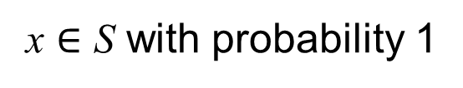
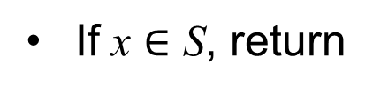
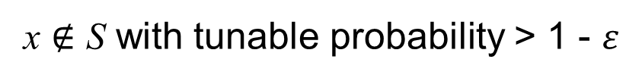
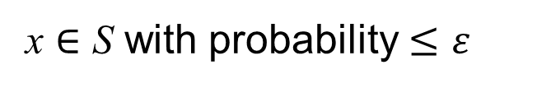
Filter data structures
Filter data structures (e.g., bloom filter, cuckoo filter) can approximately indicate whether an element x is in a given set S. Specifically,
If x $∈$ S, return
x $∈$ S with probability 1
x $∉$ S with tunable probability > 1 - 𝜀
If x ∉ S, return
hash(e) = XXXXX101
x $∈$ S with probability $≤$ 𝜀
101
Notes:
Based on this design, if an element exists in a set, the filter always returns true. If the element don’t exist, the filter can return that the element don’t exist with tunable probability.

Slide 4




Filters are ubiquitous
Many applications use filters to approximately test the existence of elements.
Database systems
Network systems
IoT applications
Bioinformatics
Notes:
Many applications use filters to approximately test the existence of elements. To meet the requirements of the above applications,

Slide 5
Filter design objectives
1. Large capacity
Can accommodate enough elements
2. High accuracy
Very low false positive rate in lookups
3. High throughput
Fast insertions, lookups, and deletions
1. large
capacity
2. high
accuracy
our work
3. high throughput
Notes:
the filters should have large capacity, high accuracy, and high throughput. However, previous works could only achieve one or two of these three objectives. Our work can simultaneously satisfy all three objectives.

Slide 6
Filter design objectives -- for objectives 1 and 2
Filters require larger storage space to achieve large capacity (objective 1) and high accuracy (objective 2).
Previous work ported filters from DRAM to SSD for larger storage space.
However, filters on SSD have low throughput (unable to achieve objective 3).
Filters on SSD
Quotient Filter [VLDB’12]
Counting Quotient Filter [SIGMOD’17]
1. large
capacity
2. high
accuracy
our work
3. high throughput
Notes:
Specifically, filters require larger storage space to achieve objectives 1 and 2. Therefore, some previous work ported the filter to SSD for larger storage space. However, filters running on SSD have low throughput, which is unable to achieve objective 3.

Slide 7
Filter design objectives -- for objective 3
Filters in DRAM can achieve high throughput (objective 3).
However, storing a large number of elements while achieving high accuracy in DRAM incurs huge memory consumption (unable to achieve objectives 1 and 2).
1. large
capacity
2. high
accuracy
our work
3. high throughput
Filters in DRAM
Bloom Filter [Comm. ACM’70]
Cuckoo Filter [CoNEXT’14]
Notes:
Filters in DRAM can achieve objective 3. However, storing a large number of elements while achieving high accuracy in DRAM incurs huge memory consumption, which is unable to achieve objectives 1 and 2.

Slide 8
Filters need to achieve all objectives
Previous filter designs have to trade off between speed (objective 3) and space (objectives 1 and 2).
Filters on SSD
Quotient Filter [VLDB’12]
Counting Quotient Filter [SIGMOD’17]
1. large
capacity
2. high
accuracy
 | Speed | Space
DRAM | fast | small
SSD | slow | large
our work
Filters in DRAM
Bloom Filter [Comm. ACM’70]
Cuckoo Filter [CoNEXT’14]
3. high throughput
Notes:
In summary, filters need to achieve all objectives. Previous filter designs have to trade off between speed and space. The reason behind this is that DRAM and SSD cannot have fast speed and large storage space capacity simultaneously.

Slide 9
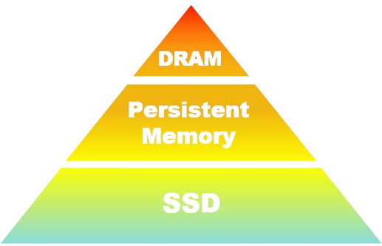
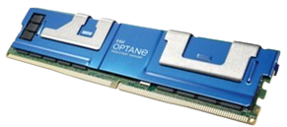
To achieve all objectives
Persistent memory has the speed close to DRAM and the capacity close to SSD. It has potential to make filters achieve the above three objectives simultaneously.
 | Speed | Space
DRAM | fast | small
Persistent Memory | close to DRAM | close to SSD
SSD | slow | large
Notes:
Persistent memory has the speed close to DRAM and the capacity close to SSD. It has potential to make filters achieve the above three objectives simultaneously.

Slide 10
Porting filters to persistent memory is not trivial
Operation throughput drops significantly after porting filters from DRAM to persistent memory. This is because:
Previous filter designs incur extensive random accesses and sequential writes.
Persistent memory's random access and sequential write speeds are much lower than those of DRAM^{[1]}.
DRAM/PM Bandwidth Ratio | Sequential | Random
Read | ~3× | ~8×
Write | ~11× | ~14×
[1] Dash: Scalable Hashing on Persistent Memory. VLDB 2020.
Notes:
However, porting filters to persistent memory is not a trivial task. Because after porting filters from DRAM to persistent memory, the operation throughput drops significantly. The reason behind this is previous filter designs incur extensive random accesses and sequential writes. However, persistent memory’s random access and sequential write speeds are much lower than those of DRAM.

Slide 11
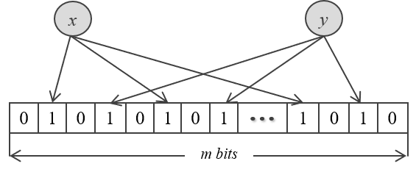
Porting filters to persistent memory is not trivial
For example, the insertion and lookup of Bloom filters require accessing k bits, resulting in a large number of random accesses. Random accesses to DRAM are fast, but random accesses to persistent memory are slow.
k=3 in this example
Notes:
For example, the insertion and lookup of Bloom filters require access to k bits, resulting in a large number of random accesses. Random accesses to DRAM are fast, but random accesses to persistent memory are slow.

Slide 12
Porting filters to persistent memory is not trivial
For example, quotient filters obtain an empty slot to insert a new element by shifting all subsequent elements after the position where a collision occurs, resulting in a large number of sequential writes.
0 |  |  | 2 |  |  | 3 |  |  | 4 |  |  | 5 |  |  | empty |  |  | empty |  |  | empty
before insertion:
2
insert a new element
1
shift all subsequent elements
0 |  |  |  |  |  | 2 |  |  | 3 |  |  | 4 |  |  | 5 |  |  | empty |  |  | empty
after insertion:
Notes:
Another example is quotient filter. Quotient filters will shift all subsequent elements after insertion position to get a new slot, resulting in a large number of sequential writes. Sequential writes to DRAM are fast, but sequential writes to persistent memory are slow.

Slide 13
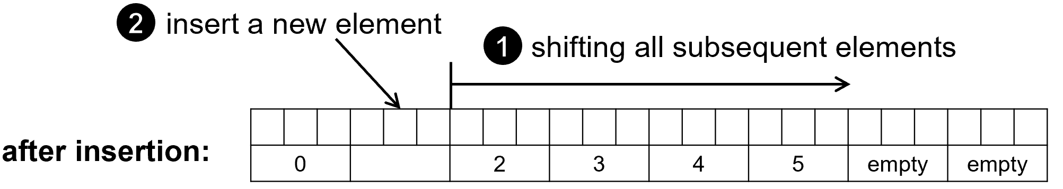
Porting filters to persistent memory is not trivial
Previous filter designs incur extensive random accesses and sequential writes.
Persistent memory has low random access and sequential write speeds.
We propose wormhole filters that achieve high performance on persistent memory by reducing random accesses and sequential writes simultaneously.
Notes:
In summary, previous filter designs incur extensive random accesses and sequential writes. However, persistent memory’s random access and sequential write speeds are much lower than those of DRAM. We propose wormhole filters that achieve high performance on persistent memory by reducing random accesses and sequential writes simultaneously.

Slide 14
Wormhole Filter: Data Structure
The figure below shows an example of a wormhole filter with 6 buckets and 3 slots in each bucket. Each element has one corresponding bucket.
0
e
1
2
6 buckets
3
4
5
3 slots
Notes:
The figure below shows an example of a wormhole filter with 6 buckets and 3 slots in each bucket. Each element has one corresponding bucket.

Slide 15
Wormhole Filter: Insertion
Next we show how to insert an element A. Assuming that the corresponding bucket of element A is bucket 1, and the fingerprint of element A is fA. Slots in gray are occupied.
0
Calculate element A’s corresponding bucket.
1
1
2
3
4
5
Notes:
Next we show how to insert an element A. Assuming that the corresponding bucket of element A is bucket 1, and the fingerprint of element A is fA. Slots in gray are occupied.

Slide 16
Wormhole Filter: Insertion
Next we show how to insert an element A. Assuming that the corresponding bucket of element A is bucket 1, and the fingerprint of element A is fA. Slots in gray are occupied.
0
Bucket 1 has an empty slot, so element A can be stored directly in it.
Calculate element A’s corresponding bucket.
2
1
1
2
3
4
5
Notes:
Because Bucket 1 has an empty slot, so element A can be stored directly in it.

Slide 17
Wormhole Filter: Insertion
Next we show how to insert an element A. Assuming that the corresponding bucket of element A is bucket 1, and the fingerprint of element A is fA. Slots in gray are occupied.
0
Bucket 1 has an empty slot, so element A can be stored directly in it.
Calculate element A’s corresponding bucket.
<0, fA>
2
1
1
2
“0” denotes the distance between element A‘s corresponding bucket and the position where element A is actually stored. (1-1=0)
3
4
“fA” is the fingerprint of element A, that is, a few bits of element A’s hash value.
5
Notes:
We store 0 and Fa in this slot. 0 denotes the distance between element A’s corresponding bucket and the position where element A is actually stored. In this example, A’s corresponding bucket is 1. The bucket where element A is actually stored is also bucket 1. Therefore, the distance value is 0. Fa is the fingerprint of element A, that is, a few bits of element A’s hash value.

Slide 18
Wormhole Filter: Insertion
Then, we insert element B. Assuming that the corresponding bucket of element B is also 1, and the fingerprint of element B is fB.
0
Calculate element B’s corresponding bucket.
1
1
2
3
4
5
Notes:
Then, we insert element B. Assuming that the corresponding bucket of element B is also 1, and the fingerprint of element B is fB.

Slide 19
Wormhole Filter: Insertion
Then, we insert element B. Assuming that the corresponding bucket of element B is also 1, and the fingerprint of element B is fB.
0
Calculate element B’s corresponding bucket.
1
Bucket 1 has no empty slots. Find an empty slot by linear probing and borrow this empty slot to store element B.
1
2
2
3
4
5
Notes:
However, Bucket 1 has no empty slots. We can find an empty slot by linear probing and borrow this empty slot to store element B.

Slide 20
Wormhole Filter: Insertion
Then, we insert element B. Assuming that the corresponding bucket of element B is also 1, and the fingerprint of element B is fB.
0
Calculate element B’s corresponding bucket.
1
Bucket 1 has no empty slots. Find an empty slot by linear probing and borrow this empty slot to store element B.
1
2
2
<1, fB>
3
“1” denotes the distance between element B's corresponding bucket and the position where element B is actually stored. (2-1=1)
4
5
“fB” is the fingerprint of element B, that is, a few bits of element B’s hash value.
Notes:
We store 1 and Fb in this slot. 1 is the distance value. Because the corresponding bucket of element B is bucket 1, but element B is actually stored in bucket 2. So the distance value is 1.

Slide 21
Wormhole Filter: Insertion
Then, we insert element C. Assuming that the corresponding bucket of element C is also 1, and the fingerprint of element C is fC.
0
Calculate element C’s corresponding bucket.
1
1
2
3
4
5
Notes:
Then, we insert element C. Assuming that the corresponding bucket of element C is also 1, and the fingerprint of element C is fC.

Slide 22
Wormhole Filter: Insertion
Then, we insert element C. Assuming that the corresponding bucket of element C is also 1, and the fingerprint of element C is fC.
0
Calculate element C’s corresponding bucket.
1
1
Bucket 1 has no empty slots. Find an empty slot by linear probing and borrow this empty slot to store element C.
2
2
3
4
5
Notes:
We find that there is an empty slot in bucket 3 through linear probing.

Slide 23
Wormhole Filter: Insertion
Then, we insert element C. Assuming that the corresponding bucket of element C is also 1, and the fingerprint of element C is fC.
0
Calculate element C’s corresponding bucket.
1
1
Bucket 1 has no empty slots. Find an empty slot by linear probing and borrow this empty slot to store element C.
2
2
3
<2, fC>
4
“2” denotes the distance between element C's corresponding bucket and the position where element C is actually stored. (3-1=2)
5
“fC” is the fingerprint of element C, that is, a few bits of element C’s hash value.
Notes:
We store 2 and fc in this slot. 2 represents the distance value. That is because the corresponding bucket of element c is 1, but element c is stored in bucket 3, so the distance value is 2.

Slide 24
Wormhole Filter: Insertion
Then, we insert element D. Assuming that the corresponding bucket of element D is also 1, and the fingerprint of element D is fD.
0
Calculate element D’s corresponding bucket.
1
1
2
3
4
5
Notes:
Then, we insert element D. Assuming that the corresponding bucket of element D is also 1, and the fingerprint of element D is fD.

Slide 25
Wormhole Filter: Insertion
Then, we insert element D. Assuming that the corresponding bucket of element D is also 1, and the fingerprint of element D is fD.
0
Calculate element D’s corresponding bucket.
1
1
2
Find an empty slot
by linear probing.
3
2
4
The distance between this empty slot and the corresponding bucket exceeds the predefined threshold 3. (5-1=4>3)
5
Notes:
We find that there is an empty slot in bucket 5 through linear probing. However, the distance between bucket 1 and 5 is too far. This distance exceeds our predefined threshold 3. This threshold is predefined. We use this threshold to prevent us from storing elements in buckets that are very far away from their corresponding buckets.

Slide 26
Wormhole Filter: Insertion
Then, we insert element D. Assuming that the corresponding bucket of element D is also 1, and the fingerprint of element D is fD.
0
Calculate element D’s corresponding bucket.
1
1
2
3
Move one inserted element to obtain a closer empty slot.
3
<0, fE>
2
Find an empty slot
by linear probing.
4
5
Notes:
To insert element D, we can move one inserted element to obtain a closer empty slot.

Slide 27
Wormhole Filter: Insertion
Then, we insert element D. Assuming that the corresponding bucket of element D is also 1, and the fingerprint of element D is fD.
0
Calculate element D’s corresponding bucket.
1
1
2
3
Move one inserted element to obtain a closer empty slot.
Find an empty slot
by linear probing.
3
2
4
5
<2, fE>
Notes:
For example, we move element E from bucket 3 to bucket 5. This will create a closer empty slot in bucket 3.

Slide 28
Wormhole Filter: Insertion
Then, we insert element D. Assuming that the corresponding bucket of element D is also 1, and the fingerprint of element D is fD.
0
Calculate element D’s corresponding bucket.
1
1
2
3
Move one inserted element to obtain a closer empty slot.
Find an empty slot
by linear probing.
3
2
4
4
Store element D in the newly created empty slot.
5
<2, fE>
Notes:
Bucket 3 is close enough to Bucket 1. So we can store element D in Bucket 3.

Slide 29
Wormhole Filter: Insertion
Then, we insert element D. Assuming that the corresponding bucket of element D is also 1, and the fingerprint of element D is fD.
0
Calculate element D’s corresponding bucket.
1
1
2
3
Move one inserted element to obtain a closer empty slot.
3
<2, fD>
2
Find an empty slot
by linear probing.
4
4
Store element D in the newly created empty slot.
5
<2, fE>
Notes:
We store the distance value 2 and fd in this newly generated empty slot.

Slide 30
Wormhole Filter: Insertion
Then, we insert element D. Assuming that the corresponding bucket of element D is also 1, and the fingerprint of element D is fD.
“2” denotes the distance between element D's corresponding bucket and the position where element D is actually stored. (3-1=2)
0
Calculate element D’s corresponding bucket.
1
“fD” is the fingerprint of element C, that is, a few bits of element C’s hash value.
1
2
3
Move one inserted element to obtain a closer empty slot.
3
<2, fD>
2
Find an empty slot
by linear probing.
4
4
Store element D in the newly created empty slot.
5
<2, fE>
Notes:
distance value is 2. It is because the corresponding bucket of element D is 1. But element D is actually stored in bucket 3. So the distance value is 2.

Slide 31
Takeaways
The key point is that the wormhole filter insertion is mainly based on linear probing (i.e., sequential reads), which is very fast on persistent memory.
0
Calculate element D’s corresponding bucket.
1
1
2
3
Move one inserted element to obtain a closer empty slot.
Find an empty slot
by linear probing.
3
2
4
4
Store element D in the newly created empty slot.
5
Notes:
For more details on the insertion operation, please refer to our paper. However, the only thing I want to emphasize is that the insertion operation wormhole filter is mainly based on sequential reads, which is very fast on persistent memory.

Slide 32
Wormhole Filter: Lookup And Deletion
In the previous example, the insertion operation ensures that the distance between the bucket where the element is actually stored and its corresponding bucket does not exceed 3.
0
1
<0, fA>
2
<1, fB>
3
<2, fD>
<2, fC>
4
5
<2, fE>
Notes:
Next I‘ll briefly introduce Lookup And Deletion. In the previous example, the insertion operation ensures that the distance between the bucket where the element is actually stored and its corresponding bucket does not exceed 3.

Slide 33
Wormhole Filter: Lookup And Deletion
Therefore, when looking up an element, the wormhole filter only needs to use linear probing to check up to 4 buckets. Take query element D as an example:
Calculate element D’s corresponding bucket.
0
1
1
2
3
<2, fD>
4
5
Notes:
Therefore, when looking up an element, the wormhole filter only needs to use linear probing to check up to 4 buckets in this example. Take querying element D as an example. Firstly, we need to locate element D's corresponding bucket.

Slide 34
Wormhole Filter: Lookup And Deletion
Therefore, when looking up an element, the wormhole filter only needs to use linear probing to check 4 buckets. Take query element D as an example:
Calculate element D’s corresponding bucket.
0
check <0, fD >
1
1
Check if there is a matching distance- fingerprint pair in the corresponding bucket and next 3 buckets.
2
2
3
<2, fD>
4
5
Notes:
And then we need to check sequentially whether there is a <0, fd> pair in bucket 1;

Slide 35
Wormhole Filter: Lookup And Deletion
Therefore, when looking up an element, the wormhole filter only needs to use linear probing to check 4 buckets. Take query element D as an example:
Calculate element D’s corresponding bucket.
0
check <0, fD >
1
1
check <1, fD >
Check if there is a matching distance- fingerprint pair in the corresponding bucket and next 3 buckets.
2
2
3
<2, fD>
4
5
Notes:
If not, we check whether there is a <1, fd> pair in bucket 2;

Slide 36
Wormhole Filter: Lookup And Deletion
Therefore, when looking up an element, the wormhole filter only needs to use linear probing to check 4 buckets. Take query element D as an example:
Calculate element D’s corresponding bucket.
0
check <0, fD >
1
1
check <1, fD >
Check if there is a matching distance- fingerprint pair in the corresponding bucket and next 3 buckets.
2
check <2, fD >
2
3
<2, fD>
4
5
Notes:
If not, we check whether there is a <2, fd> pair in bucket 3; In our example, there is a matched pair in bucket 3, so we can return that element D is in the filter.

Slide 37
Wormhole Filter: Lookup And Deletion
Therefore, when looking up an element, the wormhole filter only needs to use linear probing to check 4 buckets. Take query element D as an example:
Calculate element D’s corresponding bucket.
0
check <0, fD >
1
1
check <1, fD >
Check if there is a matching distance- fingerprint pair in the corresponding bucket and next 3 buckets.
2
check <2, fD >
2
3
check <3, fD >
4
5
Notes:
But if we can’t find a matching pair in bucket 3. We need to continue to check whether there is a <3, fd> pair in bucket 4. If we can’t find matching pair in all of 4 buckets. We will say this element does not exist in the filter.

Slide 38
Takeaways
The insertion, lookup, and deletion operations of wormhole filters are mainly based on linear probing (i.e., sequential reads), which is very fast on persistent memory.
Wormhole filters reduce the number of random reads/writes and sequential writes, which are extremely slow on persistent memory.
Notes:
All in all, the insertion, lookup, and deletion operations of wormhole filters are mainly based on linear probing which is also sequential reads. It is very fast on persistent memory. In other words, Wormhole filters reduce the number of random reads/writes and sequential writes, which are extremely slow on persistent memory.

Slide 39
Wormhole Filter: Fault Tolerance
Wormhole filters support fault tolerance by firstly supporting per-bucket fault tolerance and then supporting inter-bucket fault tolerance.
Notes:
Wormhole filters support fault tolerance by firstly supporting per-bucket fault tolerance and then supporting inter-bucket fault tolerance.

Slide 40
Wormhole Filter: Fault Tolerance
Wormhole filters support fault tolerance by firstly supporting per-bucket fault tolerance and then supporting inter-bucket fault tolerance.
Per-bucket Fault Tolerance
The atomic write unit of the mainstream persistent memory is 8 bytes.
We made each bucket 8-byte to write a fingerprint atomically.
Notes:
For Per-bucket Fault Tolerance，as the atomic write unit of the mainstream persistent memory is eight bytes, we made each bucket eight-byte to write a fingerprint atomically.

Slide 41
Wormhole Filter: Fault Tolerance
Wormhole filters support fault tolerance by firstly supporting per-bucket fault tolerance and then supporting inter-bucket fault tolerance.
Per-bucket Fault Tolerance
Inter-bucket Fault Tolerance
Moving a fingerprint between buckets involves copying to the target then deleting from the source.
We use memory fences/flush to ensure the correctness of the writing order.
Notes:
For Inter-bucket Fault Tolerance，as Moving a fingerprint between buckets involves copying to the target then deleting from the source, We use memory fences/flush to ensure the correctness of the writing order. We proved that wormhole filters support fault tolerance. Please refer to the proof in the paper for more details.

Slide 42
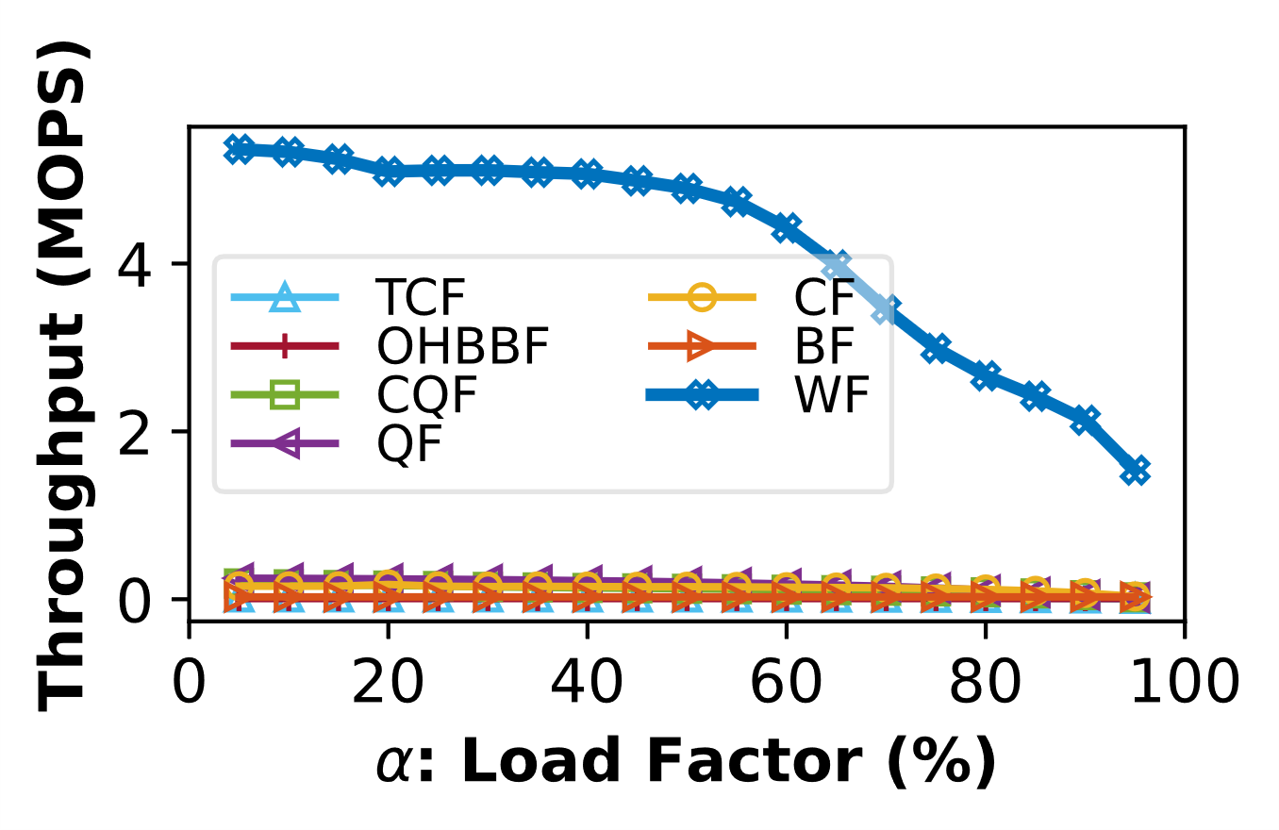
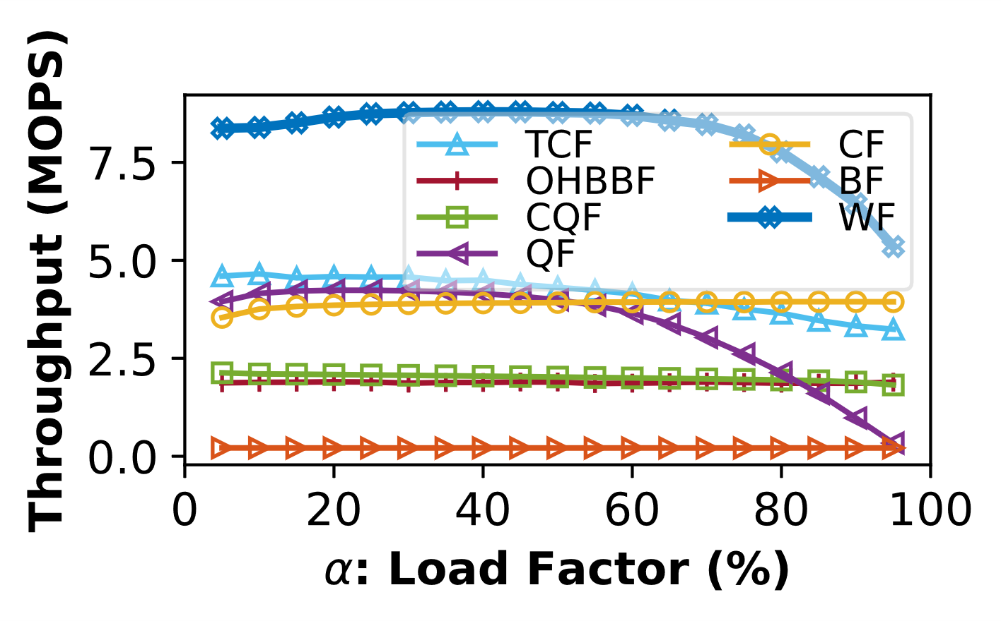
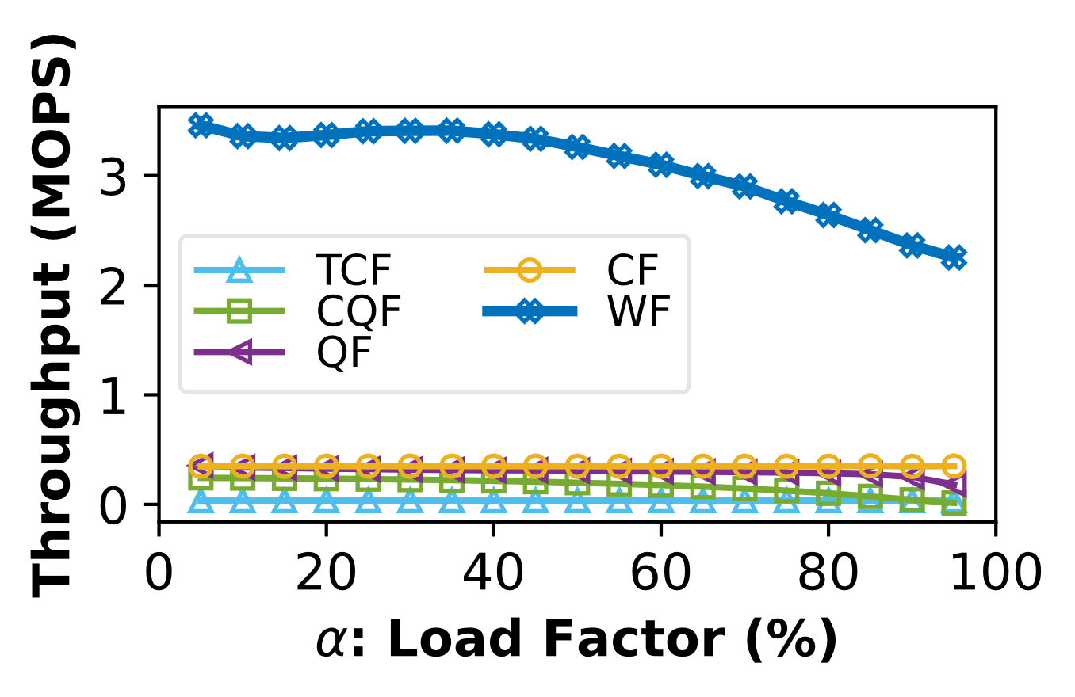
Evaluation -- On-PM Performance
We evaluate the performance of wormhole filters on persistent memory.
For insertion and deletion, the performance improvement mainly comes from wormhole filters reducing the number of random accesses and sequential writes. In addition, wormhole filters support fault tolerance with a lower cost.
Insertion
Lookup
Deletion
42
Notes:
We evaluate the performance of wormhole filters on persistent memory. Evaluation results show that wormhole filters significantly outperform competitive state-of-the-art algorithms.
For insertion and deletion, the performance improvement mainly comes from wormhole filters reducing the number of random accesses and sequential writes. In addition, wormhole filters support fault tolerance at a lower cost.

Slide 43
Evaluation -- On-PM Performance
For lookup operation, the cuckoo filter requires two random accesses. Wormhole filters only require one access.
For more details please refer to our paper.
1.98 ×
Lookup
43
Notes:
For lookup operation, the most competitive cuckoo filter requires two random accesses. Wormhole filters only require one access.

Slide 44
Conclusion
The wormhole filter^{[1]} is mainly based on linear probing (i.e., sequential reads), which is very fast on persistent memory.
The wormhole filter can reduce the number of random reads/writes and sequential writes, which are extremely slow on persistent memory.
Evaluation results show that wormhole filters significantly outperform competitive state-of-the-art algorithms.
[1] https://github.com/wanghanchengchn/wormholefilters
Notes:
All in all, the wormhole filter^{[1]} is mainly based on linear probing (i.e., sequential reads), which is very fast on persistent memory. The wormhole filter can reduce the number of random reads/writes and sequential writes, which are extremely slow on persistent memory.
We also shared our code here.

Slide 45
Thank You!
Hancheng Wang @ Nanjing University
hanchengwang@smail.nju.edu.cn
https://github.com/wanghanchengchn/wormholefilters
Notes:
That’s all, thank you.

