Slide 1


The Reinforcement Cuckoo Filter
Meng Li¹ , Wenqi Luo¹, Haipeng Dai¹, Huayi Chai¹, Rong Gu¹, Xiaoyu Wang², Guihai Chen¹
Nanjing University¹
Soochow University²

Slide 2





The cuckoo filter (CF) - Structure
(1) Reject
No Remote Access
$$f(a)$$
$$H_{1}(a)$$
(2) Accept
a
Remote Access
$$H_{2}(a)$$
Local Cuckoo filter
Remote Full Dataset

Slide 3


The cuckoo filter (CF) - One sided error
b
 | a
Accept
For element in $D$ :
accept with probability 1
Remote Access
Accept
Remote Access
a
Local Cuckoo filter
Remote Full Dataset $D$

Slide 4
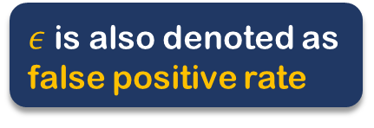


The cuckoo filter (CF) - One sided error
For element not in $D$:
Accept with probability $ε$
$ε$ is also denoted as false positive rate
False positive occurred !
b
 | a
Accept
For element in $D$:
Accept with probability 1
Remote Access
Accept
Remote Access
a
Local Cuckoo filter
Remote Full Dataset $D$

Slide 5


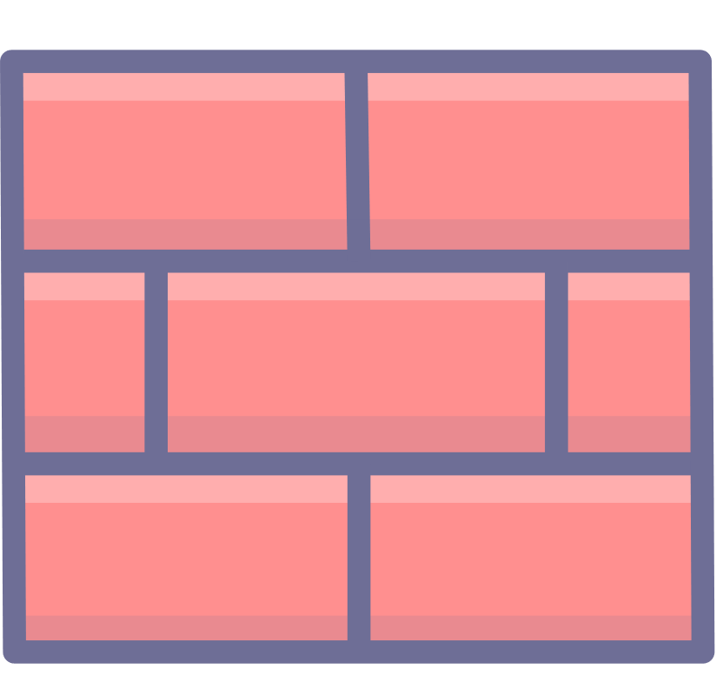
Network Applications of CF
Internet of Things
Web Applications
Firewalls

Slide 6



Challenges For Filters In Network Applications
A few hot flows account for: Majority of the traffic
Skewed data traffic
Replay false positives
Repeated false
positives queries
Attacker

Slide 7

Challenges For Filters In Network Applications
Huge amount of slow remote access
Repeated false
positives queries
Filters
Remote Full Dataset $D$

Slide 8
Challenges For Filters In Network Applications
Huge amount of slow remote access
Repeated false
positives queries
Filters
Remote Full Dataset $D$
Weaken the effectiveness of the cuckoo filter!

Slide 9

Problems of Previous Solutions
Local
Remote
Filters
Synchronize
Low lookup throughput
Stringent constraints for the remote

Slide 10
Our Contributions
We propsed the Reinforcement Cuckoo Filter (RCF) with:
Ability to handle repeated false positives queries
High lookup throughout (similar to CF)
Remote independent structure
Core ideas:
Fast one-to-one hash to encode the elements
Succinct cache to store suffix of false positives
Improved CF structure to minimize the cache access

Slide 11








Our Approach – SRF Structure Overview
$$LC\left(x\right)= h\left(x\right) \text{=} h_{1}(x) \text{|} h_{2}(x) \text{|}{ h}_{3}(x)$$
One Bucket (4 slots, adaptive slot )
One-to-one hash to perfectly encode hot false positives
$$h_{1}(x)$$
$$h_{1}\left(x\right)[1:s]$$
x
1
$$h_{1}(x)[s:]$$
$$h_{3}(x)$$
0
$$h_{1}(p)[s:]$$
$$h_{3}(p)$$
$$h_{1}\left(x\right) \text{⊕} h_{2}(x)$$
Hot Flag
Index Suffix
Hash Suffix
LC-cuckoo-filter
Suffix cache

Slide 12
Our Approach – SRF Structure Overview
$$LC\left(x\right)= h\left(x\right) \text{=} h_{1}(x) \text{|} h_{2}(x) \text{|}{ h}_{3}(x)$$
One Bucket (4 slots, adaptive slot )
One-to-one hash to perfectly encode hot false positives
CF to store prefix of both:
Positives
Hot false positives
$$h_{1}(x)$$
$$h_{1}\left(x\right)[1:s]$$
x
1
$$h_{1}(x)[s:]$$
$$h_{3}(x)$$
0
$$h_{1}(p)[s:]$$
$$h_{3}(p)$$
$$h_{1}\left(x\right) \text{⊕} h_{2}(x)$$
Hot Flag
Index Suffix
Hash Suffix
LC-cuckoo-filter
Suffix cache

Slide 13
Our Approach – SRF Structure Overview
$$LC\left(x\right)= h\left(x\right) \text{=} h_{1}(x) \text{|} h_{2}(x) \text{|}{ h}_{3}(x)$$
One Bucket (4 slots, adaptive slot )
One-to-one hash to perfectly encode hot false positives
CF to store prefix of both:
Positives
Hot false positives
Cache to store suffix of hot false positives
$$h_{1}(x)$$
$$h_{1}\left(x\right)[1:s]$$
x
1
$$h_{1}(x)[s:]$$
$$h_{3}(x)$$
0
$$h_{1}(p)[s:]$$
$$h_{3}(p)$$
$$h_{1}\left(x\right) \text{⊕} h_{2}(x)$$
Hot Flag
Index Suffix
Hash Suffix
LC-cuckoo-filter
Suffix cache

Slide 14
Our Approach – SRF Structure Overview
$$LC\left(x\right)= h\left(x\right) \text{=} h_{1}(x) \text{|} h_{2}(x) \text{|}{ h}_{3}(x)$$
One Bucket (4 slots, adaptive slot )
One-to-one hash to perfectly encode hot false positives
CF to store prefix of both:
Positives
Hot false positives
Cache to store suffix of hot false positives
$$h_{1}(x)$$
$$h_{1}\left(x\right)[1:s]$$
x
1
$$h_{1}(x)[s:]$$
$$h_{3}(x)$$
0
$$h_{1}(p)[s:]$$
$$h_{3}(p)$$
$$h_{1}\left(x\right) \text{⊕} h_{2}(x)$$
Hot Flag
Index Suffix
Hash Suffix
LC-cuckoo-filter
Suffix cache
Encode hot positives in SRF without loss

Slide 15
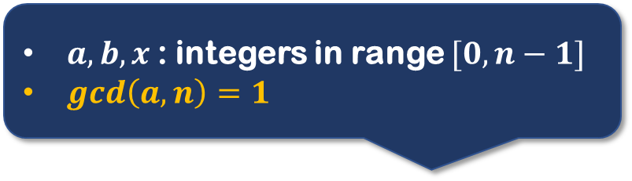
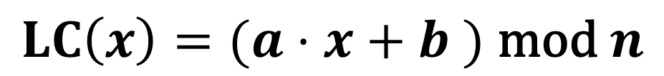
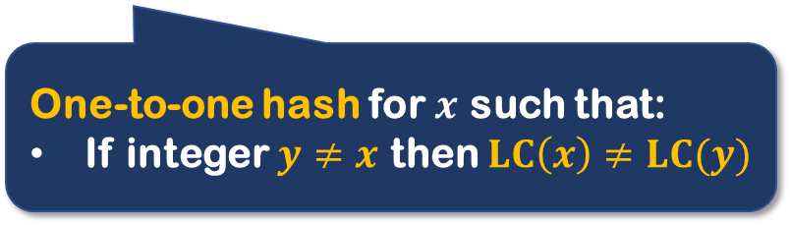
Our Approach – Perfect Linear Congruential Hash (LC)
$a,b,x$: integers in range $[0,n−1]$
$gcd\left(a,n\right)=1$
$$LC\left(x\right)=(a⋅x+b ) \text{mod} n$$
One-to-one hash for $x$ such that:
If integer $y≠x$ then $LC\left(x\right)≠LC(y)$

Slide 16
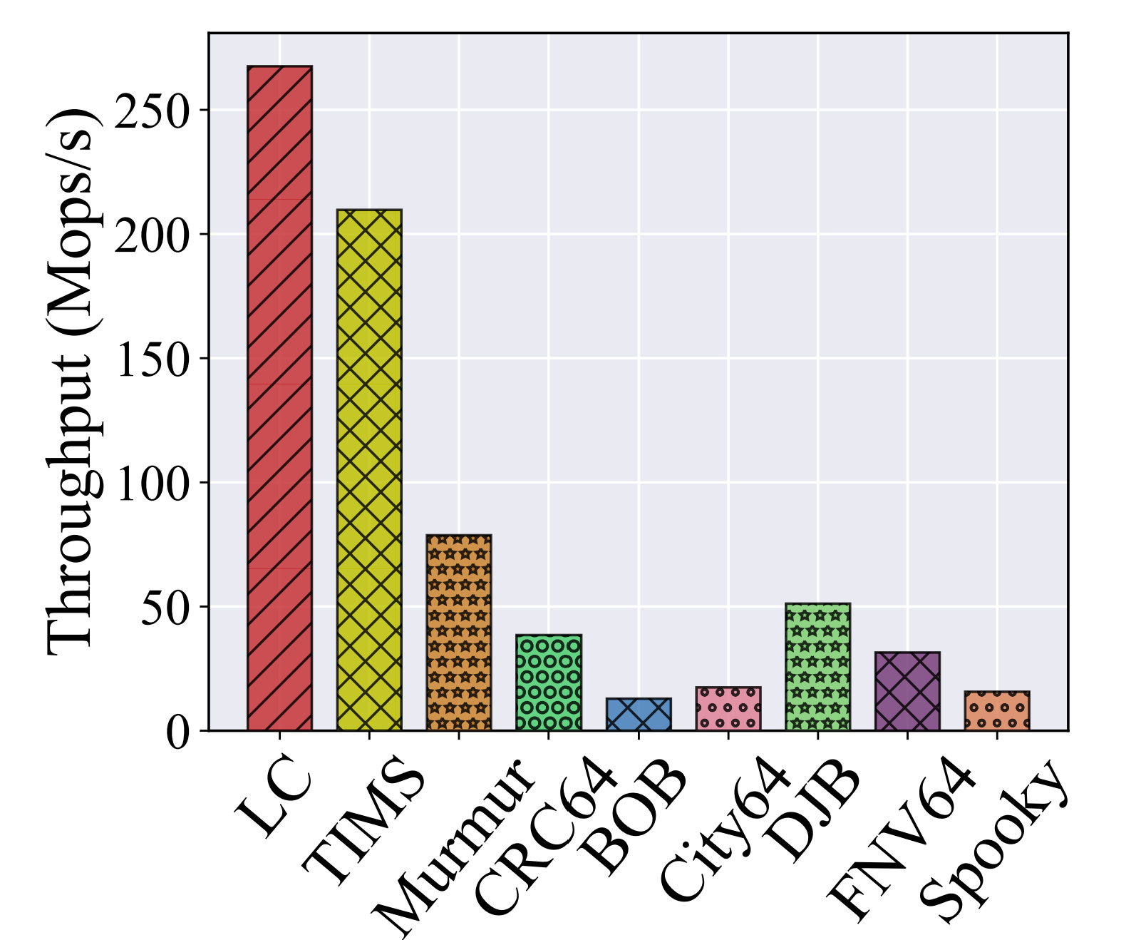
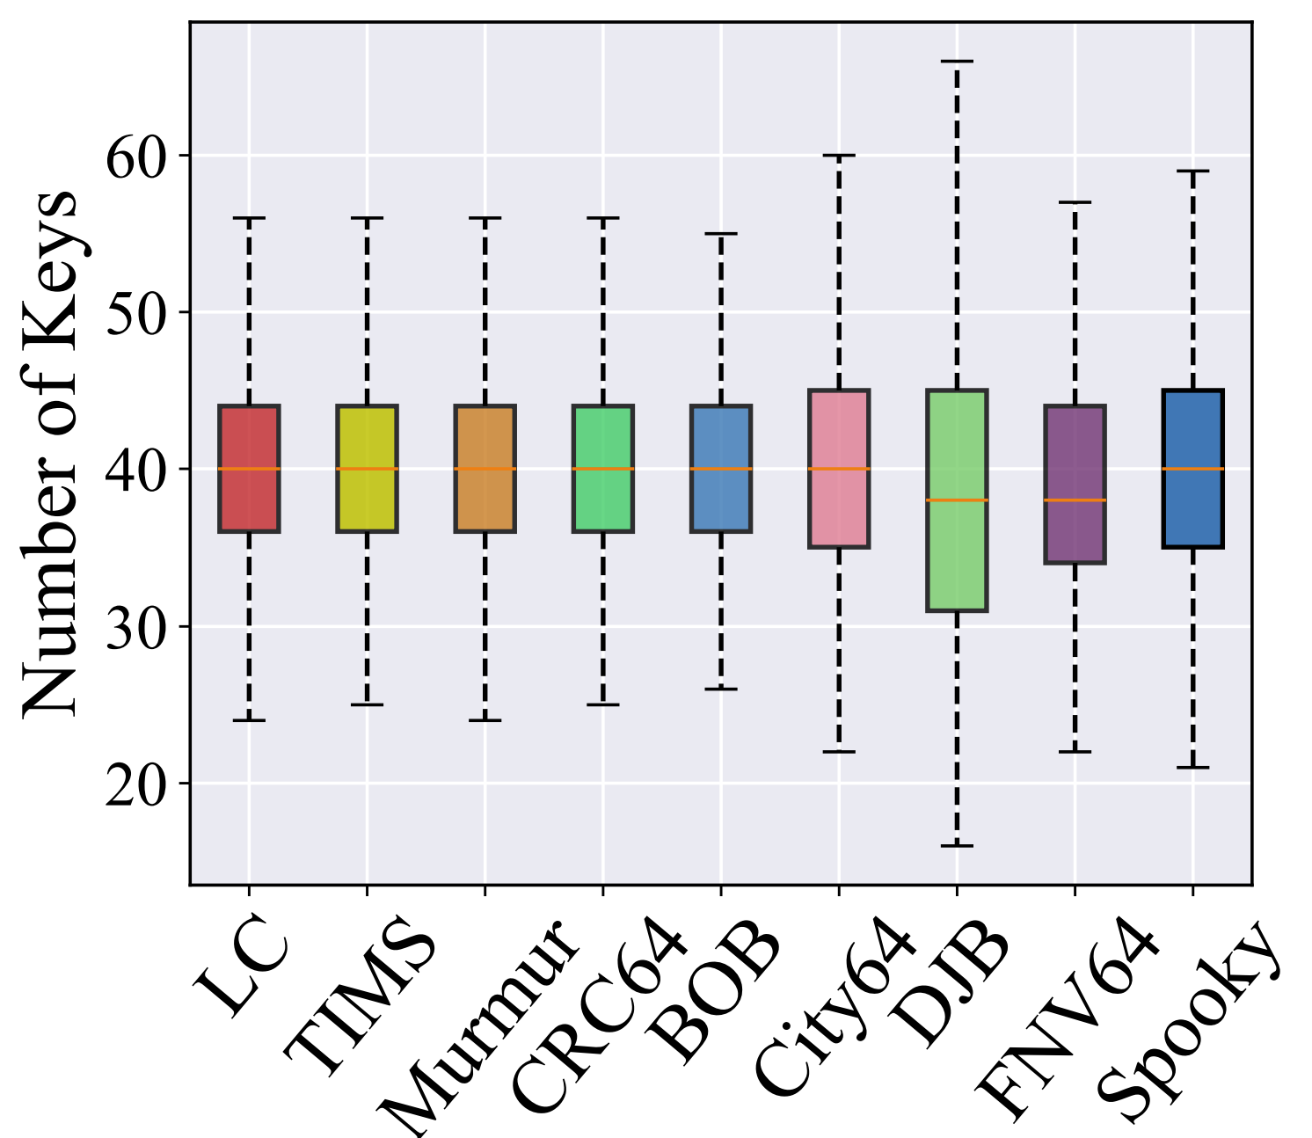

Our Approach – Perfect Linear Congruential Hash (LC)
$$LC\left(x\right)=(a⋅x+b ) \text{mod} n$$
Hash throughput
Hash uniformity
Fast
Uniform

Slide 17
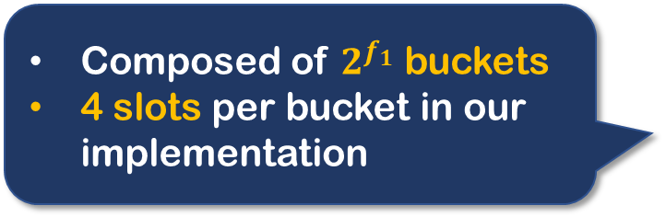
Our Approach – LC-cuckoo filter
One Bucket (4 slots, adaptive slot )
Composed of $2^{f_{1}}$buckets
4 slots per bucket in our implementation
LC-cuckoo-filter

Slide 18
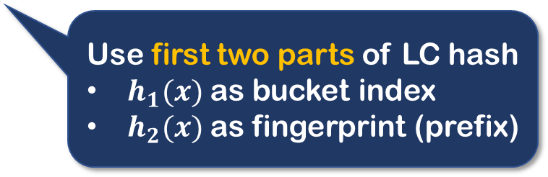

Our Approach – LC-cuckoo filter
$$LC\left(x\right)= h\left(x\right) \text{=} h_{1}(x) \text{|} h_{2}(x) \text{|}{ h}_{3}(x)$$
One Bucket (4 slots, adaptive slot )
Use first two parts of LC hash
$h_{1}(x)$ as bucket index
$h_{2}(x)$ as fingerprint (prefix)
LC-cuckoo-filter

Slide 19


Our Approach – LC-cuckoo filter
$$LC\left(x\right)= h\left(x\right) \text{=} h_{1}(x) \text{|} h_{2}(x) \text{|}{ h}_{3}(x)$$
One Bucket (4 slots, adaptive slot )
Similar “power of two choice” hash policy to encode elements
$$h_{1}(x)$$
x
$$h_{1}\left(x\right) \text{⊕} h_{2}(x)$$
LC-cuckoo-filter

Slide 20
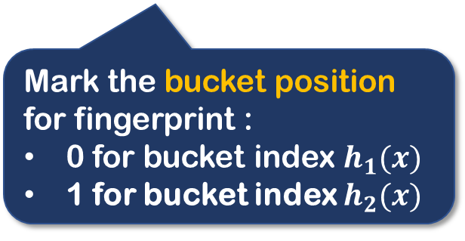

Our Approach – LC-cuckoo filter
$$LC\left(x\right)= h\left(x\right) \text{=} h_{1}(x) \text{|} h_{2}(x) \text{|}{ h}_{3}(x)$$
One Bucket (4 slots, adaptive slot )
0
$$h_{2}(x)$$
$$h_{1}(x)$$
Hash Indicator
Fingerprint
x
Mark the bucket position for fingerprint :
0 for bucket index $h_{1}(x)$
1 for bucket index $h_{2}(x)$
$$h_{1}\left(x\right) \text{⊕} h_{2}(x)$$
LC-cuckoo-filter

Slide 21
Our Approach – LC-cuckoo filter
$$LC\left(x\right)= h\left(x\right) \text{=} h_{1}(x) \text{|} h_{2}(x) \text{|}{ h}_{3}(x)$$
One Bucket (4 slots, adaptive slot )
0
$$h_{2}(x)$$
$$h_{1}(x)$$
Hash Indicator
Fingerprint
x
Mark the bucket position for fingerprint :
0 for bucket index $h_{1}(x)$
1 for bucket index $h_{2}(x)$
$$h_{1}\left(x\right) \text{⊕} h_{2}(x)$$
LC-cuckoo-filter

Slide 22
Our Approach – LC-cuckoo filter
$$LC\left(x\right)= h\left(x\right) \text{=} h_{1}(x) \text{|} h_{2}(x) \text{|}{ h}_{3}(x)$$
One Bucket (4 slots, adaptive slot )
0
$$h_{2}(x)$$
$$h_{1}(x)$$
Hash Indicator
Fingerprint
x
Specially designed for storing prefix of hot false positives
$$h_{1}\left(x\right) \text{⊕} h_{2}(x)$$
LC-cuckoo-filter

Slide 23
Our Approach – LC-cuckoo filter
$$LC\left(x\right)= h\left(x\right) \text{=} h_{1}(x) \text{|} h_{2}(x) \text{|}{ h}_{3}(x)$$
One Bucket (4 slots, adaptive slot )
0
$$h_{2}(x)$$
$$h_{1}(x)$$
Hash Indicator
Fingerprint
x
Specially designed for storing prefix of hot false positives
$$h_{1}\left(x\right) \text{⊕} h_{2}(x)$$
LC-cuckoo-filter

Slide 24



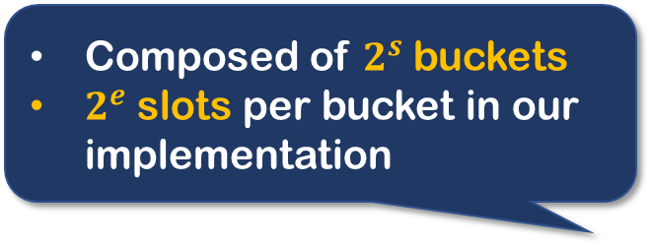







Our Approach – Suffix Cache
$$LC\left(x\right)= h\left(x\right) \text{=} h_{1}(x) \text{|} h_{2}(x) \text{|}{ h}_{3}(x)$$
Composed of $2^{s}$buckets
$2^{e}$ slots per bucket in our implementation
1
$$h_{1}(y)[s:]$$
$$h_{3}(y)$$
1
$$h_{1}(z)[s:]$$
$$h_{3}(z)$$
0
$$h_{1}(q)[s:]$$
$$h_{3}(q)$$
1
$$h_{1}(x)[s:]$$
$$h_{3}(x)$$
0
$$h_{1}(p)[s:]$$
$$h_{3}(p)$$
Hot Flag
Index Suffix
Hash Suffix

Slide 25

Our Approach – Suffix Cache
$$LC\left(x\right)= h\left(x\right) \text{=} h_{1}(x) \text{|} h_{2}(x) \text{|}{ h}_{3}(x)$$
Composed of $2^{s}$buckets
$2^{e}$ slots per bucket in our implementation
1
$$h_{1}(y)[s:]$$
$$h_{3}(y)$$
1
$$h_{1}(z)[s:]$$
$$h_{3}(z)$$
0
$$h_{1}(q)[s:]$$
$$h_{3}(q)$$
1
$$h_{1}(x)[s:]$$
$$h_{3}(x)$$
0
$$h_{1}(p)[s:]$$
$$h_{3}(p)$$
Hot Flag
Index Suffix
Hash Suffix
Last $f_{1}−s$ bits of bucket index
Help to identify corresponding suffix of certain prefix

Slide 26










Our Approach – Suffix Cache
A variation of clock-algorithm to keep hottest elements in cache
$$h_{1}\left(x\right)[f_{1}−1:f_{1}]$$
$$h_{1}\left(x\right)[f_{1}−1:f_{1}]$$
Cyclic Scanning
Hot Suffix
$$\left(1,h_{1}\left(y\right)\left[s:\right],h_{3}(y)\right)$$
$$\left(1,h_{1}\left(z\right)\left[s:\right],h_{3}(z)\right)$$
$$\left(0,h_{1}\left(y\right)\left[s:\right],h_{3}(y)\right)$$
$$\left(1,h_{1}\left(z\right)\left[s:\right],h_{3}(z)\right)$$
Unset Hot flag
Replace with $\left(1,h_{1}\left(x\right)\left[s:\right],h_{3}(x)\right)$
Hot Suffix
$$\left(0,h_{1}\left(y\right)\left[s:\right],h_{3}(y)\right)$$
$$\left(1,h_{1}\left(x\right)\left[s:\right],h_{3}(x)\right)$$
Replace with $\left(1,h_{1}\left(x\right)\left[s:\right],h_{3}(x)\right)$

Slide 27





Our Approach – Reinforcement Lookup
$$LC\left(x\right)= h\left(x\right) \text{=} h_{1}(x) \text{|} h_{2}(x) \text{|}{ h}_{3}(x)$$
Query LC-CF
x
$$h_{1}(x)$$
1
$$h_{1}(x)[s:]$$
$$h_{3}(x)$$
$$h_{1}\left(x\right) \text{⊕} h_{2}(x)$$
LC-cuckoo-filter
Suffix cache
Remote Full Dataset

Slide 28

Our Approach – Reinforcement Lookup
$$LC\left(x\right)= h\left(x\right) \text{=} h_{1}(x) \text{|} h_{2}(x) \text{|}{ h}_{3}(x)$$
$$h_{1}\left(x\right)[1:s]$$
x
$$h_{1}(x)$$
1
$$h_{1}(x)[s:]$$
$$h_{3}(x)$$
$$h_{1}\left(x\right) \text{⊕} h_{2}(x)$$
LC-cuckoo-filter
Suffix cache
Remote Full Dataset
No matched fingerprint Reject as negative

Slide 29

Our Approach – Reinforcement Lookup
$$LC\left(x\right)= h\left(x\right) \text{=} h_{1}(x) \text{|} h_{2}(x) \text{|}{ h}_{3}(x)$$
x
$$h_{1}(x)$$
1
$$h_{1}(x)[s:]$$
$$h_{3}(x)$$
$$h_{1}\left(x\right) \text{⊕} h_{2}(x)$$
Matched in normal slot
Access remote directly
LC-cuckoo-filter
Suffix cache
Remote Full Dataset

Slide 30

Our Approach – Reinforcement Lookup
$$LC\left(x\right)= h\left(x\right) \text{=} h_{1}(x) \text{|} h_{2}(x) \text{|}{ h}_{3}(x)$$
Matched in adaptive slot
Check Suffix cache bucket
$$h_{1}\left(x\right)[1:s]$$
x
$$h_{1}(x)$$
1
$$h_{1}(x)[s:]$$
$$h_{3}(x)$$
$$h_{1}\left(x\right) \text{⊕} h_{2}(x)$$
LC-cuckoo-filter
Suffix cache
Remote Full Dataset

Slide 31
Our Approach – Reinforcement Lookup
$$LC\left(x\right)= h\left(x\right) \text{=} h_{1}(x) \text{|} h_{2}(x) \text{|}{ h}_{3}(x)$$
Matched in cache
Reject as false positive
$$h_{1}\left(x\right)[1:s]$$
x
$$h_{1}(x)$$
1
$$h_{1}(x)[s:]$$
$$h_{3}(x)$$
$$h_{1}\left(x\right) \text{⊕} h_{2}(x)$$
LC-cuckoo-filter
Suffix cache
Remote Full Dataset

Slide 32
Our Approach – Lookup
$$LC\left(x\right)= h\left(x\right) \text{=} h_{1}(x) \text{|} h_{2}(x) \text{|}{ h}_{3}(x)$$
No Match in cache
Access remote
$$h_{1}\left(x\right)[1:s]$$
x
$$h_{1}(x)$$
1
$$h_{1}(x)[s:]$$
$$h_{3}(x)$$
$$h_{1}\left(x\right) \text{⊕} h_{2}(x)$$
LC-cuckoo-filter
Suffix cache
Remote Full Dataset

Slide 33






Our Approach – Reinforcement
$$LC\left(p\right)= h\left(p\right) \text{=} h_{1}(p) \text{|} h_{2}(p) \text{|}{ h}_{3}(p)$$
2.Insert suffix of false positive into the cache
$$h_{1}\left(p\right) \text{⊕} h_{2}(p)$$
p
Remote access
identifies new false positive
1
$$h_{1}(x)[s:]$$
$$h_{3}(x)$$
1
$$h_{1}(p)[s:]$$
$$h_{3}(p)$$
$$h_{1}(p)$$
$$h_{1}\left(x\right)[1:s]$$
LC-cuckoo-filter
Suffix cache
Remote Full Dataset
1.Allocate adaptive slot for previous matched fingerprint

Slide 34
Evaluation
Four datasets with different skewness
YCSB
MAWI
CAIDA
FIREHOSE
Baselines (non-adaptive):
CF
BF
VQF
CQF
Baselines (adaptive):
CBBF
ACF
TAF
ABF

Slide 35
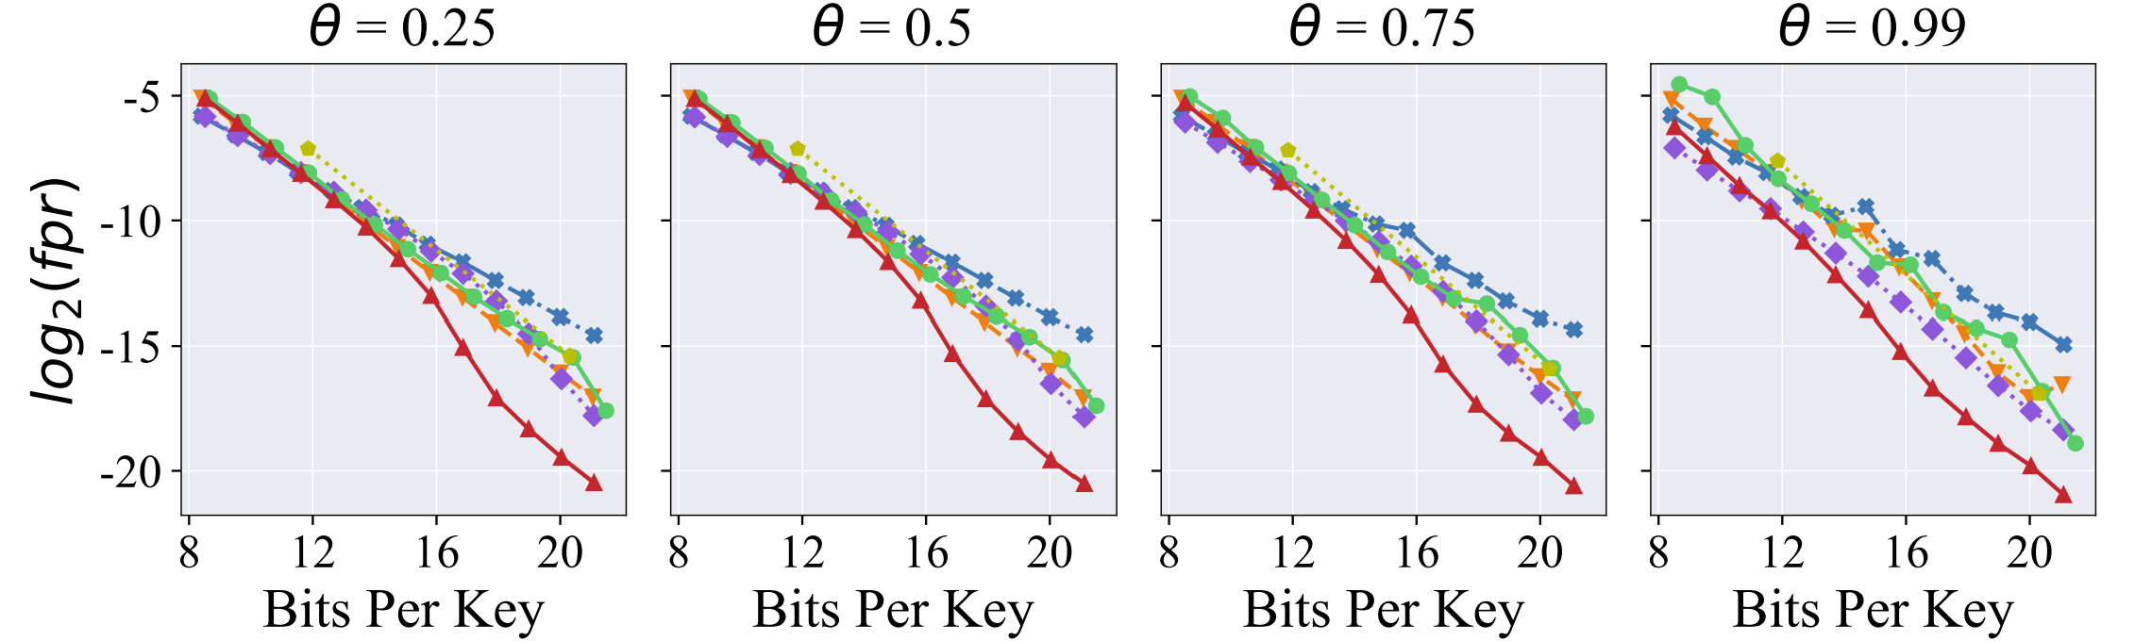
Evaluation
False positive ratio (CAIDA, varying Zipf skewness $θ$)

Slide 36
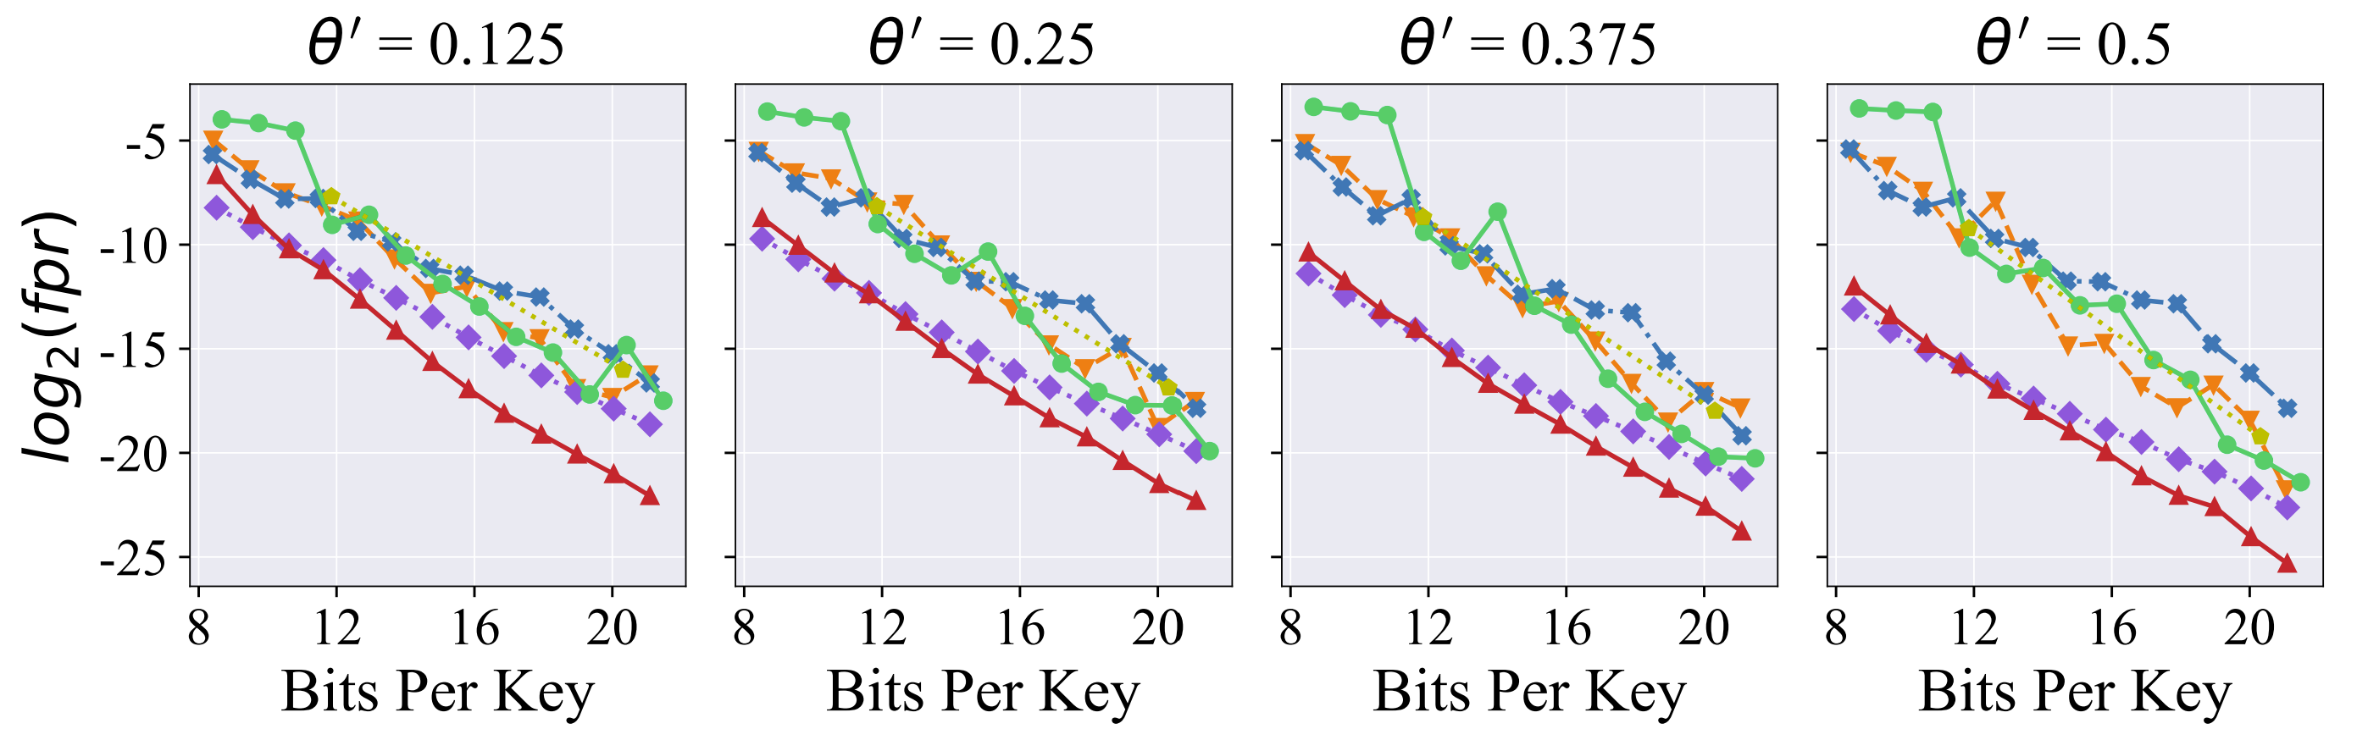
Evaluation
False positive ratio (FIREHOSE, varying Power-law slope $θ′$)
RCF can effectively handle skewed query workloads

Slide 37
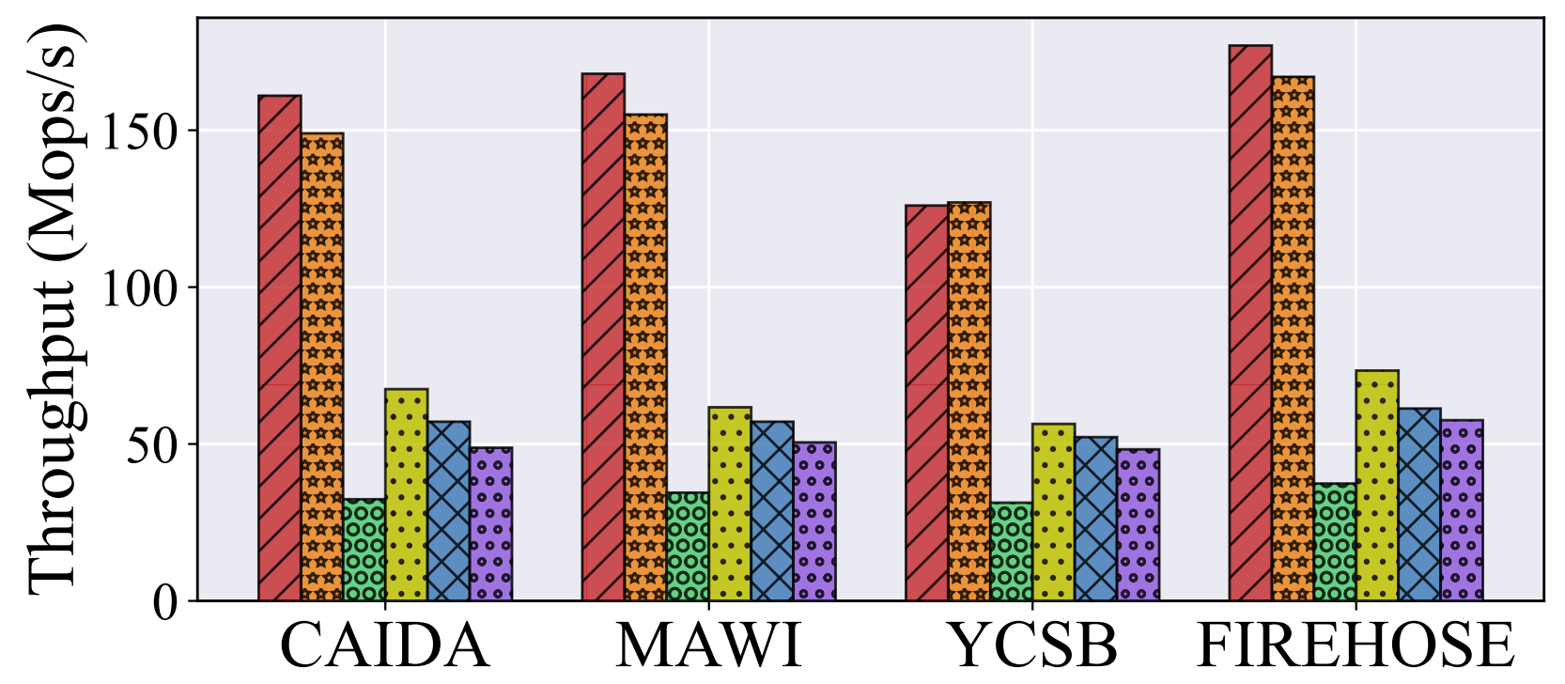
Evaluation
Lookup Throughput
RCF has high lookup throughput

Slide 38
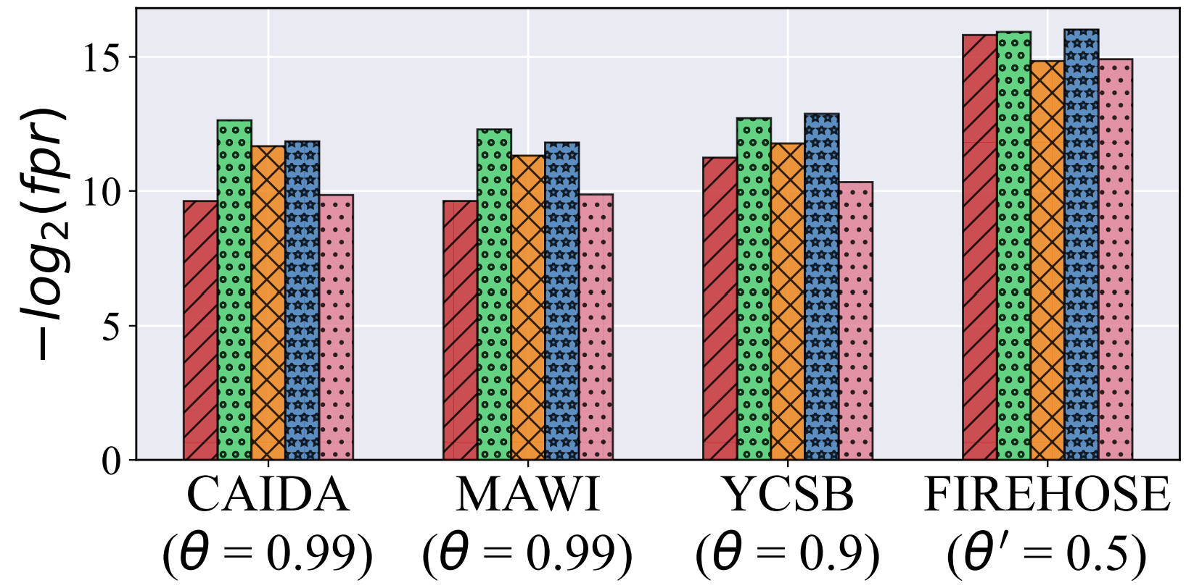
Evaluation
RCF offers competitive FPR compared with other adaptive filters

Slide 39
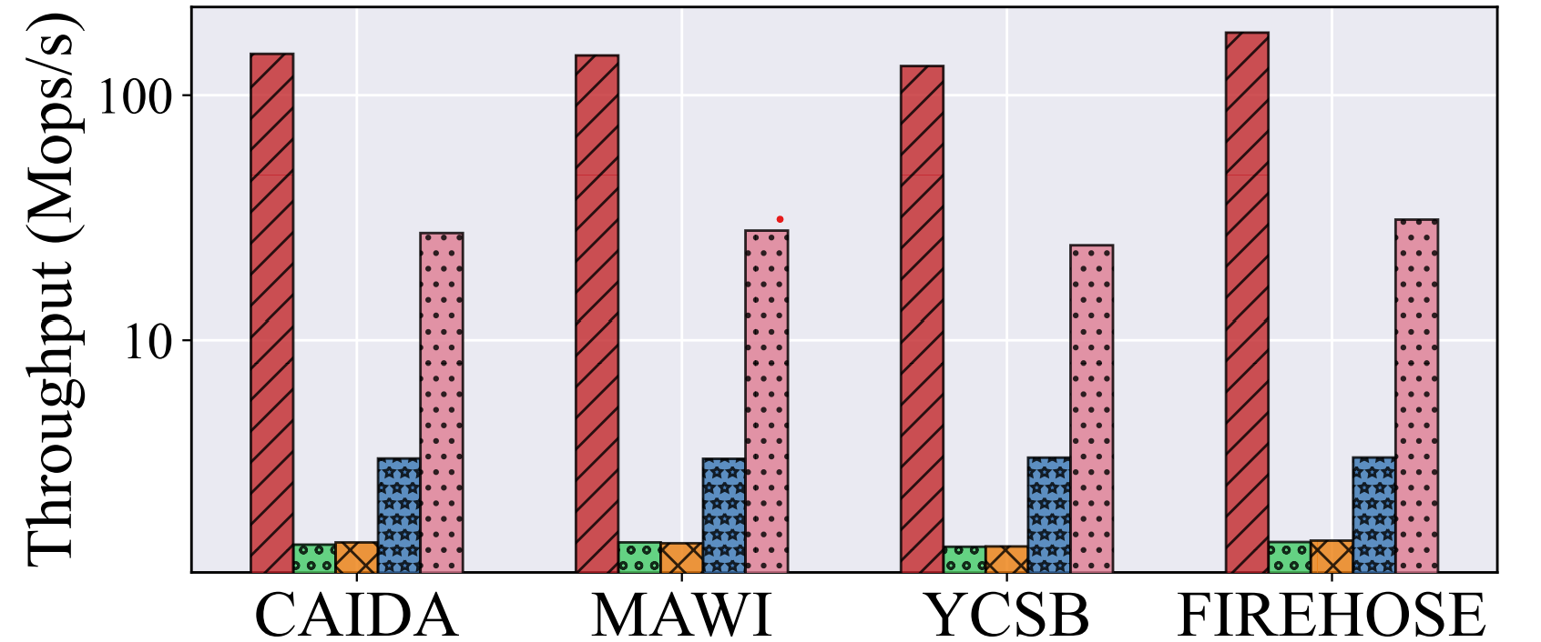
Evaluation
RCF achieves the highest lookup throughput compared with other adaptive filters

Slide 40



More details in The Paper
Proof that LC is one-to-one
More evaluation for RCF
Adaptive slots allocation for false positives

Slide 41
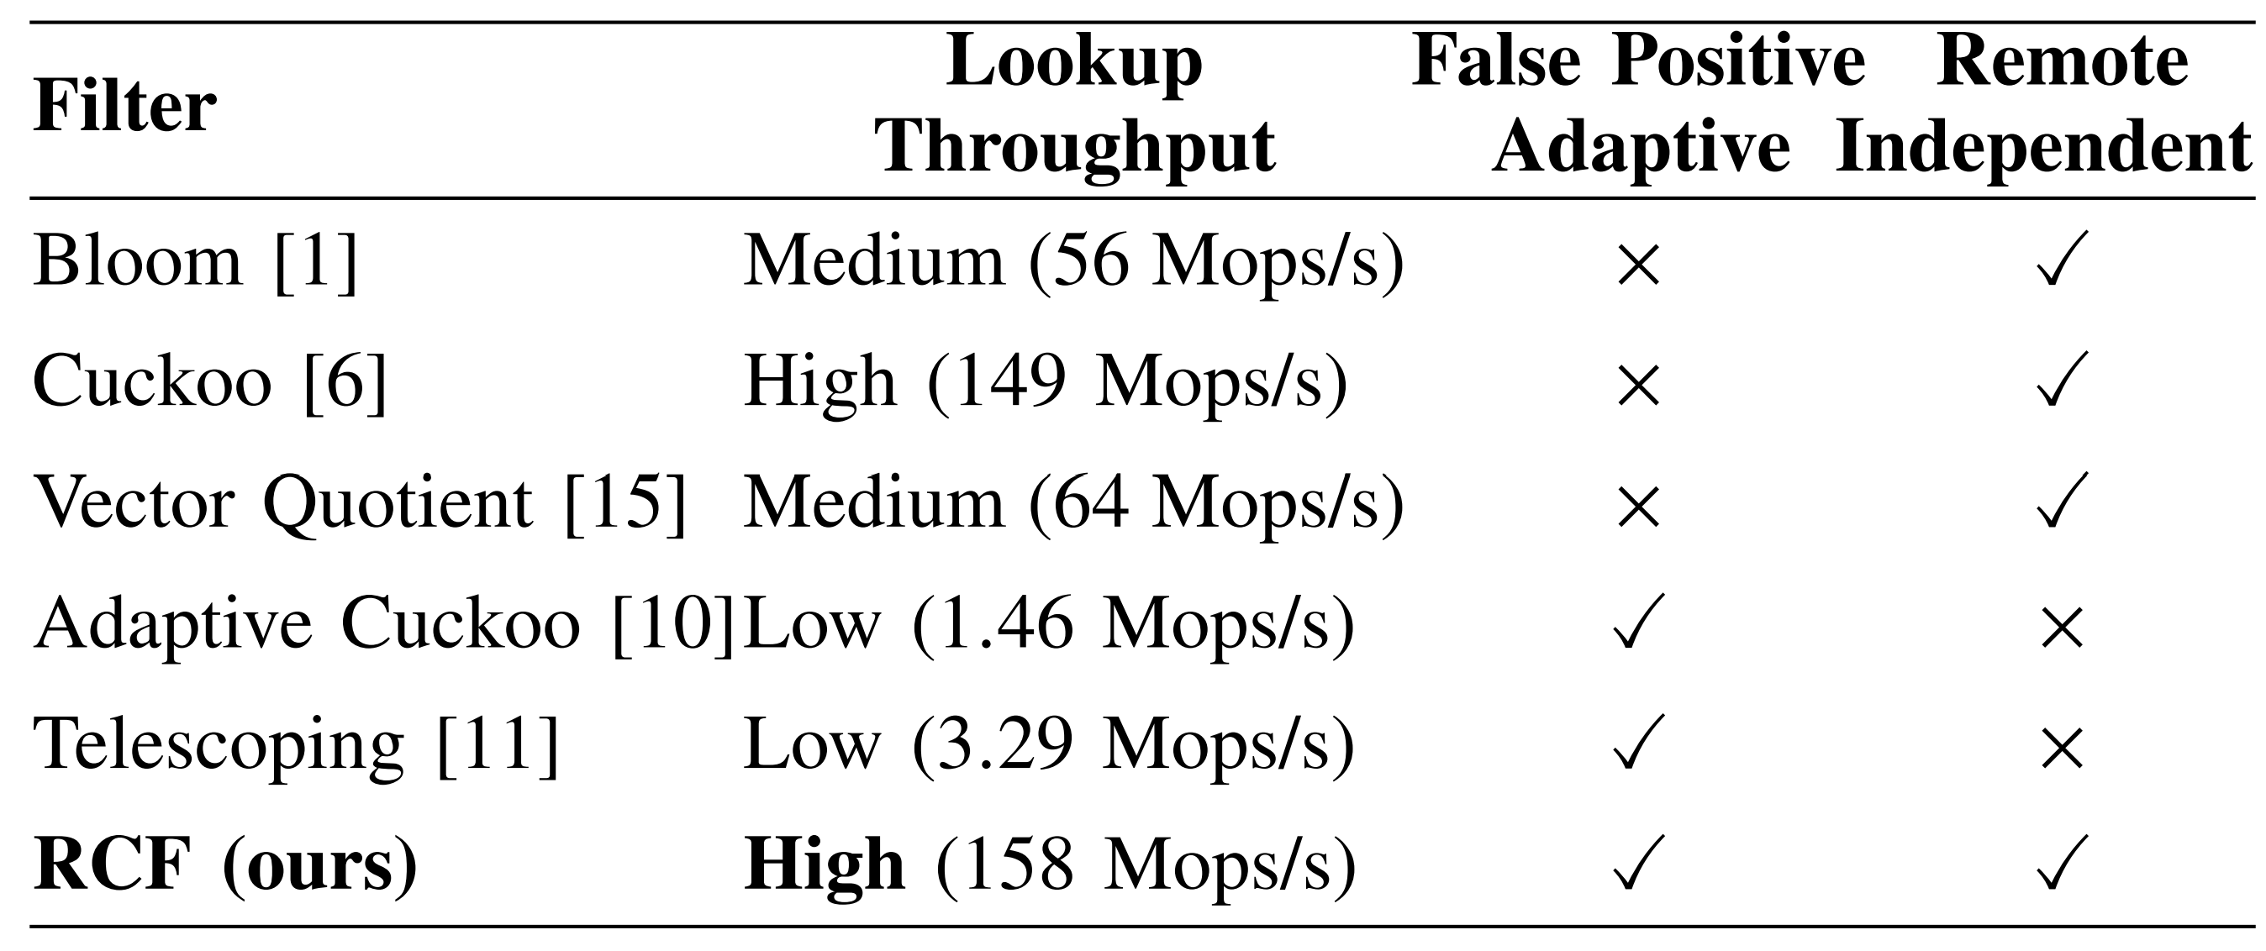
Conclusion
RCF is an effective method to process approximate membership testing on skewed data traces
The key idea is to store the suffixes of false positives in an extra cache using one-to-one hash

Slide 42
Thank you !
Q&A
wenqi-luo@smail.nju.edu.cn

