Slide 1






Cloud-Based File Management System for SCS Department
Garrido, Trixcy Anne C.
Hicaro, Mark Josh E.
Pega, Joselito D.
Unlayao, Owen Dale F.
BSIT 3-5

Slide 2



INTRODUCTION
Cloud-Based File Management System
Used to store data and information in a secure and easy manner.
Time spent printing hard copies of important papers will be reduced if files are saved to the cloud.
Faculty members will be able to categorize files that they can access during the academic year with the help of the new system.
Google Drive, which is also a file storage system, inspired the idea of creating a cloud storage system. The only difference is that cloud storage is more controllable, allowing users to organize important data and easily find what they need.

Slide 3

BACKGROUND OF THE STUDY
Traditional storing of files
Most of the Faculty members only rely on personal devices and google drive to store their reports such as course syllabus, faculty substitution, performance commitment, performance evaluation sheet and many others.
Unwanted incidents such as device malfunction exist, conflicts related to sudden loss of essential documents, including their reports, also arise due to limited space available and monitoring of the reports submitted.

Slide 4



RESEARCH DESCRIPTION Objectives (General and Specific)
The general objective of the study is to develop a system entitled “Cloud-Based File Management System for School of Computer Studies” that has the ability to sort and organize essential documents submitted by faculty members.
Specifically it aims to:
1. Design and develop the system called “Cloud-based File Management System for School of Computer Studies” that is capable of:
a. Ensuring the security of important documents and files;
b. Saving space by reducing office clutter;
c. Monitoring of the reports submitted by the Faculty Members.

Slide 5
RESEARCH DESCRIPTION Objectives (General and Specific)
2. Test the system through unit, acceptance, performance, system and integration testing;
3. Evaluate the system if it conforms with the ISO 9126 standards; and
4. Prepare an implementation plan for the deployment of the system.

Slide 6

MANAGEABILITY Scope and Limitations
The general objective of the study is to develop a system entitled “Cloud-Based File Management System for School of Computer Studies” that has the ability to sort and organize essential documents submitted by faculty members.
This study is considered for four (4) levels of access such as the:
Faculty members, people responsible for saving documents and submitting the reports to the system.
Program Coordinator (BSIT and BSCS Chairpersons), persons responsible for viewing the submitted reports of the faculty member under their course handled.

Slide 7
MANAGEABILITY Scope and Limitations
System Administrator, person responsible for accessing the entire system except the submission part.
School Dean, person responsible for monitoring the submitted reports coming from the IT and CS Department.
In addition, it will only be utilized for the SCS Department within City College of Tagaytay (CCT).

Slide 8

IMPORTANCE OF THE STUDY
It will benefit students by allowing them to gain a greater amount of knowledge and information, leading to a more efficient way of learning.
The system is primarily designed for educational purposes, and incoming students of the SCS department may use.
Future researchers can use it as a reference to establish a better system or to improve the functionality that the researchers developing.

Slide 9


RESEARCH DESIGN Methodology
Scrum Methodology
Scrum is the best methodology to use for a small group because as the process moves, it encourages members to have a better idea through experiences, problems are solved through discovering solutions and reflects the effectiveness of the system while continuing to work.

Slide 10
RESEARCH DESIGN Methodology
Scrum Methodology
It fits with this study in general because of the weekly updates. Each member of the group will present the progress of their assigned tasks at weekly meetings. The process will be determined by how the group members want to distribute the work. Once the update is done weekly, it will be easy to keep track of the system's development.

Slide 11
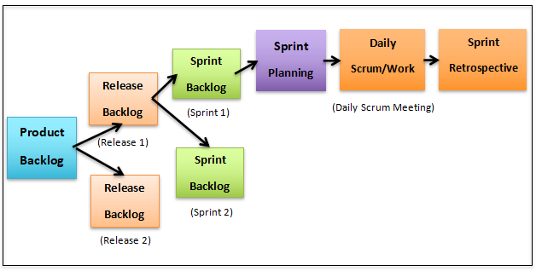
Figure 1. Scrum Processes

Slide 12

SCHEDULE OF ACTIVITIES
Activities | M1 | M2 | M3 | M4 | M5 | M6 | M7 | M8 | M9
Product Backlog
Sprint Backlog
Sprint Planning
Daily Scrum/Work
Sprint Retrospective

