Slide 1

English Forum Switzerland
Alvaro Gallego
Jose Luis Moragas

Slide 2
Introduction
This project consists about www.englishforum.chWhich is a forum for foreigners in Switzerland, where you can find some useful information about this beautiful country.

Slide 3
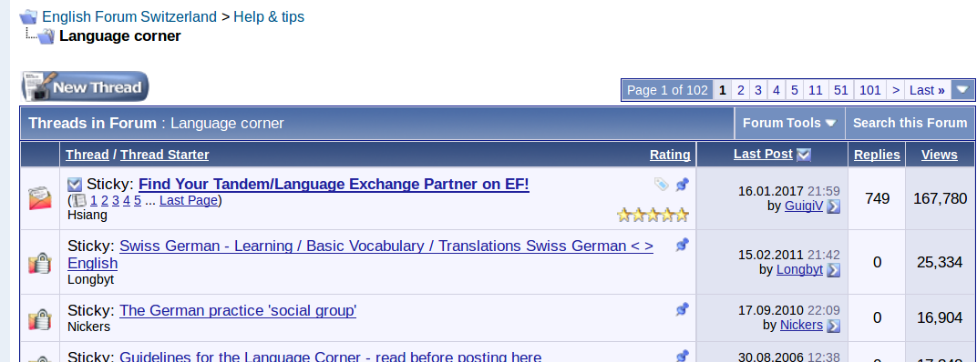
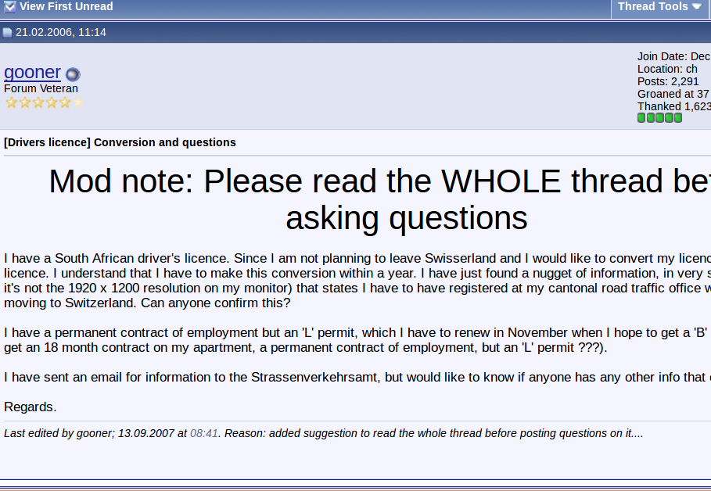
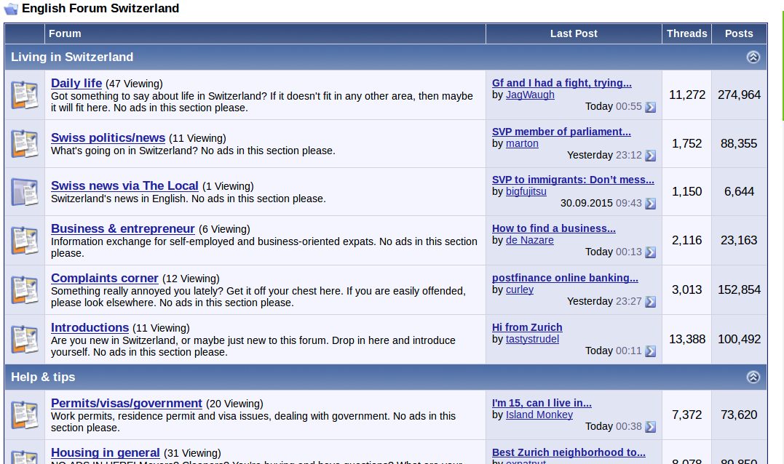
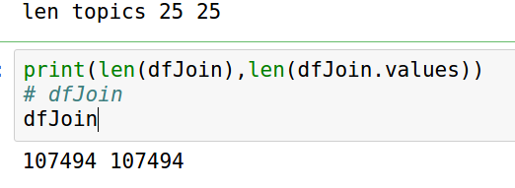
Data from Englishforum

Slide 4
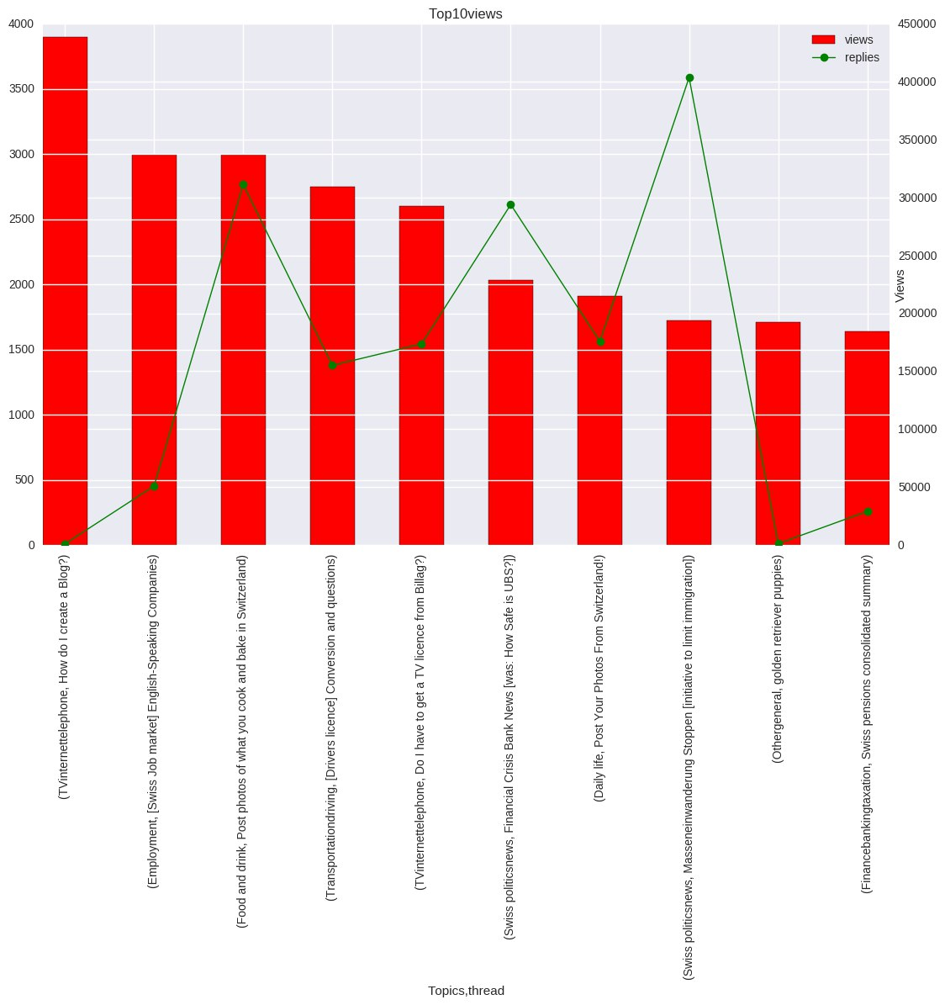
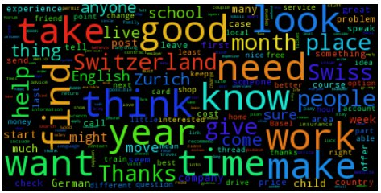
Topic of most relevant thread wordcloud:
TV, Internet and Telephone

Slide 5
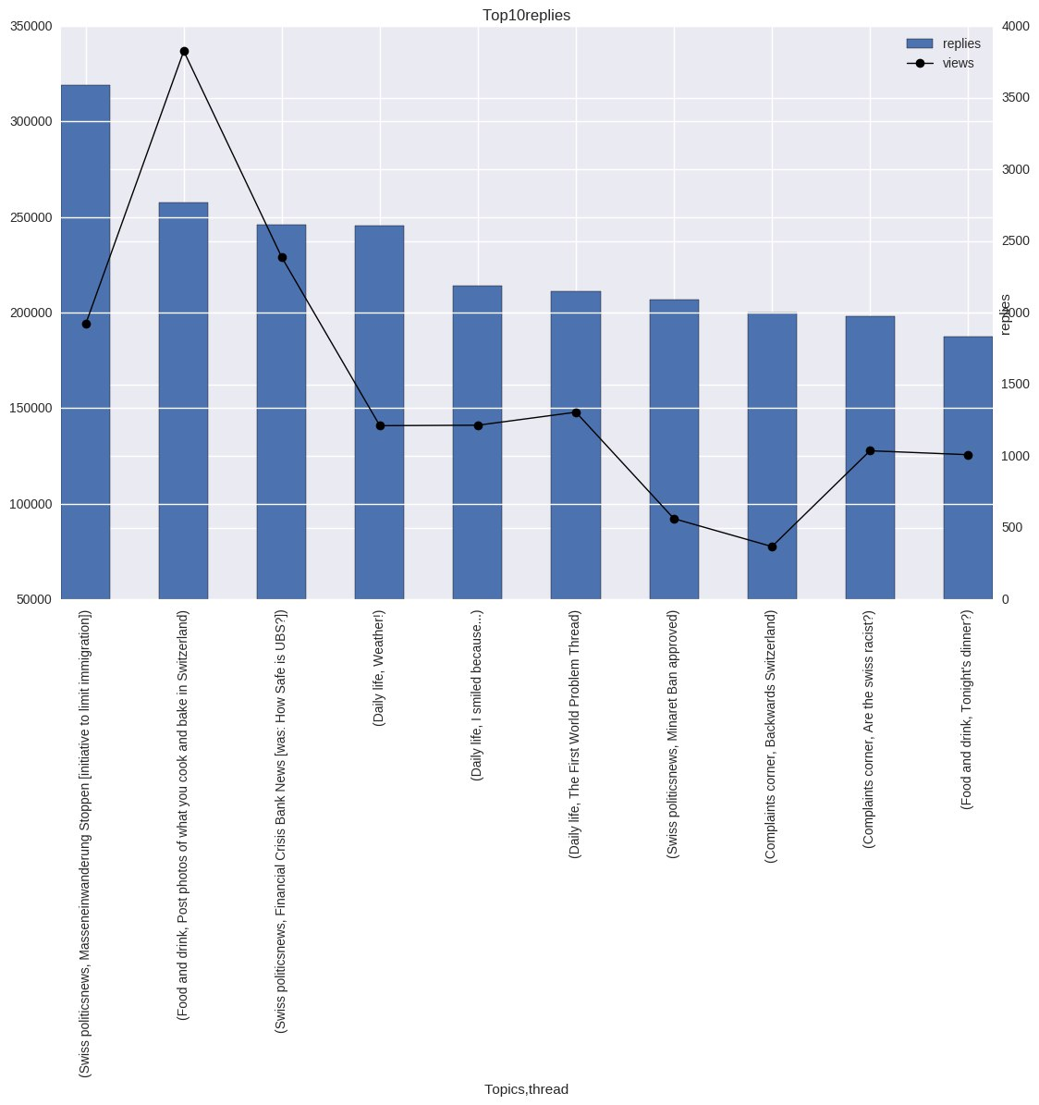
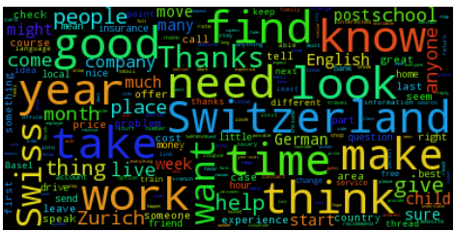
Most relevant thread:
Swiss politics news wordcloud

Slide 6
Most relevant thread:
Swiss politics news wordcloud

Slide 7
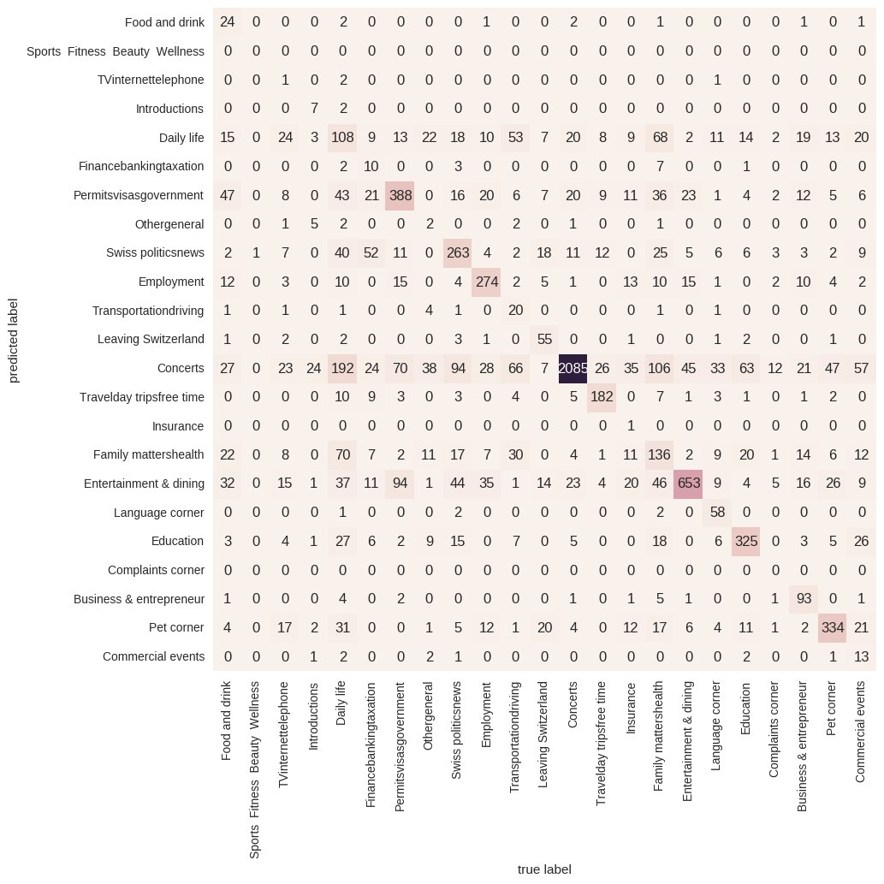
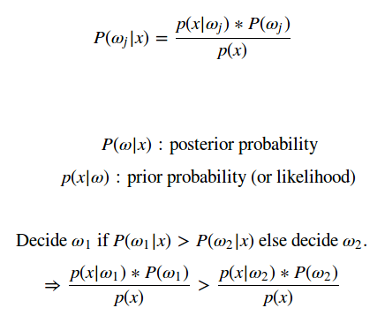
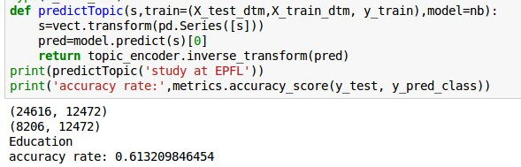
Supervised Learning
Training a Naive Bayesian Classifier
We’d like to predict the most common topic from the very first thread related to a new user, but we realised that the best accuracy we can achieve is only considering the thread name.

