Slide 1
Sales Performance Analysis
Joselyne Sarinana & Tony Nguyen

Slide 2
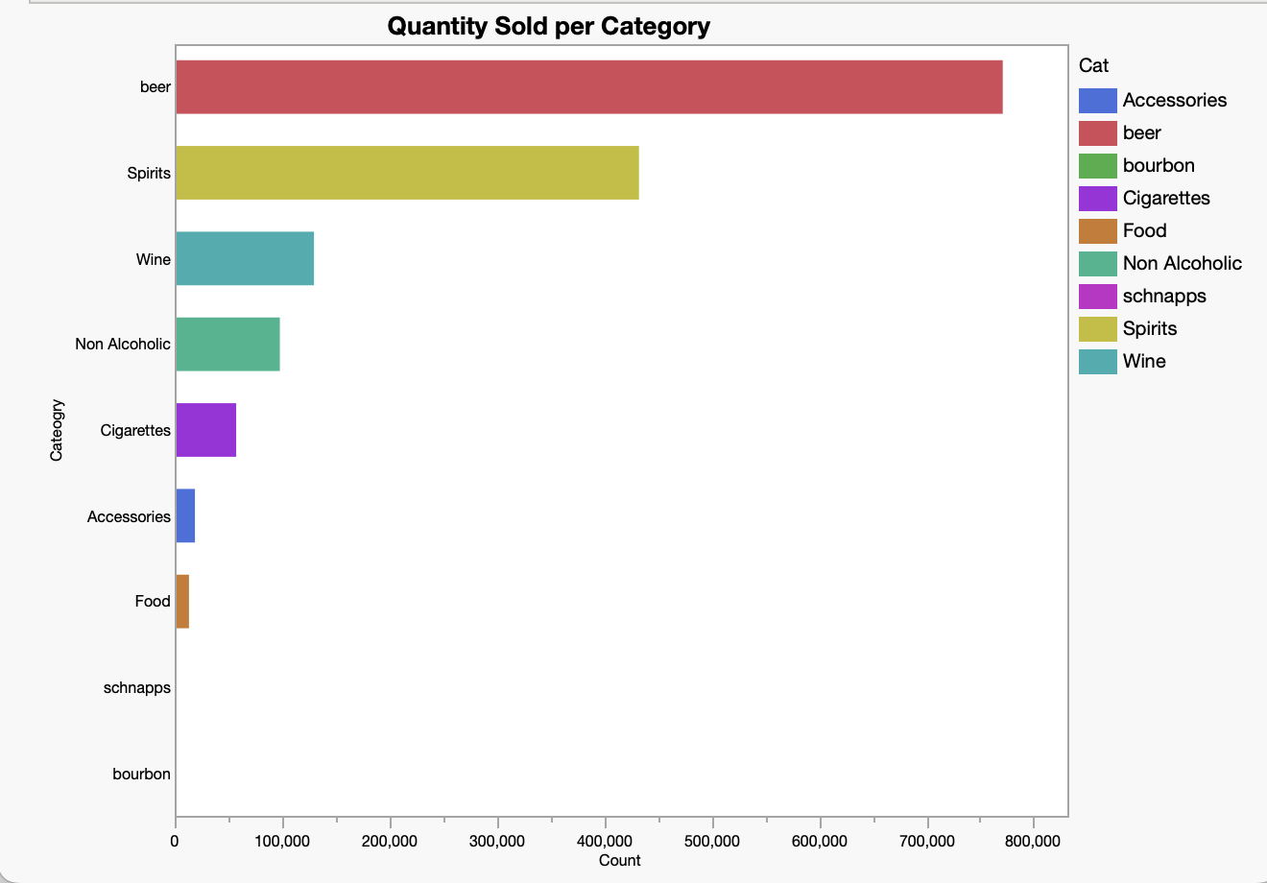
Categorical
Quantity Sold:
Category | Amt Sold
Beer | 771,242
Spirits | 432,434
Wine | 129,715
Non-Alcoholic | 97,950
Cigarettes | 57,251
None | 29,114
Accessories | 18,864
Food | 13,318
Store Account Payment | 1,622
Discount | 774
Schnapps | 3
bourbon | 1
Beer Accounts for 49.7% of total amount sold
In second, follows Spirits with 27.9%.

Slide 3
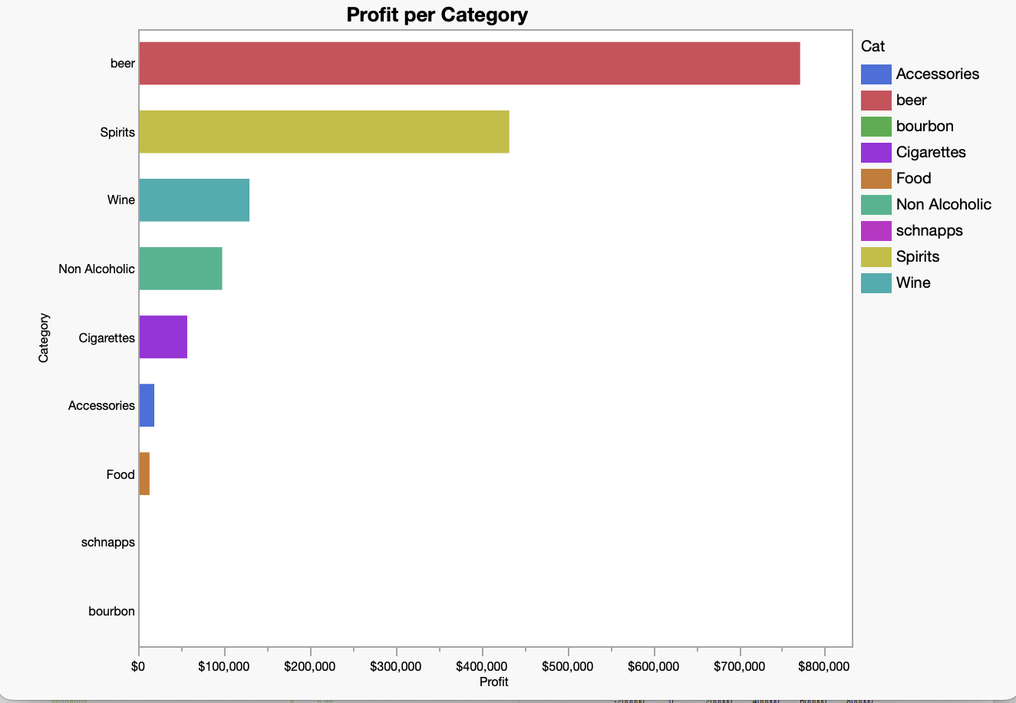
Profit
Categorical
Category | Profit
Spirits | $ 874,475.92
Beer | $ 724,071.90
Wine | $ 437,459.09
Cigarettes | $ 77,874.04
Non Alcoholic | $ 61,426.88
Accessories | $ 24,263.58
tip | $ 11,474.54
Food | $ 11,017.79
bourbon | $ 14.31
schnapps | $ 6.96
Spirits account for 42% of profits

Slide 4
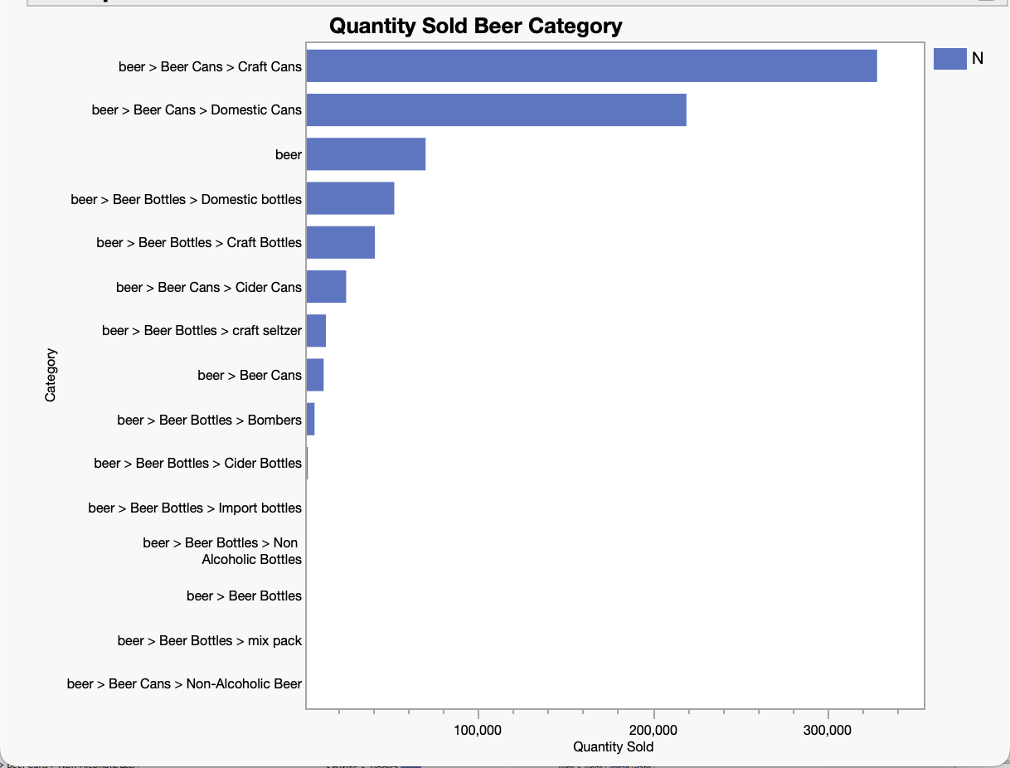
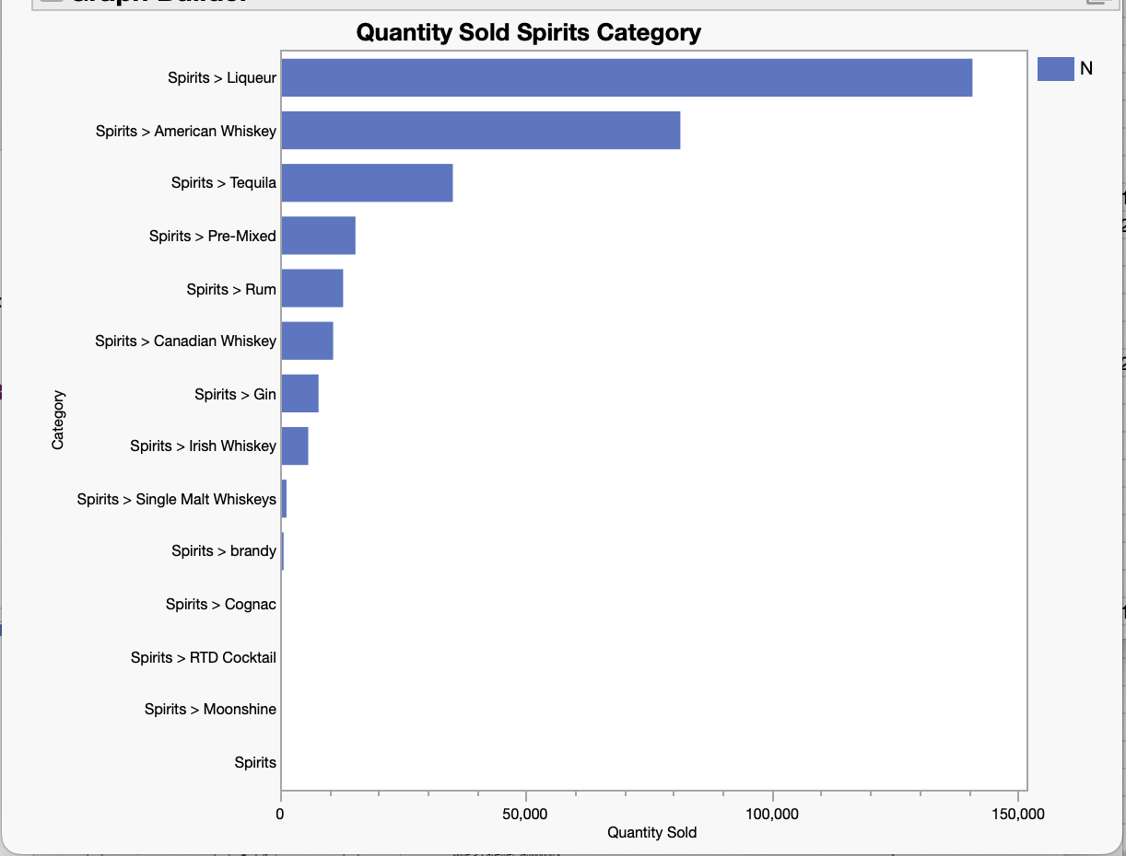
Quantity Sold
Individual
Beer | Quantity Sold
Craft Cans | 328,439
Domestic Cans | 219,335
Beer | 70,015
Spirits | Quantity Sold
Liqueur | 140,808
Vodka | 119,522
American Whiskey | 81,403

Slide 5
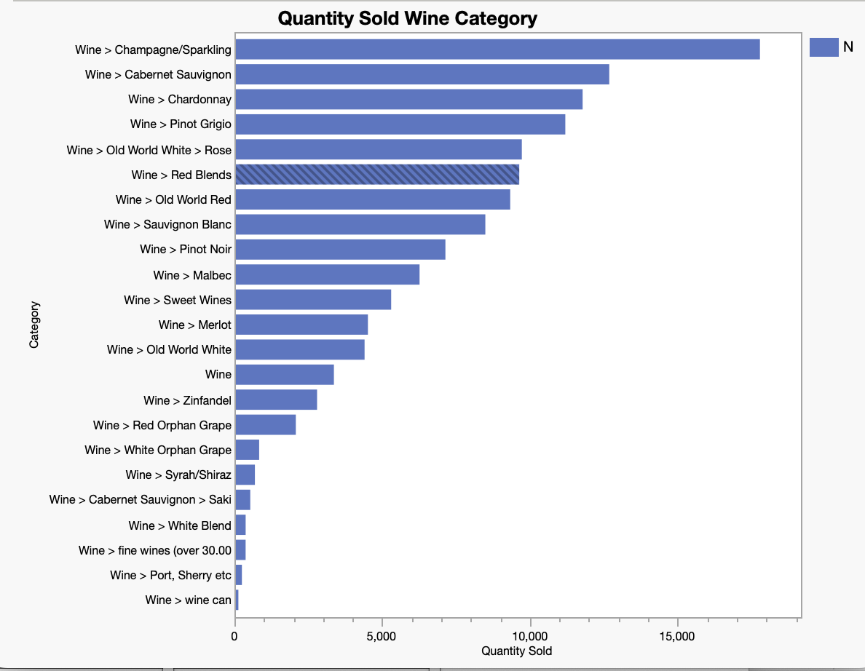
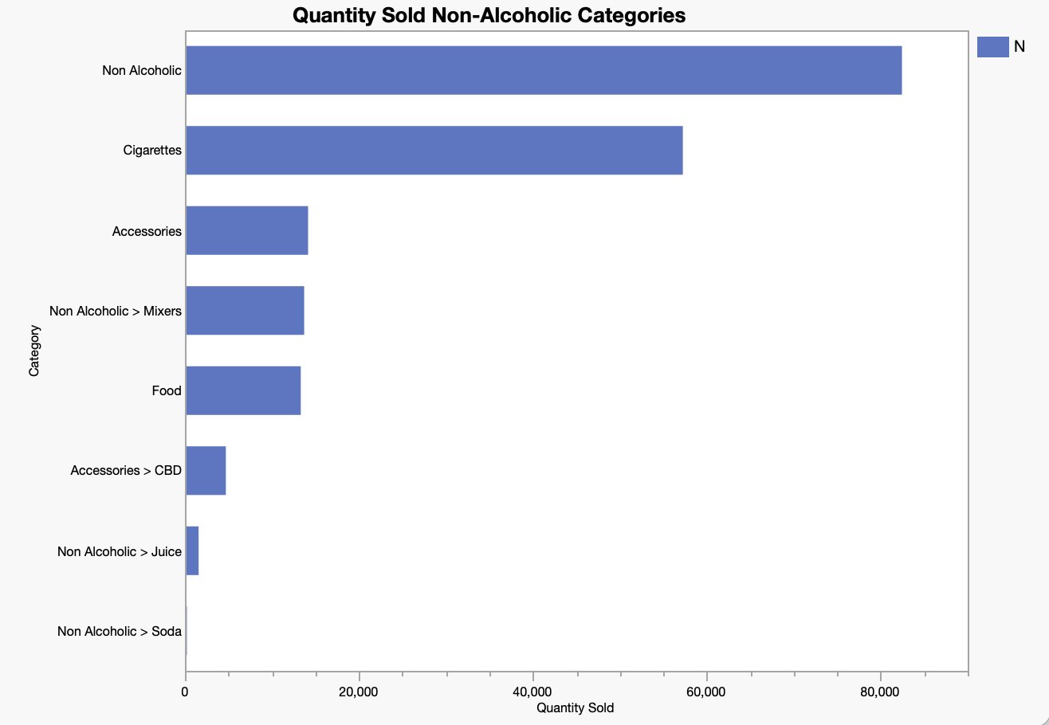
Quantity Sold
Individual
Wine | Quantity Sold
Champagne/ Sparkling | 17,785
Cabernet | 12,685
Chardonnay | 11,784
Non-Alcoholic | Quantity Sold
Non-Alcoholic | 82,422
Mixers | 13,709
Food | 13,318

Slide 6
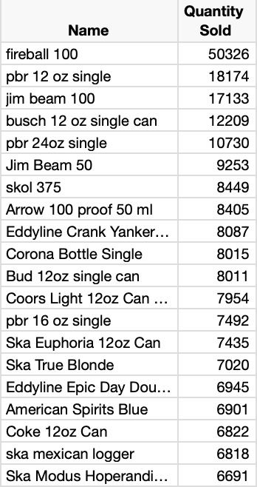
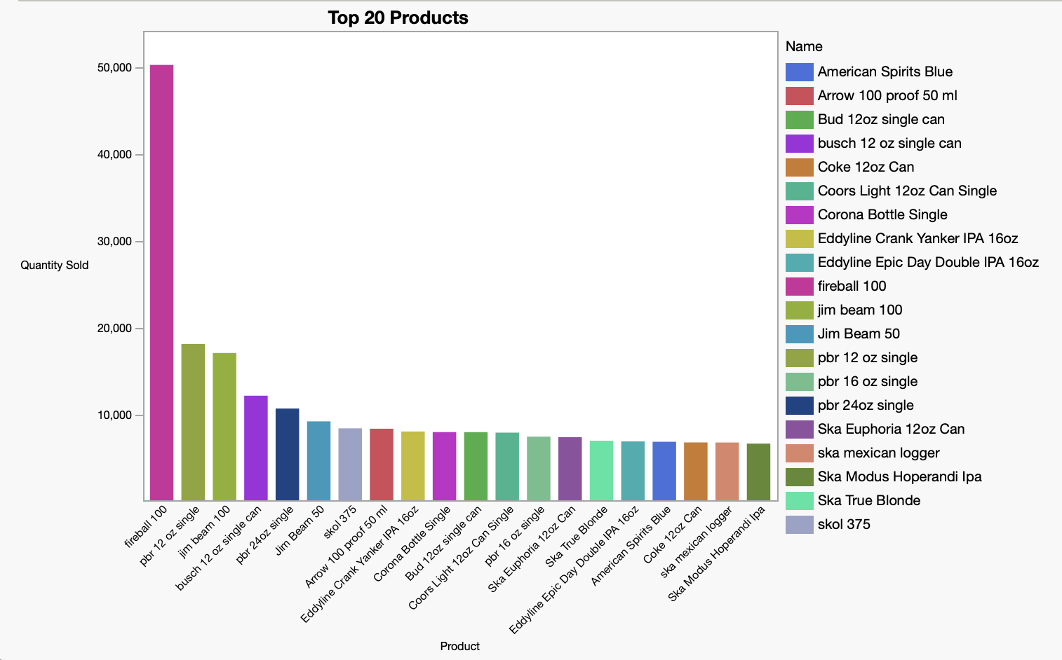
Top 20 Products (Quantity)

Slide 7
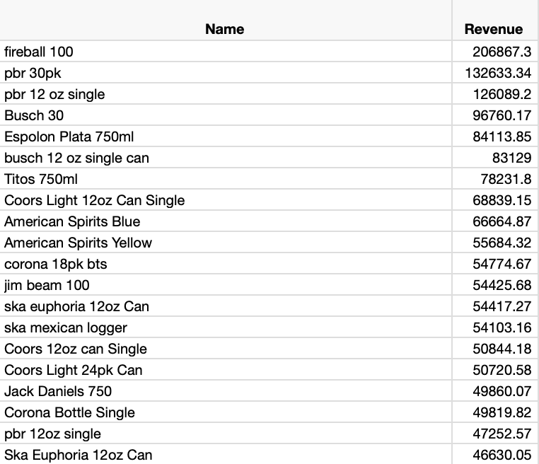
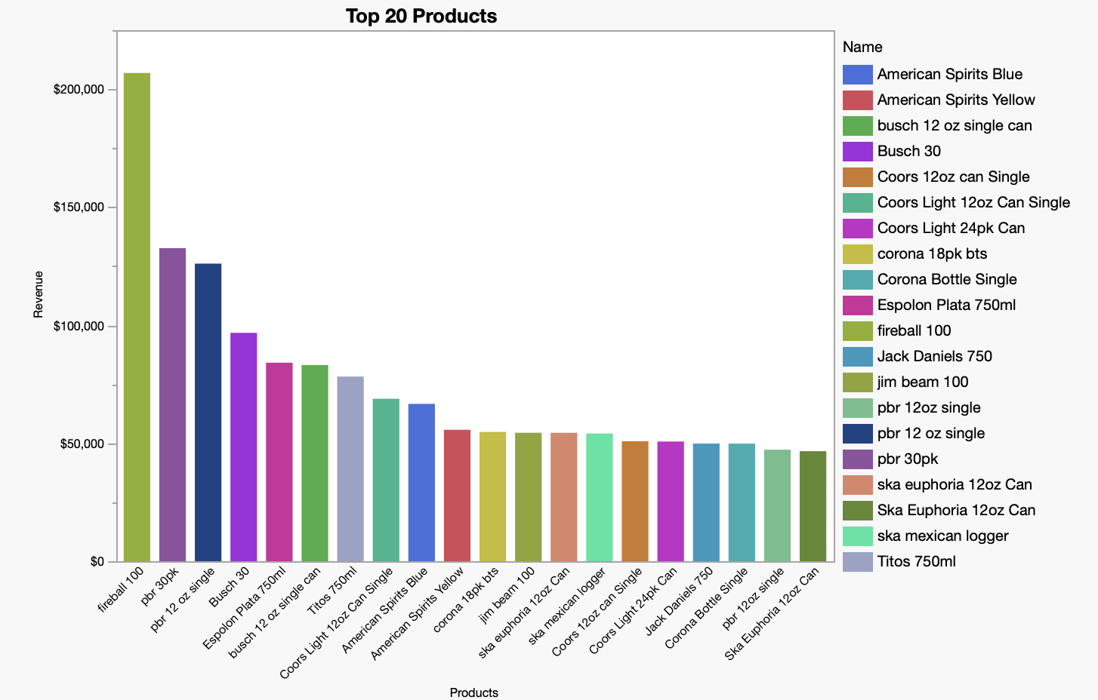
Top 20 Products (Revenue)

Slide 8
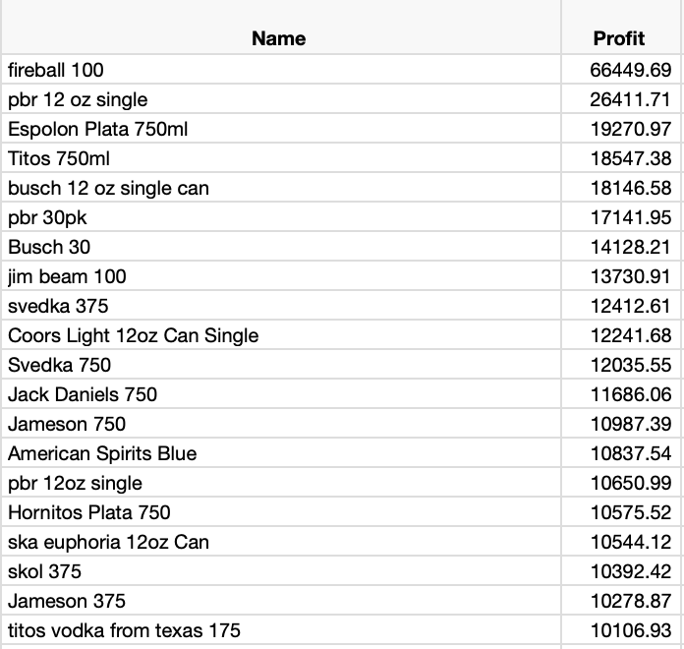
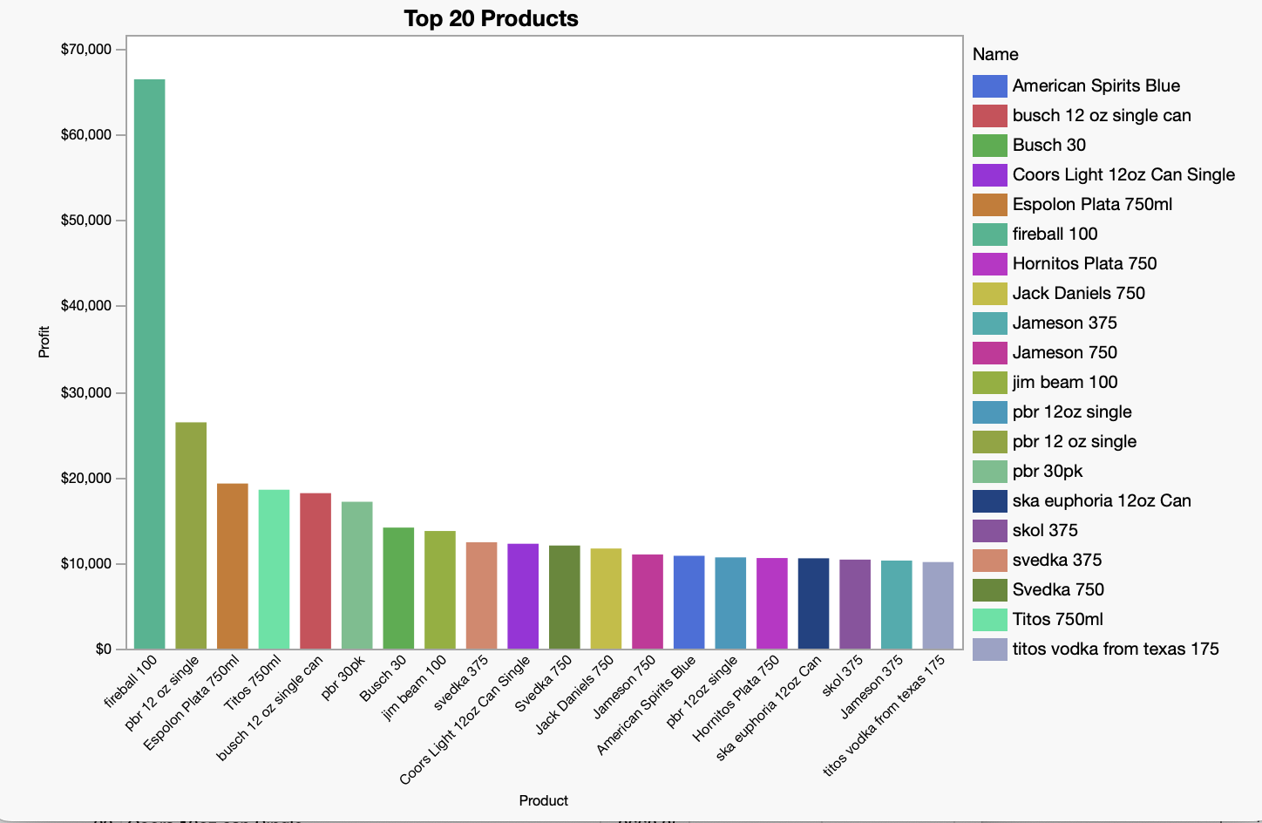
Top 20 Products (Profit)

Slide 9
2023 Top Performing SKU’s per Month

Slide 10
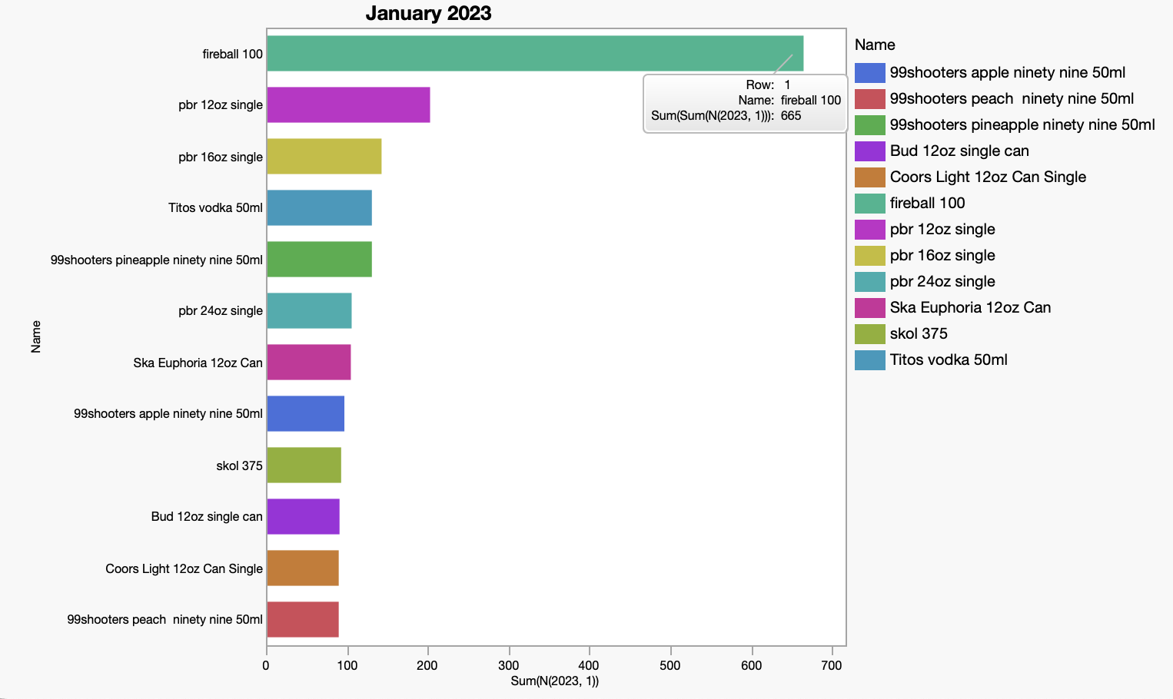
January
Qty. Sold
Most Profitable
1
2
3
4
5
6
7
8
9
10
11
12
fireball 100 | 665
pbr 12oz single | 203
pbr 16oz single | 143
99shooters pineapple ninety nine 50ml | 131
Titos vodka 50ml | 131
pbr 24oz single | 106
Ska Euphoria 12oz Can | 105
99shooters apple ninety-nine 50ml | 97
skol 375 | 93
Bud 12oz single can | 91
99shooters peach ninety-nine 50ml | 90
Coors Light 12oz Can Single | 90
fireball 100 | 893.06
Titos 750ml | 296.74
pbr 12oz single | 270.54
Jameson 375 | 239.69
Hornitos Plata 750 | 235.41
Busch 30 | 212.86
titos vodka from texas 175 | 169.92
Titos vodka 50ml | 167.75
Ska Euphoria 12oz Can | 166.6
Coors Light 12oz Can Single | 159.24
Svedka 750 | 151.55

Slide 11
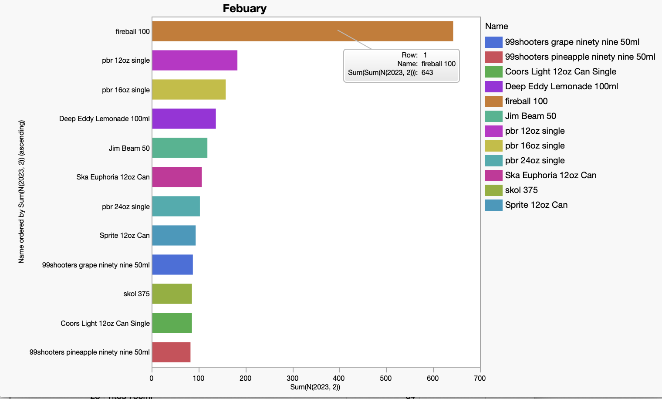
February
Qty. Sold
Most Profitable
1
2
3
4
5
6
7
8
9
10
11
12
fireball 100 | 643
pbr 12oz single | 183
pbr 16oz single | 158
Deep Eddy Lemonade 100ml | 137
Jim Beam 50 | 119
Ska Euphoria 12oz Can | 107
pbr 24oz single | 103
Sprite 12oz Can | 94
99shooters grape ninety-nine 50ml | 88
Coors Light 12oz Can Single | 86
skol 375 | 86
99shooters pineapple ninety-nine 50ml | 83
fireball 100 | 907.27
Titos 750ml | 331.52
Espolon Plata 750ml | 246.08
pbr 12oz single | 239.25
Pinnacle vodka 1.75 | 214.48
Hornitos Plata 750 | 185.44
Deep Eddy Lemonade 100ml | 177.06
busch 12 oz single can | 166.59
New Amsterdam Vodka Pink Whitney Lemonade 750 | 166.06
Busch 30 | 165.14
titos vodka from texas 175 | 149.6
Ska Euphoria 12oz Can | 145.08

Slide 12
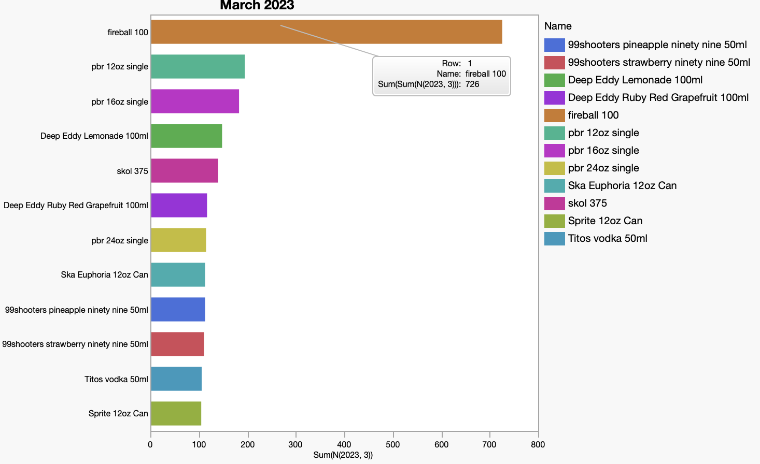
March
Qty. Sold
Most Profitable
1
2
3
4
5
6
7
8
9
10
11
12
fireball 100 | 726
pbr 12oz single | 195
pbr 16oz single | 183
Deep Eddy Lemonade 100ml | 148
skol 375 | 140
Deep Eddy Ruby Red Grapefruit 100ml | 117
pbr 24oz single | 115
99shooters pineapple ninety-nine 50ml | 113
Ska Euphoria 12oz Can | 113
99shooters strawberry ninety-nine 50ml | 111
Titos vodka 50ml | 106
Sprite 12oz Can | 105
fireball 100 | 1029.77
Titos 750ml | 284.9
pbr 12oz single | 235.89
Jameson 375 | 221.37
titos vodka from texas 175 | 211.2
New Amsterdam Vodka Pink Whitney Lemonade 750 | 201.02
Pinnacle vodka 1.75 | 196.67
skol 375 | 196.32
pbr 16oz single | 189.39
svedka 375 | 184.12
Jack Daniels 750 | 181.89
Deep Eddy Lemonade Vodka 750 | 181.74

Slide 13
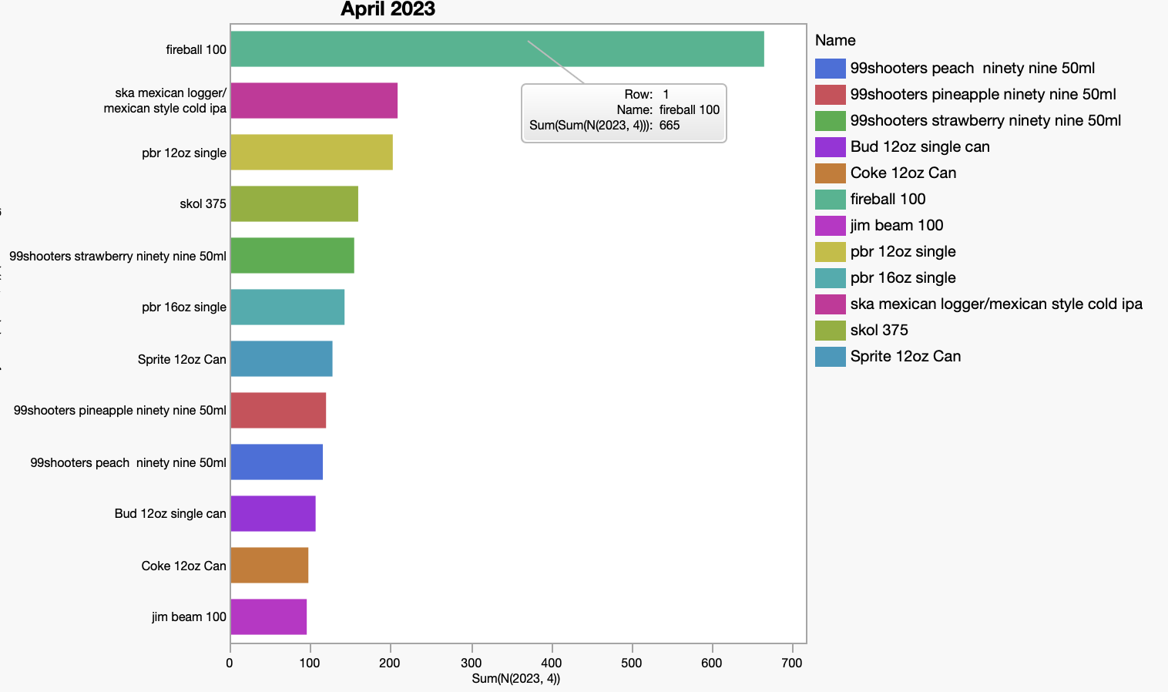
April
Qty. Sold
Most Profitable
1
2
3
4
5
6
7
8
9
10
11
12
fireball 100 | 665
ska mexican logger/mexican style cold ipa | 209
pbr 12oz single | 203
skol 375 | 160
99shooters strawberry ninety nine 50ml | 155
pbr 16oz single | 143
Sprite 12oz Can | 128
99shooters pineapple ninety nine 50ml | 120
99shooters peach ninety nine 50ml | 116
Bud 12oz single can | 107
Coke 12oz Can | 98
jim beam 100 | 96
fireball 100 | 1097.83
ska mexican logger/mexican style cold ipa | 311.13
Jameson 375 | 290.48
pbr 12oz single | 268.98
svedka 375 | 254.16
Titos 750ml | 253.82
skol 375 | 210.27
Busch 30 | 197.45
Deep Eddy Lemonade Vodka 750 | 181.74
Hornitos Plata 750 | 175.68
busch 12 oz single can | 171.87
Monopolowa 750 | 171.16

Slide 14
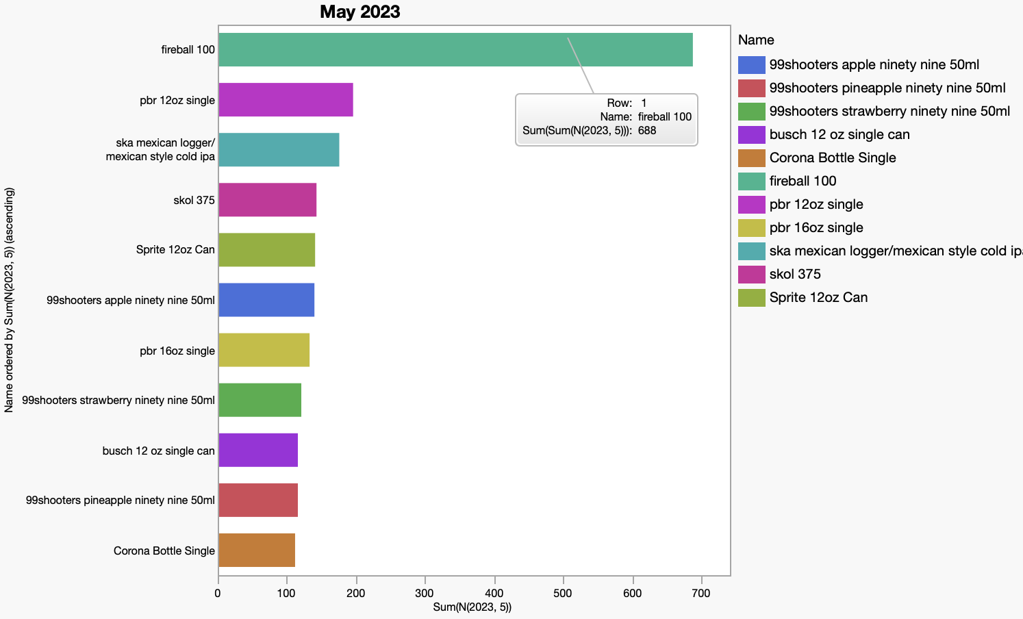
May
Qty. Sold
Most Profitable
1
2
3
4
5
6
7
8
9
10
11
12
fireball 100 | 688
pbr 12oz single | 196
ska mexican logger/mexican style cold ipa | 176
skol 375 | 143
Sprite 12oz Can | 141
99shooters apple ninety-nine 50ml | 140
pbr 16oz single | 133
99shooters strawberry ninety-nine 50ml | 121
99shooters pineapple ninety-nine 50ml | 116
busch 12 oz single can | 116
Corona Bottle Single | 112
99shooters peach ninety-nine 50ml | 106
fireball 100 | 1163.09
ska mexican logger/mexican style cold ipa | 266.43
pbr 12oz single | 257.13
svedka 375 | 224.56
busch 12 oz single can | 211.92
Jameson 375 | 204.48
Coors Light 24pk Can | 202.95
American Spirits Blue | 198.67
skol 375 | 189.63
Titos 750ml | 181.3
Busch 30 | 175.91
Bud 12oz single can | 171.34

Slide 15
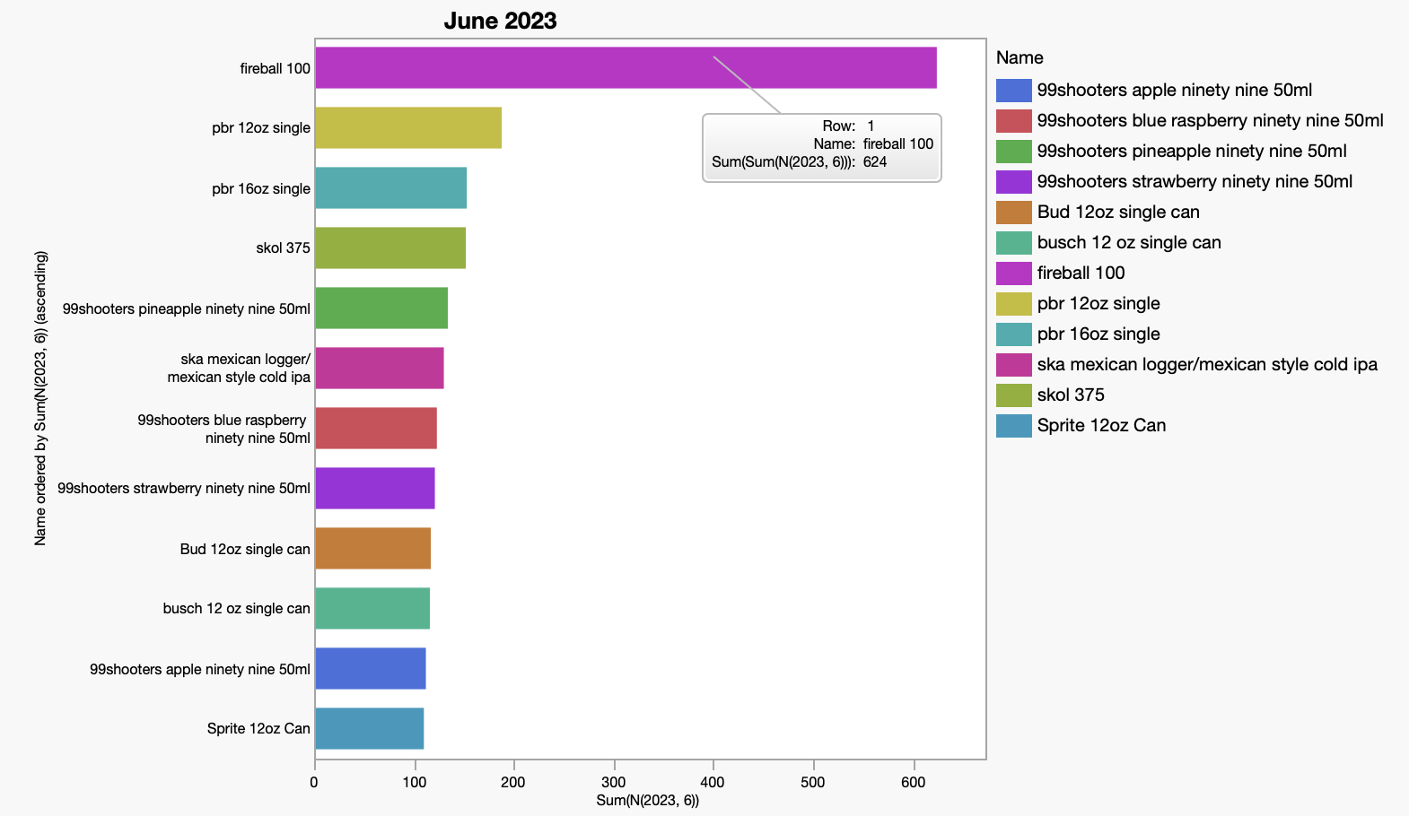
June
Qty. Sold
Most Profitable
1
2
3
4
5
6
7
8
9
10
11
12
fireball 100 | 926.92
Espolon Plata 750ml | 341.61
Jameson 375 | 306.86
svedka 375 | 283.61
pbr 12oz single | 233.88
ska mexican logger/mexican style cold ipa | 227.94
Titos 750ml | 212.38
busch 12 oz single can | 209.37
skol 375 | 206.4
Busch 30 | 179.5
American Spirits Blue | 175.07
pbr 16oz single | 163.89
fireball 100 | 926.92
Espolon Plata 750ml | 341.61
Jameson 375 | 306.86
svedka 375 | 283.61
pbr 12oz single | 233.88
ska mexican logger/mexican style cold ipa | 227.94
Titos 750ml | 212.38
busch 12 oz single can | 209.37
skol 375 | 206.4
Busch 30 | 179.5
American Spirits Blue | 175.07
pbr 16oz single | 163.89

Slide 16
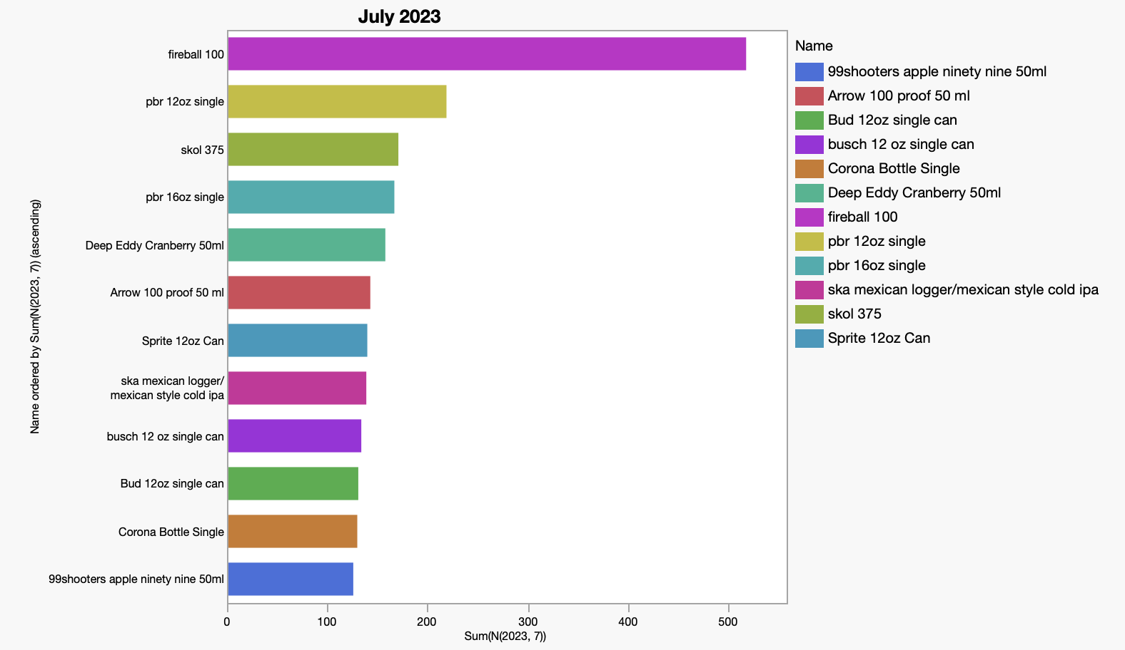
July
Qty. Sold
Most Profitable
1
2
3
4
5
6
7
8
9
10
11
12
fireball 100 | 518
pbr 12oz single | 219
skol 375 | 171
pbr 16oz single | 167
Deep Eddy Cranberry 50ml | 158
Arrow 100 proof 50 ml | 143
Sprite 12oz Can | 140
ska mexican logger/mexican style cold ipa | 139
busch 12 oz single can | 134
Bud 12oz single can | 131
Corona Bottle Single | 130
99shooters apple ninety nine 50ml | 126
fireball 100 | 779.65
pbr 12oz single | 298.37
ska mexican logger/mexican style cold ipa | 245.86
skol 375 | 245.1
busch 12 oz single can | 235.28
Jameson 375 | 230.31
svedka 375 | 225.45
Twisted Tea 12pk | 194.07
Bud 12oz single can | 189.91
pbr 16oz single | 180.25
American Spirits Blue | 178.85
Corona Bottle Single | 175.71

Slide 17
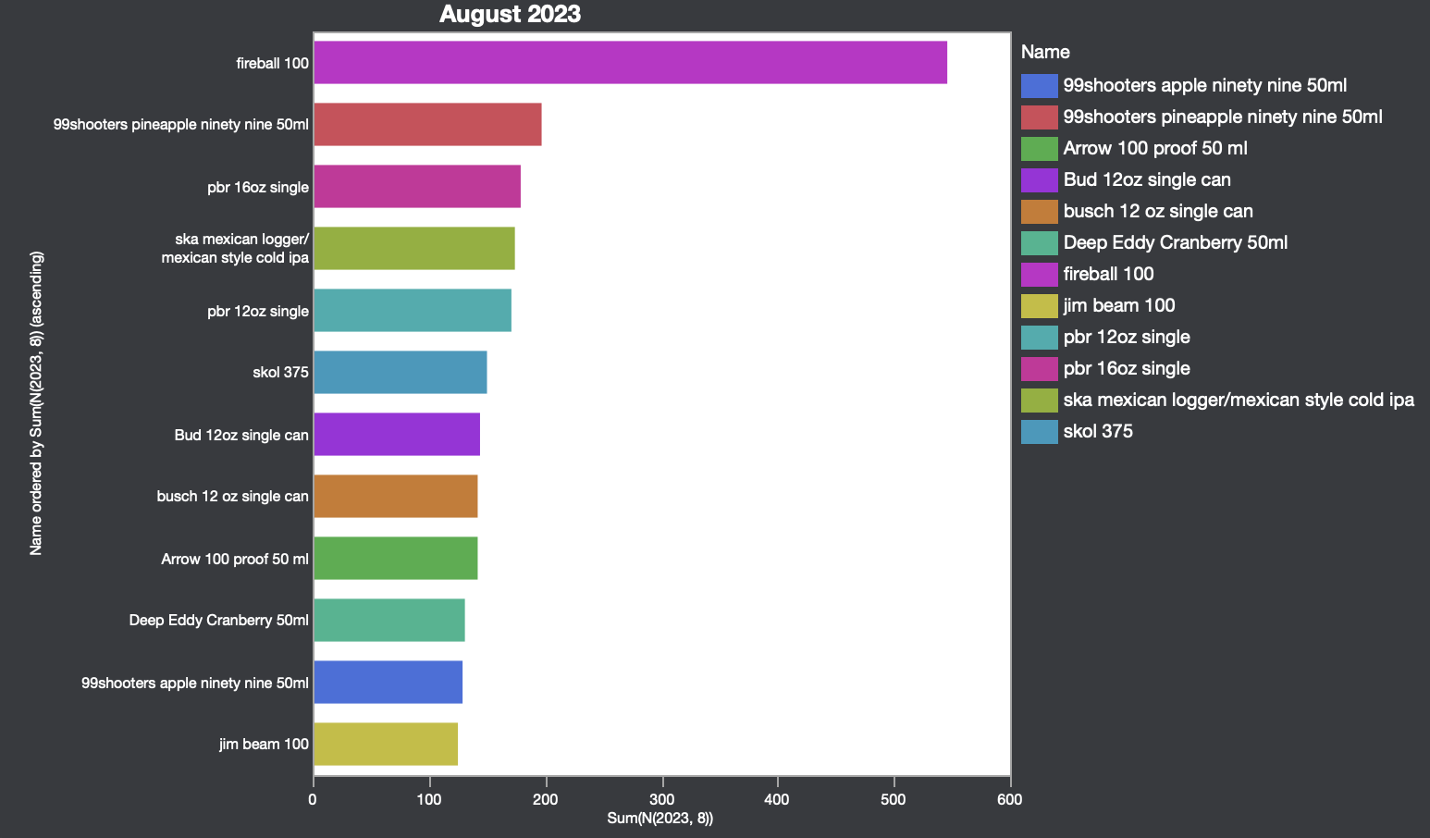
August
Qty. Sold
Most Profitable
1
2
3
4
5
6
7
8
9
10
11
12
fireball 100 | 546
99shooters pineapple ninety nine 50ml | 197
pbr 16oz single | 179
ska mexican logger/mexican style cold ipa | 174
pbr 12oz single | 171
skol 375 | 150
Bud 12oz single can | 144
Arrow 100 proof 50 ml | 142
busch 12 oz single can | 142
Deep Eddy Cranberry 50ml | 131
99shooters apple ninety nine 50ml | 129
jim beam 100 | 125
fireball 100 | 794.54
Jameson 375 | 349.73
pbr 12oz single | 277.4
New Amsterdam Orange Vodka 1.75 c/o | 263.57
busch 12 oz single can | 243.89
svedka 375 | 236.3
ska mexican logger/mexican style cold ipa | 222.99
Titos 750ml | 217.56
pbr 16oz single | 211.6
Hornitos Plata 750 | 204.96
skol 375 | 203.82
Bud 12oz single can | 203.58

Slide 18
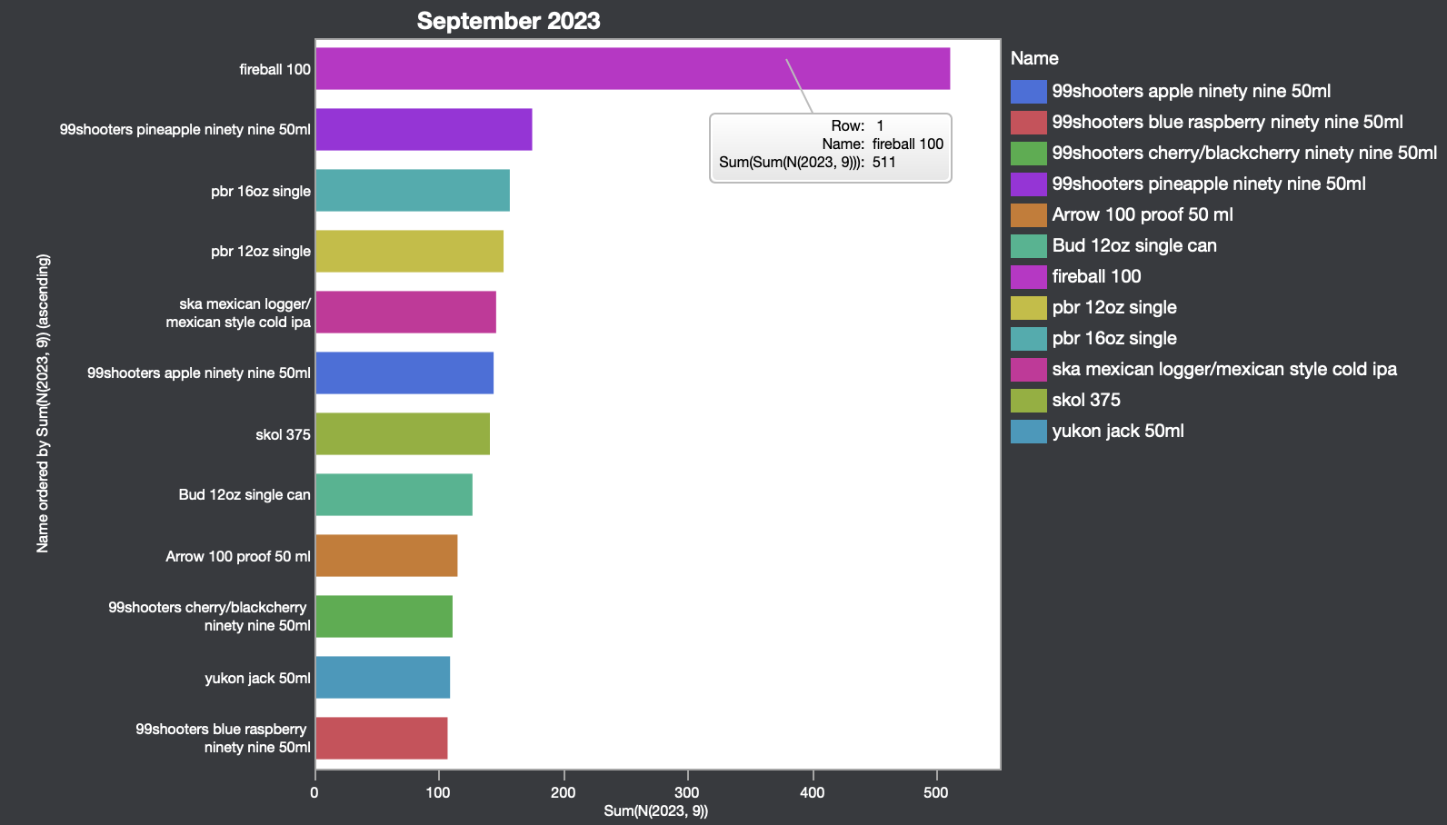
September
Qty. Sold
Most Profitable
1
2
3
4
5
6
7
8
9
10
11
12
fireball 100 | 511
99shooters pineapple ninety nine 50ml | 175
pbr 16oz single | 157
pbr 12oz single | 152
ska mexican logger/mexican style cold ipa | 146
99shooters apple ninety nine 50ml | 144
skol 375 | 141
Bud 12oz single can | 127
Arrow 100 proof 50 ml | 115
99shooters cherry/blackcherry ninety nine 50ml | 111
yukon jack 50ml | 109
99shooters blue raspberry ninety nine 50ml | 107
fireball 100 | 722.7
Jameson 375 | 290.02
pbr 12oz single | 271.58
Titos 750ml | 253.82
Espolon Plata 750ml | 230.25
not in database yet | 219.35
Bud 12oz single can | 212.68
ska mexican logger/mexican style cold ipa | 199.86
svedka 375 | 197.38
pbr 16oz single | 191.52
skol 375 | 185.76
pbr 30pk | 181.14

Slide 19
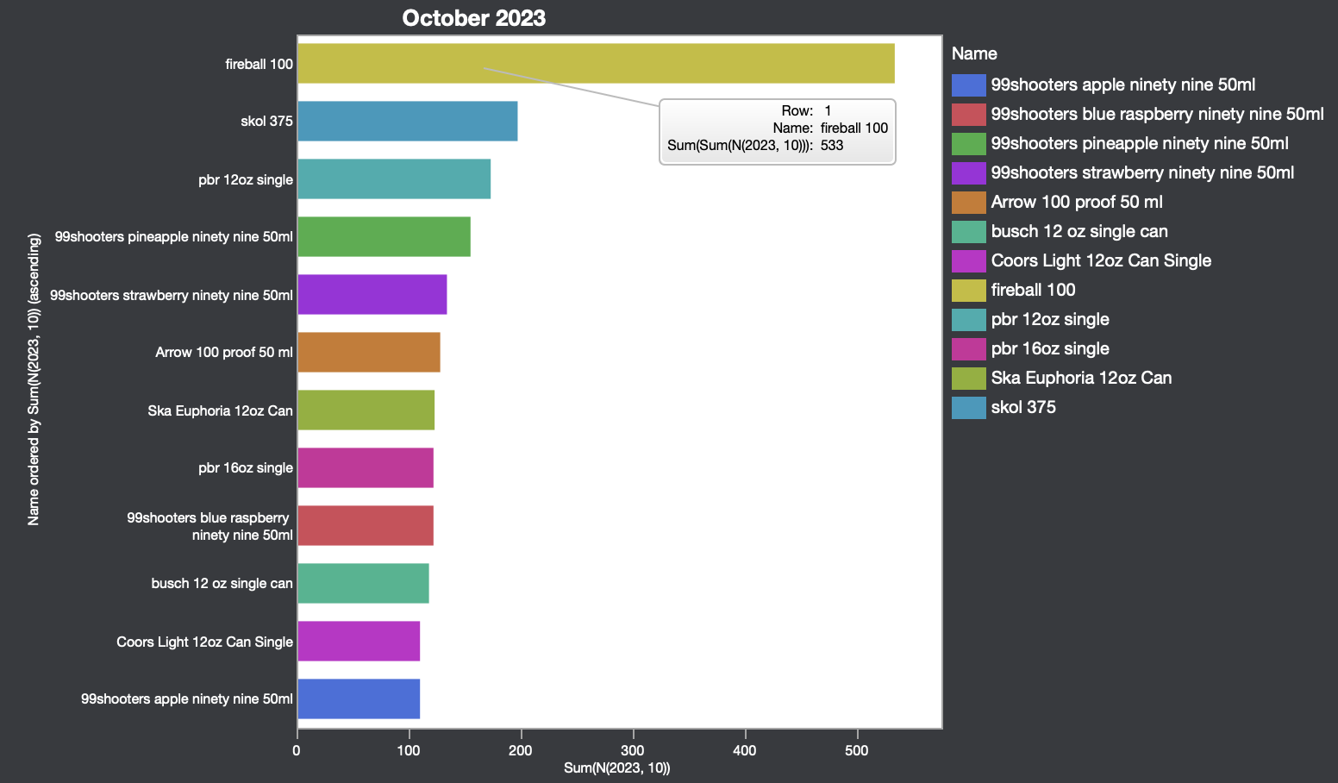
October
Qty. Sold
Most Profitable
1
2
3
4
5
6
7
8
9
10
11
12
fireball 100 | 533
skol 375 | 197
pbr 12oz single | 173
99shooters pineapple ninety nine 50ml | 155
99shooters strawberry ninety nine 50ml | 134
Arrow 100 proof 50 ml | 128
Ska Euphoria 12oz Can | 123
99shooters blue raspberry ninety nine 50ml | 122
pbr 16oz single | 122
busch 12 oz single can | 118
99shooters apple ninety nine 50ml | 110
Coors Light 12oz Can Single | 110
fireball 100 | 799.93
Titos 750ml | 362.6
Hornitos Plata 750 | 342.28
Jameson 375 | 293.96
pbr 12oz single | 282.52
skol 375 | 273.48
Espolon Plata 750ml | 248.67
Jack Daniels 375 | 212.29
busch 12 oz single can | 191.39
svedka 375 | 190.71
titos vodka from texas 175 | 189
Bud 12oz single can | 181.22

Slide 20
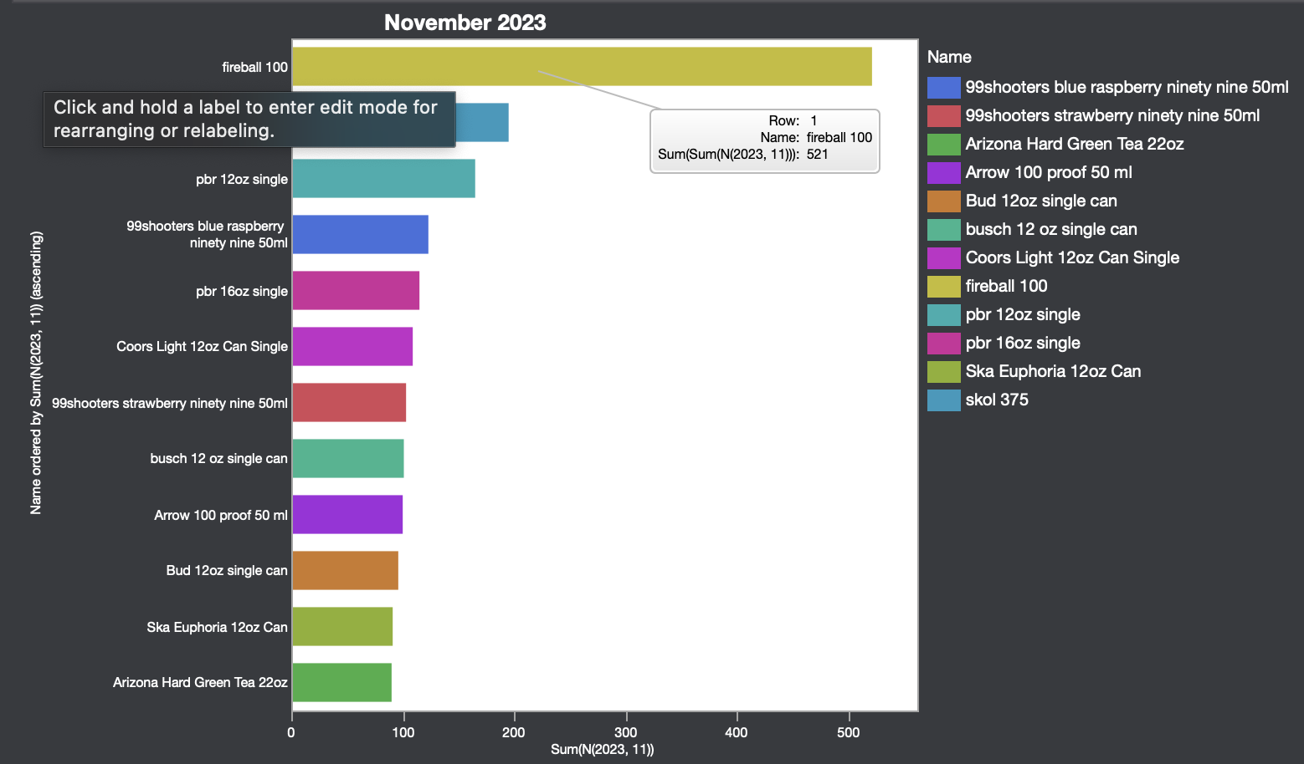
November
Qty. Sold
Most Profitable
1
2
3
4
5
6
7
8
9
10
11
12
fireball 100 | 521
skol 375 | 195
pbr 12oz single | 165
99shooters blue raspberry ninety nine 50ml | 123
pbr 16oz single | 115
Coors Light 12oz Can Single | 109
99shooters strawberry ninety nine 50ml | 103
busch 12 oz single can | 101
Arrow 100 proof 50 ml | 100
Bud 12oz single can | 96
Ska Euphoria 12oz Can | 91
Arizona Hard Green Tea 22oz | 90
fireball 100 | 803.58
pbr 12oz single | 291.4
Hornitos Plata 750 | 288.21
skol 375 | 279.93
Titos 750ml | 246.42
Jameson 375 | 241.4
Jameson 750 | 192.25
buffalo trace 750 | 185.25
svedka 375 | 180.96
Bud 12oz single can | 168.22
Coors Light 12oz Can Single | 161.76

Slide 21
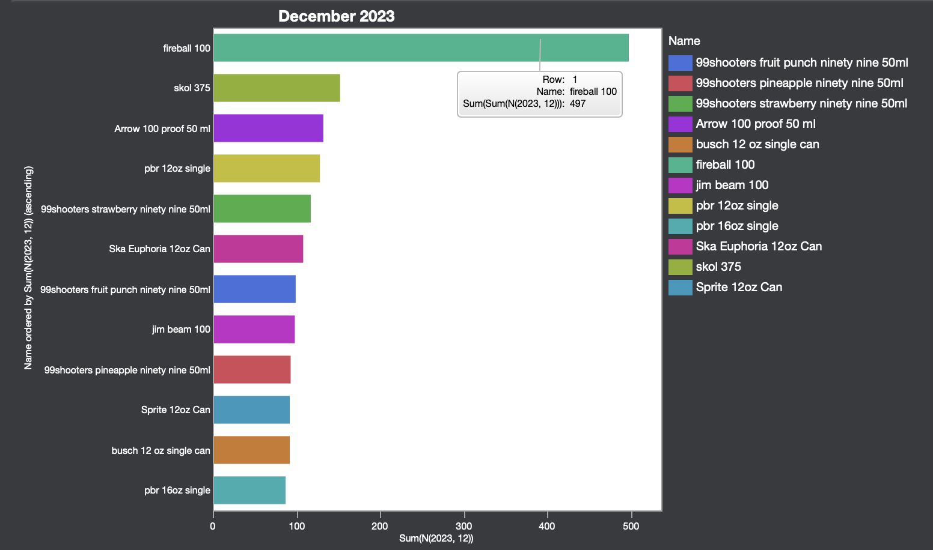
December
Qty. Sold
Most Profitable
1
2
3
4
5
6
7
8
9
10
11
12
fireball 100 | 497
skol 375 | 152
Arrow 100 proof 50 ml | 132
pbr 12oz single | 128
99shooters strawberry ninety nine 50ml | 117
Ska Euphoria 12oz Can | 108
99shooters fruit punch ninety nine 50ml | 99
jim beam 100 | 98
99shooters pineapple ninety nine 50ml | 93
busch 12 oz single can | 92
Sprite 12oz Can | 92
pbr 16oz single | 87
fireball 100 | 879.29
Hornitos Plata 750 | 347.33
Titos 750ml | 305.62
titos vodka from texas 175 | 261
Jameson 375 | 251.78
pbr 12oz single | 226.7
Jameson 750 | 223.01
skol 375 | 206.4
svedka 375 | 183.17
Coors Light 12oz Can Single | 177.77
Jack Daniels 750 | 168.22
Familia Camarena Silver 50ml | 166.83

Slide 22
2023 Recap
There are 4,088 products that did not make a single sale in all 12 months. (Too large to list)
Top 12 Sellers accumulated up to 22,878 sold (Tips/Discounts filtered out)
180,501 products sold in total

Slide 23
2023 Recap II
Marble Farm House Ale 750
Athletic Brewing Oktoberfest/first ride 6pk
cascina ballarin tre ciabot barolo c/o
Kermit Lynch VDP Vaucluse Blanc
Sean Minor Four Bears Chardonnay
Ironstone Cab Franc
Regio Old Vine Zinfandel
Cesari Justo Rosso special buy*
Chateau Champs de Durand Puisseguin Saint-Emilion
shannon ridge cabernet
Tieton Imperial Apple
*Port Brewing Wipeout IPA
Einstok Arctic Berry
Melvin Killer Bees Blonde 12oz *
Left Hand Good Juju / Fade to Black/Well Played/Peach Beerlini Seasonal/Oktoberfest/Pixan Pepper porter/S'mores milk stout
Cattin Sauvage Pinot Noir
Gentleman Jack
Colorado Native Juicy IPA variety 12pack
Boost Oxygen Menthol 22 oz can
Riff Raff Plebian Porter 12oz
Social Pumpkin Chai Sparkling Sake c/o
*Toppling Goliath Pompeii Beach
Monster Java Mean Bean*
19 Crimes Snoop Dog Cali Red Blend
Browne Tribute Red Blend
Cantera Negra Tequila Extra Anejo
Chalk Hill Chard
Cape Heights Chenin Blanc
Alcohol
fireball 100
pbr 12oz single
Titos 750ml
Jameson 375
Hornitos Plata 750
skol 375
svedka 375
busch 12 oz single can
Espolon Plata 750ml
Bud 12oz single can
titos vodka from texas 175
pbr 16oz single
Total Profit
$10,797.63
$3,153.64
$3,107.26
$3,055.60
$2,447.87
$2,431.56
$2,374.27
$2,199.10
$2,124.23
$1,966.95
$1,934.72
$1,886.15
$300,452.55 Total Profit (After deductions of tips/discounts/coupons/etc.)
The 28 Products on the right are all the products that netted a loss, anywhere from -1 cent to -$14.17

