Slide 1
Ansible
Customer Data Management
A configuration management tool

Slide 2
Not only configuration management
Deployment
Provisioning new virtual machine instance
  Amazon EC2
  Azure
  Digital Ocean
  Google Compute Engine
  Linode

Slide 3


playbook
Play
Hosts
Tasks
Play
Hosts
Tasks
Play
Hosts
Tasks

Slide 4
YAML
DSL used to describe playbook
    The first line of a YAML document should begin with “---”
    Each item in list should begin with “- ”
    Indentations
    Key and value in Hashes should be separated by “ : ”
    Comment should begin with “# ”

Slide 5
play
Connect hosts to tasks
A set of hosts
A list of tasks
Other optional settings:
  name: the name of the play
  sudo
  vars

Slide 6
task
Tasks need to be done in the hosts
name: the name of the task, optional.
module: the action to be performed on a host

Slide 7
modules
Scripts that come packaged with Ansible and perform some kinds of action on a host:
apt/yum: installs or removes packages.
copy: copies file from local machine to the hosts.
file: sets the attribute of a file.
service: starts, stops, or restarts a service.
template: generate file from template and copies to hosts.

Slide 8
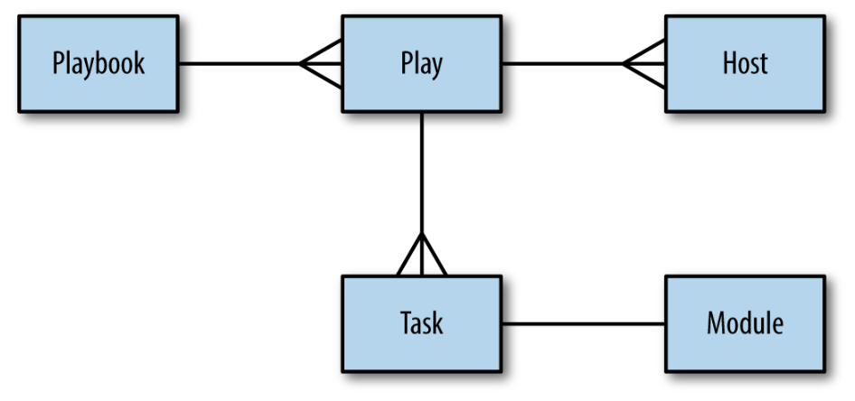
summary

Slide 9
handlers
Handler is similar to task, but:
handler runs only if it has been notified by a task.
task will fire the notification only when it has changed the state of the system.
task notifies a handler by passing the handler’s name as argument.
handlers only run after all of the tasks are run.
handlers only run once even if they are notified multiple times.
handlers only run in the order that they appear in the play

Slide 10
DEMO

Slide 11

Behind the scene
What’s going on behind the scene?

Slide 12
For each task, Ansible Will:
First, generate a Python script regarding the current task.
Copy the script to all hosts.
Execute the script on all hosts.
Wait for the script to complete execution on all hosts.
Move to next task…

Slide 13
Prerequisite
Control machine
  Python 2.6 or later
Remote Hosts
    SSH + Python 2.5 or later
    SSH + Python 2.4 + Python simplejson library

Slide 14
Modules
Command modules
  Raw
  Command
  Shell
  Script
Others
  http://docs.ansible.com/ansible/list_of_all_modules.html

Slide 15
DEMO

Slide 16
Running the playbook
ansible-playbook playbook_file –i hosts_file –t tags –start-at-task task_name

Slide 17
Variables
Variables can be defined in:
    runtime variables(facts and registered variables)
    host file (2)
    group_var (7)
    host_var (6)
    vars in plays (4)
    vars_files in plays (5)
    defaults in role (8)
    vars in role (3)
    -e switch (1)

Slide 18
Gathering Facts
Collection information of host before execute a play
    Host name
    IP address
    MAC address
    …
    You can turn off fact gathering if you don’t need it;
    You can collect fact manually using: ansible host_name –m setup
    You can use these facts directly in plays;

Slide 19
Build-in variables
hostvars
inventory_hostname
group_names
groups
play_hosts
ansible_version

Slide 20
Iterative control
when
with_items
with_dict
groups
play_hosts
ansible_version

