Slide 1
Python and Julia for Inequality Analysis
Josep Espasa Reig
Data Scientist

Slide 2

Try to answer the following question
Should I use R, Python or Julia for the analysis of income and wealth distributions?
Presentation and code in GitHub repo:
github.com/JosepER/gdansk_workshop

Slide 3
Briefly present…
I use Python, R and Julia myself. I choose one or another depending on the characteristics of the task.
Pedro has shown how to use R. I’ll therefore focus on Python and Julia.

Slide 4
Briefly present…
1- Why (not) Python?
2- Using Python to read and process data for inequality estimates
3- Using Python for ML (examples)
4- Why (not) Julia?
5- Using Julia to read and process data for inequality estimates

Slide 5
Why (not) Python?
Why using Python
"Python is the second-best language for everything" Dan Callahan at PyCon 2018
Wide popularity. Massive community (and growing). Almost dominant in certain areas such as (ML).
Great support by AI code generators.
Slow but flexible (like R). Many packages are interfaces to faster (lower-level) programming languages (like C++ or Rust).
Personal: feels more like a mature programming language than R.
Notes:
"Python is the second-best language for everything" Dan Callahan at PyCon 2018
Personal: feels more like a mature programming language than R. E.g. logging and excellent packages such as SQLAlchemy or Flask.

Slide 6
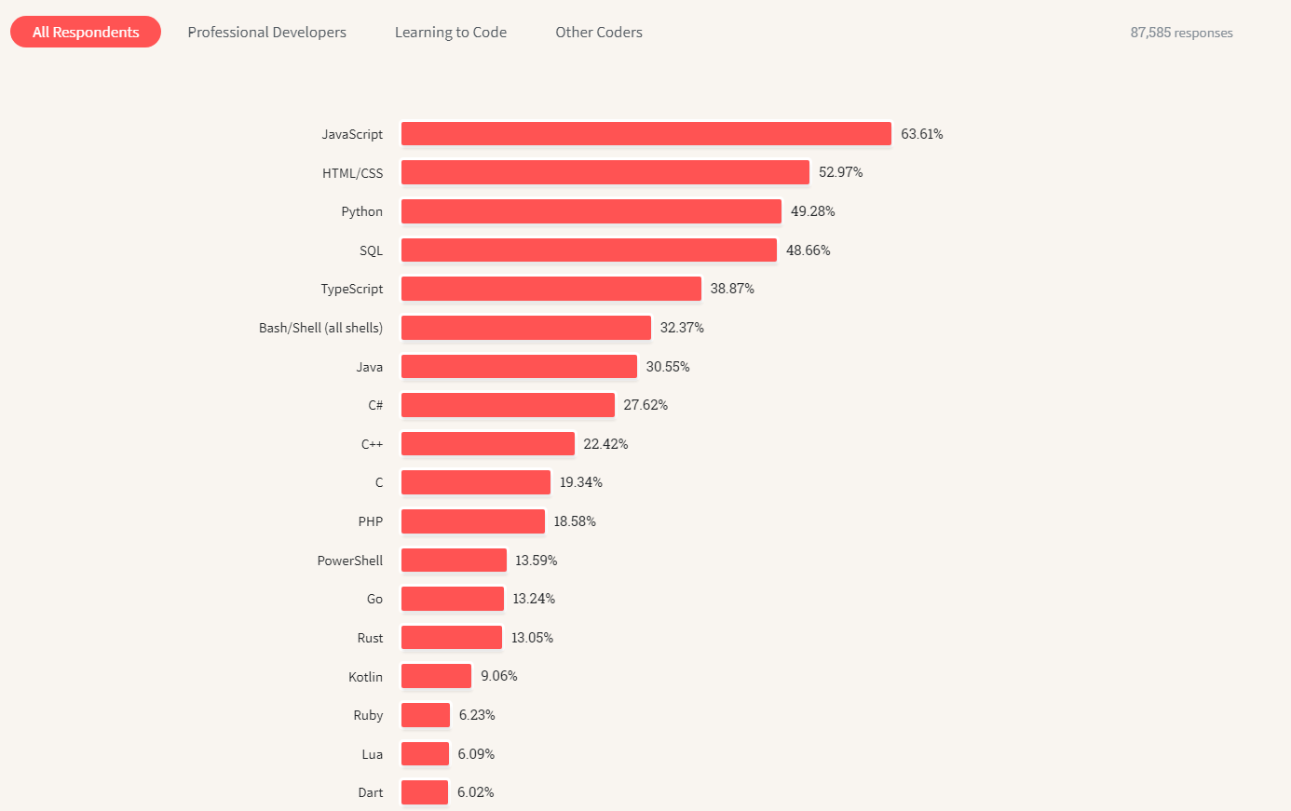
From Stack Overflow 2023 survey
Notes:
R 4.23%
Julia 1.15%

Slide 7
Why (not) Python?
Why NOT using Python
Unlike R, it did not start with data and statistics in mind.
It can feel 'clunky' to work with data at times (e.g. indexes for Pandas, or how certain libraries deal with missing values)
R has some excellent libraries such as 'dplyr', 'ggplot2' and 'shiny'
Notes:
It can feel 'clunky' to work with data at times:
indexes for Pandas,
how certain libraries deal with missing values
how it deals with categorical variables

Slide 8
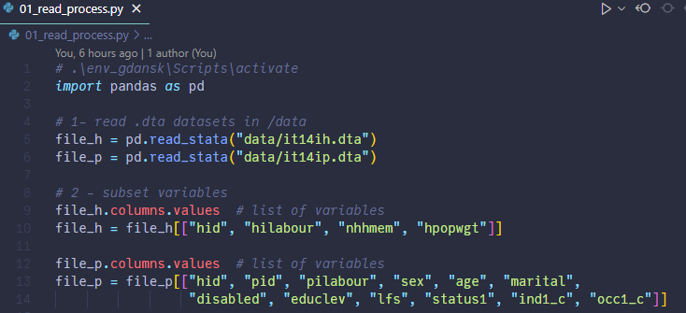
Using Python to read and process data for inequality estimates (1)
Notes:
This is the same data processing that Pedro has performed (just in case I can’t use my machine there)
Remark similarity to R

Slide 9
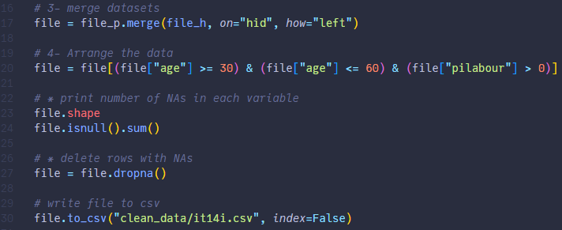
Using Python to read and process data for inequality estimates (2)
Notes:
This is the same data processing that Pedro has performed (just in case I can’t use my machine there)

Slide 10
Using Python for ML
Relies in external packages, like ‘sklearn’
3 main steps:
Create instance of model
Fit the model
Predict + assess model fit

Slide 11
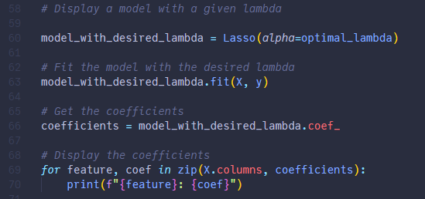
Using Python for ML
E.g. from 02_lasso.py’ in github.com/JosepER/gdansk_workshop/tree/main/python_julia/py
Notes:
Create instance of model
Fit the model
Predict + assess model fit (in this case, take coefficients)

Slide 12
Why (not) Julia?
I have a previous presentation comparing R and Julia for Official Statistics (link)
An open-source, dynamically typed language (like R and Python)
Uses Just in time (JIT) Compilation
Syntactically similar languages
Julia feels more modern, easier to read and cleaner (personal opinion)
R and Python have packages to run Julia code (and vice versa)
Cons:
the package ecosystem does not have the same maturity than the R and Python ones

Slide 13
Why (not) Julia?
Cons:
The package ecosystem does not have the same maturity than the R and Python ones
Python also has ways of accelerating its code:
E.g. Numba, Nuitka and (in the future) Mojo.
AI code generators are currently awful at Julia.

Slide 14
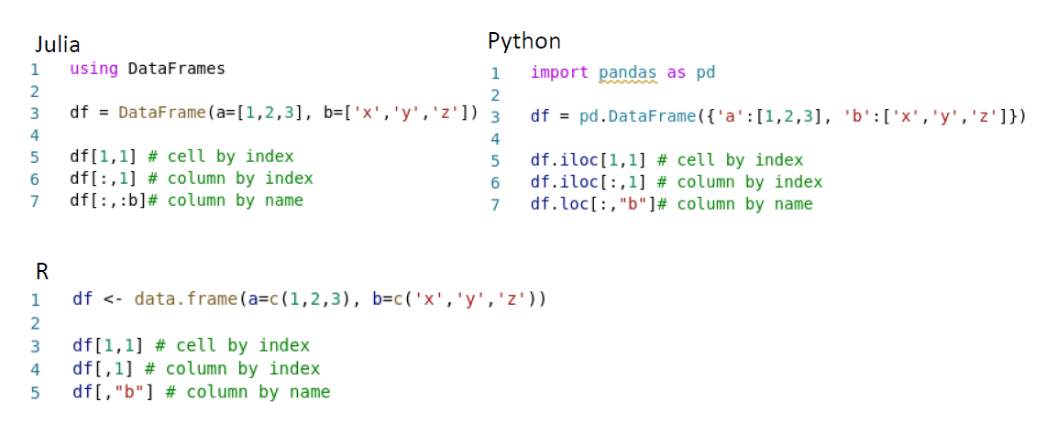
Syntactically similar languages

Slide 15
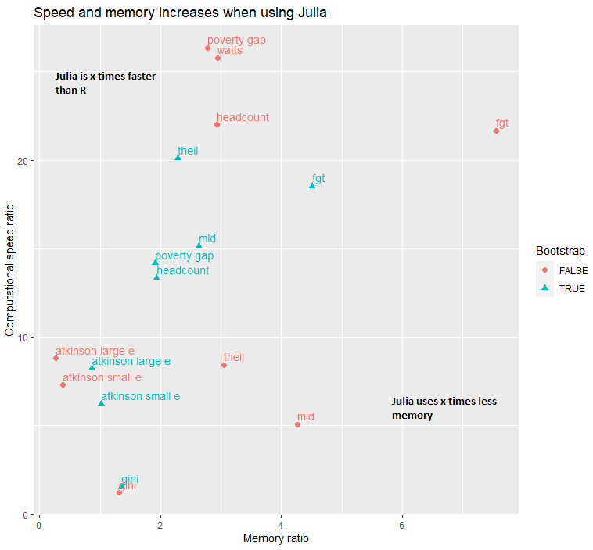
Julia is fast!
Notes:
Using Julia can lead to substantial speed increases in certain processes (typically from 2x to 20x).
There should also be a reduction in memory use, but more moderate.

Slide 16
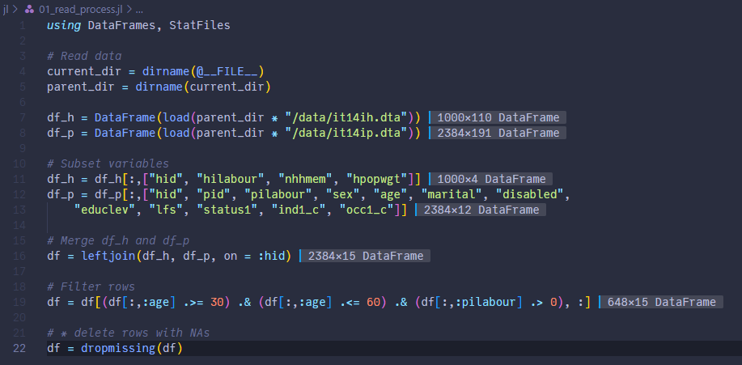
Using Julia
Full script can be found in link

Slide 17
Conclusion
My personal algorithm:
R for scripting and explorations of data.
Python for building robust applications.
Julia only if I need to increase the speed of a process.

Slide 18
Thank you for your attention Questions are welcome !

