Slide 1
Python and Julia for Inequality Analysis
Josep Espasa Reig
Data Scientist

Slide 2

Try to answer the following question
Should I use R, Python or Julia for the analysis of income and wealth distributions?
Presentation and code in GitHub repo:
github.com/JosepER/gdansk_workshop

Slide 3
Briefly present…
I use Python, R and Julia myself. I choose one or another depending on the characteristics of the task.
Pedro has shown how to use R. I’ll therefore focus on Python and Julia.

Slide 4
Briefly present…
1- Why (not) Python?
2- Using Python to read and process data for inequality estimates
3- Using Python for ML (examples)
4- Why (not) Julia?
5- Using Julia to read and process data for inequality estimates

Slide 5
Why (not) Python?
Why using Python
"Python is the second-best language for everything" Dan Callahan at PyCon 2018
Wide popularity. Massive community (and growing). Almost dominant in certain areas such as (ML).
Slow but flexible (like R). Many packages are interfaces to faster (lower-level) programming languages (like C++ or Rust).
Personal: feels more like a mature programming language than R.
Notes:
"Python is the second-best language for everything" Dan Callahan at PyCon 2018
Personal: feels more like a mature programming language than R. E.g. logging and excellent packages such as SQLAlchemy or Flask.

Slide 6
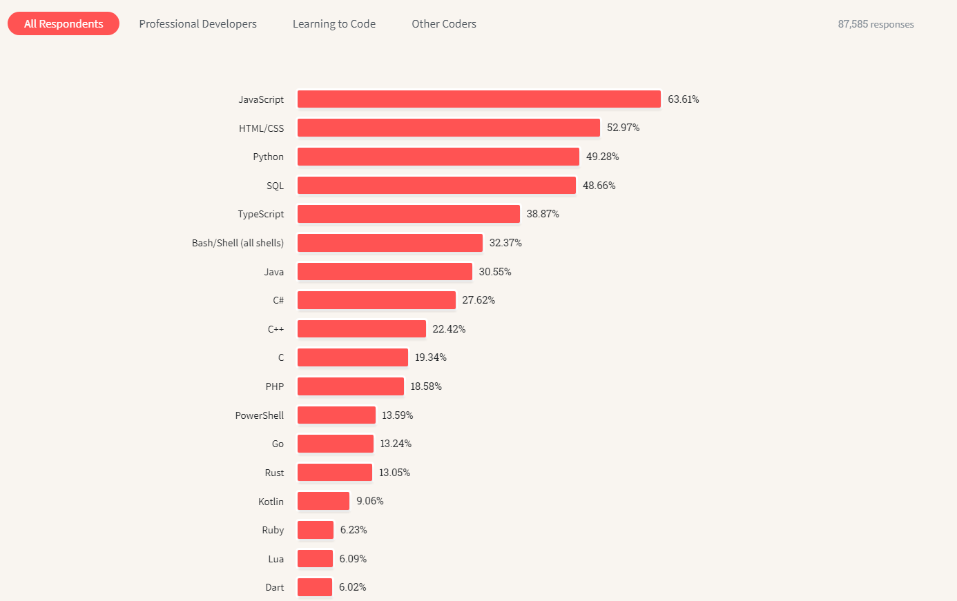
From Stack Overflow 2023 survey
Notes:
R 4.23%
Julia 1.15%

Slide 7
Why (not) Python?
Why NOT using Python
Unlike R, it did not start with data and statistics in mind.
It can feel 'clunky' to work with data at times (e.g. indexes for Pandas, or how certain libraries deal with missing values)
R has some excellent libraries such as 'dplyr', 'ggplot2' and 'shiny'
Notes:
It can feel 'clunky' to work with data at times:
indexes for Pandas,
how certain libraries deal with missing values
how it deals with categorical variables

Slide 8
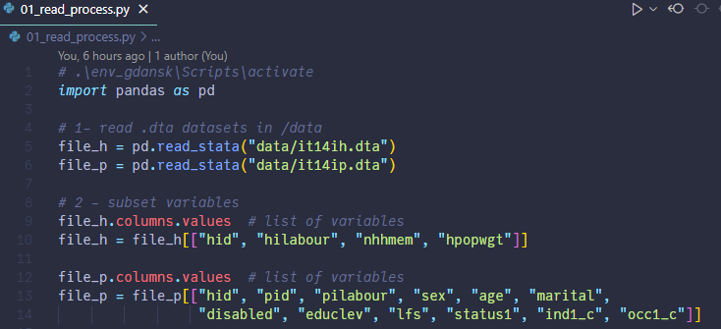
Using Python to read and process data for inequality estimates (1)
Notes:
This is the same data processing that Pedro has performed (just in case I can’t use my machine there)
Remark similarity to R

Slide 9
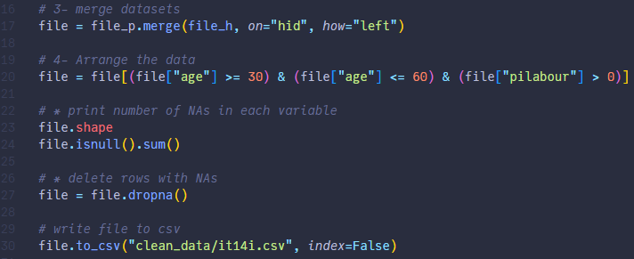
Using Python to read and process data for inequality estimates (2)
Notes:
This is the same data processing that Pedro has performed (just in case I can’t use my machine there)

Slide 10
Using Python for ML
Relies in external packages, like ‘sklearn’
3 main steps:
Create instance of model
Fit the model
Predict + assess model fit

Slide 11
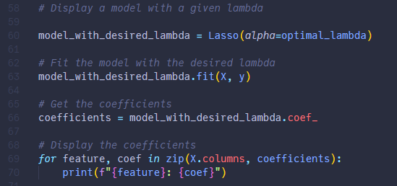
Using Python for ML
E.g. from ‘02_lasso.py’ in github.com/JosepER/gdansk_workshop/tree/main/python_julia/py
Notes:
Create instance of model
Fit the model
Predict + assess model fit (in this case, take coefficients)

Slide 12
Why (not) Julia?
I have a previous presentation comparing R and Julia for Official Statistics (link)
An open-source, dynamically typed language (like R and Python)
Uses Just in time (JIT) Compilation
Syntactically similar languages
Julia feels more modern, easier to read and cleaner (personal opinion)
R and Python have packages to run Julia code (and vice versa)
Cons:
the package ecosystem does not have the same maturity than the R and Python ones

Slide 13
Why (not) Julia?
Cons:
The package ecosystem does not have the same maturity than the R and Python ones
Python also has ways of accelerating its code:
E.g. Numba, Nuitka and (in the future) Mojo.
AI code generators are currently awful at Julia.

Slide 14
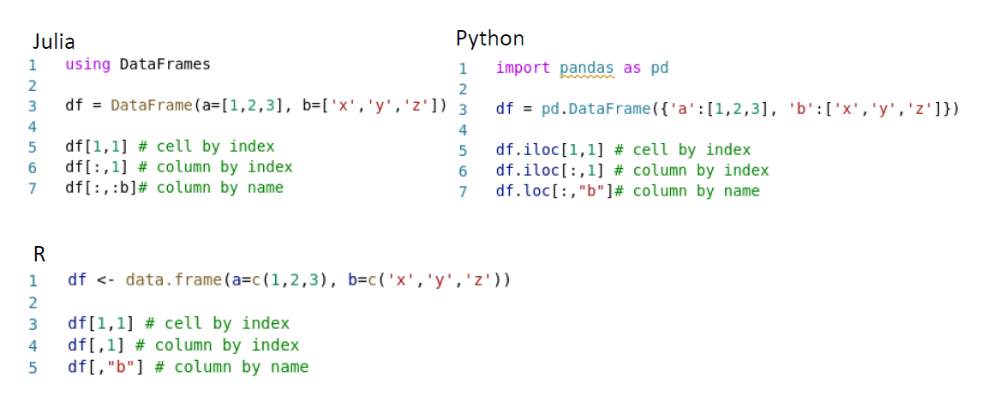
Syntactically similar languages

Slide 15
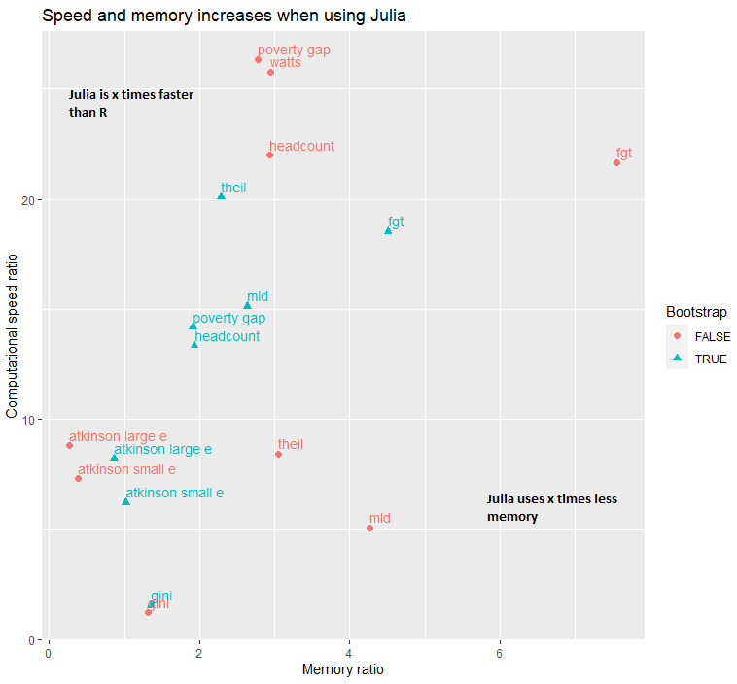
Julia is fast!
Notes:
Using Julia can lead to substantial speed increases in certain processes (typically from 2x to 20x).
There should also be a reduction in memory use, but more moderate.

Slide 16
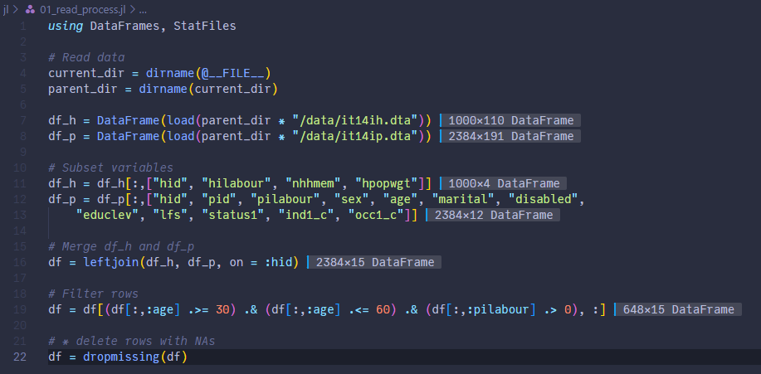
Using Julia

Slide 17
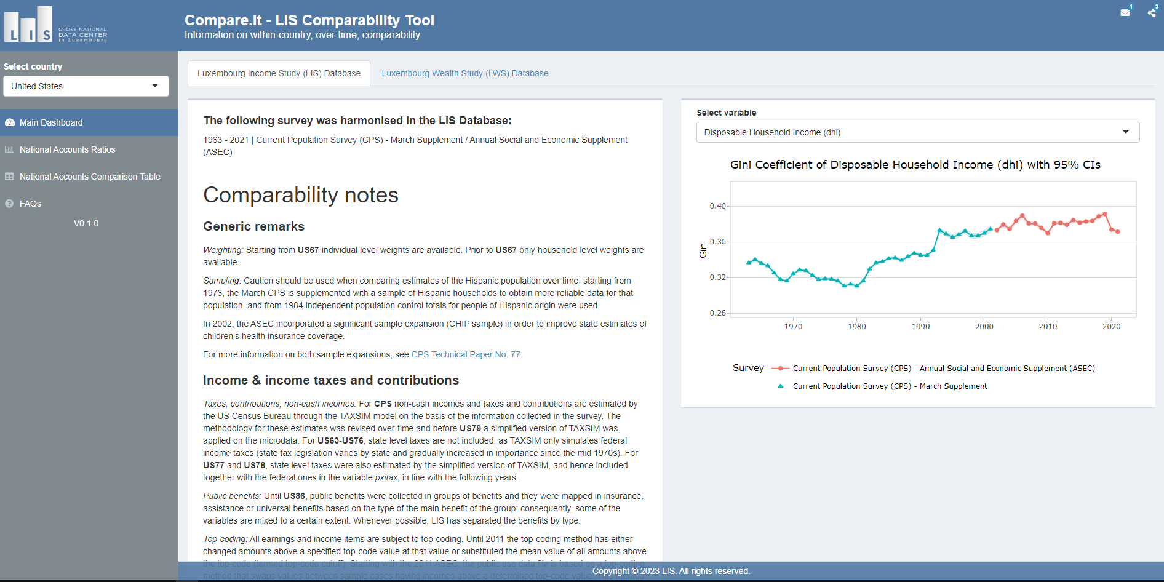
Compare.It Dashboard
Notes:
Two main goals:
Help LIS users (and other users of the same survey series) understand the consistency limitations of data series for income and wealth
Publication of National Accounts Coverage ratios with interactive plots and our methodology
Updated 4 times a year (at each LIS data release)

Slide 18
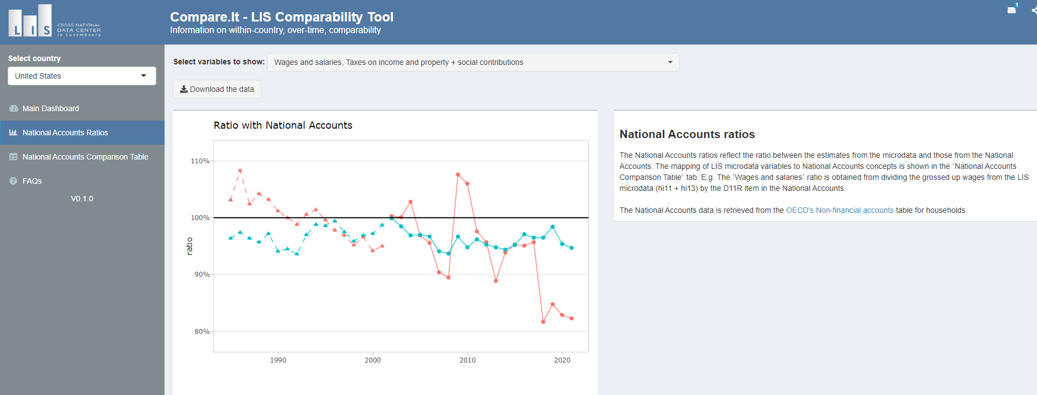
Compare.It Dashboard
https://comparability.lisdatacenter.org/shiny/comparability/

Slide 19
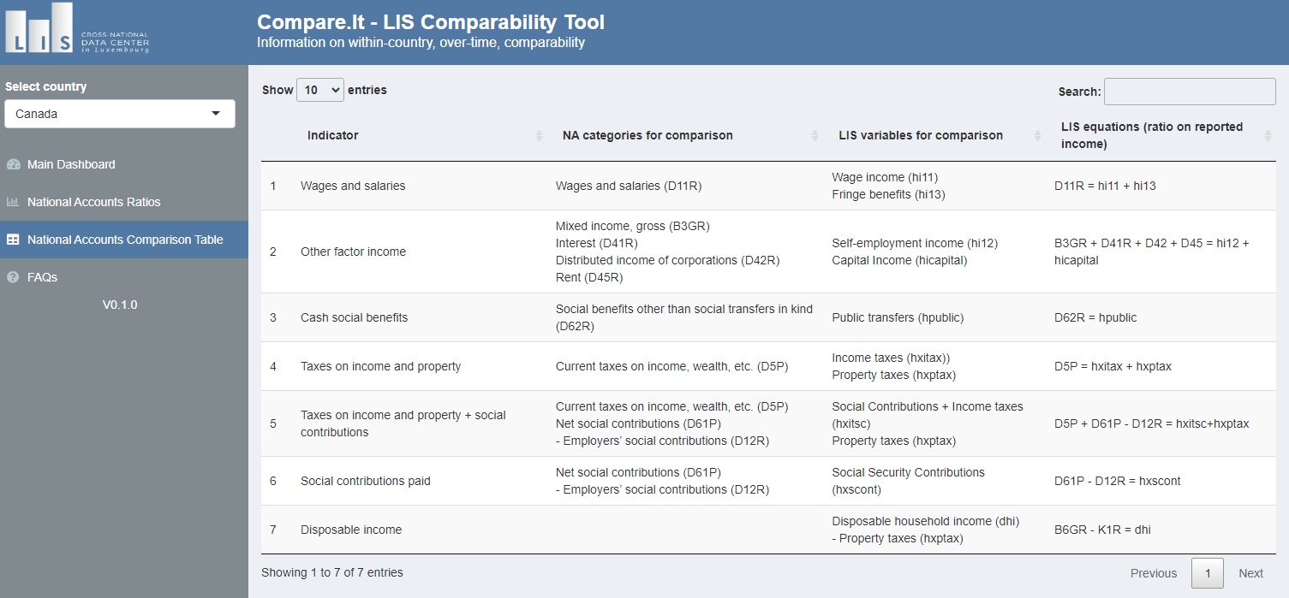
Compare.It Dashboard
Notes:
Relying on the expertise of the network (Jorrit and Jo).

Slide 20
Compare.It Dashboard
In September:
RESTful API to download the data
Early 2024:
Add coverage ratios for wealth variables

Slide 21
R package - {nationalaccountslis}
Goals:
Transparency: show how we computed the coverage ratios in Compare.It
Help LIS users link the microdata to National Accounts
Flexibility: should give useful defaults and be customizable at the same time.
Future: help LIS users make adjustments to microdata
Status:
An Alpha version is currently online.
Will be published and publicized in September, together with tutorial.

Slide 22
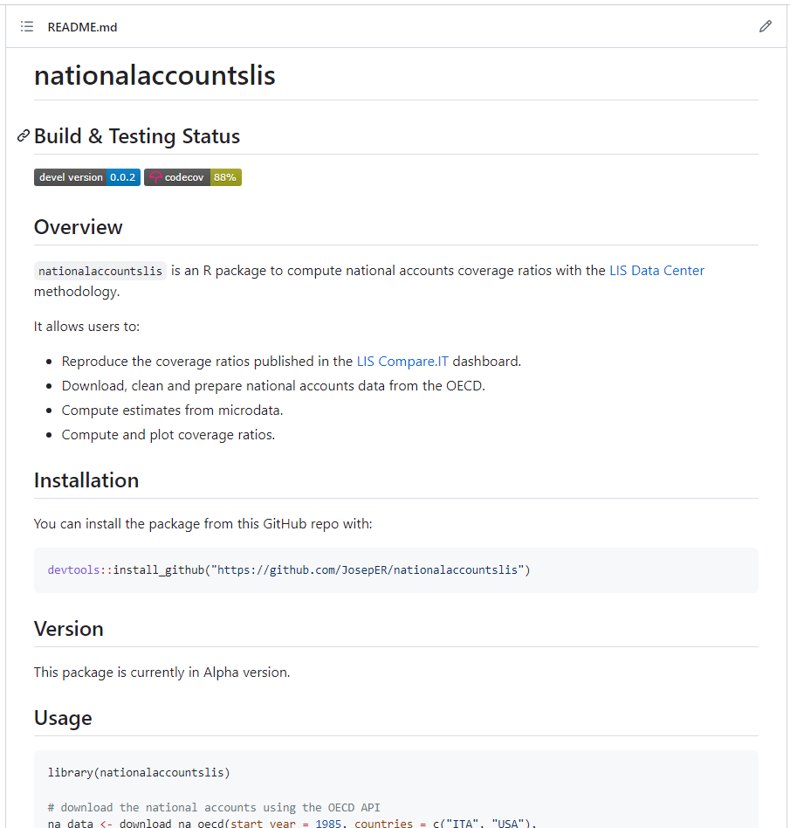

R package - {nationalaccountslis}
github.com/LIS-Cross-National-Data-Center/nationalaccountslis

Slide 23
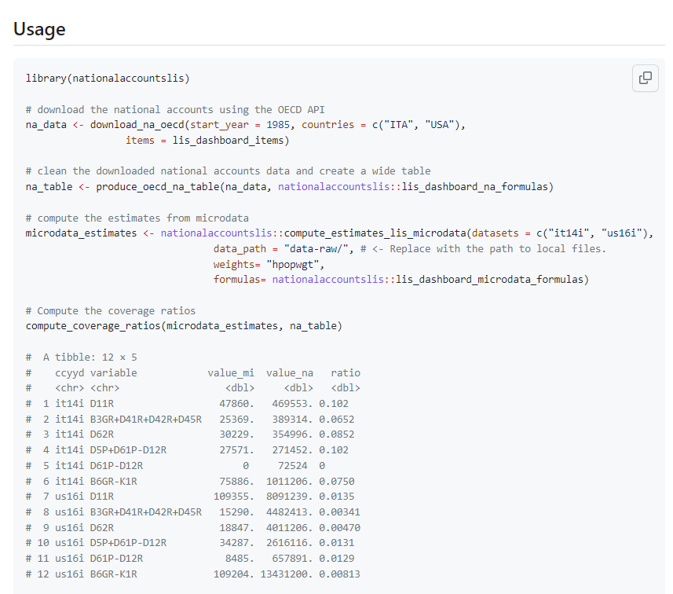
R package - {nationalaccountslis}
github.com/LIS-Cross-National-Data-Center/nationalaccountslis

Slide 24
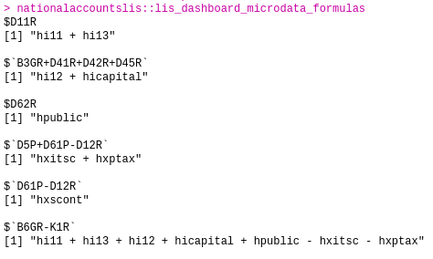
R package - {nationalaccountslis}
github.com/LIS-Cross-National-Data-Center/nationalaccountslis
Notes:
Future: S7.

Slide 25
Current and future work
Currently working on:
Linking wealth microdata to National Accounts
Expanding the number of income items linked
Expected in 2024:
Exploration of consumption linkage
Notes:
Adding more categories to the income linkage/dashboard table. Relying on the expertise of the network (Jorrit and Jo).
Consumption as welfare measure of well-being.

Slide 26
Thank you for your attention Questions are welcome !

