Slide 1
ATE MPF32020
May 2022

Slide 2
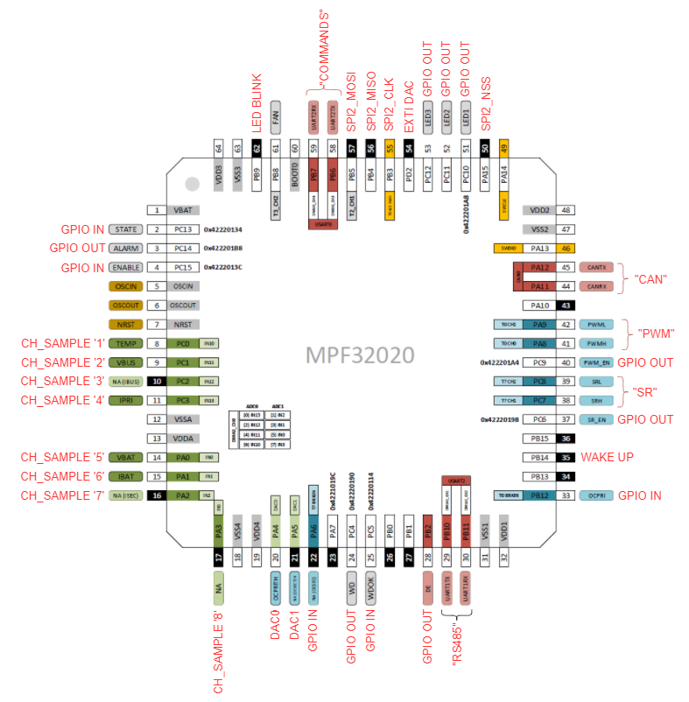
Pinout

Slide 3
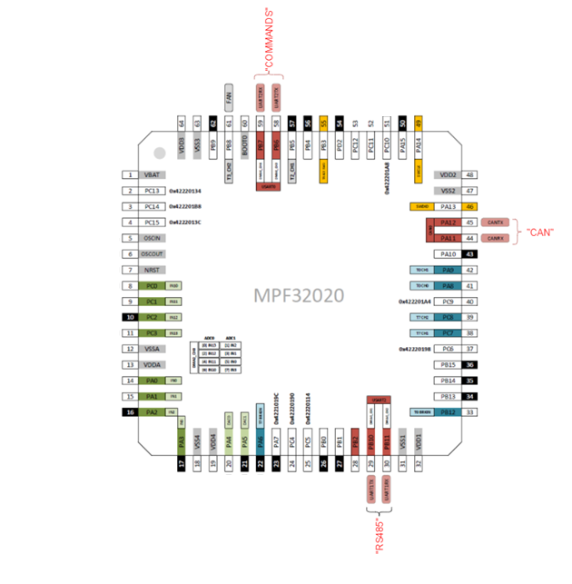
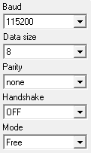
UART & CAN & SPI Module
Commands | Binary Command | Description | Atribute IN | Atribute OUT | Example | Example
PWM ON | 0x10 0x05 | Turn ON PWM_L, PWM_H | none | pwm change & text | PWM ON | 0x10 0x05
PWM OFF | 0x10 0x0A | Turn OFF PWM_L, PWM_H | none | pwm change & text | PWM OFF | 0x10 0x0A
PWM FREQ <value_freq> | 0x10 0xFC 0x<value_high> 0x<value_low> | Change the PWM frequency to the <value> one, defined in kHz | <value> | pwm change & text | PWM FREQ 20 | 0x10 0x50 0x14
PWM DT <value> | 0x10 0xD1 0x<value> | Change the PWM deadtime to <value>, when the deadtime is <value>*(1/freq) | <value> | pwm change & text | PWM DT 5 | 0x10 0xA0 0x05
PWM DC <value> | 0x10 0xDC 0x<value> | Change the duty cicle, value has to be between 0 and 100 | <value> | pwm change & text | PWM DC 50 | 0x10 0xDC 0x32
SR ON | 0x11 0x05 | Turn ON SRL, SRH
SR OFF | 0x11 0x0A | Turn OFF SRL, SRH
SR FREQ <value_freq> | 0x11 0xFC 0x<value_high> 0x<value_low> | Change the SR frequency to the <value> one, defined in kHz
SR DT <value> | 0x11 0xD1 0x<value> | Change the SR deadtime to <value>, when the deadtime is <value>*(1/freq)
SR DC <value> | 0x11 0xDC 0x<value> | Change the duty cicle, value has to be between 0 and 100
ADC START_CH <value> | 0xAD 0x37 0x<value> | Set ADC channel to be sampled | <value> | text & values (SPI) | ADC START_CH 3 | 0xAD 0x37 0x03
ADC STOP | 0xAD 0x30 | Stops ADC sampling | none | test | ADC STOP | 0xAD 0x30
UART0
Commands
UART2
RS485
Response : “Hello MPF32020”
CAN
Response: “MPS” or 0x4D 0x50 0x53
SPI
Used on DAC or ADC with EXTI input
UART0 & 2 Configuration
SPI Configuration
freq -> 15MHz Endian -> MSB Frame_Size -> 8bit Polarity -> SPI_CK_PL_LOW_PH_1EDGE
CAN Configuration
Baudrate -> 500KBps

Slide 4
UART & CAN Module
Commands | Binary Command | Description | Atribute IN | Atribute OUT | Example | Example
DAC0 <value> | 0xDC 0x<value_H> 0x<value_L> | Actualize the DAC0 value to <value>, output value will be Vout = (<value>/4096)*3,2
DAC1 <value> | 0xDD 0x<value_H> 0x<value_L> | Actualize the DAC1 value to <value>, output value will be Vout = (<value>/4096)*3,3 | <value> | gpio change & text | DAC 1035 | 0xDC 0x0D 0xE9
GPIO READ | 0x6F 0x7D | Send the state of all input GPIO and SYNC_IN | none | text | GPIO READ | 0x6F 0x7D
GPIO VIL_VIH | 0x6F 0x7F | Configure all the pin as input and return their value | none | text | GPIO VIL_VIH | 0x6F 0x7F
GPIO NORMAL | 0x6F 0xA4 | Reset the pin configuration to their default. | none | text | GPIO NORMAL | 0x6F 0xA0
GPIO MIDDLE1 | 0x6F 0x85 | Configure some pins as input and other as output, output ones will be pulled high | none | gpio change & text | GPIO MIDDLE1 | 0x6F 0x85
GPIO MIDDLE2 | 0x6F 0x58 | Configure some pins as input and other as output, output ones will be pulled high | none | gpio change & text | GPIO MIDDLE2 | 0x6F 0x58
UART TM | 0xCA | Send TM message over RS485 (UART2) | none | text | UART TM | 0xCA
CAN TM | 0xC5 | Send TM message over CAN | none | text | CAN TM | 0xC5
FAN ON | 0xFA 0xF0 | Turn ON FAN |  |  | FAN ON | 0xFA 0xF0
FAN OFF | 0xFA 0x0F | Turn OFF FAN |  |  | FAN OFF | 0xFA 0x0F
FAN DC <value> | 0xFA 0xDC 0x<value> | Change the FAN frequency to the <value> one, defined in kHz | <value> |  | FAN DC 80 | 0xFA 0xDC 0x20

Slide 5
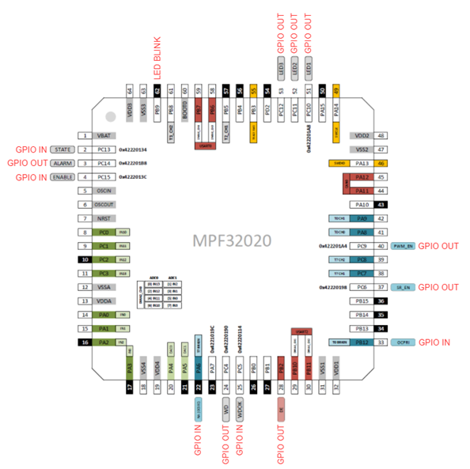
GPIO Module
Commands | Binary Command | Description | Atribute IN | Atribute OUT | Example | Example
GPIO READ | 0x6F 0x7D | Send the state of all input GPIO and SYNC_IN | none | text | GPIO READ | 0x6F 0x7D
GPIO VIL_VIH | 0x6F 0x7F | Configure all the pin as input and return their value | none | text | GPIO VIL_VIH | 0x6F 0x7F
GPIO NORMAL | 0x6F 0xA4 | Reset the pin configuration to their default. | none | text | GPIO NORMAL | 0x6F 0xA0
GPIO MIDDLE1 | 0x6F 0x85 | Configure some pins as input and other as output, output ones will be pulled high | none | gpio change & text | GPIO MIDDLE1 | 0x6F 0x85
GPIO MIDDLE2 | 0x6F 0x58 | Configure some pins as input and other as output, output ones will be pulled high | none | gpio change & text | GPIO MIDDLE2 | 0x6F 0x58
Middle connections (input -> output)
ALARM <-> SRH
WD <-> FAN
USART_DE <-> TEMP
SR_EN <-> VBUS
PWM_EN <-> NA(IBUS)
LED1 <-> IPRI
LED2 <-> VBAT
LED3 <-> IBAT
STATE <-> NA(ISEC)
ENABLE <-> NA
NC(OCSEC) <-> OCPRITH
WD_OK <-> NA(OCSEC)
OCPRI <-> UART2_TX
PWML <-> UART2_RX
PWMH <-> CAN_TX
SRL <-> CAN_RX
Middle 1
input -> output
Middle 2
output <- input

Slide 6
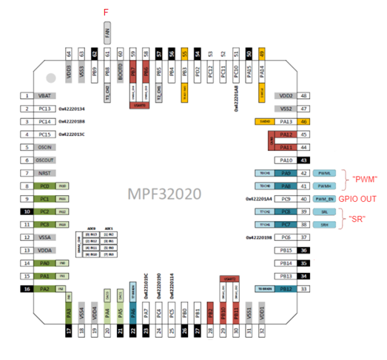
PWM & SR & FAN Module
Commands | Binary Command | Description | Atribute IN | Atribute OUT | Example | Example
PWM ON | 0x10 0x05 | Turn ON PWM_L, PWM_H | none | pwm change & text | PWM ON | 0x10 0x05
PWM OFF | 0x10 0x0A | Turn OFF PWM_L, PWM_H | none | pwm change & text | PWM OFF | 0x10 0x0A
PWM FREQ <value_freq> | 0x10 0xFC 0x<value_high> 0x<value_low> | Change the PWM frequency to the <value> one, defined in kHz | <value> | pwm change & text | PWM FREQ 20 | 0x10 0x50 0x14
PWM DT <value> | 0x10 0xD1 0x<value> | Change the PWM deadtime to <value>, when the deadtime is <value>*(1/freq) | <value> | pwm change & text | PWM DT 5 | 0x10 0xA0 0x05
PWM DC <value> | 0x10 0xDC 0x<value> | Change the duty cicle, value has to be between 0 and 100 | <value> | pwm change & text | PWM DC 50 | 0x10 0xDC 0x32
SR ON | 0x11 0x05 | Turn ON SRL, SRH
SR OFF | 0x11 0x0A | Turn OFF SRL, SRH
SR FREQ <value_freq> | 0x11 0xFC 0x<value_high> 0x<value_low> | Change the SR frequency to the <value> one, defined in kHz
SR DT <value> | 0x11 0xD1 0x<value> | Change the SR deadtime to <value>, when the deadtime is <value>*(1/freq)
SR DC <value> | 0x11 0xDC 0x<value> | Change the duty cicle, value has to be between 0 and 100
FAN ON | 0xFA 0xF0 | Turn ON FAN |  |  | FAN ON | 0xFA 0xF0
FAN OFF | 0xFA 0x0F | Turn OFF FAN |  |  | FAN OFF | 0xFA 0x0F
FAN DC <value> | 0xFA 0xDC 0x<value> | Change the FAN frequency to the <value> one, defined in kHz | <value> |  | FAN DC 80 | 0xFA 0xDC 0x20
PWM & SR -> change frequency, duty cycle and deadtime
FAN -> should be approx. 66666 Hz and 50% of duty

Slide 7
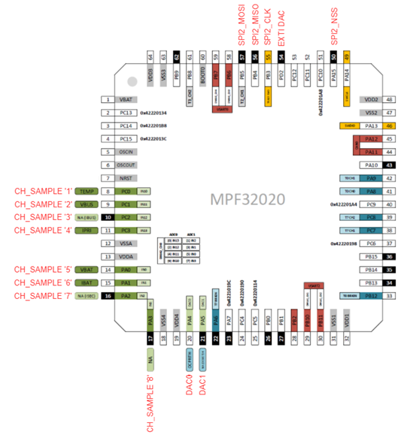
ADC & DAC Module
Commands | Binary Command | Description | Atribute IN | Atribute OUT | Example | Example
ADC START_CH <value> | 0xAD 0x37 0x<value> | Set ADC channel to be sampled | <value> | text & values (SPI) | ADC START_CH 3 | 0xAD 0x37 0x03
ADC STOP | 0xAD 0x30 | Stops ADC sampling | none | test | ADC STOP | 0xAD 0x30
DAC0 <value> | 0xDC 0x<value_H> 0x<value_L> | Actualize the DAC0 value to <value>, output value will be Vout = (<value>/4096)*3,2
DAC1 <value> | 0xDD 0x<value_H> 0x<value_L> | Actualize the DAC1 value to <value>, output value will be Vout = (<value>/4096)*3,3 | <value> | gpio change & text | DAC 1035 | 0xDC 0x0D 0xE9

Slide 8
Test list (1/3)
CHECK SLIDE 5 IN ORDER TO KNOW MORE ABOUT THE I/O CONECTIONS OR COMMANDS
UART 0
  Tx pin: 58 – PB7
  Rx pin: 59 – PB6
  At startup received message should be similar to: “START OK vX.Y.Z”
    X, Y and Z are numbers, Z is optional.
UART 2:
  Tx pin: 29 – PB10
  Rx pin: 30 – PB11
  Binary command:
    0xCA
  Expected message: “HELLO MPQ32020”
CAN:
  Tx pin: 45 – PA12
  Rx pin: 44 – PA11
  Binary command: 0xC5
  Expected message: “MPS”
GPIO I/O functionality.
  Middle 1
    Binary command: 0x6F85
  Middle 2
    Binary command: 0x6F58
  At the end send follow command:
    0x6FA4

Slide 9
Test list (2/3)
CHECK SLIDE 6 IN ORDER TO KNOW ABOUT THE INVOLVED PINS OR COMMANDS
Test PWM and SR, switch frequency, duty cycle and deadtime to verify the correct behavior.
  Turn on the module
    PWM: 0x1005
    SR: 0x1105
  Change Frequency = 10, 35, 100, 200, etc [kHz]
    PWM binary command (10kHz): 0x10FC000A
    SR binary command (10kHz): 0x11FC000A
  Change DC = 10, 20 ,30, etc [%DC]
    PWM binary command(10%): 0x10DC0A
    SR binary command(10%): 0x11DC0A
  Change DT
    PWM binary command (approx. 9ns): 0x10D101
    SR binary command (approx. 9ns): 0x11D101
  When finished send follow command:
    PWM: 0x100A
    SR: 0x1105
Test FAN.
  Turn on the module
    0xFAF0
  Measure frequency : should be 66,6 [kHz]
  Measure DC : should be 50 [%DC]
  When finish send the following command:
    0xFA0F

Slide 10
Test list (3/3)
CHECH THE SLIDE 7 IN ORDER TO KNOW ABOUT THE INVOLVED PINS OR COMMANDS
Test ADC, test different values, if the sampled values are nearly the same, ok.
  Set the Channel to be sampled
    Example channel1 0xAD3701
  Set an analog value and use EXTI pin to trigger sample
  Read over SPI
    Example read 0x0168, ADC read -> 0x168 LSB
  Change input value and go back to step 2, if finished go to step 5
  If all channels test send following command, else go to step 1 and change channel to be sampled.
    0xAD30
Test DAC
  Turn on the module and set first value
    Example DAC1 (0V): 0xDC0000
    Example DAC2 (0V): 0xDD0000
  Send over SPI following values
    Example SPI: 0x0158, new DAC value -> 0x158 LSB
  To stop send over SPI following data:
    0xC7C7

