Slide 1
Q
CONFIDENTIAL DISCUSSION DECK | MAY 2026
QUARRY
Autonomous Threat Hunting for the Post-Mythos Era
Q
A governed agentic investigation platform for financial-sector cyber defense.
Confidential
Prepared for strategic partner discussion
Demo: https://quarry.12brain.org
01/12

Slide 2
Q
THE MYTHOS MOMENT
APR
April 7, 2026 changed the threat-hunting clock.
07
Frontier agents are now credible enough to compress vulnerability discovery, exploitation, and defensive response cycles.
2026
• Anthropic disclosed Claude Mythos Preview and Project Glasswing, explicitly framing the launch as a security watershed.
• The Federal Reserve later cited Mythos at an FSOC AI / cybersecurity roundtable as evidence of rapidly evolving capability.
• The implication for financial institutions is operational: investigation workflows must move from analyst-hours to machine-minutes while remaining auditable.
Sources: Anthropic Red Team, Apr 7 2026; Federal Reserve Bowman speech, May 1 2026.
02/12

Slide 3
Q
THE WINDOW
The next 6-12 months are the adoption window.
6-12
Regulators are turning AI-cyber guidance into operating expectations while attackers gain agentic leverage first.
months
• Treasury launched public-private AI cybersecurity resources for financial services in 2026.
• Treasury's earlier AI cybersecurity report identified immediate operational risk, cybersecurity, and fraud challenges.
• The buyer will not want a chatbot. The buyer will want governed autonomy: provenance, cost control, reproducibility, and policy guardrails.
Positioning rule: auditable autonomy beats unsupervised autonomy.
Sources: U.S. Treasury AI cybersecurity initiative, Feb 18 2026; Treasury AI cybersecurity report, Mar 27 2024.
03/12

Slide 4
Q
THE GAP
Hunters cannot scale linearly with telemetry.
The industry has more alerts, more tools, more data, and fewer people who can connect it all under time pressure.
Telemetry
Tools
Hunters
Reports
MORE VOLUME
MORE SURFACE
SAME BOTTLENECK
LATE EVIDENCE
current SOC reality
current SOC reality
current SOC reality
current SOC reality
• SIEM / EDR / cloud logs are searchable, but the investigation work is still mostly human orchestration.
• Senior hunters are the bottleneck: hypothesis generation, query selection, evidence correlation, and report writing.
• Static detections miss the operating need: turning a vague brief into a defensible investigation trail.
Sources: Microsoft SecRL benchmark framing; Quarry architecture docs.
04/12

Slide 5
Q
THE SOLUTION
Quarry turns a brief into governed investigation work.
An agentic hunting platform that decomposes the brief, queries telemetry, correlates evidence, and writes the report with a ledger.
Brief
->
Hypotheses
->
Federated Search
->
Evidence Ledger
->
Report
Governed
Traceable
Measurable
POLICY GUARDRAILS AND READ-ONLY EVALUATION PATHS.
EVERY QUERY AND CONCLUSION IS WRITTEN TO THE INVESTIGATION LEDGER.
TIME, TOKENS, COST, AND ACCURACY BECOME PRODUCT METRICS.
design principle
design principle
design principle
Source: Quarry product architecture and demo build.
05/12

Slide 6
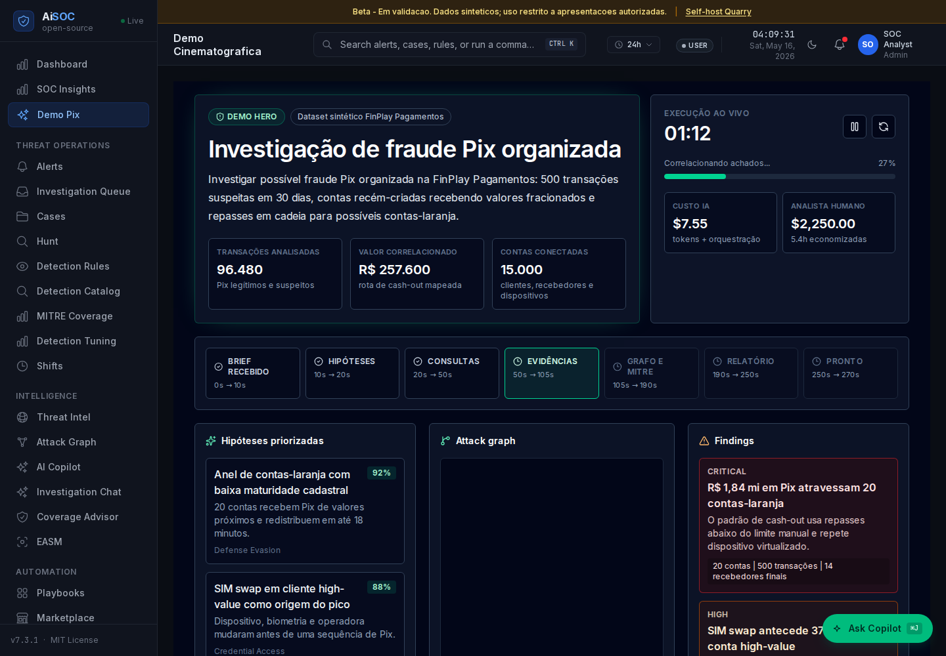
Q
HOW IT WORKS
The analyst sees a live investigation, not a black box.
Brief, hypotheses, data queries, findings, graph, MITRE coverage, cost, and report generation are visible in one flow.
• Input: natural-language investigation brief.
• Process: hypotheses -> connector queries -> evidence ledger -> report.
• Output: analyst-ready narrative with supporting artifacts.
Brief
->
Hypotheses
->
Federated Search
->
Evidence Ledger
->
Report
Source: Quarry public demo screenshot captured May 16 2026.
06/12

Slide 7
Q
THE PROOF
SecRL smoke run: 8/8 scenarios correct.
A pitch-grade regression run against Microsoft's cyber threat investigation benchmark, using the Quarry SQL investigation adapter.
8/8
8.54s
95,460
$0.243
CORRECT SCENARIOS
AVG TIME
TOKENS
COST
one question per incident
brief to answer
total run
estimated total
• Model: gpt-4o; evaluator: gpt-4o; temperature: 0; max steps: 25.
• Scope note: this is an 8-scenario pitch smoke run, not the full official question-set claim.
Conservative claim: early evidence of fit, not a completed official benchmark certification.
Sources: docs/benchmarks/microsoft-secrl-results.md; microsoft/SecRL GitHub.
07/12

Slide 8
Q
THE BEACHHEAD
Brazilian fintechs are the first wedge.
Pix created a national-scale real-time payment environment where fraud, identity, mobile, and infrastructure signals converge.
+170M
+7B
+R$3T
INDIVIDUAL PIX USERS
PIX TRANSACTIONS
MONTHLY VOLUME
BCB public stats
January 2026
October 2025
• Demo persona: FinPlay Pagamentos, a fictitious Sao Paulo fintech with 50,000 active customers.
• Synthetic 30-day dataset covers Pix, mobile banking auth, Open Finance, boleto creation, and injected fraud campaigns.
• Initial use case: Pix fraud and account-takeover investigations that require fast correlation and an auditable report.
Sources: Banco Central do Brasil Pix statistics; CARD-009 synthetic dataset.
08/12

Slide 9
Q
THE TEAM
Founder-led product, partner-scaled distribution.
The right early team pairs Brazilian market access with global enterprise-security credibility.
Jose
Meta partner
Operating model
PRODUCT VISION | BRAZILIAN MARKET ACCESS | OPERATOR DISCOVERY
ENTERPRISE CREDIBILITY | SECURITY NETWORK LEVERAGE | STRATEGIC DISTRIBUTION
DEMO FIRST | BENCHMARK VISIBLE | PILOT DISCIPLINED
role
role
role
• Jose / Increase Trainer: product vision, Brazilian market access, and hands-on operator discovery.
• Meta co-founder partner: enterprise credibility, security-network leverage, and strategic distribution.
• Operating model: narrow wedge, visible demo, measurable benchmark, then regulated pilot.
Source: founder / partner operating thesis.
09/12

Slide 10
Q
THE ROADMAP
BR -> US -> Global, with evidence gates at each step.
The roadmap protects credibility by pairing expansion with benchmark, security, and deployment milestones.
Q2 2026
Q3 2026
Q4 2026
H1 2027
PUBLIC DEMO | BR SYNTHETIC FINTECH | SECRL SMOKE RUN
FULL SECRL RUN | SOC CONNECTORS | FIRST BR PILOT
COMPLIANCE HARDENING | US FINANCE BEACHHEAD | PARTNER PACKAGING
GLOBAL PILOTS | CHANNEL MOTION | ENTERPRISE CONTROLS
milestone gate
milestone gate
milestone gate
milestone gate
Rule: every expansion step ships with a repeatable demo, benchmark evidence, and operational runbook.
Source: Quarry product roadmap, May 2026.
10/12

Slide 11
Q
THE ASK
Structure the partnership now.
The near-term ask is not broad fundraising. It is a focused partnership discussion tied to diligence and pilot execution.
• Align on co-founder / advisor / equity structure and operating responsibilities.
• Run 30-day technical diligence: public demo, architecture, SecRL harness, and synthetic fintech dataset.
• Define 60-day pilot path with one Brazilian fintech or MSSP and one enterprise-security design partner.
• Decision point: strategic partnership, seed vehicle, or customer-led buildout.
Week 1
Day 30
Day 60
ALIGNMENT
DILIGENCE
PILOT DECISION
partnership terms
technical evidence
customer path
Source: proposed partnership timeline.
11/12

Slide 12
Q
CLOSING
Human-speed teams are entering machine-speed investigations.
Quarry is the control plane that keeps autonomous hunting useful, governed, and defensible.
• Live demo: https://quarry.12brain.org
• Backup artifacts: docs/pitch/quarry-v1.pdf and docs/pitch/quarry-v1.pptx
• Next steps: partner diligence, full SecRL question-set run, first regulated pilot.
Q
quarry.12brain.org
Sources: Quarry demo and source notes in docs/pitch/quarry-v1-sources.md.
12/12

