Slide 1
Impact of Recession on Retail
Team 5
Mentor:Varun
Team members: Harish, Pratheek,Joseph,Sarthak

Slide 2
Project Architecture / Project Flow
🞑1.start with Business Problem
🞑2. Get and Clean the Data
🞑3. Perform EDA
🞑4. Apply a suitable machine learning algorithm
🞑5. Insights and Deployment

Slide 3
Business Problem:
Business Objective:
Predict who is likely to shop next month. Highlight factors that impact likelihood of customer shopping next month. For each customer shopped during 12/1/2009 till 11/9/2011, you must predict the likelihood of customer shopping next month.
Data Set Details:
The dataset contains ~2 years of transaction data for e-commerce retailer to be used for building a model. -Data set details sent in excel file.
Your task is to predict for all customers who shopped at-least once during 12/1/2009 till 11/9/2011, who will come back to buy any product next month (11/9/2011 – 12/9/2011).

Slide 4
Exploratory Data Analysis (EDA) and
Feature Engineering

Slide 5
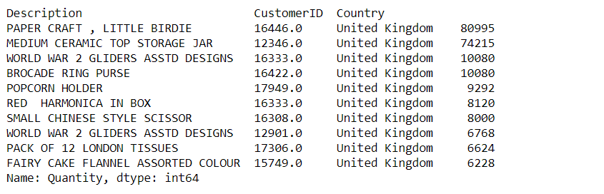
Data set details
●541909 entries , 8 Columns
●Customer ID Column has 135080 missing values and Description column has 1454 missing values.
●Customer ID,InvoiceDate, StockCode are important input data.
●Top 10 Quantities of products sold:

Slide 6
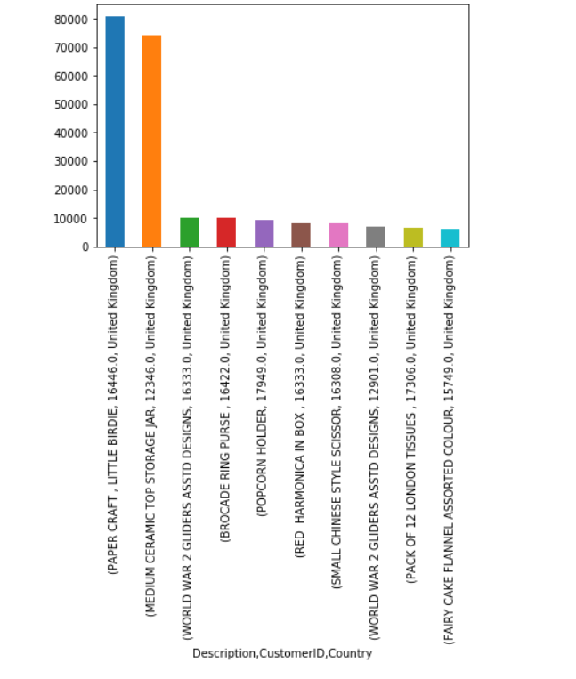
Top 10 Quantities of products sold

Slide 7
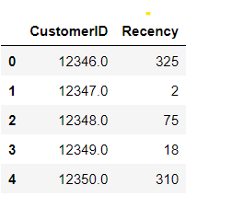
Recency
How many days ago was the customer’s last purchase(in days)?
Recency Table Head(Top 5 records)

Slide 8
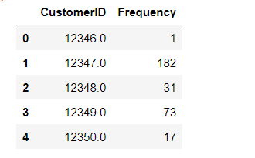
Frequency
How many times a customer purchased from us?
Frequency Table Head(Top 5 records)

Slide 9
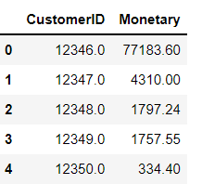
Monetary
How much money did the customer spend over time?
Monetary Table Head(Top 5 records)

Slide 10
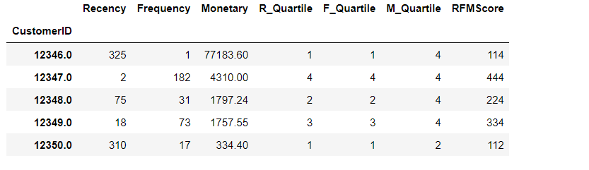
RFM
RFM Table Head(Top 5 values)

Slide 11
K Means Clustering

Slide 12
Model Deployment using R shiny / Flask or any other method

Slide 13
Challenges faced
How did you overcome?

Slide 14
Thank you

