Slide 1
Social Media Data Analysis for Disaster Response using Multi-Modal Deep Learning

Slide 2
Abstract
Multimedia content in social media platforms provides significant information during disaster events. The types of information shared include reports of injured or deceased people, infrastructure damage, and missing or found people, among others.Our proposal includes usage both text and image modalities of social media data to learn a joint representation using state-of-the-art deep learning techniques. Specifically, we utilize convolutional neural networks to define a multimodal deep learning architecture with a modality-diagnostic shared representation. Extensive experiments on real-world disaster datasets show that the proposed multimodal architecture yields better performance than models trained using a single modality (e.g., either text or image). We tried to use Xception transfer learning model for the image classification and Long Short-Term Memory Networks(LSTM) for the analysis of text data. We used this multimodal deep learning modals for better results and efficient analysis.

Slide 3
Problem Statement
To propose a novel framework for disaster analysis that further enhances performance with social media images and tweets. Using social media data for social good requires time-critical analysis of the multimedia content (e.g., textual messages, images, videos) posted during a disaster situation to help humanitarian organizations in preparedness, mitigation, response, and recovery efforts.

Slide 4
Literature Survey
Paper: Damage Identification in Social Media Posts using Multimodal Deep Learning
Officials and volunteers currently monitor social media for any useful information, but this strategy is impractical given that millions of posts are shared every minute. To effectively direct relief resources, our goal is to automate the extraction of information that may be taken action upon from social media posts. First responders can efficiently distribute resources and save as many lives as possible by identifying damage and human casualties. They suggested a multimodal deep learning framework to recognize damage-related information because social media posts on these platforms often include text, photos, and videos.

Slide 5
Paper: Automatic Image Filtering on Social Networks Using Deep Learning and Perceptual Hashing During Crises.
In this paper they suggested an image filtering pipeline that includes filters for identifying redundant (duplicate) photos in the incoming social media data stream as well as irrelevant photographs. They employed a transfer learning strategy based on cutting-edge deep neural networks to remove unimportant visual material. In order to de-duplicate images, they used perceptual hashing methods. To demonstrate the usefulness of our suggested image processing pipeline, they have carried out thorough experiments on a variety of datasets from actual disasters.

Slide 6
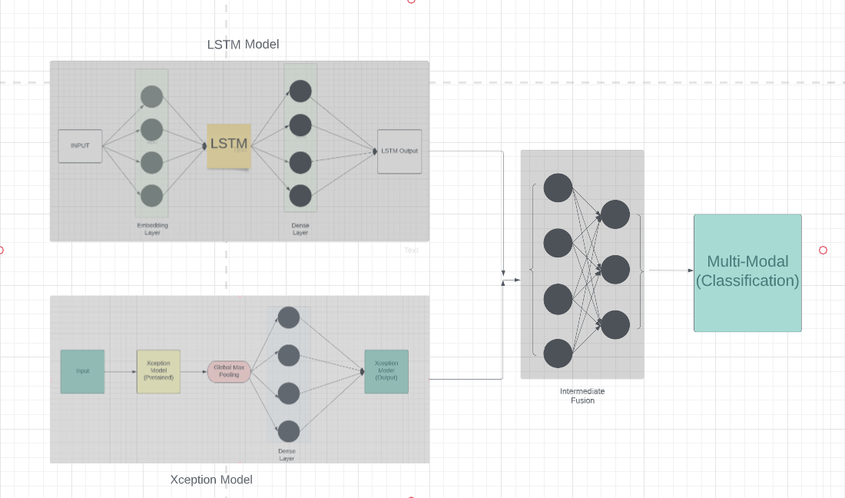
Proposed Model:

Slide 7
Proposed Methodology
The methodology for the LSTM and Xception combined fusion model on the CrisisMMD dataset can be summarized as follows:
Building individual models: An LSTM model was built for text classification, and an Xception model was built for image classification. Both models were trained and evaluated independently.
Intermediate fusion: The output from the LSTM and Xception models were combined using an intermediate fusion approach, where the outputs were concatenated and passed through a fully connected layer with a softmax activation function.
Model training and evaluation: The combined LSTM and Xception model was trained on the preprocessed CrisisMMD dataset and evaluated using various metrics such as accuracy, precision, recall, and F1 score.
Comparison with state-of-the-art models: The performance of the proposed model was compared with other state-of-the-art models on the CrisisMMD dataset.

Slide 8
Block Diagram:
Load Dataset
Text Preprocessing
Image Preprocessing
LSTM Model
Xception Model
Fusion Model using Intermediate Fusion
Classification Report

Slide 9
Dataset:
CrisisMMD Dataset
The CrisisMMD multimodal Twitter dataset consists of several thousands of manually annotated tweets and images collected during seven major natural disasters including earthquakes, hurricanes, wildfires, and floods that happened across different parts of the World.

Slide 10
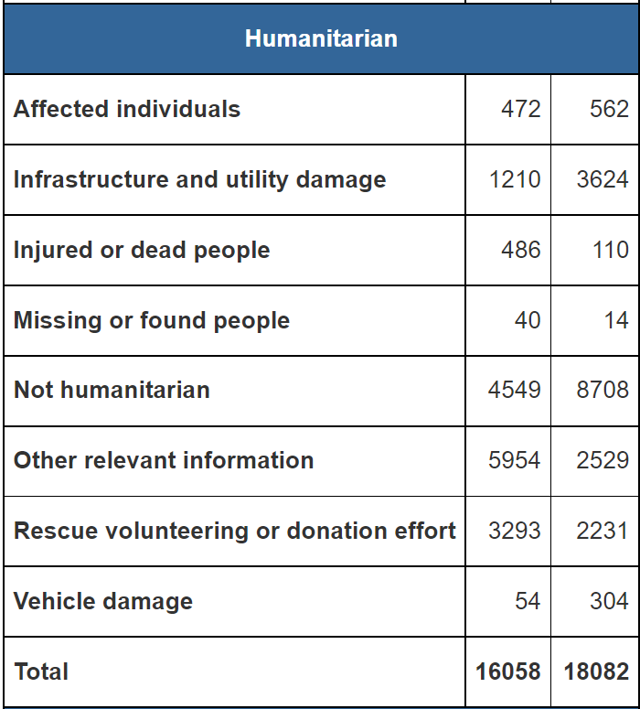
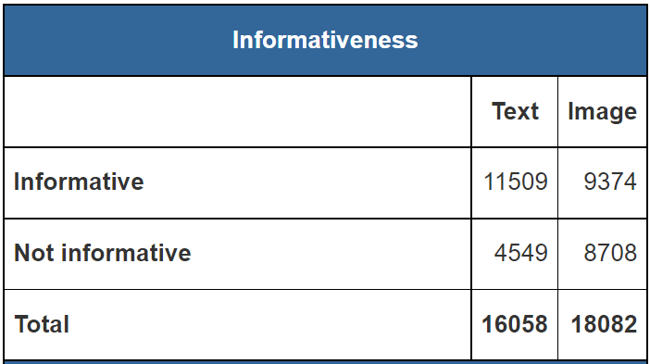
Data Distribution: Task 2:
Task 1:

Slide 11
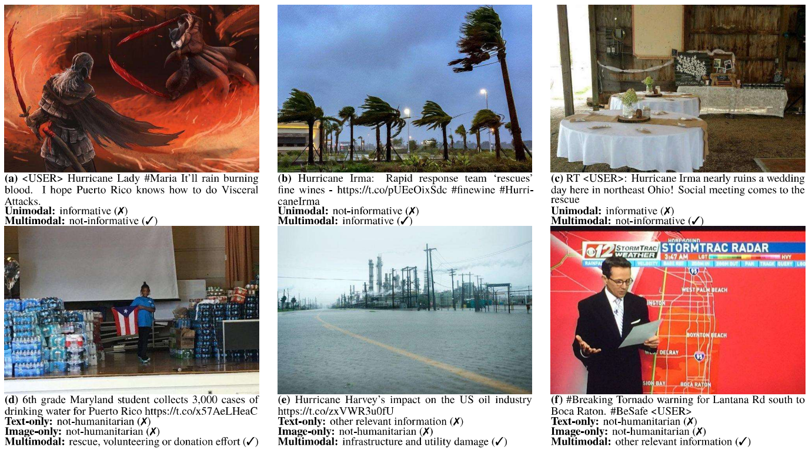

Slide 12
Obtained Results
Results for the informativeness classification task.
Training mode Modality Accuracy Precision Recall F1-score
Text 82 82 81 82
Unimodal Image 78 76 73 74
Multimodal Text + Image 83 83 81 82
Results for the informativeness classification task.
Training mode Modality Accuracy Precision Recall F1-score
Text 81.1
Unimodal Image 73.3
Multimodal Text + Image 70.6 74 70.0
Results for the humanitarian classification task.
Training mode Modality Accuracy Precision Recall F1-score
Text 81.1
Unimodal Image 73.3
Multimodal Text + Image 70.6 70.0 70.0

Slide 13
Obtained Results
Results for the informativeness classification task.
Training mode Modality Accuracy Precision Recall F1-score
Text 81.1
Unimodal Image 73.3
Multimodal Text + Image 70.6 74 70.0
Results for the humanitarian classification task.
Training mode Modality Accuracy Precision Recall F1-score
Text 81.1
Unimodal Image 73.3
Multimodal Text + Image 70.6 70.0 70.0
Results for the humanitarian classification task.
Training mode Modality Accuracy Precision Recall F1-score
Text 71 70 70 70
Unimodal Image 68 68 67 68
Multimodal Text + Image 74 73 72 74

Slide 14
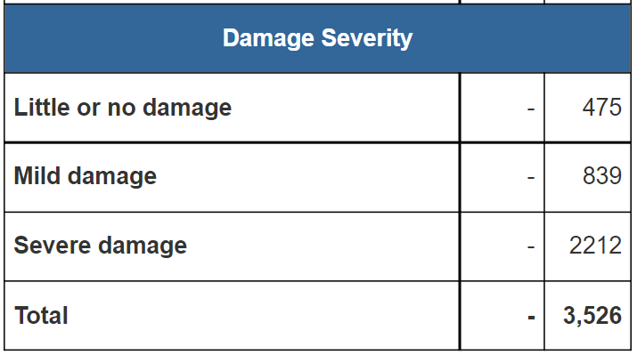
Damage Severity Classification Task:

Slide 15
Obtained Results
Results for the informativeness classification task.
Training mode Modality Accuracy Precision Recall F1-score
Text 81.1
Unimodal Image 73.3
Multimodal Text + Image 70.6 74 70.0
Results for the humanitarian classification task.
Training mode Modality Accuracy Precision Recall F1-score
Text 81.1
Unimodal Image 73.3
Multimodal Text + Image 70.6 70.0 70.0
Results for the damage assessment classification task.
Training mode Modality Accuracy Precision Recall F1-score
Text 57 55 57 56
Unimodal Image 54 58 54 54
Multimodal Text + Image 63 50 54 54

Slide 16
Analysis
Our project is about a combined LSTM and Xception model for text and image classification respectively, applied to the CrisisMMD dataset. The motivation behind combining these models is to take advantage of their respective strengths in handling sequential data and image data.
The intermediate fusion approach was used to combine the two models, where the output of the LSTM model is concatenated with the output of the Xception model, and fed to a fully connected layer for classification.

Slide 17
Conclusion
In conclusion, the combined LSTM and Xception model showed promising results for text and image classification on the CrisisMMD dataset, and has potential for real-world applications in crisis response and management.

Slide 18
Future Scope
In the future, this model could have potential applications in various real-world scenarios, such as disaster management and emergency response. Furthermore, this model can be used for other types of classification problems beyond text and image classification like videos .

Slide 19
THANK YOU!!!

