Slide 1
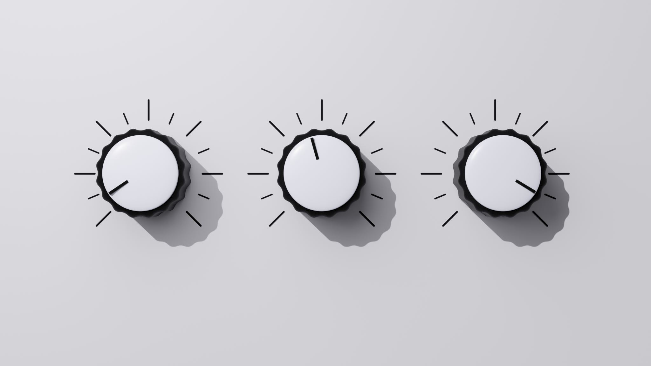
Electricity consumption analyzer

Slide 2
Worked and presented to you by:
Zeyad Saad Abdel-Fattah
Joesph George Wahba
Muhammed Ashraf El-Kateb
Zyad Gamal Saeed
Menna-Allah Ahmed
Abdelhalim Ramadan

Slide 3
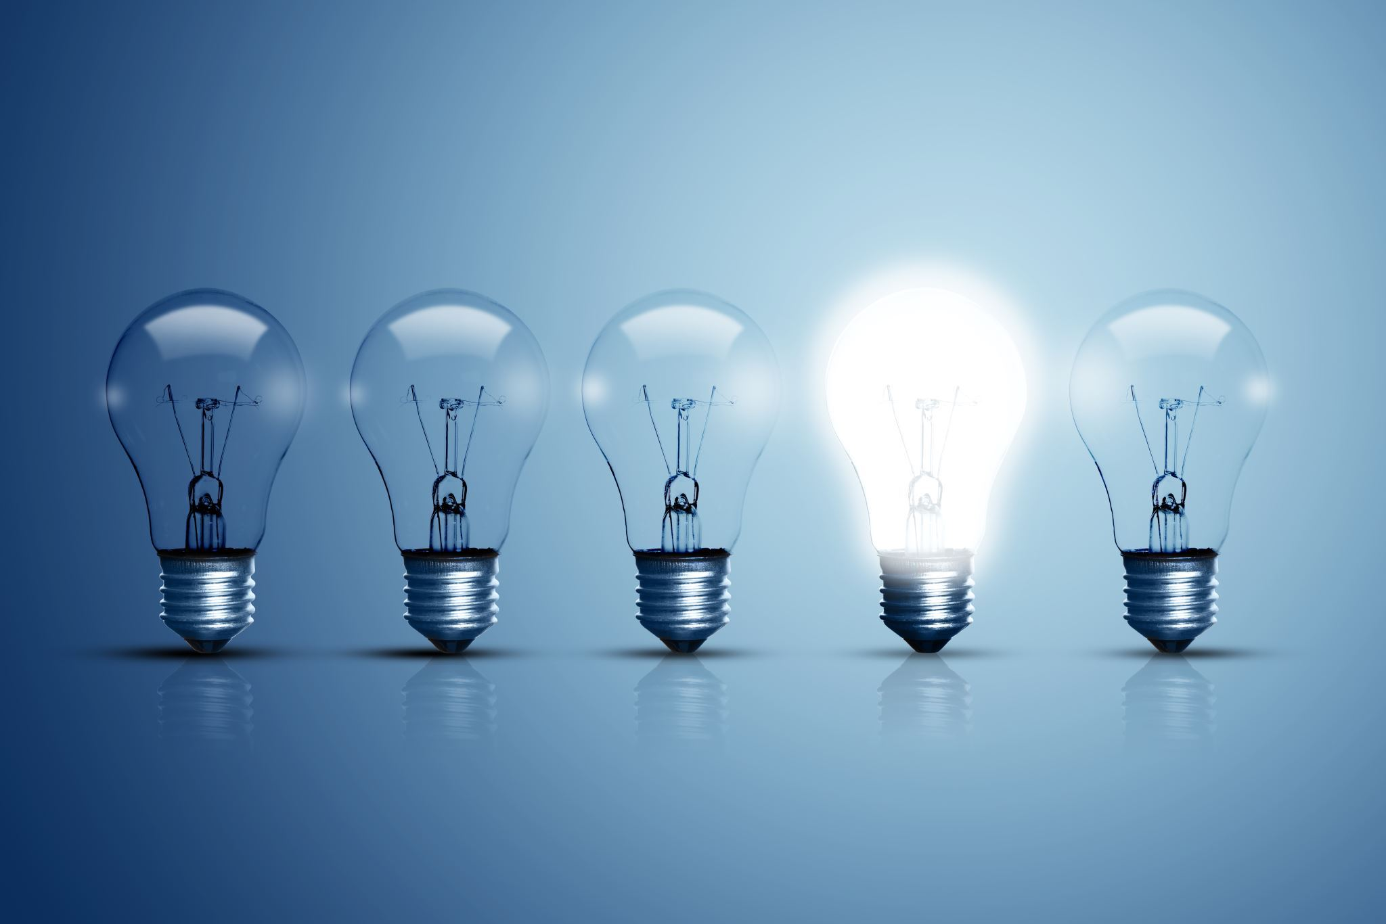
Why to build the system?
How to structure the project?
1. Rising Electricity Costs
Many households struggle with managing their electricity bills due to increasing rates and unpredictable consumption patterns.
2. Lack of Awareness
Users often don’t have a clear understanding of how much electricity they are using until they receive their bill.
3. Environmental Impact
Efficient energy usage can reduce overall consumption, which benefits the environment by lowering carbon footprints.
4. Convenience and Control
The system provides real-time updates on electricity consumption, helping users to stay within their budget and avoid unexpected expenses.
5. AI-Powered Insights
By integrating AI, the system offers personalized tips to optimize energy usage, leading to long-term savings and more energy-conscious behavior.

Slide 4
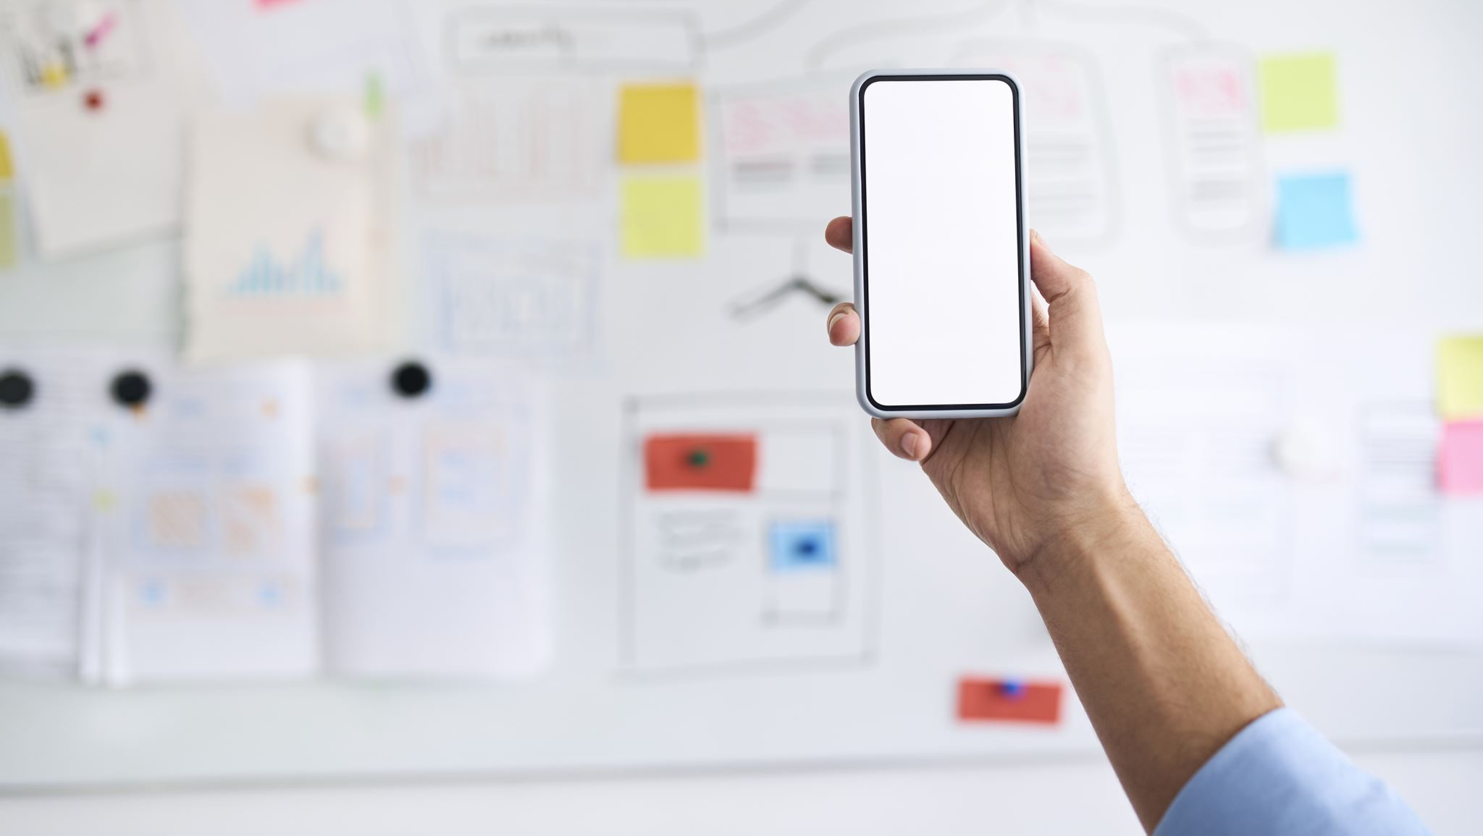
How to structure the project?
1. Requirements Gathering
Identify User Needs: Understand the target audience's pain points regarding electricity consumption and cost management
Define System Requirements: Specify core features such as consumption tracking, notifications, and AI recommendations
2. System Design
App Interface Design: Create an intuitive user interface for tracking consumption and receiving alerts
Backend Development: Design the system’s architecture, focusing on data collection, real-time analysis, and integration with AI algorithms
AI Algorithm Development: Build and train the machine learning model that provides energy-saving tips based on user data
3. Data Collection & Integration
Consumption Data: Collect real-time electricity usage data from smart meters or manual input by users
User Profile Data: Gather data on user habits (e.g., time of peak usage, appliance usage) for AI training

Slide 5
How to structure the project?
4. Development Phases
Phase 1: Prototype Development: Build a functional prototype of the app with core features (usage tracking, alerts).
Phase 2: AI Integration: Implement and train the AI algorithm for personalized energy-saving suggestions.
Phase 3: Testing & Iteration: Conduct user testing to refine features, UI, and the accuracy of AI predictions.
5. Final Implementation and Launch
Testing & Debugging: Ensure system reliability, accuracy, and usability.
Deployment: Launch the application with cloud integration for scalability.
Post-launch Support: Gather feedback and improve the app with new features and updates

Slide 6
Diagrams

Slide 7
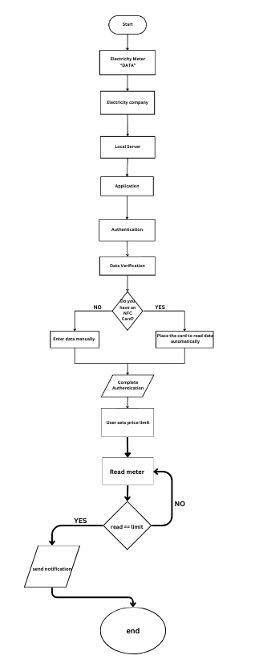
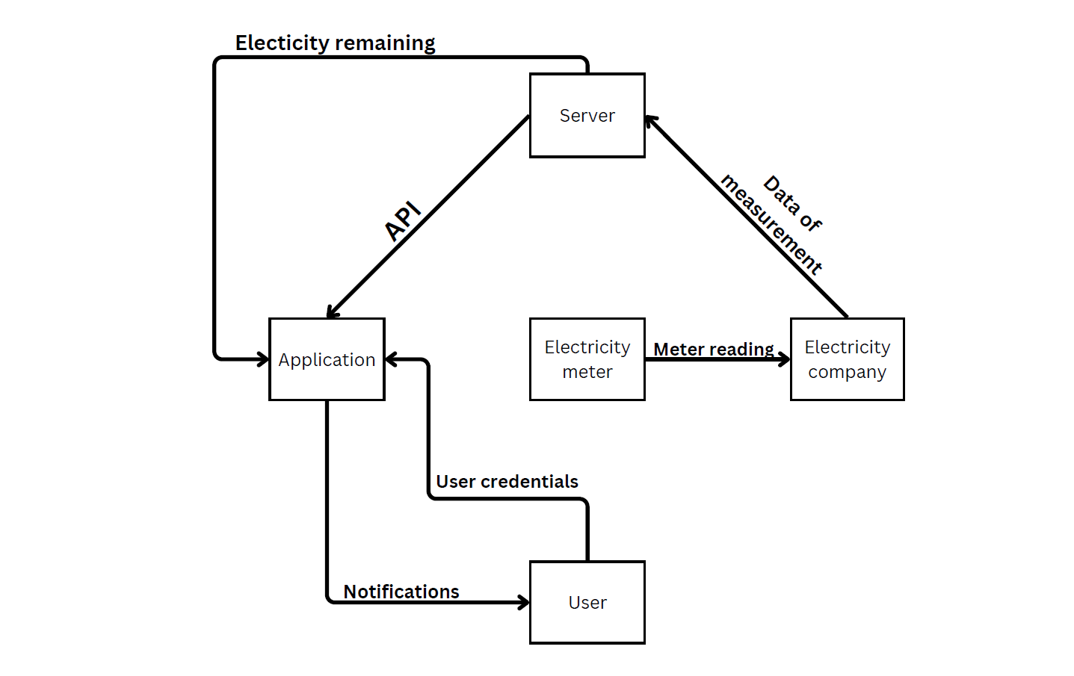
Data Flow
Diagrams

Slide 8
Flow chart
Diagrams

Slide 9
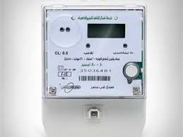
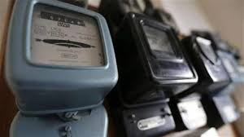
Companies , Meters and cost

Slide 10
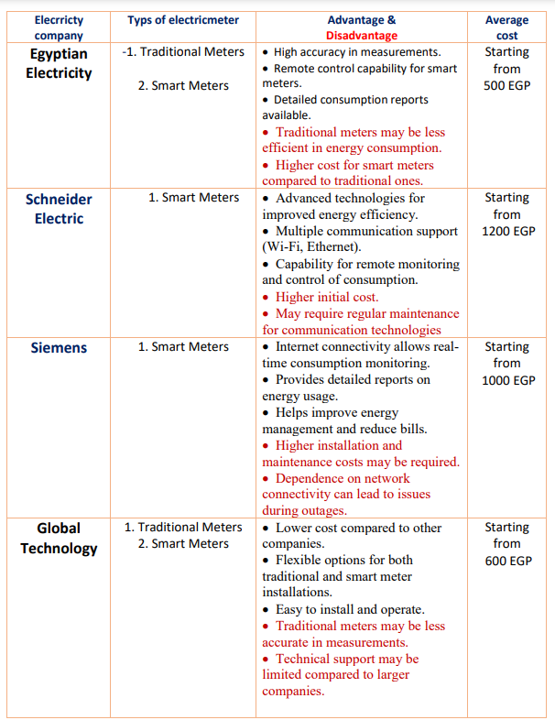
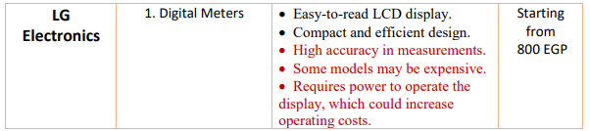
Companies , Meters and cost

Slide 11
Cost

Slide 12
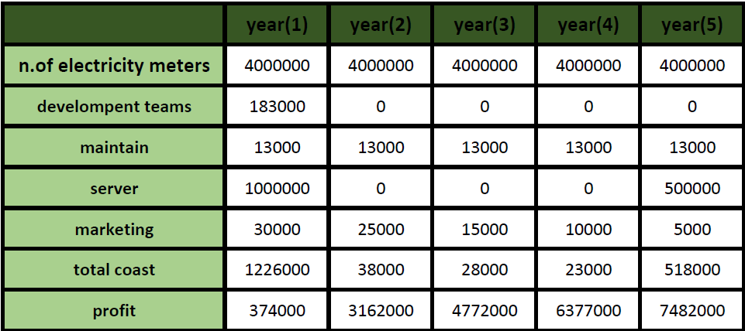

Slide 13
