Slide 1



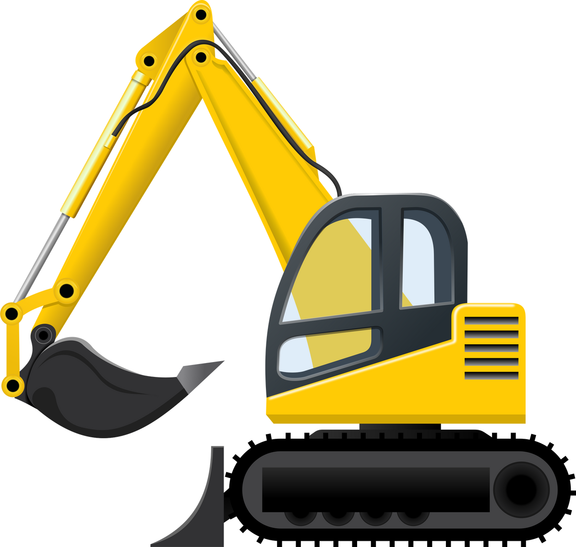

Final Prototype Presentation
Joseph Koop, Enrique Garcia, Kelvin Gordon
Human Computer Interface - SPP7

Slide 2
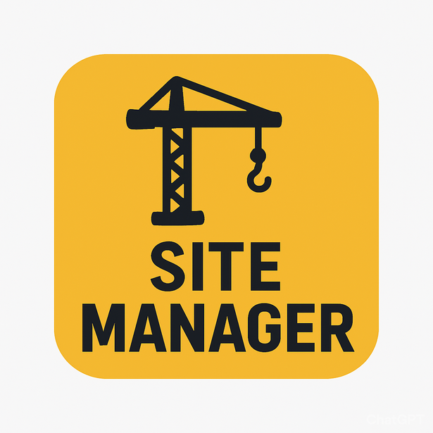

SiteManager
“Right people. Right equipment. Right on time.”

Slide 3
Problem Statement
Construction companies require a digital dashboard to track all projects, employees, and equipment in one centralized location
\

Slide 4
Solution
Our solution is to create a project dashboard and map that links to projects and shows exactly which employees, equipment, and materials are needed at each location.

Slide 5



Tools Used
GitHub (Files and Collaboration)
React + Vite (Front End Framework)
Tailwind (CSS)
JavaScript (Backend Placeholder)

Slide 6
Design Evolution
LoFi Prototype (Paper version)
MediumFi Prototype (Limited functionality and design)
HiFi Prototype (Final Version)

Slide 7
Key Revisions from MedFi
Individual Project Pages
Individual Equipment Pages
Ability to allocate resources
Map View
Improved Design

Slide 8
Features Not Incorporated
Authorization (Role-based privileges)
Manager, Foreman, Mechanic, Employee
Notifications for employees (based on reassignment)
Live tracking for equipment and deliveries

Slide 9
Three Main Tasks
Easy
Medium
Hard
Store the list of heavy equipment and their maintenance records and status, allowing the mechanic to edit as required.
Store the list of all ongoing projects and allow the foreman to see required equipment/materials and upload progress notes.
Show all ongoing projects on an interactive map. Each project contains a list of assigned employees, equipment, and materials that can be edited by the manager.
Mechanic
Foreman
Manager

Slide 10
Prototype
HiFi Prototype

Slide 11
QnA Time

Slide 12
Thank You

