Slide 1

Site Manager
“Right people. Right equipment. Right on time.”

Slide 2


POV and EXP
Human Computer Interface
Semester Project Phase 2
Joseph Koop, Kelvin Gordon, Enrique Garcia

Slide 3
Project Domain
SiteManager is a construction project management app designed for managers and foremen to:
Track employees, equipment, and projects in real time.
Streamline resource allocation and reduce inefficiencies (e.g., misrouting, manual tracking).
Focus on automation to minimize manual data entry and errors.

Slide 4
Initial POV
​​
Construction managers need a digital dashboard to track all projects, employees, and equipment in one place because current systems lack real-time visibility and lead to inefficiencies.
This POV was based on our early observations but lacked specific insights into user pain points like maintenance tracking or material lists.

Slide 5
Needfinding Results
​​
Misrouting is common:
Employees and equipment are frequently sent to the wrong locations.
Quote: “Misplacement happens all the time.” — Gideon Banman
Manual tracking is inefficient:
Paper-based systems for materials and delays are error-prone and time-consuming.
Maintenance records (e.g., oil changes) are not centrally tracked.
Notes:
Not only assigned, but current

Slide 6
Additional Needfinding Results
​​
Live tracking is less critical:
Users prioritized simplicity and automation over real-time GPS tracking.
Drones and equipment condition tracking emerged as unexpected interests.
Notes:
Not only assigned, but current

Slide 7
Revised POVs
​​
Notes:
Not only assigned, but current

Slide 8
POV #1
​​
A construction foreman needs a visual map of project locations and resource allocation because employees and equipment are frequently sent to the wrong sites, causing delays and inefficiencies.
Notes:
Not only assigned, but current

Slide 9
POV #2
​​
An equipment operator needs a system to track maintenance records and material lists per project because manual tracking is error-prone and leads to miscommunication about equipment condition and project needs.
Notes:
Not only assigned, but current

Slide 10
POV #3
​​
A construction manager needs a simplified way to log daily work results and delays because current paper-based systems are inefficient and don’t provide real-time insights into project progress.
Notes:
Not only assigned, but current

Slide 11
​​
HWM STATEMENTS
Notes:
Not only assigned, but current

Slide 12
HWM #1
​​
“How might we create a visual map interface that helps foremen and managers allocate employees and equipment to the correct project sites?”
Notes:
Not only assigned, but current

Slide 13
HWM #2
​​
“How might we design a maintenance tracking system that reduces manual data entry and ensures equipment is always in optimal conditions?”
Notes:
Not only assigned, but current

Slide 14
HWM #3
​​
“How might we streamline the process of logging daily work results and delays to provide real-time project insights for managers?”
Notes:
Not only assigned, but current

Slide 15
​​
EXPERIENCE PROTOTYPES
Notes:
Not only assigned, but current

Slide 16
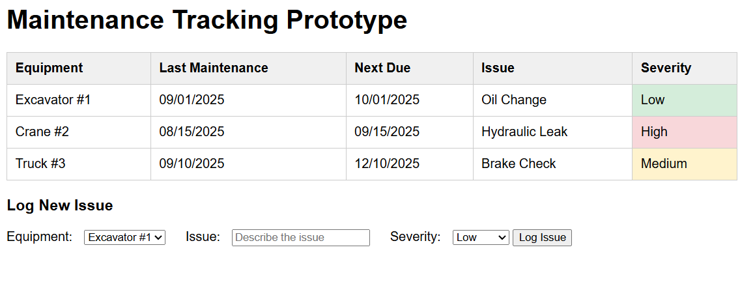
​​
Prototype #1: Maintenance Tracking

Slide 17
​​
Prototype #1: Maintenance Tracking
What worked:
Severity scale helped prioritize repairs.
What didn’t work:
Manual entry was still seen as tedious; users wanted automated reminders.
Validity of Assumption:
Partially valid: Simplified logs help, but automation is key.

Slide 18
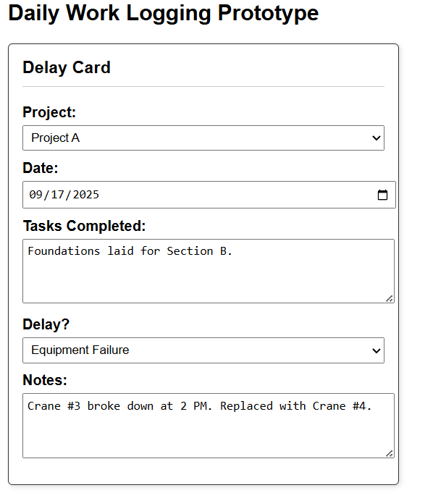
​​
Prototype #2: Daily Work Logging

Slide 19
​​
Prototype #2: Daily Work Logging
What worked:
Standardized delay reasons reduced ambiguity in reporting.
What didn’t work:
Cards were easily lost; users preferred a digital form.
Validity of Assumption:
Valid: Structured logging is helpful, but digital is preferred.

Slide 20
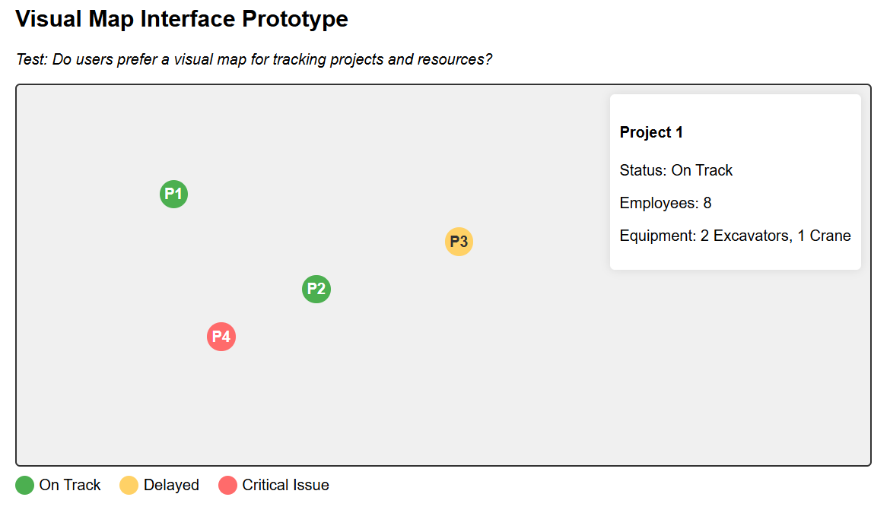
​​
Prototype #3: Visual Map Interface

Slide 21
​​
Prototype #3: Visual Map Interface
What worked:
Users liked the visual clarity of seeing all projects in one place.
What didn’t work:
Static maps lack real-time updates (users wanted digital integration).
Validity of Assumption:
Valid: Visual maps are useful, but they need interactive features.

Slide 22
Summary
​​
Key Learnings:
Automation > manual entry: Users reject systems that require excessive manual input.
Unexpected needs: Equipment condition and material tracking are as important as project progress.
Next Steps:
Interactive map with real-time updates.
Maintenance alerts and delay reporting.
Notes:
Not only assigned, but current

Slide 23
​​
Thank You

