Slide 1
Gene Set Enrichment Analysis
Joseph Lang Sunday, November 1, 2020

Slide 2
Content
Algorithm
1.1. Hypergeometric distribution
1.2. Fisher exact test
Software
2.1. DAVID
2.1.1. EASE score: a modified Fisher Exact p-value
2.2. Enrichr
2.2.1. The Basics
2.2.2. Background Information
Enrichment Bar Plot

Slide 3
Hypergeometric distribution
The following conditions characterize the hypergeometric distribution:
The result of each draw (the elements of the population being sampled) can be classified into two mutually exclusive categories (e.g. Success/Fail or Employed/Unemployed).
The probability of a success changes on each draw, as each draw decreases the population (sampling without replacement from a finite population).

Slide 4
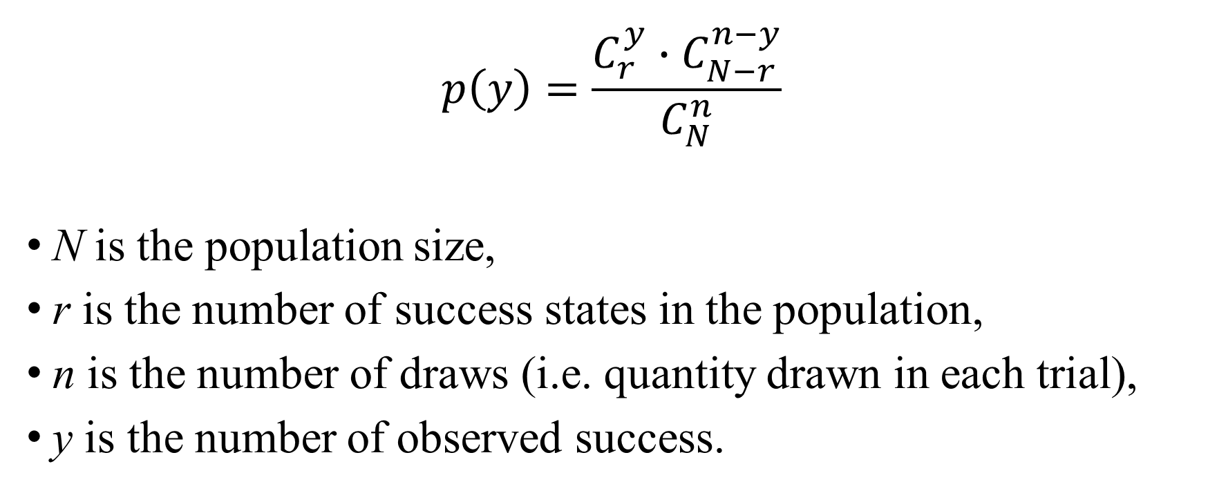
Hypergeometric distribution
$$p\left(y\right)=\frac{C_{r}^{y}∙C_{N−r}^{n−y}}{C_{N}^{n}}$$
N is the population size,
r is the number of success states in the population,
n is the number of draws (i.e. quantity drawn in each trial),
y is the number of observed success.

Slide 5
Fisher exact test
Pearson's Chi-squared test
data: Cars93$Type and Cars93$Origin
X-squared = 14.08, df = 5, p-value = 0.01511
Warning message:
In chisq.test(Cars93$Type, Cars93$Origin) : Chi-squared近似算法有可能不准
Fisher's Exact Test for Count Data
data: Cars93$Type and Cars93$Origin
p-value = 0.007248
alternative hypothesis: two.sided
 | USA | non-USA
Compact | 7 | 9
Large | 11 | 0
Midsize | 10 | 12
Small | 7 | 14
Sporty | 8 | 6
Van | 5 | 4
Notes:
此外，还有其他统计方法可以用于富集分析，如Z-score和KS-like statistic等，这里不做详细介绍。由于在进行富集分析时通常需要进行大量检验（多重检验），所以需要采用多重检验校正的方法对结果进行校正。这些方法主要包括邦弗朗尼校正（Bonferroni）、邦弗朗尼递减校正（Bonferroni step down）和本杰明假阳性率校正（Benjamini false discovery rate）等。

Slide 6
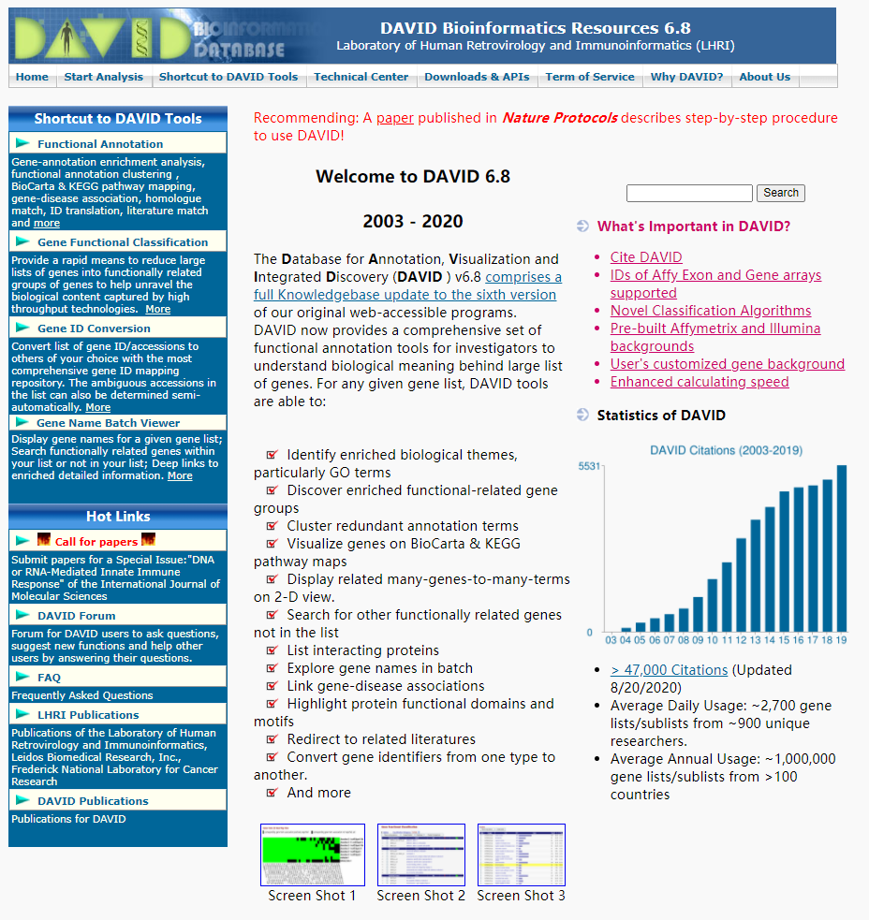
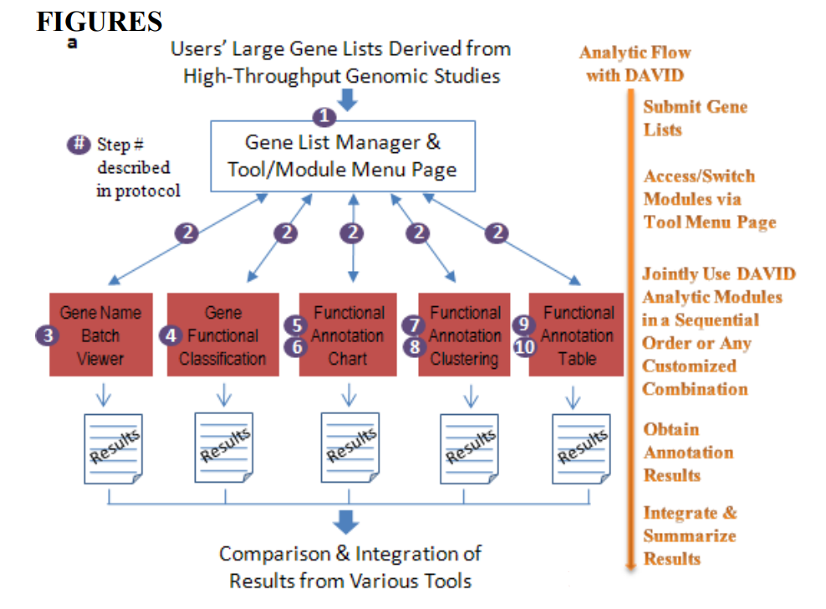
DAVID
Huang da W, Sherman BT, Lempicki RA. Systematic and integrative analysis of large gene lists using DAVID bioinformatics resources. Nat Protoc. 2009;4(1):44-57. doi: 10.1038/nprot.2008.211. PMID: 19131956.

Slide 7
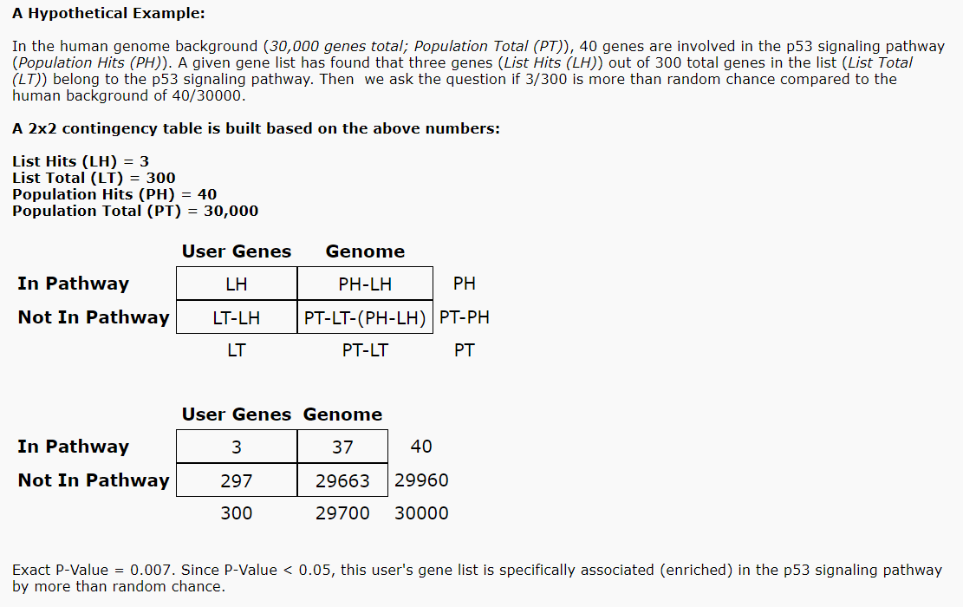
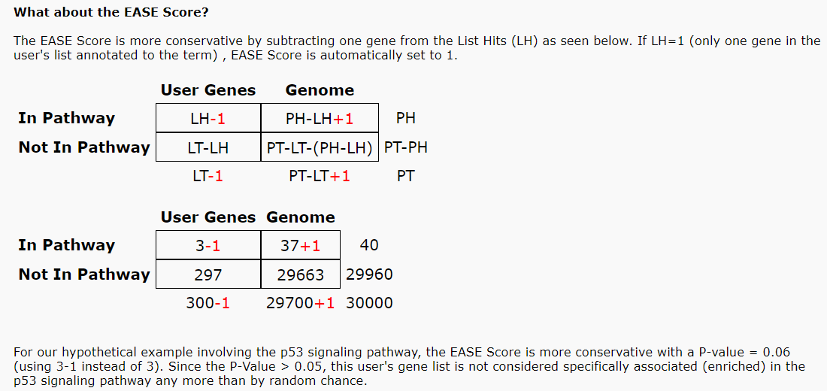
EASE score a modified Fisher Exact p-value
p-value = 0.06027
p-value = 0.007443

Slide 8
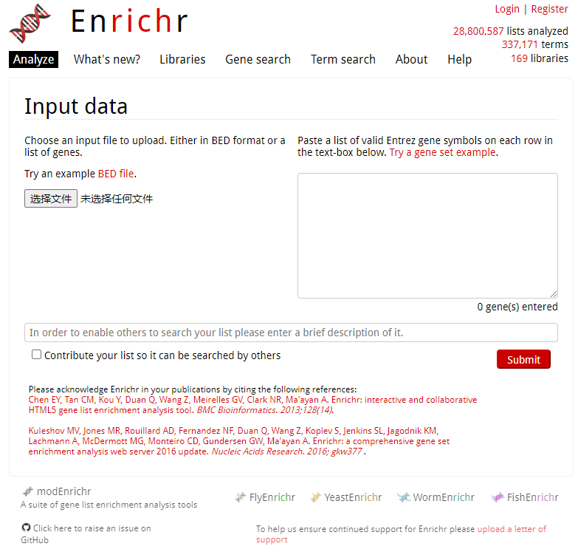
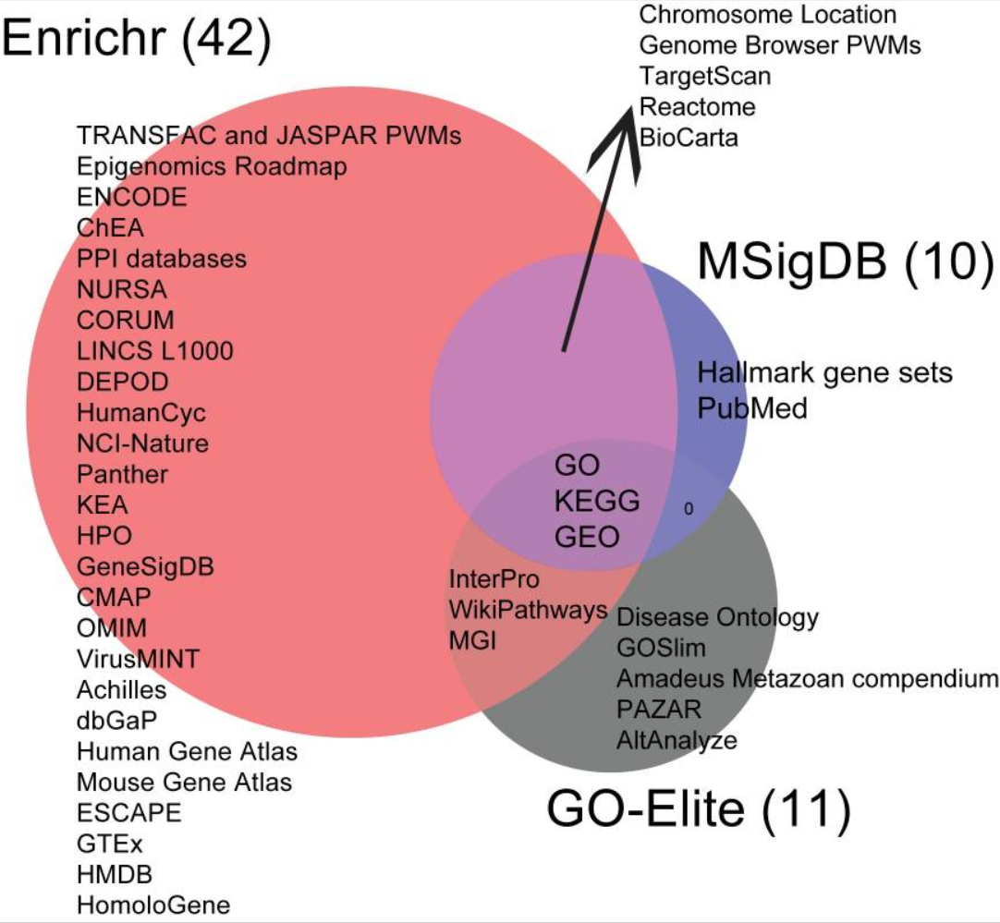
Enrichr
Kuleshov MV, Jones MR, Rouillard AD, et al. Enrichr: a comprehensive gene set enrichment analysis web server 2016 update. Nucleic Acids Res. 2016;44(W1):W90-W97. doi:10.1093/nar/gkw377

Slide 9
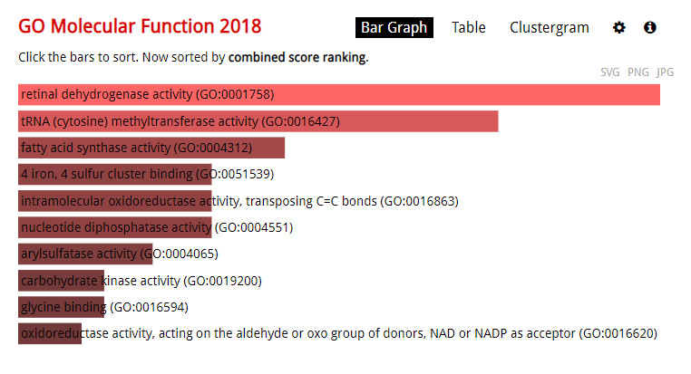
The Basics Understanding the bar graph
The length of the bar represents the significance of that specific gene-set or term.
In addition, the brighter the color, the more significant that term is.

Slide 10
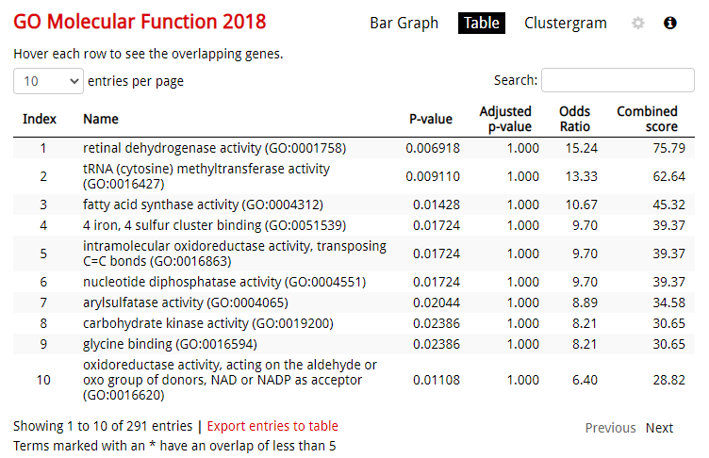
The Basics Understanding the data table
The data table gives you a raw view of the data.
By clicking on the column header, you can sort the table by the term, p-value, z-score, or combined score.

Slide 11
Background Information What is gene set
Gene sets can be fuzzy or crisp.
In a crisp set, an element is either a member of the set or not.
In a fuzzy or quantitative set, an element has an associated value indicating a degree of membership. Enrichr accepts both crisp and fuzzy gene sets as input.

Slide 12
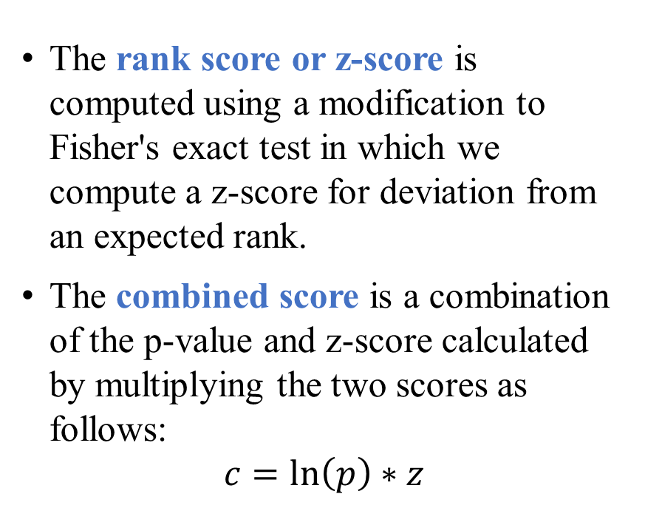
Background Information What are the four enrichment result score
The p-value: Fisher's exact test or the hypergeometric test. This is a binomial proportion test that assumes a binomial distribution and independence for probability of any gene belonging to any set.
The q-value: an adjusted p-value using the Benjamini-Hochberg method for correction for multiple hypotheses testing.
The rank score or z-score is computed using a modification to Fisher's exact test in which we compute a z-score for deviation from an expected rank.
The combined score is a combination of the p-value and z-score calculated by multiplying the two scores as follows:
$$c=\ln\left(p\right)∗z$$

Slide 13
Background Information What is a gene set library’s background
Since the Fisher's exact test produces lower p-values for longer lists even when the input lists are random, Enrichr precomputes a background expected rank for each term in each gene set library.
The background is a lookup table of expected ranks and variances for each term in the library. These expected values are precomputed using Fisher's exact test for many random input gene lists for each term in the gene set library. Enrichr uses this lookup table to calculate the mean rank and standard deviation from this expected rank as the z-score.

Slide 14
Background Information How does Enrichr correct for multiple hypotheses
Enrichr uses the Benjamini-Hochberg (BH) procedure to account for this issue. We display the correct BH q-values in the tables and charts. The bar chart appears gray if it does not meet the cutoff of 0.05 before correction.

Slide 15
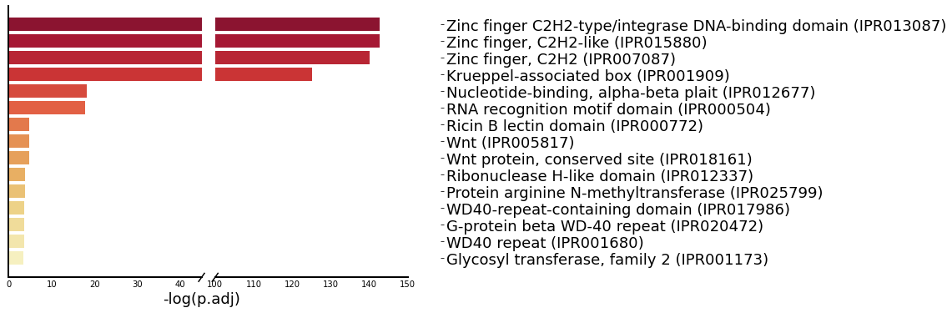
Enrichment Bar Plot

