Slide 1
Gene Set Enrichment Analysis
Joseph Lang Sunday, November 1, 2020

Slide 2
Content
Algorithm
1.1. Hypergeometric distribution
1.2. Fisher exact test
Software
2.1. DAVID
2.1.1. EASE score: a modified Fisher Exact p-value
2.2. Enrichr
2.2.1. The Basics
2.2.2. Background Information
Application Example

Slide 3
Hypergeometric distribution
The following conditions characterize the hypergeometric distribution:
The result of each draw (the elements of the population being sampled) can be classified into two mutually exclusive categories (e.g. Success/Fail or Employed/Unemployed).
The probability of a success changes on each draw, as each draw decreases the population (sampling without replacement from a finite population).

Slide 4
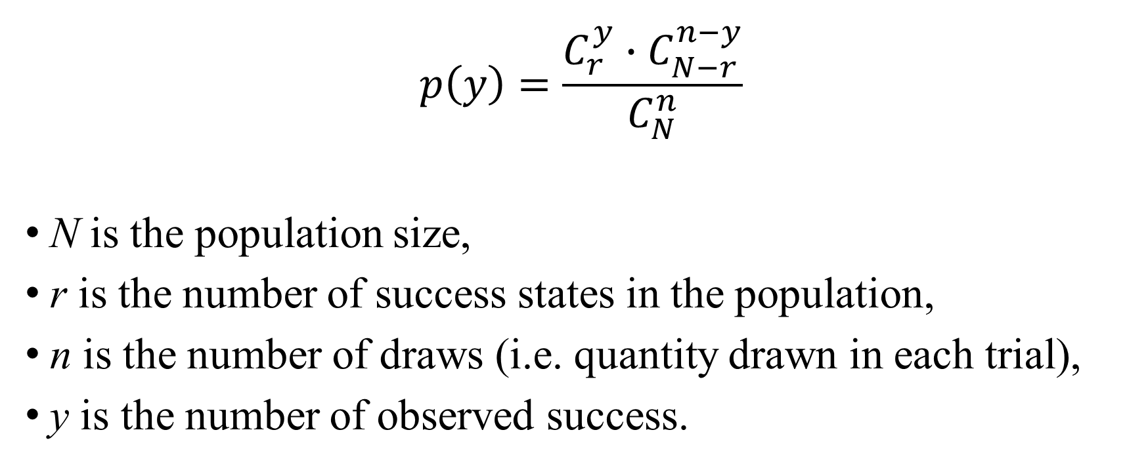
Hypergeometric distribution
$$p\left(y\right)=\frac{C_{r}^{y}∙C_{N−r}^{n−y}}{C_{N}^{n}}$$
N is the population size,
r is the number of success states in the population,
n is the number of draws (i.e. quantity drawn in each trial),
y is the number of observed success.

Slide 5
Fisher exact test
Pearson's Chi-squared test
data: Cars93$Type and Cars93$Origin
X-squared = 14.08, df = 5, p-value = 0.01511
Warning message:
In chisq.test(Cars93$Type, Cars93$Origin) : Chi-squared近似算法有可能不准
Fisher's Exact Test for Count Data
data: Cars93$Type and Cars93$Origin
p-value = 0.007248
alternative hypothesis: two.sided
 | USA | non-USA
Compact | 7 | 9
Large | 11 | 0
Midsize | 10 | 12
Small | 7 | 14
Sporty | 8 | 6
Van | 5 | 4
Notes:
此外，还有其他统计方法可以用于富集分析，如Z-score和KS-like statistic等，这里不做详细介绍。由于在进行富集分析时通常需要进行大量检验（多重检验），所以需要采用多重检验校正的方法对结果进行校正。这些方法主要包括邦弗朗尼校正（Bonferroni）、邦弗朗尼递减校正（Bonferroni step down）和本杰明假阳性率校正（Benjamini false discovery rate）等。

Slide 6
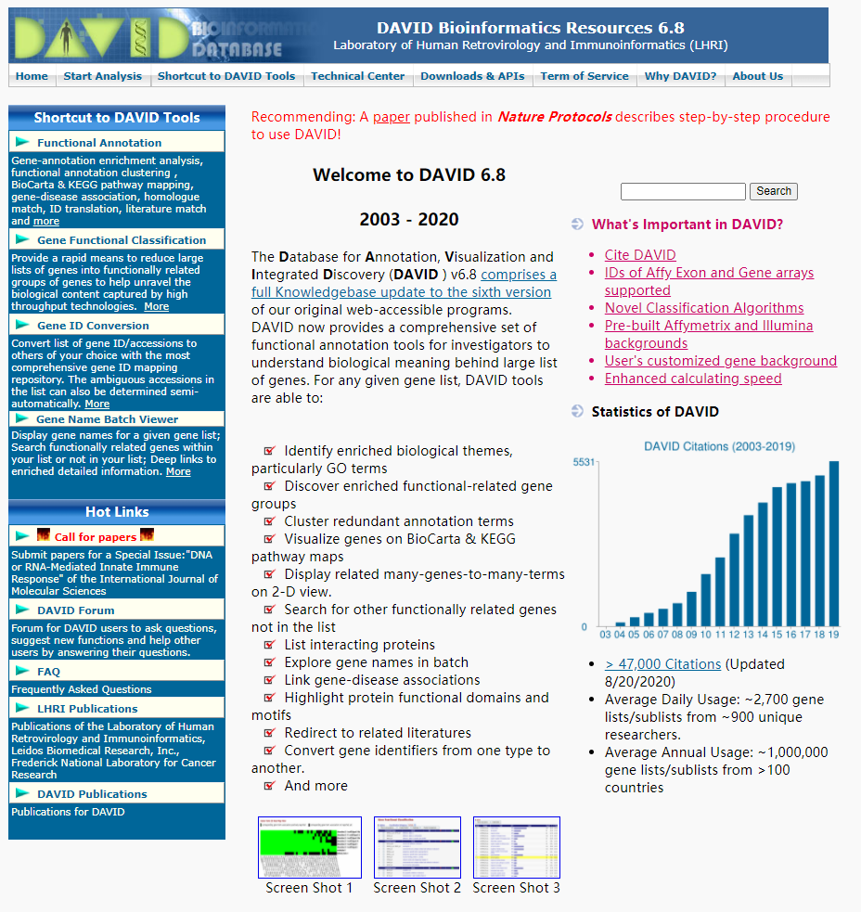
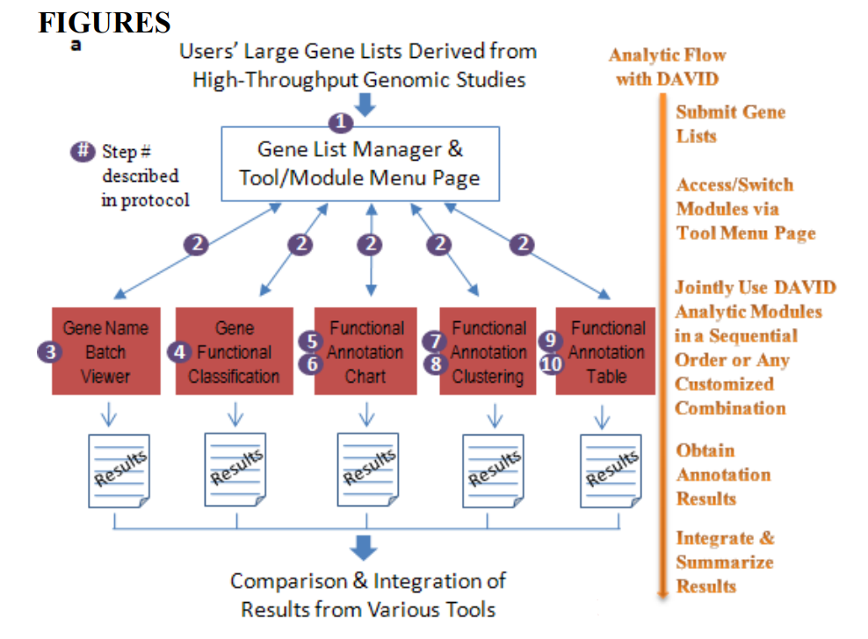
DAVID
Huang da W, Sherman BT, Lempicki RA. Systematic and integrative analysis of large gene lists using DAVID bioinformatics resources. Nat Protoc. 2009;4(1):44-57. doi: 10.1038/nprot.2008.211. PMID: 19131956.

Slide 7
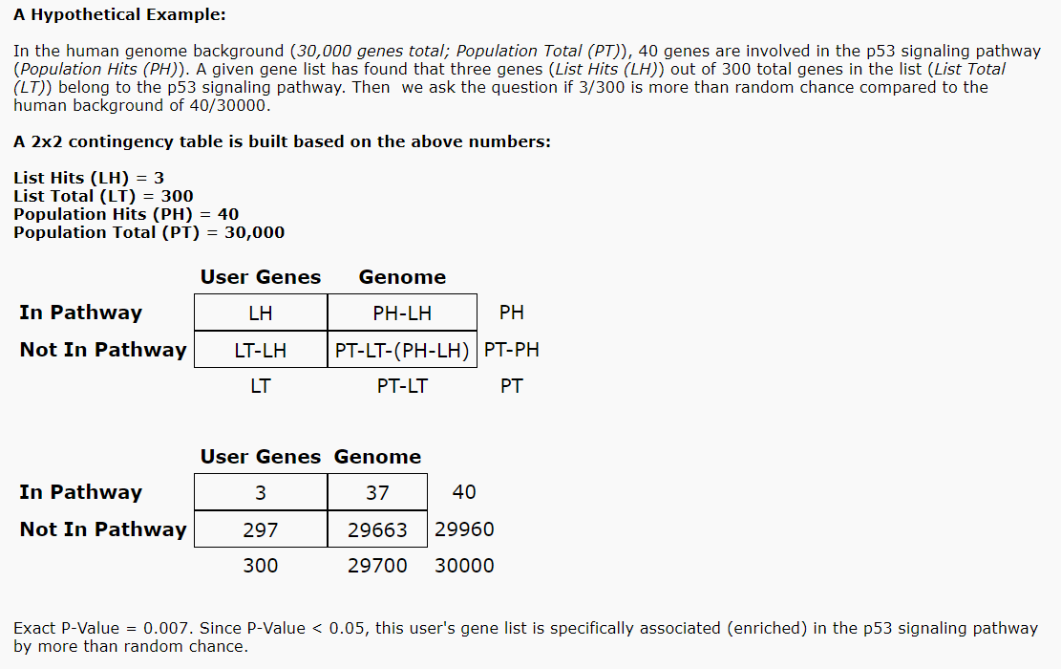
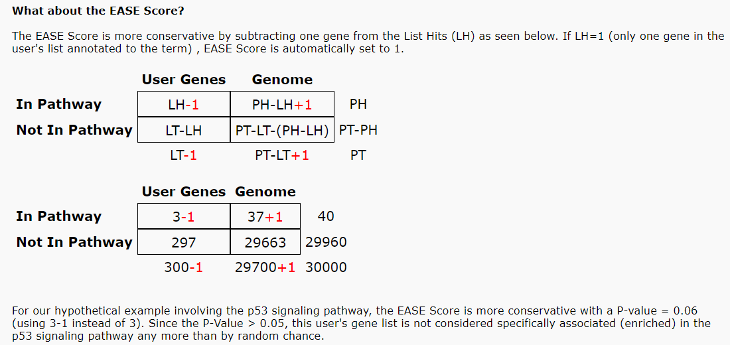
EASE score a modified Fisher Exact p-value
p-value = 0.06027
p-value = 0.007443

Slide 8
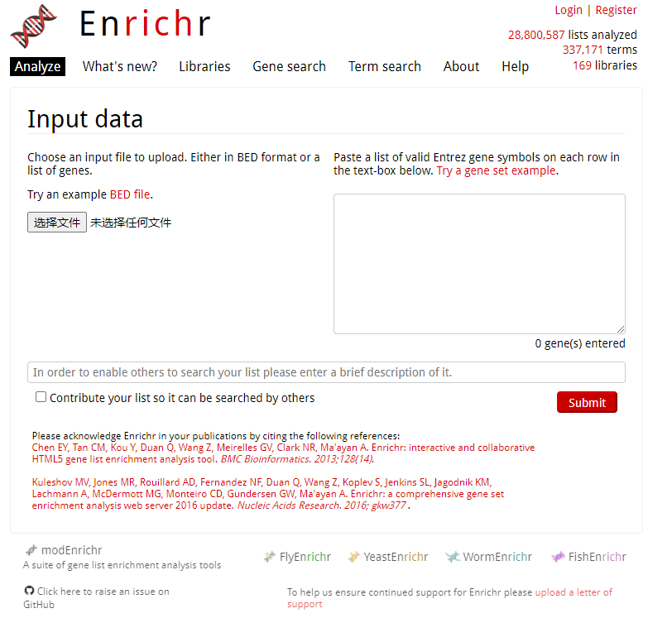
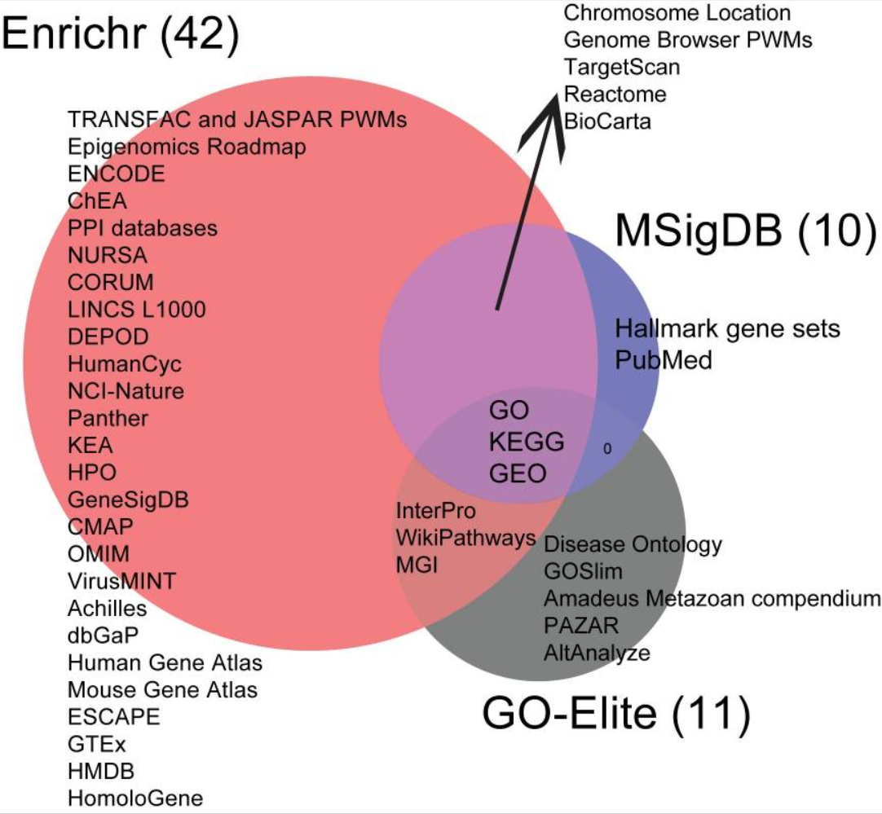
Enrichr
Kuleshov MV, Jones MR, Rouillard AD, et al. Enrichr: a comprehensive gene set enrichment analysis web server 2016 update. Nucleic Acids Res. 2016;44(W1):W90-W97. doi:10.1093/nar/gkw377

Slide 9
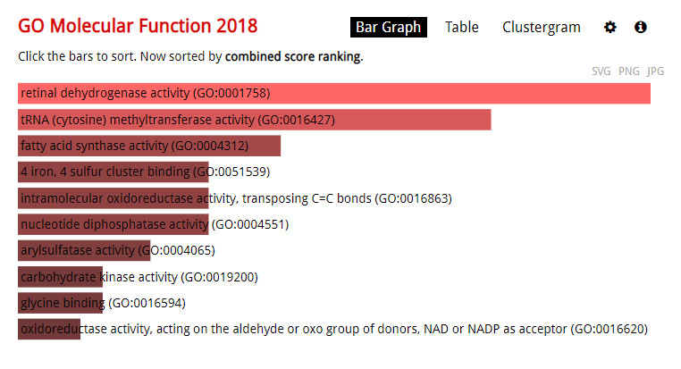
The Basics Understanding the bar graph
The length of the bar represents the significance of that specific gene-set or term.
In addition, the brighter the color, the more significant that term is.

Slide 10
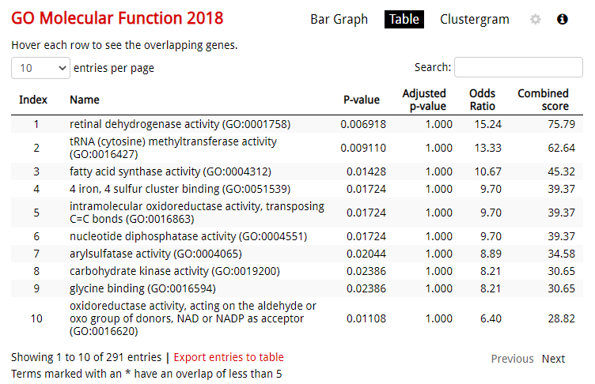
The Basics Understanding the data table
The data table gives you a raw view of the data.
By clicking on the column header, you can sort the table by the term, p-value, z-score, or combined score.

Slide 11
Background Information What is gene set

Slide 12
Background Information What are the four enrichment result score

Slide 13
Background Information What is a gene set library’s background

Slide 14
Background Information How does Enrichr correct for multiple hypotheses

Slide 15
Application Example

