Slide 1
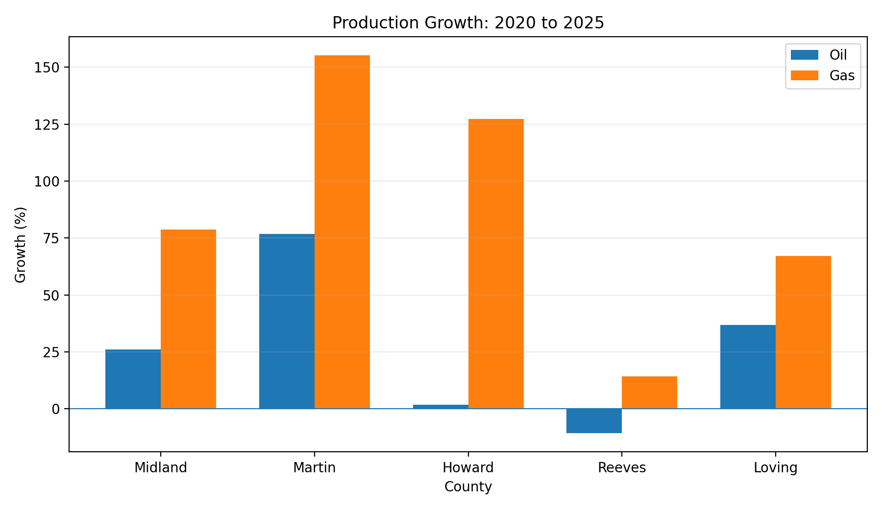
Permian Basin RRC Production Comparison
Midland | Martin | Howard | Reeves | Loving
Part 2 of the Midland County RRC Production Analysis
Joseph Luongo | August 2026

Slide 2
Executive Snapshot
Five-county public-data screen focused on metrics relevant to asset and operating teams
+76.8%
Martin oil growth
2020-2025
1,218.9 Bcf
Reeves gas production
2025
54.4%
Reeves condensate share
of 2025 liquids
4.32
Howard 2025 GLR
vs 1.93 in 2020
77.9%
Loving top-5 operator share
cumulative oil
Martin is the clearest high-growth county in the comparison and the best candidate for deeper well-level follow-up.
Condensate is economically important in Reeves and Loving; oil-only rankings materially understate their liquids scale.
Howard has shifted strongly toward gas: oil is nearly flat versus 2020 while gas more than doubled.
Competitive concentration differs sharply by county, with Reeves and Howard more fragmented than Loving/Martin/Midland.
Texas Railroad Commission public production data | Jan 2020 - Mar 2026

Slide 3
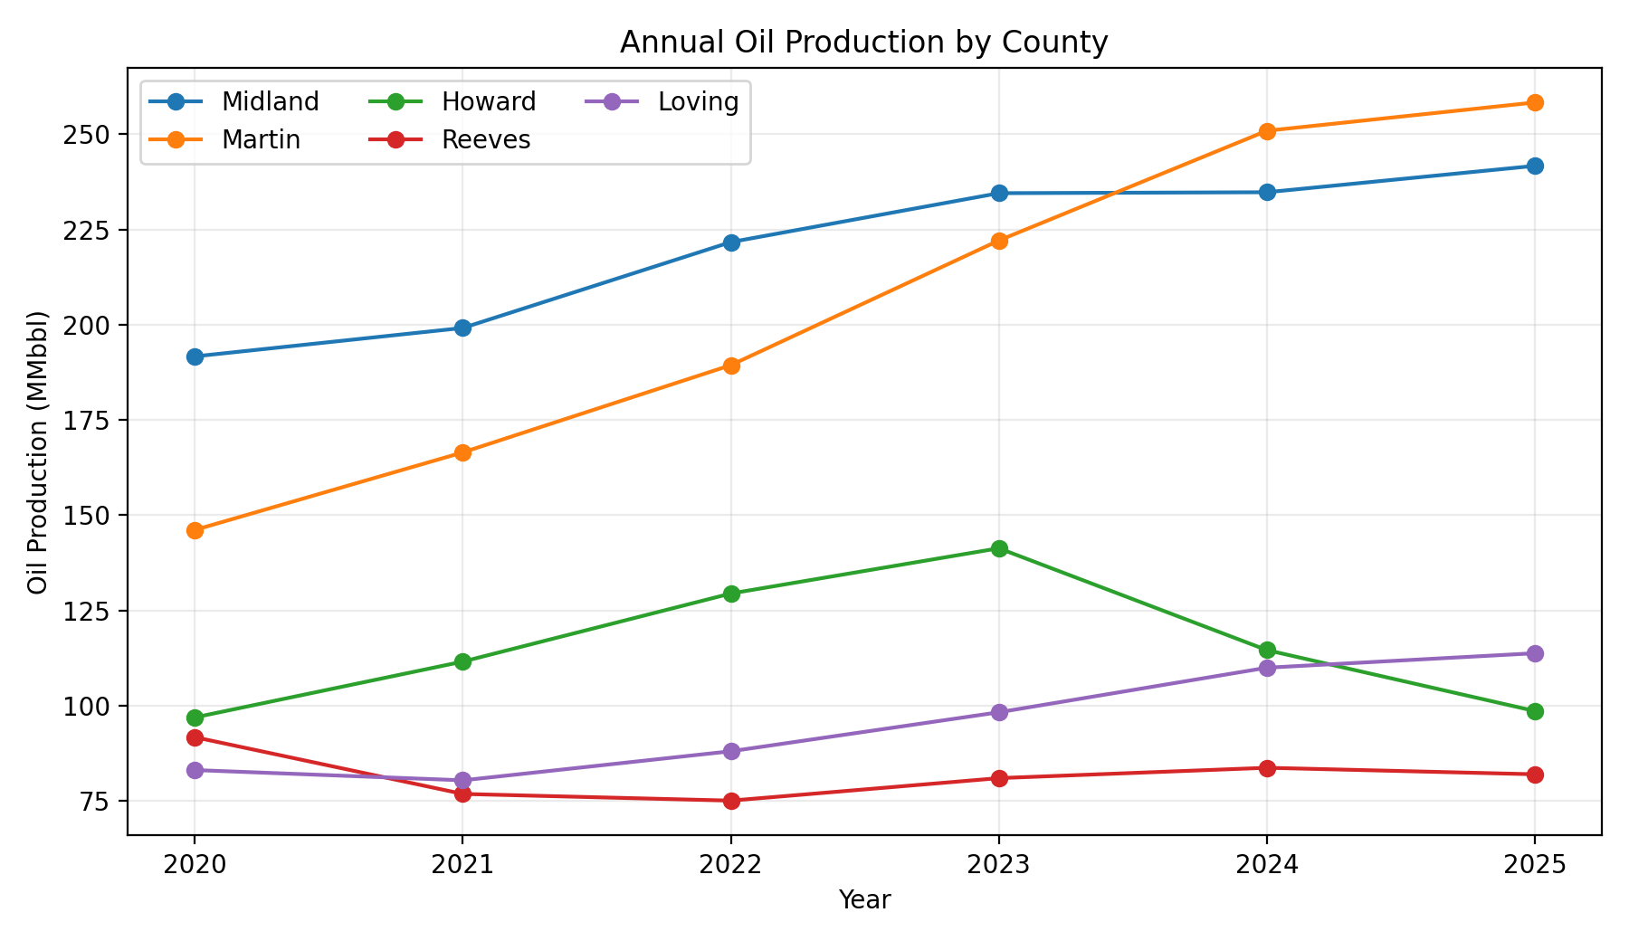
Production Growth and Scale
2020-2025 full-year comparison; 2026 excluded because only Jan-Mar are available
Martin grew both oil and gas rapidly; Reeves remained gas-dominant even as oil declined; Howard is the clearest oil-flat / gas-growth transition.
Texas Railroad Commission public production data | Jan 2020 - Mar 2026

Slide 4
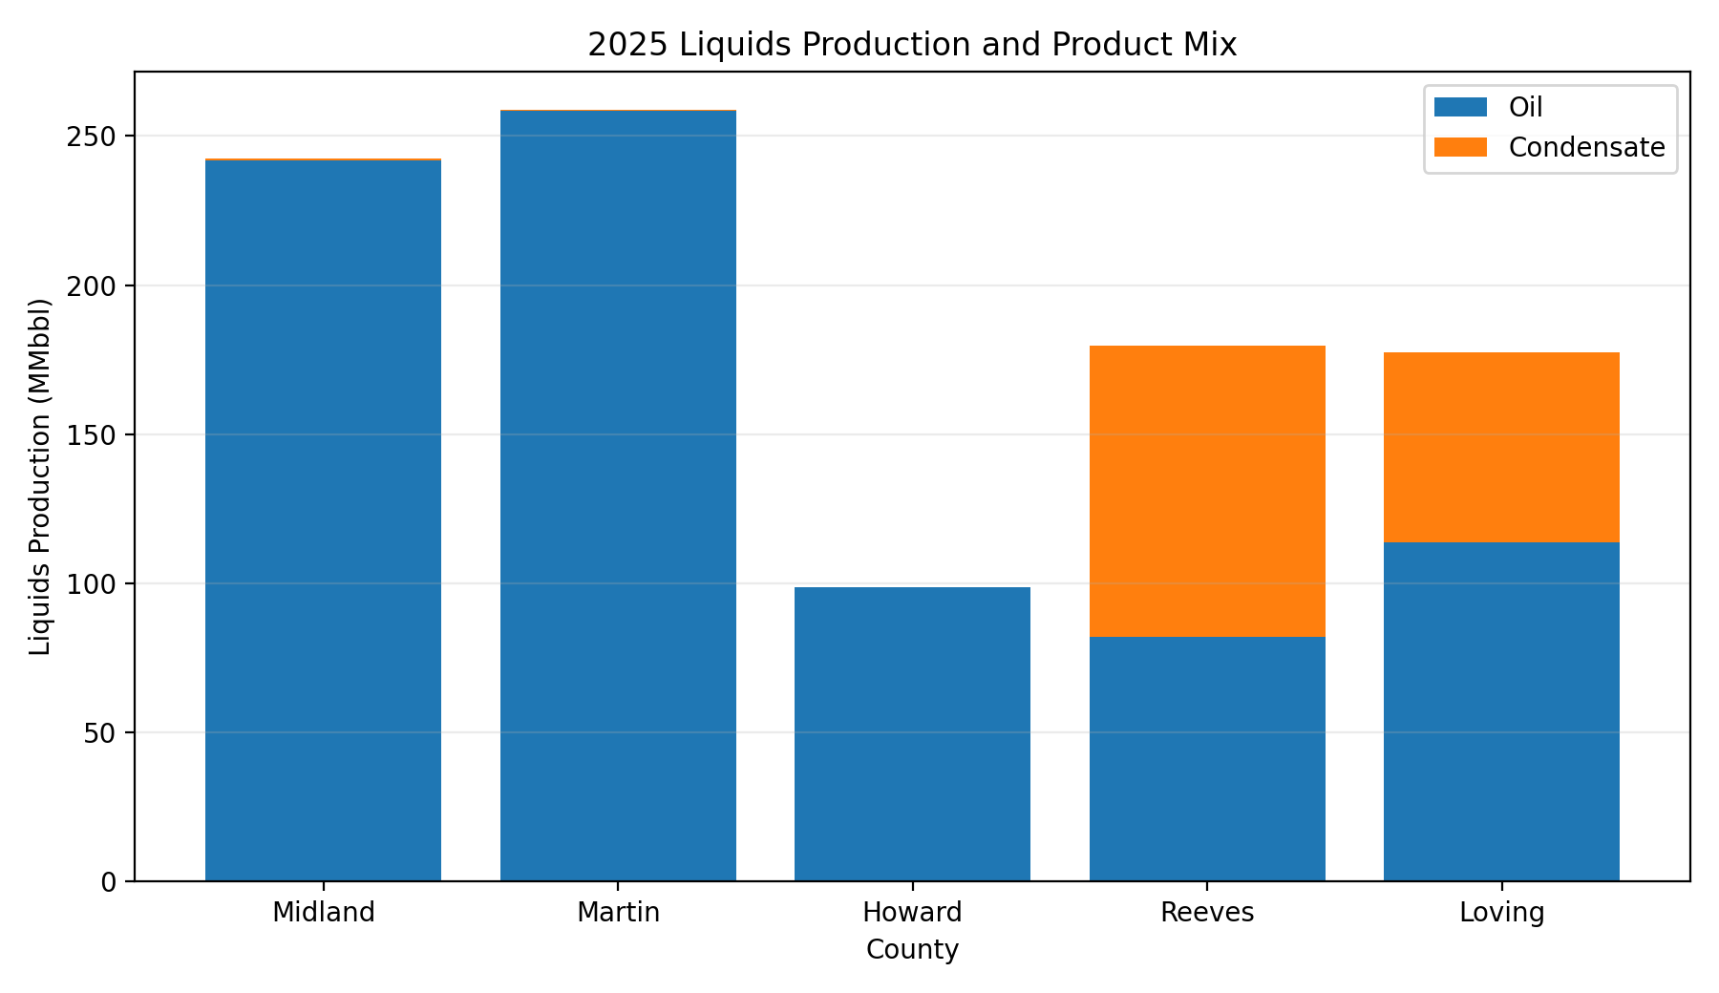
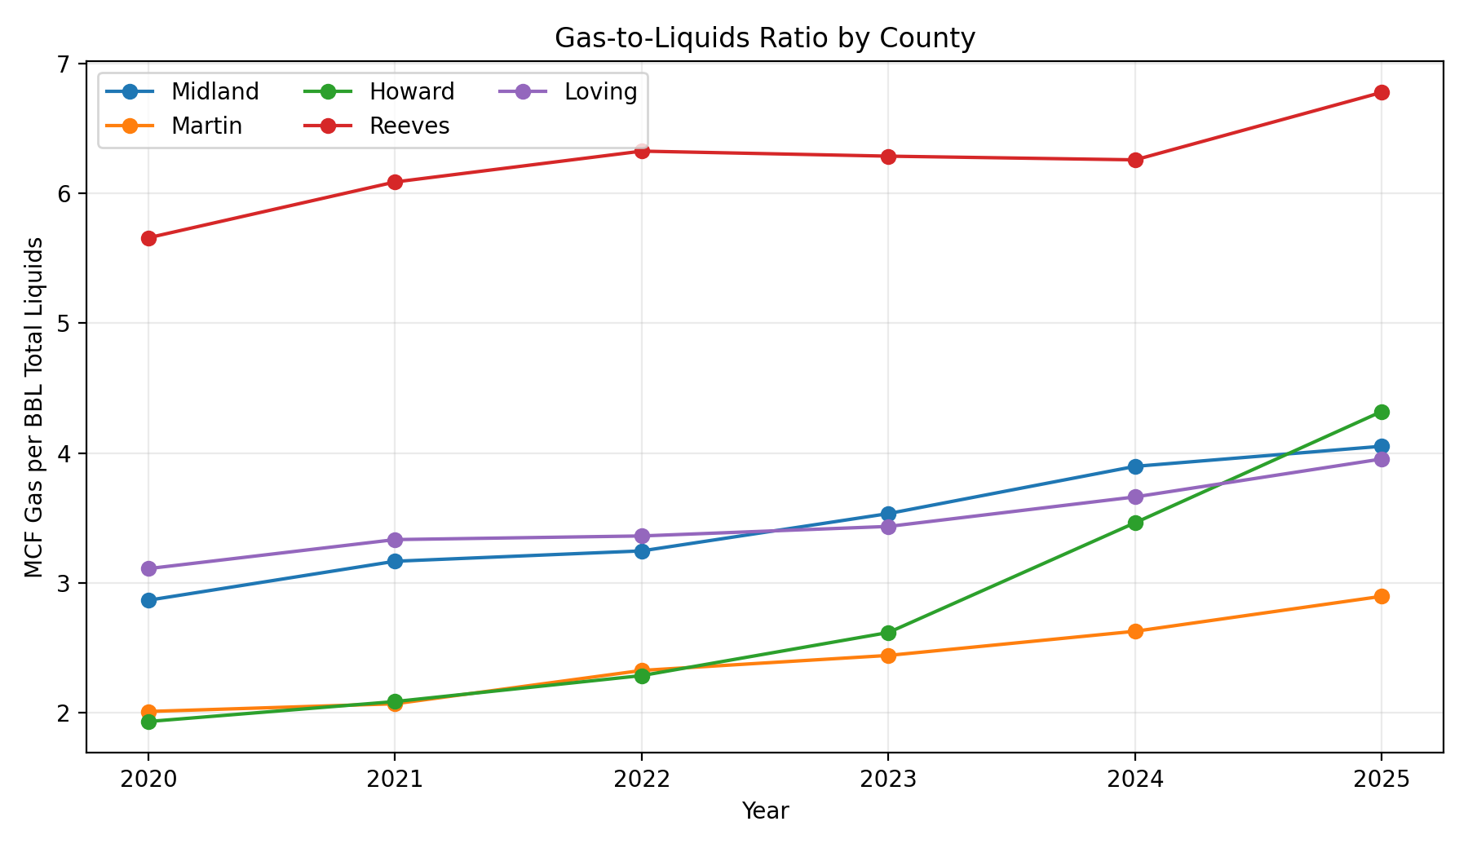
Product Mix Matters
Total liquids = oil + condensate; GLR = gas / total liquids
Reeves: 82.0 MMbbl oil becomes 179.9 MMbbl total liquids after condensate; Loving: 113.8 MMbbl oil becomes 177.5 MMbbl total liquids.
Howard GLR more than doubled from 1.93 to 4.32 MCF/BBL, indicating a materially more gas-intensive production mix.
Texas Railroad Commission public production data | Jan 2020 - Mar 2026

Slide 5
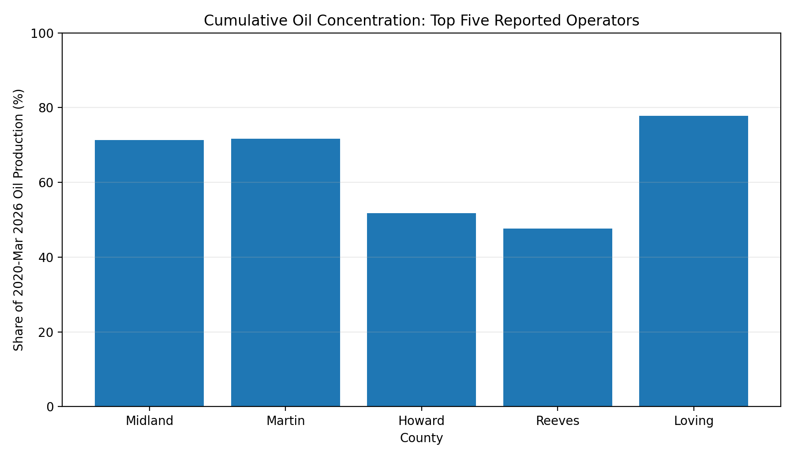
Competitive and Field Concentration
Cumulative production over the RRC query period; operator names can be historical
County | Top reported oil operator | Top field
Midland | PIONEER NATURAL RES. USA, INC. | SPRABERRY (TREND AREA)
Martin | DIAMONDBACK E&P LLC | SPRABERRY (TREND AREA)
Howard | SM ENERGY COMPANY | SPRABERRY (TREND AREA)
Reeves | NOBLE ENERGY INC | WOLFBONE (TREND AREA)
Loving | ANADARKO E&P ONSHORE LLC | PHANTOM (WOLFCAMP)
Field concentration is extreme in Martin/Howard (Spraberry ~97%) but much lower in Reeves (Wolfbone ~40%).
Operator reports aggregate Jan 2020-Mar 2026 and may retain historical names after asset transfers.

Slide 6
Q1 2026 Run Rate and What It Means
Directional comparison of Jan-Mar 2026 average monthly production versus the 2025 monthly average
County | Oil vs 2025 avg | Gas vs 2025 avg
Midland | -7.3% | -5.3%
Martin | -0.9% | +3.2%
Howard | -21.0% | -3.5%
Reeves | -9.8% | -6.2%
Loving | -1.8% | -1.7%
Martin and Loving are holding closest to their 2025 oil run rates; Howard shows the sharpest Q1 slowdown.
Martin is the only county with positive Q1 2026 gas momentum (+3.2%).
For company-style follow-up, the highest-value next step is well-level decline and productivity analysis in Martin, then a condensate-aware economics screen in Reeves/Loving.
This county-level screen is not a reserve or economic evaluation; costs, EURs, acreage quality, pricing, midstream and current ownership are outside scope.
Texas Railroad Commission public production data | Jan 2020 - Mar 2026

