Slide 1
Midland County
Production Analysis
Using Texas Railroad Commission Public Data
January 2020 – March 2026
Joseph Luongo | Petroleum Engineering | The University of Texas at Austin
Independent summer production-data project
Texas Railroad Commission public data | Midland County Production Analysis
1
Notes:
Start by saying this is an independent summer project using public RRC data. The goal is to show real-world production analysis in a simple, understandable way.

Slide 2
What this project is
A simple version of a real oil-and-gas production analysis workflow.
I took public production records and turned them into clear insights about Midland County.
Public records show how much oil and gas was reported over time.
I organized the data by month, operator, field, and lease.
Then I created graphs and rankings to see what changed and who/what produced the most.
Plain-English goal
Answer: what happened to Midland County production, who produced the most, and how concentrated production was.
Why it matters
This is the same kind of thinking used in production engineering, reservoir analysis, and asset evaluation.
Raw RRC
CSV files
Python + Excel
cleaning
Charts +
rankings
Report +
GitHub
Texas Railroad Commission public data | Midland County Production Analysis
2
Notes:
Explain the project without jargon: I used public data, cleaned it, and used it to answer practical questions about production.

Slide 3
Data used
Five Texas Railroad Commission report exports for Midland County.
Dataset
What it tells us
Rows
The lease report is the “deepest” data: it shows production concentration across thousands of producing leases.
Monthly Totals
County-wide production by month
76
Operator Report
Production grouped by company
186
Field Report
Production grouped by producing field
95
Lease Report
Most detailed dataset; production by lease
5,675 rows → 5,674 leases analyzed
Lease
A reporting unit in RRC production data. It can represent an oil-and-gas producing asset used for production reporting.
District Report
RRC district-level summary
3
GOR
Gas-oil ratio: gas produced divided by oil produced. Higher GOR means more gas per barrel of oil.
Texas Railroad Commission public data | Midland County Production Analysis
3
Notes:
The audience should understand the data types before seeing the results. Emphasize that the lease report is the most detailed file.

Slide 4
How the analysis was built
The project is reproducible: the same raw files can recreate the workbook and figures.
1
Load raw CSVs
2
Clean columns
3
Calculate metrics
4
Create outputs
District, field, lease, monthly, operator
Remove totals, convert volumes, fix dates
Oil, gas, GOR, rankings, shares
Excel workbook, figures, report, GitHub
Main calculations
Important limitation
Oil and gas production growth from 2020 to 2025
Top operators and fields by cumulative oil production
Gas-oil ratio trend over time
Lease concentration: how much oil came from the top 10% of leases
RRC exports are great for production volumes, but they do not include full completion design details such as lateral length, proppant loading, or well spacing. That means the project identifies production patterns, not exact reservoir causes.
Texas Railroad Commission public data | Midland County Production Analysis
4
Notes:
This slide is important for credibility. It shows the project is reproducible and also explains the limitations honestly.

Slide 5
Main results at a glance
The data shows growth, increasing gas intensity, and concentrated production.
+26.1%
+78.7%
5,674
58.1%
Oil production growth from 2020 to 2025
Gas production growth from 2020 to 2025
Leases analyzed after removing the RRC total row
Oil share produced by the top 10% of leases
PIONEER NATURAL RES. USA, INC. was the top producing operator.
SPRABERRY (TREND AREA) was the top producing field.
Gas production grew much faster than oil, and the GOR trend moved upward.
A small share of leases drove more than half of lease-level oil production.
Midland County grew, became more gas-heavy, and production was not evenly spread across leases.
Texas Railroad Commission public data | Midland County Production Analysis
5
Notes:
Use this as the summary slide. Even a nontechnical audience should understand the three big ideas: growth, more gas, concentration.

Slide 6
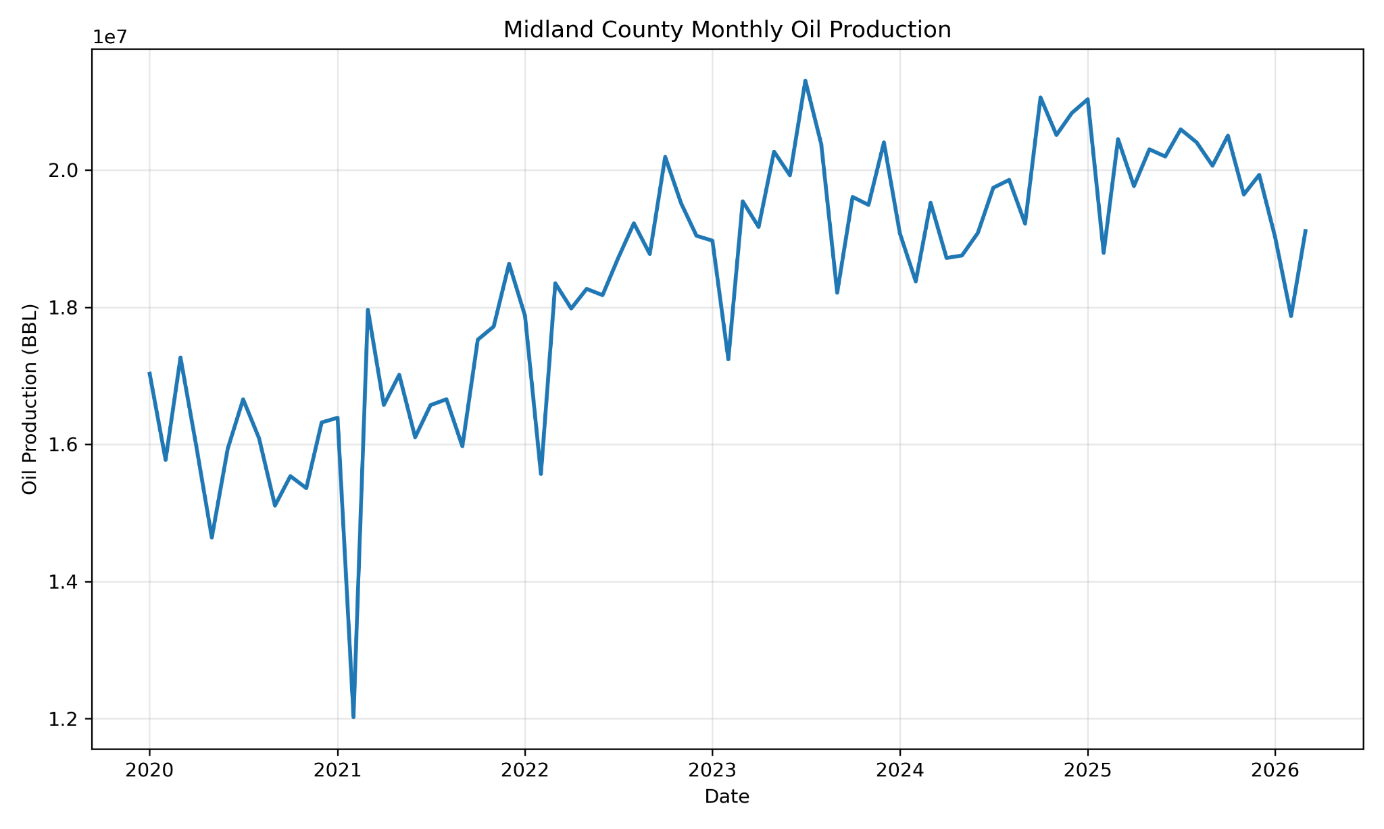
Oil production trend
Monthly oil production increased from 2020 to 2025, with short-term volatility.
Oil production grew 26.1% from 2020 to 2025.
The line does not move smoothly because monthly production can fluctuate.
The early-2021 drop appears as a sharp monthly disruption in the data.
The overall trend from 2020 through 2025 is upward.
How to read the graph
Higher points mean more barrels of oil reported that month. The trend matters more than one single month.
Texas Railroad Commission public data | Midland County Production Analysis
6
Notes:
Explain that oil production increased overall, but monthly data naturally has ups and downs. Avoid over-explaining causes without supporting completion data.

Slide 7
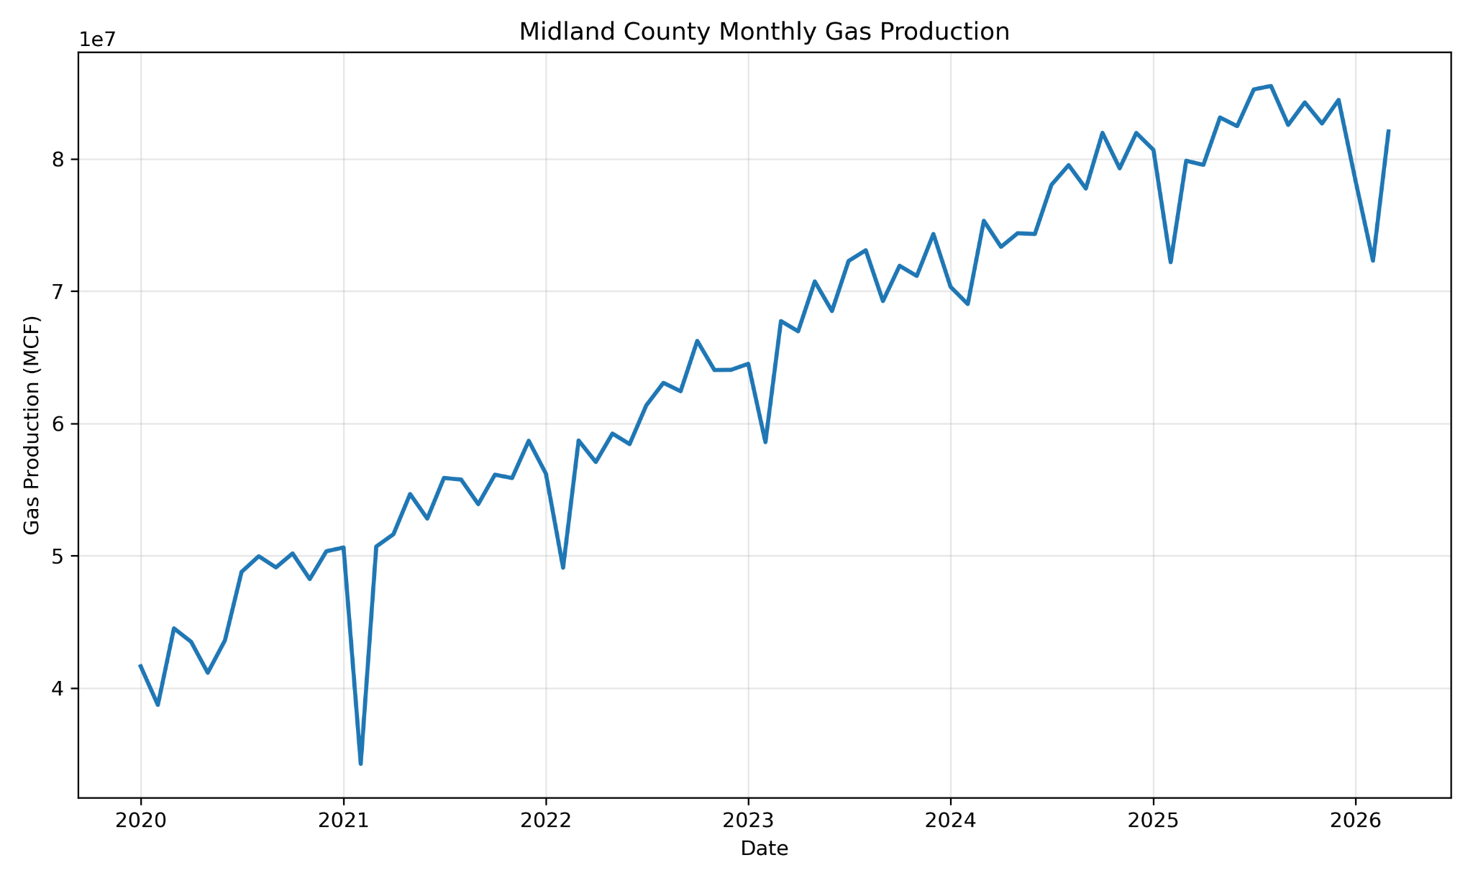
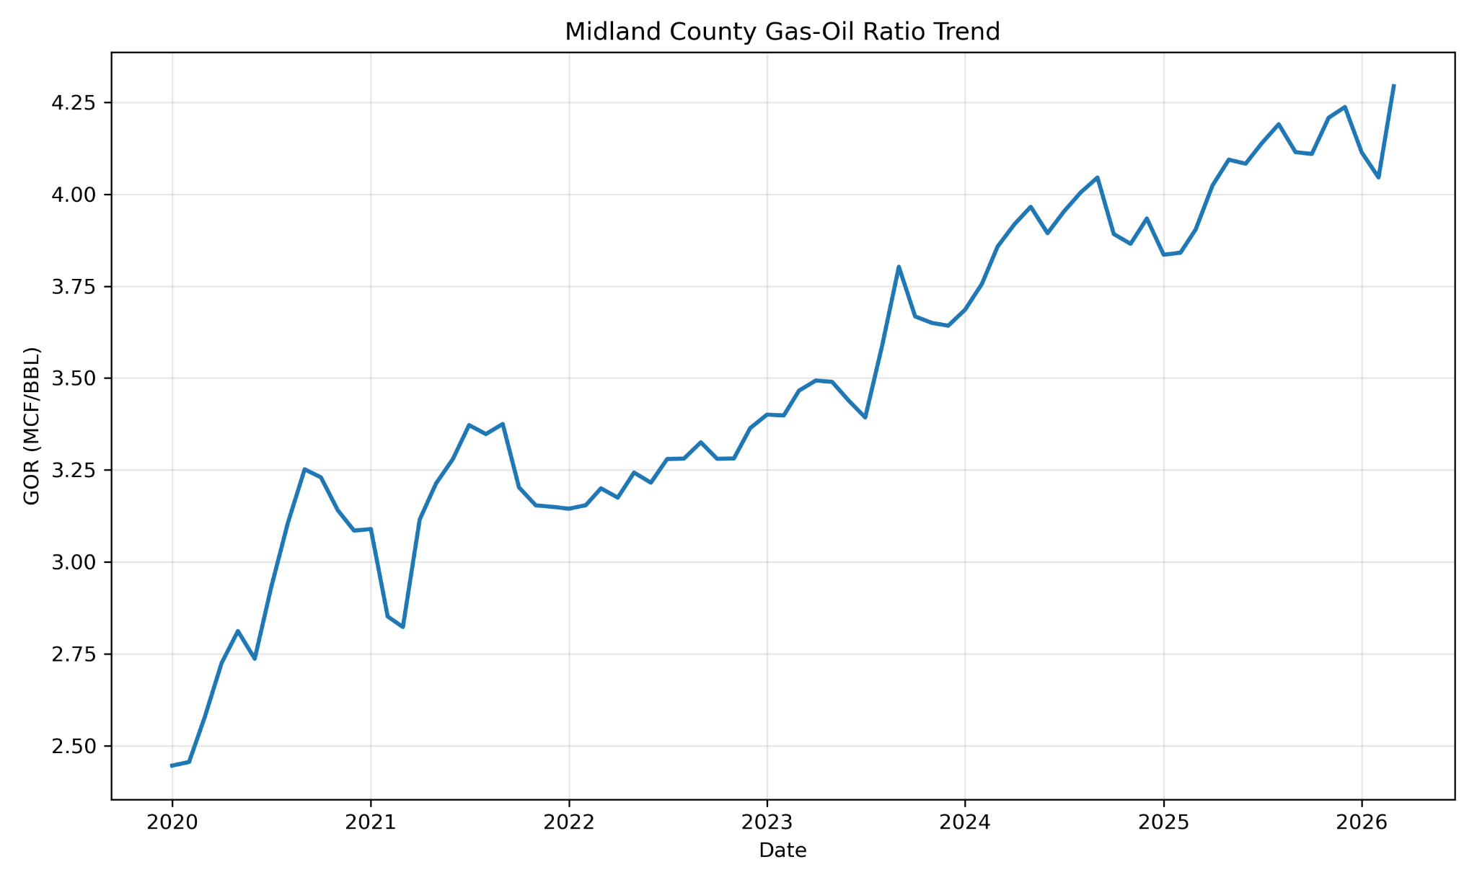
Gas grew faster than oil
Gas production and gas-oil ratio both moved upward over the study period.
Monthly gas production
Gas-oil ratio trend
Gas production grew 78.7% from 2020 to 2025, much faster than oil.
What it means: each barrel of oil was increasingly associated with more gas over time.
Texas Railroad Commission public data | Midland County Production Analysis
7
Notes:
Define GOR simply. Say that this suggests Midland County became more gas-heavy during the period, but do not claim the exact reservoir cause without more data.

Slide 8
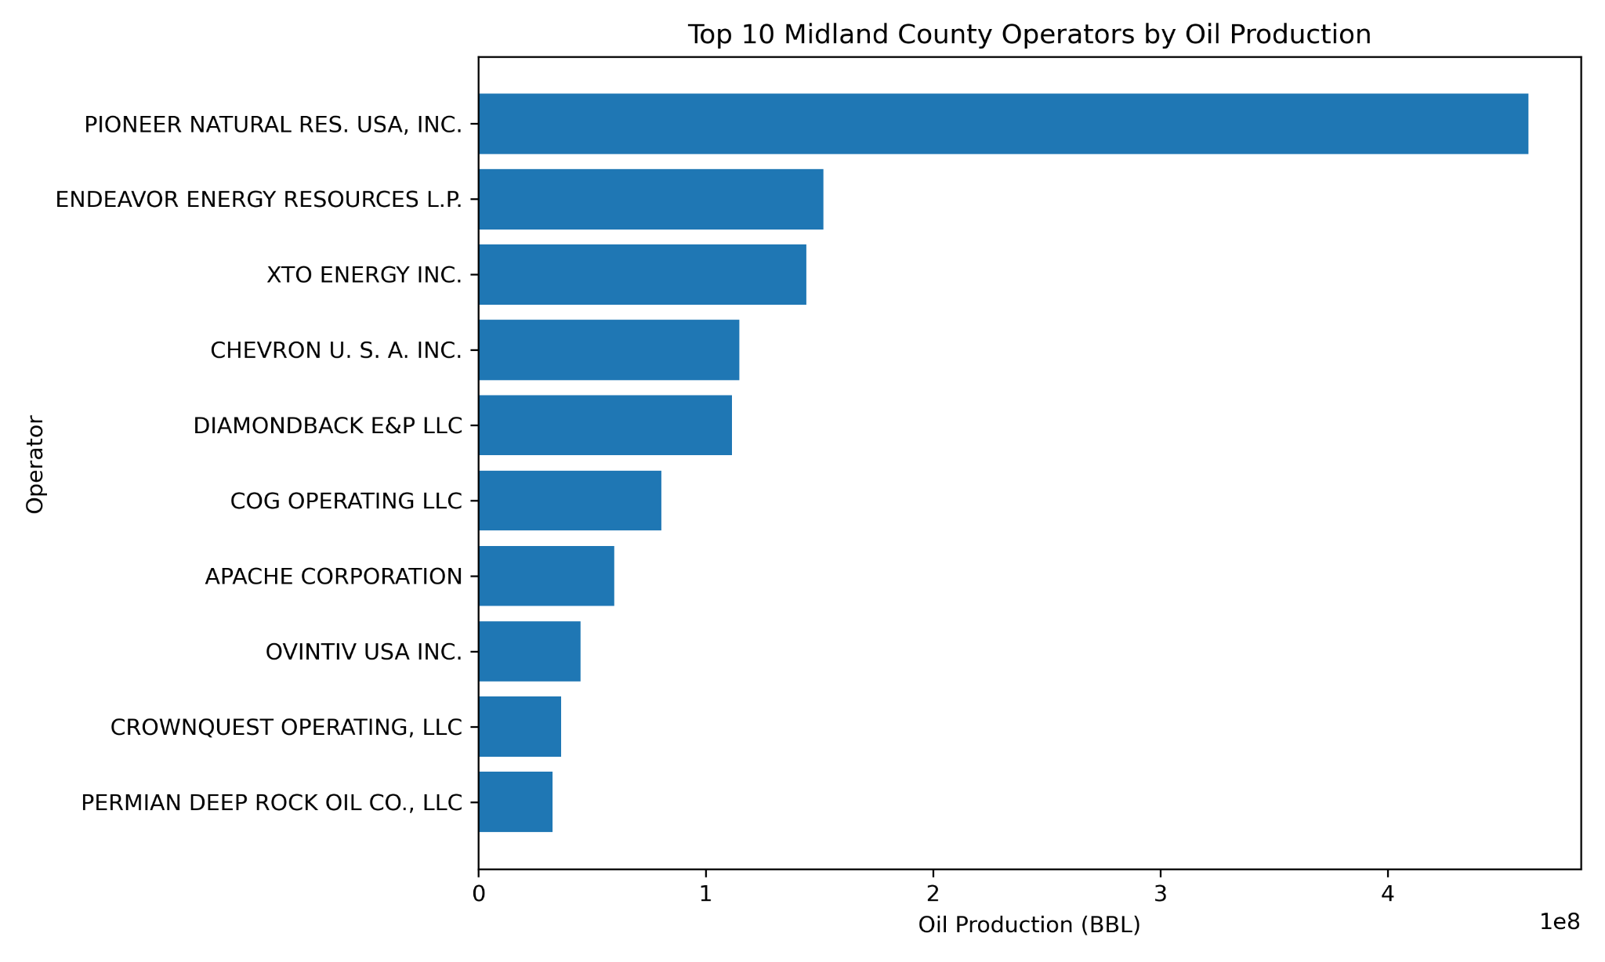
Operator analysis
The largest operators account for a major share of reported oil production.
Pioneer was the top operator, producing about one-third of the county oil total in this dataset.
Top 5 operator shares
1
Pioneer Natural Res. USA, Inc.
33.5%
2
Endeavor Energy Resources L.P.
11.0%
3
XTO Energy Inc.
10.5%
4
Chevron U.S.A. Inc.
8.3%
5
Diamondback E&P LLC
8.1%
The operator chart answers “which companies produced the most oil?”
Texas Railroad Commission public data | Midland County Production Analysis
8
Notes:
This slide connects production data to business reality: operator rankings reveal who holds the biggest production footprint in the dataset.

Slide 9
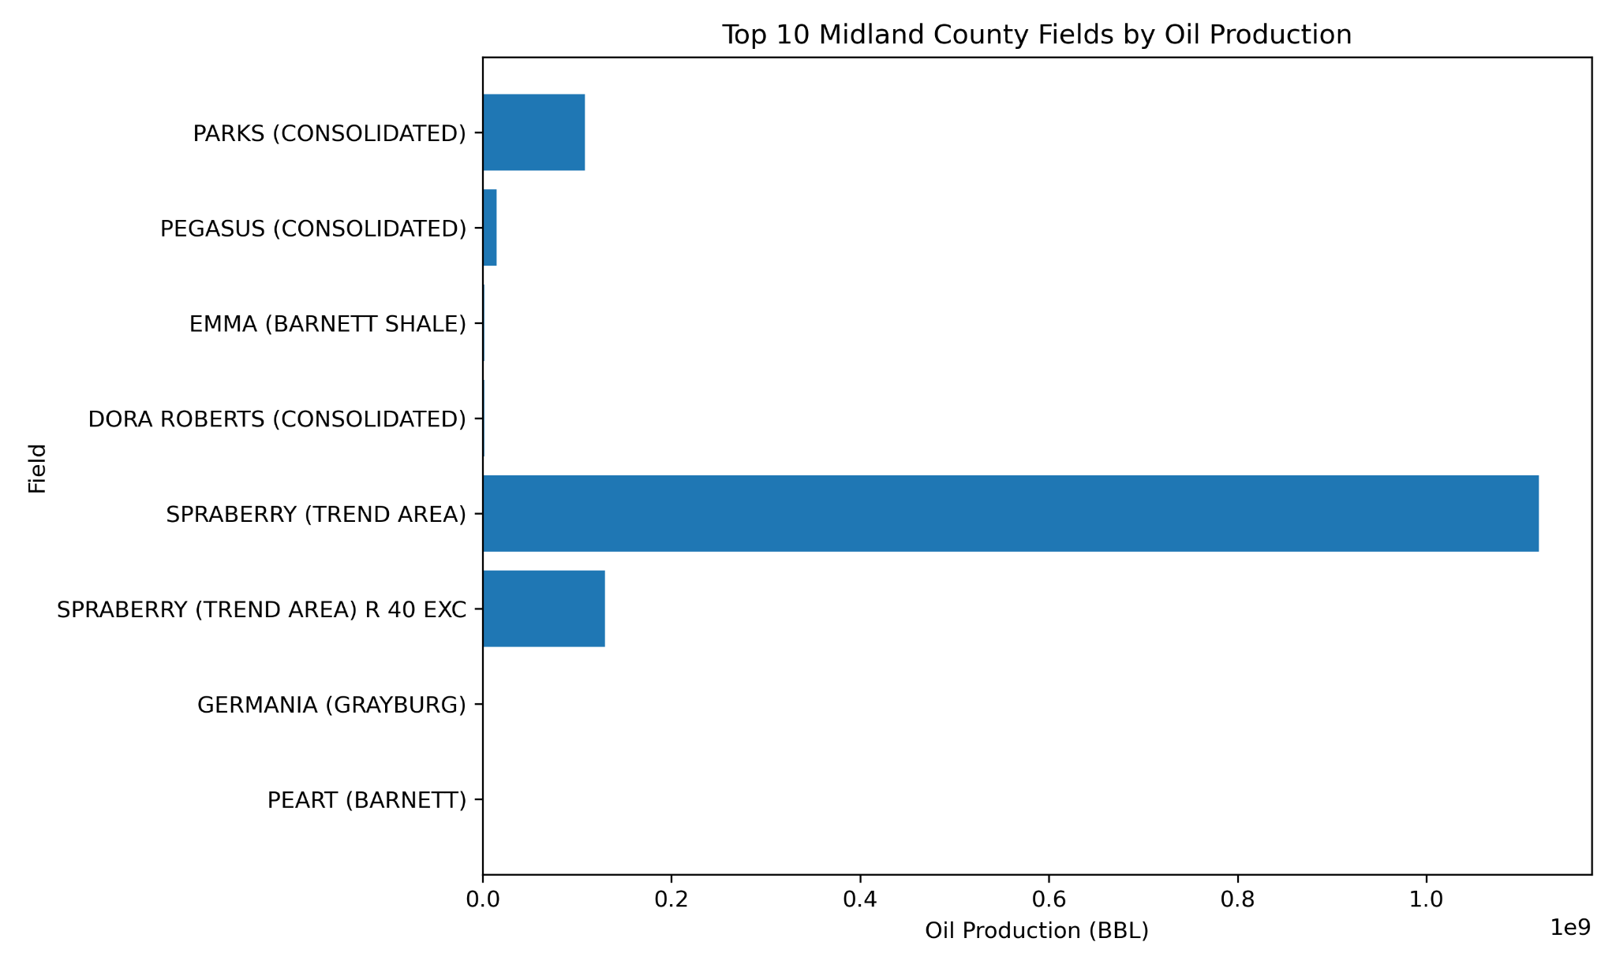
Field analysis
The Spraberry Trend dominates Midland County reported oil production.
SPRABERRY (TREND AREA) accounted for roughly 81% of field-level oil production.
The field chart answers “where did production come from?”
One field is much larger than the rest in the dataset.
That is why the graph has one very long bar.
Field
A named producing area used in oil-and-gas reporting. Field-level analysis groups production by producing region/formation naming.
Texas Railroad Commission public data | Midland County Production Analysis
9
Notes:
Explain the field chart slowly because the scale is dominated by Spraberry. The main message is concentration by field.

Slide 10
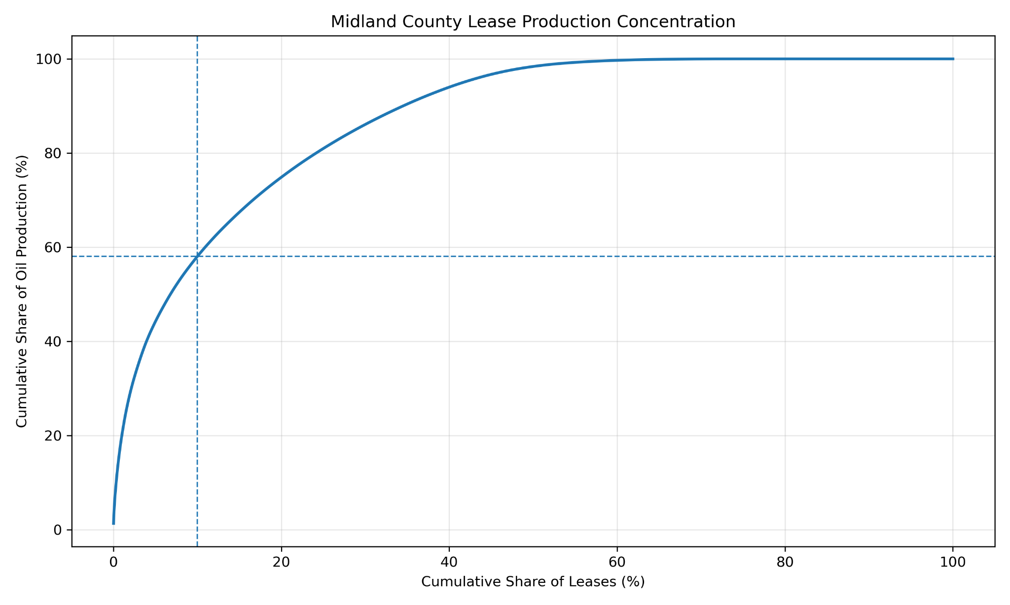
Lease concentration analysis
A small share of leases generated a large share of oil production.
The top 10% of leases produced 58.1% of lease-level oil production.
How to read this curve
Move right to include more leases. Move up to see how much cumulative oil those leases produced.
Why it matters
Production is not evenly spread. The strongest leases drive a disproportionate amount of total output.
This is similar to a Pareto-style view: a small group accounts for a large share.
Texas Railroad Commission public data | Midland County Production Analysis
10
Notes:
This is one of the strongest insights. Emphasize that it moves beyond a simple trend chart and shows production concentration.

Slide 11
What I built
Final deliverables show both engineering analysis and data-workflow skills.
SPE-style technical report with figures and tables
Cleaned Excel workbook with summary sheets
Python/Jupyter workflow that recreates the analysis
GitHub repository with raw data, cleaned data, figures, and report
Data
Original RRC CSV Data + Cleaned Data
Notebook
Python cleaning + calculations
Workbook
Cleaned tables + summaries
The project is not just a report — it is reproducible from the raw public data.
Report
SPE-style written analysis
Texas Railroad Commission public data | Midland County Production Analysis
11
Notes:
This is the slide you can use with recruiters. It shows the project is organized and reproducible.

Slide 12
Conclusions and next steps
This Midland County study is a strong first phase of a larger Permian Basin project.
Conclusions
Next steps
Midland County oil production increased 26.1% from 2020 to 2025.
Gas production increased 78.7%, and GOR moved upward.
Pioneer was the top operator; Spraberry was the top field.
The top 10% of leases produced 58.1% of lease-level oil output.
Expand from Midland County to Martin, Reeves, Loving, Howard, and Upton Counties.
Compare county-level growth, GOR trends, and operator performance.
Add well-level decline analysis if more detailed well data is collected.
Build a Power BI or Python dashboard for interactive exploration.
Built a reproducible Python/Excel production analysis using public Texas RRC data across 5,674 Midland County leases.
Texas Railroad Commission public data | Midland County Production Analysis
12
Notes:
End by framing this as phase one. The next version is a Permian county comparison, which would make the project even stronger.

